Slide 1
Jet/MET/HLTCalo shift report
Ricardo Gonçalo – LIP
Jet trigger weekly meeting – 26/9/2016

Slide 2
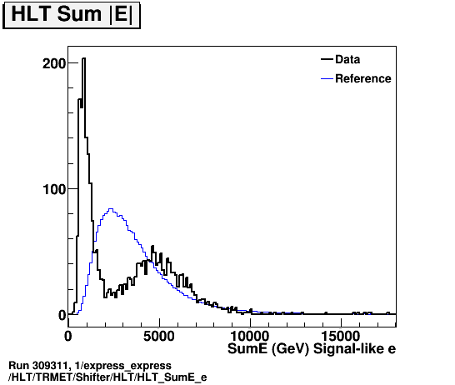
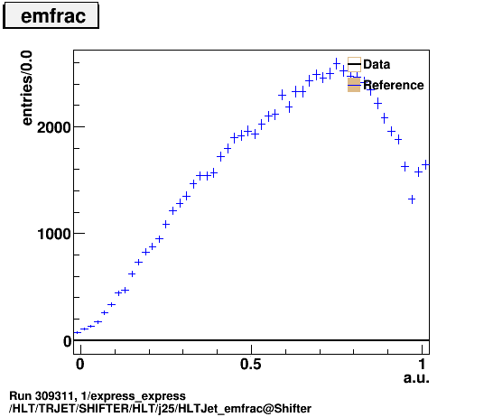
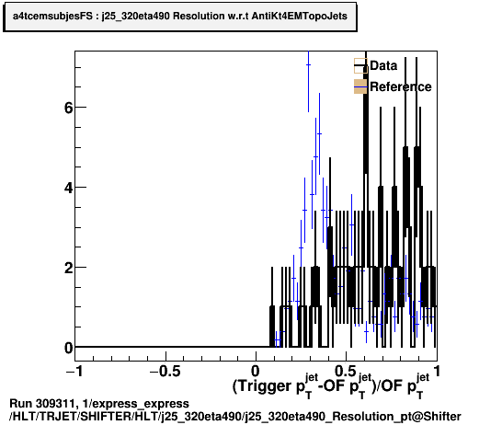
Summary:
Quiet week:
Mostly ALFA runs with no jet chains running:
https://its.cern.ch/jira/browse/ATR-15092 (308979 308982 309010 309039 309074 and 309165)
BULK signoff missing - coming soon
https://its.cern.ch/jira/browse/ATR-15107 (309074 and 309165)
More standard runs starting only Sunday (1200 bunches not yet checked – tomorrow):
https://its.cern.ch/jira/browse/ATR-15120 (309314 - 300 bunches; and 309346 – 600 bunches)
Run 309311 is unusual:
https://its.cern.ch/jira/browse/ATR-15118
From LBs 166 to 310, both Jet and MET chains are used in these keys:
https://atlas-trigconf.cern.ch/run2/smkey/2440/l1key/11151/hltkey/8278/
But only MET histos are filled (look ok with some differences wrt the reference, e.g.:
https://atlasdqm.cern.ch/webdisplay/tier0/1/express_express/run_309311/run/HLT/TRMET/Expert/HLT/mht/
https://atlasdqm.cern.ch/webdisplay/tier0/1/express_express/run_309311/run/HLT/TRMET/Shifter/HLT/HLT_SumE_e
Reason is L1Calo was in low-mu settings and so L1 menu is unusual – will change in 1200 bunch run

Slide 3
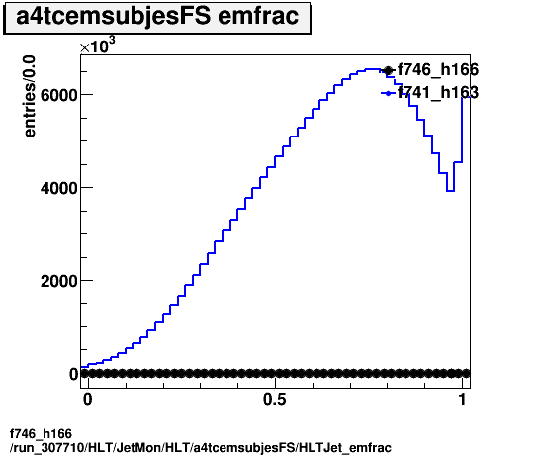
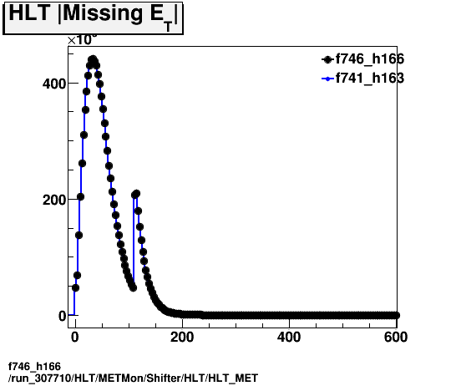
Reprocessing tests
Request from DataQuality to check a new release to be deployed at Tier 0
The objective is to compare between release 20.7.7 (tag f741) and 20.7.8 (tag f746).
Jet triggers not running in menu
MET looks fine
https://its.cern.ch/jira/browse/ATR-15112
HLT reprocessing to test MC_HI_v4 in 20.11.1.5.1 AtlasCAFHLT for p-Pb
https://its.cern.ch/jira/browse/ATR-15070
Reprocessing in progress

