Slide 1
Jet/MET/HLTCalo shift Report
Ricardo Gonçalo – LIP
Jet and E_{T}^{miss} Trigger Meetings – 6/9/2016

Slide 2
Run by Run DQ Summary
Run | Duration | Events | Lumi | Ended | Obs.
307394 | 1017.0m | 57,723,356 | 0.38/fb | Mon 15:16 | Low-E_{T} hotspot in jets η=-0.5/φ=1.5
307454 | 1433.0m | 77,105,231 | 0.50/fb | Tue 19:22 | Low-E_{T} hotspot in jets η=-0.5/φ=1.5
307514 | 731.2m | 35,612,256 | 0.21/fb | Wed 08:54 | Low-E_{T} hotspot in jets η=-0.5/φ=1.5
307539 | 250.6m | 15,286,646 | 0.08/fb | Wed 14:19 | Low-E_{T} hotspot in jets η=-0.5/φ=1.5
307569 | 907.5m | 52,809,575 | 0.36/fb | Thu 06:45 | Low-E_{T} hotsp. (η,φ)=(-0.5,0.5),(-2,-3)
307601 | 722.3m | 47,578,917 | 0.32/fb | Thu 20:10 | Low-E_{T} hotsp. (η,φ)=(-0.5,0.5),(-2,-3)
307619 | 249.4m | 10,237,550 | 71.4/pb | Fri 03:31 | Low-E_{T} hotsp. (η,φ)=(-0.5,0.5),(-2,-3)
307656 | 1316.4m | 68,420,018 | 0.46/fb | Sat 08:48 | Low-E_{T} hotspot (η,φ)= (-2,-3) MET hotspot (η,φ)=(2,2.5) from calo
307710 | 208.8m | 12,757,663 | 0.08/fb | Sat 13:51 | Low-E_{T} hotspot (η,φ)= (-2,-3)
307716 | 508.9m | 32,764,641 | 0.23/fb | Sat 23:45 | Low-E_{T} hotspot (η,φ)= (-2,-3)
307732 | 1551.8m | 83,902,599 | 0.56/fb | Mon 02:57 | Low-E_{T} hotspot (η,φ)= (-2,-3)

Slide 3
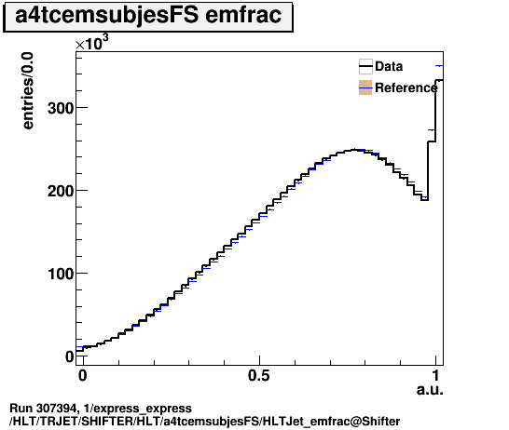
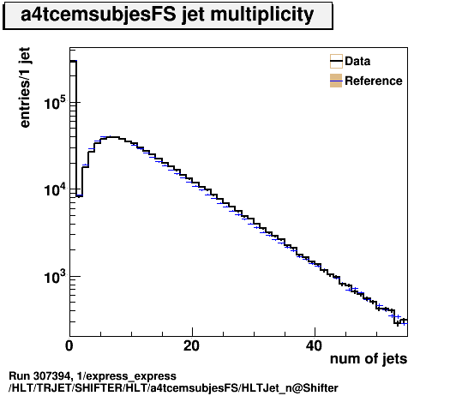
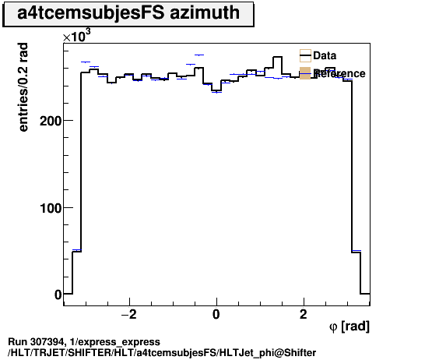
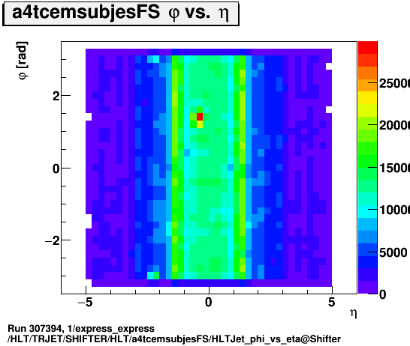
Jets: e.g. run 307394
L1: ok
a4tcemsubjesFS: mostly ok but is red
Due to hotspot at (eta,phi) = (-0.5,1.5)
Low p_{T} (can be seen in j25 but not j460)
Energy scale slightly different from reference; can be seen in EMfrac too
Most likely caused by the hotspot

Slide 4
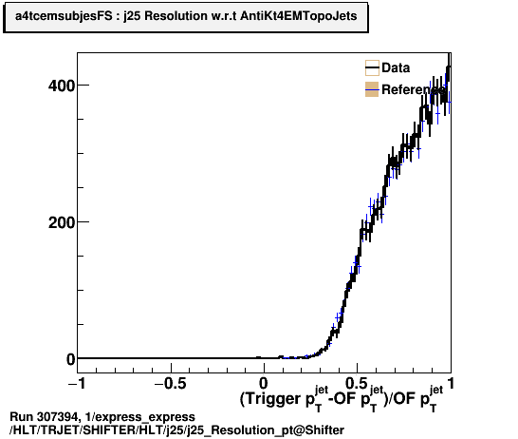
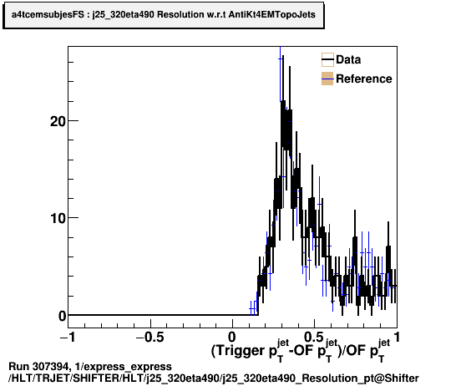
Jets: e.g. run 307394
j25: green
Online (pileup-subtracted + MCJES scale) vs offline (AntiKt4EMTopo, pileup-subtracted scale) p_{T} looks quite bad but agrees with reference
Caused by different online/offline calibrations: corrections from PU subtraction have large effect on low-E_{T} jets (high-E_{T} looks much better)
j25_320eta490: green
Online vs offline p_{T} looks better than j25 due to higher jet energy
j25
j25_320eta490

Slide 5
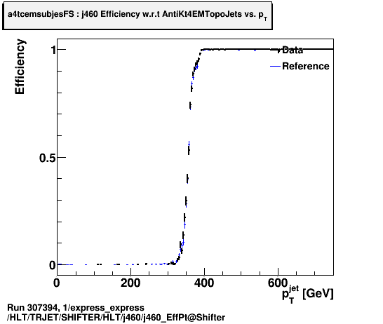
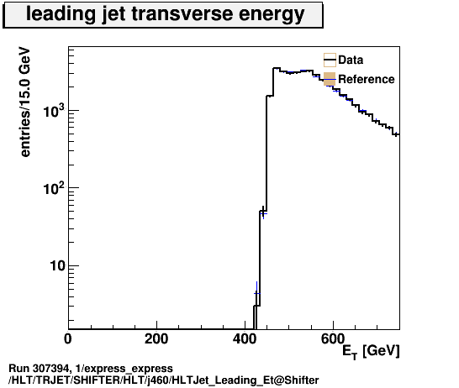
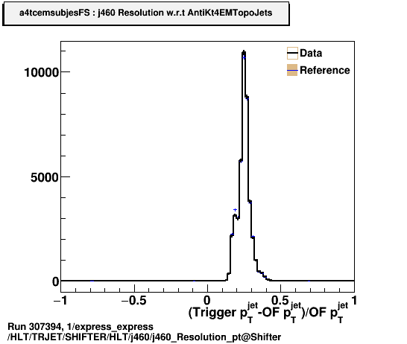
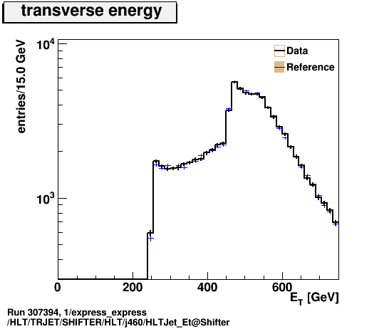
Jets: e.g. run 307394
j460: green but shows a few surprising features
Efficiency wrt offline starts at 350GeV:
Again difference comes from ≠ online/offline calibration
In plot B:
First peak comes from j460_a10_lcw_sub_L1J100 (same rate in express stream as j460)
Second peak (at E_{T} ≈ 550GeV) comes from j460 turning on fully
Jet response (C) for j460: E_{T}^{trig} ≈ 1.25 x E_{T}^{offl.}
Again due to calibration differences
Plot D has lower cut at 250 GeV applied by monitoring
A
B
C
D

Slide 6
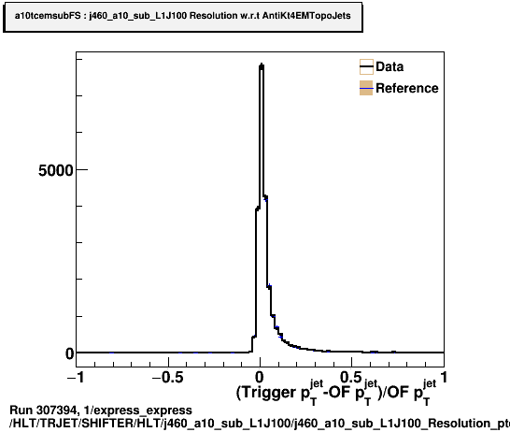
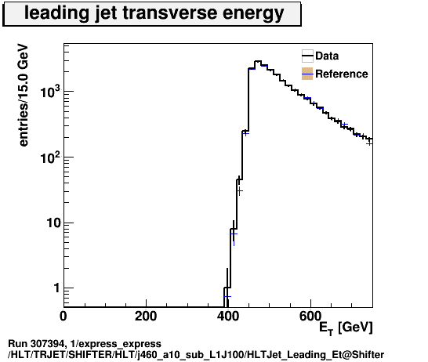
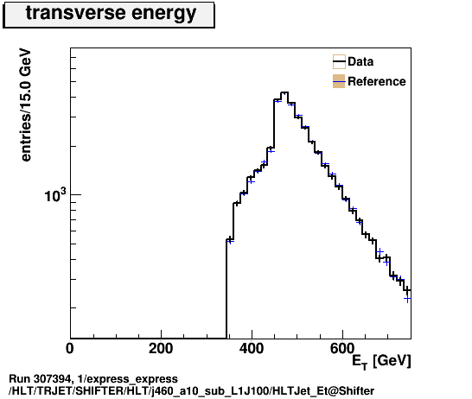
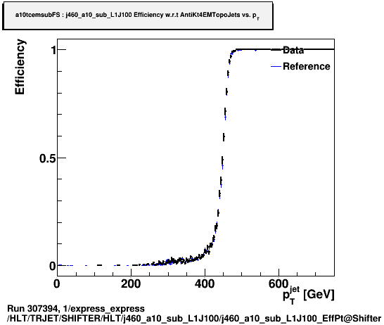
Jets: e.g. run 307394
j460_a10_sub_L1J100: green
Much better jet response than j460
To be expected from larger jet radius and calibration more similar to offline

Slide 7
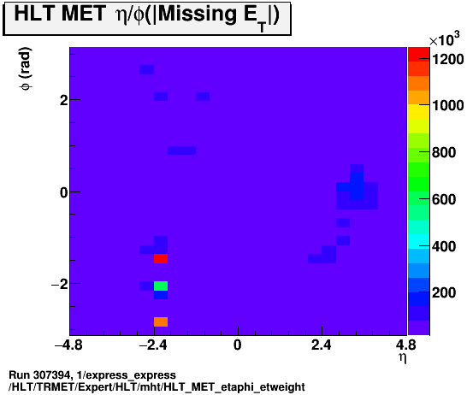
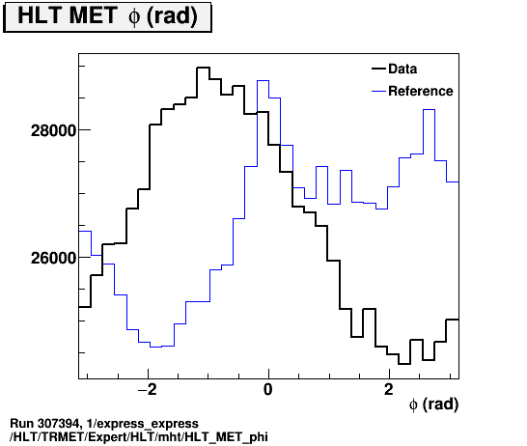
Missing E_{T}
SHIFTER folder not totally up to date: data is mht and reference is tc_lcw
Look here instead: TRMET/Expert/HLT/mht/
The spikes on the left plot (ET-weighted eta/phi) are due to a few high-ET jets and not important for MET unless the MET eta/phi plot (HLT_MET_etaphi) has peaks
The wiggle in the phi distribution moves around; the difference in the plot on the right is expected
Thanks to Koji Hamano for this info!

Slide 8
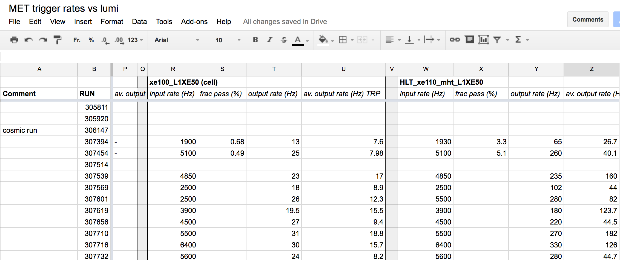
Missing E_{T}
Reminder:
New-ish task: fill rates spreadsheet for MET chains
https://docs.google.com/spreadsheets/d/1XFmykacHZZLkzLPDkcxDy5Qu24DHXKcOZvdH0TDMxWo/edit#gid=0

Slide 9
Old Runs Signed Off
Run | Duration | Events | Lumi | Ended | Obs.
306384 | 849.1m | 41,054,022 | 0.21/fb | Tue 10:30 | Jet hotspot eta=-2/phi=-3 ATR-14862
306419 | 248.1m | 15,227,462 | 0.09/fb | Tue 17:02 | Jet hotspot eta=-2/phi=-3 ATR-14862
306442 | 402.8m | 7,552,841 | 0.03/fb | Wed 1:03 | Jet hotspot eta=-2/phi=-3 ATR-14862
306448 | 329.8m | 15,729,431 | 0.11/fb | Wed 6:45 | Jet hotspot eta=-2/phi=-3 ATR-14862
306451 | 890.6m | 49,769,088 | 0.35/fb | Wed 22:27 | Andy already signed off ATR-14866
306475 | 46.0m | 682,376 | 0.01/fb | Thu 00:15 | Andy already signed off ATR-14866
306499 | 238.5m | 9,098,210 | 0.03/fb | Thu 06:57 | Andy already signed off ATR-14866
306556 | 883.7m | 14,483,931 | 0.09/fb | Fri 09:36 | Jet hotspot eta=-2/phi=-3 ATR-14890
306655 | 287.1m | 12,889,650 | 0.02/fb | Fri 21:22 | Jet hotspot eta=-2/phi=-3 ATR-14890 Clear high-ET hotspots in j460 etc
306657 | 397.9m | 16,188,800 | 0.01/fb | Sat 04:00 | Looks ok; ATR-14890
306714 | 644.2m | 26,250,676 | 0.15/fb | Sun 06:37 | Hot area eta=-0.5/phi=1 ATR-14891

Slide 10
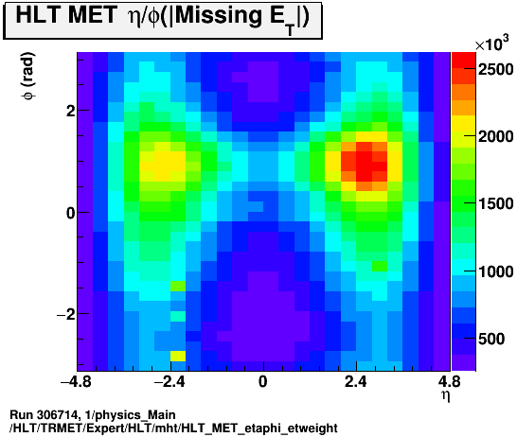
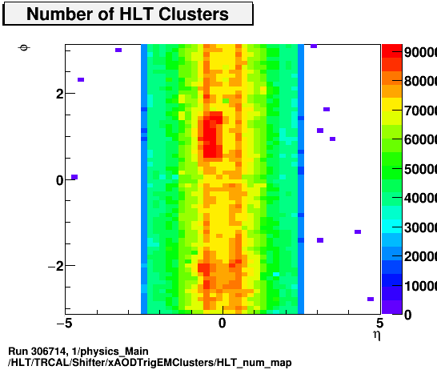
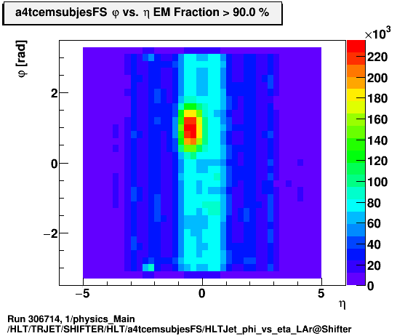
Run 306714
Checked physics_Main
Hot LAr region shows in calo, jet (only low ET) and met

Slide 11
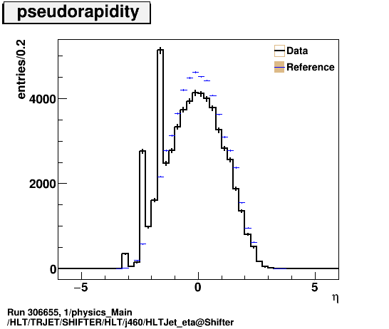
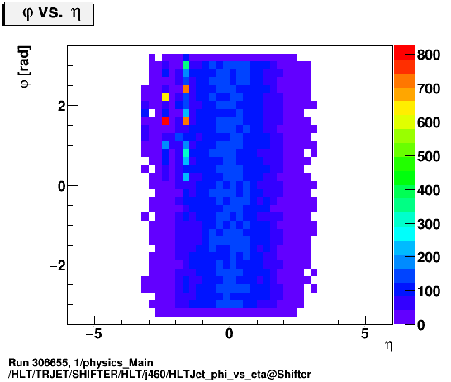
Run 306655
Checked physics_Main
High-ET hotspots affecting e.g. j460
https://atlasdqm.cern.ch/webdisplay/tier0/1/physics_Main/run_306655/run/HLT/TRJET/SHIFTER/HLT/j460/HLTJet_phi_vs_eta@Shifter

Slide 12
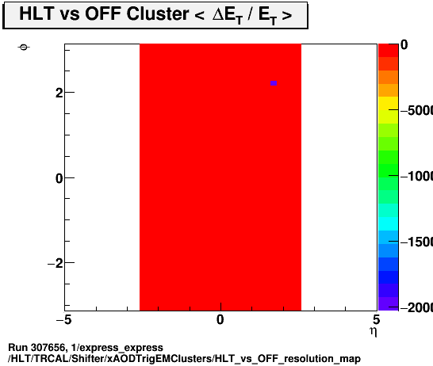
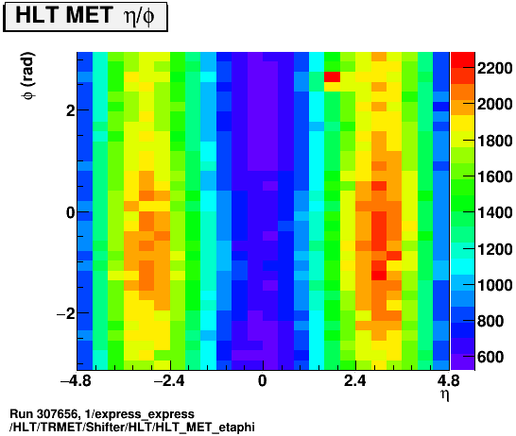
Run 307656
Calo problematic spot (miscalibration?) at (η,φ)= (2,2.5)
Shows up as MET hotspot? (very localized!)
https://atlasdqm.cern.ch/webdisplay/tier0/1/express_express/run_307656/run/HLT/TRCAL/Shifter/xAODTrigEMClusters/HLT_vs_OFF_resolution_map

Slide 13
BULK signoffs
306147/f738_h161: all ok
307259 BULK:
Small hotspots in EM-like jets at eta/phi = -0.5/1.5 and -0.5/-0.5
307195 BULK:
Small hotspot in EM-like jets (LAr?) at eta/phi = -0.5/-0.5 https://atlasdqm.cern.ch/webdisplay/tier0/1/physics_Main/run_307195/run/HLT/TRJET/SHIFTER/HLT/a4tcemsubjesFS/HLTJet_phi_vs_eta_LAr@Shifter
jet energy scale different from reference (different calibration?). Can be seen in jet spectrum and number of trigger jets: https://atlasdqm.cern.ch/webdisplay/tier0/1/physics_Main/run_307195/run/HLT/TRJET/SHIFTER/HLT/a4tcemsubjesFS/HLTJet_n@Shifter https://atlasdqm.cern.ch/webdisplay/tier0/1/physics_Main/run_307195/run/HLT/TRJET/SHIFTER/HLT/a4tcemsubjesFS/HLTJet_Et@Shifter But doesn't seem to affect high-ET jets.
307126 BULK:
Small hotspot in EM-like jets (LAr?) at eta/phi = -0.5/-0.5
Same jet energy scale difference from reference as above. Can be seen in jet spectrum, number of trigger jets, etc.
Effect of trigger jet calibration can be seen in MET trigger, e.g.: https://atlasdqm.cern.ch/webdisplay/tier0/1/physics_Main/run_307126/run/HLT/TRMET/Expert/HLT/mht/HLT_SumEt
307124 BULK:
Small hotspot in EM-like jets (LAr?) at eta/phi = -0.5/-0.5
Same jet energy scale difference from reference as above. Can be seen in jet spectrum, number of trigger jets, etc.
2-3 hotspots probably in Tile (don't match EM-like jets) at around eta=-0.5 positive phi https://atlasdqm.cern.ch/webdisplay/tier0/1/physics_Main/run_307124/run/HLT/TRJET/SHIFTER/HLT/a4tcemsubjesFS/HLTJet_phi_vs_eta@Shifter Can be seen also in EMfrac and jet multiplicity: https://atlasdqm.cern.ch/webdisplay/tier0/1/physics_Main/run_307124/run/HLT/TRJET/SHIFTER/HLT/a4tcemsubjesFS/HLTJet_emfrac@Shifter https://atlasdqm.cern.ch/webdisplay/tier0/1/physics_Main/run_307124/run/HLT/TRJET/SHIFTER/HLT/a4tcemsubjesFS/HLTJet_n@Shifter But no visible effect in higher ET jets (j60 and above) https://atlasdqm.cern.ch/webdisplay/tier0/1/physics_Main/run_307124/run/HLT/TRJET/EXPERT/HLT/j60/HLTJet_phi_vs_eta
hot region in MET: https://atlasdqm.cern.ch/webdisplay/tier0/1/physics_Main/run_307124/run/HLT/TRMET/Shifter/HLT/HLT_MET_etaphi https://atlasdqm.cern.ch/webdisplay/tier0/1/physics_Main/run_307124/run/HLT/TRMET/Shifter/HLT/HLT_MET_etaphi_etweight

Slide 14
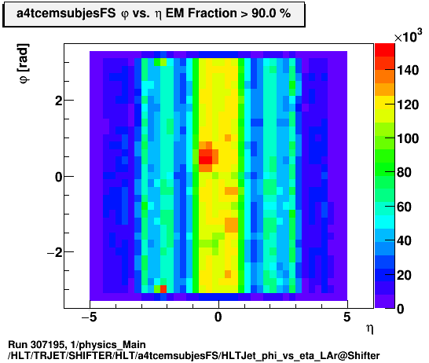
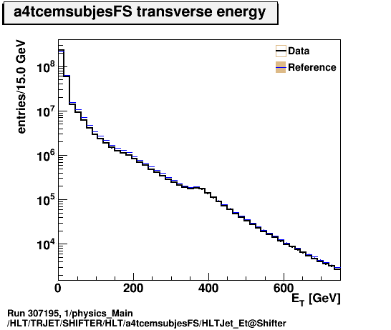
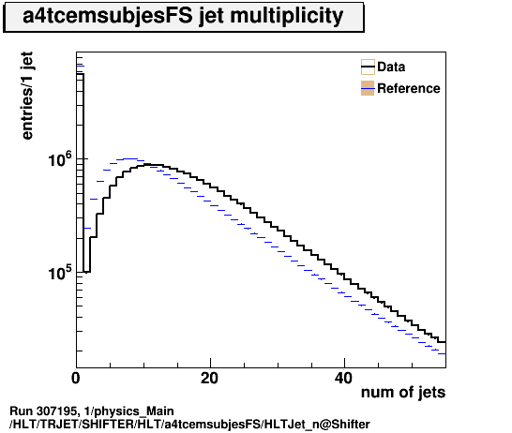
BULK signoffs for DQ meeting (1/3)
Meeting on 31 Aug.: https://indico.cern.ch/event/566266/
Cosmics run 306147/f738_h161 – to be used as new cosmics reference: all ok
307195 BULK:
Small hotspot in EM-like jets (LAr?) at eta/phi = -0.5/-0.5
jet spectrum different from reference
Change in calibration? Or simply from hotspot?)
Can be seen in jet spectrum and number of trigger jets but doesn't affect high-E_{T} jets

Slide 15
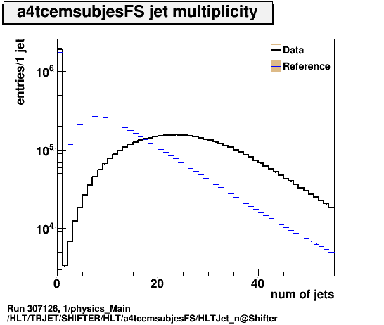
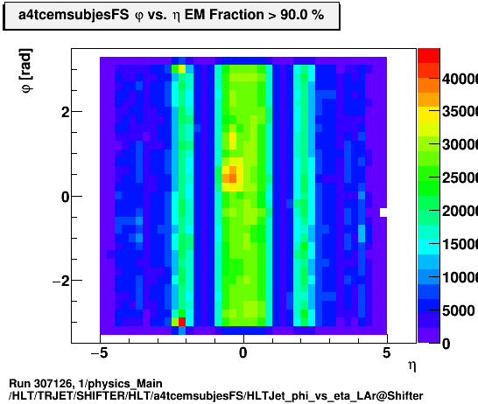
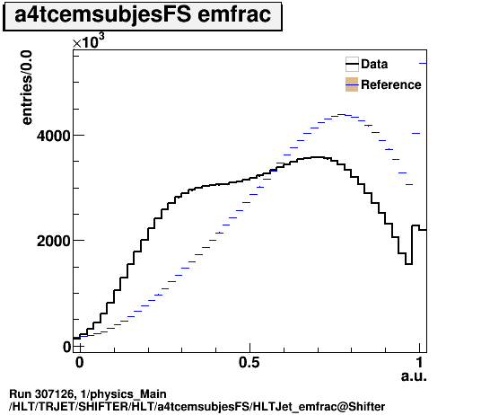
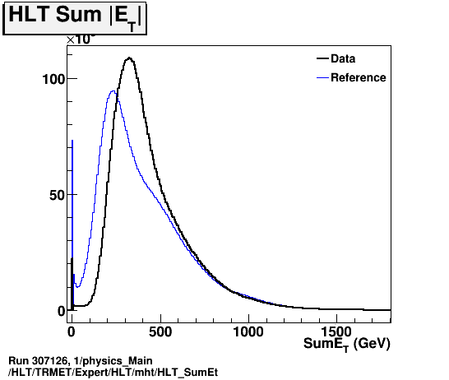
BULK signoffs for DQ meeting (2/3)
307126 BULK:
Small hotspot in EM-like jets (LAr?) at eta/phi = -0.5/-0.5
Same jet energy scale difference from reference as above. Can be seen in jet spectrum, number of trigger jets, etc.
Effect of trigger jet calibration visible in MET trigger (mht)?

Slide 16
Reprocessings
For DQ meeting of 31 Aug.:
Checked BULK of runs: 307124 307126 307195 307259
Checked BULK of reprocessed cosmic run 306147 with the tags f738-h161
Will become reference for cosmics this year.
ATR-14910:
Checked Enhanced Bias run 307126 to validate CAFHLT,20.11.0.25.2
Ongoing:
ATR-14940: Repro of EB 302956 with CAFHLT,20.11.1.3.1, atlas-r2-2015-04-00-00 used in the HLT step
ATR-14941: Repro with AtlasCAFHLT,20.11.1.3.1 Physics_pp_v6 tightperf, AtlasProduction,20.7.7.5
Rate comparison could be made easier… instructions need checking/reviewing
BULK signoffs for 7th September DQ meeting: ATR-14979
https://its.cern.ch/jira/browse/ATR-14979

Slide 17
Bonus slides

