Slide 1
Jet/MET Trigger On-Call Report And some validation as well
Ricardo Gonçalo – LIP
Missing E_{T} Trigger Meeting – 13/5/2015

Slide 2
Reprocessing – 1
HLT EnhancedBias reprocessing with AtlasCAFHLT,20.2.1.1.3
  https://its.cern.ch/jira/browse/ATR-11022
  Run data_12TeV%212967, enhanced bias stream
  Ref. r6634_p1831_p1831
  Test: r6646_p1831_p1831
  Compare HLTMON
Signed off

Slide 3
Reprocessing - 2
HLT EnhancedBias reprocessing with AtlasCAFHLT,20.2.1.1.2
  https://its.cern.ch/jira/browse/ATR-11022
  Run data_12TeV%212967, enhanced bias stream
  Ref. r6634_p1831_p1831
  Test: r6644_p1831_p1831
  Newer repro: 20.2.1.1.3
  Test: r6646_p1831_p1831
  Compare HLTMON
Calo ok – signed off

Slide 4
Reprocessing - 3
L1Calo reprocessing
  Purpose: exercise turn-around time of a reprocessing right after the run is over, and the HLT
  Release: AtlasP1HLT,20.2.1.1
  Menu: MC_pp_v5
  Run: 264034
  Stream: L1Calo
  Prescales: [default]
  Apply L1 prescales?: no
  Rerun L1?: yes
  Reconstruction?: no
  https://its.cern.ch/jira/browse/ATR-11055
Signed off

Slide 5
Reprocessing - 4
L1Calo reprocessing
Purpose: HLT reprocessing of 264034/L1Calo stream with offline outputs for ID trigger studies
  Release: AtlasP1HLT,20.2.1.1
  Menu: MC_pp_v5
  Run: 264034
  Stream: L1Calo
  Prescales: [default]
  Apply L1 prescales?: no
  Rerun L1?: yes
  Reconstruction?: yes
Signed off

Slide 6
Run by Run DQ Summary
Run | Duration | Ended | Events | Online Hist. | Offline Hist. | Obs.
263896 | 856.4m | Mon 10:43 | 8512363 | Ok | Ok | No j0_lcw_L1J12
263956 | 229.3m | Mon 23:17 | 535922 | Ok jet Ok met Ok calo | Ok jet Ok met | No j0_lcw_L1J12 in menu Jet spike (eta,phi)=(-2,2) Spike not in HLTCalo plots
263961 | 565.9m | Tue 09:02 | 1652781 | Ok met Ok jet |  | Strange cluster phi distr. Spike in eta,phi=1,1 (cluster & jet)
263964 | 130m | Tue 12:41 | 1808555 | No HLT | Ok jet Ok met | 900GeV collisions!
263965 | 225m | Tue 15:09 | 3289095 | No HLT | Ok jet Ok met | 900GeV collisions!
263989 | 227.9m | Tue 22:05 | 2801086 | Ok met Ok calo Ok jet | Ok jet Ok met | Jet spike (eta,phi)=(0.7,-1)

Slide 7
Run | Duration | Ended | Events | Online Hist. | Offline Hist. | Obs.
263993 | 731.5m | Wed 10:30 | 10750593 | Ok met Ok jet Bad calo | Ok jet Ok met | Spike eta=0.6,phi=-1.2 Cluster hot square, not in tcemFS or in tclcwFS
264058 | 429.4m | Thu 09:07 | 1324162 | Ok met Ok jet Bad calo | Ok jet Ok met | Spike eta=0.6,phi=-1.2 Different cluster hot square: eta,phi=1,2
264219 | 34.3m | Thu 20:32 | 404965 | Empty met & jet Bad calo | Empty jet & met | Again cluster hot area – change in shape? HLT_j0_lcw_jes_L1J12 now in menu
264220 | 728.3m | Fri 08:53 | 14455898 | Ok met Ok jet Bad calo | Ok met Ok jet | Jet spike at phi=1.6 Cluster hot sector
264330 | 140.5m | Fri 19:59 | 4522402 | Ok met Ok jet Bad calo | Ok met Ok jet | Low stats Cluster hot sector
264336 | 841.1m | Sat 10:19 | 11240468 | Ok met Ok jet Bad calo | Ok met Ok jet | Cluster hot sector

Slide 8
Run | Duration | Ended | Events | Online Hist. | Offline Hist. | Obs.
264345 | 99.4m | Sat 12:33 | 2760289 | Empty Ok calo | Empty | Low stats Cluster hot sector
264379 | 29.9m | Sat 13:12 | 799783 | Empty Ok calo | Empty | Low stats Cluster hot sector
264391 | 82.4m | Sat 15:53 | 704856 | Ok met Ok jet Ok calo | Ok met Ok jet | Low stats Cluster hot sector
264415 | 921.1m | Sun 10:11 | 36467721 | Ok jet bad met & calo | No histos | Jet spike eta,phi=-0.4,1.6 Double peak in MET Cluster hot sector
264425 | 251.6m | Sun 14:33 | 7655317 | Empty met & jet | Ok met Jet empty | Low stats Cluster hot sector
264467 | 207.1m | Sun 18:12 | 4082322 | Empty met & jet Bad calo | Ok met Empty jet | Low stats Cluster hot sector

Slide 9
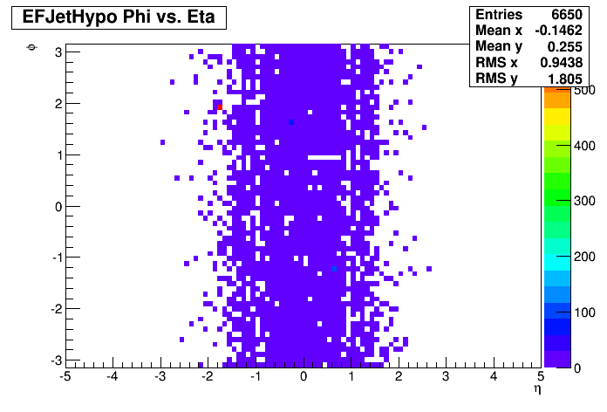
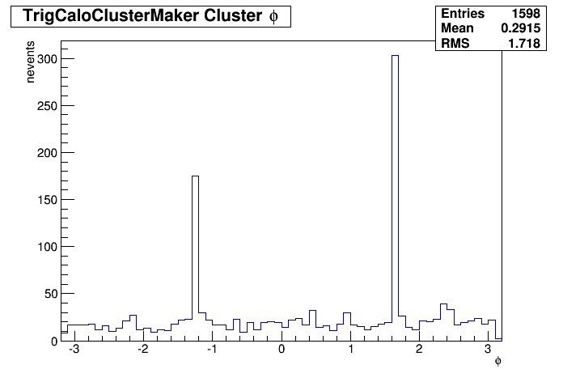
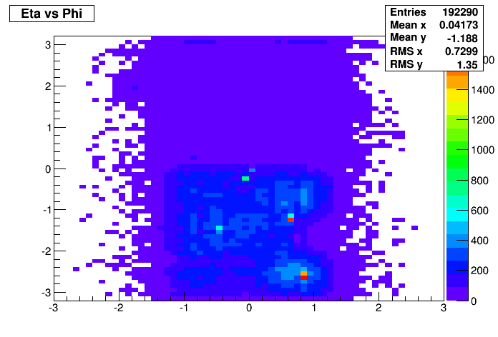
Run 263956
Jet spike not in HLTCalo

Slide 10
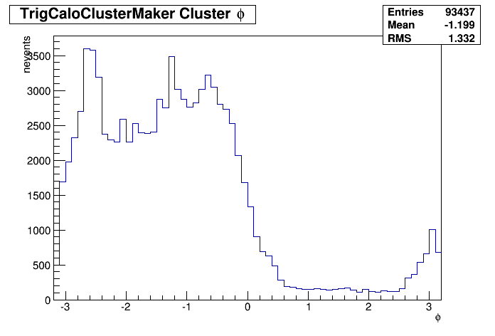
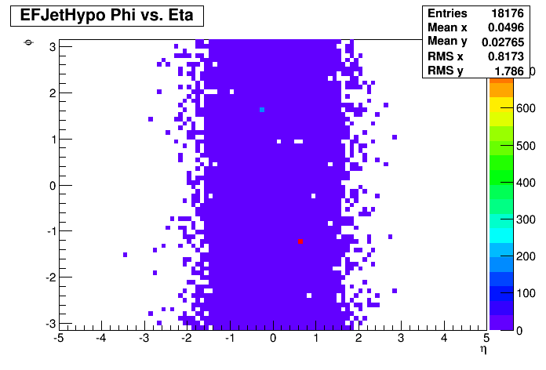
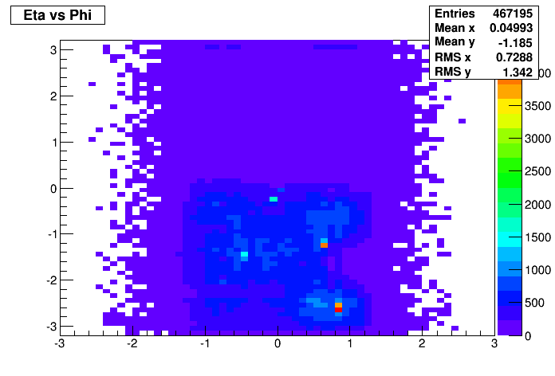
263961
Strange phi distribution?

Slide 11
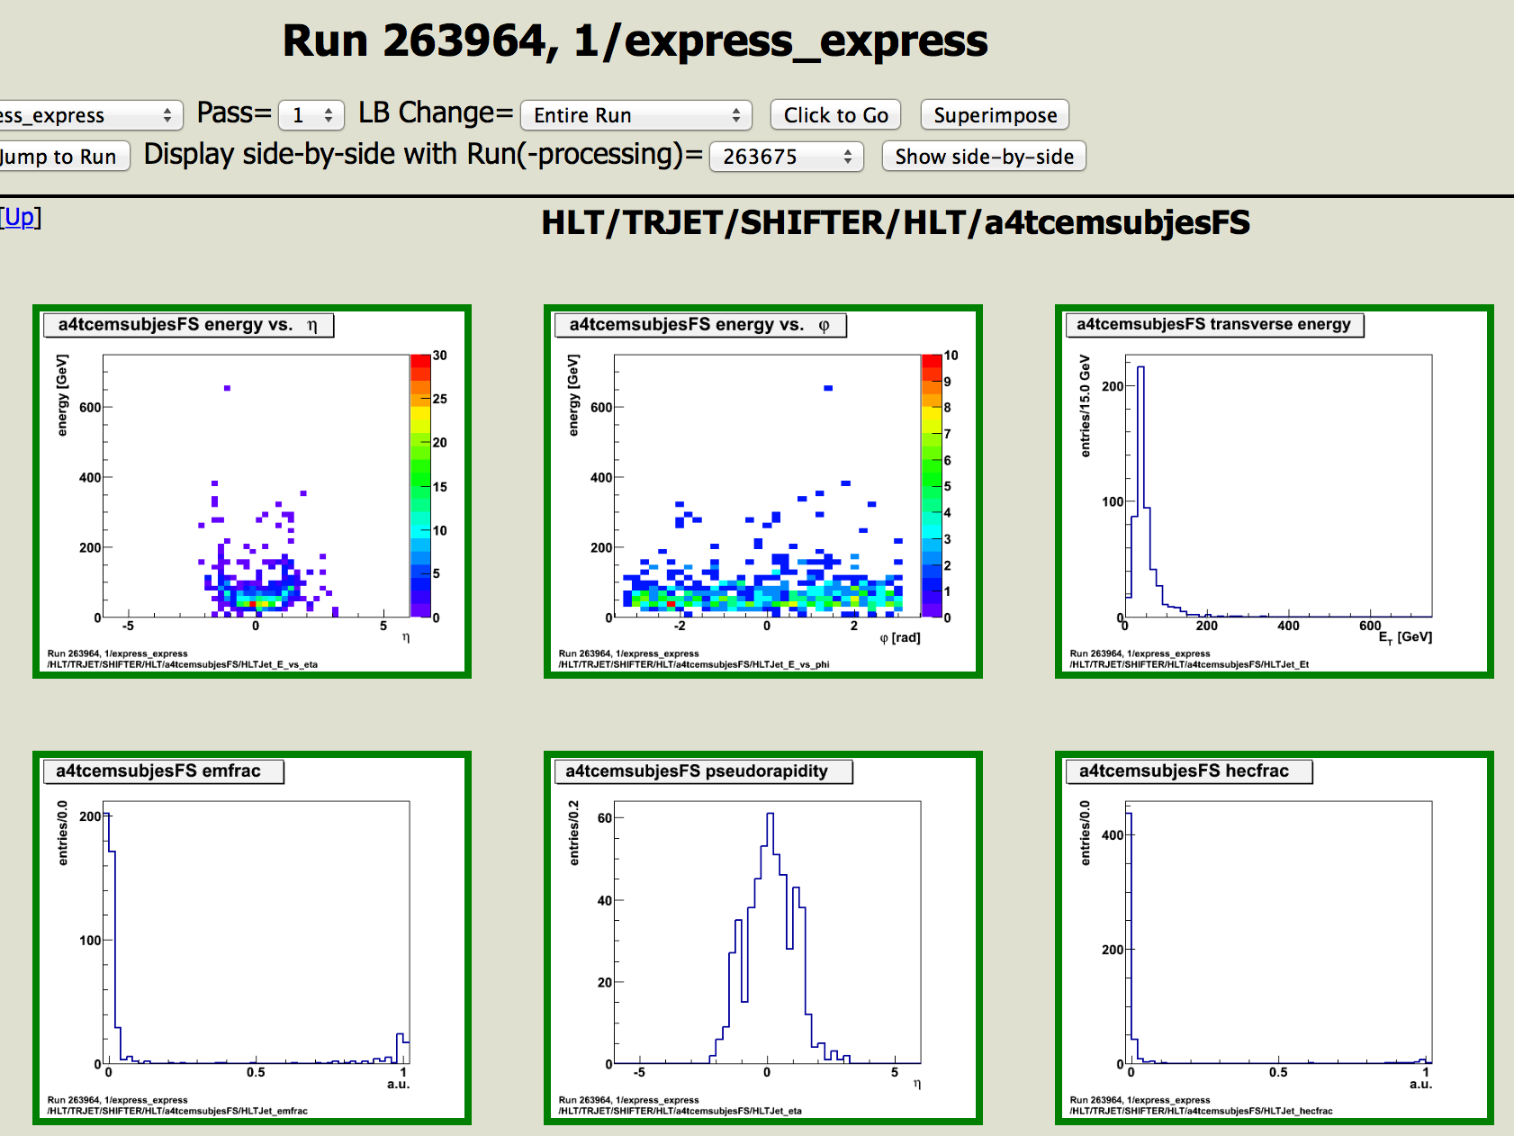
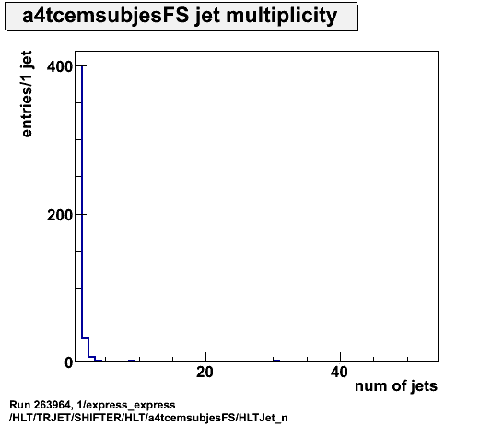
Collisions @ 900GeV
Runs 263964 and 263965

Slide 12
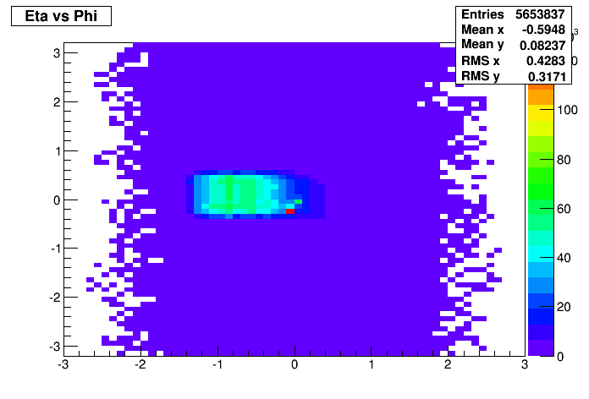
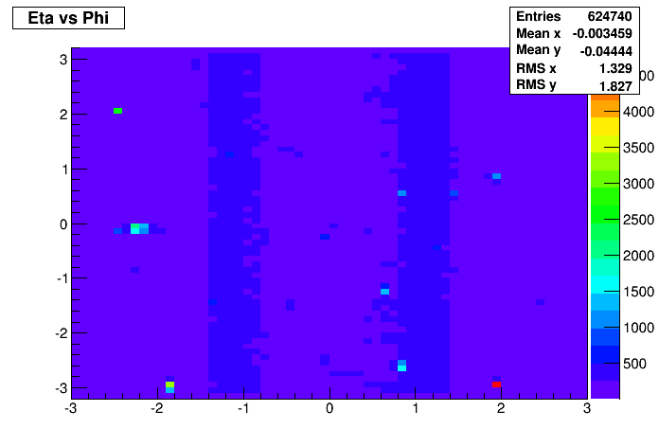

263993
Hot sector in HLTCalo topocluster eta,phi distribution
Not in tcem or tclcw
Comes from L1Muon-seeded tau chains! (thanks Sebastien!)
TrigCaloClusterMaker_topo
TrigCaloClusterMaker_topo_tclcwFS
TrigCaloClusterMaker_topo_tcemFS

Slide 13
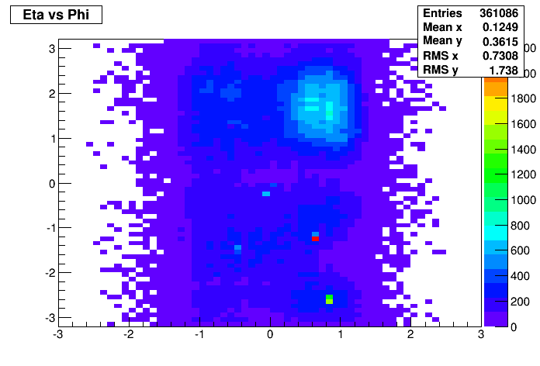
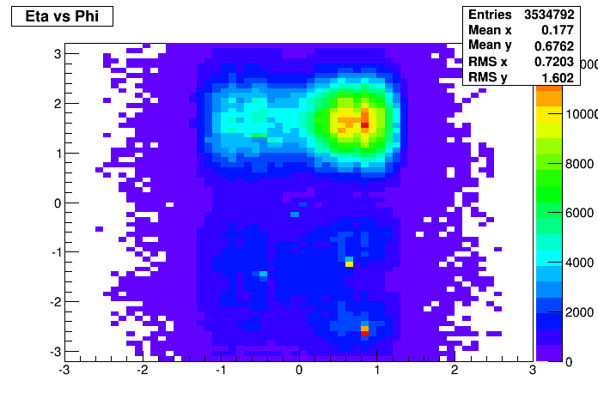
264058/264219/264415
364058
Different hot sector than run 363993 in HLTCalo topocluster eta,phi distribution
Again not in tclcwFS and tcemFS
TrigCaloClusterMaker_topo
363993
364415
TrigCaloClusterMaker_topo
TrigCaloClusterMaker_topo

Slide 14
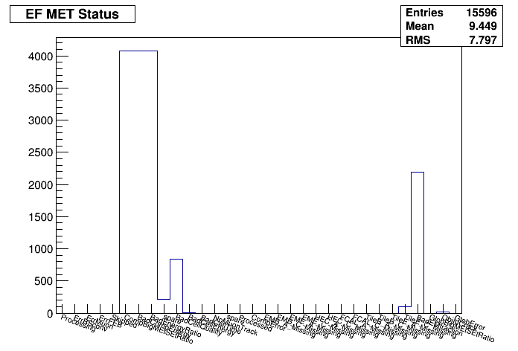
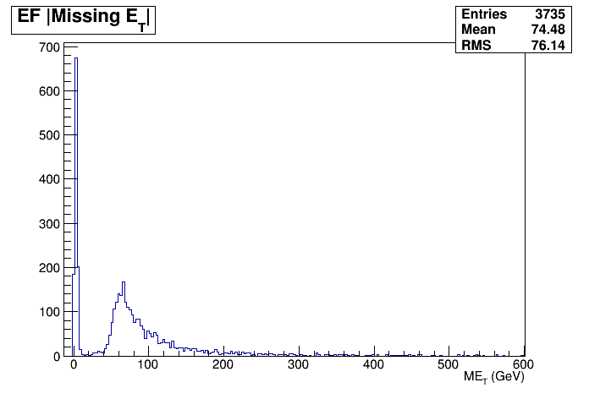
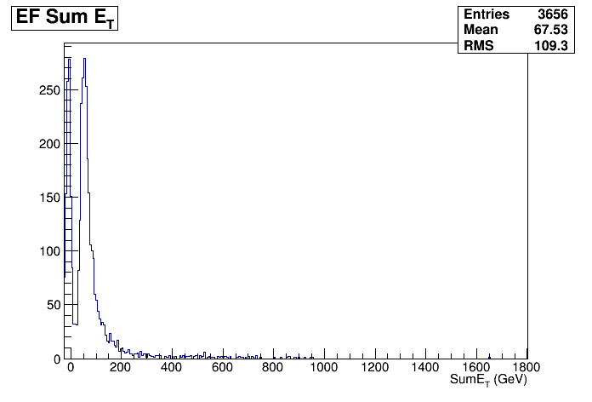
264415
Double peak in MET and spike in MET phi=0.1
Events with a true muon not accounted by L1??
EFMissingET_Fex_topoClustersPS/EF_MET_lin
EFMissingET_Fex_2sidednoiseSupp/EF_SumEt_lin

Slide 15
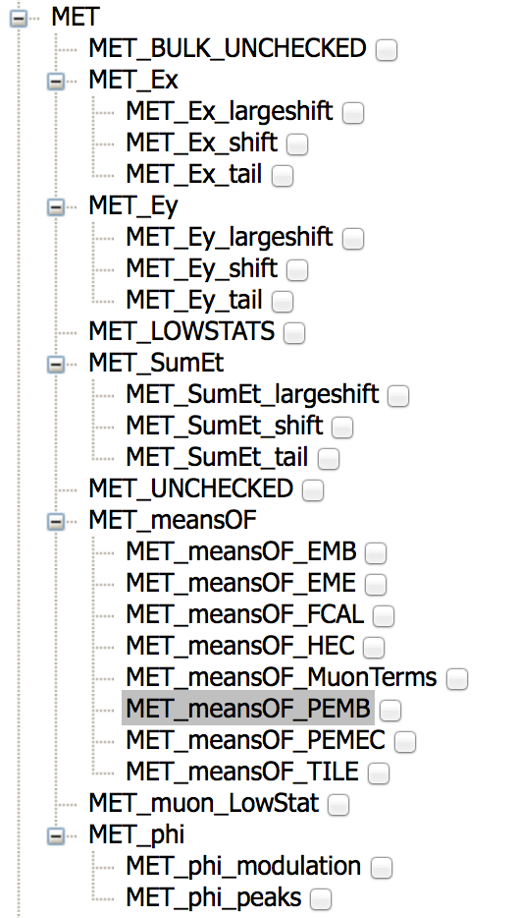
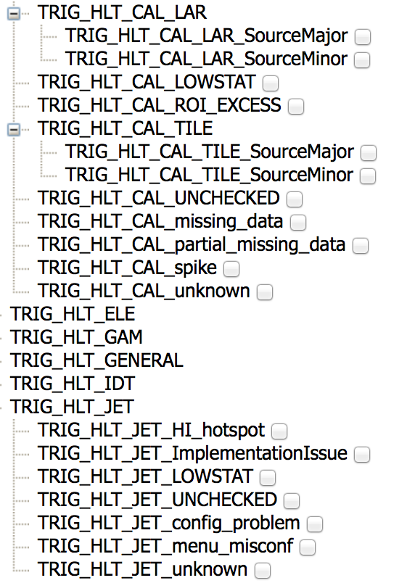
Sign-off/defects
Run | Defect/OK
263956 | TRIG_HLT_JET_HI_hotspot
263961 | TRIG_HLT_JET_HI_hotspot
263989 | TRIG_HLT_JET_HI_hotspot
263993 | TRIG_HLT_JET_HI_hotspot TRIG_HLT_MET_missing_energy_spike
264058 | TRIG_HLT_JET_HI_hotspot TRIG_HLT_MET_missing_energy_spike
264219 | TRIG_HLT_JET_LOWSTAT TRIG_HLT_MET_missing_energy_spike
264220 | TRIG_HLT_JET_HI_hotspot TRIG_HLT_MET_missing_energy_spike
264330 | TRIG_HLT_MET_missing_energy_spike
264336 | TRIG_HLT_MET_missing_energy_spike
264345 | TRIG_HLT_MET_missing_energy_spike
264379 | TRIG_HLT_MET_missing_energy_spike
264391 | TRIG_HLT_MET_missing_energy_spike
264415 | TRIG_HLT_MET_missing_energy_spike
264425 | TRIG_HLT_JET/MET_LOWSTAT TRIG_HLT_MET_missing_energy_spike
264467 | TRIG_HLT_JET/MET_LOWSTAT TRIG_HLT_MET_missing_energy_spike

