Slide 1
HSG5: Status, Plans, Wishes & Hopes
Ricardo Gonçalo (RHUL)
Higgs Working Group Meeting – 29 March 2012

Slide 2
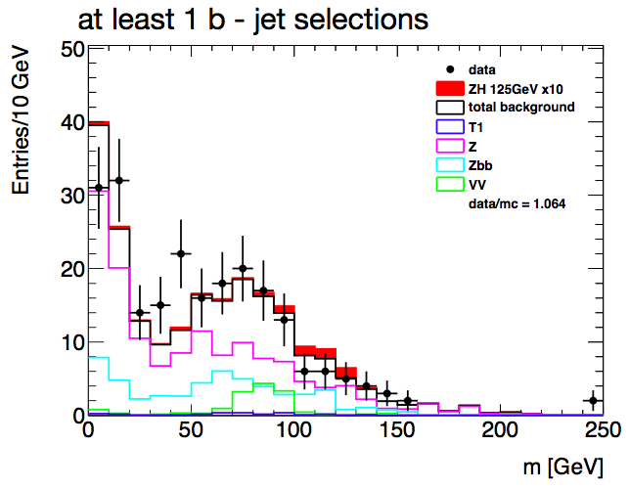
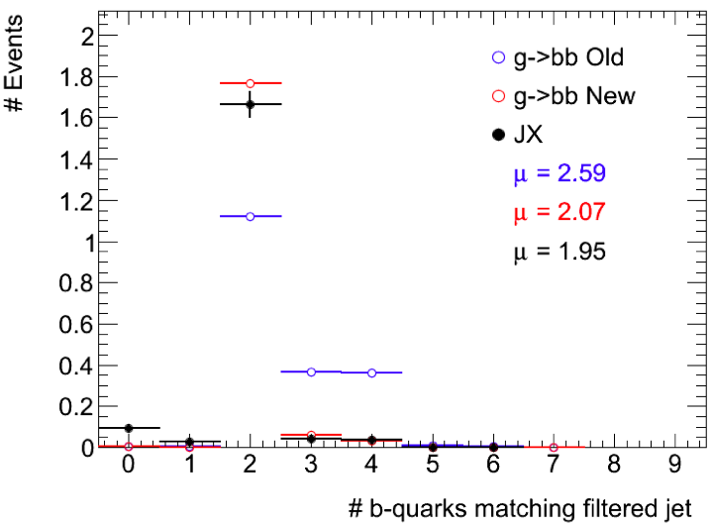
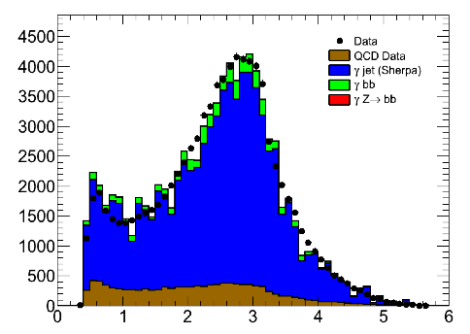
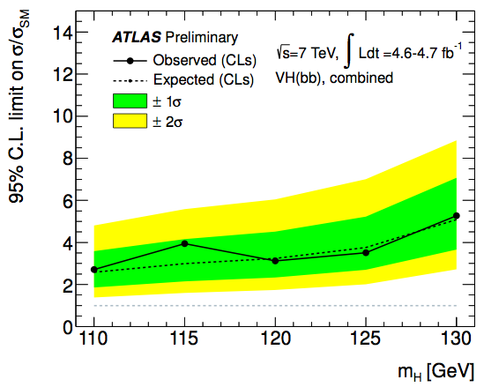
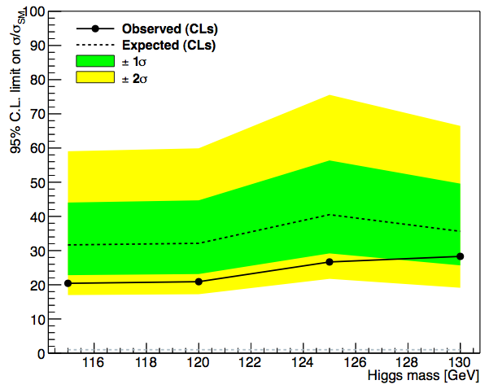
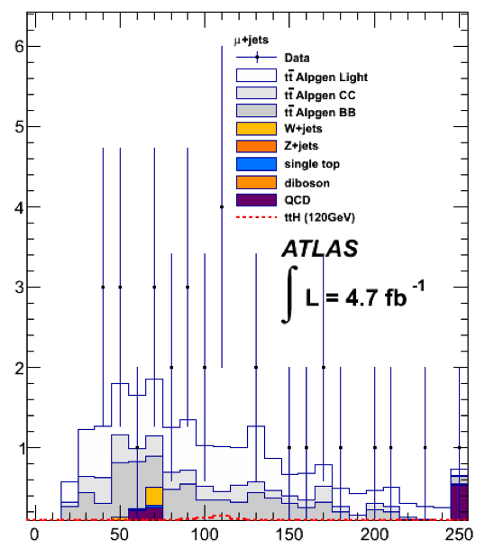
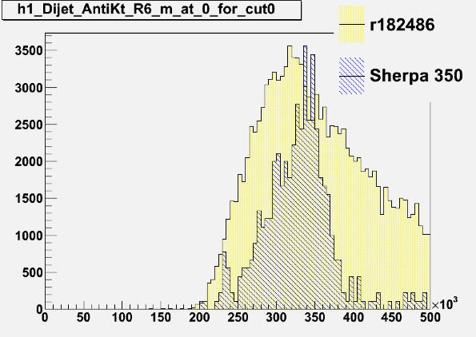
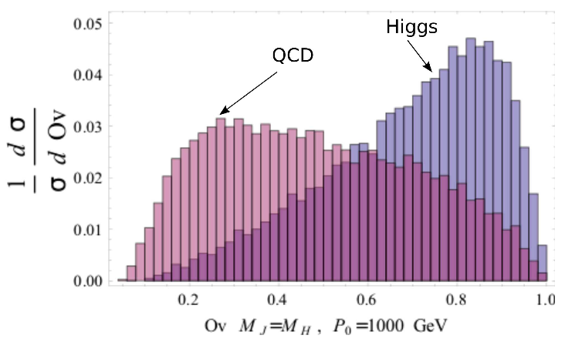
Status
WH/ZH:
CONF note sent to Moriond (2012-015)
3 channels: llbb, lνbb, ννbb
Now need to turn into paper
Higgs approval next week
Timescale: mid-April
ttH:
Analyses of 4.7fb⁻¹
Now looking at systematics
Lots of work ahead but ramping up nicely
Both cut-based and NN analyses
New development using kinematic fit
Boosted VH:
Work progressing steadily
New development: template method
(Rumour) CMS aiming boosted analysis for ICHEP
Boosted Z->bb:
Problem found in MC filter
Investigation ongoing
VBF H->bb:
Validating data-driven background determination
Badly MC-starved and one-(valiant!)-man show so far
But more interest recently
MSSM bH->bbb:
Analysis exploring possible discriminating variables
γZ->γbb:
Work ongoing to isolate γZ->γbb sample
Would be great achievement! And great for calibration
Plus work on trigger, D3PDs, etc
1 fb⁻¹
Signal
m_{A}=350GeV
m_{bb}^{lead} [GeV]
m_{bb} [GeV]

Slide 3
Plans, wishes and hopes
Plans:
First: get the H->bb paper out of the way!
Nearly there, but still some work to be done
Add boosted VH, H->bb analysis
Merge with existing WH/ZH analyses
Contributes in the highest p_{T}^{W/Z} bins of WH/ZH
Were aiming for ICHEP but timescale now uncertain
Add ttH analysis
Difficult but can contribute to H->bb results from 2011/12
Need to prepare the future: Higgs property measurements
Lateral thinking:
WH/ZH and ttH have points of contact with exotics channels
Continue to increase contribution to CP activity
H->bb channels depend critically on trigger, jets and b-tagging!
Timeline:
Moslty Aiming for September Strategy Meeting
Wishes and Hopes:
Lots of Monte Carlo! (Preferably MC which reproduces data)
Great performance from combined performance
Lots of 2012 data to analyze
LHC luminosity
Good Performance
Monte Carlo

Slide 4
Bonus slides

