Slide 1
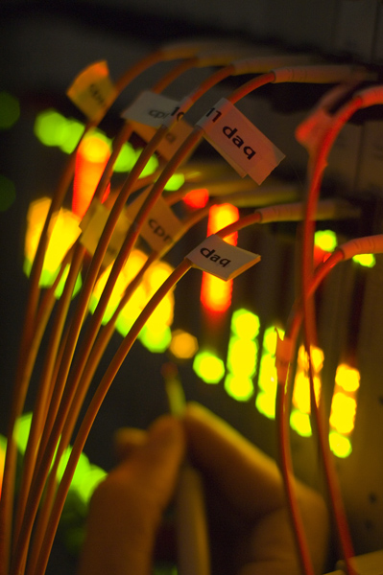
Trigger News
Higgs Working Group Meeting – 29 April 2010
Ricardo Gonçalo, RHUL

Slide 2
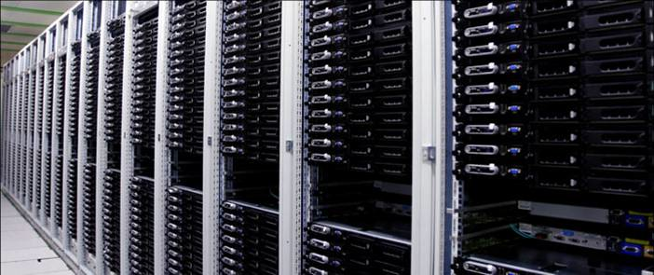
Outlook
LHC plans (well… LHC plans today)
Update on trigger status and plans
Trigger contacts in Higgs analyses
Plans for Physics menu

Slide 3
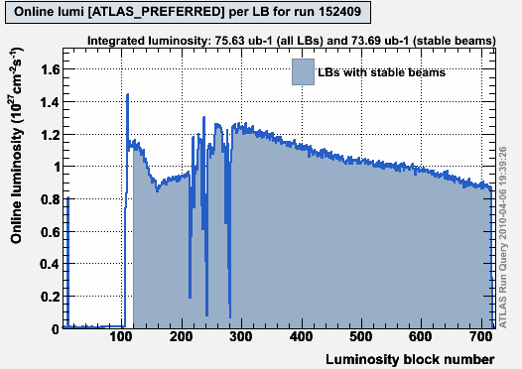
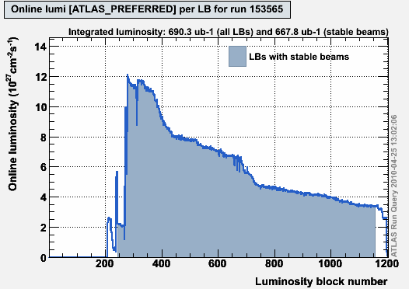
LHC is only just learning to walk, but soon it will be running!
First LHC high-energy run on March 30th
Last week running routinely at 10²⁷ cm⁻² s⁻¹ with stable-beams flag
Crossed the 10²⁸ cm⁻² s⁻¹ line with squeezed, stable beams this weekend
Might achieve 10³⁰ cm⁻²s⁻¹ as early as June
Should take about 3 months to go from 10³⁰ to a few times 10³¹ or 10³²
Luminosity will double every ~2 weeks!!!
Collected just over 1 nb^{‐1} with stable beams so far
Expect 1000,000 times more until the end of the 2010 – 2011 run…
10²⁷ cm⁻² s⁻¹
10²⁸ cm⁻² s⁻¹
25 April 2010
http://lhc-commissioning.web.cern.ch/lhc-commissioning/luminosity/2010-lumi-estimate.htm

Slide 4
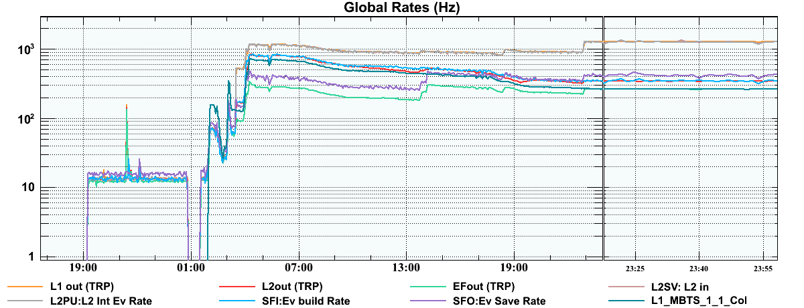
First time we had stable-beams flag on after LHC beam squeeze
Stable-beams flag means inner detector high voltage can be fully up
β* squeezed from 11m to 2m
Higher luminosity: L proportional to 1/σ²_{IP} = 1/(ε × β*)
Higher trigger rejection achieved with higher pre-scales to suppress biggest sources of rate
Rates dominated by minimum-bias triggers
HLT running mostly in transparent mode so far: Initial Beam menu
One exception L2 MB trigger measuring activity in Inner Detector
More rejection at HLT will be needed soon
https://atlas-trigconf.cern.ch/wtrp_archive/2010-04-24/WTRP_wmi/

Slide 5
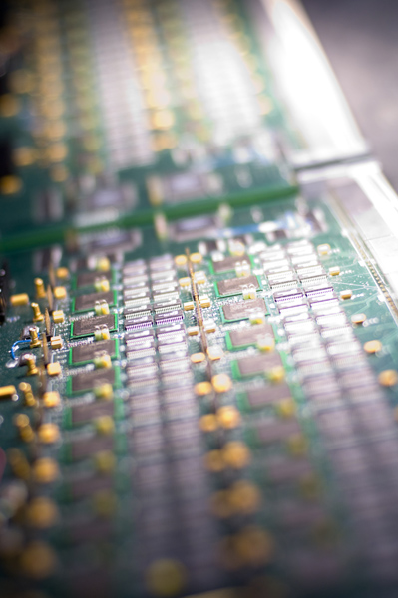
Trigger Plans

Slide 6
Currently using the InitialBeam_v3 commissioning menu
Plan to move to Physics menu when we reach around 10³⁰ cm⁻²s⁻¹
Physics menu on the drawing board right now
To be based on current estimates for 10³¹ menu https://twiki.cern.ch/twiki/bin/view/Atlas/L31TriggerMenu
L1 menu similar to current one and will not change in 2010
Plan is to contain most of what will be needed throughout the year, to be activated/deactivated through prescale changes

Slide 7
From 10²⁸ cm⁻²s⁻¹ up to 10³⁰ cm⁻²s⁻¹
At low luminosities, MinBias triggers take up most of the rate
With increasing luminosities, MinBias triggers are more prescaled
As L1Calo and L1Muon rates grow, HLT starts to be deployed in active rejection (around 10²⁹)
This can be done one for small groups of chains at a time
HLT chains being validated every day in every run
In case HLT chains not yet validated, L1 prescales will be used instead.

Slide 8
Other News
Meaning of pass-through factor:
Used to be fraction of events seen by trigger that will be forced through the system
Will soon be expressed wrt prescaled events – as fraction of non-prescaled-out events that are forced through the system
Avoids need to change passthrough factors for every change of prescales
Zero-Bias trigger: L1_ZB
Collects unbiased events according to the luminosity profile.
Seeded by MBTS_4_4 and triggering on the same bunch after one full revolution around LHC
Menu Tools: looking into tools to monitor the evolution of subsets of the menu (e.g. chains of interest to Phys & CP groups)
Releases:
Trigger using 15.5.X caches online – very stable and bug free after a lot of work
Under discussion whether to move to 15.6.9.Y caches in next technical stop
Many new offline developments could be picked up, but involves very serious validation work
Streams:
L1CaloEM stream dropped, since it became large fraction of L1Calo
RNDM stream now contains both simple random trigger and ZeroBias

Slide 9
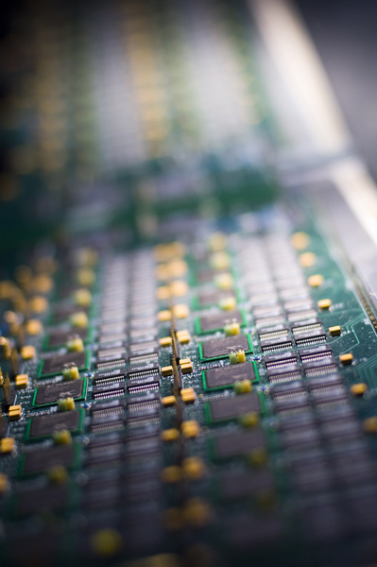
Trigger and Higgs

Slide 10
Trigger Menus Coordination is forum for discussing and approving trigger menus
Includes detector, comb.perf., and physics groups, plus phys.coord., data prep. etc
Higgs Group represented by me
“Menu representatives encouraged to discuss trigger strategy and collect feedback from respective groups”
For rapid and efficient feedback, essential to have good contact with all ongoing analyses
Set up network of people involved in each analysis
Not expected to do all (or almost any) trigger studies
Mostly to know “who to ask”
Many thanks to all who volunteered for this!

Slide 11
Trigger Contacts in Analyses
Higgs Group | Channel | Contact Person
HSG1 | H->γγ | Li Yuan
HSG2 | H->4l | Diego Rodriguez
 | H->2l2tau, H->2l2nu and H->2l2b | Paul Thompson
 | HZ (H->invisible) | Sylvie Brunet
HSG3 | H->WW (gg, VBF, WH, ttH, inv.) | Gemma Wooden
HSG4 | H->ττ leptonic and lep-had final states | Matthew Beckingham and Henrik Nilssen
 | H->ττ hadronic final states | Stefania Xella
HSG5 | ttH (H->bb) semileptonic | Catrin Bernius
 | ttH (H->bb) hadronic | Michael Nash
 | H+ (light, hadronic tau) | Martin Flechl
 | H+ (light, leptonic tau) | Arnaud Ferrari
 | H+ (heavy) | Martin zur Nedden

Slide 12
Under Discussion: the Physics Menu

Slide 13
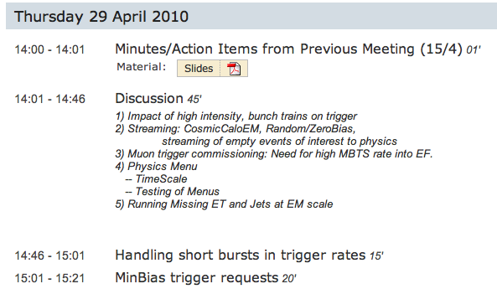
Menu Coordination Meeting Today
http://indico.cern.ch/conferenceDisplay.py?confId=93130

Slide 14
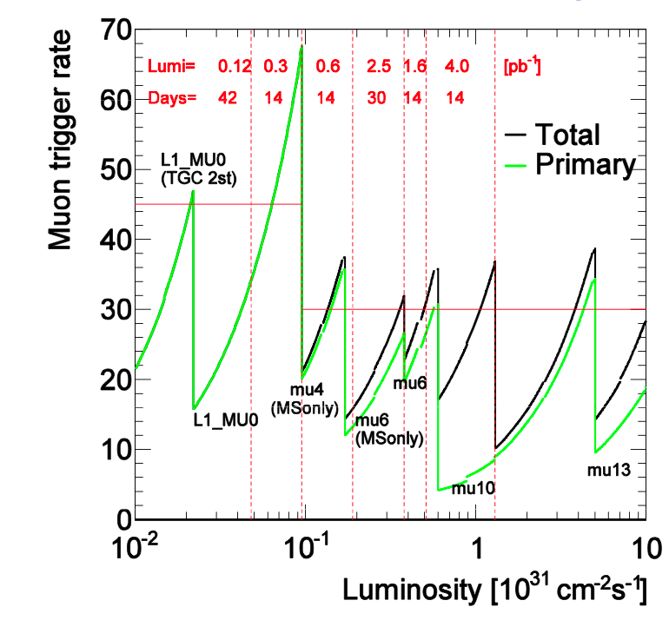
Muons
Primary Physics Triggers as a function of luminosity
Primary trigger mu10 up to 4x10³¹
Then move to mu13 up to 10³²
Details in http://indico.cern.ch/conferenceDisplay.py?confId=74183

Slide 15
Note: zero pileup assumed
Monika Wielers

Slide 16
Monika Wielers

Slide 17
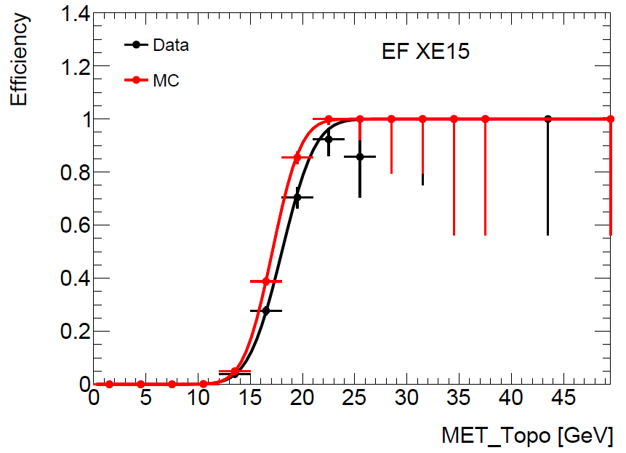
Missing ET
The hope is to have xe30 unprescaled up to a luminosity of 10³¹
An inclusive bandwidth of 20Hz was requested so that xe30 can remain unprescaled up to 10³²
Current bandwidth allows running XE15 unprescaled up to 10³⁰ (around 15Hz)
D.Casadei

Slide 18
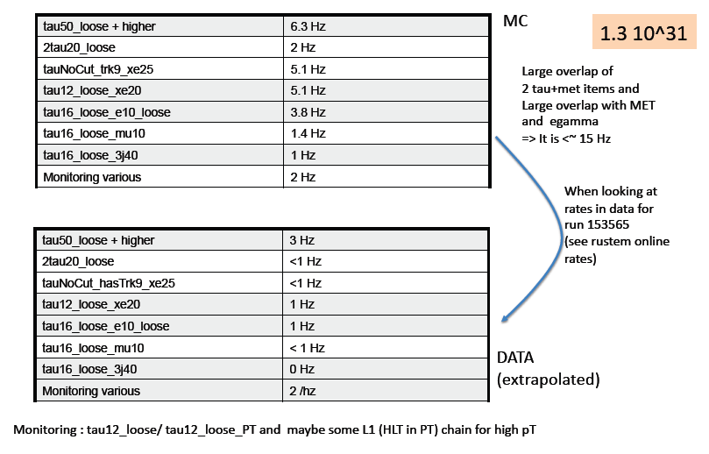
Stefania Xella

Slide 19
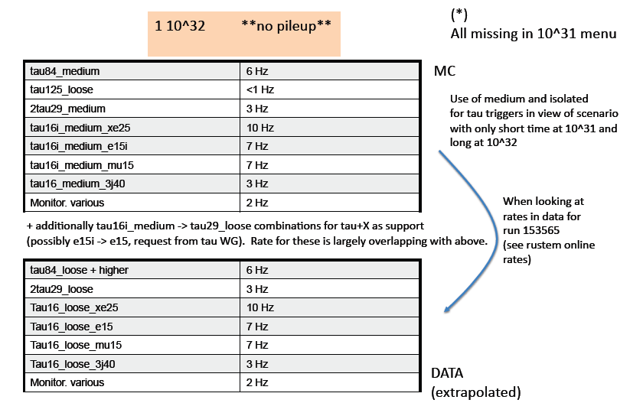
Work in progress
Stefania Xella

Slide 21
Conclusions

Slide 22
The increasing LHC luminosity means the HLT will soon need to actively reject events
Moving from commissioning menu to physics menu
Relying on trigger contact people in analyses to spread information on trigger strategy
Input welcome!

Slide 23
Backup Slides

Slide 24
B.Gorini – ATLAS weekly 27/4.2010

Slide 25
ATLAS weekly 27/4.2010

Slide 26
Moving from 15.5.X to 15.6.9.Y online
Summary:
– many changes make commissioning the HLT w.r.t. offline much harder to understand the efficiency of the EF in particular
• ID ~100 tag changes, Tracking ~50 tag changes
– most are multiple updates and most are used in the trigger.
– Performance tweaks, especially for low pt tracking., and EDM interface changes.
• Some minor changes to the persistent classes for the muon EDM, which may improve online
performance but definitely improve ESD/AOD/DPD i/o performance. Not especially needed online.
• Tau: the 'current safe tau offline optimization‘ due to change soon, not necessarily in Tier0
• Many calo and tau reco changes, hard to tell effect from ChangeLog, so request reprocessing.
• Jets: new offline jet software brings the data-based JES and anti-kT jet algorithm , move to EM energy scale. Some of this could be back-ported.
• MET: few things (robustness fixes for higher lumi) they would like to either back port or get by moving to 15.6.9.
• Muons: major changes in offline muon reco which affect EF & EDM, in particular would reduce EF timeouts. Would prefer to move to 15.6.9 but back port looks possible.
• Conclusions from this:
– Strong cases to move to 15.6.9 from tracking, ID and muon.
– Requests to run tests with 15.6.9 to get more feedback from the
signature groups.
Pro
– Useful/essential for HLT commissioning to have very similar EF & Reco
in HLT and Tier0
• June already too late though?
– Useful to have HLT online and MC with much closer release, for
analysis
– Validation of physics perf in 15.6.9 by signature groups has been very
thorough, for MC
Con
– 15.5.7 very well validated for online use w.r.t. technical issues, while
15.6.9 is not; would take some time and effort
– Would not be great time to switch release after HLT commissioning
has started. But still sooner is better than later.
– Unknown how reco will respond to higher lumi. If Tier0 doesn’t
effectively freeze at 15.6.9 for the rest of the year we gradually lose
the “closer” advantages above.

Slide 27
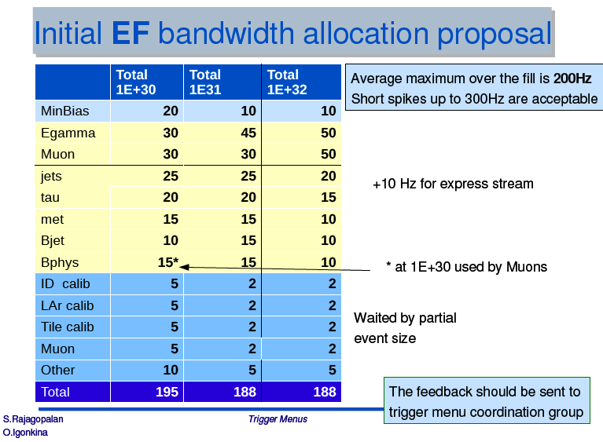

Slide 28
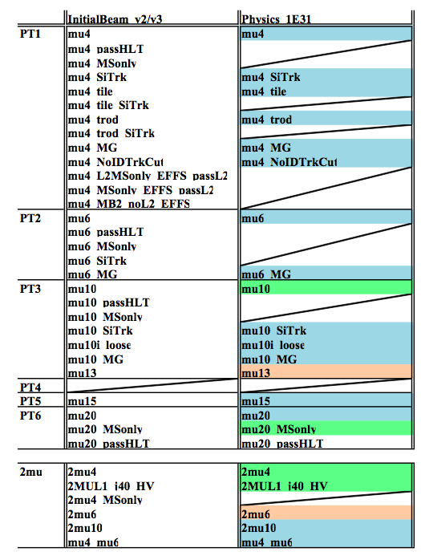
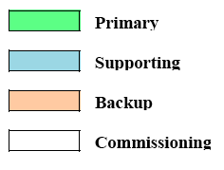
Muon trigger
primary=mu6_MSonly mu4_MSonly PS=10 primary=mu6 mu4 PS=10 primary=mu10 < 10*31 mu4 PS=8 mu6 PS=6 10**31 mu4 PS=200 mu6 PS=100 primary=mu13 mu6 PS=100 mu10 PS=10
Missing in this table Primary: MU4_MV Supporting: EF_mu4_MB2_noL2_EFFS
Alex Oh

Slide 29
Additional Information
Trigger user info: https://twiki.cern.ch/twiki/bin/view/Atlas/TriggerUserPages
Tutorials: https://twiki.cern.ch/twiki/bin/view/Atlas/TriggerSoftwareTutorialPage
TDT Twiki: https://twiki.cern.ch/twiki/bin/view/Atlas/TrigDecisionTool
TDT Doxygen: http://atlas-computing.web.cern.ch/atlas-computing/links/nightlyDevDirectory/AtlasOffline/latest_doxygen/InstallArea/doc//TrigDecisionTool/html/index.html
Trigger obj matching: https://twiki.cern.ch/twiki/bin/view/Atlas/TriggerObjectsMatching
TrigAnalysisExample: http://atlas-computing.web.cern.ch/atlas-computing/links/nightlyDevDirectory/AtlasOffline/latest_doxygen/InstallArea/doc/TrigAnalysisExamples/html/index.html
UserAnalysis example: https://twiki.cern.ch/twiki/bin/view/AtlasProtected/UserAnalysis
Trigger Configuration: http://trigconf.cern.ch
TriggerTool: http://www.cern.ch/triggertool
Run query: http://atlas-runquery.cern.ch/
Trigger EDM: https://twiki.cern.ch/twiki/bin/view/Atlas/TriggerEDM, http://alxr.usatlas.bnl.gov/lxr/source/atlas/Trigger/TrigEvent/TrigEventARA/TrigEventARA/selection.xml
TriggerMenu group: https://twiki.cern.ch/twiki/bin/view/Atlas/TriggerPhysicsMenu
TriggerSW group: https://twiki.cern.ch/twiki/bin/view/Atlas/TAPMCoreSW
TriggerConfig group: https://twiki.cern.ch/twiki/bin/view/Atlas/TriggerConfiguration
Help on e-groups: hn-atlas-TriggerHelp at cern.ch

