Slide 1
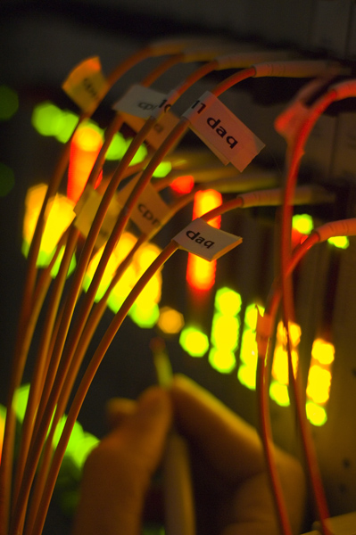
Higgs Trigger Menu
Higgs Working Group Meeting
27 May 2010
Ricardo Gonçalo
Royal Holoway University of London

Slide 2
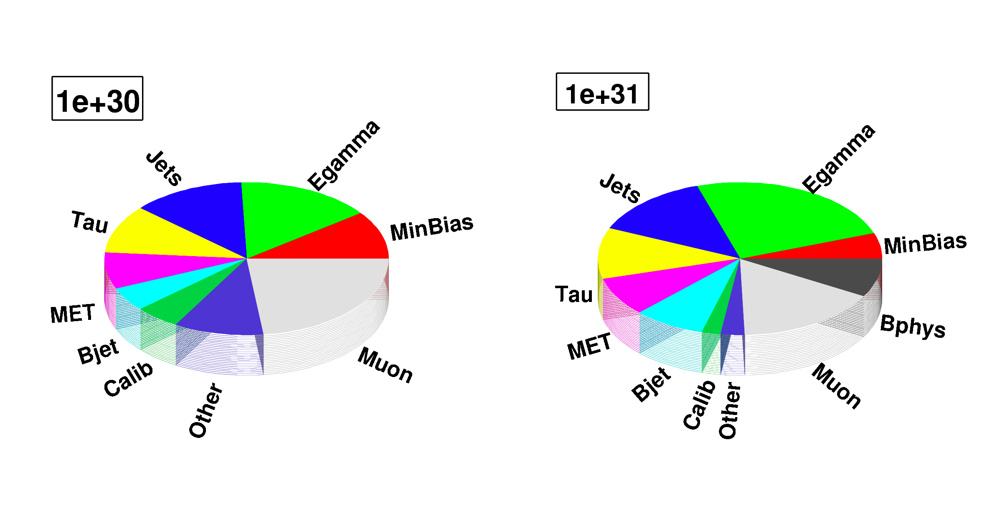
Physics Menu
Menu on the drawing board – in particular prescales not yet known!
Status (automatically generated from nightly, search a different rel_X if invalid):
http://atlas-trigconf.cern.ch/nightlies/display/release/15.6.X.Y.Z/project/CAFHLT/nightly/rel_1/name/Test_pp_v1_15.6.9.4.1/
To be used between 10³⁰cm⁻²s⁻¹ and 10³²cm⁻²s⁻¹ (until end of this year)
There will be other opportunities to update the menu during the year, but not many
Final approval next week for deployment sometime in June
Purpose of this talk is to discuss needs & constraints of each analysis before request from the Higgs WG goes to menu coordination

Slide 3
Higgs Requests

Slide 4
Higgs Trigger Gang
Higgs Group | Channel | Contact Person
HSG1 | H->γγ | Li Yuan
HSG2 | H->4l | Diego Rodriguez
 | H->2l2tau, H->2l2nu and H->2l2b | Paul Thompson
 | HZ (H->invisible) | Sylvie Brunet
HSG3 | H->WW (gg, VBF, WH, ttH, inv.) | Gemma Wooden
HSG4 | H->ττ leptonic and lep-had final states | Matthew Beckingham and Henrik Nilssen
 | H->ττ hadronic final states | Stefania Xella
HSG5 | ttH (H->bb) semileptonic | Catrin Bernius
 | ttH (H->bb) hadronic | Michael Nash
 | H+ (light, hadronic tau) | Martin Flechl
 | H+ (light, leptonic tau) | Arnaud Ferrari
 | H+ (heavy) | Martin zur Nedden

Slide 5
HSG1: H -> γγ
Li Yuan
L = 10³⁰ to 10³¹ cm⁻²s⁻¹:
g20_loose – primary trigger (7 Hz⁽¹⁾ 15 Hz⁽²⁾ at 10³¹ cm⁻²s⁻¹)
2g20_loose – backup trigger: will become primary trigger when needed (>10³² cm⁻²s⁻¹ ?)
g20i_loose – supporting trigger: study isolation at Level 1
g10_loose (11 Hz⁽¹⁾ 35 Hz⁽²⁾ at 10³⁰ cm⁻²s⁻¹) or g5_loose – support triggers for efficiency determination (bootstrap); can be prescaled to a low rate
L = 10³² cm⁻²s⁻¹:
Primary trigger: g20_loose (70 Hz⁽¹⁾ – prescaled) or g20_medium (no prescale expected?)
2g20_medium or g20_g30_loose – primary trigger for event collection
g20i_loose – supporting trigger: study isolation at Level 1
g10_loose or g5_loose – backup triggers for bootstrap methods; heavily prescaled
Questions:
Any reason to not go to g20_medium or g20_tight at 10³² if g20_loose prescaled?
Why use both g20_loose and 2g20_loose as primary triggers?
Rates I saw are stilluncertain (Li’s rates larger then egamma trigger) – how are they calculated?
If we need to use new trigger (g30_g20) should justify – what’s increase in efficiency?
Extrapolated – see Rainer Stamen in http://indico.cern.ch/conferenceDisplay.py?confId=94961
Estimated in MC https://twiki.cern.ch/twiki/bin/view/Atlas/AtlasTriggerRates

Slide 6
HSG2: H->ZZ*->llll
L = 10³⁰ to 10³¹ cm⁻²s⁻¹:
e10_medium – primary trigger (34 Hz⁽¹⁾ or 48 Hz⁽²⁾ at 10³¹ cm⁻²s⁻¹)
e12_medium – backup for e10_medium if rate too high
e10_medium_SiTrk – supporting (alternative L2 tracking)
mu10 – primary trigger (15 Hz⁽²⁾ at 10³¹ cm⁻²s⁻¹)
mu6 – supporting (4.4 Hz⁽²⁾ – prescale 200 – at 10³¹ cm⁻²s⁻¹)
mu15 – backup for mu10 (3 Hz⁽²⁾ at 10³¹ cm⁻²s⁻¹)
L = 10³² cm⁻²s⁻¹:
e15_medium – primary trigger (10 Hz⁽²⁾ at 10³¹ cm⁻²s⁻¹)
e15_medium_SiTrk – suporting (still needed?)
e20_medium – (2 Hz⁽²⁾ at 10³¹ cm⁻²s⁻¹) backup for e15_medium if the rate too high
mu13 – primary trigger (no rates found)
mu15 – (3 Hz⁽²⁾ at 10³¹ cm⁻²s⁻¹) backup for mu13
mu10 – supporting
Questions:
Could we have e10_tight (or e15_medium) as backup for e10_medium instead at 1e31?
Supporting trigger e15_medium_SiTrk still needed at 1e32?
For 1e32 would mu15 be ok if mu13 not in menu? (How much would we loose?)
Any reason to go to di-lepton triggers? (I.e. is there need to lower p_{T} thresholds? Or is there some margin?)
⁽¹⁾ Extrapolated – see Rainer Stamen in http://indico.cern.ch/conferenceDisplay.py?confId=94961
⁽²⁾ Estimated in MC https://twiki.cern.ch/twiki/bin/view/Atlas/AtlasTriggerRates
Diego Rodriguez

Slide 7
ZH->inv, H->2l2τ, H->2l2ν and H->2l2b
Paul Thompson
Sylvie Brunet
All four analyses rely on leptons for trigger
In signal these come from Z decay
Can use same triggers as H->4l channel in previous page

Slide 8
HSG3: H->WW (gg, VBF, WH, ttH, inv.)
Gemma Wooden
L = 10³⁰ to 10³² cm⁻²s⁻¹:
e10_medium and mu10 – primary single lepton triggers for H->WW->ll (l = e,mu)
2e5_medium(2 Hz(2) at 10³¹ cm⁻²s⁻¹) and 2mu6 – backup: di-lepton trigger in case offline lepton p_{T} may be lowered
e10_loose – support trigger to study fake rate
VBF trigger: seems useful at ≈ 10³² cm⁻²s⁻¹, when single-lepton triggers need to get tight
Di-jet trigger + rapidity gap + lepton
Lepton p_{T} threshold low (perhaps ~8 GeV)
Would give gain in phase space for VBF H->WW at the cost of little extra rate
In the tau channel, this trigger increases the number of events by 20-25%, but lower gain expected for WW channel
Questions:
Rates too high for above single-lepton triggers at 10³² cm⁻²s⁻¹. Would the ones below be ok? (I.e. how much do we loose?)
e15_medium – primary trigger (10 Hz⁽²⁾ at 10³¹ cm⁻²s⁻¹)
e20_medium – (2 Hz⁽²⁾ at 10³¹ cm⁻²s⁻¹) backup for e15_medium if the rate too high
mu13 – primary trigger (no rates found)
mu15 – (3 Hz⁽²⁾ at 10³¹ cm⁻²s⁻¹) backup for mu13
Would e10_loose_mu6 be useful? (with e10_medium_mu10 for higher lumi) – requested for H->ττ
Would be great to have lepton trigger efficiencies and p_{T} spectrum
VBF trigger:
Which di-jet+gap trigger? (EF_2j40_deta3_5, EF_2j20_deta3_5, EF_2j10_deta3_5, EF_2j10_deta5? Prescales not yet known)
Can we live with existing lepton pT cut ? E.g. electron 10GeV, muon 6GeV. What would we gain with pT >5GeV for electrons?
What is the efficiency for signal with each possibility?

Slide 9
HSG4: H->ττ leptonic and lep-had
From: https://twiki.cern.ch/twiki/bin/view/AtlasProtected/HiggsTauTau#Trigger and input from Matthew
L = 10³⁰ to 10³¹ cm⁻²s⁻¹:
e10_medium – primary trigger (34 Hz⁽¹⁾ or 48 Hz⁽²⁾ at 10³¹ cm⁻²s⁻¹)
e12_medium – backup for e10_medium if rate too high
e10_medium_SiTrk – supporting (alternative L2 tracking)
mu10 – primary trigger (15 Hz⁽²⁾ at 10³¹ cm⁻²s⁻¹)
mu6 – supporting (4.4 Hz⁽²⁾ – prescale 200 at 10³¹ cm⁻²s⁻¹)
mu15 – backup for mu10 (3 Hz⁽²⁾ at 10³¹ cm⁻²s⁻¹)
e10_loose_mu6 – (1Hz ⁽²⁾ at 10³¹ cm⁻²s⁻¹): 50% increase in signal efficiency wrt e10_medium || mu10 – requested into Physics menu)
e5_medium_mu4 – support trigger for e10_loose_mu6 (fake rate & bias studies)
L = 10³² cm⁻²s⁻¹:
e20i_loose – primary trigger (10 Hz⁽²⁾ at 10³¹ cm⁻²s⁻¹) – e20i_medium not in the menu (shall we request it?)
e15_medium, e20_medium – supporting
e25_medium – (≈0 Hz⁽²⁾ at 10³¹ cm⁻²s⁻¹) backup for e15_medium if the rate too high – e25i_medium not in phys menu
mu20 – primary trigger (2 Hz⁽²⁾ at 10³¹ cm⁻²s⁻¹)
mu10 or mu15 – supporting trigger: mu15 – (3 Hz⁽²⁾ at 10³¹ cm⁻²s⁻¹) backup for mu13
e10_loose_mu6 or e10_loose_mu10 – It may be necessary to go to higher muon p_{T} cut, depending on luminosity
Questions:
Is list of single-lepton triggers up to date?
How do we gain so much (50%) by going from e10_medium || mu10 to e10_loose_mu6? (decrease in offline p_{T} cut?)
Obs.: 2e5_medium has 2 Hz at EF (1E31) but 2mu6 has 10Hz – can’t assume they will be un-prescaled
Some healthy resistance in menu group to adding triggers in particular not clear about e5_medium_mu4
⁽¹⁾ Extrapolated – see Rainer Stamen in http://indico.cern.ch/conferenceDisplay.py?confId=94961
⁽²⁾ Estimated in MC https://twiki.cern.ch/twiki/bin/view/Atlas/AtlasTriggerRates
Matthew Beckingham
Henrik Nilssen

Slide 10
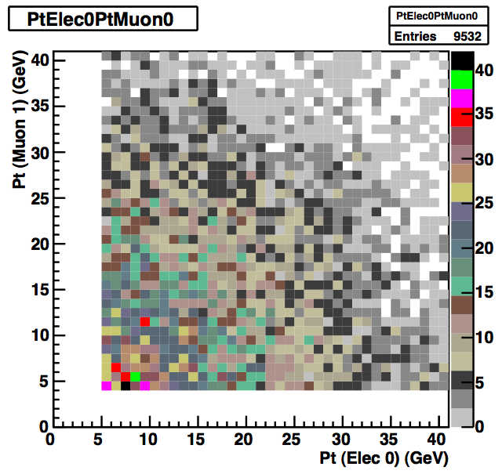
H -> τ τ -> eν μν
Matthew Beckingham
Henrik Nilssen
Could live with p_{T} thresholds for single-lepton triggers if the other remains low, but moving both to 20 costs ~35% of signal:
e10_medium|| mu10 → e10_medium mu20: keep ~99% of events
e10_medium || mu10 → e20_medium mu10: keep ~95% of events
e10_medium || mu10 → e15_medium mu15: keep ~88% of events
e10_medium || mu10 → e20_medium mu20: keep ~65-70% of events
Solution: use di-electron, di-muon and e+mu trigger
Including e10_loose_mu6 we gain 50% more events wrt to e10_medium || mu10
Including e5_medium_mu4 we gain 56% more events wrt to e10_medium || mu10
…and lowering electron and muon preselection cuts to p_{T}>5 GeV
Matthew Beckingham

Slide 11
HSG4: H->ττ Hadronic
Stefania Xella
From: https://twiki.cern.ch/twiki/bin/view/AtlasProtected/HiggsTauTau#Trigger
L = 10³⁰ to 10³¹ cm⁻²s⁻¹:
double tau:
primary trigger = 2tau20_loose – version with isolation (2tau20i_loose) not available in menu
support trigger = e10_medium || mu10 || xe30 – not clear which xeYY will be unprescaled for 1e31
backup trigger = 2tau29_loose – version with isolation (2tau29i_loose) not available in menu
tau+MET:
primary trigger = tau16_loose_xe25 – ok
support trigger = tau16i_loose_4j23 – not available in menu
backup trigger = tau16_loose_xe20 and tau16i_loose_xe25 - ok
L = 10³² cm⁻²s⁻¹:
double tau:
primary trigger = 2tau29i_loose – version with isolation (2tau29i_loose) not available in menu
support trigger = e20_medium || mu20 || xe40 – not clear which xeYY will be unprescaled for 1e32
backup trigger = 2tau38_loose - ok
tau+MET:
primary trigger = tau29i_loose_xe30 – not in physics menu
support trigger = ?
backup trigger = tau38_loose_xe40 – not in menu
Questions:
List needs to be updated – some of the triggers not in Physics menu, but similar chains could be used (or request new if really needed)

Slide 12
HSG5: ttH (H->bb) semileptonic
Catrin Bernius
Also including Fat-Jet analysis
Basically need lowest un-prescaled single-lepton trigger; my proposal:
L = 10³⁰ to 10³¹ cm⁻²s⁻¹:
e10_medium – primary trigger (34 Hz⁽¹⁾ or 48 Hz⁽²⁾ at 10³¹ cm⁻²s⁻¹)
e12_medium – backup for e10_medium if rate too high
mu10 – primary trigger (15 Hz⁽²⁾ at 10³¹ cm⁻²s⁻¹)
mu15 – backup for mu10 (3 Hz⁽²⁾ at 10³¹ cm⁻²s⁻¹)
L = 10³² cm⁻²s⁻¹:
e15_medium – primary trigger (10 Hz⁽²⁾ at 10³¹ cm⁻²s⁻¹)
e20_medium – (2 Hz⁽²⁾ at 10³¹ cm⁻²s⁻¹) backup for e15_medium if the rate too high
mu13 – primary trigger (no rates found)
mu15 – (3 Hz⁽²⁾ at 10³¹ cm⁻²s⁻¹) backup for mu13
Absolute efficiencies from CSC studies were 82% mu20 || e22i || e55, so we should be in safe ground for this year
Obs.:
Jet triggers will be studied, but numbers are not available for now, so better hold off on requests

Slide 13
HSG5: ttH (H->bb) hadronic
Michael Nash
Not clear what triggers are needed and possible at present
Only jet triggers and E_{T}^{sum} could be useful
Menu currently has some multi-jet triggers: EF_3j80, EF_4j40, EF_5j20
But not clear which will be prescaled and when
Available numbers:
For the MC@NLO fully hadronic ttbar dataset, the 'useful' chains I can see are:
EF_2j10 (100%) not in new menu
EF_2j20 (99%) not in new menu
EF_2j40 (96%) – looks very useful!
EF_3j20 (93%) percale 10 000 000!

Slide 14
HSG5: Heavy charged Higgs
Martin zur Nedden
Looking at new menu:
The combinations of ”e + MET" and "tau + MET" currently in the menu are ok
A new combination ”e + MET + jet” exists but still to be checked
Missing combined triggers:
combination "mu + MET" is MISSING
combination "tau + MET + jet" is MISSING
combination "mu + MET + jet" is MISSING
And more details that I won’t mention

Slide 15
Conclusions

Slide 16
Requested e10_loose_mu6 and e5_medium_mu4 already
Will look into VBF trigger (dijet+gap+lepton)
Anyone missing? Please let me know ASAP
First physics menu will be approved next week
Many thanks to Higgs trigger gang for input!

Slide 17
Backup Slides

Slide 18
Dear all,
As announced last week we have first draft of the trigger menu for physics
run covering 1e+30 - 1e+32 luminosity. Below you find links to the first
draft of the "Test_pp_v1" menu, justification page and rate estimates for
1e+31 lumi. The prescales sets for various lumi points are not yet
available, so you would need to use your judgement on what items *could*
run unprescaled at various luminosities for now.
We ask every *physics*, *detector* and *CP* group representatives to look
very carefully through tables, make a list of important items for each
group, discuss them this and next week during your group meetings, and
come back to us with 3 tables for 3 lumi points (1e30, 1e31, 1e32, more if
possible) with 3 columns :
a. each needed trigger item is listed together with
b. which type should it be for you at this lumi (primary,
supporting, backup) - few simultaneous options are possible
c. reason/justification (very short sentence, preferably <10 words)
- be prepared to give longer justification if asked, so
just tag "Exotics" will not be sufficient, but "main 1e32
electron trigger for high pt Exotics" or "soft pt trigger for
efficiency measurement" is good.
We ask you to send us feedback asap, best before May 31st, but earlier
will be much appreciated. The triggers which will lack justification will
*not* be propogated to Physics_pp_v1 menu. Please let us know if something
is already missing in Test_pp_v1.
Iterations on the lists will certainly be possible.
Thank you in advance,
Olya and Srini
P.S. We remind trigger signature group representatives that they are also
representatives of corresponding CP group, and while following up here
should also consider other types of triggers, e.g. for studies of fakes
and such.
------------- Details : -----------------------------------------
The *first draft* of menu is available at
http://atlas-trigconf.cern.ch/nightlies/display/release/15.6.X.Y.Z/project/CAFHLT/nightly/rel_3/name/Test_pp_v1_15.6.9.3.1/
This is what we call "Test_pp_v1" menu which contains primaries,
supporting, some commissioning, backup, and *test* items - you can see
what is latest tag if you press "load" button on top of the page.
Once you provide us with the list of "favorites" we will upload it as
predefined view, and you will be able to see only your triggers using
"predefined view" link.
You can see current justification for each trigger , if you press "+"
after "load". The link http://atlas-trigconf.cern.ch/just/list/ shows all
current available motivations - obviously we (with your help) have to
improve it.
The plans prepared by trigger groups are
available at http://indico.cern.ch/conferenceDisplay.py?confId=74183
The rates for 1e31 given at
http://atlas-trig-cost.cern.ch/offline/html_user10.EdwardSarkisyan-Grinbaum.EnhBias7TeV1555Offls31m.digit.RD
O.d238_18-05-2010_AtlasCAFHLT-rel_2-15.6.X.Y.Z.04/
No prescales are taken into account, so use your judgement and plans of
trigger groups of what is possible at each lumi.
Unfiltered rates with much smaller statistics is available here :
http://atlas-trig-cost.cern.ch/offline/html_mc09_7TeV.105001.pythia_minbias.digit.RDO.e468_s624_s633_d238_18
-05-2010_AtlasCAFHLT-rel_2-15.6.X.Y.Z/
The rates are calculated on *MC* using enhancedBias sample filtered on
EM3, J15, MU0, XE25, TE250, FJ18, TAU5. L1 EM calibration was used.
This particular MC tune is known to give rates factor of ~2 higher than
seen on data.
Many thanks to menu and rate experts on preparing menu and rates!
Request from Menu Coordination for next week

Slide 19
VBF trigger for HSG3
As for the VBF trigger, the pT threshold of the lepton would be low (perhaps ~8 GeV) since this would give us a gain in phase space.
It would also provide an alternative trigger in the case that lepton rates may increase more than expected, leading to prescaled single lepton triggers, which would be undesirable for us.
Mario believes this trigger would be most useful at the point where the single lepton trigger would need to be prescaled (which he says would be ~1e33 for 15 GeV leptons).
So, it seems that perhaps this trigger would only really be useful for us possibly at 1e32 or more.
In the tau channel, this trigger increases the number of events by 20-25%, but for the tau analysis, a higher single lepton trigger threshold is used so I think the gain in the WW channel would be less than this.
In any case, Mario says that the trigger logic will be implemented soon so if the H->WW group wants to add a lower threshold than the H->tau tau group according to him it shouldn't be a problem.

Slide 20
Rate estimates from Li Yuan
Hz (10³¹cm⁻²s⁻¹) | Monte Carlo |  | Data (scaled from 155160)
Matching: | Match offl. γ | Match offl. γ/e | Match offl. γ | Match offl. γ/e
g20_loose | 18.1 | 26.2 | 9.2 | 12.4
2g20_loose | 0.97 | 2.1 | 0.26 | 0.47
g20i_loose | 16.7 | 23.3 | 8.2 | 10.8
Extrapolated from run 155160 (peak lumi 1e28) - very preliminary numbers
Estimated based on trigger object matching with offline photon or offline photon or electron.
These results are consistent with the MC/data ratio of 2.0 as you can see at page 3 of the talk:
http://indico.cern.ch/getFile.py/access?contribId=32&sessionId=5&resId=0&materialId=slides&confId=92039
So for luminosity at 1e32, g20_loose may reach to 90Hz, while 2g20_loose will be over 2.6 Hz.

Slide 21
HSG5: ttH hadronic
Michael Nash
Efficiencies for from 10TeV - Fully hadronic ttH (NB 10TeV !)
10^31
Trigger item % Prescale in new menu
======================================================
EF_1b40_2b20_3L1J10 46 unprescaled
EF_1b40_2b20_3L1J20 46 unprescaled
EF_1b40_2b20_4L1J20 0 unprescaled
EF_2b20_3L1J20 17 unprescaled
EF_2b40_3L1J20 30 unprescaled
EF_3b20_4L1J10 30 unprescaled
EF_3b20_4L1J20 17 unprescaled
EF_3j80 70 unprescaled - back-up trigger?
EF_4j40 93 unprescaled - best trigger by far
EF_b100 N/A! unprescaled
EF_j260 19 unprescaled
-------------------------------------------------------------------------------------
EF_2b10_3L1J10 N/A!
EF_2b10_4L1J5 N/A!
EF_3b10_4L1J10 N/A!
EF_3b10_4L1J5 N/A!
10^32, 10^33: since the prescales are, even for 10^31, not fixed, I
can't really give much input here.
Fully hadronic tt with MC@NLO (7 TeV)
10^31
Trigger item % Prescale in new menu
==========================================================
EF_2j10 100 N/A!
EF_2j20 99 N/A!
EF_2j40 96 N/A!
EF_3j20 93 10000000
EF_j20 100 100
EF_j200 11 10
EF_j40 100 500
EF_j80 85 N/A!
EF_j80_larcalib 28 10000000
EF_mu4 21 1500 (300@EF, 5@L2; not sure I've understood)
EF_mu6 16 30
EF_tau12_loose 58 1000
EF_tau16_loose 55 300
EF_te100 93 N/A!
EF_xe20 40 1 - best trigger (to my surprise)
-------------------------------------------------------------------------------------
The following potentially useful triggers from the new menu are not
found in the above AODs:
EF_5j20
EF_4j40
EF_3j80
EF_j260

Slide 22
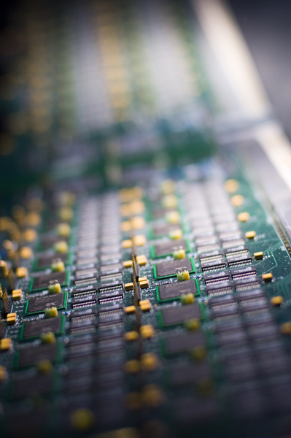
Physics Menu Proposals from Signature Groups

Slide 23
e/γ Proposal for 10³⁰
Trigger item | type | justification
2e3_loose | primary | J/psi
2g5_loose | Primary | Di-γ, Gravitons
e5_medium | Primary | Incl. Electrons
g10_loose | Primary | Incl. Photons
e10_loose | Primary | Incl. Electrons
e3_medium | Support | t&p for 2e3_loose
g5_loose | support | 2&p for 2g5_loose
Additional Information
0.3 Hz
3 Hz
14 Hz
11Hz
2 Hz
4 Hz after prescale
2 Hz after prescale
+ support triggers with different tracking
e3_medium and g5_loose can be used to fill up the bandwith during a fill
when inst. lumi. decreases
Rainer Stamen: http://indico.cern.ch/conferenceDisplay.py?confId=94961

Slide 24
e/γ Proposal for 10³¹
Trigger item | type | justification
2e3_loose | Primary | J/psi
2g10_loose | Primary | Di-γ, Gravitons
e10_medium | Primary | Incl. Electrons
e15_loose | Primary | Incl. Electrons
g20_loose | Primary | Incl. Photons
em105_passHLT | Primary | High pt exotics
e3_medium (presc) | support | t&p 2e3_loose
g10_loose (presc) | Support | t&p 2g10_loose
e20_loose | Support
Additional Information
5 Hz
few Hz
14 Hz
12Hz
7 Hz
< 1Hz
3 Hz with prescale=?
3 Hz with prescale=?
2 Hz with prescale=?
At some point here we might have enough data to fully validate the tracking. After that
drop the support chains with different tracking options

Slide 25
e/γ Proposal for 10³² (i.e. few 10³¹)
Here it gets difficult to predict (high threshold rates not known yet, pile-up effect not known yet, physics needs probably not well defined yet)
Evolution:
2e3_loose (10³¹)-> 2e3_medium (3*10³¹)-> 2e3_tight, 2e5_medium or 2e3_medium(prescaled)
e10_medium, e15_loose (2*10³¹)-> e10_tight, e15_medium (410³¹)-> e15_tight
g20_loose (2*10³¹)-> g20_tight
Proposal: Put all these triggers into the menu and decide later on the exact evolution strategy (once we know details to take a reasonable decision)

Slide 26
e/γ Proposal for 10³² (i.e. few 10³¹)
Trigger item | type | justification
2e3_loose | Primary | J/psi
2e3_medium
2e5_medium
2e3_tight
2g10_loose | Primary | Diphoton, GMSB
e10_medium | Primary | Incl. Electrons
e10_tight
e15_loose | Primary | Incl. Electrons
e15_medium
e15_tight
g20_loose | Primary | Incl. Photons
em105_passHLT | Primary | High pt exotics
e3_medium (presc) | support | t&p 2e3_loose
g10_loose (presc) | Support | t&p 2g10_loose
e20_loose | Support
Exact strategy to
be decided later
Switch over
during evolution

Slide 27
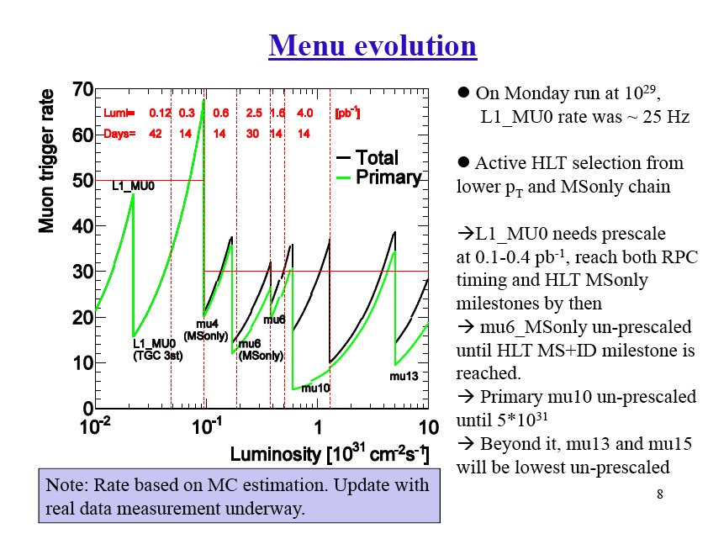
Kunihiro Nagano: http://indico.cern.ch/conferenceDisplay.py?confId=95409

Slide 28
Kunihiro Nagano: http://indico.cern.ch/conferenceDisplay.py?confId=95409

Slide 29
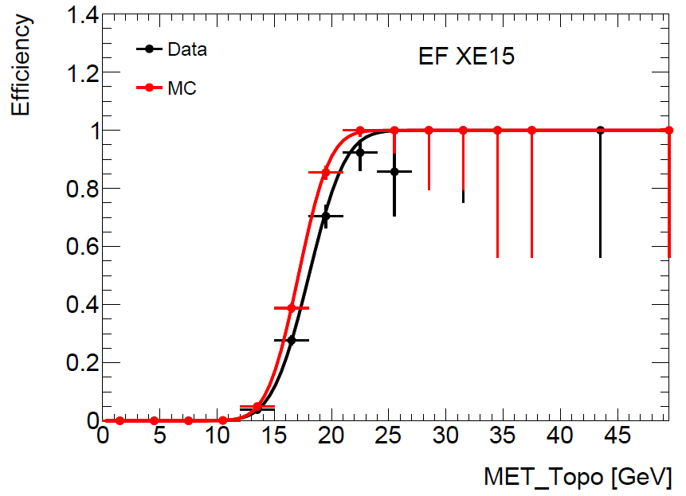
Missing ET
The hope is to have xe30 unprescaled up to a luminosity of 10³¹
An inclusive bandwidth of 20Hz was requested so that xe30 can remain unprescaled up to 10³²
Current bandwidth allows running XE15 unprescaled up to 10³⁰ (around 15Hz)
D.Casadei

Slide 30
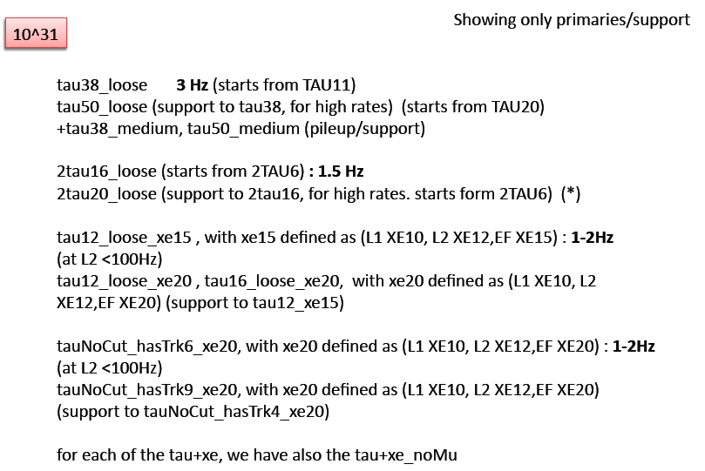
Stefania Xella:

Slide 31
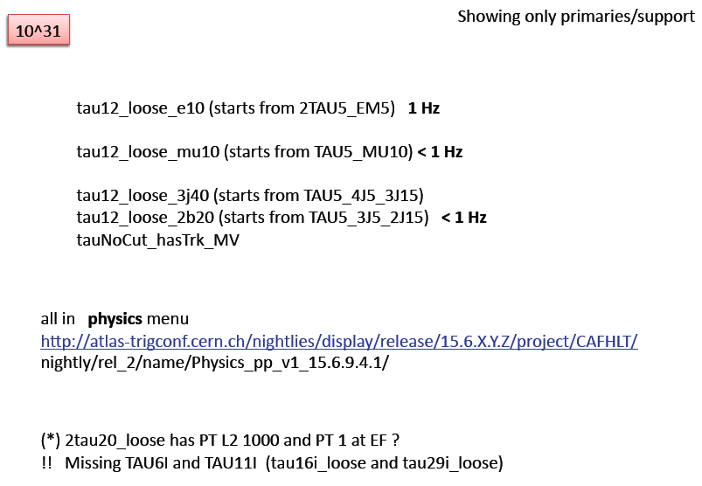

Slide 33
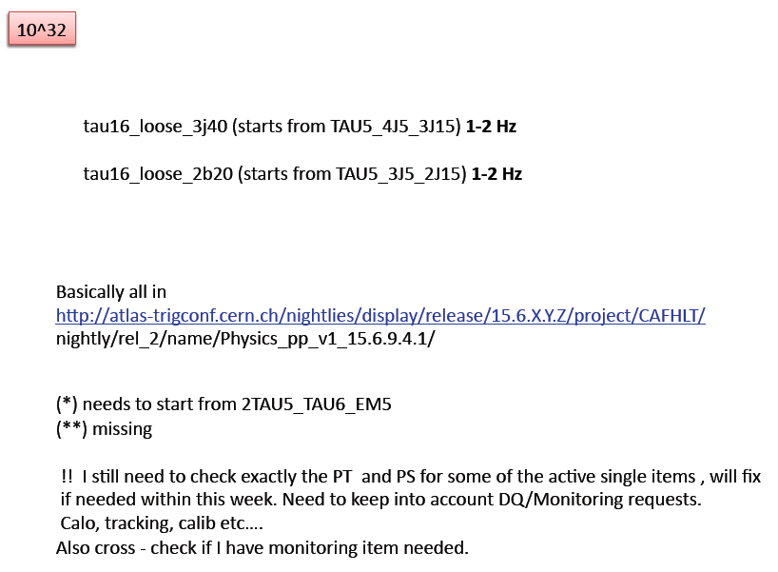

Slide 34
Trigger Performance

Slide 35
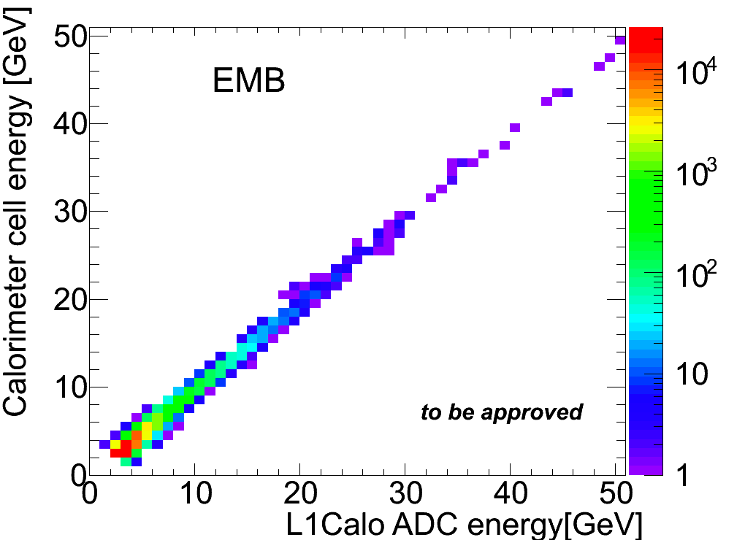
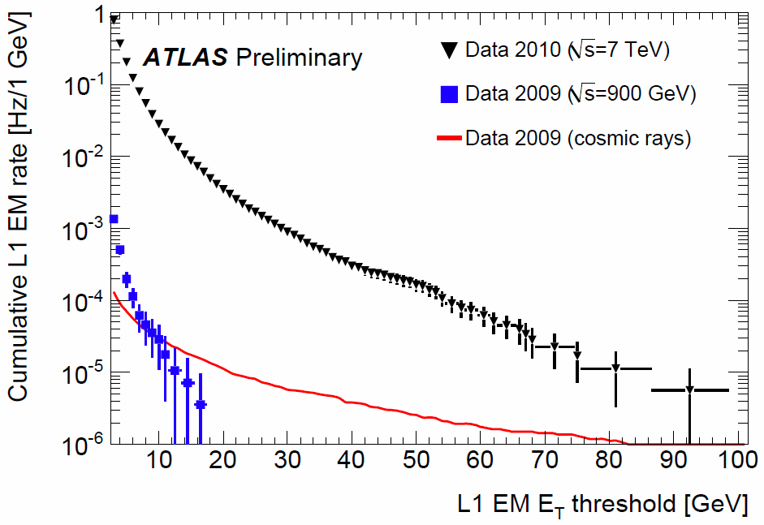
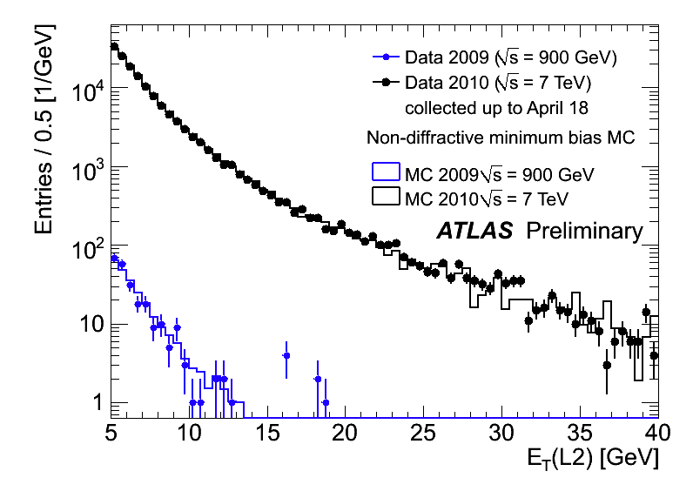
Calorimeter
L1 Calo has different energy scale and readout than HLT – coarser granularity
Summing cells and comparing to trigger tower
Recent improvement in timing of signals
HLT relies on DSP-decoded quantities for each cell - cannot re-fit samplings as for offline reconstruction
Developments in parallel with detector
L1:
9μb⁻¹ @ 900GeV
400μb⁻¹ @ 7TeV
L2:
9μb⁻¹ @ 900GeV
400μb⁻¹ @ 7TeV

Slide 36
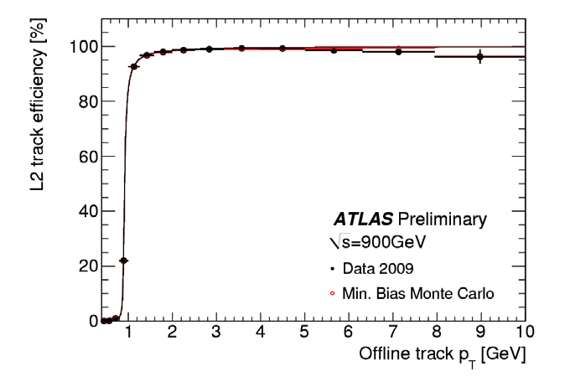
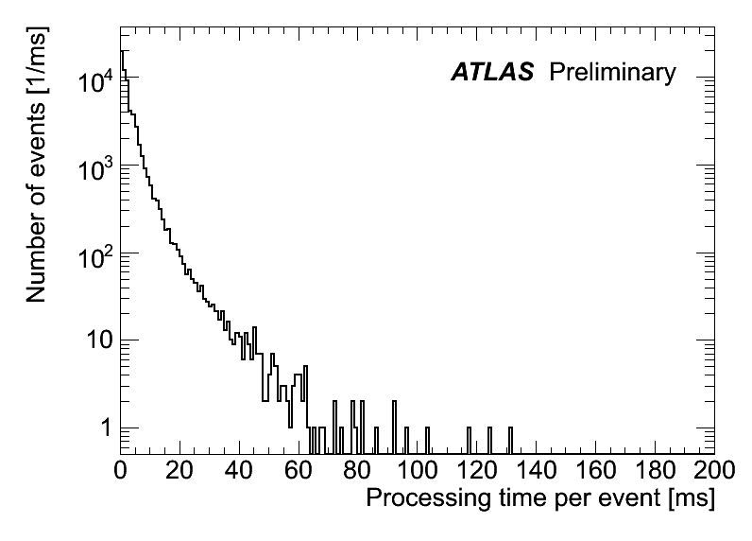
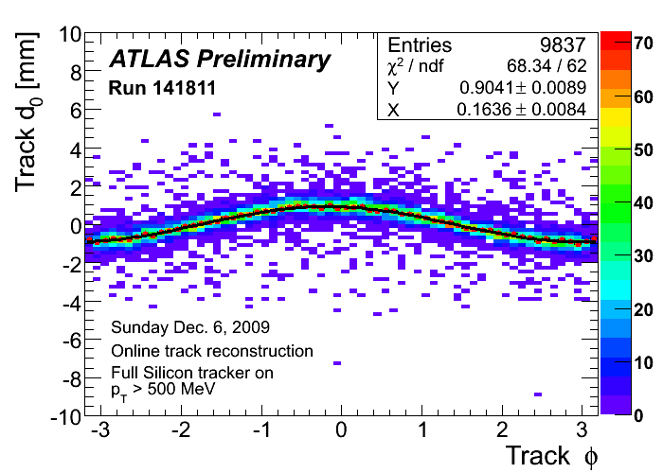
HLT Tracking
Efficiency for L2 tracks close to 100%; compares well to MC
L2 tracking used online for beamspot calculation and feedback to LHC
L2 tracking algorithm processing time per event – average 40ms/event for whole L2

Slide 37
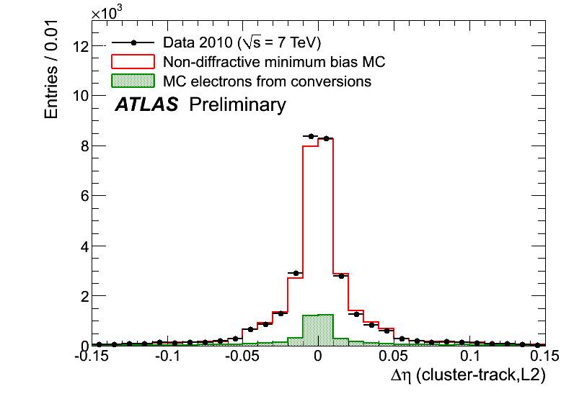
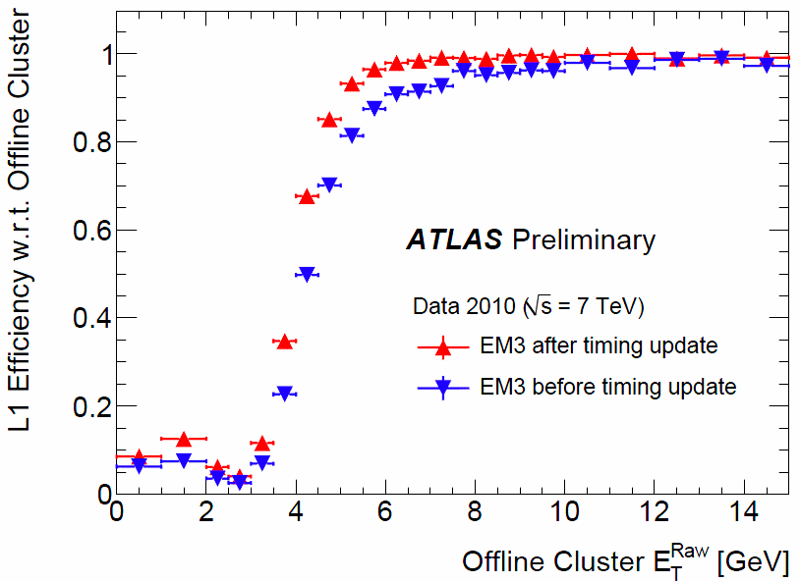
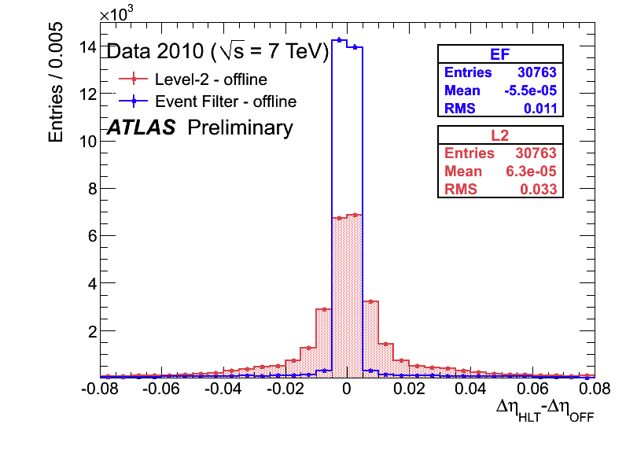
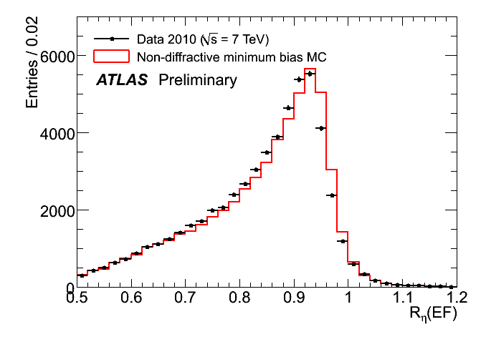
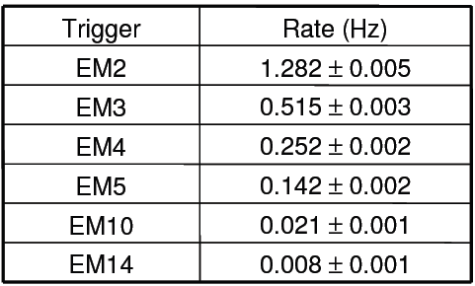
e/gamma Trigger
Improvements from L1Calo timing
HLT some disagreement in shower shapes between data and MC – likely cross talk, or dead material map in MC not correct
Rates show EM2 will need to be prescaled or HLT rejection @ 10²⁹
L2 track cluster matching well described by MC
L2
L1 rates measured for 10²⁷cm⁻²s⁻¹ – stat. errors only (luminosity error ≈20%)
R_{η}=E_{3x7}/E_{7x7}

Slide 38
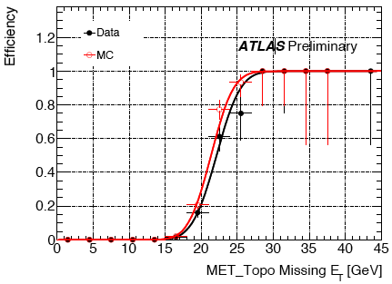
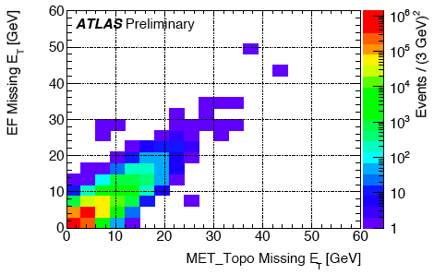
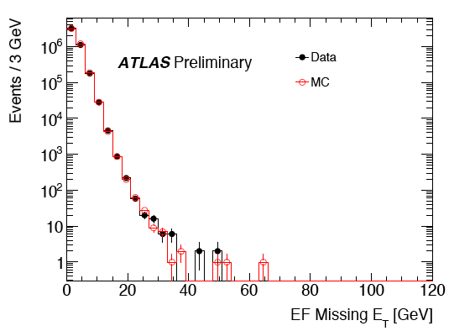
Missing E_{T}
Turn-on curve for EF_xe20 with 7TeV data compared to MC
Data-MC comparison of E_{T}^{miss} at the Event Filter after jet-cleaning cuts (stat. errors only)
Correlation between online and offline at E_{t}^{miss} 7 TeV
EF_xe20

Slide 39
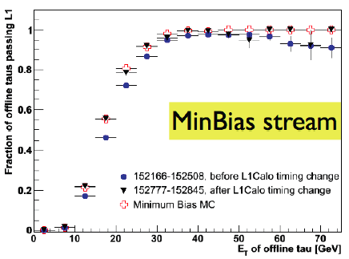
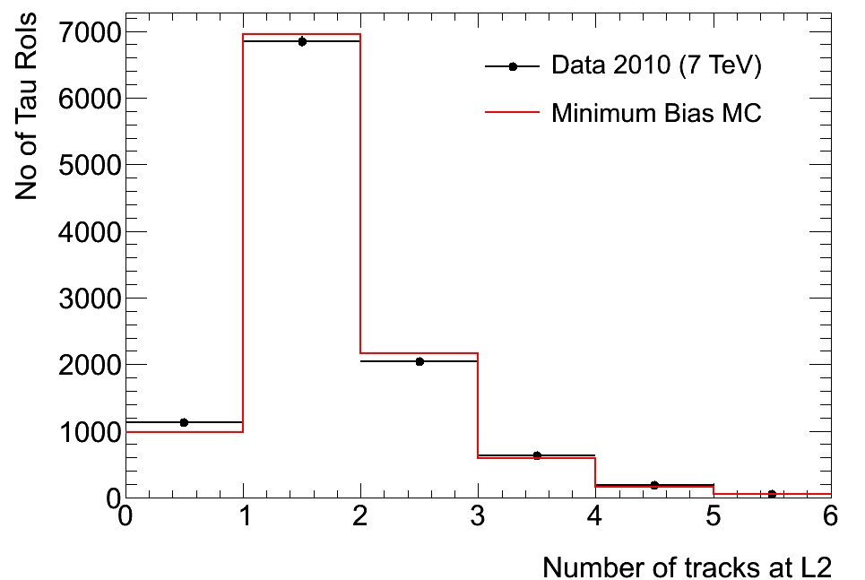
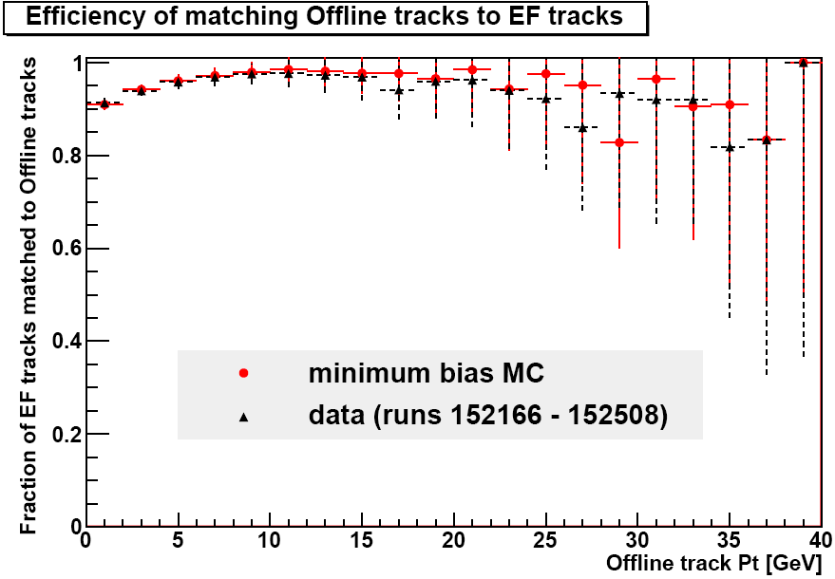
Tau
Improvement of the L1 tau efficency after L1Calo timing change
EF tracking efficiency for tau candidates:
Offline: Pt>1GeV, nPIXhits >=1 , nSCThits >=6
EF tracks: Pt > 0.5 GeV, nPixhits >=1, nSCThits >=6
#tracks in tau candidates: MinBias MC compared to 7TeV

Slide 40
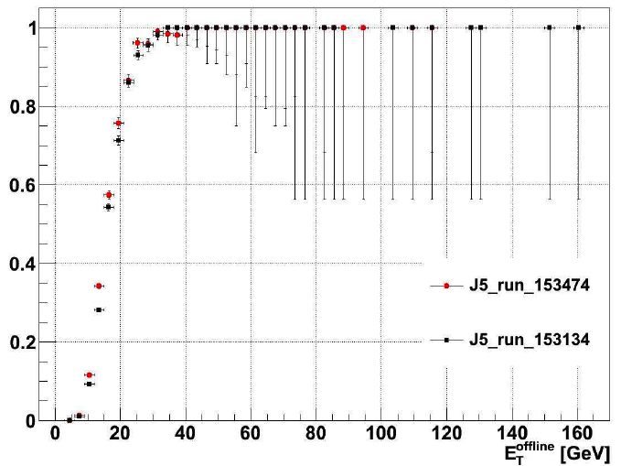
Jets
Improvements from L1Calo timing in – better agreement with MC
Investigated changing L1Calo noise threshold from 4 to 3 ADC counts – no significant change
Moving trigger jet energy scale to EM scale
Planning to introduce jet-cleaning cuts online

Slide 41
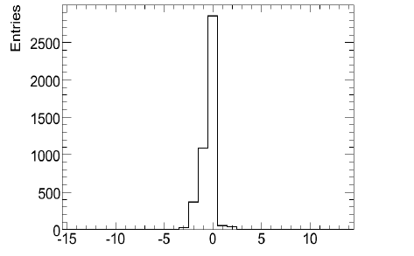
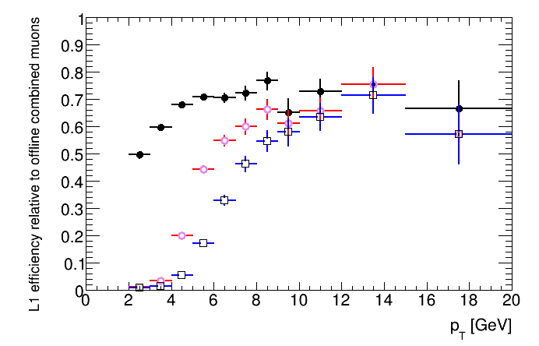
L1 Muon – RPC
Currently fighting problems with timing-in RPC
Need more non-cosmic muons
Problem : MU6 is expected to be as efficient as MU0 for p_{T}>6 GeV – under investigation
Problem possibly from non-prompt muons plus chamber inefficiency
Minbias stream, 7TeV, RPC, MuId
MU0
MU6
MU10

Slide 42
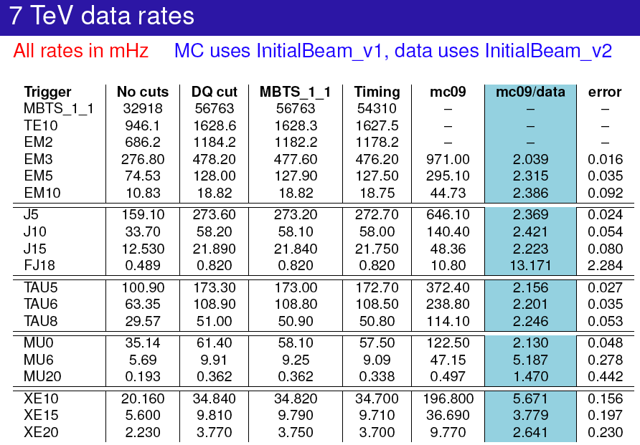
Rate predictions

