Slide 1
Organisation of the Beatenberg Trigger Workshop
Ricardo Gonçalo
Higgs WG Meeting - 22 Jan.09

Slide 2
https://twiki.cern.ch/twiki/bin/view/Atlas/TriggerWorkshop2009
http://indico.cern.ch/confRegistrationFormDisplay.py?confId=44626
Session 1: operations (including experience from 2008 run) – Monday 2 Feb.
Review of menu-wide issues related to actual operation: what happened/how long it took to implement, test, deploy new menus? What problems affected the trigger operation?
Session 2: trigger motivation – Tuesday 3 Feb.
Understand what is at stake in each trigger: What physics/detector commissioning/monitoring do they serve? What can be prescaled? How rates can be controlled? What other triggers are related and how?
Session 3: rate and resource measurement and management – Wednesday 4 Feb.
Review the existing tools to estimate resource usage: how much does a new trigger cost? How close are we to the limit? How best to predict the cost of a new trigger?
Session 4: trigger menu evolution – Wednesday 4 Feb.
How to get a trigger online? How it evolves with changing luminosity? Who decides and based on what information?
Session 5: trigger efficiency – Thursday 5 Feb.
How to determine the efficiency and bias for each trigger? What analysis data is needed for this? How much luminosity is needed for this?
Session 6: complements and closeout – Friday 6 Feb.

Slide 3
Session 2: Trigger Motivation(s)Session
Each trigger needs to be justified based on physics / performance / calibration / commissioning (as appropriate). This includes expected rates and efficiencies, as well as a ranking of priority, e.g. "never ever even consider a prescale", or "prescale only above luminosity of ...”
This justification should also describe the key characteristics of the trigger, i.e. which requirements are more important than others. E.g. for a Z’->ee search, the pT threshold is less critical than L1 isolation.
Questions for each trigger:
Which commissioning/calibration/performance/physics studies use this trigger?
What are the physics control channels for these studies?
Will these use the same trigger? If not, how will the control sample(s) be triggered and "mapped" to the physics channel?
Which parameters (threshold, isolation, etc.) are more important given the trigger's purpose?
What is the impact of changes in the values of these parameters on the physics goals?
Does this trigger use an algorithm which is very similar to that of another trigger? If so, what are the differences? Is this needed or could the triggers share an algorithm?
Can this trigger be prescaled? If no, why not?
What should its priority be in terms of prescaling? Only at highest luminosities?
If this trigger cannot run for some reason, what are the primary and secondary fallback triggers? Why?
Does this physics/performance/calibration/commissioning topic have a specific range of application? For example, are 10^6 events all that's needed?
For specialized data: Are special runs ok? Or does the data need to be taken continuously?
How stable is this trigger expected to be if pile-up effects or other backgrounds are different from expectation?

Slide 4
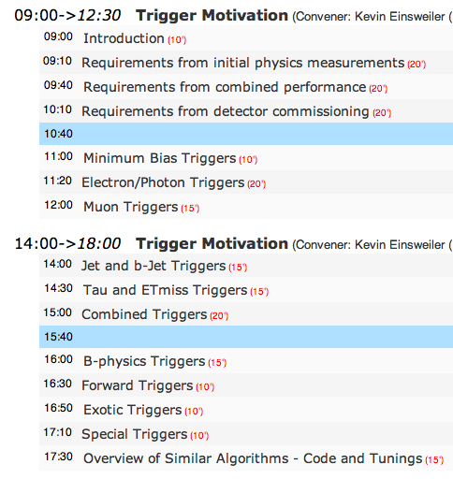
Higgs WG contribution
The Higgs group can contribute directly to session 2: Trigger Motivation
Unfortunately, the talks were organized with a focus on the trigger slices and no space to present a single contribution from physics groups
This means that the Higgs WG input will need to be spread across several talks

Slide 5
Higgs WG contribution
Proposal: after this meeting we’ll have a good idea of the resultsof Higgs WG studies
During next week, I can contact each speaker to point him/her to the material relevant
This would be done in consultation with the authors of each study, Leandro and Ketevi, and the workshop organisers
The aim is to make sure our trigger needs get noticed

Slide 6
The Higgs WG studies will also be important for other sessions
E.g. trigger evolution, where it will be important:
To know which triggers will be available at higher luminosity
To promote trigger stability – we need long running periods where trigger response stays constant
The workshop is intended for discussion and contributions from the floor – should be used to make sure the Higgs needs are noticed
Several members of the group will be in Beatenberg, including Leandro
Most of all, these studies are for our own information: to know what to expect from real data, where the trigger is always present…

Slide 7
Backup…

Slide 8
Proposed contribution from Higgs WG - I
For each analysis/channel:
Determine the trigger efficiency for signal samples with respect to the offline selection (or reasonable preselection)?
Be quantitative and clear
Take prescales into account – see slide on available data below
Apply no truth/fiducial cuts at trigger level (don’t make it look nice, make it real)
Use several possible triggers even if not optimal – The interesting question is: “How much data do we loose if we have to use this trigger?”
Useful to know: what is the offline (pre-)selection efficiency?
What (if any) bias do you find in which distributions/measurements? (e.g. shift in estimated m_{H} with /without trigger)
Would help to understand if something needs to be improved on a given trigger
How much luminosity will you need to have some sensitivity? (e.g. 1-2fb⁻¹ for H -> WW; 10 fb⁻¹ for ttH … approximate numbers are ok here)
Helps to understand what plan should be as luminosity increases

Slide 9
Proposed contribution from Higgs WG - II
The first priority is described in the previous slide, but…
Most of the work next year will be on:
Studying and understanding the backgrounds
Discovering methods to determine bias, systematic uncertainties, and efficiencies (incl. trigger efficiencies), etc from real data
It would be very useful to understand:
What triggers will be used to select any control samples, samples needed for performance studies, samples to study trigger and reconstruction efficiency
e.g. use electron and muon triggers to select ttbar background sample
How much statistics (i.e. integrated luminosity) will be needed to achieve the required precision
Most important issue is to suppress bias: don’t use b-tag trigger if you need to study offline b-tagging efficiency
As much quantitative information as you can provide: this will make it more likely that the right trigger will be there when you need it

Slide 10
Data for trigger studies
In principle, there’s no time to re-do data samples before workshop
Use trigger menu available in data currently being produced (See Junichi’s talk today)
Data produced with release 14.2.20.3; centre of mass energy: 10TeV
Geometry: ATLAS-GEO-02-01-00
http://atlas.web.cern.ch/Atlas/GROUPS/OPERATIONS/dataBases/DDDB/show_branch_tag_comments.php?tag_name=ATLAS-GEO-02-01-00
Trigger Menu: lumi1E31_no_Bphysics_no_prescale
Prescales not applied in AOD – can be found from “lumi1E31_no_Bphysics” page: and corrected by hand (easy for single triggers, ask when in doubt)
Trigger menu pages: lumi1E31_no_Bphysics :http://tbold.web.cern.ch/tbold//view_menu.php?name=lumi1E31_no_Bphysics_14.2.20&tag=
lumi1E31_no_Bphysics_no_prescale :http://tbold.web.cern.ch/tbold//view_menu.php?name=lumi1E31_no_Bphysics_no_prescale_14.2.20&tag=

