Slide 1
News from the Beatenberg Trigger Workshop
Ricardo Gonçalo - 18 February 2009
Higgs WG Meeting during ATLAS Week

Slide 2
There was lots of input from the Higgs group; summarized in: http://indico.cern.ch/materialDisplay.py?contribId=0&materialId=slides&confId=50993
This was very well received and appreciated
THANK YOU!

Slide 3
Introduction
This talk: won’t repeat the workshop summary – see G. Brooijmans talk yesterday: http://indico.cern.ch/conferenceDisplay.py?confId=47254#2009-02-17
Instead will try to look ahead to the Higgs trigger issues for the next year
Won’t go into details: too much would be specific information
The assumed scenario was a 1-2 months run followed by a long shutdown: this conditioned the discussions to some extent
Current scenario includes this period but significantly expands it – see S. Meyers’ talk on Monday: http://indico.cern.ch/conferenceDisplay.py?confId=47254#2009-02-16
Higgs WG contributions to the workshop are important for guiding analysis plans for the coming year! Especially given the new running plans for 2009

Slide 4
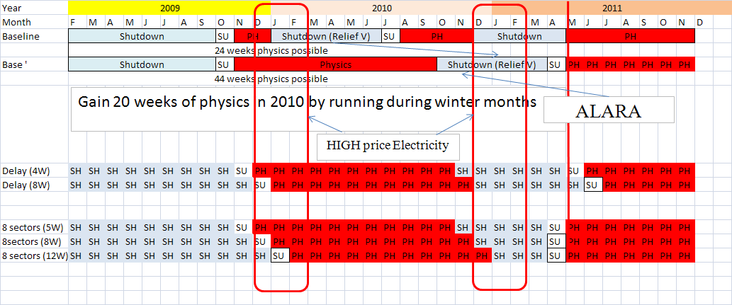
LHC plans
Plans for 2009 mean that this will (finally!) be a physics run
But before we get there, need to commission detector and trigger until we are taking physics-quality data
Expect competition between running with stable detector and trigger needed for physics and frequent changes for testing/calibrating/fixing problems in detector and trigger
Plans:
Start operation in Sep/Oct, and run at 5TeV/beam during winter to get >200pb⁻¹
First 100 days to get ~100pb⁻¹
Start at L=5x10³¹ cm⁻²s⁻¹
Go to L=2x10³² cm⁻²s⁻¹
Gather another ~200pb⁻¹
Run heavy ions
S.Myers

Slide 5
Trigger commissioning plans - I
Phase 1 – phase already exercised in 2008:
HLT not doing any selection but streaming according to L1 trigger type
Output rate is adjusted by changing L1 pre-scales
Phase 2:
HLT in pass-through mode streaming according to L1 trigger type
Output rate is adjusted by changing L1 and HLT pre-scales (streams)
Phase 3 – exercised for triggering cosmic rays in 2008:
Only when the need arises (i.e. output rate to Tier0 too high):
The HLT in active mode in a controlled and simple way first
Output rate is adjusted by changing L1 and HLT pre-scales
Essential to use initial phases to:
Debug the trigger - verify every part of the DAQ chain; study HLT selection performance and bias
Gather (as much as possible) unbiased data for evaluating trigger/reconstruction bias
Provide data for detector calibration
Last, but definitely not least: react to unexpected problems

Slide 6
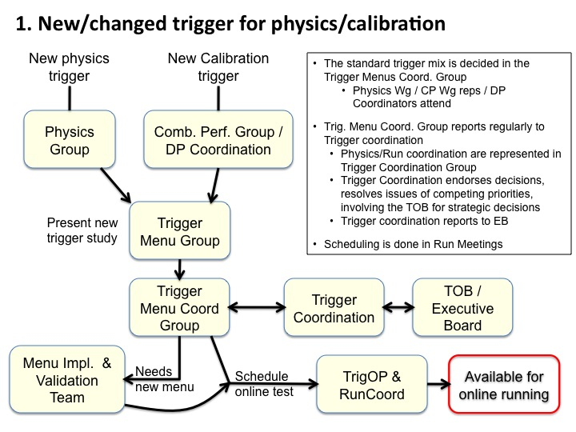
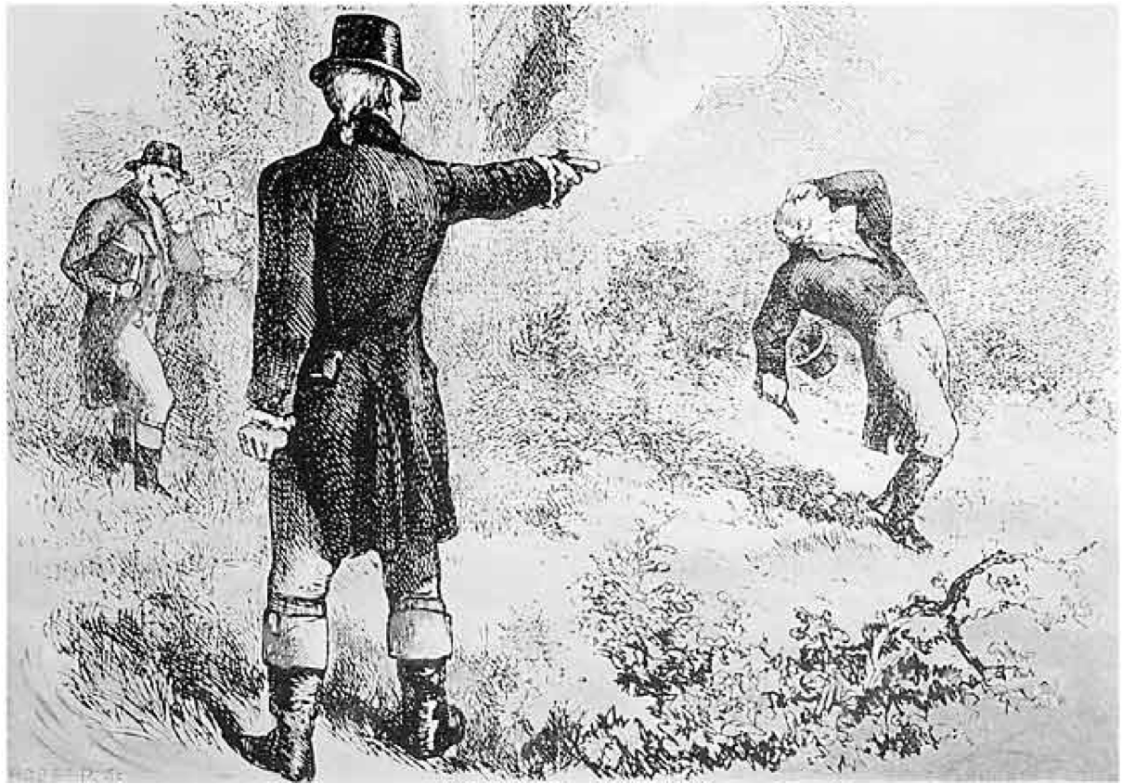
Trigger commissioning plans - II
As we move from commissioning to physics running, stability will become essential!
No frequent code changes or new triggers
Manage updates: add several changes at once instead of as they come
Not optimal for data collection but optimal for analysis
Will evolve from commissioning mode (frequent changes to react to problems/satisfy detector requests) to (managed) physics running mode
Menu changes decided in menu coordination according to physics strategy
See talks by Dave Charlton and Chris Bee during workshop

Slide 7
Some trigger menu issues
Online menu will start as a minimal menu with simple signatures and will gradually evolve to the L=10³¹ menu we know
Online and offline menus decoupled, at least until we get to “physics mode”
Ongoing work on rationalizing and simplifying menu: not all triggers optimized; not all follow naming convention…
Menu for MC production will need to reflect what was run online: issues such as prescales and menu vs pileup will be important
Current plan from jet trigger slice is to run HLT in passthrough mode while possible
Likely that there will be an unprescaled xe40 missing ET trigger (40GeV) for a limited time
Categories of triggers (helps to read a huge menu…see next slide)

Slide 9
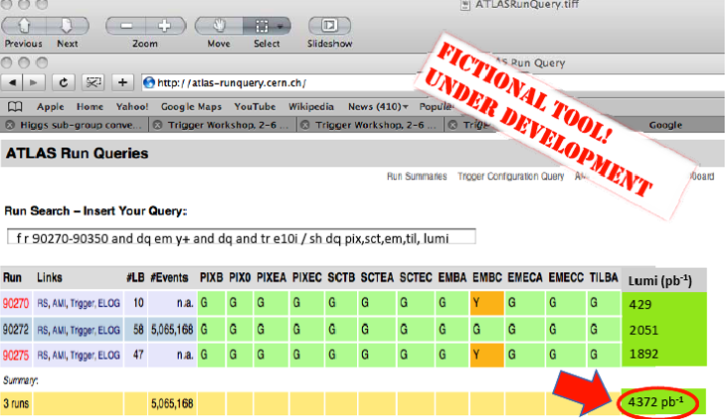
Luminosity and trigger issues
Prescales and data quality flags can change between luminosity blocks
Need tools to easily:
Select “good runs” (actually good lumi blocks) list based on quality flags and trigger needed
Calculate integrated luminosity in data analyzed
See Marjorie Shapiro’s talk today and Joerg Stelzer’s in plenary yesterday

Slide 10
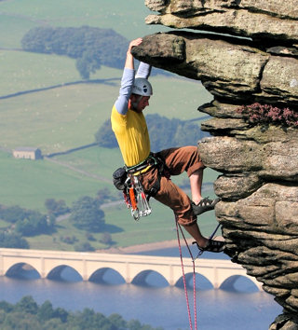
Where do we stand?…

Slide 11
Trigger studies were done (with recent software) for several channels:
H->γγ, H->4l, H->WW, H->ττ, H⁺->τν, tbH⁺(H⁺->tb), ZH (invisible), ttH, WH(W->lν)..
Studies concentrated on the (realistic) proposed objectives:
Determine the trigger efficiency for signal samples with respect to the offline selection (or reasonable preselection)?
What (if any) bias do you find in which distributions/measurements? (e.g. shift in estimated m_{H} with /without trigger)

Slide 12
What are we missing?
At first glance, we miss studies on background
E.g.: what are the trigger effects if m_{H} is extracted from fit to data+background?
“Data-driven” studies:
How are we going to get/verify trigger efficiency and bias?
Work together with trigger slices as much as possible (a few good examples!)
How are we going to verify the performance of reconstruction algorithms? What triggers do we need for this? Are we missing something?
How are we going to normalize our data samples (and compare with Monte Carlo)? Can we calculate the luminosity if we’re using a combination of triggers?
Again, see Marjorie Shapiro’s talk

Slide 13
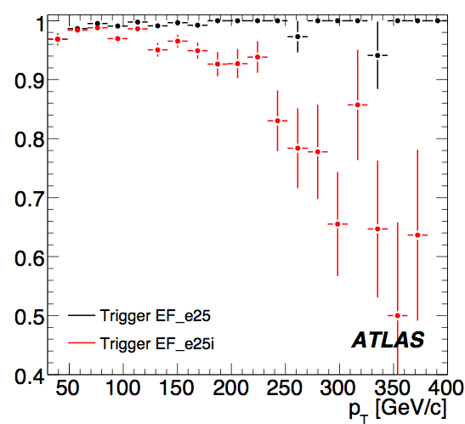
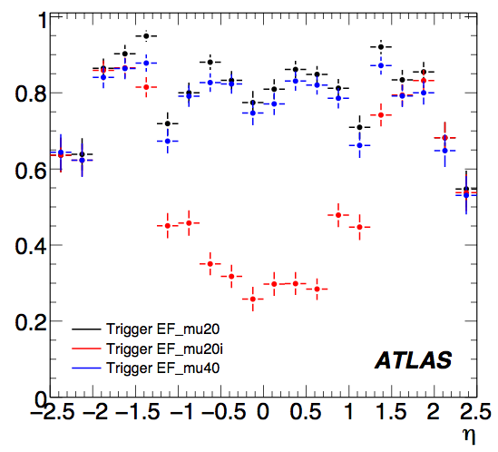
What (else) are we missing?
Also, we lack information on some channels
VBF Invisible Higgs: MET and forward jets?
ttH: all-hadronic channel trigger?
WH/ZH:
WH->lnu bb and ZH->l+l- bb: lepton triggers (preliminary study)
ZH->nunu bb: large MET>100 GeV (preliminary plan)
Giacinto Piacquadio

Slide 14
Summary
Big THANK YOU to Higgs group for a job well done
Next steps for Higgs group:
Continue to build on work done and plan ahead for use of trigger in physics analysis of 2009 run
How are analyses going to use real data from 2009?
Fill the “holes” – some channels don’t have good estimates of trigger performance
Workshop was very exciting, busy and productive: planning for first month of new run is ±clear; need to plan beyond that
More info:
Workshop agenda: http://indico.cern.ch/conferenceOtherViews.py?view=standard&confId=44626
Workshop conclusions will be written up

