Slide 1
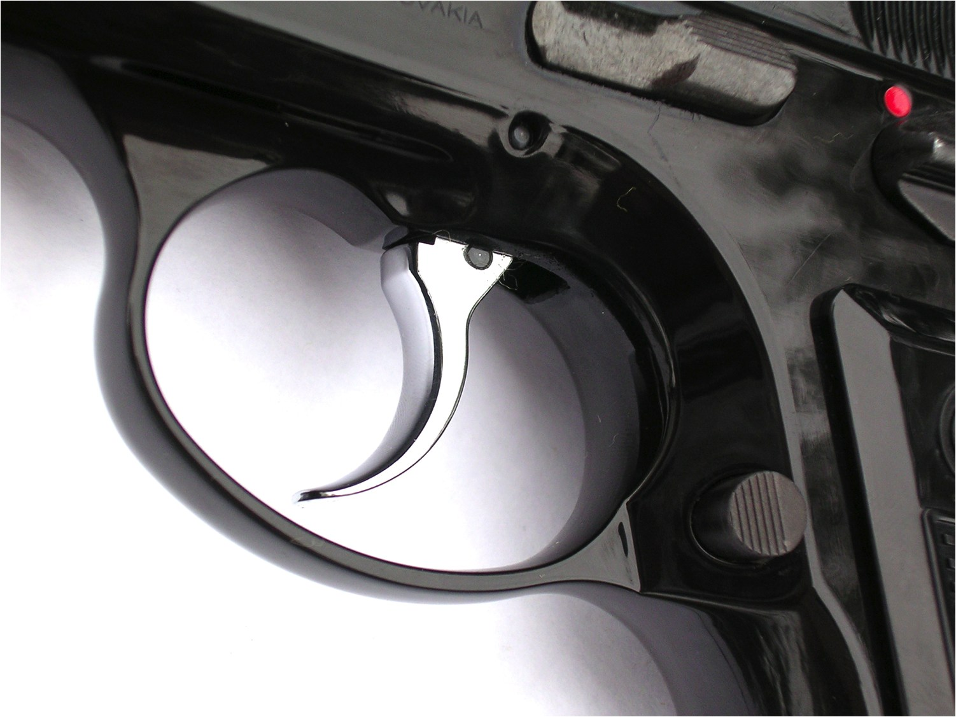
Higgs Trigger Update
Higgs Working Group Meeting – 10th September 2010
Ricardo Gonçalo – Royal Holoway University of London

Slide 2
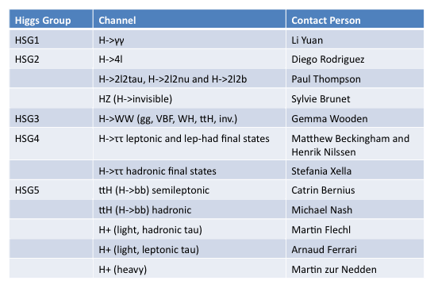
Higgs Trigger Crew

Slide 3
Online Issues and Menu Status
Currently in Technical Stop – no stable beams before Tuesday
Data-taking period G will start after technical stop
Luminosity reached 10³¹ cm⁻²s⁻¹ in late August
46/50 bunches filled so far
Bunch trains to come next week (150ns)
Now approving menu for 3x10³¹ cm⁻²s⁻¹: http://trigmenu.web.cern.ch/trigmenu/scratch0/15.6.9.22/newEB/testRatesNew_30/
Newly activated chains:
2e10 loose, 2e10 medium, 2e15 loose, and g17_etcut_EFxe20
STANDBY stream introduced for data from warm-up period
Three UNPAIRED bunch groups introduced:
Useful for beam background estimation
UNPAIRED_ISO: bunches > 3 BCIDs from other beam filled bunches
UNPAIRED_NONISO: bunches < 3 BCIDs from other beam filled bunches
UNPAIRED: OR of above bunch groups
See menu expert report in last Trigger General Meeting (yesterday): http://indico.cern.ch/getFile.py/access?contribId=10&sessionId=0&resId=0&materialId=slides&confId=74202

Slide 4
 | L = 1 x 10³¹ cm⁻²s⁻¹ | L = 2 x 10³¹ cm⁻²s⁻¹ | L = 3 x 10³¹ cm⁻²s⁻¹
Lowest unprescaled chains | e10_medium mu10_msonly_tight tau_tau38_loose xe30_noMu | e10_tight mu10_msonly_tight tau38_loose xe30_noMu | e10_tight mu10_MG tau50_loose xe30_noMu
Disabling or prescaling chains | L2_xe17_tight_noMu L2_mu10_Msonly L2_g15_loose | L1_2J30 L1_4J5_J15 e10_medium e15_loose mu4_L1J5_matched mu4_L1J10_matched | L1_3J15 J30_XE10 tau38_loose and tau38_medium L2_tau12_loose xe15_noMu L2_tau12_loose_IdScan xe15_noMu 2mu6_noAlg mu10_Msonly_tight 2mu4 g20_loose
From E.Strauss

Slide 5
Other News
Level 1
Presampler noise started in early August and has been affecting trigger rates – LAr experts investigating
L1_J10 is main Level 1 item affected
Possible way to deal with issue is to automatically prescale chain when rate goes above a threshold – under tests and discussion
Can only be done safely for “*_EMPTY” triggers – i.e. in empty bunch group, not for physics triggers
T.Bold

Slide 6
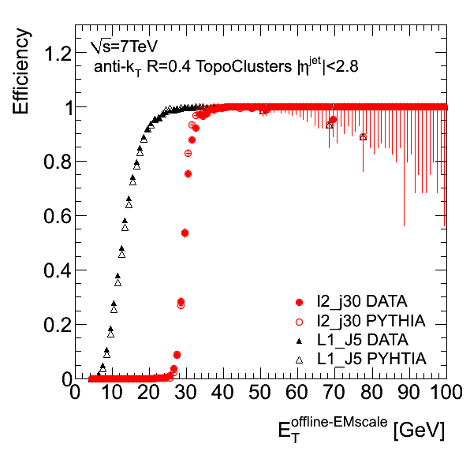
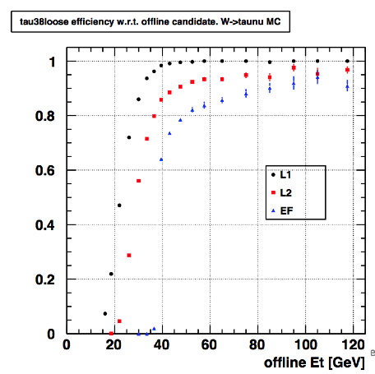
P.Conde-Muino
Jets
Level 2 jet chains validated
See details in: ATL-COM-DAQ-2010-136
Expect all L2 jet chains to be activated when run re-starts next week, including multi-jet chains
Taus
Tau chain optimization softened cuts for:
tau38_loose
No rate change
tau50_loose
Increases from 4Hz to 9Hz at 3E31
tau84_loose
Increases from 0.5Hz to 1Hz at 3E31
Efficiency improvement, especially near threshold
S.Xella

Slide 7
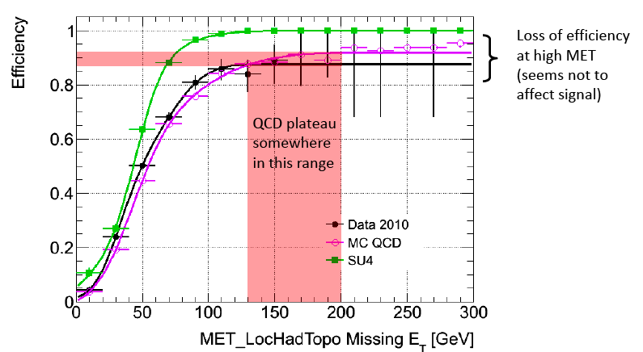
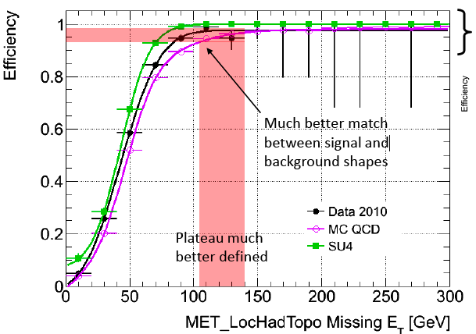
L1_XE + EF_xe
Missing ET Trigger:
MET+forward jet veto:
Spacing of 5GeV between MET trigger thresholds means factor 10x in rate
To allow smaller steps, MET slice proposed to introduce MET chains with Forward Jet Veto “_vfj”:
xe30_vfj_noMu
xe30_vfj_medium_noMu
xe30_vfj_tight_noMu
Not good for VBF channels! BUT these are always in addition to plain MET triggers
Not added for the moment until use case more clear
L1 jet + EF MET:
SUSY group proposed L1_Jet + EF_MET triggers
Improve reach in some channels and avoid difficulties in L1 MET:
j75_jetNoCut_EFxe20/25/30/35/40_noMu
L1_J + EF_xe
A.Pinder

Slide 8
Coherent Prescales (CPS)
Possible to have groups of (prescaled) triggers with fully correlated prescale rejection
I.e. if triggers A and B have prescales 2 and 5 respectively, then B would run only in 5/2 of the events where A also runs and in no other events
Notes:
Only items with the same L1 input could be coherent
Correlated prescales are done before L2
No bearing on L2 decision
The correlated chains only run on the same events. They don’t necessarily accept the same events
No coherent passthrough (CPT) so far

Slide 9
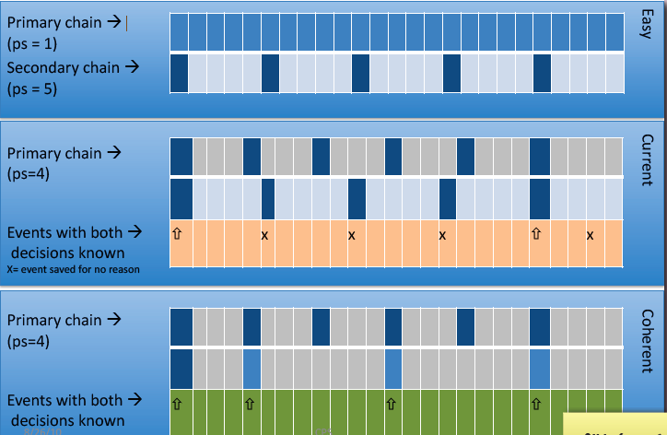
T.Bold

Slide 10
Several possible advantages for:
Operation: easier to know what resources will be used/saved by including/excluding correlation group
Bandwidth:
estimated rate savings of 25Hz in 200Hz – equivalent to e.g. all jet triggers
In practice, it would mean that some resource-hungry chains like beamspot and ID full-scan would continue to be feasible (due to caching of event data)
Performance studies: for bootstrap studies, run on less events to get same statistical uncertainty – by a factor of Prescale(chain A) x Prescale(chain B)
Also potential dangers:
Overlook correlation between 2 chains in analysis:
Simple prescale de-correlates chains – allows to take events from e.g. mu4 (P=800) and mu6 (P=300) and consider them un-correlated to 1 event in 240000 – would not work with CPS
Depends of course on use case… infinite possibilities for errors if one is not careful
There are claims that the lumi calculation would be harder (I can’t see why)
More info:
http://indico.cern.ch/getFile.py/access?contribId=8&resId=0&materialId=slides&confId=74201
http://indico.cern.ch/getFile.py/access?contribId=5&sessionId=0&resId=0&materialId=slides&confId=74202

Slide 11
The plan is to use CPS only for monitoring/supporting items
Start from (use as case study):
L1_MU0 (separate mu4, mu6, mu10 groups)
L1_EM5, L1_EM10, L1_2EM2
L1_TAU5 (move all trk items to start from L1_TAU5)
No primary/physics items will be included in CPS groups except 2e3_medium (J/psi triggers) and xe15/20_noMu (?)
Physis groups feedback being requested to cross check CPS groups for physics items once created
Comments? ☺

