Slide 1
HSG5: H➝bb
Ricardo Goncalo for the HSG5 group
Higgs Working Group Meeting, 10 November 2011

Slide 2
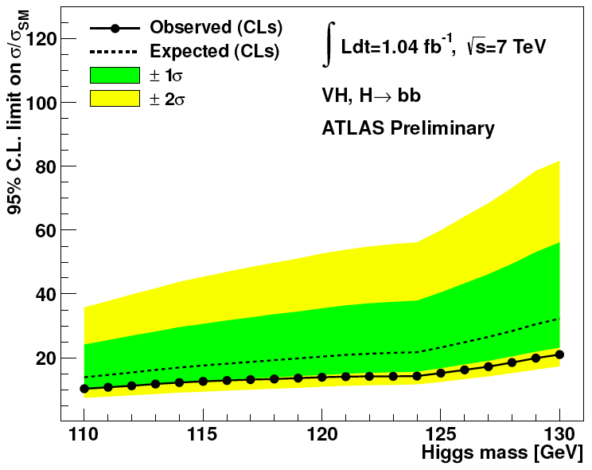
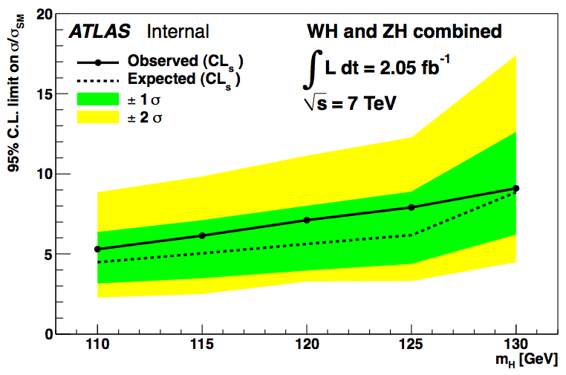
State of the art…
Two channels seem possible for the CERN Council meeting:
WH➝lνbb and ZH➝llbb
Other channels need more time:
ZH➝ννbb, jet substructure in VH (WH➝lνbb, ZH➝llbb, ZH➝ννbb) ttH➝ttbb
WH➝lνbb and ZH➝llbb:
Analysis: select a good W or Z boson and search Higgs in mbb spectrum
First results made public in EPS with 1fb⁻¹
Analyses optimized for 5fb⁻¹ in release 16
Paul Thompson

Slide 3
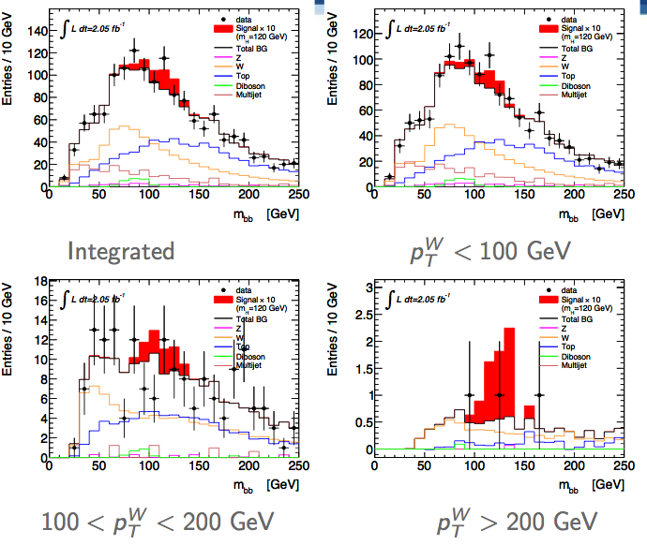
WH->lνbb and ZH->llbb Optimisation
Paul Thompson
Changes to suppress top bkgr in WH
Looser η and p_{T} cuts on additional lepton veto
Looser p_{T} cut on additional jet veto
Now at the same level as W+jets
Improve efficiency and significance
JetNNComb instead of IP3D+SV1
Tuned cuts in separate p_{T}^{W} and p_{T}^{Z} bins

Slide 4
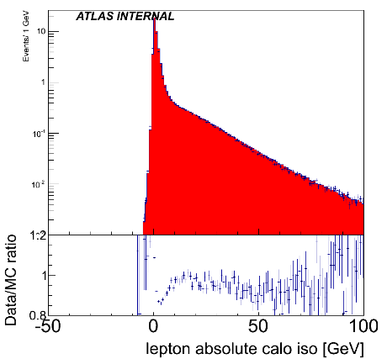
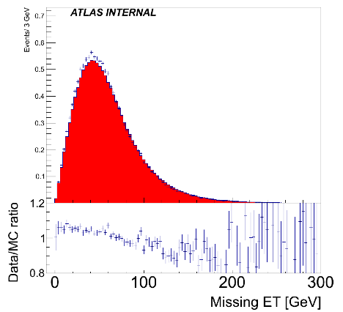
Stumbling blocks…
Giacinto Piacquadio, Chiara Debenedetti, Heather Gray
Monte Carlo!!! ☹
We don’t have the rel.17 MC yet
It’s not yet clear if we’ll have it in time
H->bb signal in plans with priority 1 (end of November)
Many backgrounds have priority 0
Main concern is W+h.f.
Should be solved now with Atlfast-II
Validated this week and looks ok for our purposes
AFII/FS differences from cut flow:
0.5% in muon isolation
1% in electron ID
2% in electron calo isolation
5% in MET below ≈80 GeV
Small differences in jet energy scale

Slide 5
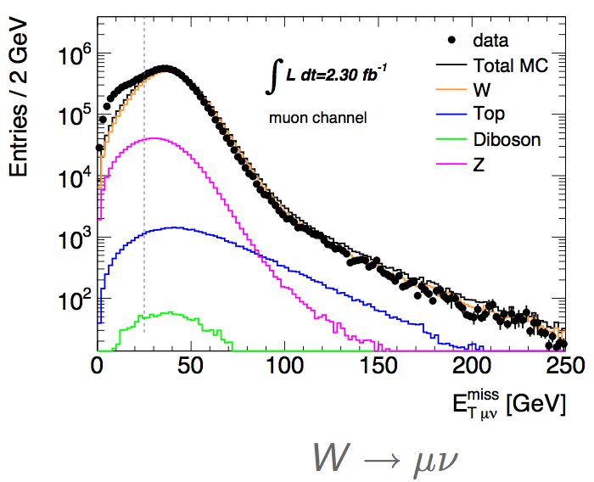
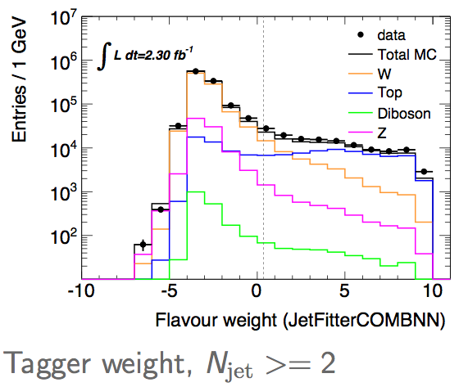
Stumbling blocks…
Paul Thompson
Scaling factors, fake rates, etc
Expect preliminary values from H.F.-tagging group
Hope to have best possible information from jets and MET
Data/MC agreement in all control variables not yet seen
But already pretty good
A broken crystal ball…
What else will happen?
Not much time to let analysis mature
But very good starting point!

Slide 6
Backup

Slide 7
ZH➝llbb Selection
Trigger:
e (p_{T}^{e}>20GeV) or μ (p_{T}^{μ}>18GeV)
2e/2μ trigger (p_{T}>12GeV)
Exactly 2 leptons p_{T} > 20GeV
Opposite charge for μ
Z mass cut: 76 < m_{ll} < 106 GeV
E_{T}^{miss} < 50GeV
Two leading jets b tagged

Slide 8
WH➝lνbb Selection
Trigger: e (p_{T}^{e}>20GeV) or μ (p_{T}^{μ}>18GeV)
Exactly 1 lepton – p_{T} > 25GeV
M_{T} = √2p_{T}^{l}p_{T}^{ν}(1 - cos Δφ_{lν} ) > 40 GeV
E_{T}^{miss} > 25GeV
Exactly 2 jets (anti-k_{T} 0.4; E_{T} > 25GeV) to reduce top background
Both jets b tagged

Slide 9
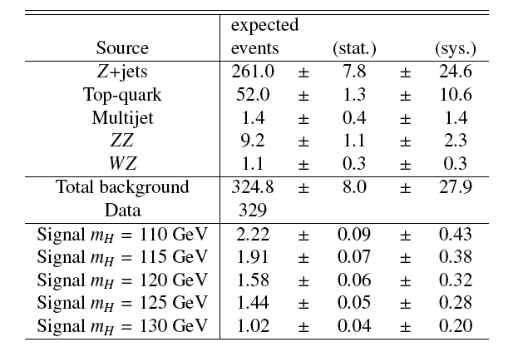
ZH➝llbb
Good description of the background
No excess observed
Single-channel exclusion of ≈20x Standard Model

Slide 10
ZH➝llbb
Good description of the background
No excess observed
Single-channel exclusion of ≈20x Standard Model

Slide 11
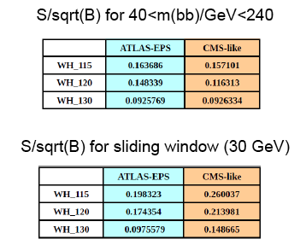
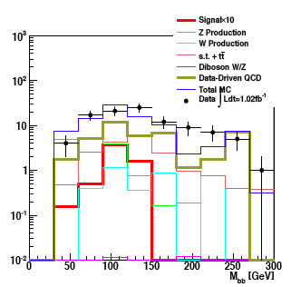
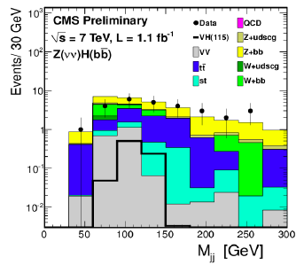
ATLAS-CMS comparisons
Jonas and Jike have emulated CMS’s cuts in WH->lνbb and ZH->ννbb
Differences not yet clear – need to continue to pursue this
Similar significances in WH ->lνbb when applying mass window cut
But very different event numbers – by factor 10-100 depending on channel
CMS seems to get a lower QCD background than us in ZH->ννbb
WH->lνbb

Slide 12
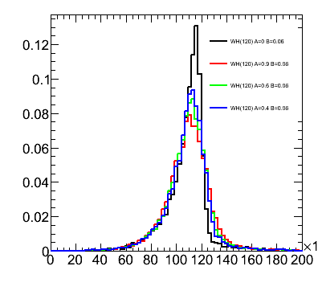
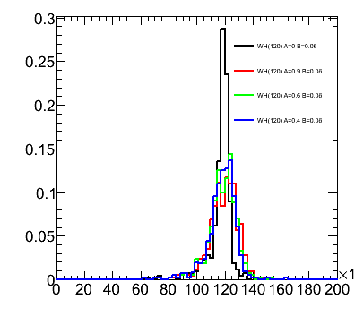
Performance studies
Main systematics are jet and b-tagging related
Current tasks listed in Wiki
More questions than answers at the moment, but pursuing several threads:
Jet resolution:
We seem to be affected by out-of-cone losses
Will try different jets
B-tagging:
Find how much improvement needed to reduce syst
Improve MC statistics term of b-tagging uncertainty with AFII – requesting some AFII validation samples
Differences between hadronic and semileptonic b-jets

Slide 13
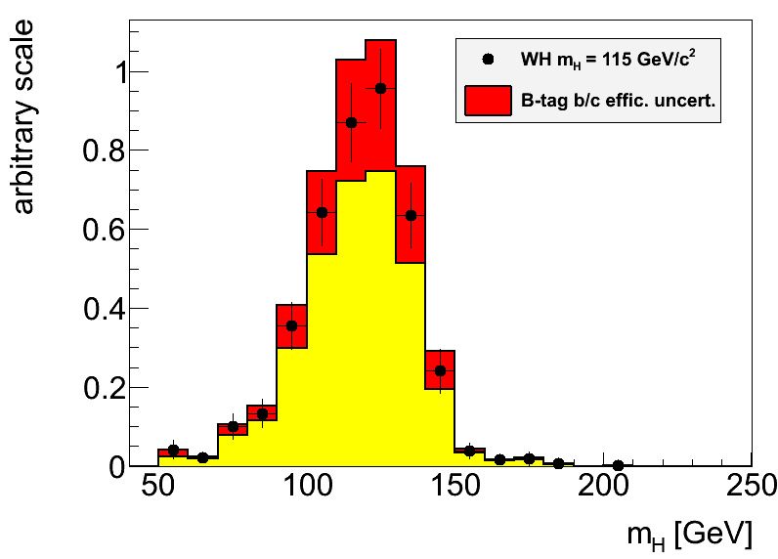
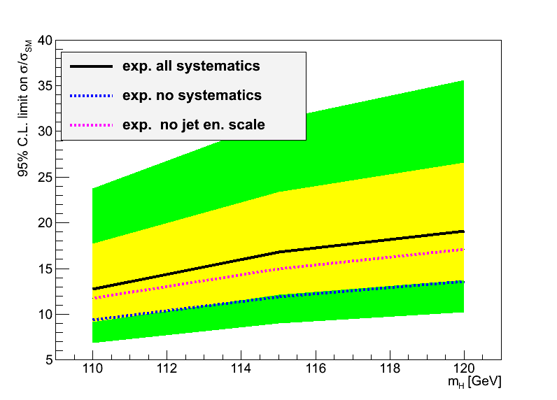
Hgbb – Reconstruction Performance
Main limitations from jet reconstruction and b-tagging uncertainties
Try to improve b-tagging efficiency/fake rate uncertainty:
Dominant uncertainty on signal yield in EPS analyses
Try to optimize di-jet mass resolution:
A sharper peak improves analysis sensitivity (10% width reduction ≈4% limit improvement)
Try to reduce jet energy scale uncertainty:
Large effect in limit through changes in m_{bb} shape

Slide 14
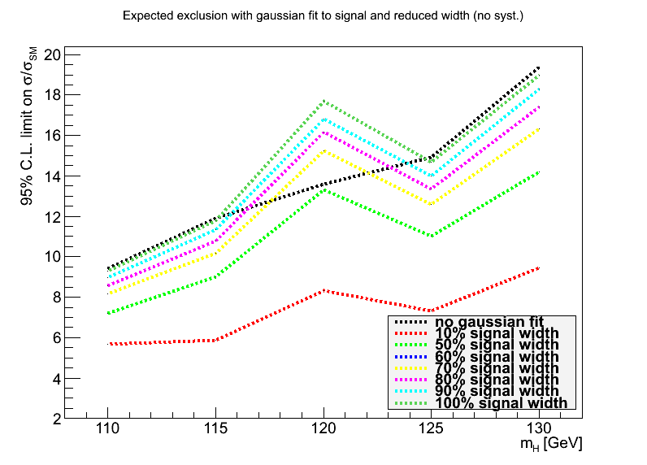
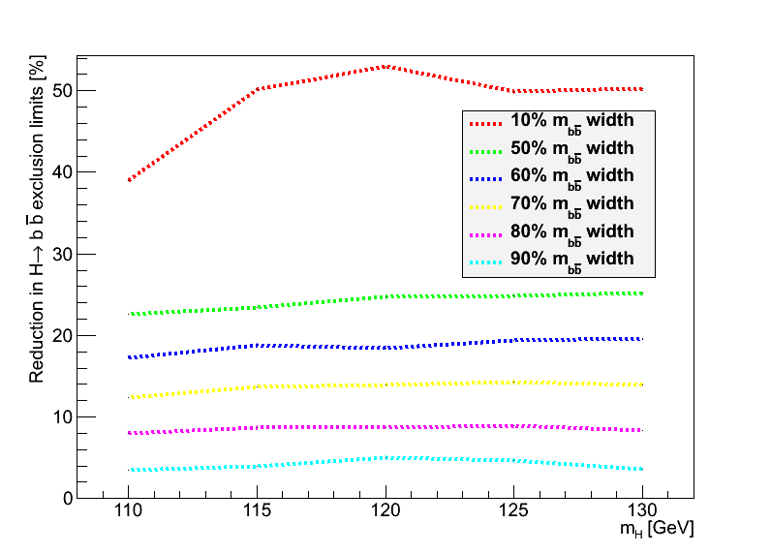
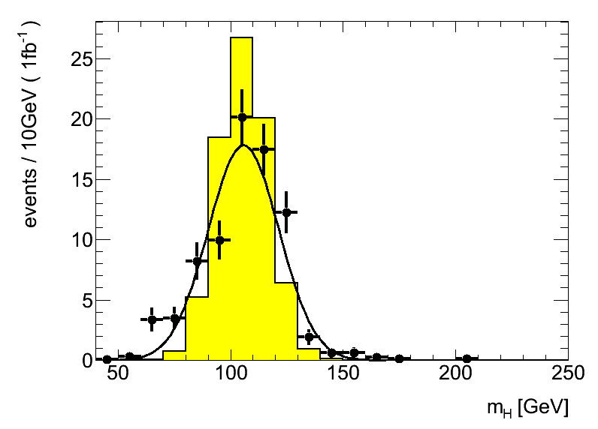
Backup
Replaced signal with fitted Gaussian to manipulate signal width
Estimated improvement in limits (1fb⁻¹) with reduced signal width
Reduction to 80% gives 8% improved limits (magenta line, bottom left)

