Slide 1
HSG5 Report: ongoing activity and 2012 plans
Ricardo Gonçalo (RHUL)
Higgs Working Group Meeting – 10 May 2012

Slide 2
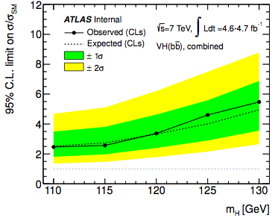
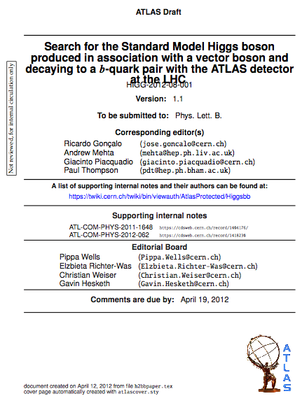
H->bb 2011 paper
H->bb 2011 paper near second circulation https://cdsweb.cern.ch/record/1440266
3 channels: ZH->llbb, WH->lνbb, ZH->ννbb

Slide 3
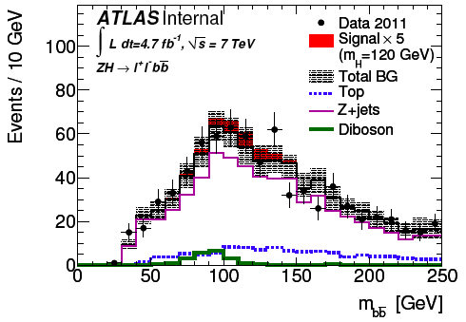
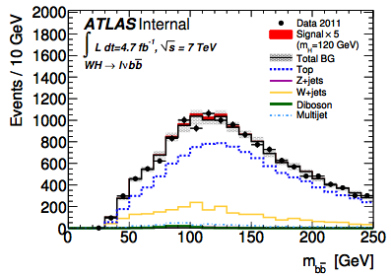
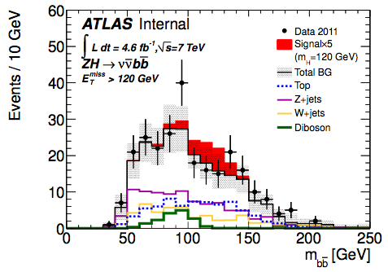
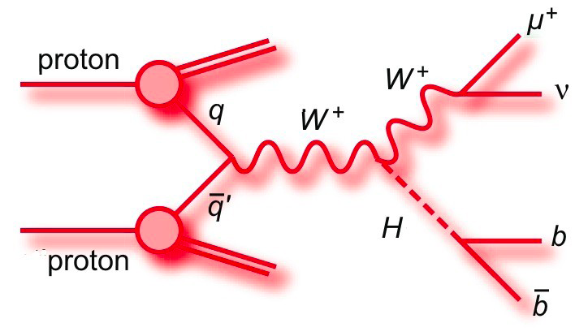
H->bb 2011 analyses
“Simple” cut-based analyses
Search for a good W or Z, then search for 2 b-tagged jets
Main difficulties:
Determination of main backgrounds from control regions
Long discussions on b-tagging and JES systematics – often just before deadlines
MC description of data (N_{jets}, p_{T}^{W} …) not ideal => higher systematic uncertainties
Plenty of lessons learned for future…

Slide 4
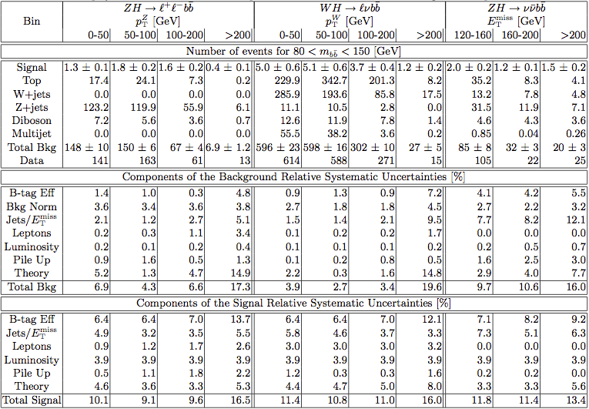

Slide 5
Improvements…
Systematics already playing a very big role:
1st p_{T} bin systematics-dominated
degradation of limits: 25% to 40%
Adding more data will help… but improving systematics will help more (plus adding more data…)
Concerns:
Monte Carlo
Theory uncertainties
JES (happy with new developments, but waiting for convergence)
B-tagging
llbb | 0-50 | 50-100 | 100-200 | >200
Data stat (%) | 8.4 | 7.8 | 12.8 | 27.7
BG syst (%) | 6.9 | 4.3 | 6.6 | 17.3
lvbb | 0-50 | 50-100 | 100-200 | >200
Data stat (%) | 4.0 | 4.1 | 6.1 | 25.8
BG syst (%) | 3.9 | 2.7 | 3.4 | 19.6
vvbb | 120-160 | 160-200 | >200
Data stat (%) | 9.8 | 21.3 | 20.0
BG syst (%) | 9.7 | 10.6 | 16.0

Slide 6
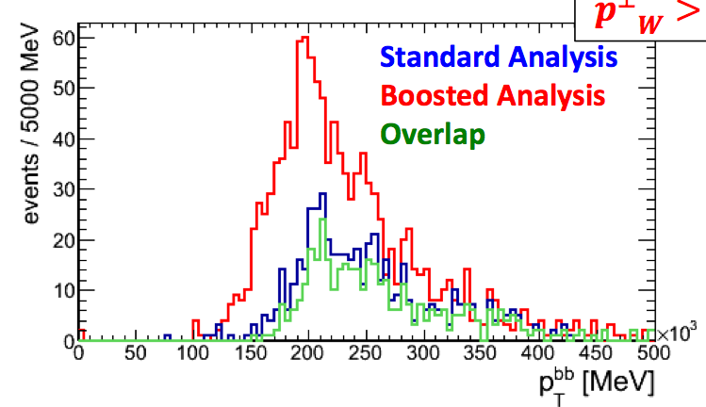
Planned improvements
Fitting the backgrounds:
Plan to fit backgrounds in the limit code together with profiling uncertainties
Instead of sidebands and control regions
b-jet energy corrections:
Semileptonic B decays
Inclusive b-JES?
Improve background rejection
Adjust to new pileup conditions
Add substructure analysis
Ongoing: recent progress
…but CMS will have this for ICHEP
…
p_{T}^{W}>200GeV

Slide 7
Ongoing 2011 analyses
Some 2011 analyses in new channels are progressing:
ttH, H->bb analysis
Boosted VH analyses: same channels as existing H->bb analyses
Common with Exo: Minimal Walking Technicolor interpretation of existing analyses
Z->bb in diboson production – a standard candle for H->bb search
More exploratory for now:
bH/A -> bbb
VBF H->bb interest from Victoria and Waseda

Slide 8
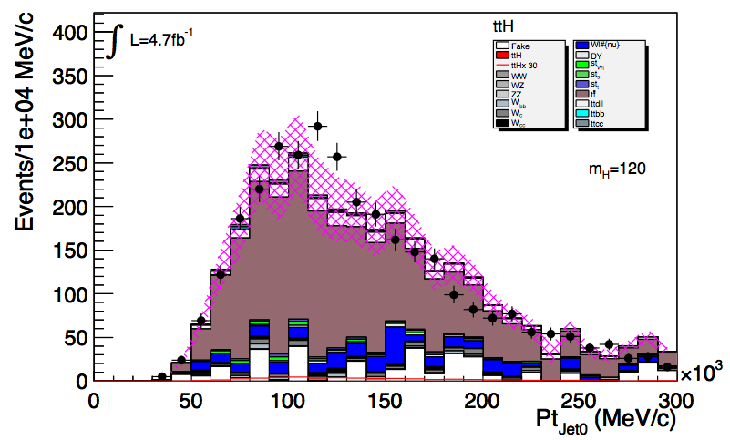
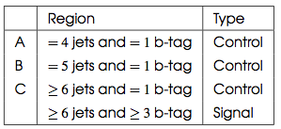
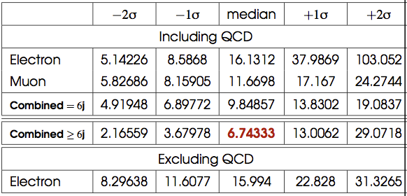
ttH analysis
Analysis is progressing fast! Single-lepton channel looks promising
Control regions to evaluate background/check data description
Evaluating systematics: b-tagging dominant
Complementary analyses: cut-based NN and kinematic fit
Lead jet p_{T}
No shape uncertainties

Slide 9
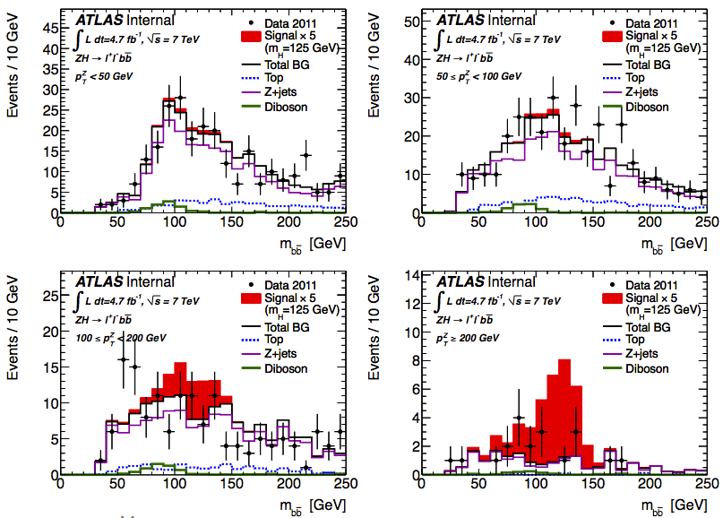
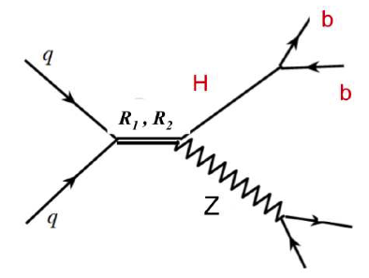
Minimal Walking Technicolor
The idea is to see if we exclude some part of MWT parameter space using current WH/ZH analyses - proposed by Georges Azuelos
Simply using existing ZH->llbb analysis obtained reasonable limits
Will investigate reach with new signal MC

Slide 10
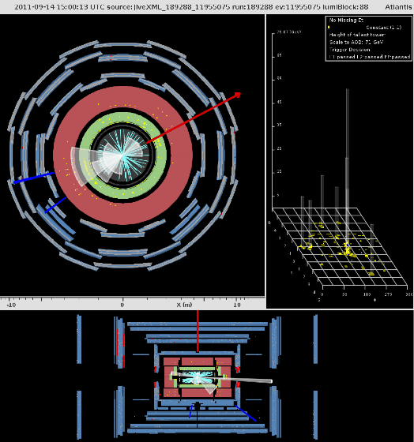
Conclusions
Lots of activity ongoing
Plans not yet crystalized
Sorry I couldn’t make justice to all

Slide 11
Bonus slides

