Slide 1
H->bb Note Plans for Summer
Ricardo Gonçalo (RHUL) on behalf of the HSG5 H->bb group
Higgs Working Group Meeting, 9 June 2011

Slide 2
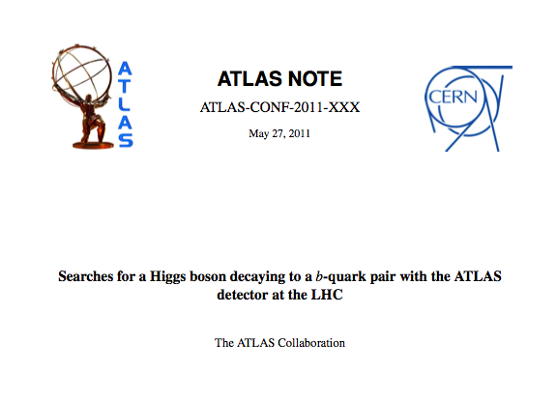
H->bb CONF note plans
ATL-COM-PHYS-2010-929
CONF note for EPS
First H->bb results from ATLAS with real data
WH and ZH un-boosted channels only, for now
Expect exclusion limits for WH and ZH in low Higgs mass range
If all goes well…
Introduction
Data and MC samples
Object selection
Event selection
WH analysis
ZH analysis
Systematic uncertainties
Results
Summary
Editors:
Patricia Conde Muino
Andrew Mehta
Paul Thompson

Slide 3
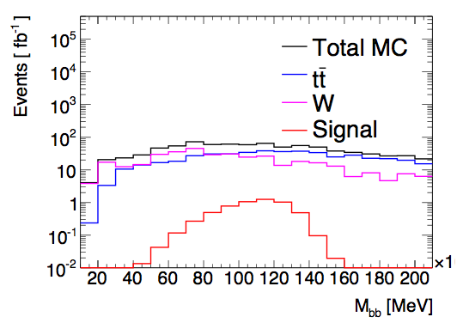
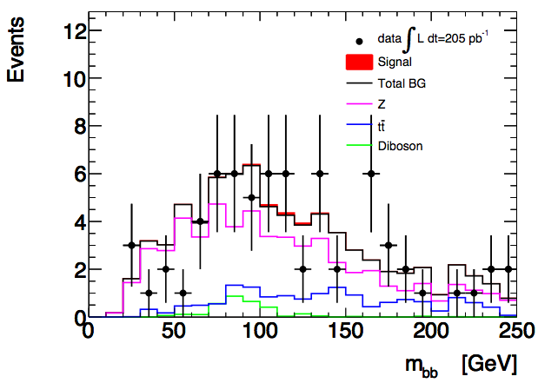
Results so far
Before systematic uncertainties…
WH: reject around 7x the SM at 95% CL with 1 fb⁻¹
ZH: reject 12x the SM with 1 fb⁻¹ / 3.5x for 10fb⁻¹
Note: these are just preliminary numbers, shown in the Dubna workshop, and likely to change significantly after systematics
WH
ZH

Slide 4
Missing Ingredients
Editorial board:
Composition almost final
b tagging:
Need advanced tagger for increased background rejection
Efficiency scale factors almost done
Calibration & fake rate: preliminary on week of 20th June - will re-do analysis with final numbers
IP3D+SV1, 60% efficiency working point
Jet Vertex Fraction:
Bug affecting all data reconstructed with rel.16
Fix exists but applicable only to AOD-based analyses – i.e. only one analysis in our group
Would like to re-run D3PD production
MC10b:
Can move to this essentially now
QCD background (incl. bb, cc):
Tuning method to estimate from data
Almost there, but not quite – examining remaining features (at 10% level)
Systematics:
First estimates done – dominated by b-tagging uncertainty (around 30%)
Jet energy scale uncertainty still missing – expected of same order
For note & beyond… exclusion analysis & SM Higgs combination:
Done “by hand” for each channel
Need to produce inputs for SM Higgs combination

Slide 5
Outlook
Skeleton draft of INT note should be available tomorrow
Then a couple of weeks to finish details of QCD BG determination and interact with Editorial Board
Expect some changes to cuts etc during this
Dataset frozen on 22 June (I think)
Preliminary b-tagging calibrations around same time
Aim for Higgs approval at end of June
Last iteration with final b-tagging calibrations on…
Circulate note to ATLAS for CONF approval in early July for approval in time for EPS

Slide 6
Backup

Slide 7
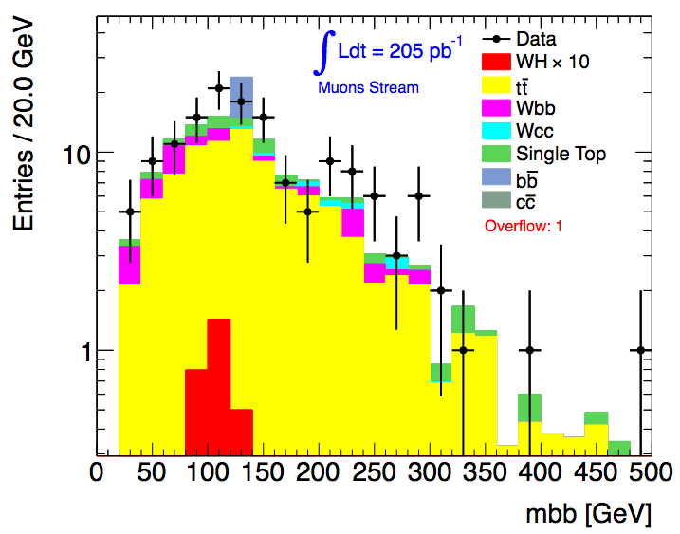
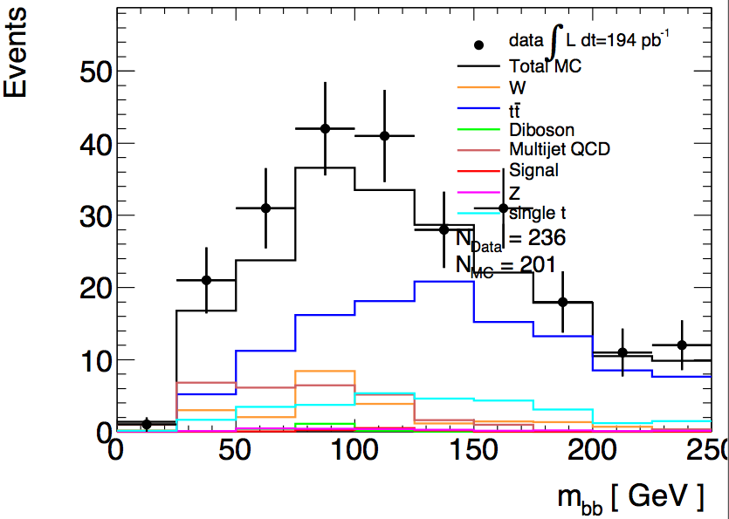
Do we need a JVF cut?
In principle yes!…
Need to use cut N_{jets} = 2 to suppress tt background; use N_{jets} = 3 as tt control region
So must suppress spurious jets from pileup…
Njets < 4
All backgrounds from Monte Carlo
bb and cc MC clearly not enough
Njets = 2
QCD background from data
Before last scale factor (1-b sideband)
Lianliang Ma
Paul Thompson

Slide 8
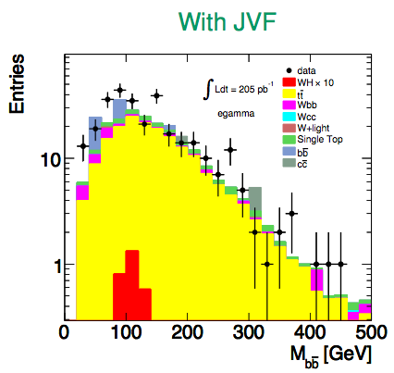
Do we need a JVF cut?
In fact, not using the Jet Vertex Fraction seems to have a significant effect on Njets
But a small effect after all cuts…
 | data | tt MC
No JVF cut | 303 | 200
JVF > 0.75 | 300 | 185
Haifeng Li
Haifeng Li

Slide 9
WH Cuts Summary

Slide 10
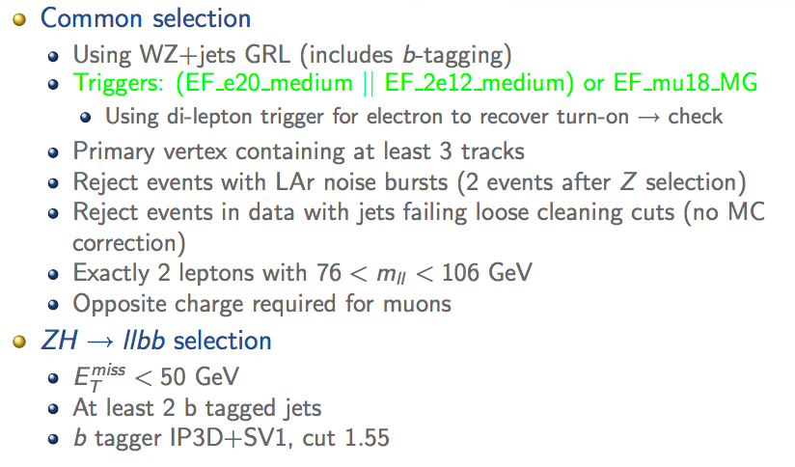
ZH Cuts Summary

Slide 11
Poster abstract for EPS-HEP
H->bb searches with the ATLAS detector at the LHC
The H -> bb channel is extremely important for the observation of a Higgs boson signal at the LHC. In the Standard Model, this channel would provide a significant contribution to the Higgs boson search in the low mass region, where this decay mode constitutes the dominant Higgs decay channel. Due to the enormous jet production cross-section at the LHC, the search must target channels where the Higgs boson is produced in association with a weak boson, a pair of top quarks, or jets separated by a rapidity gap. It also requires complex techniques to reconstruct the signal and separate it from an overwhelmingly large background. We present the status of Higgs searches in the H->bb channel currently being performed within ATLAS.
Accepted by the conference
Will be presented by Patricia Conde Muino – after random selection

