Slide 1
Higgs Trigger Menu
Higgs Working Group Meeting – 9th July 2010
Ricardo Gonçalo – Royal Holoway University of London

Slide 2
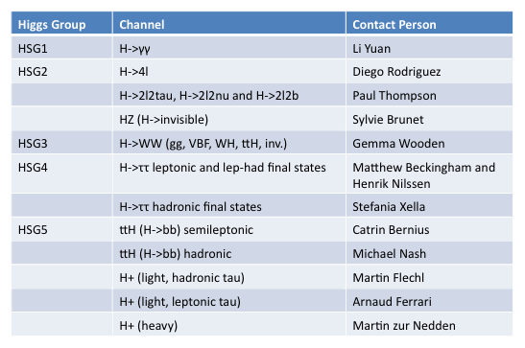
Higgs Trigger Crew

Slide 3
Starters
Physics menu will be activated around July 19th technical stop
Higgs Group requests made after last Higgs WG meeting (and many many emails):
Higgs WG talk:
http://indico.cern.ch/getFile.py/access?contribId=2&resId=1&materialId=slides&confId=86986
Menu request:
https://savannah.cern.ch/bugs/?68310
Several changes since, as more data was taken and rate estimates became better
Current status of menu design is almost the final one; some changes still coming in
Can be seen in CAFHLT nightly releases through atlas-trigconf:
http://atlas-trigconf.cern.ch/nightlies/display/release/15.6.X.Y.Z/project/CAFHLT/nightly/rel_4/name/Physics_pp_v1_15.6.9.11.1/
Further changes will be possible as needed, but at a low rate for stability
This talk gives a (very) short account of the menu

Slide 4
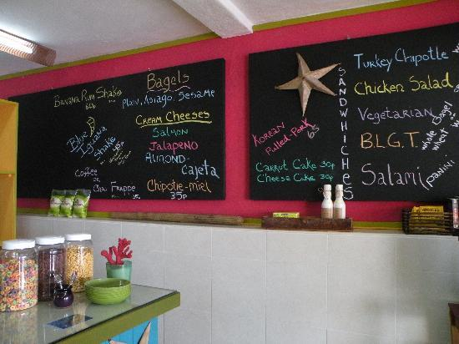
Assorted Salads…
Primary E_{T}^{miss} triggers will have no muon correction until a better understanding of these is achieved
Will also not be cutting on forward jets (bad for VBF) or number of vertices – experimental
Jet triggers will have no High Level Trigger active rejection until this is understood and commissioned
4j30_j50 replaced with 4j20_j50 (at least for now) but not yet clear until when this can survive – affects ttH hadronic channel

Slide 5
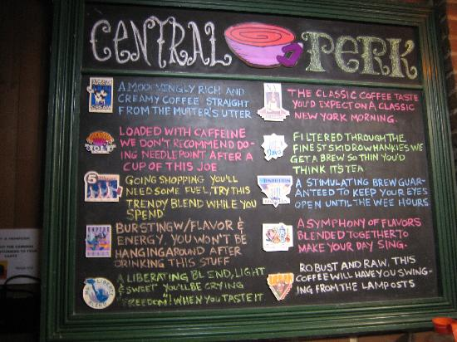
L = 1x10³⁰ cm⁻²s⁻¹

Slide 6
Trigger | Classification | Obs.
e/gamma:
g10_loose | primary | for H->γγ event selection until rates too high: don't prescale while possible
2g10_loose | backup | for H->γγ: backup for event selection at higher lumi if needed
em105_passHLT | primary | for H->WW (gg, VBF, WH, ttH, inv.), H->4l, ZH->inv, H->2l2τ, H->2l2ν, H->2l2b, ttH (semileptonic), tbH+, H->γγ event selection: avoid efficiency drop at high pT common in other e/gamma chains
e10_loose | primary | for H->WW (gg, VBF, WH, ttH, inv.), H->4l, ZH->inv, H->2l2τ, H->2l2ν and H->2l2b, H->ττ->lh and ll, ttH (semileptonic), tbH+ : primary trigger for signal selection
e15_medium | backup | for H->WW (gg, VBF, WH, ttH, inv.), H->4l, ZH->inv, H->2l2τ, H->2l2ν and H->2l2b, H->ττ->lh and ll, ttH (semileptonic), tbH+: backup trigger if e10_medium rate too high (since e15_loose seems to have same rate as e10_medium)
2e5_medium | primary | for H->ττ - leptonic, H->WW (gg, VBF, WH, ttH, inv.): primary to increase efficiency in 2-e final state; ZH->inv.
muon:
mu10 | primary | for H->WW (gg, VBF, WH, ttH, inv.), H->4l, ZH->inv, H->2l2τ, H->2l2ν and H->2l2b, H->ττ->lh and ll, ttH (semileptonic), tbH+, light H+->tau(lep)nu or csbar or a1W: primary trigger for signal selection
2mu6 | primary | for H->ττ leptonic (primary to increase efficiency in 2-mu final state) and light H+->a1W->uuW, ZH->inv.
mu13 | backup | for H->WW (gg, VBF, WH, ttH, inv.), H->4l, ZH->inv, H->2l2τ, H->2l2ν and H->2l2b, H->ττ->lh and ll, ttH (semileptonic), tbH+: backup trigger if mu10 rate too high
mu6 | support | for H->WW (gg, VBF, WH, ttH, inv.), H->4l, ZH->inv, H->2l2τ, H->2l2ν and H->2l2b, H->ττ->lh and ll, ttH (semileptonic), tbH+: support trigger for rate and bias studies
tau:
tau20_loose | primary | for light H+ hadronic final state event selection
2tau12_loose | primary | for H->ττ hadronic final state event selection

Slide 7
Trigger | Classification | Obs.
ETmiss:
xe30_noMu | primary | for light H+ hadronic channel
jet:
4j35 | primary | for ttH hadronic: primary trigger for event selection (90% eff. at 10TeV) - keep unprescaled whenever possible
4j30_j50 | primary | for ttH hadronic: primary trigger for event selection at 10^30 if rates allow - otherwise go to 4j20_3j40_2j60
b-jet:
3b10_4L1J5 | primary | for ttH hadronic: primary trigger for event selection if rates allow, otherwise go to…
3b10_4L1J10 | backup | for ttH hadronic: backup for 3b10_4L1J5
3b15_4L1J10 | test | for ttH hadronic: test for higher lumi
EF_mu4_l1j5_matched | support | for ttH hadronic: to produce a b-enriched sample for b-tagging studies; go to lower
EF_mu4_l1j10_matched | support | ... or higher thresholds depending on rate to get more stats
combined
e10_loose_mu6 | primary | for H->ττ - leptonic: primary to increase efficiency in e-mu final state
e5_medium_mu4 | support | for H->ττ - leptonic: support trigger for e-mu final state for fake studies
tau12_loose_e10_loose | primary | for H->ττ - lep-had: primary for e-tau final state
tau12_loose_mu10 | primary | for H->ττ - lep-had: primary for mu-tau final state
tau12_loose_2b15 | primary | for tbH+ -> 2b W(had) tau(had) nu: primary trigger for event selection
tau12_loose_xe15_noMu | primary | for tbH+ -> 2b W(had) tau(had) nu, H->ττ hadronic final state event selection
j35_xe30_mu15 | test | for heavy tbH+: test trigger to allow studies for higher lumi
j35_xe30_e15_medium | test | for heavy tbH+: test trigger to allow studies for higher lumi

Slide 8
L = 1x10³¹ cm⁻²s⁻¹

Slide 9
Trigger | Classification | Obs.
e/gamma:
g20_loose | primary | for H->γγ event selection until rates too high: don't prescale while possible
2g10_loose | primary | for H->γγ: backup for event selection at higher lumi if needed
g10_loose | support | for H->γγ: support trigger for efficiency estimation
g30_tight | primary | for H->γγ: test trigger to be used for selection at higher lumi
em105_passHLT | primary | for H->WW (gg, VBF, WH, ttH, inv.), H->4l, ZH->inv, H->2l2τ, H->2l2ν, H->2l2b, ttH (semileptonic), tbH+, H->γγ event selection: avoid efficiency drop at high pT common in other e/gamma chains
e10_medium | primary | for H->WW (gg, VBF, WH, ttH, inv.), H->4l, ZH->inv, H->2l2τ, H->2l2ν and H->2l2b, H->ττ->lh and ll, ttH (semileptonic), tbH+ : primary trigger for signal selection
e15_medium | backup | for H->WW (gg, VBF, WH, ttH, inv.), H->4l, ZH->inv, H->2l2τ, H->2l2ν and H->2l2b, H->ττ->lh and ll, ttH (semileptonic), tbH+: backup trigger if e10_medium rate too high (since e15_loose seems to have same rate as e10_medium)
2e5_medium | primary | for H->ττ - leptonic, H->WW (gg, VBF, WH, ttH, inv.): primary to increase efficiency in 2-e final state; ZH->inv.
muon:
mu10 | primary | for H->WW (gg, VBF, WH, ttH, inv.), H->4l, ZH->inv, H->2l2τ, H->2l2ν and H->2l2b, H->ττ->lh and ll, ttH (semileptonic), tbH+, light H+->tau(lep)nu or csbar or a1W: primary trigger for signal selection
2mu6 | primary | for H->ττ leptonic (primary to increase efficiency in 2-mu final state) and light H+->a1W->uuW, ZH->inv.
mu13 | backup | for H->WW (gg, VBF, WH, ttH, inv.), H->4l, ZH->inv, H->2l2τ, H->2l2ν and H->2l2b, H->ττ->lh and ll, ttH (semileptonic), tbH+: backup trigger if mu10 rate too high
mu6 | support | for H->WW (gg, VBF, WH, ttH, inv.), H->4l, ZH->inv, H->2l2τ, H->2l2ν and H->2l2b, H->ττ->lh and ll, ttH (semileptonic), tbH+: support trigger for rate and bias studies
tau:
tau38_loose | primary | for light H+ hadronic final state event selection
2tau16_loose | primary | for H->ττ hadronic final state event selection

Slide 10
Trigger | Classification | Obs.
ETmiss:
xe30_noMu | primary | for light H+ hadronic channel
jet:
4j35 | primary | for ttH hadronic: primary trigger for event selection (90% eff. at 10TeV) - keep unprescaled whenever possible
4j30_j50 | primary | for ttH hadronic: primary trigger for event selection at 10^30 if rates allow - otherwise go to 4j20_3j40_2j60
b-jet:
3b10_4L1J5 | primary | for ttH hadronic: primary trigger for event selection if rates allow, otherwise go to…
3b10_4L1J10 | primary | …this one
3b15_4L1J10 | test | for ttH hadronic: test for higher lumi
EF_mu4_l1j5_matched | support | for ttH hadronic: to produce a b-enriched sample for b-tagging studies; go to lower
EF_mu4_l1j10_matched | support | ... or higher thresholds depending on rate to get more stats
combined
e10_loose_mu6 | primary | for H->ττ - leptonic: primary to increase efficiency in e-mu final state
e5_medium_mu4 | support | for H->ττ - leptonic: support trigger for e-mu final state for fake studies
tau12_loose_e10_loose | primary | for H->ττ - lep-had: primary for e-tau final state
tau12_loose_mu10 | primary | for H->ττ - lep-had: primary for mu-tau final state
tau16_loose_2b15 | primary | for tbH+ -> 2b W(had) tau(had) nu: primary trigger for event selection
tau12_loose_xe15_noMu | primary | for tbH+ -> 2b W(had) tau(had) nu, H->ττ hadronic final state event selection
j35_xe30_mu15 | test | for heavy tbH+: test trigger to allow studies for higher lumi
j35_xe30_e15_medium | test | for heavy tbH+: test trigger to allow studies for higher lumi

Slide 11
L = 1x10³² cm⁻²s⁻¹

Slide 12
Trigger | Classification
e/gamma:
g30_tight | primary | for H->γγ event selection
2g15_loose | primary | for H->γγ event selection
g15_loose | support | for H->γγ: support trigger for efficiency estimation
em105_passHLT | primary | for H->WW (gg, VBF, WH, ttH, inv.), H->4l, ZH->inv, H->2l2τ, H->2l2ν, H->2l2b, ttH (semileptonic), tbH+, H->γγ event selection: avoid efficiency drop at high pT common in other e/gamma chains
e15_medium | primary | for H->WW (gg, VBF, WH, ttH, inv.), H->4l, ZH->inv, H->2l2τ, H->2l2ν and H->2l2b, H->ττ->lh and ll, ttH (semileptonic), tbH+ : primary trigger for signal selection
e20_medium | backup | for H->WW (gg, VBF, WH, ttH, inv.), H->4l, ZH->inv, H->2l2τ, H->2l2ν and H->2l2b, H->ττ->lh and ll, ttH (semileptonic), tbH+: backup trigger if e10_medium rate too high (since e15_loose seems to have same rate as e10_medium)
2e5_medium | primary | for H->ττ - leptonic, H->WW (gg, VBF, WH, ttH, inv.): primary to increase efficiency in 2-e final state; ZH->inv.
2e10_medium | backup | for H->ττ - leptonic, H->WW (gg, VBF, WH, ttH, inv.): backup for 2e5_medium
muon:
mu13 | primary | for H->WW (gg, VBF, WH, ttH, inv.), H->4l, ZH->inv, H->2l2τ, H->2l2ν and H->2l2b, H->ττ->lh and ll, ttH (semileptonic), tbH+, light H+->tau(lep)nu or csbar or a1W: primary trigger for signal selection
2mu6 | primary | for H->ττ leptonic (primary to increase efficiency in 2-mu final state), light H+->a1W->uuW, ZH->inv.
mu15 | backup | for H->WW (gg, VBF, WH, ttH, inv.), H->4l, ZH->inv, H->2l2τ, H->2l2ν and H->2l2b, H->ττ->lh and ll, ttH (semileptonic), tbH+: backup trigger if mu10 rate too high
2mu10 | backup | for H->ττ - leptonic, H->WW (gg, VBF, WH, ttH, inv.): backup for 2mu6
mu6 | support | for H->WW (gg, VBF, WH, ttH, inv.), H->4l, ZH->inv, H->2l2τ, H->2l2ν and H->2l2b, H->ττ->lh and ll, ttH (semileptonic), tbH+: support trigger for rate and bias studies
tau:
tau38_medium | primary | for light H+ hadronic final state event selection
2tau29_loose | primary | for H->ττ hadronic final state event selection
tau50_medium | backup | for light H+ hadronic final state: backup for tau38_medium (can't go any higher for this channel)

Slide 13
Trigger | Classification
ETmiss:
xe30_noMu | primary | for light H+ hadronic channel
xe35_noMu | backup | for light H+ hadronic channel: backup for xe30
jet:
4j35 | primary | for ttH hadronic: primary trigger for event selection (90% eff. at 10TeV) - keep unprescaled whenever possible
4j30_j50 | primary | for ttH hadronic: primary trigger for event selection at 10^30 if rates allow - otherwise go to 4j20_3j40_2j60
b-jet:
3b10_4L1J5 | backup | for ttH hadronic: in case rate affordable
3b10_4L1J10 | primary | for ttH hadronic: primary trigger for event selection if rates allow, otherwise go to…
3b15_4L1J10 | test | test for higher lumi
EF_mu4_l1j5_matched | support | for ttH hadronic: to produce a b-enriched sample for b-tagging studies; go to lower
EF_mu4_l1j10_matched | support | ... or higher thresholds depending on rate to get more stats
combined
e10_loose_mu6 | primary | for H->ττ - leptonic: primary to increase efficiency in e-mu final state
e10_loose_mu10 | primary | for H->ττ - leptonic: backup to e10_loose_mu6
e5_medium_mu4 | support | for H->ττ - leptonic: support trigger for e-mu final state for fake studies
tau12_loose_e10_loose | primary | for H->ττ - lep-had: primary for e-tau final state
tau12_loose_mu10 | primary | for H->ττ - lep-had: primary for mu-tau final state
tau12_loose_2b15 | primary | for tbH+ -> 2b W(had) tau(had) nu: primary trigger for event selection
tau16_loose_xe25_noMu | primary | for tbH+ -> 2b W(had) tau(had) nu, H->ττ hadronic final state event selection
j35_xe30_mu15 | test | for heavy tbH+: test trigger to allow studies for higher lumi
j35_xe30_e15_medium | test | for heavy tbH+: test trigger to allow studies for higher lumi

Slide 14
Comments?

Slide 15
Backup Slides

Slide 16
HSG1: H -> γγ
Li Yuan
L = 10³⁰ to 10³¹ cm⁻²s⁻¹:
g20_loose – primary trigger (7 Hz⁽¹⁾ 15 Hz⁽²⁾ at 10³¹ cm⁻²s⁻¹)
2g20_loose – backup trigger: will become primary trigger when needed (>10³² cm⁻²s⁻¹ ?)
g20i_loose – supporting trigger: study isolation at Level 1
g10_loose (11 Hz⁽¹⁾ 35 Hz⁽²⁾ at 10³⁰ cm⁻²s⁻¹) or g5_loose – support triggers for efficiency determination (bootstrap); can be prescaled to a low rate
L = 10³² cm⁻²s⁻¹:
Primary trigger: g20_loose (70 Hz⁽¹⁾ – prescaled) or g20_medium (no prescale expected?)
2g20_medium or g20_g30_loose – primary trigger for event collection
g20i_loose – supporting trigger: study isolation at Level 1
g10_loose or g5_loose – backup triggers for bootstrap methods; heavily prescaled
Questions:
Any reason to not go to g20_medium or g20_tight at 10³² if g20_loose prescaled?
Why use both g20_loose and 2g20_loose as primary triggers?
Rates I saw are still uncertain (Li’s rates larger then egamma trigger) – how are they calculated?
If we need to use new trigger (g30_g20) should justify – what’s increase in efficiency?
Extrapolated – see Rainer Stamen in http://indico.cern.ch/conferenceDisplay.py?confId=94961
Estimated in MC https://twiki.cern.ch/twiki/bin/view/Atlas/AtlasTriggerRates

Slide 17
HSG2: H->ZZ*->llll
L = 10³⁰ to 10³¹ cm⁻²s⁻¹:
e10_medium – primary trigger (34 Hz⁽¹⁾ or 48 Hz⁽²⁾ at 10³¹ cm⁻²s⁻¹)
e12_medium – backup for e10_medium if rate too high
e10_medium_SiTrk – supporting (alternative L2 tracking)
mu10 – primary trigger (15 Hz⁽²⁾ at 10³¹ cm⁻²s⁻¹)
mu6 – supporting (4.4 Hz⁽²⁾ – prescale 200 – at 10³¹ cm⁻²s⁻¹)
mu15 – backup for mu10 (3 Hz⁽²⁾ at 10³¹ cm⁻²s⁻¹)
L = 10³² cm⁻²s⁻¹:
e15_medium – primary trigger (10 Hz⁽²⁾ at 10³¹ cm⁻²s⁻¹)
e15_medium_SiTrk – suporting (still needed?)
e20_medium – (2 Hz⁽²⁾ at 10³¹ cm⁻²s⁻¹) backup for e15_medium if the rate too high
mu13 – primary trigger (no rates found)
mu15 – (3 Hz⁽²⁾ at 10³¹ cm⁻²s⁻¹) backup for mu13
mu10 – supporting
Questions:
Could we have e10_tight (or e15_medium) as backup for e10_medium instead at 1e31?
Supporting trigger e15_medium_SiTrk still needed at 1e32?
For 1e32 would mu15 be ok if mu13 not in menu? (How much would we loose?)
Any reason to go to di-lepton triggers? (I.e. is there need to lower p_{T} thresholds? Or is there some margin?)
⁽¹⁾ Extrapolated – see Rainer Stamen in http://indico.cern.ch/conferenceDisplay.py?confId=94961
⁽²⁾ Estimated in MC https://twiki.cern.ch/twiki/bin/view/Atlas/AtlasTriggerRates
Diego Rodriguez

Slide 18
ZH->inv, H->2l2τ, H->2l2ν and H->2l2b
Paul Thompson
Sylvie Brunet
All four analyses rely on leptons for trigger
In signal these come from Z decay
Can use same triggers as H->4l channel in previous page

Slide 19
HSG3: H->WW (gg, VBF, WH, ttH, inv.)
Gemma Wooden
L = 10³⁰ to 10³² cm⁻²s⁻¹:
e10_medium and mu10 – primary single lepton triggers for H->WW->ll (l = e,mu)
2e5_medium(2 Hz(2) at 10³¹ cm⁻²s⁻¹) and 2mu6 – backup: di-lepton trigger in case offline lepton p_{T} may be lowered
e10_loose – support trigger to study fake rate
VBF trigger: seems useful at ≈ 10³² cm⁻²s⁻¹, when single-lepton triggers need to get tight
Di-jet trigger + rapidity gap + lepton
Lepton p_{T} threshold low (perhaps ~8 GeV)
Would give gain in phase space for VBF H->WW at the cost of little extra rate
In the tau channel, this trigger increases the number of events by 20-25%, but lower gain expected for WW channel
Questions:
Rates too high for above single-lepton triggers at 10³² cm⁻²s⁻¹. Would the ones below be ok? (I.e. how much do we loose?)
e15_medium – primary trigger (10 Hz⁽²⁾ at 10³¹ cm⁻²s⁻¹)
e20_medium – (2 Hz⁽²⁾ at 10³¹ cm⁻²s⁻¹) backup for e15_medium if the rate too high
mu13 – primary trigger (no rates found)
mu15 – (3 Hz⁽²⁾ at 10³¹ cm⁻²s⁻¹) backup for mu13
Would e10_loose_mu6 be useful? (with e10_medium_mu10 for higher lumi) – requested for H->ττ
Would be great to have lepton trigger efficiencies and p_{T} spectrum
VBF trigger:
Which di-jet+gap trigger? (EF_2j40_deta3_5, EF_2j20_deta3_5, EF_2j10_deta3_5, EF_2j10_deta5? Prescales not yet known)
Can we live with existing lepton pT cut ? E.g. electron 10GeV, muon 6GeV. What would we gain with pT >5GeV for electrons?
What is the efficiency for signal with each possibility?

Slide 20
HSG4: H->ττ leptonic and lep-had
From: https://twiki.cern.ch/twiki/bin/view/AtlasProtected/Higgsττ#Trigger and input from Matthew
L = 10³⁰ to 10³¹ cm⁻²s⁻¹:
e10_medium – primary trigger (34 Hz⁽¹⁾ or 48 Hz⁽²⁾ at 10³¹ cm⁻²s⁻¹)
e12_medium – backup for e10_medium if rate too high
e10_medium_SiTrk – supporting (alternative L2 tracking)
mu10 – primary trigger (15 Hz⁽²⁾ at 10³¹ cm⁻²s⁻¹)
mu6 – supporting (4.4 Hz⁽²⁾ – prescale 200 at 10³¹ cm⁻²s⁻¹)
mu15 – backup for mu10 (3 Hz⁽²⁾ at 10³¹ cm⁻²s⁻¹)
e10_loose_mu6 – (1Hz ⁽²⁾ at 10³¹ cm⁻²s⁻¹): 50% increase in signal efficiency wrt e10_medium || mu10 – requested into Physics menu)
e5_medium_mu4 – support trigger for e10_loose_mu6 (fake rate & bias studies)
L = 10³² cm⁻²s⁻¹:
e20i_loose – primary trigger (10 Hz⁽²⁾ at 10³¹ cm⁻²s⁻¹) – e20i_medium not in the menu (shall we request it?)
e15_medium, e20_medium – supporting
e25_medium – (≈0 Hz⁽²⁾ at 10³¹ cm⁻²s⁻¹) backup for e15_medium if the rate too high – e25i_medium not in phys menu
mu20 – primary trigger (2 Hz⁽²⁾ at 10³¹ cm⁻²s⁻¹)
mu10 or mu15 – supporting trigger: mu15 – (3 Hz⁽²⁾ at 10³¹ cm⁻²s⁻¹) backup for mu13
e10_loose_mu6 or e10_loose_mu10 – It may be necessary to go to higher muon p_{T} cut, depending on luminosity
Questions:
Is list of single-lepton triggers up to date?
How do we gain so much (50%) by going from e10_medium || mu10 to e10_loose_mu6? (decrease in offline p_{T} cut?)
Obs.: 2e5_medium has 2 Hz at EF (1E31) but 2mu6 has 10Hz – can’t assume they will be un-prescaled
Some healthy resistance in menu group to adding triggers in particular not clear about e5_medium_mu4
⁽¹⁾ Extrapolated – see Rainer Stamen in http://indico.cern.ch/conferenceDisplay.py?confId=94961
⁽²⁾ Estimated in MC https://twiki.cern.ch/twiki/bin/view/Atlas/AtlasTriggerRates
Matthew Beckingham
Henrik Nilssen

Slide 21
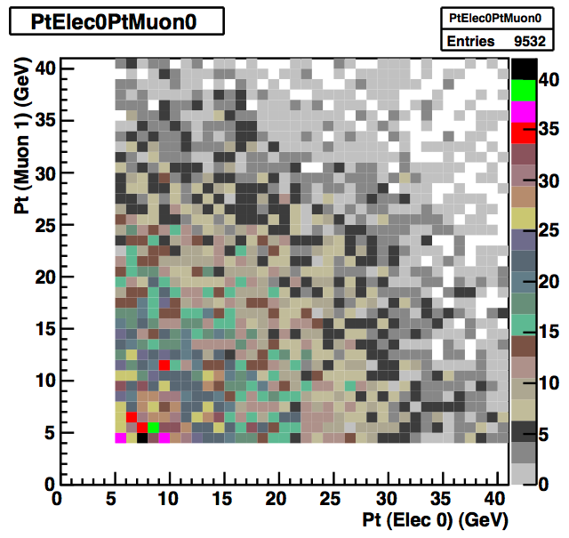
H -> τ τ -> eν μν
Matthew Beckingham
Henrik Nilssen
Could live with p_{T} thresholds for single-lepton triggers if the other remains low, but moving both to 20 costs ~35% of signal:
e10_medium|| mu10 → e10_medium mu20: keep ~99% of events
e10_medium || mu10 → e20_medium mu10: keep ~95% of events
e10_medium || mu10 → e15_medium mu15: keep ~88% of events
e10_medium || mu10 → e20_medium mu20: keep ~65-70% of events
Solution: use di-electron, di-muon and e+mu trigger
Including e10_loose_mu6 we gain 50% more events wrt to e10_medium || mu10
Including e5_medium_mu4 we gain 56% more events wrt to e10_medium || mu10
…and lowering electron and muon preselection cuts to p_{T}>5 GeV
Matthew Beckingham

Slide 22
HSG4: H->ττ Hadronic
Stefania Xella
From: https://twiki.cern.ch/twiki/bin/view/AtlasProtected/Higgsττ#Trigger
L = 10³⁰ to 10³¹ cm⁻²s⁻¹:
double tau:
primary trigger = 2tau20_loose – version with isolation (2tau20i_loose) not available in menu
support trigger = e10_medium || mu10 || xe30 – not clear which xeYY will be unprescaled for 1e31
backup trigger = 2tau29_loose – version with isolation (2tau29i_loose) not available in menu
tau+MET:
primary trigger = tau16_loose_xe25 – ok
support trigger = tau16i_loose_4j23 – not available in menu
backup trigger = tau16_loose_xe20 and tau16i_loose_xe25 - ok
L = 10³² cm⁻²s⁻¹:
double tau:
primary trigger = 2tau29i_loose – version with isolation (2tau29i_loose) not available in menu
support trigger = e20_medium || mu20 || xe40 – not clear which xeYY will be unprescaled for 1e32
backup trigger = 2tau38_loose - ok
tau+MET:
primary trigger = tau29i_loose_xe30 – not in physics menu
support trigger = ?
backup trigger = tau38_loose_xe40 – not in menu
Questions:
List needs to be updated – some of the triggers not in Physics menu, but similar chains could be used (or request new if really needed)

Slide 23
HSG5: ttH (H->bb) semileptonic
Catrin Bernius
Also including Fat-Jet analysis
Basically need lowest un-prescaled single-lepton trigger; my proposal:
L = 10³⁰ to 10³¹ cm⁻²s⁻¹:
e10_medium – primary trigger (34 Hz⁽¹⁾ or 48 Hz⁽²⁾ at 10³¹ cm⁻²s⁻¹)
e12_medium – backup for e10_medium if rate too high
mu10 – primary trigger (15 Hz⁽²⁾ at 10³¹ cm⁻²s⁻¹)
mu15 – backup for mu10 (3 Hz⁽²⁾ at 10³¹ cm⁻²s⁻¹)
L = 10³² cm⁻²s⁻¹:
e15_medium – primary trigger (10 Hz⁽²⁾ at 10³¹ cm⁻²s⁻¹)
e20_medium – (2 Hz⁽²⁾ at 10³¹ cm⁻²s⁻¹) backup for e15_medium if the rate too high
mu13 – primary trigger (no rates found)
mu15 – (3 Hz⁽²⁾ at 10³¹ cm⁻²s⁻¹) backup for mu13
Absolute efficiencies from CSC studies were 82% mu20 || e22i || e55, so we should be in safe ground for this year
Obs.:
Jet triggers will be studied, but numbers are not available for now, so better hold off on requests

Slide 24
HSG5: ttH (H->bb) hadronic
Michael Nash
Not clear what triggers are needed and possible at present
Only jet triggers and E_{T}^{sum} could be useful
Menu currently has some multi-jet triggers: EF_3j80, EF_4j40, EF_5j20
But not clear which will be prescaled and when
Available numbers:
For the MC@NLO fully hadronic ttbar dataset, the 'useful' chains I can see are:
EF_2j10 (100%) not in new menu
EF_2j20 (99%) not in new menu
EF_2j40 (96%) – looks very useful!
EF_3j20 (93%) percale 10 000 000!

Slide 25
HSG5: Heavy charged Higgs
Martin zur Nedden
Looking at new menu:
The combinations of ”e + MET" and "tau + MET" currently in the menu are ok
A new combination ”e + MET + jet” exists but still to be checked
Missing combined triggers:
combination "mu + MET" is MISSING
combination "tau + MET + jet" is MISSING
combination "mu + MET + jet" is MISSING
And more details that I won’t mention

