Slide 1
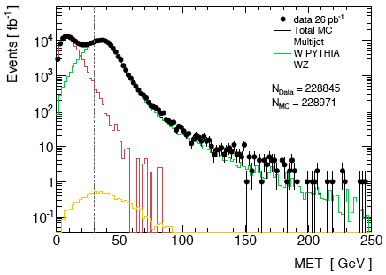
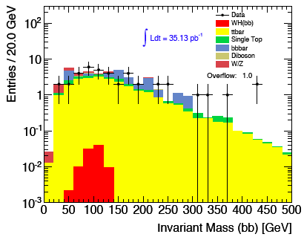
H->bb activity - I
No notes for Winter conferences – aiming to have WH, ZH, possibly ttH for Summer
WH and ZH analyses progressing in parallel – concentrating on non-boosted for now
Most activity from Birmingham/Liverpool, Wisconsin, LMU Munich, Lisbon at the moment – also from Carleton, Argonne, Glasgow and Royal Holloway
Several groups showed cut flows agree to reasonable level; description of backgrounds reasonably under control; currently moving to rel.16, then reproduce results
First impression of sensitivity, definitely NOT to be quoted:
Exclude 56 x SM in WH and 139 x SM in ZH with 35pb⁻¹ (e & μ channels combined)
IP3D+SV1, m_{bb}∈ [70, 130] GeV, assuming 10% uncertainty in S & B ⊕ 11% Lumi
First look at rel.16
m_{bb} in WH ➔ μνbb channel – rel.15

Slide 2
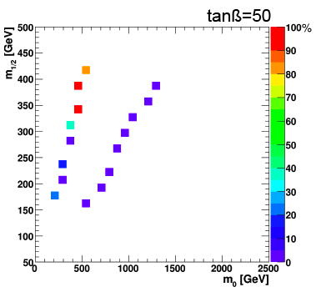
H->bb activity - II
Boosted WH/ZH to follow – more relevant for higher lumi
Activity in UCL London at the moment – commission jet substructure observables
Much interest from rest of group currently involved in non-boosted analyses
ttH analysis progressing – developing multivariate analysis
Glasgow involved, Edinburgh just joined… a Scottish Higgs channel!
VBF H->bb – recent activity from Victoria
Rough estimate: sensitivity between hh and ll channels of VBF H->ττ (no trigger, 30fb⁻¹)
Trigger is crucial in this analysis – currently working on this, in contact with jet trigger
SUSY H->bb – activity in Freiburg within SUSY
See ATL-COM-PHYS-2011-030 – Atlfast II study
Challenging: no discovery at √s = 10 TeV, 10fb⁻¹
Becomes quite interesting for √s = 14 TeV, 30pb⁻¹, at m₀≈500GeV, m_{1/2}≈350GeV (mSUGRA)
Trigger is crucial in this analysis – ongoing work

