Slide 1

HSG5: Status and Plans
Ricardo Gonçalo (RHUL)
on behalf of Higgs Subgroup 5 (H->bb)

Slide 2
Outlook
Inclusive analyses:
  Analysis results and status of paper draft
Boosted Z->bb status
Analysis plans up to Summer

Slide 3
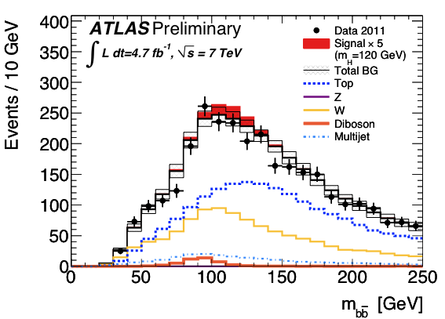
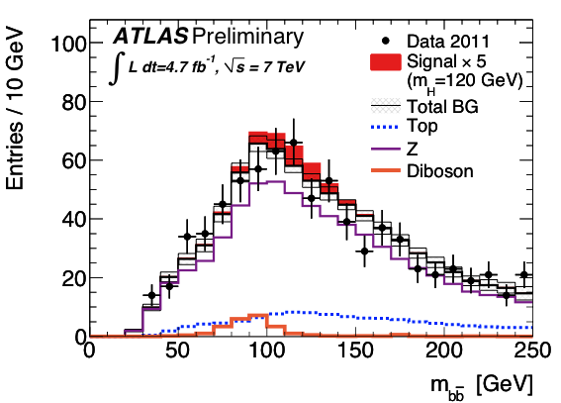
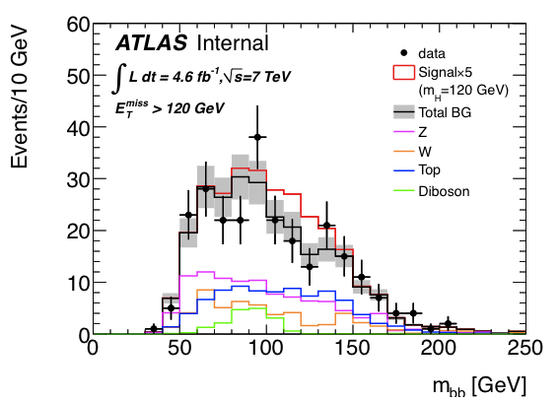
Inclusive analyses
Cut-based analyses
ZH➝llbb and WH➝lνbb and ZH➝ννbb
Select Z or W or large E_{T}^{miss} and search for 2 additional b jets
Search Higgs in m_{bb} spectrum
Determine main backgrounds from data (sidebands & control regions)
Both ZH and WH (≈20%) contribute to ZH➝ννbb
Internal
ZH➝llb
Internal
ZH➝ννbb
WH➝lνbb

Slide 4
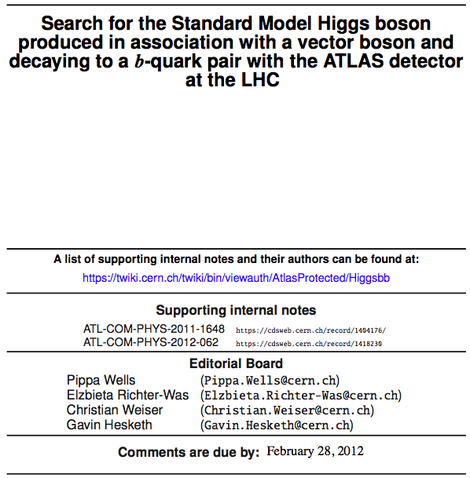
Many thanks to our editorial board for their dedication and guidance!
Editorial board:
  Chair:
  Pippa Wells
  Members:
  Elzbieta Richter-Was Christian Weiser
  Gavin Hesketh
Editors:
  Ricardo Gonçalo Andrew Mehta Giacinto Piacquadio Paul Thompson
Editors of ZH->ννbb note:
  Bill Murray
  Song-Ming Wang
Paper CDS record: https://cdsweb.cern.ch/record/1425880
Draft 1 under approval as CONF note: https://cdsweb.cern.ch/record/1428142
Support material:
  ZH➝llb & WH➝lνbb: https://cdsweb.cern.ch/record/1404176/
  ZH➝ννbb: https://cdsweb.cern.ch/record/1418230

Slide 5
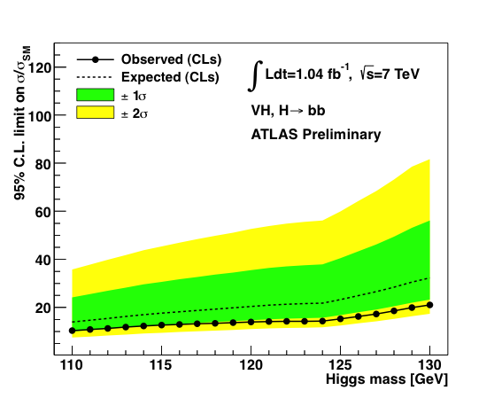
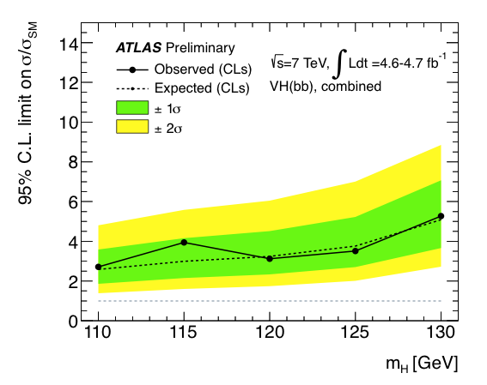
The state of the art…
Previous results – EPS2011: 15 – 20 x SM (expected)
  ZH➝llbb and WH➝lνbb (1.04 fb⁻¹)
Since last Summer:
  Cuts changed mainly to suppress top background
  Lumi increased by 4.5x and included ZH➝ννbb
Latest results – under approval: 2.6 – 5.1 x SM (expected)
  ZH➝llbb and WH➝lνbb (4.7 fb⁻¹) and ZH➝ννbb (4.6 fb⁻¹)

Slide 6
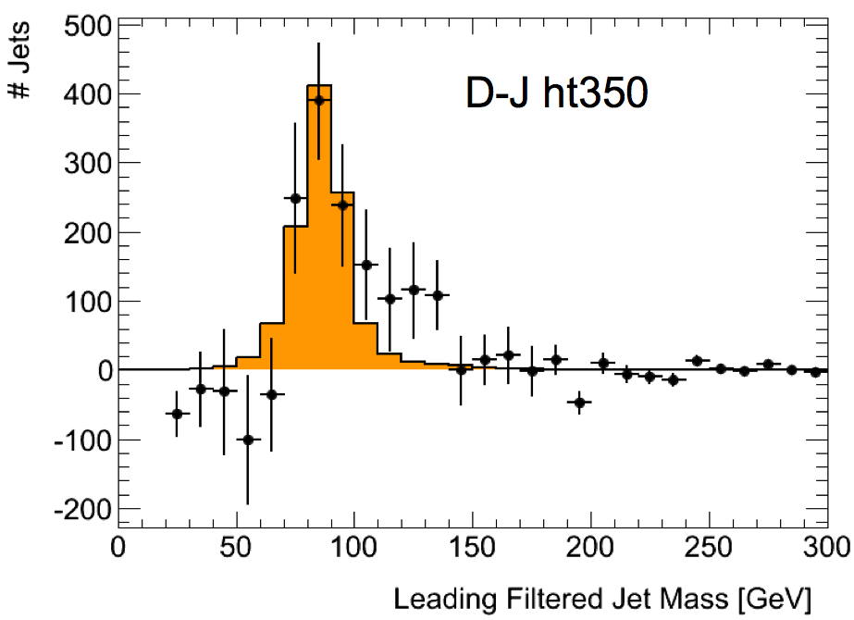
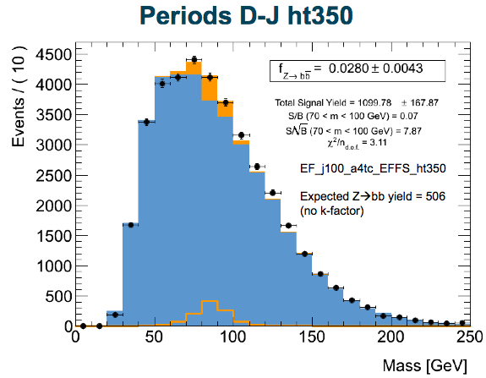
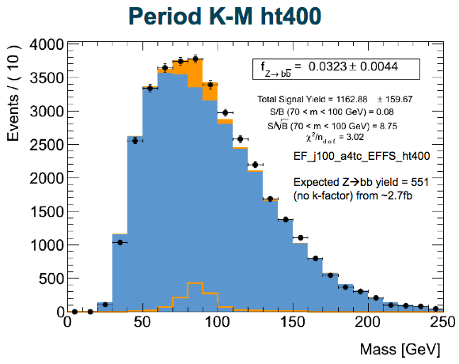
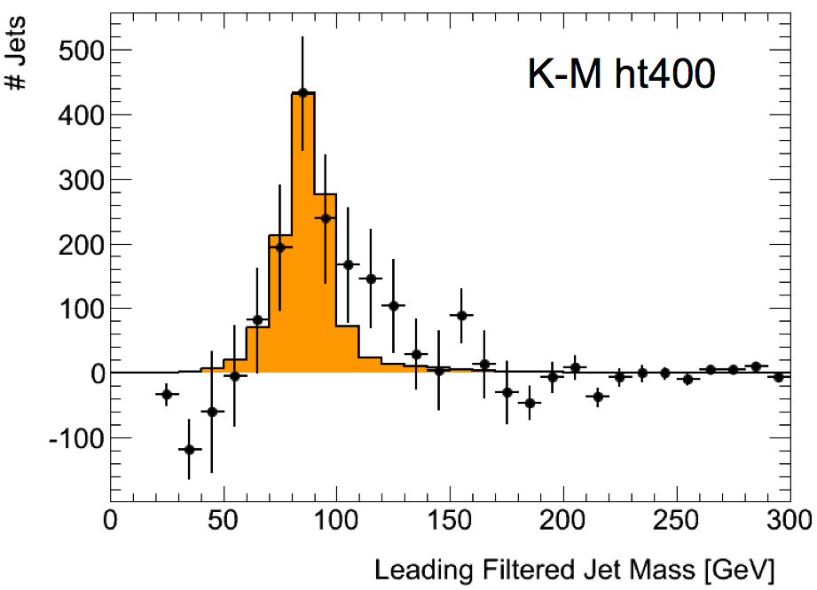
Boosted Z->bb
Z->bb analysis with jet substructure in HSG5
  Perfect calibration for boosted H->bb!
An exciting Z->bb peak can be seen after background subtraction
  And (perhaps even more exciting?!) there is a shoulder just above the Z mass… at around 126GeV ☺
  Caveat: get excited, but don’t get too excited!
  A lot of work has been going on to test the results
Much progress made so far
  But many questions remain and must be answered
  Observing the Z->bb in this analysis would be fantastic!
Current status:
  Now looking at full simulation MC
  Observations in D-J is still there in periods K-M!
    D – J with trigger EF_j100_a4tc_EFFS_ht350
    K – M with trigger EF_j100_a4tc_EFFS_ht400
    See Luke Lambourne’s talk at HSG5 meeting: https://indico.cern.ch/conferenceDisplay.py?confId=167396

Slide 7
Plans up to Summer - I
H->bb paper:
  The CONF note for Moriond is the first draft
  Must finish paper soon to contribute to combination(s)
Expect other analyses to converge, e.g.:
  Z->bb work will continue to evolve
  Boosted H->bb analysis very lively:
    Aim to converge for Summer results
    Try to merge with inclusive analyses at the highest pT(W/Z) bin
    First results point at significant improvement – see talk by Ines Ochoa at the last HSG5 meeting: https://indico.cern.ch/conferenceDisplay.py?confId=167398
  ttH has shown first baseline results:
    Stat-only limits of ≈15xSM with 1fb-1
    => expect ≈7xSM with full 2011 data (stats only) – See Donnachda Quilty’s talk here: https://indico.cern.ch/conferenceDisplay.py?confId=167391
    ttH cross section may help a lot for √s = 8TeV (≈2x?)
… and much more!

Slide 8
Plans up to Summer - II
Continue to work on the existing channels:
  ZH➝ννbb had first iteration, but has space to evolve
  MV methods not yet explored enough
Essential to get the best of our data:
  More interaction with CP groups:
    Main points and open questions in current analyses are on jets, MET and b-tagging
    Would benefit (a lot!!) from better understanding of jet energy scale, MET, di-jet mass resolution
    Trigger – e.g. MET trigger, trigger for VBF H->bb, b(b)H, etc
  Preparing list of MC samples needed for MC12
    Crucial to get enough MC (and of the right kind)
Produce new results for ICHEP2012 with 2012 data
…maybe shortly after… see the Higgs in H->bb ☺

Slide 9
Backup slides

Slide 10
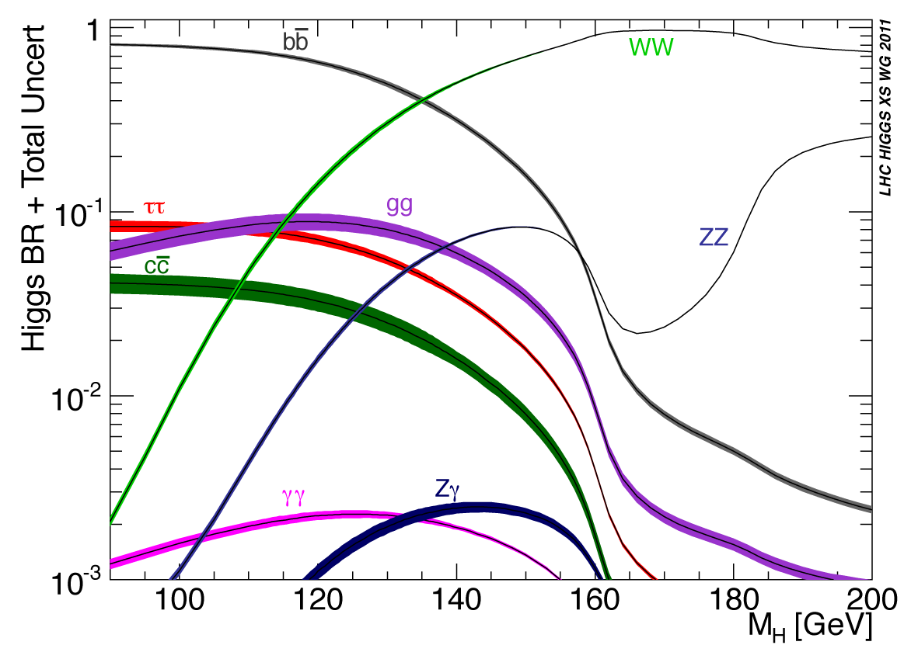
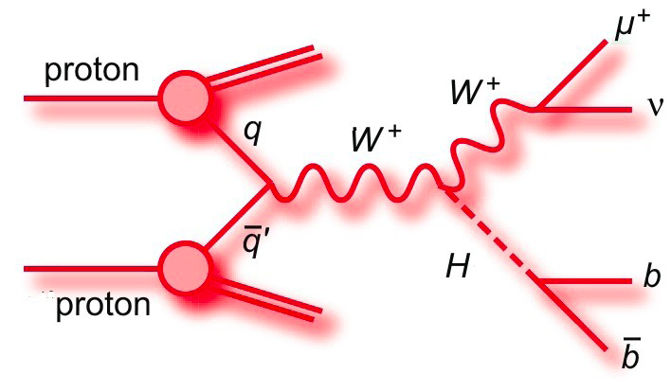
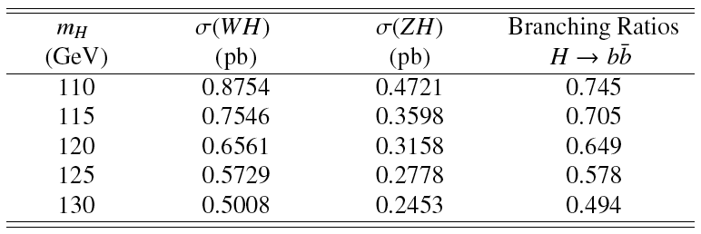
This paper:
  ZH➝llb, WH➝lνbb and ZH➝ννbb
  4.6 – 4.7 fb⁻¹ analyzed
H->bb dominant at low mass
  WH cross section factor ≈2x higher than ZH, but important top background
Cut-based analyses:
  Select Z or W or large E_{T}^{miss} and search for 2 additional b jets
  Search Higgs in m_{bb} spectrum

Slide 11
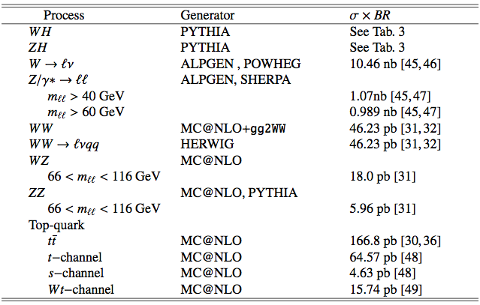
Monte Carlo samples

Slide 12
Datasets
Full 2011 data from periods B-M
  4.7 fb⁻¹ e/μ streams (ZH➝llb, WH➝lνbb)/4.6 fb⁻¹ JetTauETmiss (ZH➝ννbb)
Signal (MC11c)
  ZH➝llbb, WH➝lνbb, ZH➝ννbb simulated in Pythia
  Normalized to NLO (EW) + NNLO (QCD) from LHC Higgs cross section WG (Yellow Report I)
  m_{H} = 110 − 130 GeV in steps of 5 GeV
Background (MC11c)
  Z/W+jets: ALPGEN to model l (l and c jets) for Z(W)
  High statistics Zcc/Zbb(Wbb) using SHERPA(POWHEG)
  Top: ttbar + single top from MC@NLO
  Diboson: ZZ/WZ/WW from MC@NLO
QCD background
  ZH➝llbb multi-jet electron from loose-loose no medium data scaled
  WH➝lνbb electron and muon from anti-isolation data scaled
  ZH➝ννbb from data (ABCD method) – negligible

Slide 13
Lepton Selection: WH➝llb, WH➝lνbb
Electrons
  medium++ (tight++) with pT > 20(25) GeV and |η| < 2.47 for Z(W)
  Include crack region
  Trackisolation: Ptracks /pT < 0.1 within R = 0.2
  For WH: Calo isolation: Pcalo /ET < 0.14 within R = 0.3
  For WH: Impact parameter cut d0 < 0.1 mm
  Latest recommended smearing and efficiency corrections
  Veto in WH: use central loose++ with pT > 10 GeV and forward loose
  with pT > 20 GeV(|η| < 4.5). Require trk/calo isolation (except forward)
Muons
  STACO(Muid) tight with pT > 20(25) GeV and |η| < 2.5 for Z(W)
  Track isolation (as for electrons); For WH calo isolation
  Impact paramter cuts d0 < 1(0.1) mm for Z(W)
  Impact parameter cut against cosmics z0 < 10 mm
  Latest recommended smearing and efficiency corrections
  For veto in WH extend to Loose/standalone, pT > 10 GeV and
  |η| < 2.7. Require track isolation (except standalone)

Slide 14
Jet/E_{t}^{miss} selection
Jets – not updated to last week’s recommendations
  Anti-kT 4 with pT > 25 GeV and |η| < 2.5 ”AntiKt4TopoEMJets”
  For jet veto in WH pT > 20 GeV and |η| < 4.5
  Remove events with jets pointing to the bad FEB region
  Pile-up: reject jets with |JVF| < 0.75 for jets with |η| < 2.5
  Current JES/JER uncertainty including pile-up, close by and b JES
b-tagging – not updated to last week’s version
  MV1 with w > 0.602 ( 70% efficiency)
  Applying corrections and uncertainties derived by b-tagging group.
MET – not updated to last week’s version
  MET RefFinal out-of-the-box
  Apply pile-up reweighting for each MC run period
  Additional μ scaling reweighting: scale <μ> by 1.03±0.03

Slide 15
Lepton and jet veto: ZH➝ννbb, WH➝lνbb
Veto leptons:
  Electron : medium , pT>10 GeV, |η|<2.47, pTcone20/pT<0.1
  Muon : Combined & segmented-tagged STACO, pT>10 GeV, |η|<2.4, pTcone20/pT<0.1
Veto on any event having an object with:
  pT > 20 GeV. Veto lepton has wider range than trigger electron
  (standalone muons, forward electrons).
Remove any event with:
  1 extra lepton with pT > 20 GeV
  1 extra opposite sign lepton with pT < 20 GeV
  > 1 extra leptons
Remove any event with ≥ 3 jets (veto jet: pT > 20 GeV and |η| < 4.5)
In ZH➝llbb, WH➝lνbb: remove overlaps between electrons, muons, jets

Slide 16
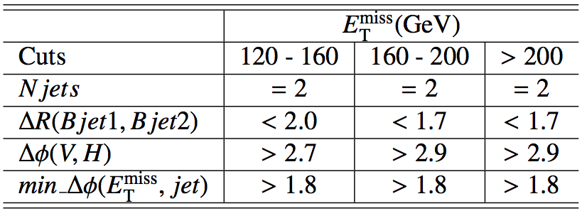
Event selection
Common selection
  Using WZ+jets GRL (incl. b-tagging)
  Primary vertex containing at least 3 tracks
ZH➝llb
  Triggers: single and dilepton triggers
  Exactly 2 leptons with 83 < mll < 99 GeV
  Opposite charge required for muons
  ET^{miss} < 50 GeV
  At least 2 jets (1 jet with p_{T} >45 GeV), exactly 2 b tagged
WH➝lνbb
  Triggers: single lepton trigger
  1 lepton and MT > 40 GeV
  Emiss
  T > 25 GeV
  Exactly 2 jets(1 jet with pT >45 GeV) and both b tagged
  ZH➝ννbb
  Trigger: EF_xe70_noMu
  No lepton (e or μ)
  Etmiss > 120 GeV
  Ptmiss > 30 GeV (remove events with fake high Etmiss)
  2 or 3 jets, exactly 2 b-tagged jets
  Leading jet Pt>45 GeV (new)
  B-tagged jets separated by dR(b1,b2)>0.7 (for 120<Etmiss<200 GeV)
  Δφ(Etmiss, Ptmiss) < π/2 (new)
  Plus optimized angular cuts (table)

Slide 17
Other aspects of the analysis
Selected sample is divided into pT(W/Z) categories to increase significance
Some cuts are optimized for each bin in ZH➝ννbb analysis
Heavily data-driven estimation of backgrounds
  Normalization of main backgrounds transferred from
ZH➝llbb/WH➝lνbb analysis to ZH➝ννbb analysis
More info in support material:
  ZH➝llb & WH➝lνbb: https://cdsweb.cern.ch/record/1404176/
  ZH➝ννbb: https://cdsweb.cern.ch/record/1418230

Slide 18
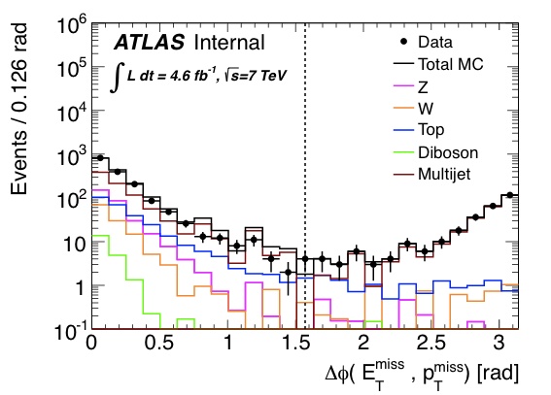
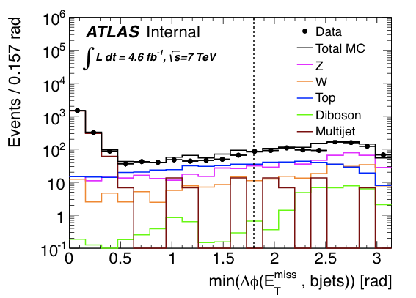
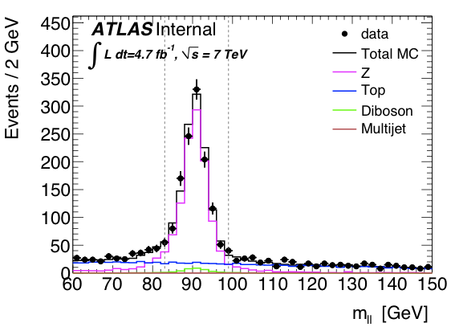
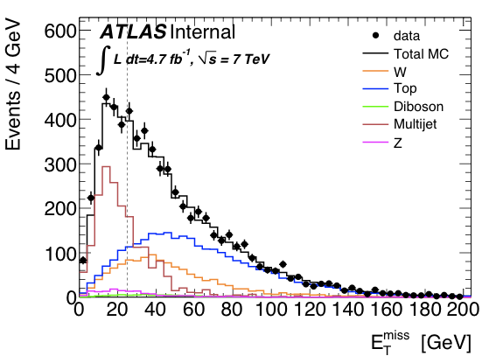
Plots for approval – Fig.1

Slide 19
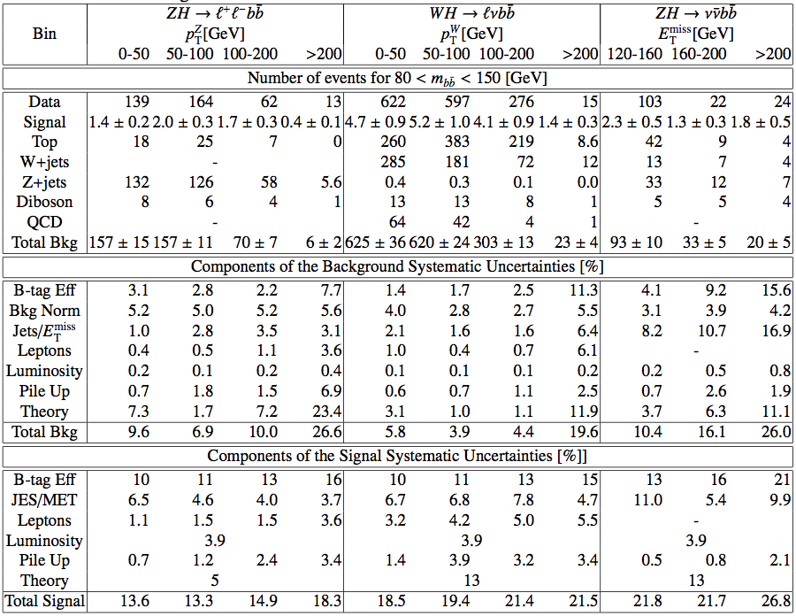

Slide 20
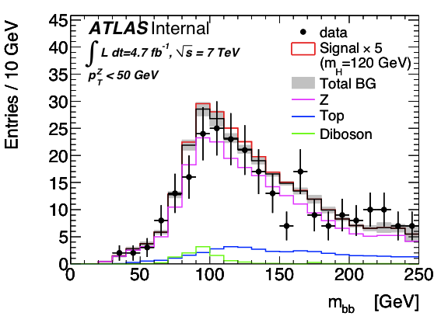
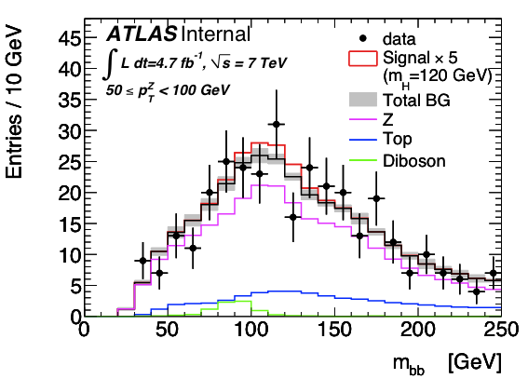
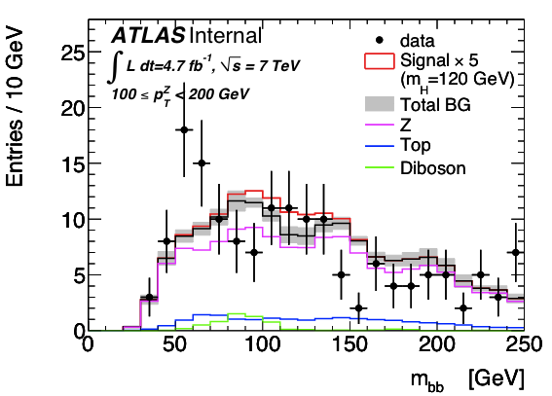
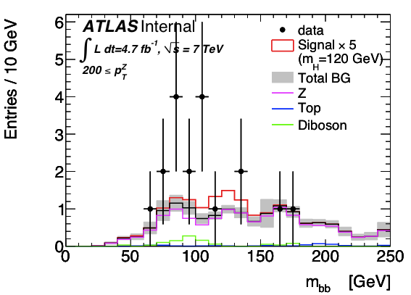
Plots for approval – Fig.2 (ZH➝llbb)

Slide 21
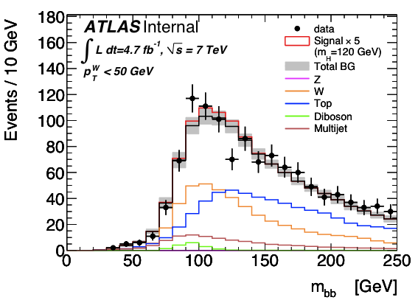
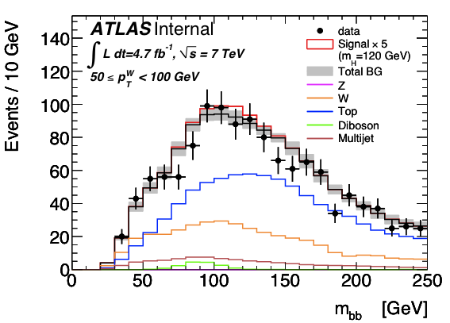
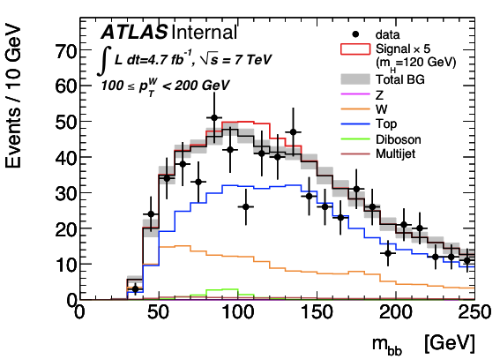
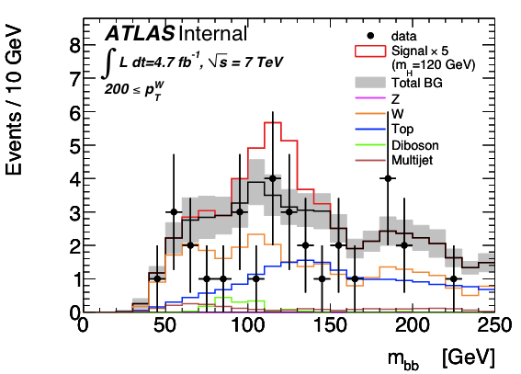
Plots for approval – Fig.3 (WH➝lνbb)

Slide 22
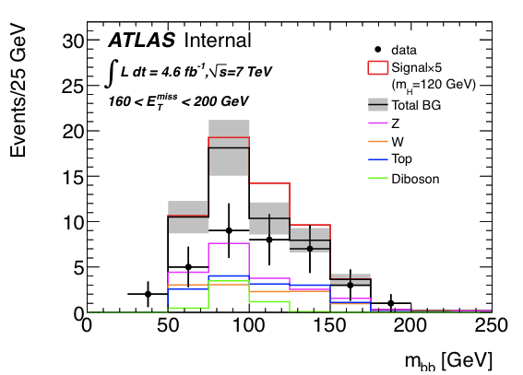
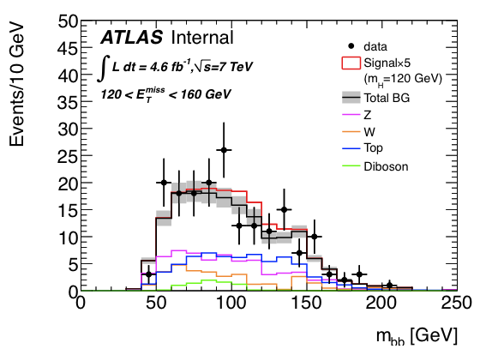
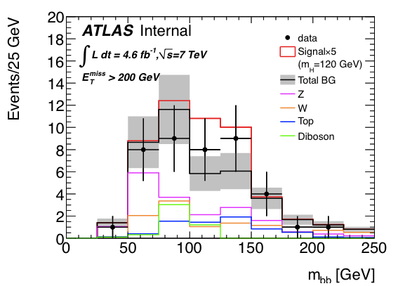
Plots for approval – Fig.4 (WH➝lνbb)

Slide 23
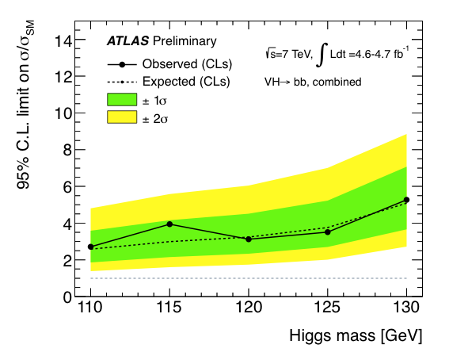
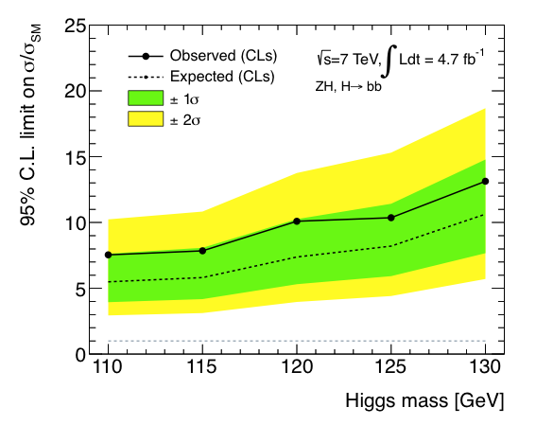
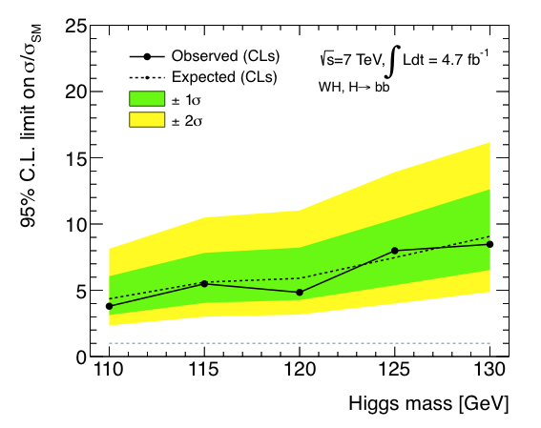
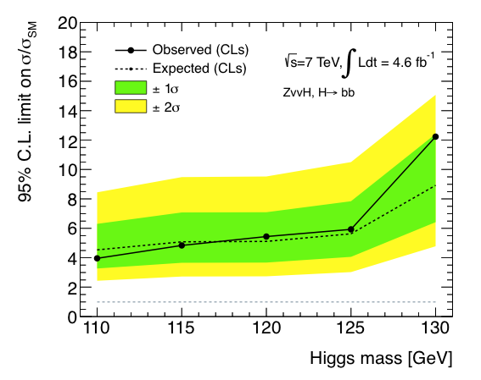
Limits plots for approval

Slide 24
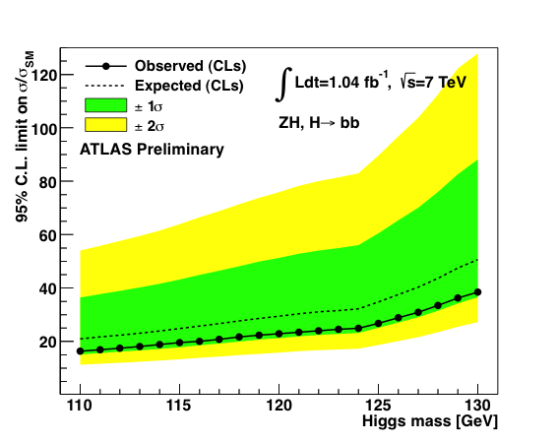
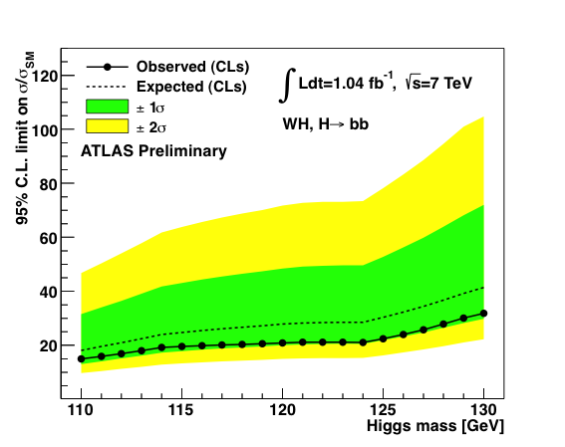
Last public results:
First H➝bb search from the LHC shown at EPS – July 2011
ZH➝llb, WH➝lνbb only
1fb⁻¹ @ 7 TeV
Combined sensitivity: ≈10-20xSM
Ref.: ATLAS-CONF-2011-103

Slide 25
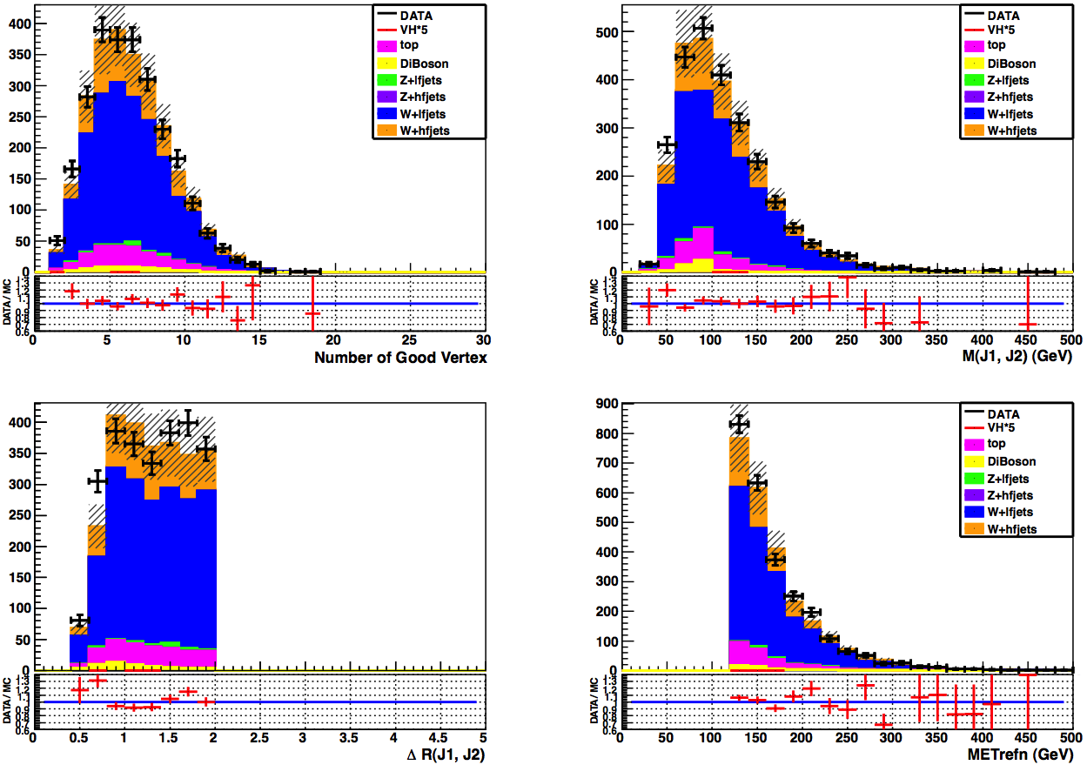
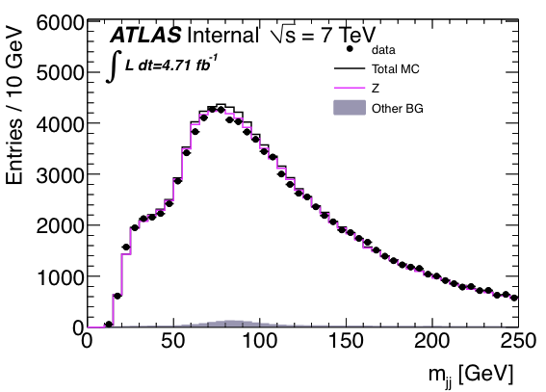
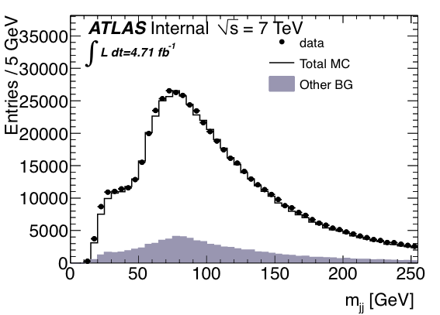
Un-tagged m(j,j) plots
Added to WH/ZH support note (appendix O.7): https://cdsweb.cern.ch/record/1404176/
Also in control regions of ZH->ννbb support note: https://cdsweb.cern.ch/record/1418230
ZH->llbb
ZH->vvbb
WH->lvbb

Slide 26
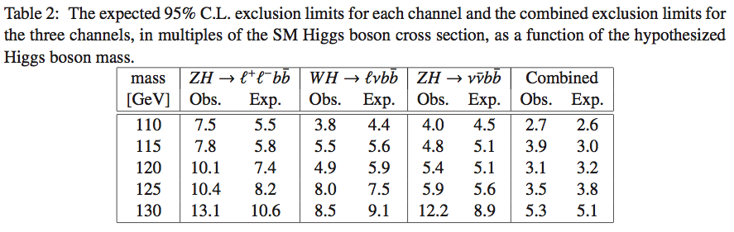
Table 2 – Exclusion Limits

