Slide 1
HSG5: work towards Moriond
H->bb paper for Moriond:
WH->lνbb and ZH->llbb:
Analysis seems ready. See status here:https://indico.cern.ch/getFile.py/access?contribId=6&resId=0&materialId=slides&confId=167393
Possible pitfalls:
Fit to W+bb and ttbar to be done inside Roostats – Lianliang promised to do this
Use of b-tagging scale factors (MV1) – discussion to happen in editorial board on our proposed method: average pT-dependent SFs and propagate errors?
Combination: last time we were kicked out… don’t want that to happen again ☺
ZH->ννbb:
Now meeting twice a week (Tue and Fri)
Cut-flow comparison progressing fast
Possible pitfalls: Time! Time! Time!
Boosted VH:
Would like to start a note independent of the more urgent issues
Data/MC comparisons; comparison with inclusive analysis (expected limit)
If possible would like to keep ed.board as much as possible
If not done for Moriond then still ok -
Plan is to converge with the inclusive analyses for ICHEP
Main open question is what we gain from using jet substructure

Slide 2
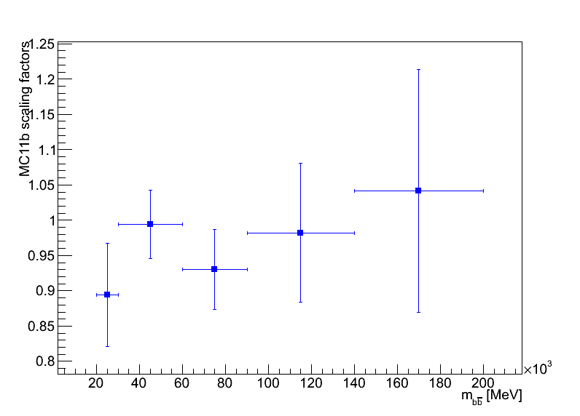
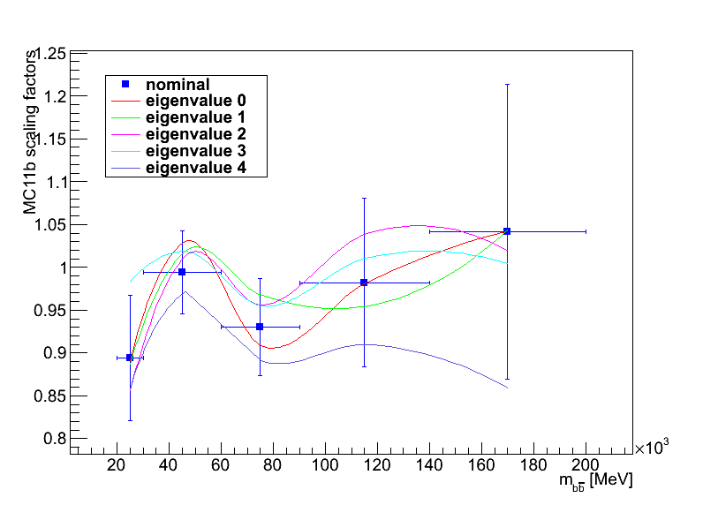
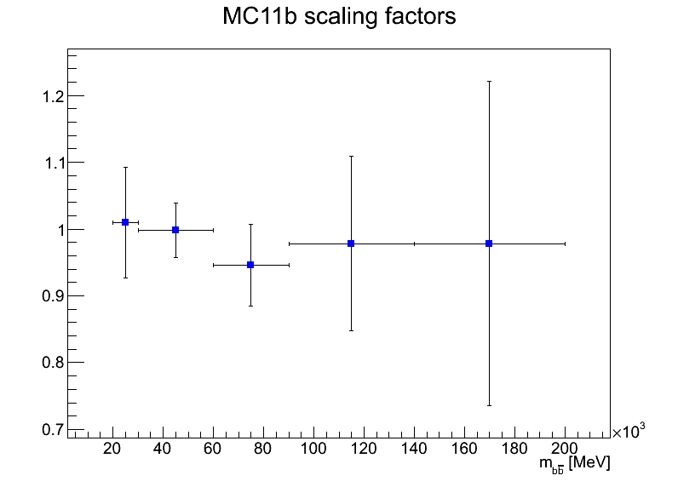
New b-tagging scale factors
MV1 factors
Fresh from the H.F. group:
Preliminary!
pTrel method only for now
May still get updated factors in early February
We moved to MV1
Larger pT dependence now
What do we do with our recipe to apply SFs and estimate uncertainties?
pT [MeV]
MC11a scaling factors
pT [MeV]

Slide 3
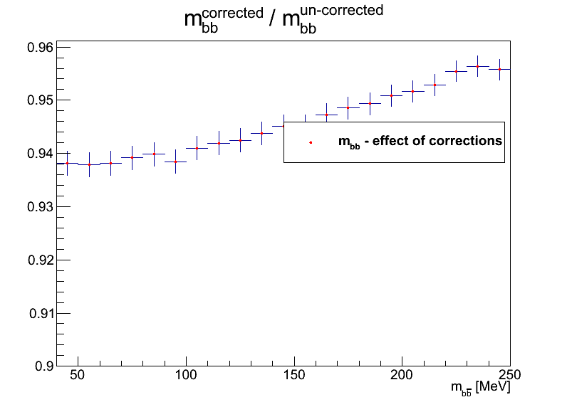
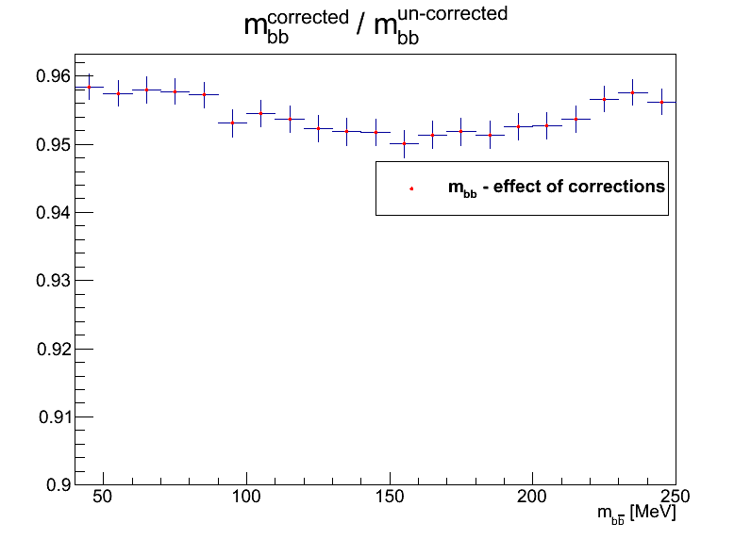
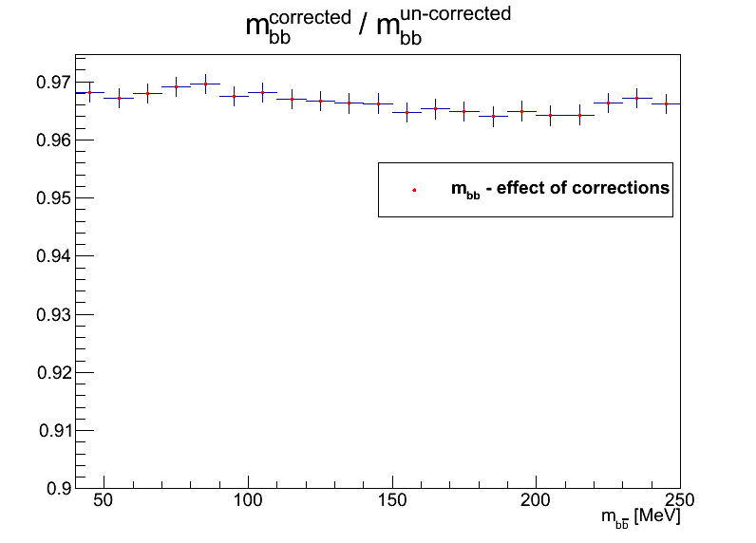
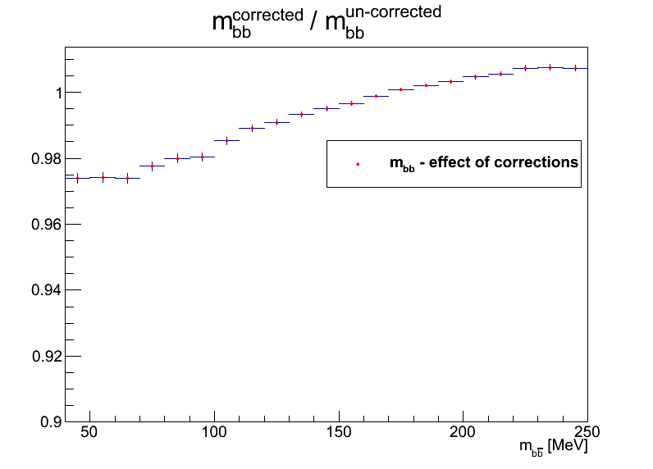
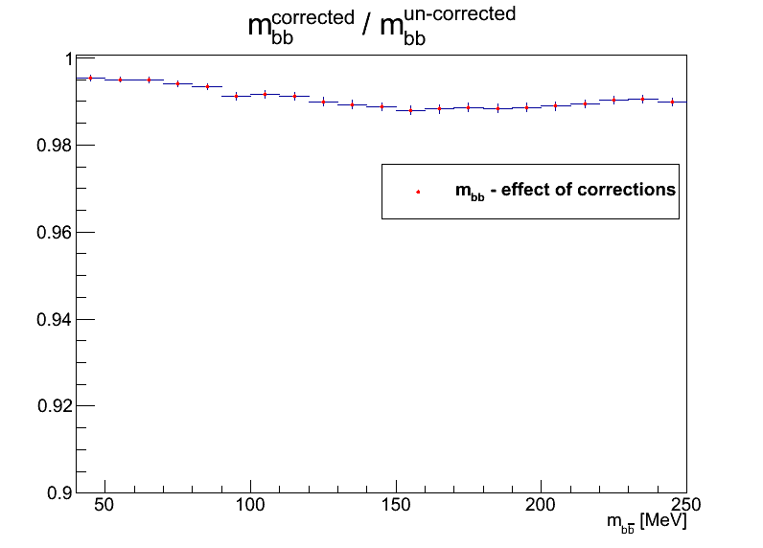
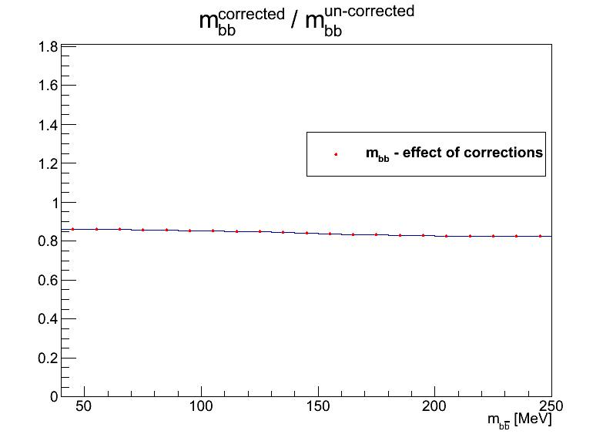
Effect of new b-tagging scale factors
Nominal
Variation eigenvalue 0
Variation eigenvalue 1
Variation eigenvalue 2
Variation eigenvalue 3
Variation eigenvalue 4

Slide 4
Backup

Slide 5
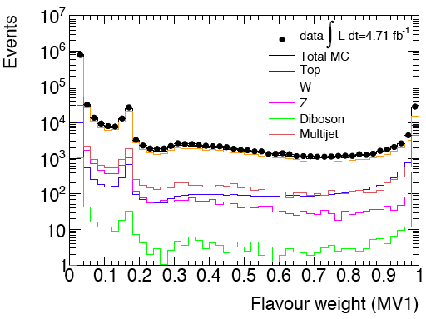
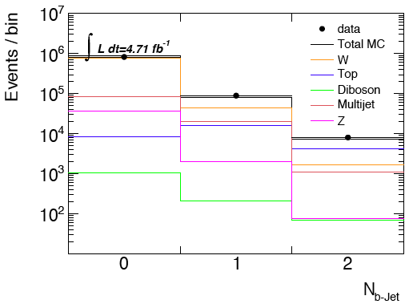
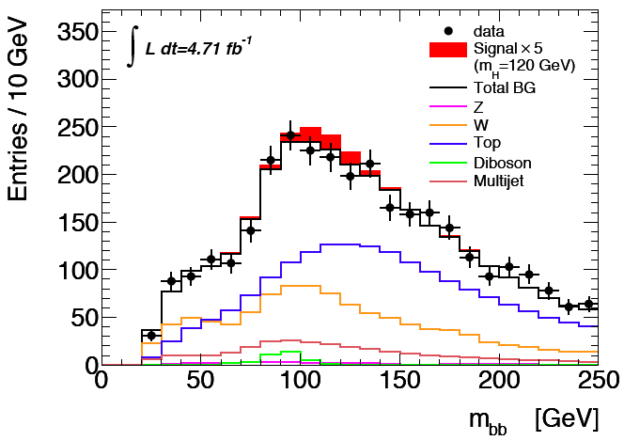
Current status
Expect exclusion of around 3.5-4 x SM for m(H)=120GeV
ZH/WH analyses just moved to MV1 and all looks ok so far
But lots still to do before Moriond…

Slide 6
Effect of b-tagging Scale Factors on M_{bb} distribution
B-tagging scale factors enter the analysis as a weight for each b-jet, and depends on jet p_{T}
This introduces a distortion in the jet p_{T} distribution
…which potentially introduces a distortion on the shape of the invariant mass
May be important since we are looking for a small excess in the form of a wide peak in m(bb)
We propose to average scaling factors propagate SF uncertainties into systematic uncertainties
The MC11b scaling factors at present show little evidence of a p_{T} dependence
But such a dependence would clearly be possible

Slide 7
Giacinto P

Slide 8
Giacinto P

Slide 9
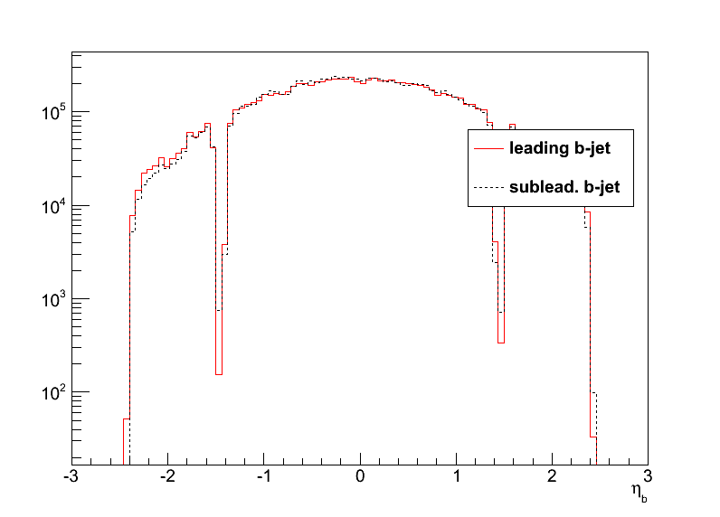
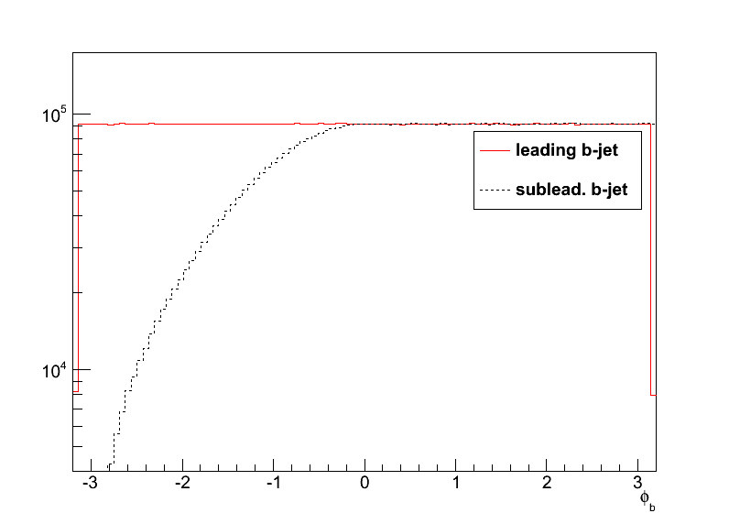
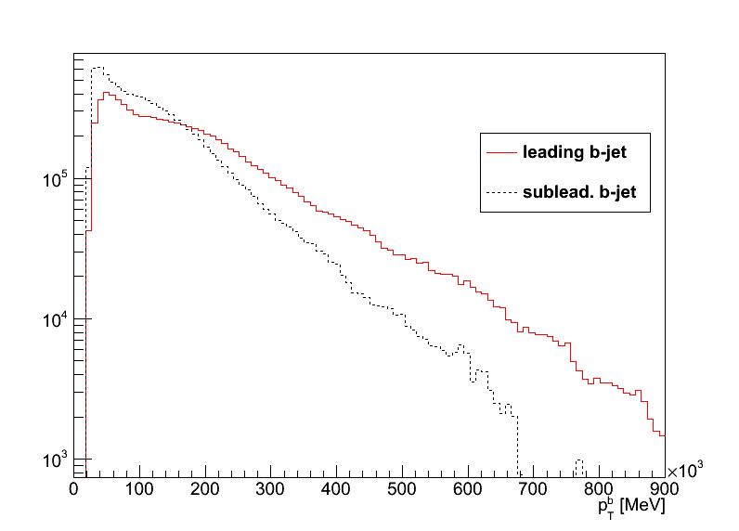
Toy Monte Carlo study of mass distortion
Toy MC to study the effect of b-tag scale factors
Caveat: first study done with di-photon MC kinematics – a look at bb background later
Sample p_{T} and η of leading and subleading b-jets
Generate flat φ_{lead b-jet} and flat mass distribution
Calculate φ_{sublead b-jet} to be consistent with generated mass (and reject unphysical solutions

Slide 10
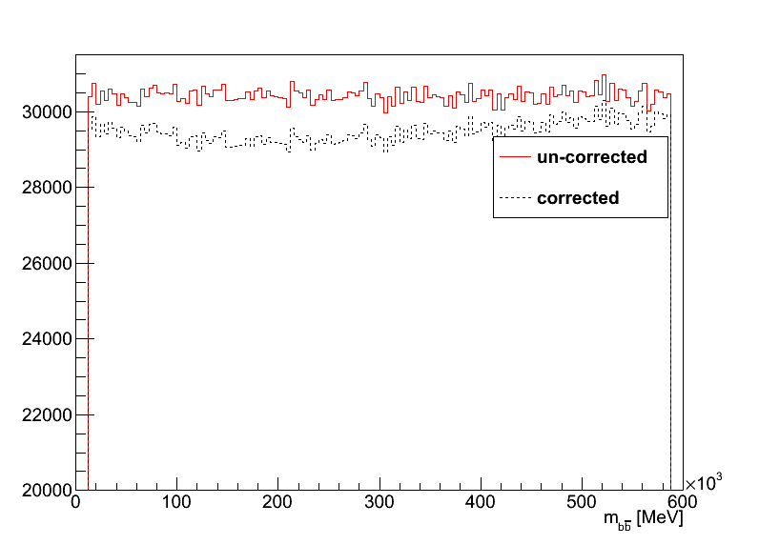
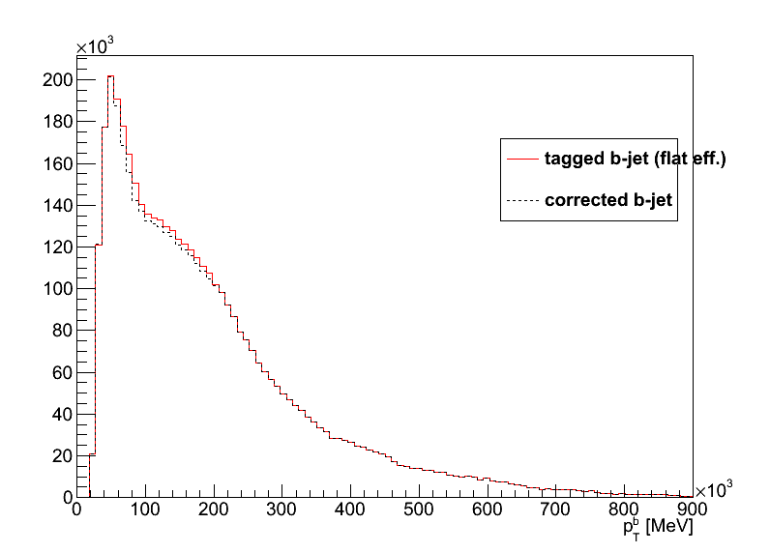
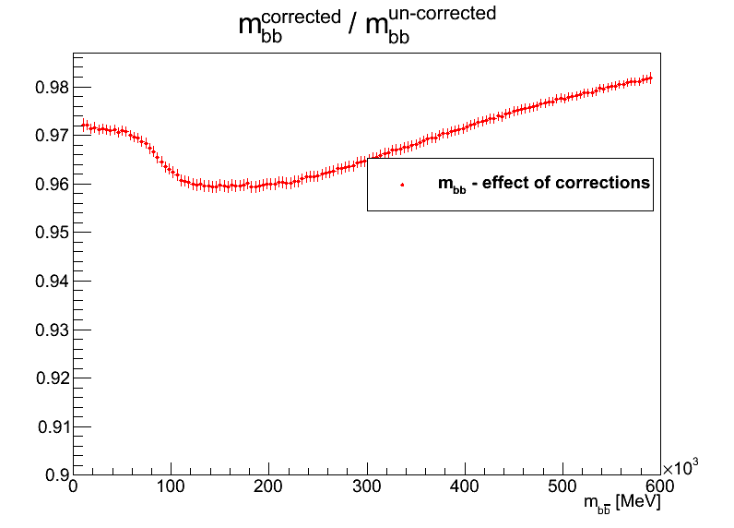
Effect of MC11b scaling factors
The reweighting causes a distortion in the flat invariant mass distribution (plus constant term)
The distortion is small, but then so is our signal compared to the background
May be more serious if width comparable to m_{bb} resolution, as in our case (σ_{m(bb)}≈20GeV)

Slide 11
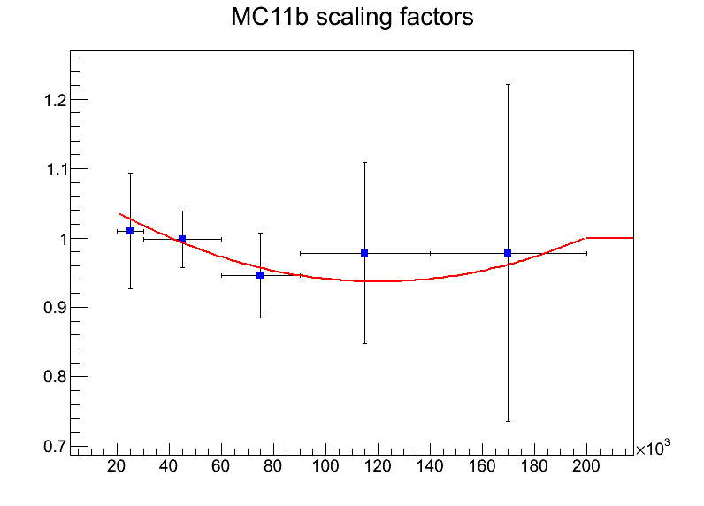
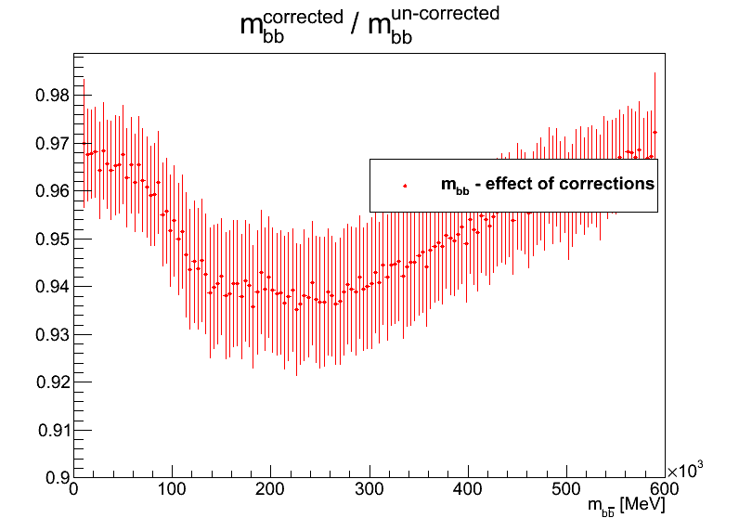
Binning effect?
To see whether this is an effect of the binning, fitted scaling factors (SF) with a parabola (and W_{b}=1 for p_{T}^{b}>200GeV)
Still get similar distortion => not (only) binning effect

Slide 12
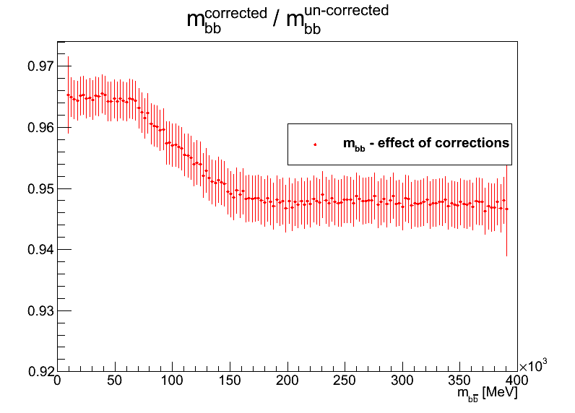
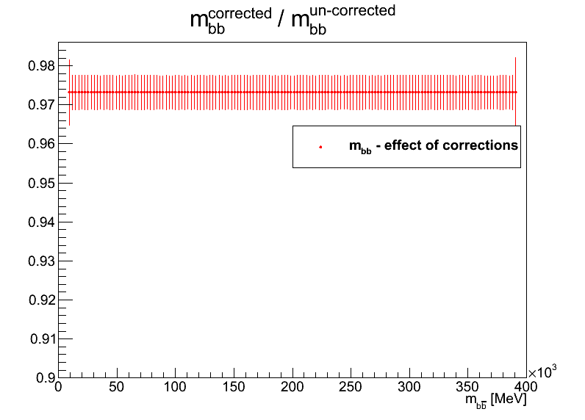
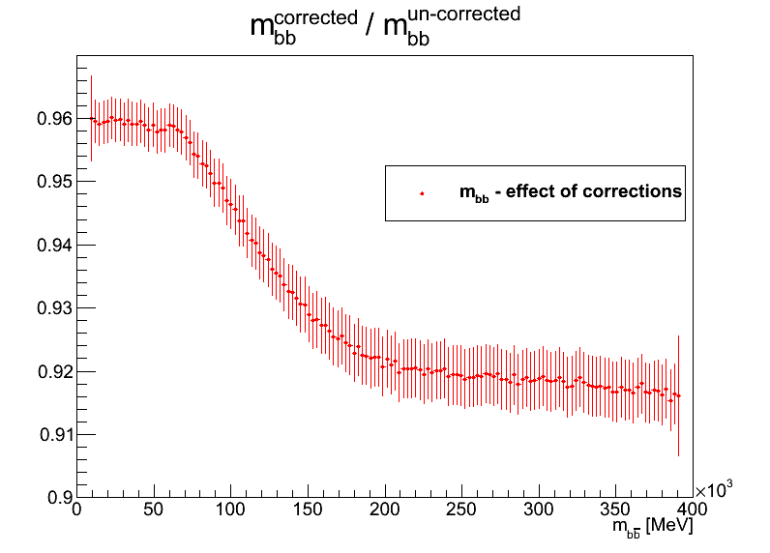
Results using background kinematics
Basically same conclusion:
MC11b scaling factors distort mass distribution (top right)
Even if a parametrization is used (bottom right)
Our averaging procedure removes shape distortion (bottom left) – note zero distortion in this case only due to jet pT cutoff at 200 GeV!

Slide 13
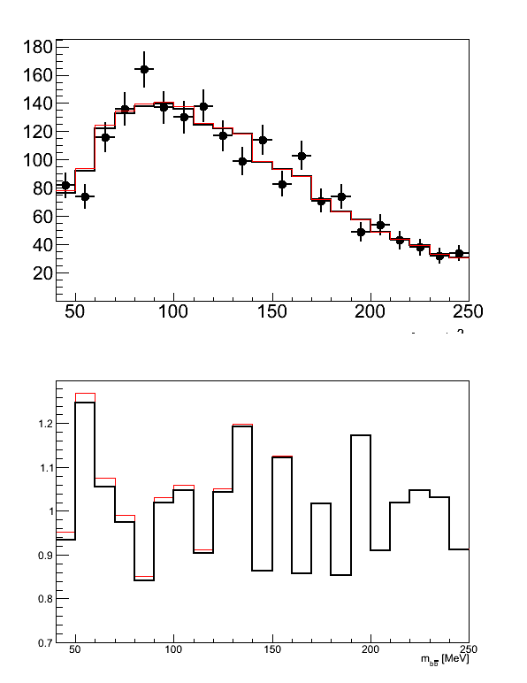
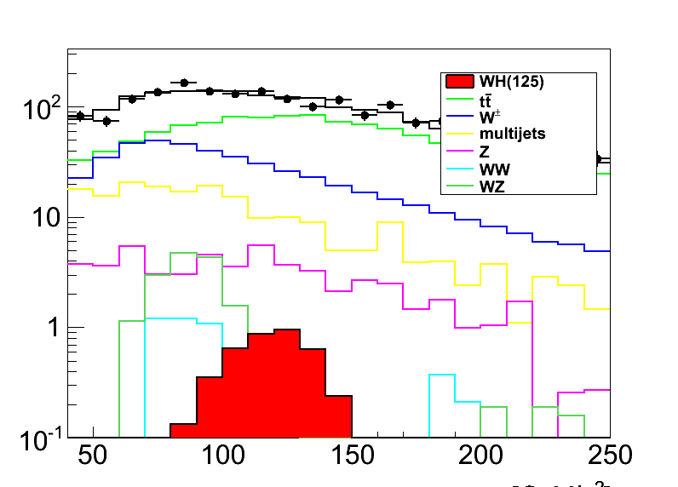
Effect on final distribution
Well… the effect is small, but is there
Tried applying distortion on 1fb⁻¹ mass distribution

Slide 14
Conclusions
These are interesting times for Higgs and H->bb!
We depend critically on the b-tagging performance (BIG THANKS everyone!!!)
Looked at distorting effects from p_{T} dependence of the b-tagging scale factors
A method for removing the mass distortion in JFC scale factors exists and works
May need to think again depending on what you find for MV1

