Slide 1
First ed. board for CERN Council note
Ed.board meeting on Friday: https://indico.cern.ch/conferenceDisplay.py?confId=163296
Analysis is update of analysis shown at EPS: ZH->llbb and WH->lnubb (l=e/μ; τ also in MC)
A few changes to keep up with reconstruction recommendations etc:
Updated trigger - but still single-lepton triggers for WH and single- OR double-lepton triggers for ZH
Updated lepton quality cuts (e.g. medium++ electrons instead of tight)
(not yet done) move to METRefFinal instead of METLocHadTopo (+ analysis muon in muon channel)
A few changes in analysis to improve background rejection (mostly top):
Tighter lepton and jet veto
Angular cuts between reconstructed Z->ll and H->bb in ZH channel
Separate categories defined by bins in p_{T}(W) and p_{T}(Z) for WH and ZH resp.
Not yet done:
Run on all 2011 data (missed part of period M and some other data files) & on MC11b datasets
Move to METRefFinal done in analysis software but unchecked
Apply recommended electron fudge factors (made available on day of ed.board)
Treatment of inefficiency due to bad muon trigger region in period L (μ trigger scale factors now exist)
Points of concern/to follow up
Availability of MC11b datasets
Vertex multiplicity/MET/pile-up due to pythia 8 minbias events in mc11 (ongoing)
Data/MC agreement in 0-jet bin of WH analysis (note analysis cut on Njet>2)
b-tagging scale factors – p_{T}-dependence may sculpt signal, especially due to bin edges (ongoing)
Jet/MET systematics – recommendations?

Slide 2
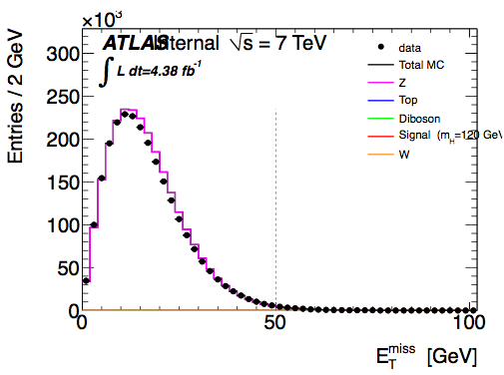
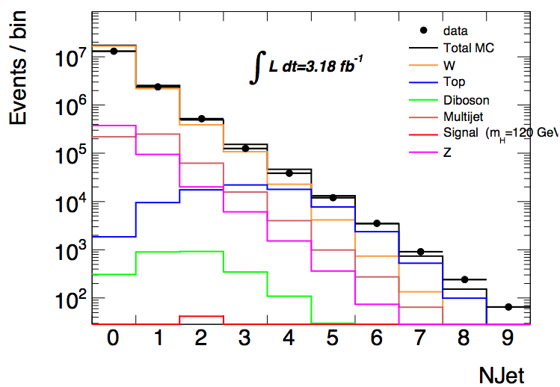
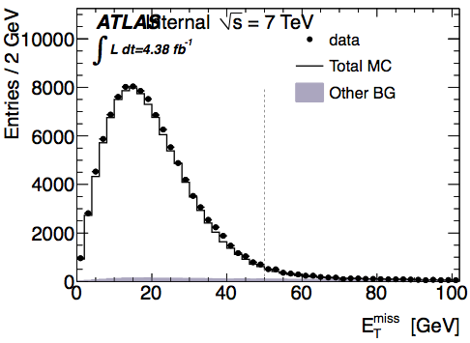
MC11 vs release 17 data
First look at E_{T}^{miss} in release 17 – MC11a
In ZH analysis (fake E_{T}^{miss}) effect only visible before cut on N_{jets} ≥ 2 – p_{T}^{jet} > 25 GeV
Seems to confirm soft activity as source of mismatch
Means we’re dominated by jet energy deposition and not sensitive to soft activity
Suggests use of cut on MET significance (E_{T}^{miss}/√ΣE_{T}) to avoid problem
Disagreement (≈x2) in WH for Njets = 0
But no vertex reweighting applied yet etc etc
Not there in ZH
Z ➔ ll
No Njets cut
Z ➔ ll
Njets ≥ 2

Slide 3
HSG5 preparations for Moriond
Inclusive analyses:
WH->lνbb:
Liverpool/Birmingham have mature analysis – involved in Council analysis
LMU and Bonn ramping up analysis – Bonn looking into BDT for enhanced significance
ZH->ννbb:
Ac.Sinica, Liverpool/Birmingham, IFAE last Friday
Need to keep track of MC for Z->vv+bb/+jets, ZZ, WZ samples
Will divide into 3 MET bins [120GeV~160GeV], [160GeV~200GeV], [200GeV~]
ZH->llbb: Liverpool/Birmingham have mature analysis
ttH: hoping to rally troops at Glasgow, but not clear what will happen
Boost/Jet substructure analyses:
Edinburgh and UCL - UCL & Argonne involved in Z->bb reconstruction
So far only WH->lνbb, but possible interest in ZH->llbb from Edinburgh
CPPM ramping up on ZH->ννbb
Other:
NN energy correction tool for b-jet energy scale (Lei Zhang)
Looking into cutting on d0 significance instead of d0 (Philipp Fleischmann)
Truth-level study of di-jet mass (Maaike Limper)
MC generator studies of WH and ZH (Michiel Sanders)
Atlfast II validation for Jx_muFIXED samples needed by b-tagging group

