Slide 1
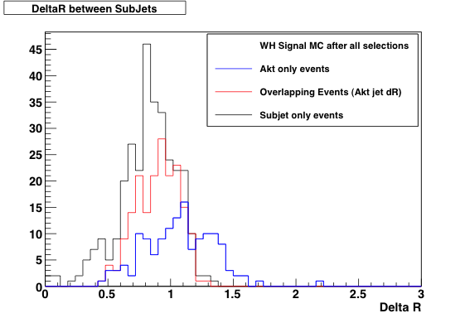
To do list for paper
Time scale: end of March/beginning of April (Higgs approval 29 Mar)
b-tagging scale factors: got final b-tagging scale factors yesterday
There will be a new update in next few days but only for c-tag SFs for JetFitterComb - doesn’t affect us
METUtility: will move to new version for final analysis run
Jet pileup correction: to be applied for final run – finally not much improvement (if any) but already in the code
Di-b-jet mass scale: will apply 5% correction to m(b,b)
Top normalization scale factors:
  Changing to new method to improve consistency with W+jets and with ZH->lvbb analysis
ΔR_{jj} study: look again at low ΔR_{jj} region to answer EB questions
Limits:
  Cross checks ongoing, but looks like asymptotics not good enough – differences between Lianliang and Silje because of Asimov set determined at different values of mu (?!)
  Giacinto trying different approach but no agreement
Smoothing of backgrounds:
  Previously done in llbb/lvbb but not on vvbb – need input from stats forum!
Theory uncertainties should be revisited slightly: to do
Boosted H->bb – lots of interest from elsewhere!
  Hope will converge in Summer
  Not many people…
ttH activity ramping up
  Similar to vector-boson like quarks but different enough to make it a Higgs analysis
  Could have results for summer maybe
Z->bb having difficulties:
  Bug found in g->bb samples – being re-generated
  Re-produced AFII g->bb – bad description of data
Possible Technicolor interpretation of H->bb
  Thinking about this

