Slide 1
H->bb Plans
Higgs Subconveners weekly meeting, 17 October 2011

Slide 2
Summary of Plans
For CERN Council meeting:
Update results on WH->lνbb and ZH->llbb with optimized analyses
Produce results on ZH->ννbb
In parallel:
VH boosted channels: WH->lνbb, ZH->llbb, and ZH->ννbb
Aim to produce results for Moriond 2012
Related to this: analyses of boosted Z->bb and WZ/ZZ->lljj/llbb
Other channels – won’t go into these today:
Work on VBF H->bb – maybe results for Moriond
Gluon-fusion H->bb
Boosted Higgs in ttH
Inclusive ttH analysis
Production of γbb
Publication(s?):
Plan is to have a paper on WH->lνbb, ZH->llbb and ZH->ννbb
Draft should be ready to be turned into CONF note for CERN council meeting
Better results with final rel.17 performance for Moriond
Add boosted analyses for Moriond

Slide 3
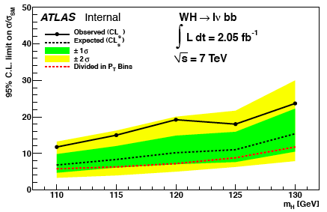
WH->lνbb and ZH->llbb
EPS analyses updated in rel.16 for 2fb⁻¹:
Much improved top rejection in WH analysis:
Tighten lepton veto – as in HSG2: pT > 7 GeV and |η|< 4.5
Reduced tt by 50%, for signal efficiency of 92%.
Use JetFitterNNComb flavour tag (70% eff. w > 0.35)
Tighten extra jet veto: p_{T} > 15 GeV
Gives 70%(40%) signal(background) efficiency
Separated into categories of p_{T}^{W} and p_{T}^{Z}:
p_{T}^{W} < 100GeV; 100 < p_{T}^{W} < 200 GeV; p_{T}^{W} > 200 GeV
p_{T}^{Z} < 50GeV; 50 < p_{T}^{Z} < 100 GeV; p_{T}^{Z} > 100 GeV
Latest results with rel.16 are very nice:
For m_{H}=115GeV and 2fb⁻¹:
WH: 6.3 x SM with p_{T}^{W} bins / 8.4 x SM without (all syst.)
ZH: 8.3 x SM with p_{T}^{W} bins / 11.4 x SM without (no syst)
Main groups behind analysis are Liverpool and Birmingham (Andy Mehta and Paul Thompson)
Jonas Will (LMU) starts to have confirmation analysis in shape
Jonas also investigated ATLAS-CMS differences, but not yet clear

Slide 4
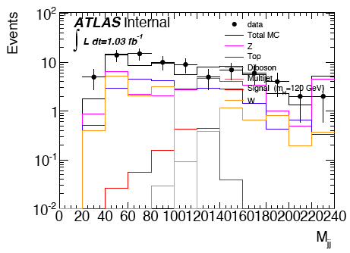
Plans for ZH->ννbb
Perhaps CMS’s best channel
We should be able to do just as well
Two groups contributing so far and more interested:
Academia Sinica: Jike Wang, David Jamin, Song-Ming Wang
Liverpool: Matthew Jackson (Andy Mehta’s student)
Interest expressed by CPPM Marseille and IFAE
Should soon have a brainstorming session to optimally join various analyses – letting things evolve for the moment
No huge uncertainties in analysis
Seems feasible to produce results for December CERN Council meeting
Should make sure we have the necessary MC samples
Ongoing work:
Optimizing analysis cuts
Looking for differences wrt CMS
Analyses start to look ok…
Angular cuts to reduce QCD:
Δφ(Z,H) > 2.9
Δφ(MET,ClosestJet) > 1.5

Slide 5
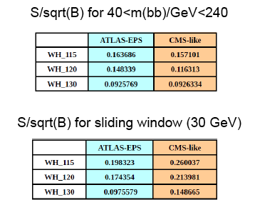
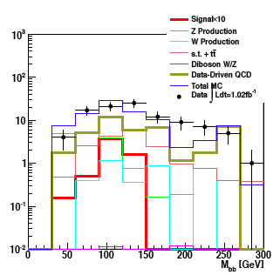
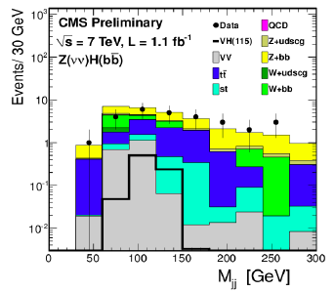
ATLAS-CMS comparisons
Jonas and Jike have emulated CMS’s cuts in WH->lνbb and ZH->ννbb
Differences not yet clear – need to insist on this
Similar significances in WH ->lνbb when applying mass window cut
But very different event numbers – by factor 10-100 depending on channel
CMS seems to get a lower QCD background than us in ZH->ννbb
WH->lνbb

Slide 6
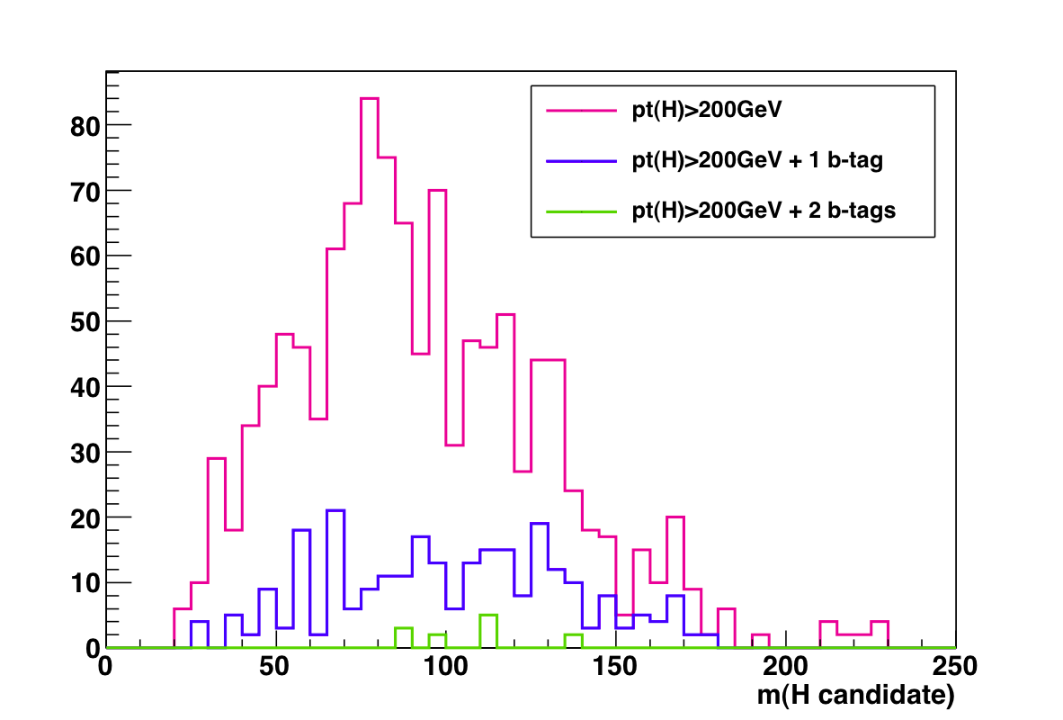
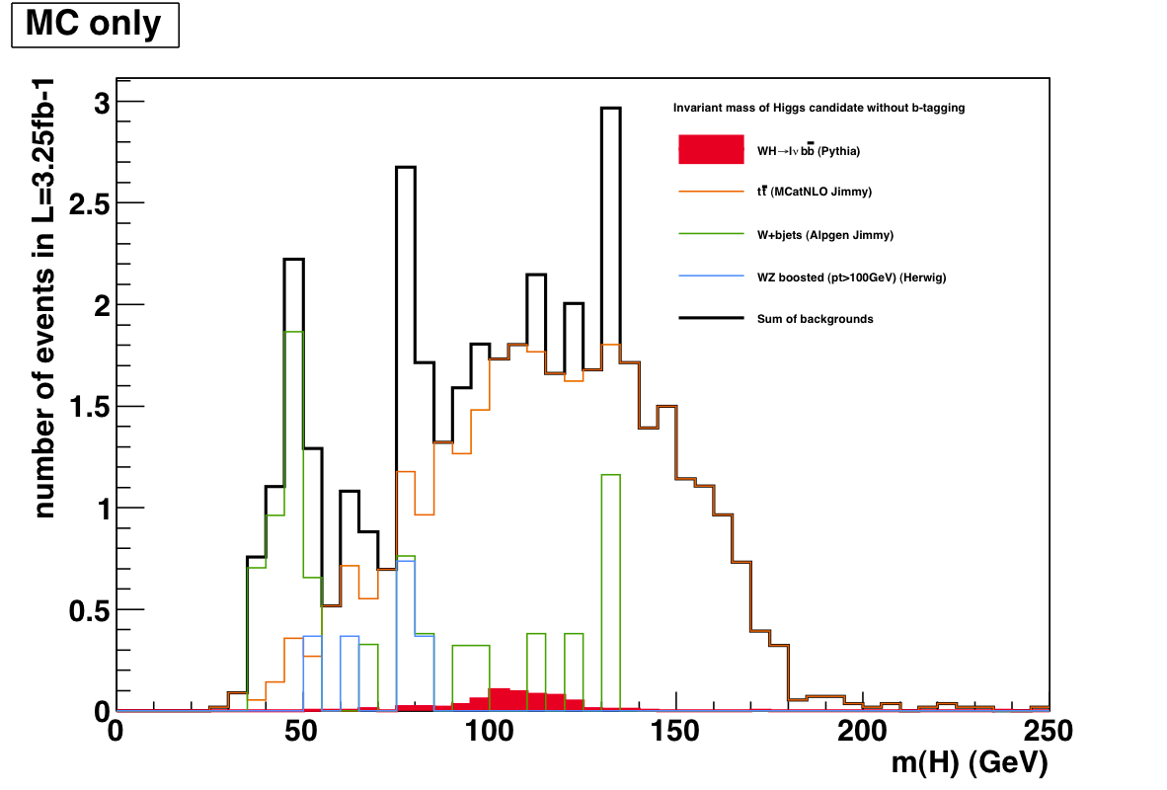
Boosted VH
These channels raise more questions…
New technique needs to be well understood and proven
But should bring us very good sensitivity in the medium term
My perception at present is that we should not aim for earlier than Moriond for this channel
But healthy number of people involved and no reason to not aim for Moriond publication
Main groups interested are UCL and Edinburgh – starting to work more closely together
UCL concentrating on SM analyses:
Ben Cooper – boosted Z->jj/bb
Ilektra Christidi – b-tagging in boosted bb
Gavin Hesketh – boosted WH->lljj/llbb
Adam Davison – jet substructure performance
Edinburgh contributing in DPD development and VH analysis:
Robert Harrington – D3PD and skimming
Wahid Bhimji, Chiara Debenedetti, Brendan O’Brien – VH analysis
E1 – H4: 150pb⁻¹

Slide 7
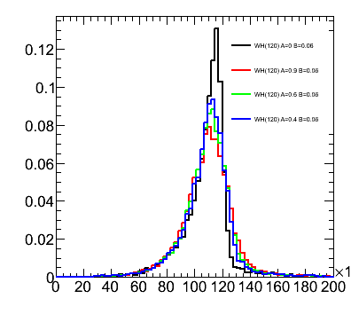
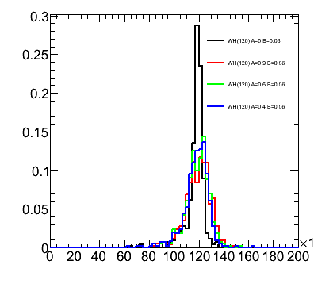
Performance studies
Started interacting with jet group in SLAC hadronic workshop
Main systematics are jet and b-tagging related
Current tasks listed in Wiki
More questions than answers at the moment, but pursuing several threads:
Jet resolution (Giacinto Piacquadio, IFAE):
We seem to be affected by out-of-cone losses
Will try different jets
B-tagging:
Find how much improvement is needed to reduce syst
Improve MC statistics term of b-tagging uncertainty with AFII (Eric Ouellette (unconfirmed), Ricardo Goncalo) – requesting some AFII validation samples
Differences between hadronic and semileptonic b-jets
And will continue to interact with CP groups as much as possible to get good performance

Slide 8
Backup

Slide 9
HSG5 D3PD Status
New stream for gamma+bb:
Selection modified to loosen cuts for gamma+bb
Z->bb:
Some changes to HighPtTracks mplemented by Ilektra:
Lowered pT cut, stored more track info
Not yet validated
Adding b-tagging info and more changes to D3PD, will privately produce small validation samples for tests
WH->lnubb: Validated by Edinburgh
WH stream ready to go to DPD train!
Means getting your D3PDs for new data with no effort…
ZH analyses need to check Skim selections before adding this to DPD train!
Output Skim | #events | Size
HSG5WH | 5.5 M | 340 GB
HSG5ZHLL | 5.5 M | 340 GB
HSG5ZHMET | 4.8 M | 240 GB
HSG5ZBB | 8 M | 480 GB
Total | 24 M | 1.4 TB
Input Stream | Period | #events | Size
JetTauEtmiss | E | 8,588,376 | 1.27 TB
Muons | E | 6,182,165 | 0.89 TB
Egamma | E | 8,157,991 | 1.01 TB
JetTauEtmiss | H | 37,748,640 | 5.51 TB
Muons | H | 28,367,693 | 3.99 TB
Egamma | H | 29,506,835 | 3.56 TB
Total | E+H | 118,551,700 | 16.2 TB

Slide 10
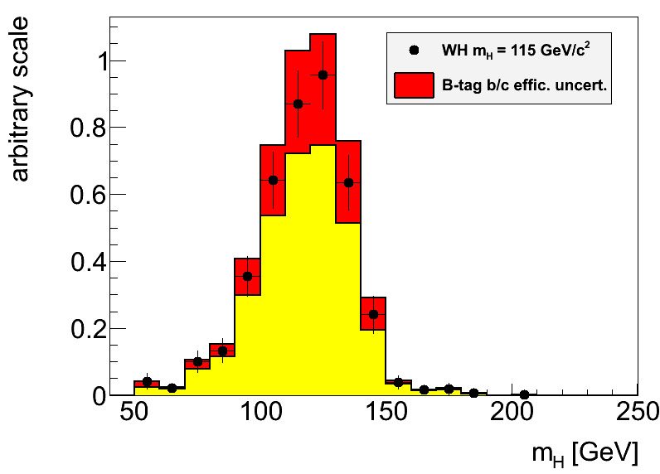
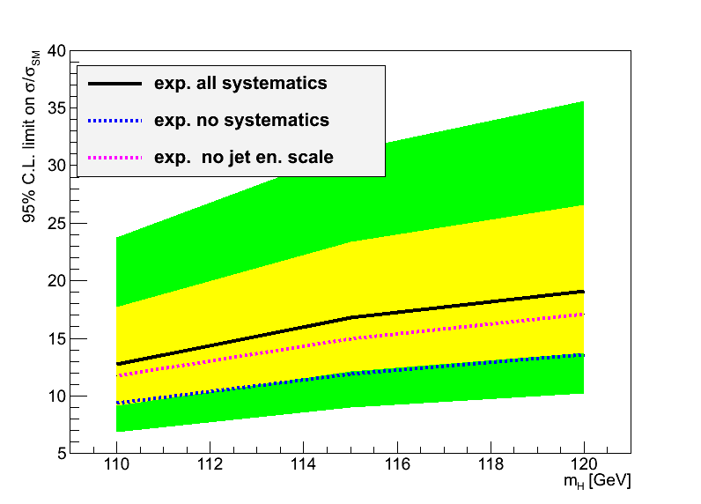
Hgbb – Reconstruction Performance
Main limitations from jet reconstruction and b-tagging uncertainties
Try to improve b-tagging efficiency/fake rate uncertainty:
Dominant uncertainty on signal yield in EPS analyses
Try to optimize di-jet mass resolution:
A sharper peak improves analysis sensitivity (10% width reduction ≈4% limit improvement)
Try to reduce jet energy scale uncertainty:
Large effect in limit through changes in m_{bb} shape

Slide 11
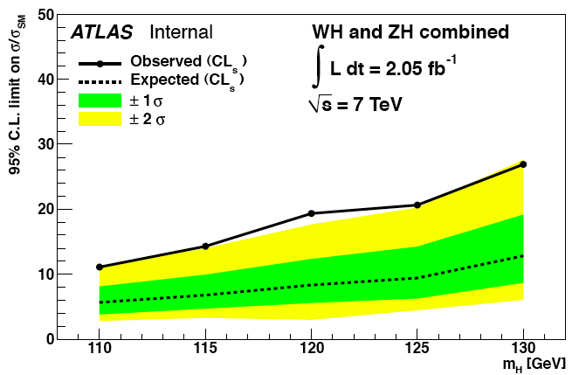
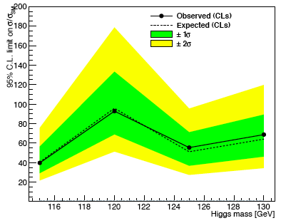
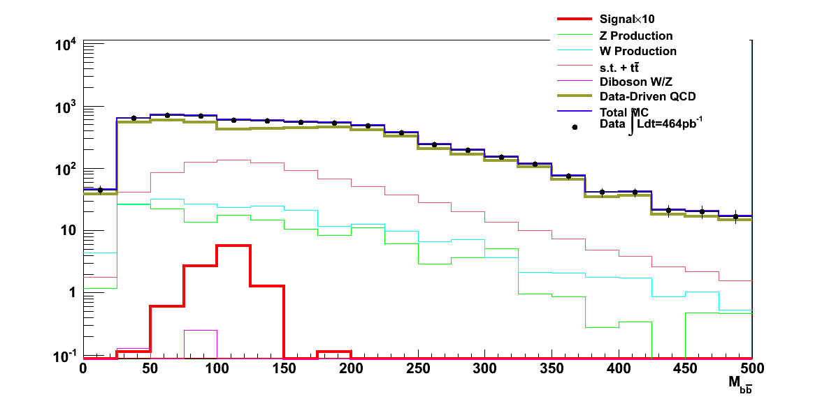
Hgbb – Recent Highlights
Update and optimization of WHglνbb and ZHgllbb analyses with 2fb⁻¹ (r.16)
Much reduced top background in WH
First results appearing from other analyses: ZHgννbb, boosted Z, VBF,…
New ideas being tried: e.g. exploiting kinematics of transition region between low and high Higgs p_{T}
Optimized EPS analyses
Rough first estimate!
VBF Hgbb
0.26 fb⁻¹
ZHgννbb
0.46 fb⁻¹

Slide 12
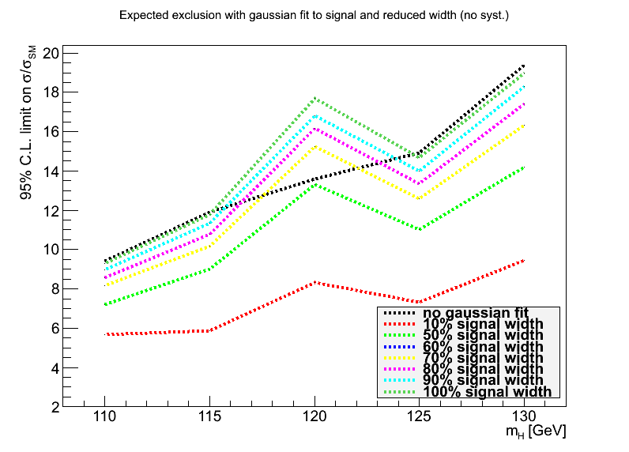
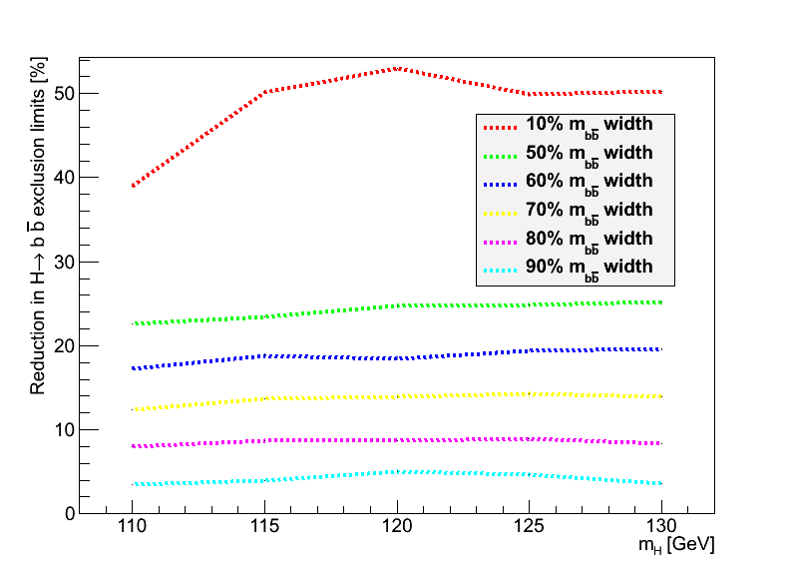
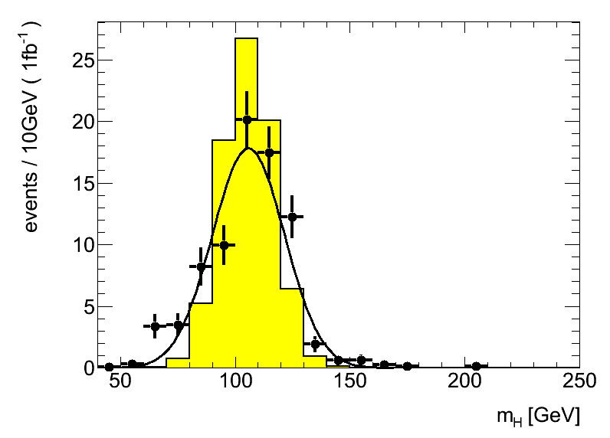
Backup
Replaced signal with fitted Gaussian to manipulate signal width
Estimated improvement in limits (1fb⁻¹) with reduced signal width
Reduction to 80% gives 8% improved limits (magenta line, bottom left)

Slide 13
MC requests
Inclusive and boosted H->bb samples for MC11b:
Herwig++ in Powheg
Mass points: M_{H} = 110, 115, 120, 125, 130, 135, 140, 145, 150 GeV
WH->lνbb, ZH->llbb, ZH->ννbb
Both boosted and inclusive for each mass
Approved for production – still in waiting list for MC11b production (delays in MC11a)
Other samples:
Wbb, Zbb
ZH, WZ, WW -> lljj and llbb final states
Gluon-fusion H->bb
See Junichi’s page: https://twiki.cern.ch/twiki/bin/view/AtlasProtected/HSG5Higgs2bbFinalState#H_bb_MC_samples

Slide 14
Priority-1 WH signal samples for MC11b
New signal samples:
128061 WH, W->lnu, H->bb (l=e,mu,tau) Herwig++/PowHeg 110 30k
128062 WH, W->lnu, H->bb (l=e,mu,tau) Herwig++/PowHeg 115 30k
128063 WH, W->lnu, H->bb (l=e,mu,tau) Herwig++/PowHeg 120 30k
128064 WH, W->lnu, H->bb (l=e,mu,tau) Herwig++/PowHeg 125 30k
128065 WH, W->lnu, H->bb (l=e,mu,tau) Herwig++/PowHeg 130 30k
128066 WH, W->lnu, H->bb (l=e,mu,tau) Herwig++/PowHeg 135 30k
128067 WH, W->lnu, H->bb (l=e,mu,tau) Herwig++/PowHeg 140 30k
128068 WH, W->lnu, H->bb (l=e,mu,tau) Herwig++/PowHeg 145 30k
128069 WH, W->lnu, H->bb (l=e,mu,tau) Herwig++/PowHeg 150 30k
WH->lnubb with 1-lepton filter (e/mu, pT>15GeV) – Already in MC11a (mc11_001)
116590 WH, W->lnu, H->bb (l=e,mu,tau) with 1lep(e/mu 15GeV) Pythia 115 100k
116591 WH, W->lnu, H->bb (l=e,mu,tau) with 1lep(e/mu 15GeV) Pythia 120 100k
116592 WH, W->lnu, H->bb (l=e,mu,tau) with 1lep(e/mu 15GeV) Pythia 130 100k
116127 WH, W->inc, H->bb Herwig 120 30k - inclusive W decay

Slide 15
Priority 2 – Boosted WH samples
New samples requested for MC11b:
128030 WH, W->lnu, H->bb (l=e,mu,tau) pT(W)>100GeV with 1lep EF Pythia8 115 10k
128031 WH, W->lnu, H->bb (l=e,mu,tau) pT(W)>100GeV Herwig++/PowHeg 110 10k
128032 WH, W->lnu, H->bb (l=e,mu,tau) pT(W)>100GeV Herwig++/PowHeg 115 10k
128033 WH, W->lnu, H->bb (l=e,mu,tau) pT(W)>100GeV Herwig++/PowHeg 120 10k
128034 WH, W->lnu, H->bb (l=e,mu,tau) pT(W)>100GeV Herwig++/PowHeg 125 10k
128035 WH, W->lnu, H->bb (l=e,mu,tau) pT(W)>100GeV Herwig++/PowHeg 130 10k
128036 WH, W->lnu, H->bb (l=e,mu,tau) pT(W)>100GeV Herwig++/PowHeg 135 10k
128037 WH, W->lnu, H->bb (l=e,mu,tau) pT(W)>100GeV Herwig++/PowHeg 140 10k
128038 WH, W->lnu, H->bb (l=e,mu,tau) pT(W)>100GeV Herwig++/PowHeg 145 10k
128039 WH, W->lnu, H->bb (l=e,mu,tau) pT(W)>100GeV Herwig++/PowHeg 150 10k
Existing sample for cross check:
109140 WH, W->incl, H->bb, Pt(H/W)>150/100GeV, 1e/mu filter Herwig 120 20k

Slide 16
Priority 1 – ZH->llbb signal samples
New signal samples:
128071 ZH, Z->ll, H->bb (l=e,mu,tau) Herwig++/PowHeg 110 30k
128072 ZH, Z->ll, H->bb (l=e,mu,tau) Herwig++/PowHeg 115 30k
128073 ZH, Z->ll, H->bb (l=e,mu,tau) Herwig++/PowHeg 120 30k
128074 ZH, Z->ll, H->bb (l=e,mu,tau) Herwig++/PowHeg 125 30k
128075 ZH, Z->ll, H->bb (l=e,mu,tau) Herwig++/PowHeg 130 30k
128076 ZH, Z->ll, H->bb (l=e,mu,tau) Herwig++/PowHeg 135 30k
128077 ZH, Z->ll, H->bb (l=e,mu,tau) Herwig++/PowHeg 140 30k
128078 ZH, Z->ll, H->bb (l=e,mu,tau) Herwig++/PowHeg 145 30k
128079 ZH, Z->ll, H->bb (l=e,mu,tau) Herwig++/PowHeg 150 30k
Existing samples in MC10:
116312 ZH, Z->ll, H->bb (l=e,mu,tau) Pythia 115 30k
116313 ZH, Z->ll, H->bb (l=e,mu,tau) Pythia 125 30k
116314 ZH, Z->ll, H->bb (l=e,mu,tau) Pythia 130 30k
116128 ZH, Z->inclusive, H->bb Herwig 120 30k

Slide 17
Priority 2 – Boosted ZH->llbb samples
New samples requested for MC11b:
128040 ZH, Z->ll, H->bb (l=e,mu,tau) pT(Z)>100GeV with 1lep EF Pythia8 115 10k
128041 ZH, Z->ll, H->bb (l=e,mu,tau) pT(Z)>100GeV Herwig++/PowHeg 110 10k
128042 ZH, Z->ll, H->bb (l=e,mu,tau) pT(Z)>100GeV Herwig++/PowHeg 115 10k
128043 ZH, Z->ll, H->bb (l=e,mu,tau) pT(Z)>100GeV Herwig++/PowHeg 120 10k
128044 ZH, Z->ll, H->bb (l=e,mu,tau) pT(Z)>100GeV Herwig++/PowHeg 125 10k
128045 ZH, Z->ll, H->bb (l=e,mu,tau) pT(Z)>100GeV Herwig++/PowHeg 130 10k
128046 ZH, Z->ll, H->bb (l=e,mu,tau) pT(Z)>100GeV Herwig++/PowHeg 135 10k
128047 ZH, Z->ll, H->bb (l=e,mu,tau) pT(Z)>100GeV Herwig++/PowHeg 140 10k
128048 ZH, Z->ll, H->bb (l=e,mu,tau) pT(Z)>100GeV Herwig++/PowHeg 145 10k
128049 ZH, Z->ll, H->bb (l=e,mu,tau) pT(Z)>100GeV Herwig++/PowHeg 150 10k

Slide 18
Priority 1 – ZH->ννbb signal samples
New signal samples:
128081 ZH, Z->nunu, H->bb Herwig++/PowHeg 110 10k
128082 ZH, Z->nunu, H->bb Herwig++/PowHeg 115 10k
128083 ZH, Z->nunu, H->bb Herwig++/PowHeg 120 10k
128084 ZH, Z->nunu, H->bb Herwig++/PowHeg 125 10k
128085 ZH, Z->nunu, H->bb Herwig++/PowHeg 130 10k
128086 ZH, Z->nunu, H->bb Herwig++/PowHeg 135 10k
128087 ZH, Z->nunu, H->bb Herwig++/PowHeg 140 10k
128088 ZH, Z->nunu, H->bb Herwig++/PowHeg 145 10k
128089 ZH, Z->nunu, H->bb Herwig++/PowHeg 150 10k
Existing samples in MC10:
109351 ZH, Z->nunu, H->bb Pythia 120 30k - Already in MC11a

Slide 19
Priority 2 – Boosted ZH->ννbb samples
New samples requested for MC11b:
128050 ZH, Z->nunu, H->bb pT(Z)>100GeV with 1lep EF Pythia8 115 10k
128051 ZH, Z->nunu, H->bb pT(Z)>100GeV Herwig++/PowHeg 110 10k
128052 ZH, Z->nunu, H->bb pT(Z)>100GeV Herwig++/PowHeg 115 10k
128053 ZH, Z->nunu, H->bb pT(Z)>100GeV Herwig++/PowHeg 120 10k
128054 ZH, Z->nunu, H->bb pT(Z)>100GeV Herwig++/PowHeg 125 10k
128055 ZH, Z->nunu, H->bb pT(Z)>100GeV Herwig++/PowHeg 130 10k
128056 ZH, Z->nunu, H->bb pT(Z)>100GeV Herwig++/PowHeg 135 10k
128057 ZH, Z->nunu, H->bb pT(Z)>100GeV Herwig++/PowHeg 140 10k
128058 ZH, Z->nunu, H->bb pT(Z)>100GeV Herwig++/PowHeg 145 10k
128059 ZH, Z->nunu, H->bb pT(Z)>100GeV Herwig++/PowHeg 150 10k

Slide 20
Priority 2 – VBF samples
Gluon-fusion H->bb sample:
Existing sample:
128380 ggF H->bb Pythia6.4 115GeV 10k
Request: extend this sample to 50k
We expect 65k in 5fb⁻¹, but could do the rest in AFII for example
VBF H->bb: extend this sample to 30k:
116090 VBF H->bb Herwig 120 20k
Already existing samples in MC10:
116306 VBF H->bb Herwig 115 30k
116090 VBF H->bb Herwig 120 20k
116307 VBF H->bb Herwig 125 30k
116308 VBF H->bb Herwig 130 30k
116091 VBF H->bb with mJJ>400GeV Herwig 120 40k

Slide 21
Priority 2 – ttH samples
Existing samples in MC10
128020 ttH -> bl+(e,mu)nbqq bbbar (positive lep) Pythia6.4 110 30k
128021 ttH -> bl+(e,mu)nbqq bbbar (negative lep) Pythia6.4 110 30k
116300 ttH -> bl+(e,mu)nbqq bbbar (positive lep) Pythia6.4 115 30k
116303 ttH -> bl+(e,mu)nbqq bbbar (negative lep) Pythia6.4 115 30k
109840 ttH -> bl+(e,mu)nbqq bbbar (positive lep) Pythia6.4 120 30k
109841 ttH -> bl+(e,mu)nbqq bbbar (negative lep) Pythia6.4 120 30k
116301 ttH -> bl+(e,mu)nbqq bbbar (positive lep) Pythia6.4 125 30k
116304 ttH -> bl+(e,mu)nbqq bbbar (negative lep) Pythia6.4 125 30k
116302 ttH -> bl+(e,mu)nbqq bbbar (positive lep) Pythia6.4 130 30k
116305 ttH -> bl+(e,mu)nbqq bbbar (negative lep) Pythia6.4 130 30k
128030 ttH -> bl+(e,mu)nbqq bbbar (positive lep) Pythia6.4 140 30k
128031 ttH -> bl+(e,mu)nbqq bbbar (negative lep) Pythia6.4 140 30k

Slide 22
Background samples
New:
- ZZ->vvqq - would be good to have 100k generated with e.g. Sherpa - maybe already exists
- WW->lnuqq - xsec is 46pb: would be good to have about 50k-100k with lepton filter - maybe already exists
= top = total~7.5M
105200 ttbar (1-lepton) MC@NLO xsec=144.12pb 15M - would be good to have at least 7.5M (10 x #evt for 5fb-1)
108340 - 108345, 108346 - single top MC@NLO
= ZZ = total=150k
109294 ZZ->2l2q Pythia 0.841 pb 60k - already in MC11a
107108 ZZincllNp0 Alpgen 40k - already in MC11a
107109 ZZincllNp1 Alpgen 20k - already in MC11a
107110 ZZincllNp2 Alpgen 20k - already in MC11a
107111 ZZincllNp3 Alpgen 10k - already in MC11a
= WZ = total=225k
105942 W+Z->qqll MC@NLO 11.147pb*BR 25k - already in MC11a - would be good to extend this to 100k
105972 W-Z->qqll MC@NLO 6.0394pb*BR 100k- already in MC11a
105940 W+Z->lnuqq MC@NLO 11.23 pb*BR 50k - already in MC11a - would be good to extend this to 100k
105970 W-Z->lnuqq MC@NLO 6.085 pb*BR 50k - already in MC11a

Slide 23
= Wbb = total=920k
These have only about 2x #evts for 5fb-1 - would be nice to increase
107280 WbbFullNp0_pt20 Alpgen 48 pb 475k - in production for MC11a
107281 WbbFullNp1_pt20 Alpgen 35 pb 200k - in production for MC11a
107282 WbbFullNp2_pt20 Alpgen 17 pb 175k - in production for MC11a
107283 WbbFullNp3_pt20 Alpgen 7.6pb 70k - in production for MC11a
AtlfastII could be used to extend these samples to:
MC11.107280.AlpgenJimmyWbbFullNp0_pt20.py 3,500,000
MC11.107281.AlpgenJimmyWbbFullNp1_pt20.py 2,500,000
MC11.107282.AlpgenJimmyWbbFullNp2_pt20.py 1,500,000
MC11.107283.AlpgenJimmyWbbFullNp3_pt20.py 500,00
= Wcc = total=650k
117284 WccFullNp0_pt20 Alpgen 128pb 250k - already in MC11a
117285 WccFullNp1_pt20 Alpgen 104pb 200k - already in MC11a
117286 WccFullNp2_pt20 Alpgen 52pb 100k - already in MC11a
117287 WccFullNp3_pt20 Alpgen 20pb 100k - already in MC11a
= Zbb = total=900k
109525 Z->ee+jets+b/c (enhanced) Sherpa 787pb 300k - in production for MC11a
109526 Z->mumu+jets+b/c (enhanced) Sherpa 787pb 300k - in production for MC11a
109527 Z->tautau+jets+b/c (enhanced) Sherpa 787pb 300k - in production for MC11a
= bb = total=9M
108405 bbmu15X PythiaB 4.5M - already in MC11a
108326 bbe15X PythiaB 4.5M - already in MC11a
= cc = total=3M
106059 ccmu15X PythiaB 1.5M - already in MC11a
108327 cce15X PythiaB 1.5M - already in MC11a

Slide 24
Cross sections
Channel | Cross section x BR(H->bb) at 7TeV | #evt in 5fb⁻¹ | Ref.
Gluon fusion H (m_{H}=115GeV) | 18.7pb x 0.7 = 13.09 | 65.4k | LHC Higgs Xsec YR1
VBF (m_{H}=115GeV) | 1312fb x 0.7 = 918fb | 4.6k | LHC Higgs Xsec YR1
WH (m_{H}=115GeV) | 755fb x 0.7 = 528fb | 2.6k | LHC Higgs Xsec YR1
ZH (m_{H}=115GeV) | 411fb x 0.7 = 288fb | 1.4k | LHC Higgs Xsec YR1
ttH (semileptonic decay, m_{H}=115GeV) | 39fb | 195 | Junichi’s page
ttH (m_{H}=115GeV) | 115fb x 0.7 = 80.5fb | 402 | LHC Higgs Xsec YR1
WW | 46pb | 230k | 1109.2576v2 [hep-ex]
WZ | 47.8pb (14TeV) | 239k | CERN-OPEN-2008-020
ZZ | 14.8pb (14TeV) | 74k | CERN-OPEN-2008-020

