Slide 1
Introduction
Ricardo Gonçalo (RHUL)
Higgs Weekly Meeting – 8 March 2012

Slide 2
To do list for paper
b-tagging scale factors:
Will use SFs in 5 bins and do 5 (x2) eigenvector variations to get systematic uncertainties
Will need a couple of days to put new SFs in the right interface code
Will need ≈3 days to run analyses once SFs are available plus a couple of days to test analysis results
METUtility version changed:
Both pileup terms (note used since we use mu rescaling) and soft jet and cell out terms have changed
No impact on schedule – we’ll do this once we have new b-tagging SFs
b-jet energy scale:
llbb/lvbb used Scott’s rescaling of jet p_{T} as in HSG2; vvbb used 1.05 scaling of m(bb)
Will meet with Tancredi tomorrow 11:30am to find out what his objections are
Would be ok with moving to 1.05 rescaling, but not so much with no rescaling, since this would imply moving sidebands down by 5%
The theory uncertainties should be revisited slightly:
We used LO (Pythia) signal MC and assigned a flat 10% theory uncertainty (acceptance modelled at LO)
Apply uncertainty equal to difference between the LO and NLO QCD cross sections
Apply EW NLO corrections as a multiplicative factor to cross section in each bin (no effect on acceptance)
Cross-check size of uncertainties on pT(W/Z) and Njets distributions
Variation of single-top, Wc and Zc backgrounds missing from vvbb analysis (in principle small)
Jike will estimate size of single-top uncertainty in vvbb – neglect if small
Andy will apply the Wc and Zc variations to the output of the vvbb analysis
Update text:
Explain better the methods used in analyses, especially concerning multiple scale factors and fits to data etc
Should we aim for longer paper or to remove much of the information and aim for a shorter paper?
Smoothing of the backgrounds in llbb/lvbb: should be mentioned in support note
Time scale for combination paper??

Slide 3
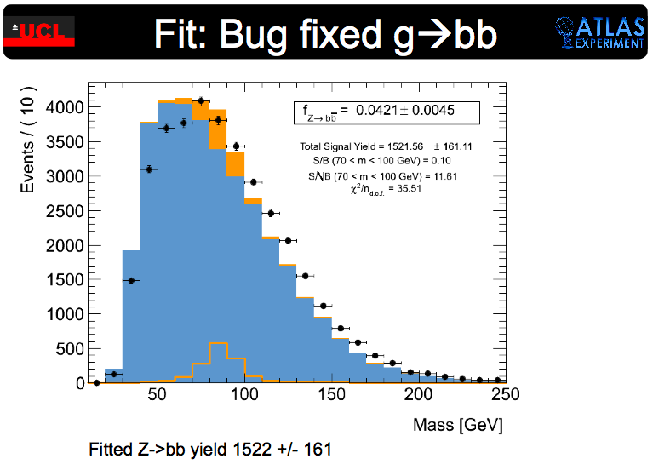
Plans for Summer
Boosted H->bb
Add to WH analysis (maybe ZH) at highest p_{T}^{W/Z}
Multivariate analyses
Already stared, but needs to be pushed
More interaction with CP groups:
Jets and MET – need to work more on this!
Would benefit (a lot!!) from better understanding of jet energy scale, MET, di-jet mass resolution
Already useful interaction with b-tagging
Improved H->bb b-tagging uncertainty
Useful interaction with Trigger:
ννbb, VBF H->bb, b(b)H, boosted Z->bb trigger
ttH activity ramping up
Stat-only limits of ≈15xSM with 1fb-1
But very affected by systematics (but early days)
Kinematic fit may improve things (also early days)
Z->bb having difficulties:
Bug found in g->bb samples – being re-generated
Re-produced AFII g->bb – bad description of data
Other channels to continue working:
VBF H->bb (MC hungry!), b(b)H

Slide 4
Backup slides

Slide 6
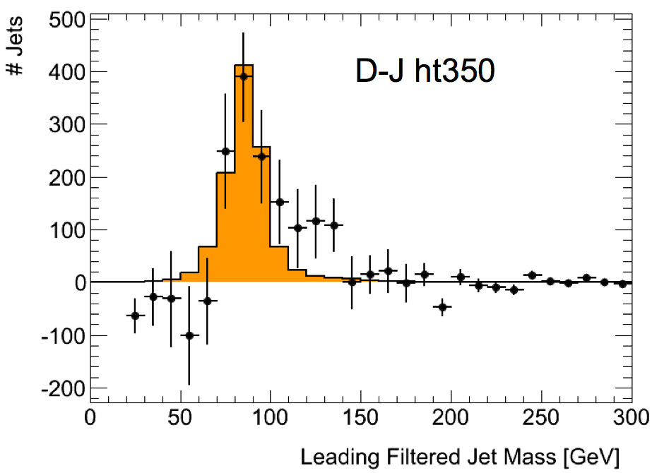
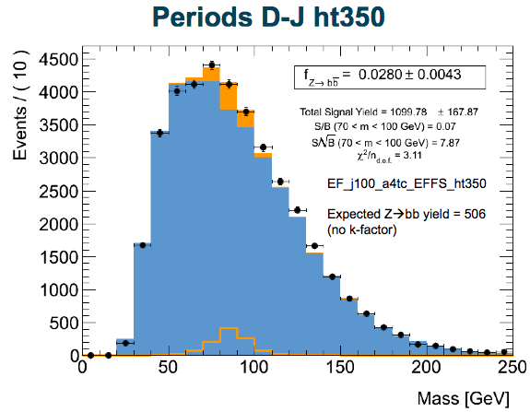
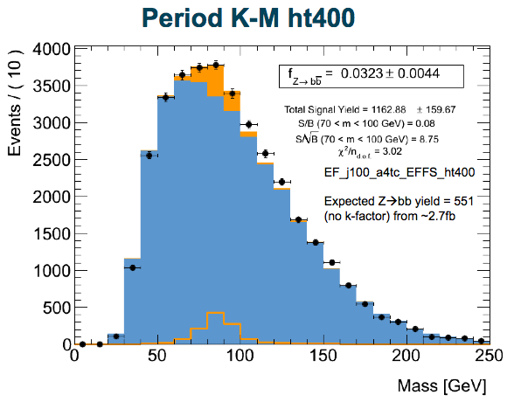
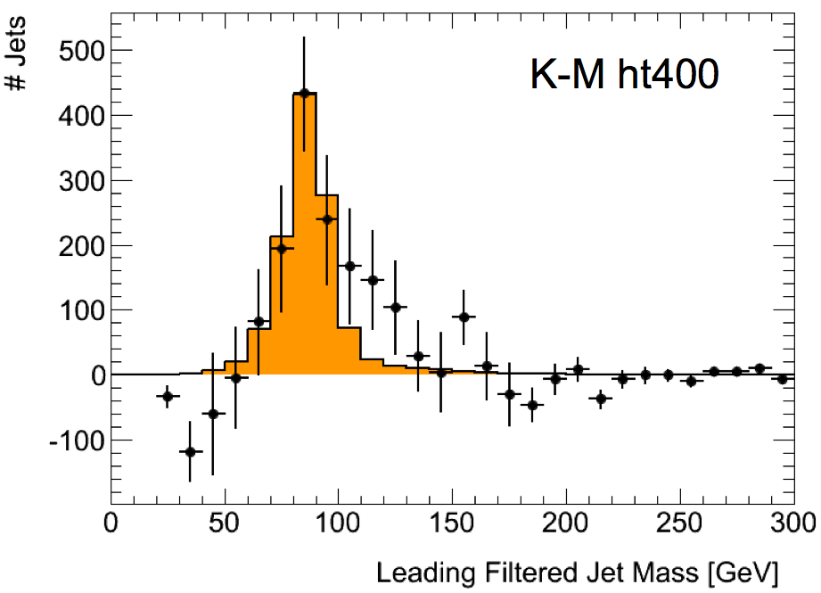
Boosted Z->bb
Z->bb analysis with jet substructure in HSG5
Perfect calibration for boosted H->bb!
An exciting Z->bb peak can be seen after background subtraction
And (perhaps even more exciting?!) there is a shoulder just above the Z mass… at around 126GeV ☺
Caveat: get excited, but don’t get too excited!
A lot of work has been going on to test the results
Much progress made so far
But many questions remain and must be answered
Observing the Z->bb in this analysis would be fantastic!
Current status:
Now looking at full simulation MC
Observations in D-J is still there in periods K-M!
D – J with trigger EF_j100_a4tc_EFFS_ht350
K – M with trigger EF_j100_a4tc_EFFS_ht400
See Luke Lambourne’s talk at HSG5 meeting: https://indico.cern.ch/conferenceDisplay.py?confId=167396

