Slide 1
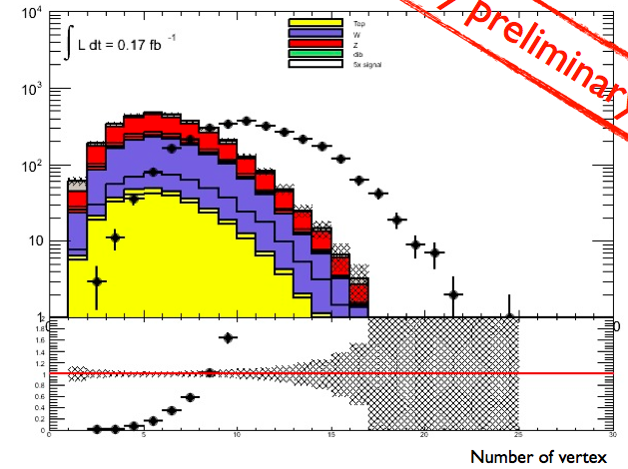
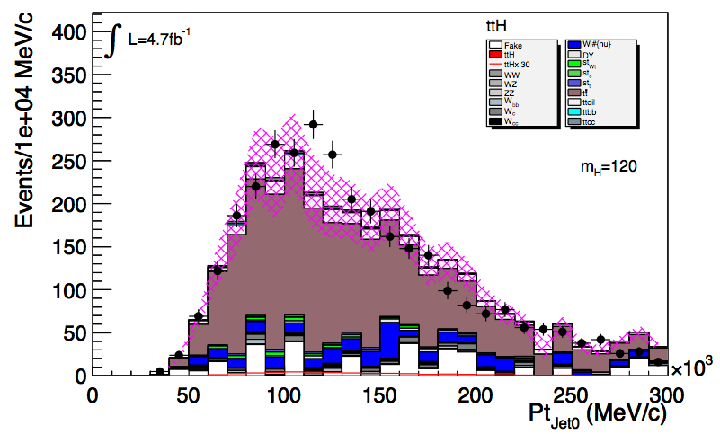
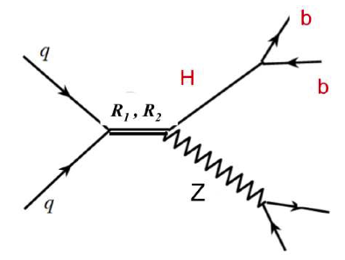
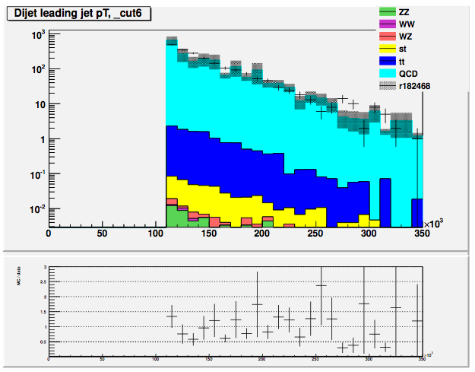
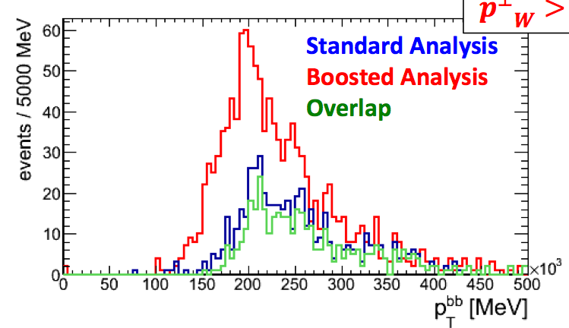
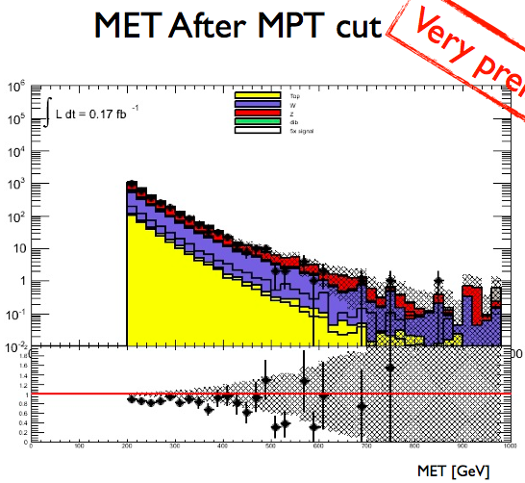
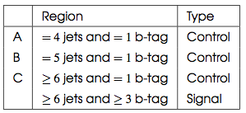
HSG5: H ➔ bb
Inclusive WH/ZH, H->bb
Paper circulation: first reading of paper went well
Getting ready for 2nd circulation; slight delay due to SVN problem
Combination:
Inputs for combination: separated WH/ZH for vvbb
Future: many intended developments, but need time to evaluate
MC requests: W/Z+h.f. crucial – Need stats more than perfection, but clear preferences – asking for large AFII Sherpa samples
Other channels:
Boosted H->bb – aim for results in Summer
Some improvement on inclusive sensitivity clear
Ongoing… progress in cut-flow comparison
Rumour is CMS will have for ICHEP… ☹
ttH working for 2011 analysis in mid May
Ongoing… control region checks, estimating model uncertainties, Kin.fitter vs χ² for mass reconstruction
Walking technicolor analysis with Exo group:
Preliminary results shown some sensitivity with ≈zero effort:
https://indico.cern.ch/conferenceDisplay.py?confId=187283
Waiting for MC for 1 model point to see if we have exclusion
WZ->lνbb: use as a calibration for H->bb mass peak
Simple mods from existing analysis
Expect preliminary results this week – then decide
First look at 2012 data – exploratory
Using PDF reweighting
Needed to scale down MC by 20% (lumi? Pileup? JES?)
Other:
bA/H->bbb: difficult analysis, early results show masses < 300GeV hard
VBF H->bb: difficult analysis; investigating QCD estimate from data (TRF)
Internal Note
Note started (skeleton): ATL-COM-2012-416
Will send first draft to all analyses to fill this weekend
Will be a “statement of intention” instead of a deep study… (no MC, no time, etc)
Lead jet p_{T}
bA/H->bbb
p_{T}^{W}>200GeV

Slide 2
HSG5: H ➔ bb
bA/H->bbb
Lead jet p_{T}
p_{T}^{W}>200GeV

