Slide 1
HSG5 Status
Paper/note circulation:
The 3 analyses were re-run:
Newest b-tagging scale factors
Jet pileup correction
Changes to sideband fit
vvbb trigger treatment changed (error 1%)
vvbb re-evaluated QCD background (negligible)
Small changes in the number of data events from the use of the jet pileup correction
Small changes on total backgrounds, mostly from small changes to the top and W+jets
Differences in the Z+jets yield in WH because of bug in previous version:
Flavour content treatment was intended for a Sherpa sample, but an Alpgen sample was used instead, without changing the code
Other issues
ttH working for 2011 analysis in mid May
In parallel to vector-like quarks
Boosted H->bb ? CMS will have analysis for ICHEP
Walking technicolor analysis could be done quickly from ZH analysis
NEW:
OLD:

Slide 2
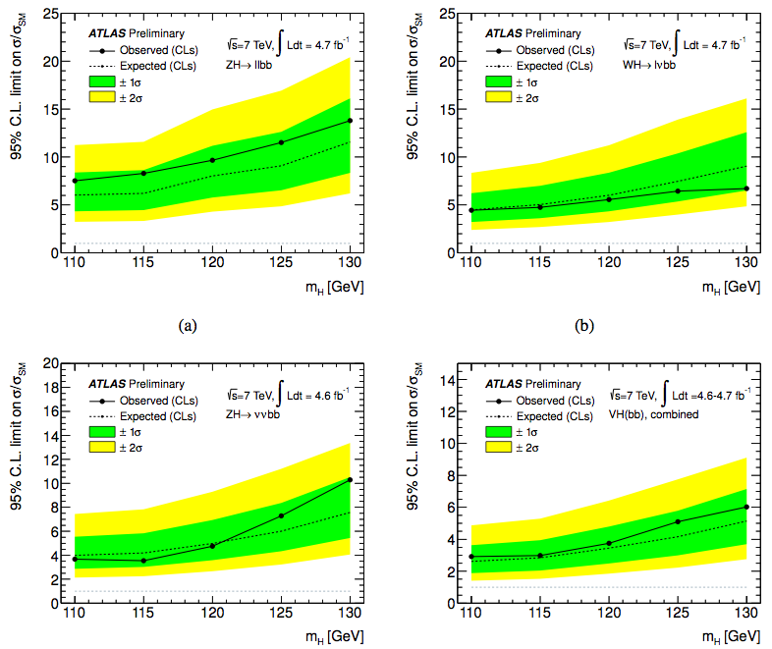
New

Slide 3
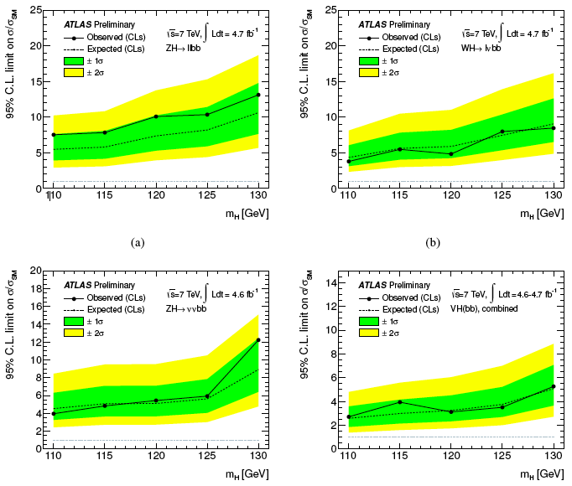
Old

