Slide 1
Higgs input to the Beatenberg Trigger Workshop
Minimum bias triggers
Photon triggers
Electron triggers
Jet/b-jet triggers
Forward jet triggers
Tau/missing ET triggers
Combined triggers
Ricardo Gonçalo
Higgs sub-groups conveners meeting - 26 Jan.09

Slide 2
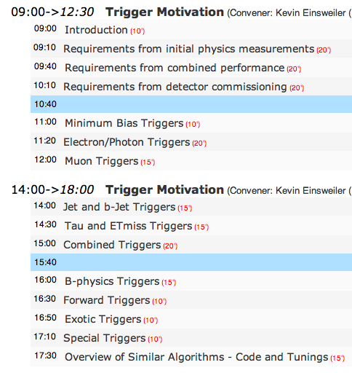
These transparencies try to collect a summary of the studies done for the Beatenberg trigger workshop
More detailed information can be found in the slides presented at the Higgs meeting of 22 January 09
An indication of the source of material is added for each analysis shown below
This material is intended for the speakers from each trigger slice at the workshop and so is separated by slice
Most material is useful for the motivation session, with some material useful for other sessions

Slide 3
Minimum bias triggers
Nothing much to say for now, BUT:
Will be used in the very beginning to obtain sample of unbiased data
Essential for efficiency determination and performance studies
Calorimeter noise can be extracted from random-trigger events
Pileup subtraction techniques may need to be developed for analysis – use minbias events
We’re hoping there will be large samples of minbias events, but no detailed analysis work plan exists yet

Slide 4
Photon triggers: H->γγ

Slide 5
Photon triggers - I
See talk by Marumi Kado: http://indico.cern.ch/conferenceDisplay.py?confId=50222
H->γγ is an important client for γ triggers
Experimental sensitivity around M_{H} ≈ 120 GeV with ≤ 10 fb⁻¹
No pure sample of photons exists
Offline reconstruction is the only reference definition available of a “photon”
But offline reconstruction is looser than trigger selection: background efficiency is higher for offline reconstruction than for trigger when using L1 isolation
Creates bias in efficiency determination
2g17i | Signal | L1 | L2 | EF
Efficiency (%) | Signal | 99.0±0.2 | 98.9±0.2 | 93.6±0.4
 | γ + jets | 90.1±0.6 | 89.3±0.6 | 80.2±0.8
Understanding L1 isolation is essential
This means that non-isolated electron triggers are needed
H->γγ group working together with e/γ slice to develop efficiency determination from data (complementary methods): bootstrap, tag&probe (wrt offline electrons!), using Z->ee as proxies for photons, using Zγ->llγ

Slide 6
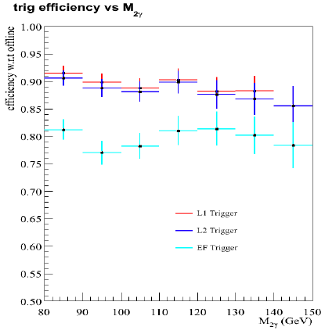
Photon triggers - II
Large drop between L2 and EF
Understood: different online and offline selection
Probable trigger bias at m_{γγ}~120 GeV/c²
Cuts tuned on H->γγ sample?
Dangerous for analysis
γ+jets sample
2g17i_L33

Slide 7
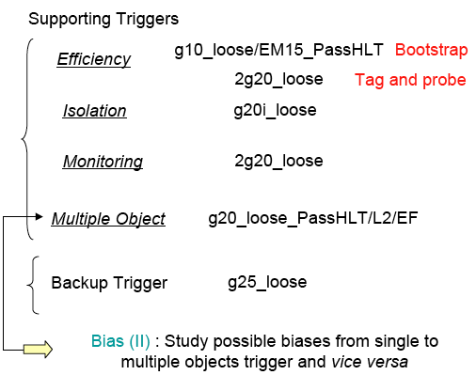
Photon triggers - III
Main trigger for H->γγ analysis: g20_loose
Support triggers (kept under the e/γ trigger slice? Should Higgs WG sign up for them?):
For bootstrap method: g10_loose or, even better, EM15_PassHLT
To study isolation: g20i_loose
To study bias on efficiency determination in events with 2 photons: 2g20_loose, g20_loose_passHLT/L2/EF
Backup trigger: g25_loose
Main trigger for 2009 data: g20_loose

Slide 8
Electron triggers
H->WW
H->ZZ^{(*)}->4l
HZ, Z->l⁺l⁻, H->invisible
ttH
tbH⁺

Slide 9
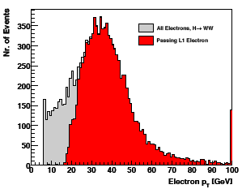
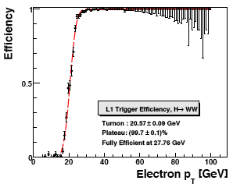
Electron triggers: H->WW
Talk by Jonas Strandberg:
http://indico.cern.ch/conferenceDisplay.py?confId=50222
Experimental sensitivity around M_{H} ≈ 160 GeV with ≤ 2 fb⁻¹
H->WW->l⁺νl⁻ν
Important for SM Higgs, M_{H}~160GeV
ee, eμ, μμ channels investigated
Interested in:
e10_medium and e20_loose
Basically happy with 10³¹ menu
L1_EM18
 | eμ | ee | μμ
e5_e7_medium | - | 98.7% | -
e10_loose | 99.0% | 99.9% | 0.5%
e20_medium | 92.5% | 99.5% | 0.3%
preselection: electron author 1 or 3; |η|<2.5; crack excluded; isEM medium, no isolation; p_{T} > 6 GeV
With respect to CSC selection

Slide 10
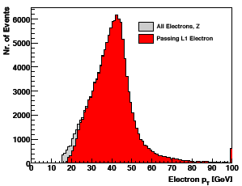
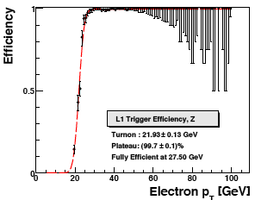
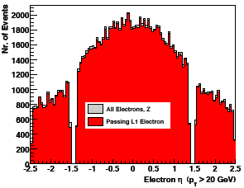
Efficiency determination
H->WW analysis will look at Z->ll events in 1st data
Good e20_loose L1 efficiency determination using ~10pb⁻¹ of data
From 10k Z->ee with selection:
p_{T}^{lep}>15GeV
|m_{Z}-m_{ll}|<15GeV
MET<10GeV
Note error bars
L1_EM18
10pb⁻¹

Slide 11
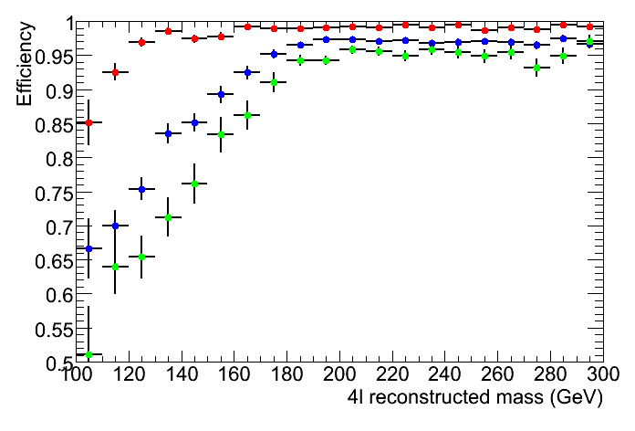
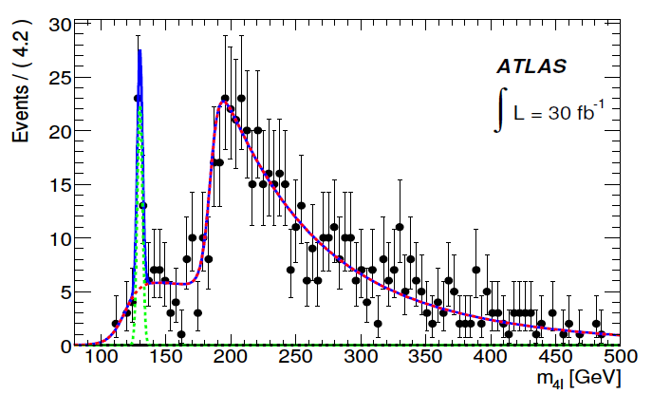
Electron triggers: H->4l
Stefano Rosati: http://indico.cern.ch/conferenceDisplay.py?confId=50222
Important channel for SM Higgs searches from M_{H}>130GeV to about 600GeV
Experimental sensitivity above M_{H} ≈ 130 GeV already with 2 fb⁻¹
Older (CSC) study on ZZ->4l background – efficiency vs M_{4l} invariant mass
Measurement of M_{H} comes from fit to signal + background
Efficiency wrt offline cuts, M_{H}=130 GeV
Offline selection as in CSC note
1μ10 and 1e15i or 2μ10 or 2e15i
1μ20 and 1e25i or 2μ20 or 2e25i
1μ25 and 1e30i or 2μ25 or 2e30i
Selection | 4e | 4μ | 2e2μ
e10_medium | >99.8 | 0.2 | 99.7
e20i_loose | 99.9 | 0.2 | 82.9
e25i_loose | 99.7 | 0.1 | 68.5
2e6_medium | >99.8 | - | 97.9
2e15_medium | >99.8 | - | 66.2
2e10_loose | >99.8 | - | 86.3
2e20_loose | 98.6 | - | 52.4
2e12_tight | 96.0 | - | 57.7
2e10_loose OR 2μ10 | >99.8 | 95.7 | 99.8
2e20_loose OR 2μ20 | 98.6 | 75.5 | 89.1

Slide 12
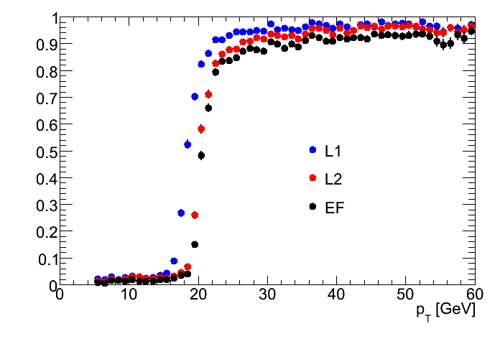
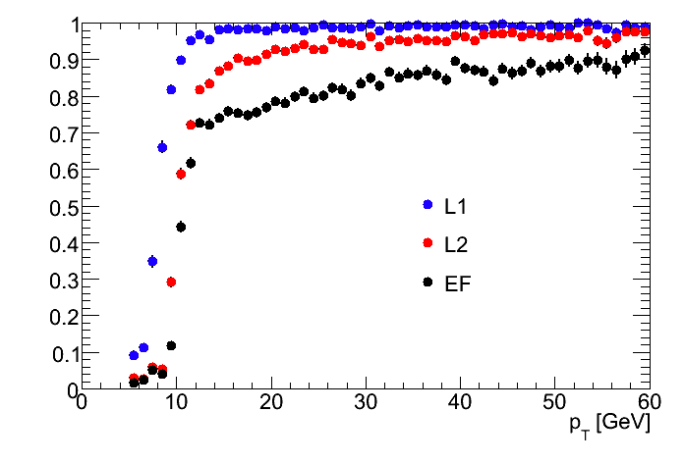
Efficiency curves
Absolute efficiency curves – matching true leptons to trigger RoIs
Slow rise in e10 efficiency at EF – different online/offline selection?
Trigger efficiency for dominant background (ZZ->4l)
e20i_loose
 | 4e | 4μ | 2e2μ
e10_medium | 100% | 27% | 100%
e20i_loose | 100% | 3.3% | 99%
e10i_loose

Slide 13
ZH, Z->ll, H->invisible
Pauline Gagnon: http://indico.cern.ch/conferenceDisplay.py?confId=50222
Signature is a Z->ll decay AND E_{T}^{miss}
EF efficiency and purity before and after preselection:
Same flavour, opposite charge leptons,|m_{l+l-} - mZ| < 20 GeV, E_{T}^{miss}> 90GeV
All individual signatures give about 98-99% efficiency w.r.t. preselection
EF_e20_loose slightly more efficient than EF_e15_medium
Purity | selection | 2e10_loose | 2e15_medium | e15_medium | e20_loose
HZ, mH = 130 GeV | before | 81.2% | 75.3% | 65.1% | 63.0%
 | after | 95.2% | 95.2% | 94.0% | 93.0%
HZ, mH = 200 GeV | before | 82.0% | 76.4% | 66.9% | 65.0%
 | after | 94.9% | 94.8% | 93.1% | 92.4%
Efficiency | selection | 2e10_loose | 2e15_medium | e15_medium | e20_loose
HZ, mH = 130 GeV | before | 96.0% | 71.6% | 76.2% | 77.1%
 | after | 98.2% | 98.1% | 99.3% | 99.9%
HZ, mH = 200 GeV | before | 96.2% | 71.9% | 76.9% | 77.8%
 | after | 97.8% | 97.9% | 99.1% | 99.7%

Slide 14
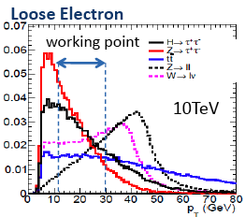
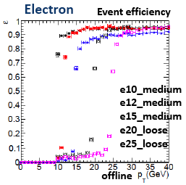
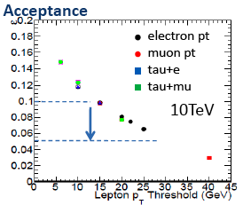
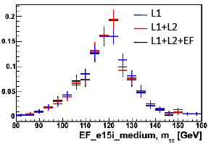
Triggering on τ->e decays
See talk by Soshi Tsuno: http://indico.cern.ch/conferenceDisplay.py?confId=50222
Experimental sensitivity around M_{H} ≈ 120 GeV with ≈ 10 fb⁻¹
Tau decays to e with BR~17%
Need thresholds between p_{T}=15 GeV and p_{T}=30GeV
40% acceptance lost going from 15GeV to 30GeV
No bias found (see bottom left plot)
Event Filter efficiency for τ->eνν after cuts:
p_{T} > 10GeV; |eta| <2.7; author=1 or 3,econe20/p_{T}<0.2

Slide 15
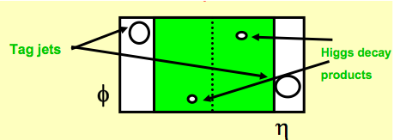
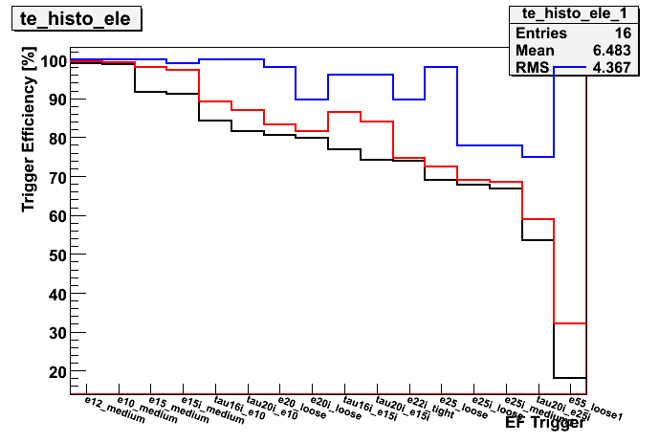
H->ττ in Vector Boson Fusion (lep-had)
49104 initial events | After analysis
Without trigger | 1149
With trigger | 983
Efficiency | 85.5% (2% absolute)
VBF: only Higgs decay products in central region
After all analysis cuts
For M_{H}=120GeV
Using e12_medium and mu10
Efficiency wrt analysis cuts:
Lower efficiency using combined electron+tau signatures; equivalent to higher electron E_{T} thresholds

Slide 16
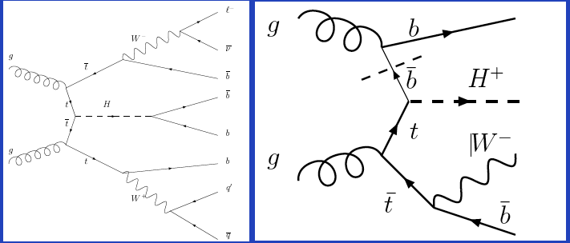
Electron triggers for ttH and tbH+
See talk by Chris Potter: http://indico.cern.ch/conferenceDisplay.py?confId=50222
ttH
Lep lep: both tops decay leptonically
Had had: both decay hadronically
Lep+ had: 1 top decays to bl⁺ν and the other hadronically
Absolute efficiencies (wrt to the whole generated sample)
e20i_loose efficiency (wrt MC generated sample)
ttH | lep-lep | lep⁺ had | lep⁻ had | had-had
efficiency | 55.2% | 34.4% | 36.7% | 2.1%
tbH⁺; m_{H+}= | 200GeV | 250 GeV | 300 GeV | 400 GeV
efficiency | 34.4% | 35.7% | 35.3% | 33.1%

Slide 17
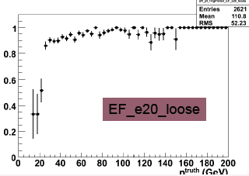
Electron triggers for ttH
ttH study by Catrin Bernius
Efficiencies wrt preselection:
1 isolated lepton:
Electron: isEM&&0xFF, pT>25GeV, |η|<2.5
Muon: pT>20GeV, |η|<2.5, ETcode20<10GeV+pTratio<0.3
6 jets with pT>20GeV, |η|<5, 4 central jets b weight>0

Slide 18
Muon triggers
H->WW
H->ZZ^{(*)}->4l
HZ, Z->l⁺l⁻, H->invisible
ttH
tbH⁺

Slide 19
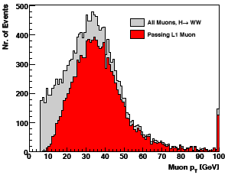
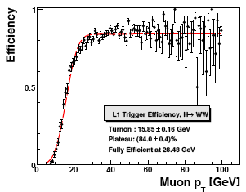
Muon triggers: H->WW
Talk by Jonas Strandberg:
http://indico.cern.ch/conferenceDisplay.py?confId=50222
Experimental sensitivity around M_{H} ≈ 160 GeV with ≤ 2 fb⁻¹
H->WW->l⁺νl⁻ν
ee, eμ, μμ channels investigated
Interested in:
mu10, mu20, looked at mu4_mu6
Basically happy with 10³¹ menu
L1_MU20
Event Filter | eμ | ee | μμ
mu4_mu6 (bug) | 86.9% | 98.7% | 62.7%
mu10 | 86.9% | 0.1% | 98.2%
mu20 | 76.4% | 0.0% | 94.7%
preselection: combined muon; |η|<2.5; p_{T} > 6 GeV
Efficiency with respect to CSC selection

Slide 20
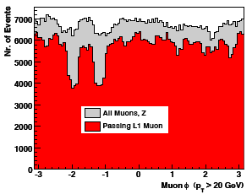
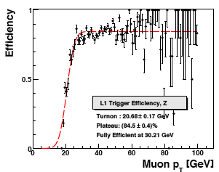
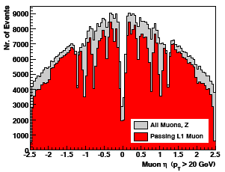
Efficiency determination
H->WW analysis will look at Z->ll events in 1st data
Can get good mu20 L1 efficiency determination using ~10pb⁻¹ of data
From 10k Z->ee with selection:
p_{T}^{lep}>15GeV
|m_{Z}-m_{ll}|<15GeV
MET<10GeV
Note error bars
10pb⁻¹

Slide 21
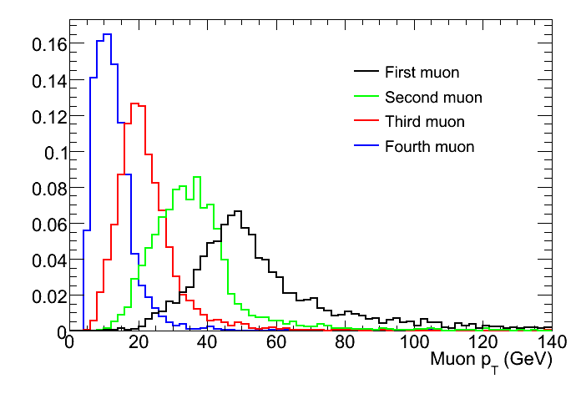
Muon triggers: H->4l
Stefano Rosati: http://indico.cern.ch/conferenceDisplay.py?confId=50222
Experimental sensitivity above M_{H} ≈ 130 GeV already at 2 fb⁻¹
Identified list of useful triggers from 10³¹ menu:
Older (CSC) study on ZZ->4l background – efficiency vs M_{4l} invariant mass
Measurement of M_{H} comes from fit to signal + background
Efficiency wrt offline cuts (as in CSC note), M_{H}=130 GeV:
1μ10 and 1e15i or 2μ10 or 2e15i
1μ20 and 1e25i or 2μ20 or 2e25i
1μ25 and 1e30i or 2μ25 or 2e30i
Selection | 4e | 4μ | 2e2μ
mu10 | 0.6 | 99.9 | 94.6
mu20 | - | 98.1 | 70.9
mu15i_loose | 0.3 | 99.0 | 81.0
mu20i_loose | - | 97.7 | 66.6
mu40 | - | 67.7 | 35.6
e10_medium | >99.8 | 0.2 | 99.7
e20i_loose | 99.9 | 0.2 | 82.9
e25i_loose | 99.7 | 0.1 | 68.5
p_{T} of muons in H->4μ; M_{H}=130GeV

Slide 22
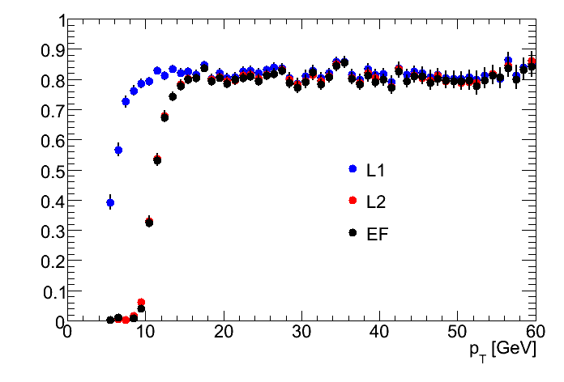
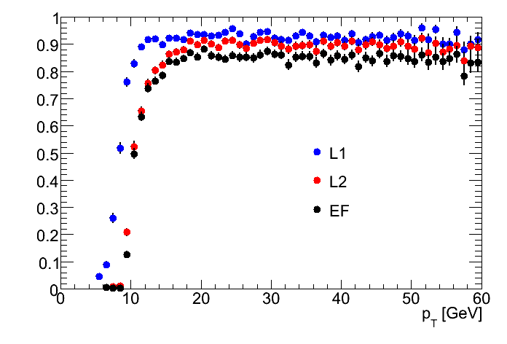
Efficiency curves: H->4l
Absolute efficiency curves – matching true leptons to trigger RoIs
Barrel efficiency affected by coverage (MS feet)
Endcap EF efficency 5-10% less than L1 efficiency (support ribs)
Trigger efficiency for dominant background (ZZ->4l)
mu10 Barrel
 | 4e | 4μ | 2e2μ
mu10 | 0.6% | 100% | 98.1%
mu15_loose | 0.2% | 99.9% | 96.9%
2mu10 | 0.1% | 99.1% | 74.9%
2mu20 | 0.0% | 97.4% | 64.5%
mu10 Endcap

Slide 23
H->4l at higher M_{H}
Also looked at H->4l with M_{H}=300GeV
Higher mass scale means even mu40 has good efficiency
Selection | 4e | 4μ | 2e2μ
mu40 | - | 97.7 | 84.8
2e10_loose/2mu10 | >99.8 | 98.0 | >99.8
2e20_loose/2mu20 | >99.8 | 93.7 | 99.0

Slide 24
ZH, Z->ll, H->invisible
Pauline Gagnon: http://indico.cern.ch/conferenceDisplay.py?confId=50222
Signature is a Z->ll decay AND E_{T}^{miss} > 90GeV
EF efficiency and purity before and after preselection
Same flavour, opposite charge leptons,|m_{l+l-} - mZ| < 20 GeV, E_{T}^{miss}> 90GeV
All individual signatures give about 98-99% efficiency w.r.t. preselection
EF_mu10 only slightly more efficient than EF_mu15
Purity | selection | 2mu10 | mu10 | mu15
HZ, mH = 130 GeV | before | 98.7% | 82.0% | 82.6%
 | after | 99.7% | 99.4% | 99.5%
HZ, mH = 200 GeV | before | 98.4% | 84.4% | 84.4%
 | after | 99.5% | 99.4% | 99.4%
Efficiency | selection | 2mu10 | mu10 | mu15
HZ, mH = 130 GeV | before | 69.7% | 96.9% | 94.9%
 | after | 70.0% | 97.1% | 95.1%
HZ, mH = 200 GeV | before | 69.9% | 96.9% | 94.9%
 | after | 70.4% | 96.9% | 95.0%

Slide 25
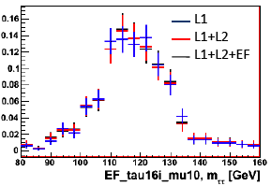
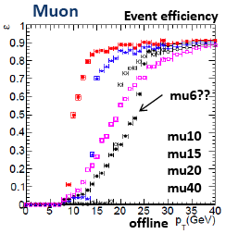
Triggering on τ->μ decays
See talk by Soshi Tsuno: http://indico.cern.ch/conferenceDisplay.py?confId=50222
Experimental sensitivity around M_{H} ≈ 120 GeV with ≈ 10 fb⁻¹
Tau decays to e with BR~17%
Need thresholds between p_{T}=15 GeV and p_{T}=30GeV
40% acceptance lost going from 15GeV to 30GeV
No bias found (see bottom left plot)
Event Filter efficiency for τ->eνν after cuts:
p_{T} > 10GeV; |eta| <2.7; author=1 or 3,econe20/p_{T}<0.2

Slide 26
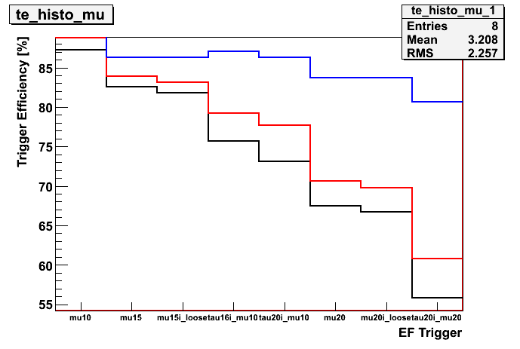
H->ττ in Vector Boson Fusion (lep-had)
49104 initial events | After analysis
Without trigger | 1149
With trigger | 983
Efficiency | 85.5% (2% absolute)
VBF: only Higgs decay products in central region
After all analysis cuts
For M_{H}=120GeV
Trigger: e12_medium OR mu10
Efficiency wrt analysis cuts:
Lower efficiency using combined electron+tau signatures; equivalent to higher electron E_{T} thresholds

Slide 27
Muon triggers for ttH and tbH+
See talk by Chris Potter: http://indico.cern.ch/conferenceDisplay.py?confId=50222
ttH
Lep lep: both tops decay leptonically
Had had: both decay hadronically
Lep+ had: 1 top decays to bl⁺ν and the other hadronically
Absolute efficiencies (wrt to the whole generated sample)
mu20 efficiency (wrt MC generated sample)
ttH | lep-lep | lep⁺ had | lep⁻ had | had-had
efficiency | 57.3% | 34.6% | 38% | 4.9%
tbH⁺; m_{H+}= | 200GeV | 250 GeV | 300 GeV | 400 GeV
efficiency | 34.1% | 33.2% | 34.5% | 39%

Slide 28
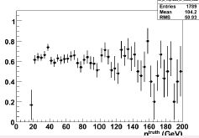
Muon triggers for ttH
ttH study by Catrin Bernius
Efficiencies wrt preselection:
1 isolated lepton:
Electron: isEM&&0xFF, pT>25GeV, |η|<2.5
Muon: pT>20GeV, |η|<2.5, ETcode20<10GeV+pTratio<0.3
6 jets with pT>20GeV, |η|<5, 4 central jets b weight>0

Slide 29
Jet and b-jet triggers
ttH, H->bb
tbH⁺, H⁺->tb
Other channels use jet triggers combined with lepton/tau/MET triggers

Slide 30
Jet/b-jet triggers for complex final state Higgs
See talk by Chris Potter: http://indico.cern.ch/conferenceDisplay.py?confId=50222
ttH, H->bb and tbH⁺, H⁺->tb have 4 b quarks and 2 W bosons in the final state
ttH with both tops decaying hadronically has the largest branching ratio
Jet triggers are essential, but this channel is not much explored yet – ongoing
Both analyses are investigating the b-tag triggers
2b23_3L1J23 efficiency (wrt MC generated sample)
ttH | lep-lep | lep⁺ had | lep⁻ had | had-had
efficiency | 7.4% | 8.9% | 11% | 14%
tbH⁺; m_{H}= | 200GeV | 250 GeV | 300 GeV | 400 GeV
efficiency | 17.4% | 27.6% | 33.7% | 37.3%

Slide 31
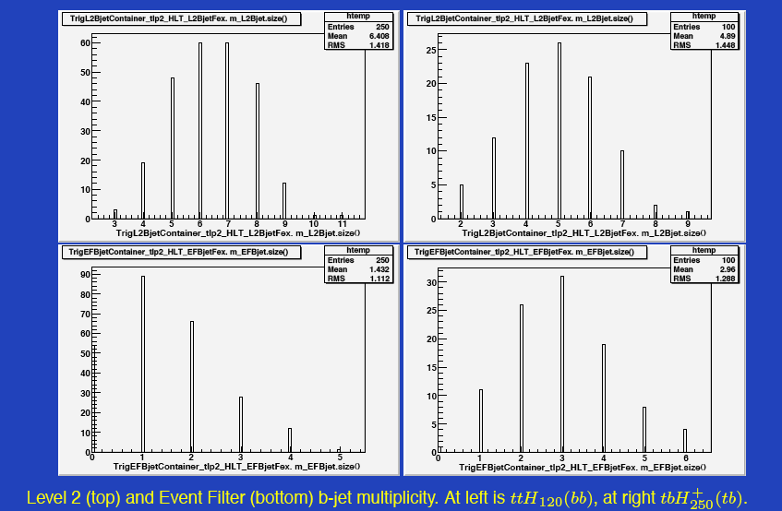

Slide 32
Jet triggers for ttH
ttH study by Catrin Bernius
Efficiencies wrt preselection:
1 isolated lepton:
Electron: isEM&&0xFF, pT>25GeV, |η|<2.5
Muon: pT>20GeV, |η|<2.5, ETcode20<10GeV+pTratio<0.3
6 jets with pT>20GeV, |η|<5, 4 central jets b weight>0
B-jet trigger may be an option; sould investigate further
Unprescaled non-tagged jets not really an option: investigate lower pT jets + lepton
Current prescales (10³¹): L1_4j23: 20; L1_XE40: 20; L1_XE50: 2

Slide 33
Forward Jets
Vector Boson Fusion Higgs production
Several Higgs searches may benefit from this trigger
VBF H->WW
VBF H->ττ
VBF H->invisible
Didn’t exist for CSC exercise but physics studies beginning to appear

Slide 34
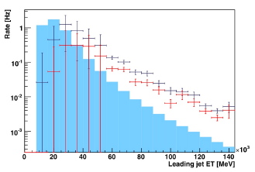
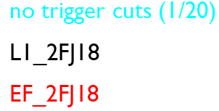
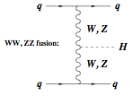
VBF Higgs and Forward Jet Triggers
See talk by Mario Campanelli : http://indico.cern.ch/conferenceDisplay.py?confId=50222
FJ add coverage from η=3.2 to η=4.9 (one eta bin)
May provide a way to tag Vector Boson Fusion events through their tag jets
VBF important for several early-discovery (Standard Model) Higgs searches:
H->WW (needs ~2fb⁻¹)
H->ττ (needs ~10fb⁻¹)
Also: H->invisible, where signature is E_{T}^{miss} + 2 tag jets
FJ trigger also relevant for Diffractive Higgs
tag jets

Slide 35
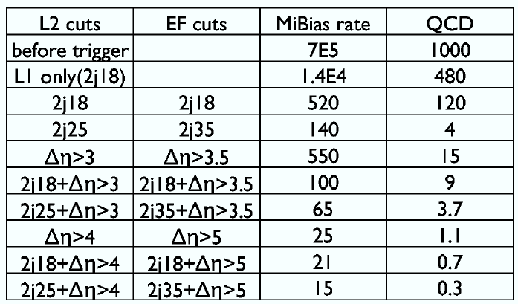
Forward Jet triggers for VBF Higgs
VBF H->l⁺l⁻
Triggers in previous study (CSC): e22i, mu20
Currently in the menu:
EF_FJ18 (PS=7000)
EF_FJ35 (PS=700)
EF_FJ70 (PS=20)
EF_FJ120 (PS=1)
EF_2FJ18 (PS=100)
EF_2FJ35 (PS=1)
EF_2FJ70 (PS=1)
Need also:
Central-central and central-forward jet configurations for VBF and diffractive physics
High prescales make searches impossible
Trigger can combine central and forward jets and request Δη and E_{T} cuts
Need to find FJ+J or FJ+J+lepton triggers with good rate and performance
E_{CM}=10TeV
VBF: only Higgs decay products in central region

Slide 36
Proposal for new trigger for VBF H->ll
Several combinations tried (see table)
Loose lepton (muon or electron): L1 p_{T}>6GeV, L2 p_{T}>6GeV, EF p_{T}>10GeV
Loose jets: Δη>3, E_{T}>18GeV (L2); Δη>3.5, E_{T}>18GeV (EF)
Tight jets: Δη>4, E_{T}>25GeV (L2); Δη>5, E_{T}>35GeV (EF)
Proposal is tight jet cut + 1 loose lepton
40% gain in signal acceptance wrt CSC cuts (which used lepton p_{T}>20(μ)/25(e) GeV)
Efficiency is 53% wrt offline CSC cuts
The price is a rate of 16Hz (not unique rate)
Plans:
L1 Δη trigger (with Alan Watson)
Look at rapidity gap trigger (with Diego Casadei)
Produce working version of trigger and include it in test menu for official rate estimates
tight

Slide 37
Tau and ETmiss triggers
Standard Model:
Vector Boson Fusion H->ττ
MSSM:
enhanced H->ττ xsection
Charged Higgs
BSM:
Invisible Higgs: HZ, H->invisible

Slide 38
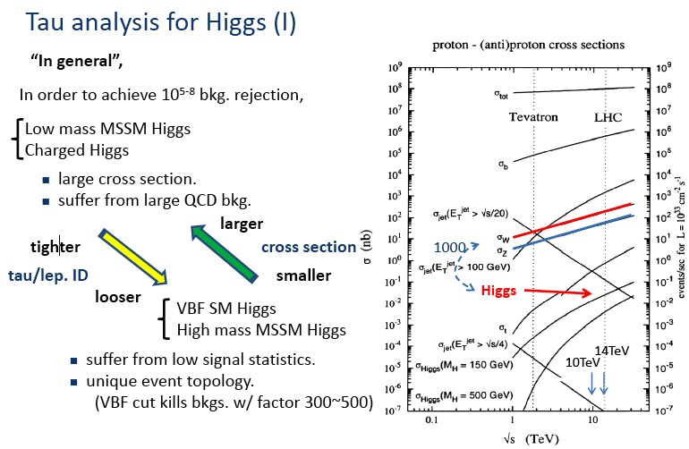
Tau Triggers for Higgs
See talk by Soshi Tsuno: http://indico.cern.ch/conferenceDisplay.py?confId=50222

Slide 39
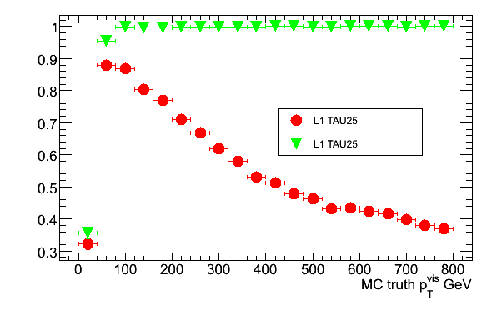
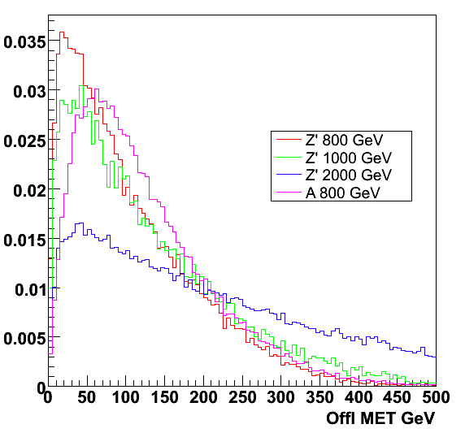
Heavy Neutral Higgs in the MSSM
In parts of the MSSM parameter space the Higgs coupling to τ is greatly enhanced
A->ττ->had.had is most significant channel
Important to use un-isolated tau trigger
For A->ττ->had.had with M_{A}~800GeV
Efficiency wrt offline selection: 2 τ with p_{T}>60GeV and MET>40GeV
Lumi | Signature | Evts/100pb⁻¹ | EF Rate
10³¹ cm⁻²s⁻¹ Loose selec. | tau125 | 0.72 | 0.2Hz
 | tau38_tau50 | 0.72 | 0.3Hz
10³² cm⁻²s⁻¹ medium selection | tau125 | 6.6 | 0.5Hz
 | tau38_tau50 | 6.4 | 0.3Hz
 | 2tau50 | 5.7 | 0.7Hz
10³³ cm⁻²s⁻¹ | 2tau50 | 50.5 | 0.2Hz

Slide 40
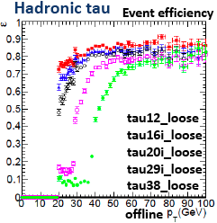
Different menus tried
Trigger efficiency for 10³³ menu
Channel sensitivity starts at 10fb⁻¹ (10³³ cm⁻²s⁻¹)
Used 14TeV (no 10TeV samples ready)
Offline selection:
tau > 35/45GeV for tau29i/tau38i respectively
llh cut (1-, 3-prong dependent);
MET>40GeV
Tau trigger efficiency: 10³¹ menu
Offline selection:
pT > 30GeV, ||<2.7
Author = TauRec
Ntrack = 1 or 3, |charge| = 1
LLH>0, El.LLH>0

Slide 41
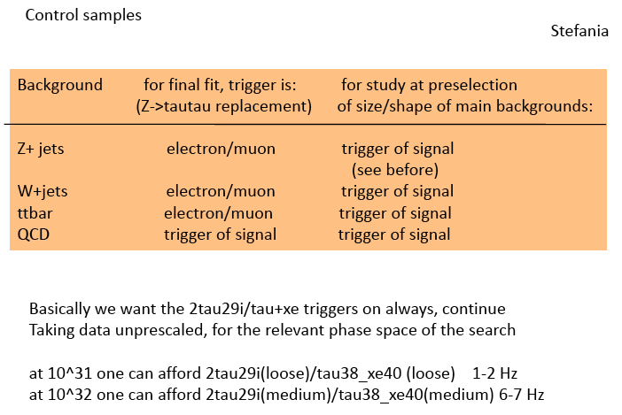

Slide 42
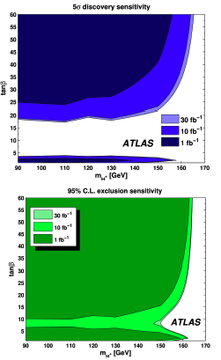
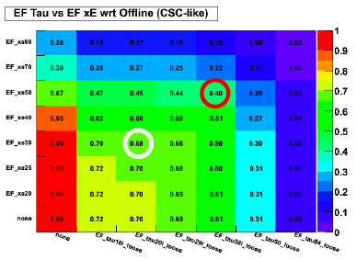
MET triggers for Higgs: H⁺->τν
tt->(bqq)(bH⁺) with H⁺->τν (hadronic τ decay)
Sensitivity already for 1fb⁻¹
Investigated using a pure MET trigger xE40
See blue rectangle
Unfortunately this trigger is prescaled by a factor of 20 already at 10³¹

Slide 43
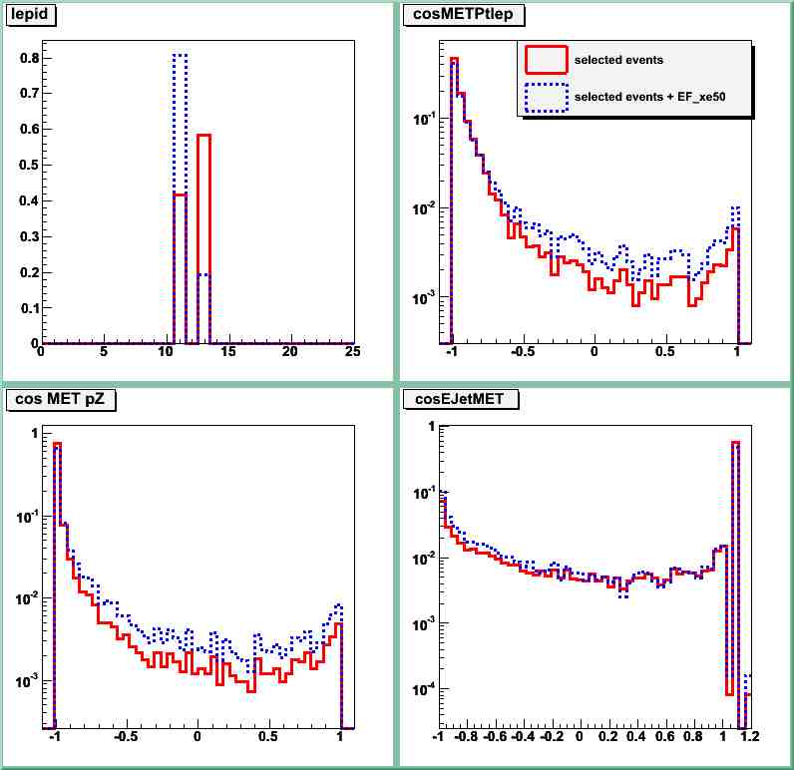
MET Triggers for Higgs: ZH->inv
xE50 tried in analysis of ZH, H->invisible
Strange feature found:
Events with Z->μμ suppressed by trigger and distributions distorted
Will not use xE in analysis
Overlap with other (lepton) triggers in signal events is almost complete: only 0.2% signal loss
Increases acceptance for ttbar background

Slide 44
Modified input distributions used for final selection when using EF_xe50 trigger: lepton ID, angles between (MET, pT lepton), MET and pZ, MET and leading jet.
lepton composition changes: selects more electrons
seems to select events with different characteristics…
all angular distributions are slightly modified
Not quite understood since 50% of all selected events pass this trigger…

Slide 45
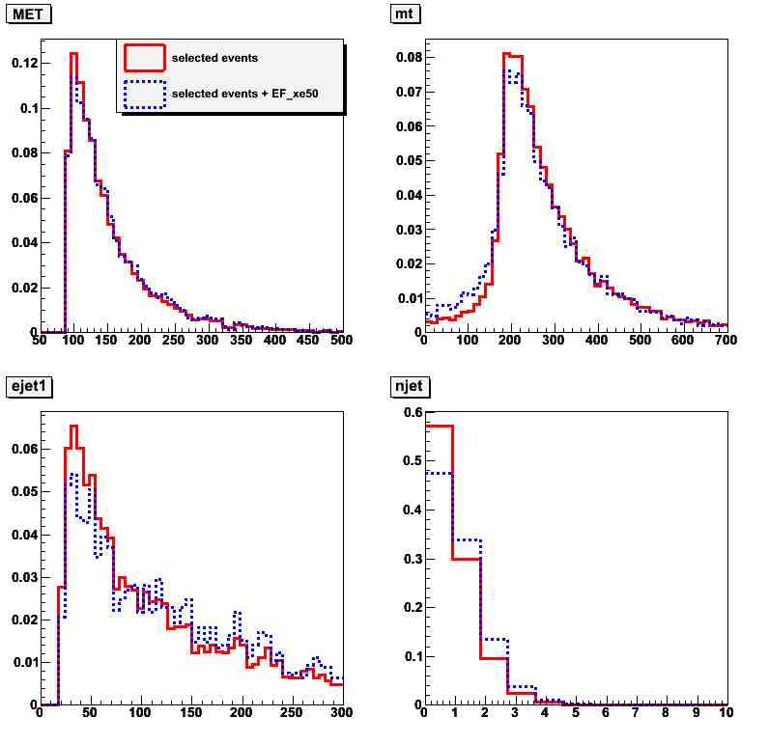
Modified input distributions used for final selection when using EF_xe50 trigger: MET, transverse mass mT, E leading jet, # jets.
sees more jets in HZ → ll events
MET and transverse mass distributions are also affected

Slide 46
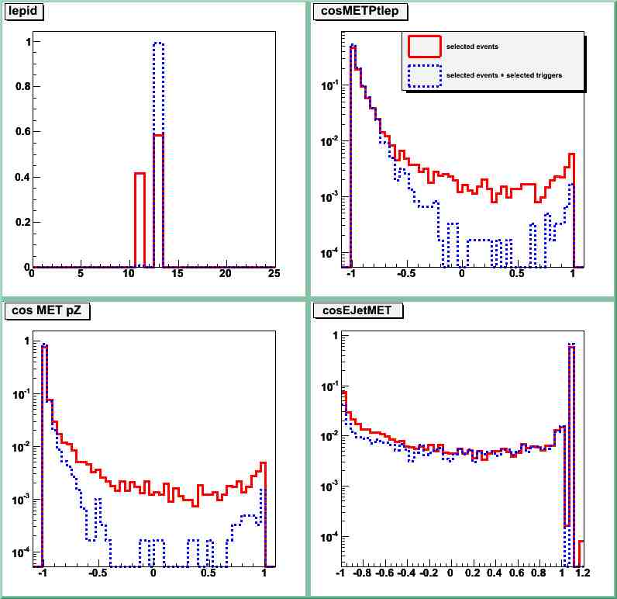
Preselected events passing or not passing EF_xe50 trigger
Passing EF_xe50 Not passing EF_xe50

Slide 47
MET triggers for ttH
ttH study by Catrin Bernius
Efficiencies wrt preselection:
1 isolated lepton:
Electron: isEM&&0xFF, pT>25GeV, |η|<2.5
Muon: pT>20GeV, |η|<2.5, ETcode20<10GeV+pTratio<0.3
6 jets with pT>20GeV, |η|<5, 4 central jets b weight>0
MET triggers don’t look very useful due to prescales, but could maybe be used in combination with lepton
Current prescales (10³¹): L1_4j23: 20; L1_XE40: 20; L1_XE50: 2

Slide 48
Combined triggers
Vector Boson Fusion H->ττ
Low-mass charged Higgs: H⁺->τ(had)ν
High-mass charged Higgs: tbH⁺, H⁺->tb
Associated production: ttH

Slide 49
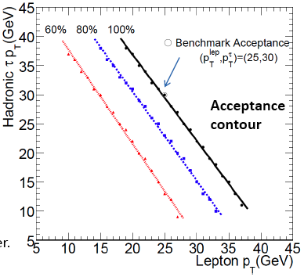
Combined triggers for H->ττ
See talk by Soshi Tsuno: http://indico.cern.ch/conferenceDisplay.py?confId=50222
Tau decays to e/μ with BR~34%
Need e/mu thresholds between p_{T}=15 GeV and p_{T}=30GeV
40% acceptance lost going from 15GeV to 30GeV
Combined trigger (τ+e, τ+μ) may help keep low thresholds and low rate

Slide 50
L1
L1+L2
L1+L2+L3

Slide 51
L1
L1+L2
L1+L2+L3

Slide 52
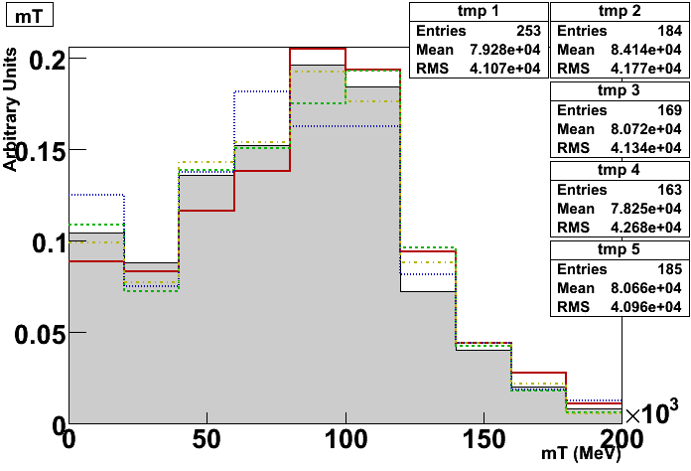
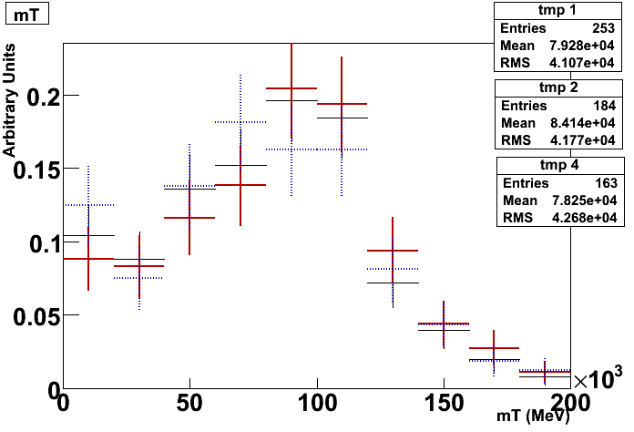
Combined triggers for H⁺->τ(had)ν
See talk by Elias Coniavitis: http://indico.cern.ch/conferenceDisplay.py?confId=50222
Searched for bias in transverse mass from different triggers: variation within statistical fluctuation
EF_xe40 (no PS!)
EF_tau20i_xe30
EF_tau16i_3j23 EF_2j42_xe30

Slide 53
Combined triggers for ttH and tbH⁺
Take advantage of features in event topology other than leptons, and of post-rel.12 developments in trigger: MET, b-tag
Other numbers for ttH->(blν)(bjj)(bb):
With respect to preselection:
1 isolated lepton:
Electron: isEM&&0xFF, pT>25GeV, |η|<2.5
Muon: pT>20GeV, |η|<2.5, ETcode20<10GeV+pTratio<0.3
6 jets with pT>20GeV, |η|<5, 4 central jets b weight>0

Slide 54
Conclusions
In general:
Try to tighten purity cuts instead of raising pT thresholds
Prescaled triggers are usually unusable for Higgs: use combined triggers
Minimum bias: will need samples from random and minimum bias triggers!
Wishlist:
E/gamma: Important to study L1 electron/photon isolation
H->4l, H->WW: e10_medium, e20i_loose, e20_loose, 2e6_medium, 2e15_medium
G10_loose, g20i_loose, g20_loose, 2g20_loose, g25_loose, g20_loose_PassHLT/L1/EF
Muons: H->4l, H->WW: mu10, mu20, mu15i_loose, 2mu10,
Tau/Etmiss: 2tau29i, tau38i_xe40, tau38i_EFxe40; xe40, xe50 (but problem with prescales)
Jet/b-jet: 2b23_3L1J23
Combined: tau16i_e10, tau16i_e15i, tau20i_e15i, tau20i_e25i, tau16i_mu10, tau16i_mu20, tau20i_mu10, tau20i_xe30, tau16i_3j23, 2j42_xe30
Forward Jets: VBF H->ll; proposal for new trigger:
Δη>4, E_{T}>25GeV (L2); Δη>5, E_{T}>35GeV (EF) + 1 e or μ lepton with p_{T}>10GeV
40% gain in signal acceptance wrt CSC cuts (which used only lepton p_{T}>20(μ)/25(e) GeV)
Efficiency is 53% wrt offline CSC cuts
The price is a rate of 16Hz (not unique rate)

