Slide 1
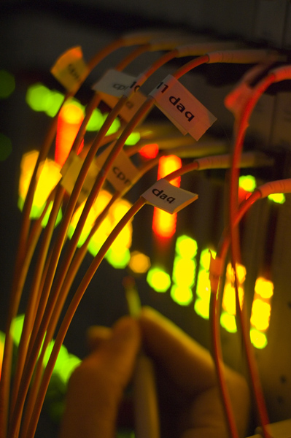
Trigger Performance
HSG5 Meeting at JINR
Dubna – 29 April 2010
Ricardo Gonçalo
Royal Holoway University of London

Slide 2
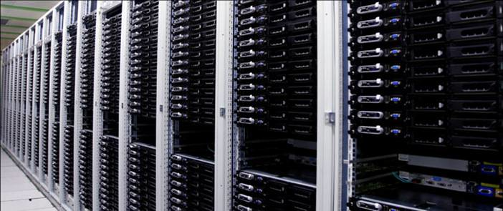
Outlook
Introduction – the ATLAS trigger
Trigger commissioning
Trigger selection performance
Plans for physics menu
The Trigger is a large system – Inevitably, I am reporting on the work of too many people to mention by name – many thanks to them!

Slide 3
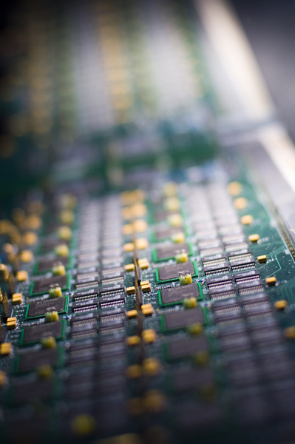
The ATLAS Trigger

Slide 4
What is the ATLAS trigger for?
Much of LHC physics will mean cross sections at least ~10⁶ times smaller than total cross section
25ns bunch crossing interval (40 MHz)
Offline storing/processing: ~200 Hz
~5 events per million crossings!
In one second at design luminosity:
40 000 000 bunch crossings
~2000 W events
~500 Z events
~10 top events
~0.1 Higgs events?
200 events written out
The right 200 events should be written out!

Slide 5
Level 1 architecture
Level 1 uses calorimeter and muon systems only
Muon spectrometer:
Dedicated trigger chambers
Thin Gap Chambers (endcap) – TGC
Resistive Plate Chambers (barrel) – CSC
Calorimeter:
Trigger towers group calorimeter cells in coarse granularity: Δη×Δϕ = 0.1×0.1 (EM/Tau); Δη×Δϕ = 0.2×0.2 (Jets)
Identify regions of interest (RoI) and classify them as MU, EM/Tau, Jet
Information passed to level 2:
RoI type
E_{T} threshold passed
Multiplicity
Location
The response of the level 1 hardware is emulated in Athena.

Slide 6
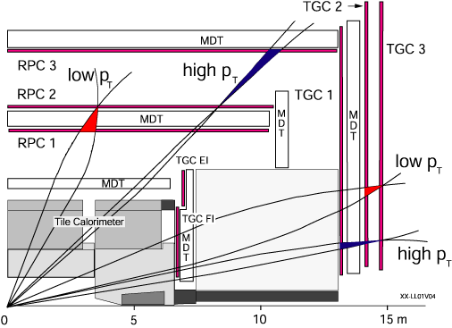
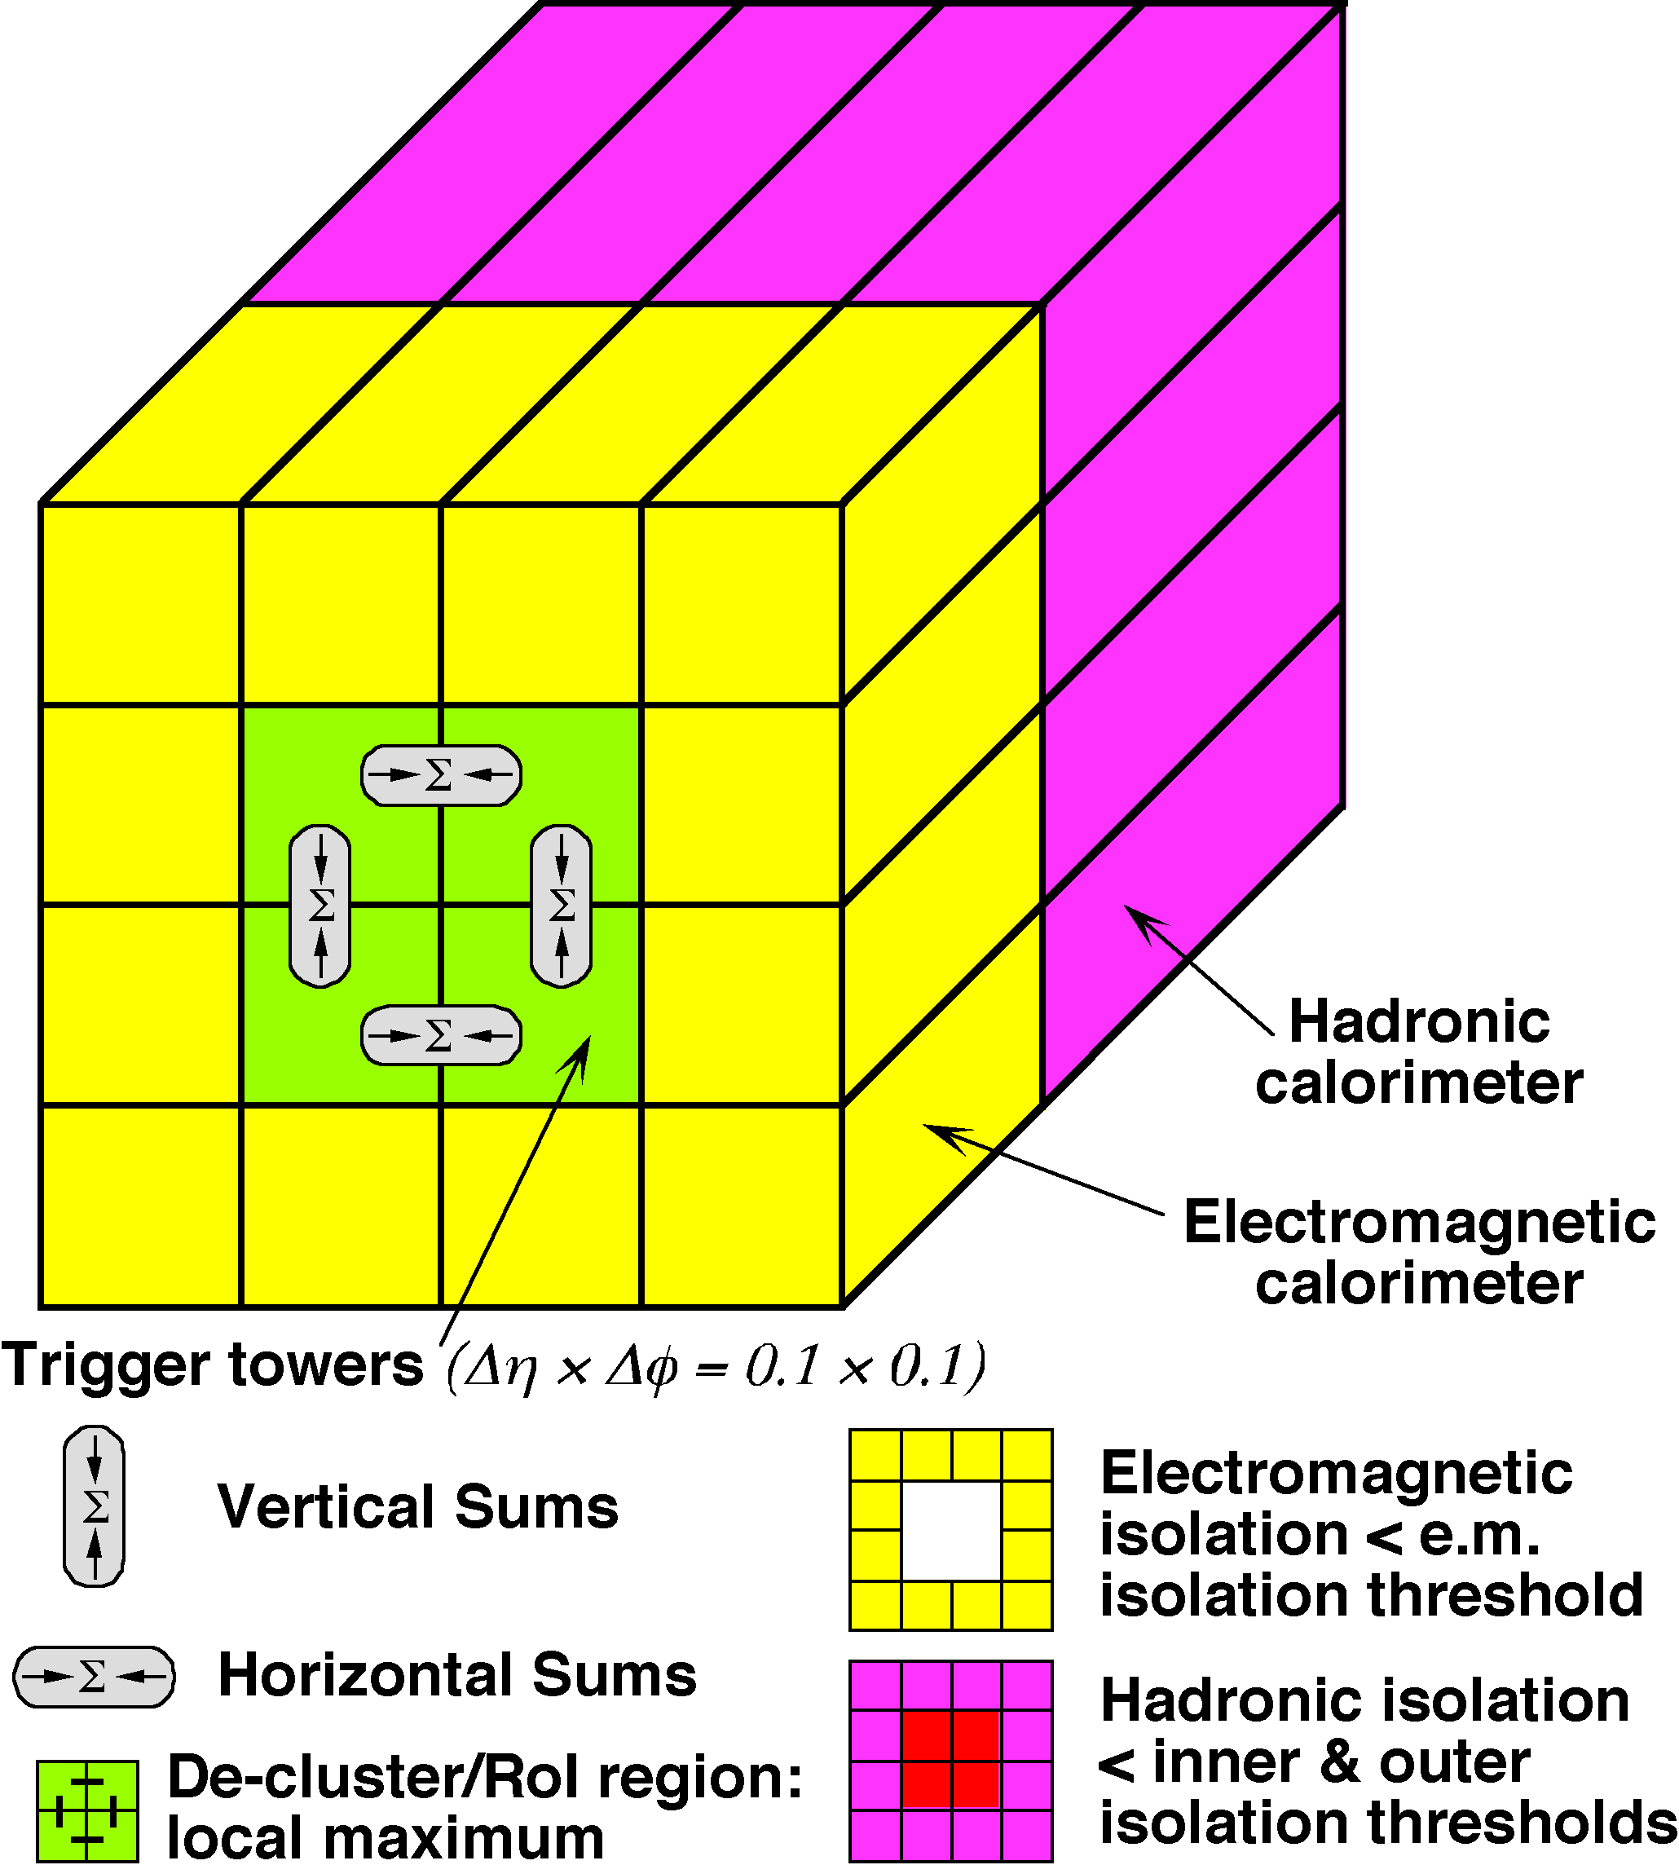
L1 - Muons & Calorimetry
e/γ trigger
Toroid
Muon Trigger looking for coincidences in muon trigger chambers – e.g.: 3 out of 4 (low-p_{T}; >6 GeV) and
3 out of 4 + 1/2 (Barrel) or 2/3 (Endcap) - high-p_{T}; >20 GeV
Calorimetry Trigger looking for e/γ, τ,/isolated hadron, jets
Various combinations of cluster sums and isolation criteria
ΣE_{T}^{em,had} , E_{T}^{miss}

Slide 7
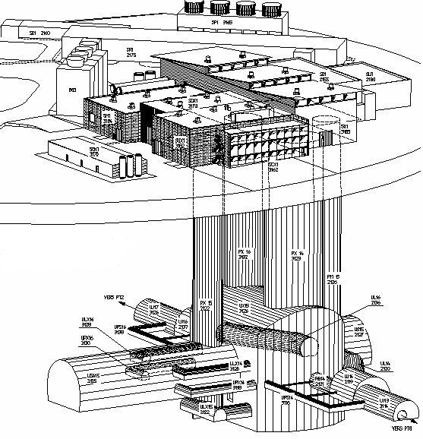
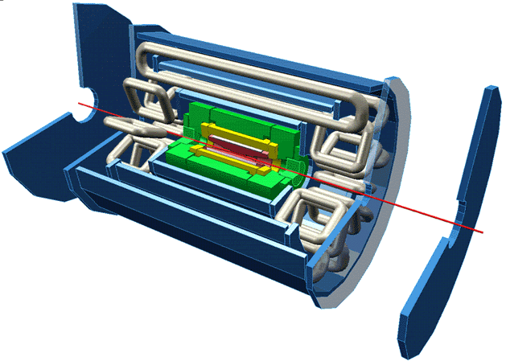
Trigger / DAQ architecture
CERN
computer
centre
4-core dual-socket nodes
6
~1600
~100
~ 500
Event rate
~ 200 Hz
Local
Storage
SubFarm
Outputs
(SFOs)
Event
Filter
(EF)
Event
Builder
SubFarm
Inputs
(SFIs)
LVL2
farm
Second-
level
trigger
Data
storage
DataFlow
Manager
Network
switches
pROS
stores
LVL2
output
Network switches
LVL2
Super-
visor
Gigabit Ethernet
Event data requests
Delete commands
Event data
pulled:
partial events
@ ≤ 100 kHz,
full events
@ ~ 3 kHz
Event size
~1.5MB
Average out
rate ~200Hz
Requested event data
Regions Of Interest
Data of events accepted
by first-level trigger
~150
PCs
1600
Read-
Out
Links
VME
Dedicated links
Read-Out
Subsystems
(ROSs)
Read-
Out
Drivers
(RODs)
RoI
Builder
First-
level
trigger
Timing Trigger Control (TTC)
Event data pushed @ ≤ 100 kHz,
1600 fragments of ~ 1 kByte each

Slide 8
High Level Trigger
Level1 Region of Interest is found and position is passed to Level 2
EMROI
L2 calorim.
Event rejection possible at each step
cluster?
Electromagnetic
clusters
Level 2 seeded by Level 1
Fast reconstruction algorithms
Reconstruction within RoI
L2 tracking
track?
match?
E.F.calorim.
E.F.tracking
Ev.Filter seeded by Level 2
Offline reconstruction algorithms
Refined alignment and calibration
track?
e/γ reconst.
e/γ OK?

Slide 9
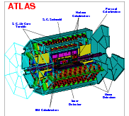
Trigger Configuration + Data
TriggerDB All configuration data
Preparation
Stores
decoded Trigger Menu
Configures
Data
taking
Online
Conditions
Database
COOL
Encoded trigger result
from all 3 levels
Decoded trigger menu
Reconstruction
Trigger Result
passed?, passed through?, prescaled?, last successful step in trigger execution?
Trigger EDM
Trigger objects for trigger selection studies
Trigger Configuration
Trigger names, prescales, pass throughs
access through TrigDecisionTool
ESD
AOD
With decreasing amount of detail
Trigger aware analysis
DPD
TAG

Slide 10
Trigger Algorithms and Trigger Data
The Trigger Execution
FEX algo’s are executed to create features on which selection in HYPO algo’s is based
Chain:
Started, if seed has fired and chain is not prescaled
Stopped at step, if a HYPO is not passed
Last HYPO passed → chain passed
Event:
Passed, if at least one EF chain is passed
Put into all streams that are associated with the passed EF chains
Trigger objects associated with triggers through Navigation TriggerElements
Trigger information in
Trigger Decision + Configuration + +
EM ROI
EM ROI
FEX
EM_ROI
Feature
HYPO
L2 calorim.
L2 calorim.
TE Pass/Fail
TrigEMCluster
cluster?
cluster?
L2 tracking
TrigInDetTracks
track?
match?
E.F.calorim.
TE Pass/Fail
E.F.calorim.
CaloCluster
E.F.tracking
TE Pass/Fail
EFTrack
track?
e/γ reconst.
e/γ reconst.
TE Pass/Fail
egamma
ESD
AOD
DPD
TAG
γ OK?
e OK?
γ OK?
e OK?
Navigation
Feature

Slide 11
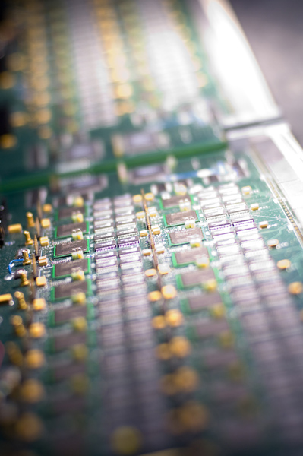
Trigger Commissioning

Slide 12
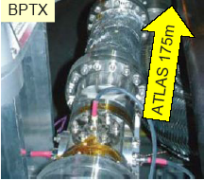
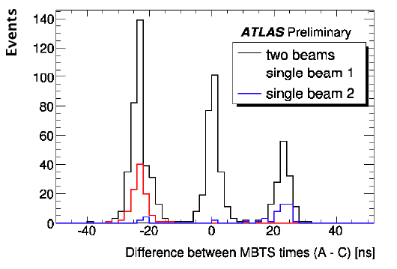
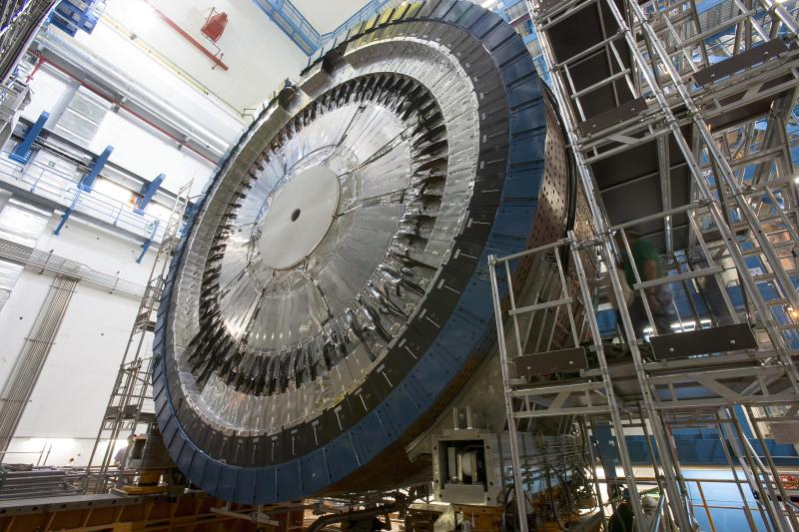
Long period of commissioning with cosmics
Good side was we got used to infrastructure
Finally followed by 900GeV running last December
Beam pickups (BPTX) and MBTS give workhorse L1 triggers
Skeleton HLT only: no algorithms
Beam Pickup: ±175m from ATLAS
Minbias Trigger Scintillator:
32 sectors on LAr cryostat

Slide 13
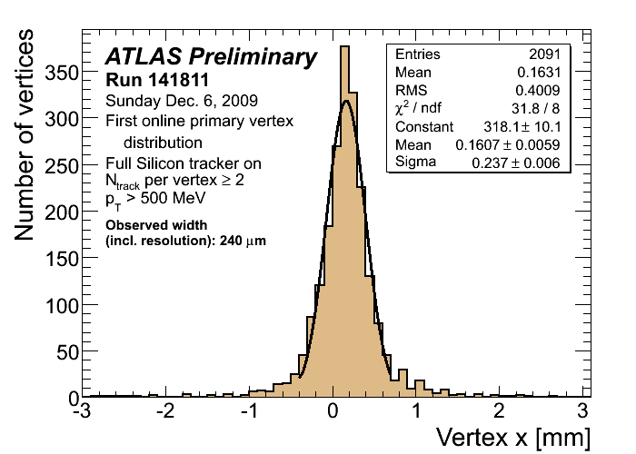
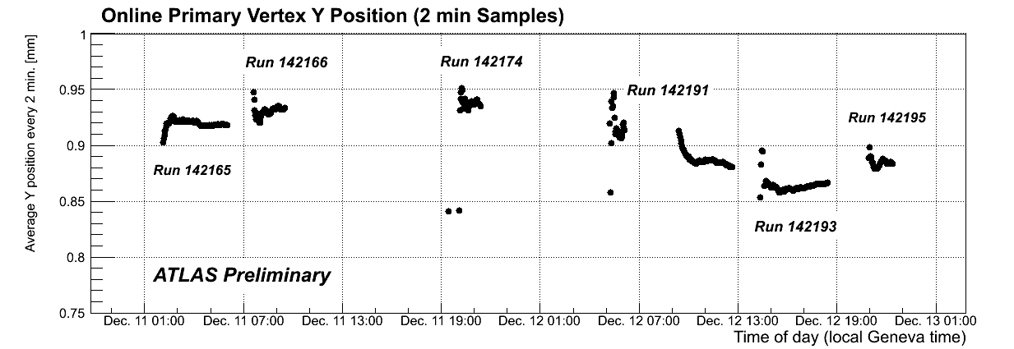
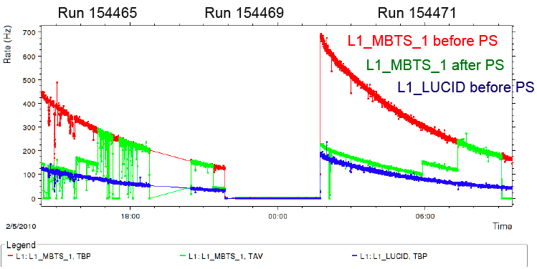
HLT algorithms introduced a few days after first 900GeV run
E.g. L2 beamspot algorithm sends immediate info to LHC
Running HLT online important to debug and commission algorithms and monitoring
Started prescaling loosest MBTS triggers only when we reached 4x10²⁷cm⁻²s⁻¹
Start rejecting events in HLT for MinBias triggers only (using InDet chains at L2)
900GeV High-intensity runs

Slide 14
Trigger Performance

Slide 15
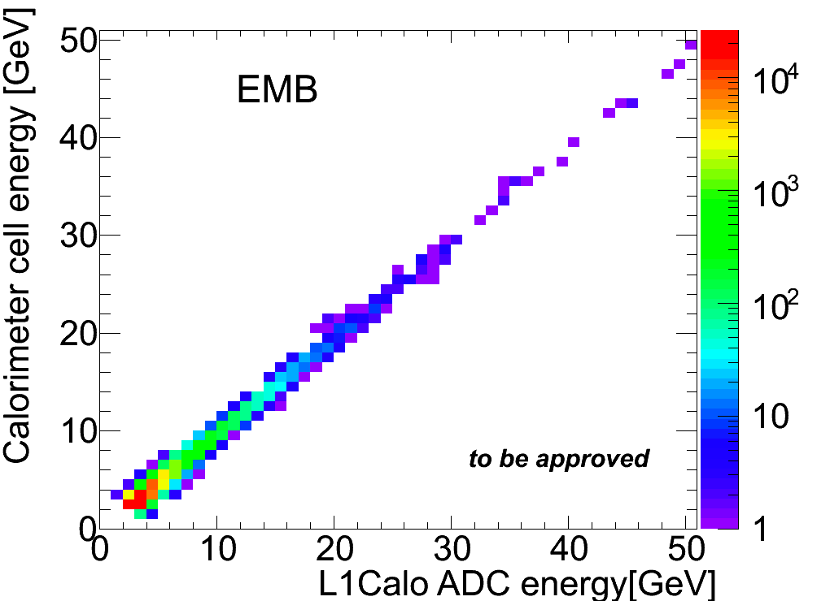
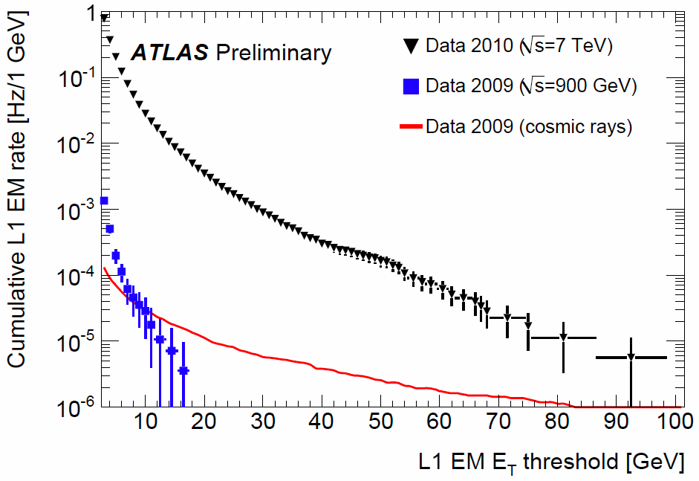
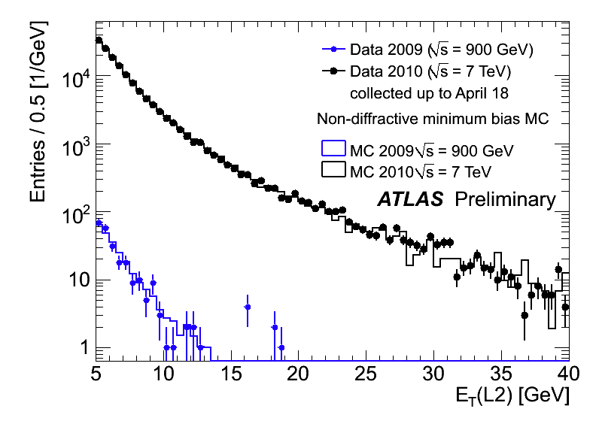
Calorimeter
L1 Calo has different energy scale and readout than HLT – coarser granularity
Summing cells and comparing to trigger tower
Recent improvement in timing of signals
HLT relies on DSP-decoded quantities for each cell - cannot re-fit samplings as for offline reconstruction
Developments in parallel with detector
L1:
9μb⁻¹ @ 900GeV
400μb⁻¹ @ 7TeV
L2:
9μb⁻¹ @ 900GeV
400μb⁻¹ @ 7TeV

Slide 16
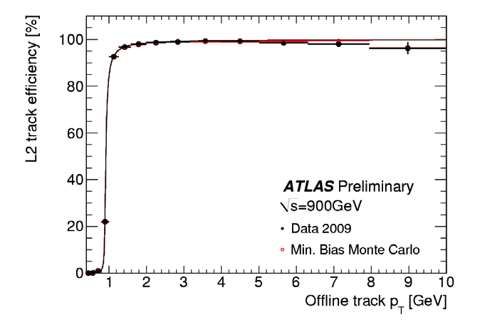
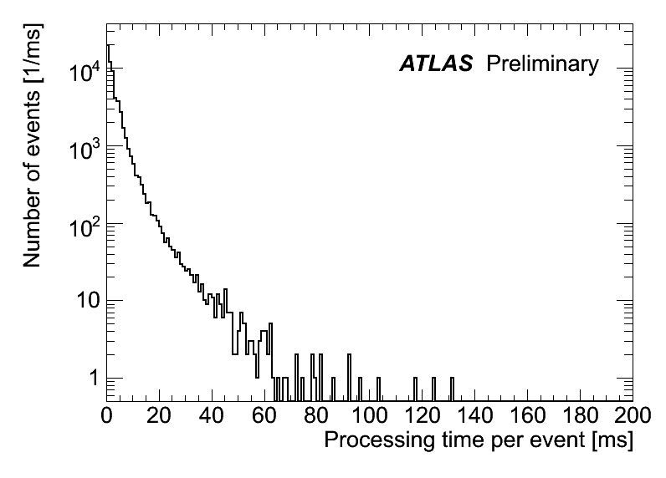
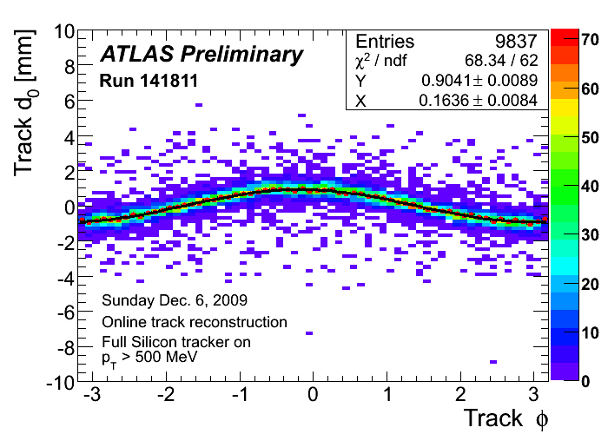
HLT Tracking
Efficiency for L2 tracks close to 100%; compares well to MC
L2 tracking used online for beamspot calculation and feedback to LHC
L2 tracking algorithm processing time per event – average 40ms/event for whole L2

Slide 17
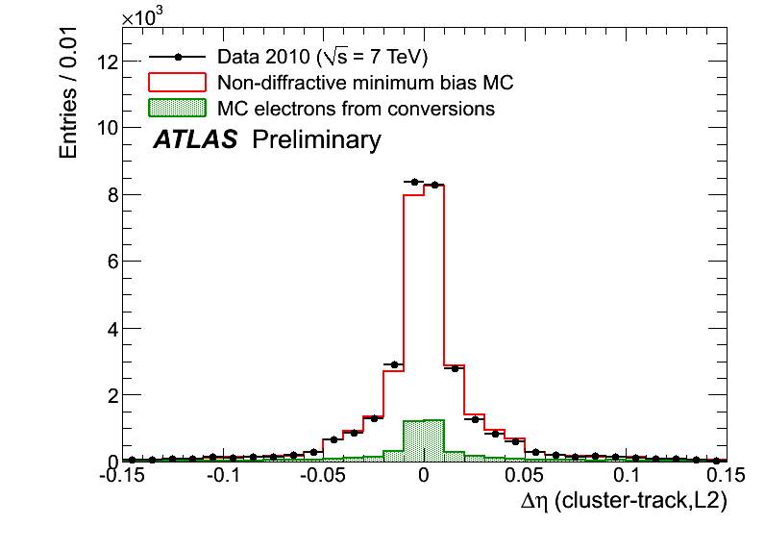
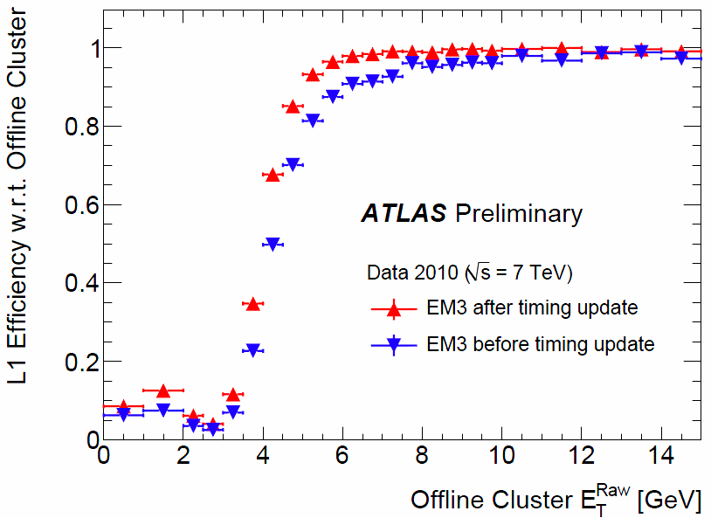
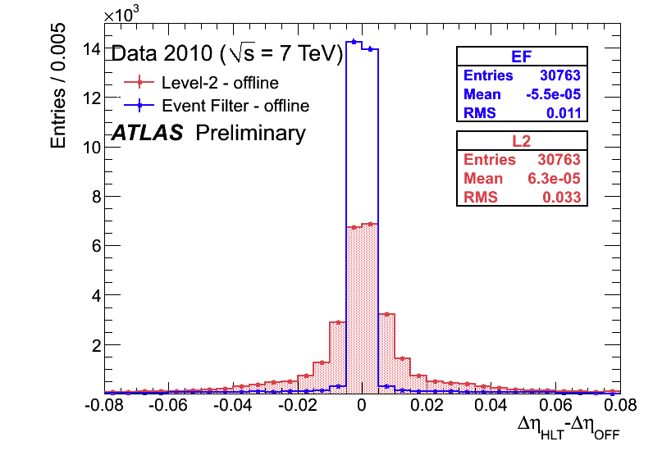
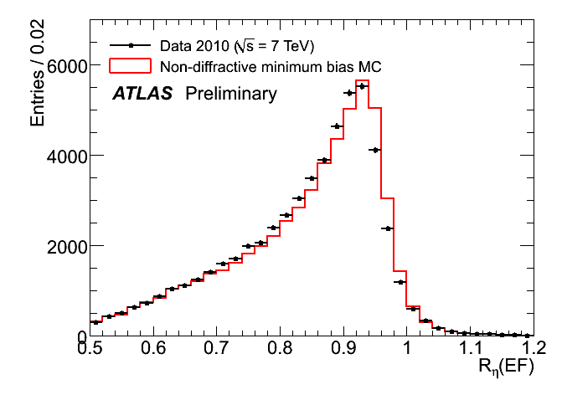
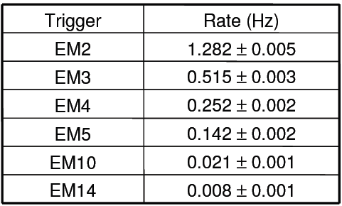
e/gamma Trigger
Improvements from L1Calo timing
HLT some disagreement in shower shapes between data and MC – likely cross talk, or dead material map in MC not correct
Rates show EM2 will need to be prescaled or HLT rejection @ 10²⁹
L2 track cluster matching well described by MC
L2
L1 rates measured for 10²⁷cm⁻²s⁻¹ – stat. errors only (luminosity error ≈20%)
R_{η}=E_{3x7}/E_{7x7}

Slide 18
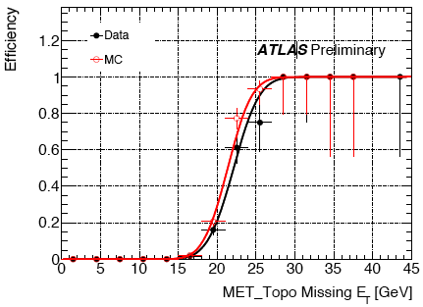
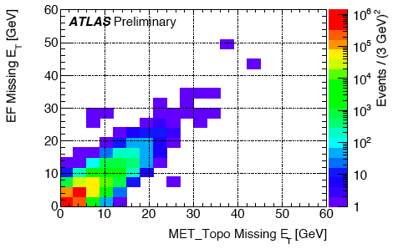
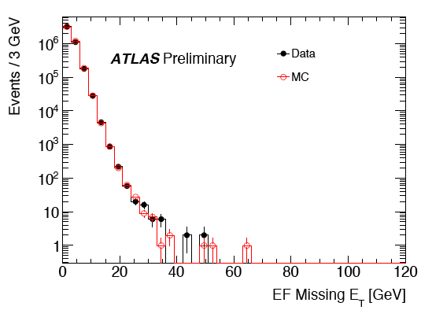
Missing E_{T}
Turn-on curve for EF_xe20 with 7TeV data compared to MC
Data-MC comparison of E_{T}^{miss} at the Event Filter after jet-cleaning cuts (stat. errors only)
Correlation between online and offline at E_{t}^{miss} 7 TeV
EF_xe20

Slide 19
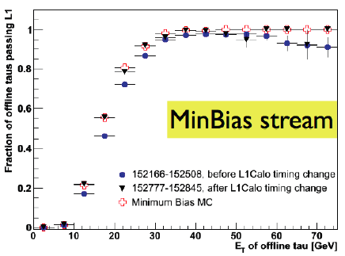
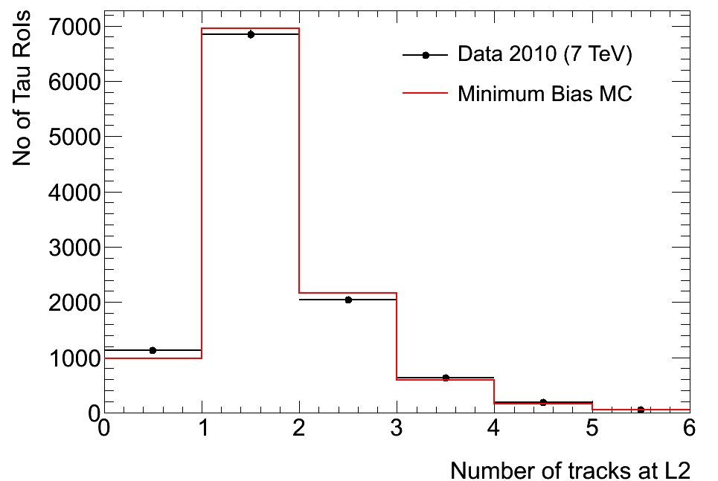
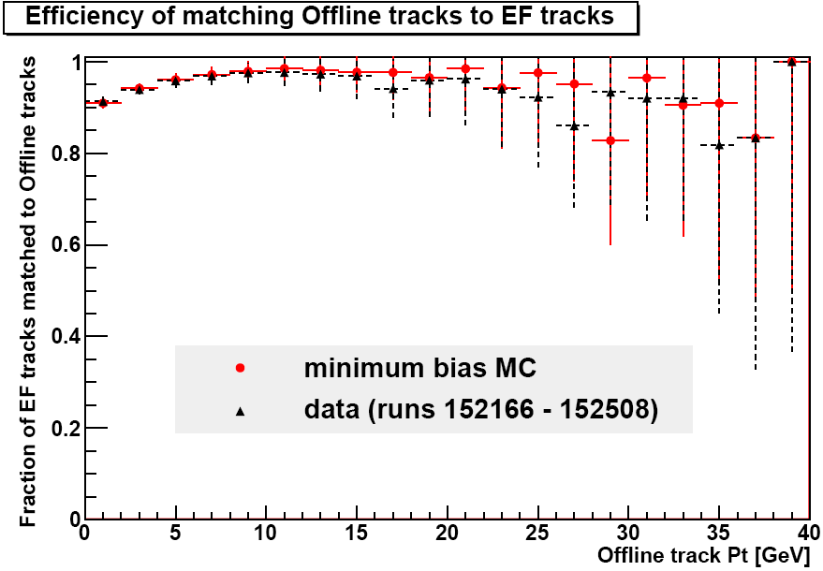
Tau
Improvement of the L1 tau efficency after L1Calo timing change
EF tracking efficiency for tau candidates:
Offline: Pt>1GeV, nPIXhits >=1 , nSCThits >=6
EF tracks: Pt > 0.5 GeV, nPixhits >=1, nSCThits >=6
#tracks in tau candidates: MinBias MC compared to 7TeV

Slide 20
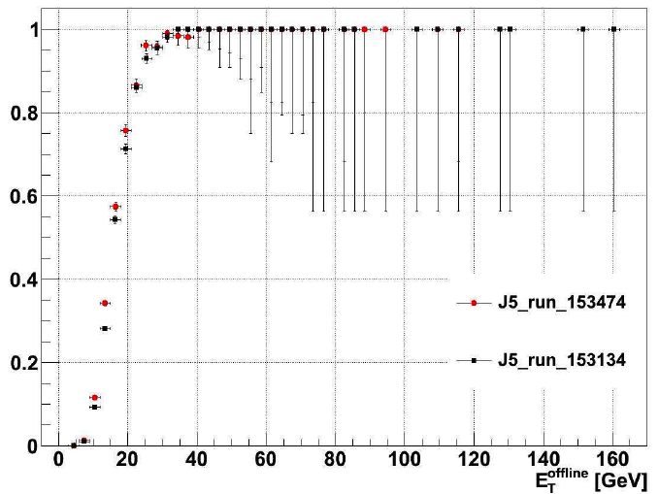
Jets
Improvements from L1Calo timing in – better agreement with MC
Investigated changing L1Calo noise threshold from 4 to 3 ADC counts – no significant change
Moving trigger jet energy scale to EM scale
Planning to introduce jet-cleaning cuts online

Slide 21
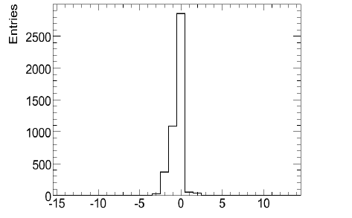
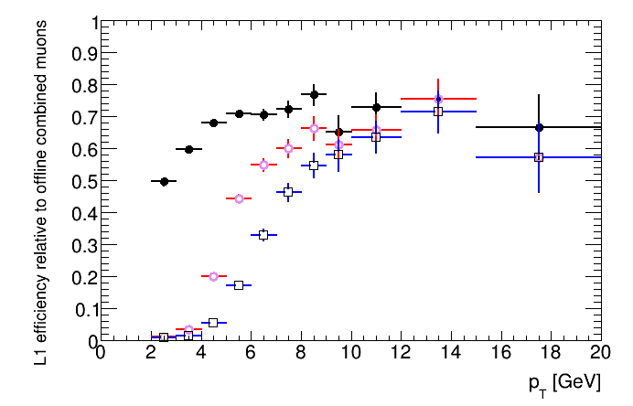
L1 Muon – RPC
Currently fighting problems with timing-in RPC
Need more non-cosmic muons
Problem : MU6 is expected to be as efficient as MU0 for p_{T}>6 GeV – under investigation
Problem possibly from non-prompt muons plus chamber inefficiency
Minbias stream, 7TeV, RPC, MuId
MU0
MU6
MU10

Slide 22
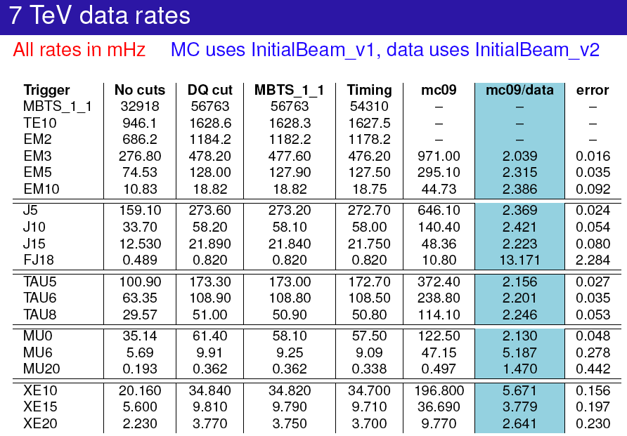
Rate predictions

Slide 23
the Physics Menu

Slide 24
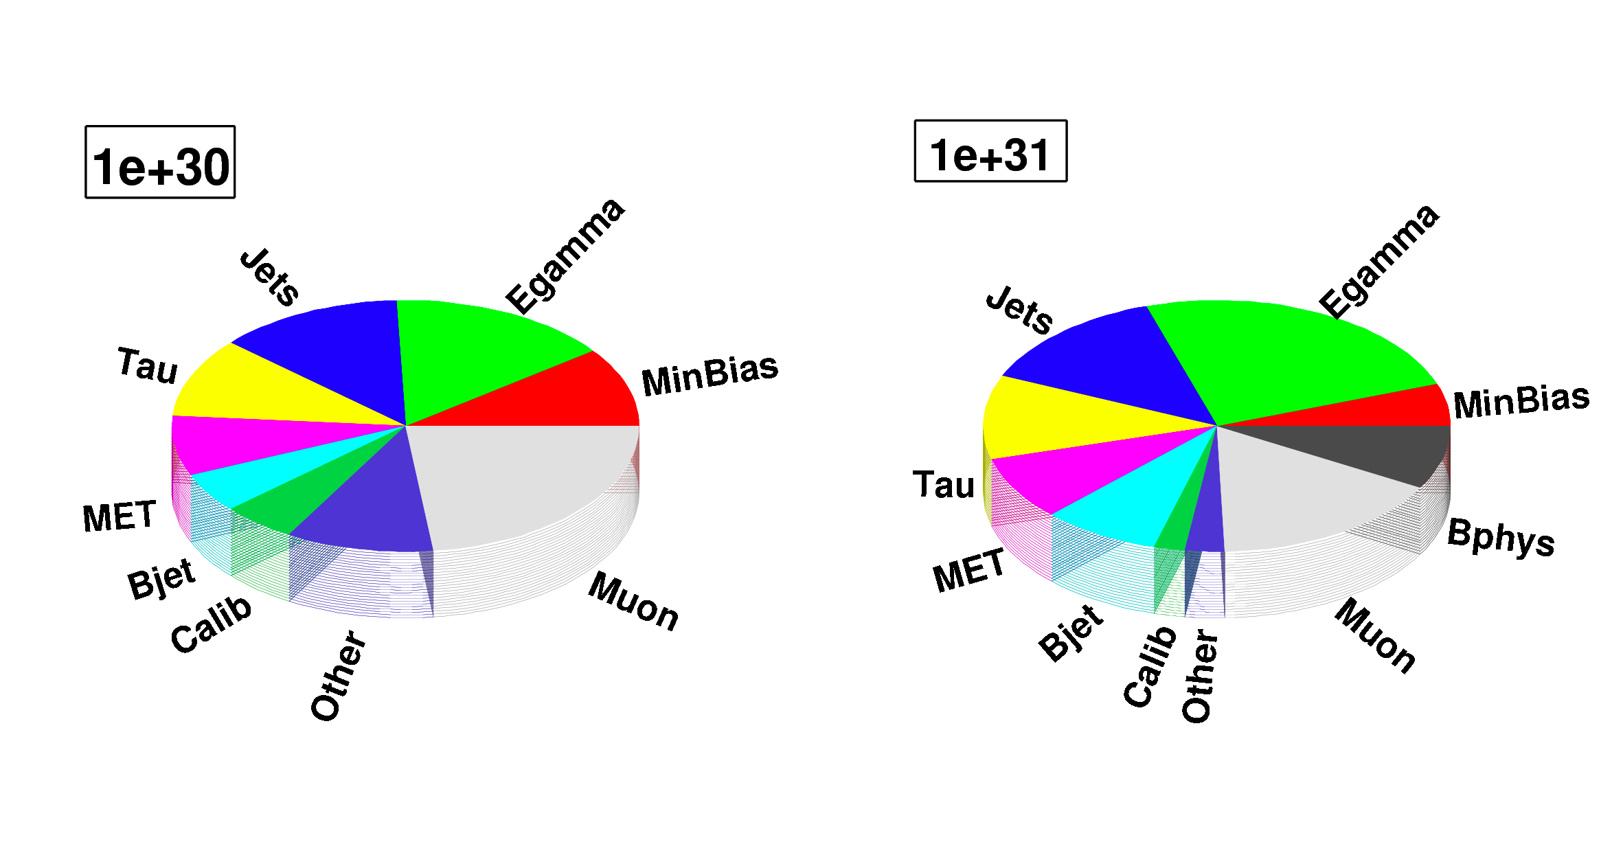
Menu Coordination News
Physics menu to be used when we reach 10³⁰cm⁻²s⁻¹
Menu currently being designed
Will be available until the end of this year (from 10³¹ to 10³²cm⁻²s⁻¹)
To improve uniformity and ease operations
A preliminary version will be made available soon for input from physics and CP groups
Final approval at the end of May for deployment anytime afterwards

Slide 25
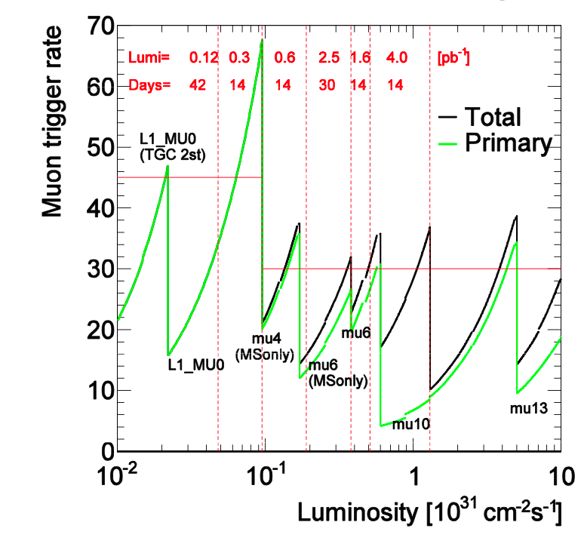
Muons
Primary Physics Triggers as a function of luminosity
Primary trigger mu10 up to 4x10³¹
Then move to mu13 up to 10³²
Details in http://indico.cern.ch/conferenceDisplay.py?confId=74183

Slide 26
Note: zero pileup assumed
Monika Wielers

Slide 27
Monika Wielers

Slide 28
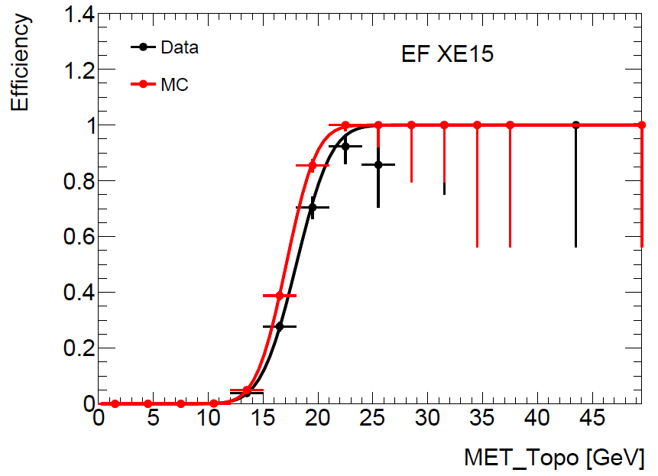
Missing ET
The hope is to have xe30 unprescaled up to a luminosity of 10³¹
An inclusive bandwidth of 20Hz was requested so that xe30 can remain unprescaled up to 10³²
Current bandwidth allows running XE15 unprescaled up to 10³⁰ (around 15Hz)
D.Casadei

Slide 29
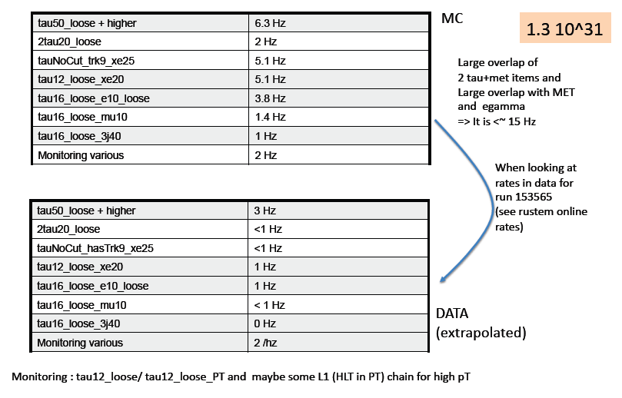
Stefania Xella

Slide 30
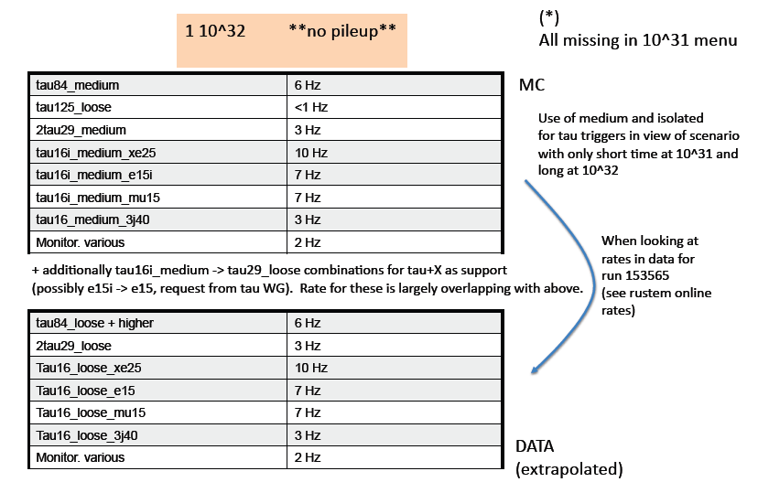
Work in progress
Stefania Xella

Slide 32
Conclusions

Slide 33
An enormous amount of activity is taking place in the trigger
The increasing LHC luminosity means the HLT will soon need to actively reject events
Trigger performance needs to be understood before activating the HLT in rejection mode
Moving from commissioning menu to physics menu

Slide 34
Backup Slides

Slide 35
Calo MuTrCh
40 MHz
Other detectors
1 PB/s
LVL1
2.5 μs
Calorimeter
Trigger
Muon
Trigger
LVL1 Acc.
75 kHz
ROD
ROD
ROD
120 GB/s
H
L
T
LVL2
ROS
~40ms
L2SV
ROB
ROB
ROB
L2P
RoI data
L2P
L2N
3 GB/s
L2P
Event Builder
2 kHz
Event Filter
~4sec
EB
EFP
EFP
EFP
EFN
200 Hz
300 MB/s

Slide 36
Example: level 2 e/γ calorimeter reconstruction
Full granularity but short time and only rough calibration
Reconstruction steps:
LAr sample 2; cluster position and size (E in 3x3 cells/E in 7x7 cells)
LAr sample 1; look for second maxima in strip couples (most likely from π⁰→γγ, etc)
Total cluster energy measured in all samplings; include calibration
Longitudinal isolation (leakage into hadronic calorimeter)
Produce a level 2 EM cluster object (note EDM different from offline)
π⁰
γ

Slide 37
Example: level 2 tracking algorithm
Form pairs of hits in Pixel and SCT in thin φ slices;
extrapolate inwards to find Z_{vtx} from a 1D histogram
Using Z_{vtx}, make 2D histogram of hits in η-φ plane;
remove bins with hits in too few layers
Do 2D histogram using space point triplets in 1/p_{T}-φ plane;
Form tracks from bins with hits in >4 layers
Use Kalman technique on the space points obtained in previous steps
Start from already estimated parameters: Z_{vtx}, 1/p_{T}, η, φ
Full granularity but short time
Algorithms optimised for execution speed, including data access time
Produce level 2 tracks
ρ
Z
Z
Y
Y
ρ
X
X
Z

Slide 38
Bringing it Together – TrigDecisionTool
ESD
AOD
DPD
contain persistent
Configuration can change between runs
Decision + Navigation
EDM
Configuration
Unpacking
Dec. + Nav.
EDM P/T
convertion
IOV based P/T conv.
BUT:
Prescales can change between lumiblocks
(trigger on/off)
IOVDbSvc
Upon Request
ConfigSvc
Transient:
TrigDecision
Feature Nav.
Configuration
TrigDecisionTool

Slide 39
Tool Usage
Alg.h: define ToolHandle to a TrigDecisionTool
Alg.cxx – Alg::Alg(): declare ToolHandle as public tool
Alg.cxx – Alg::initialize(): retrieve tool
Has to be in initialize()!
Alg.cxx – Alg::execute(): use tool
private:
ToolHandle<Trig::TrigDecisionTool> tdt;
MyAlgo::MyAlgo(const std::string &name, …) tdt("Trig::TrigDecisionTool/TrigDecisionTool”)
{…}
StatusCode sc = tdt.retrieve();
if (tdt->isPassed (“L2_e15i”)) {
log << MSG::INFO << ”I’m happy!“ << endreq;
}
TWIKI: https://twiki.cern.ch/twiki/bin/view/Atlas/TrigDecisionTool15
Doxygen: http://atlas-computing.web.cern.ch/.../TrigDecisionTool/html/

Slide 40
Working with ChainGroups
Alg.h: define ChainGroup pointer
Alg.cxx – Alg::initialize(): declare ChainGroup
Note: the ChainGroup automatically updates with each run (chain content) and lumiblock (prescales)
Use regular expressions, e.g. “EF_e.*”
Alg.cxx – Alg::execute():
Access to trigger configuration
Access to trigger decision
Access to trigger objects
const Trig::ChainGroup* mMyTrigger;
mMyTrigger =
tdt.createChainGroup(“EF_e10_loose”,”EF_mu10”,...);
bool useLB = ! mMyTrigger->getListOfTriggers().empty();
bool myEvent = mMyTrigger.isPassed();
const Trig::FeatureContainer fc = mMyTrigger.features();
const std::vector< Trig::Feature< TrigTau > > taus =
fc.get();
Anonymous ChainGroups:
Note that one can work without steps 1 and 2. In Alg::execute() define the triggers on the fly:
Equally fast (TDT keeps ChainGroups)
string tr (“EF_e10_loose”);
bool useLB = ! tdt->getListOfTriggers().empty(tr);
bool myEvent = tdt->isPassed(tr);
const Trig::FeatureContainer fc = tdt.features(tr);

Slide 41
Athena Example for using Features
FeatureContainer for ‘EF_tau16i_loose_2j23’
Access the feature
You need to know the type of the Feature: ‘JetCollection’ in EF
Access the object (implicit conversion)
Access information of object
Find corresponding L2 jet using TDT::ancestor<T>
FeatureContainer f = tdt->features("EF_tau16i_loose_2j23"); // creating the feature container
std::vector< Feature<JetCollection> > jetColls = f.get<JetCollection>();
mLog << MSG::INFO << "Number of JetCollections: " << jetColls.size() << endreq;
if(jetColls.size()>0) {
const Feature<JetCollection>& jcf = jetColls[0]; // get the first Feature
mLog << MSG::INFO << "Label: " << jcf.label() << endreq;
const JetCollection* jc = jcf; // implicit Feature -> object conversion
mLog << MSG::INFO << "Number of Jets: " << jc->size() << endreq;
JetCollection::const_iterator jIt = jc->begin();
for (; jIt != jc->end(); ++jIt ) {
Jet* jet = *jIt;
mLog << MSG::INFO << "Jet e : " << jet->e() << endreq;
}
// find the corresponding jets in Lvl2 through the inheritance tree (navigation does that all)
Feature<TrigT2Jet> l2jetF = tdt->ancestor<TrigT2Jet>(jcf);
mLog << MSG::INFO<<"Found “<< (l2jetF.empty()?"no ":"“)<< "corresponding L2 Jet.”<<endreq;
if ( !l2jetF.empty() ) {
const TrigT2Jet* t2jet = l2jetF.cptr(); // explicit Feature -> object conversion
mLog << MSG::INFO << " e : " << t2jet->e() << endreq;
}
}
Output:
Number of JetCollections: 1
TE Label: TrigJetRec
Number of Jets: 1
Jet e : 82827.9
Found corresponding L2 Jet.
e : 83197.4

Slide 42
Tools to Investige the Trigger Setup
http://atlas-trigconf.cern.ch:
Main web portal to trigger configuration by run number, MC menu name, configuration keys
Uses TriggerTool and AtlCoolTrigger.py underneath
TriggerTool:
Java based GUI to browse the TriggerDB (replica) for all information
Also used at point 1 for preparation of trigger
AtlCoolTrigger.py:
Command line tool to show release, configuration keys, menu information, streams for data
http://atlas-runquery.cern.ch/
Query page for trigger chains, prescales, trigger release for data

Slide 43
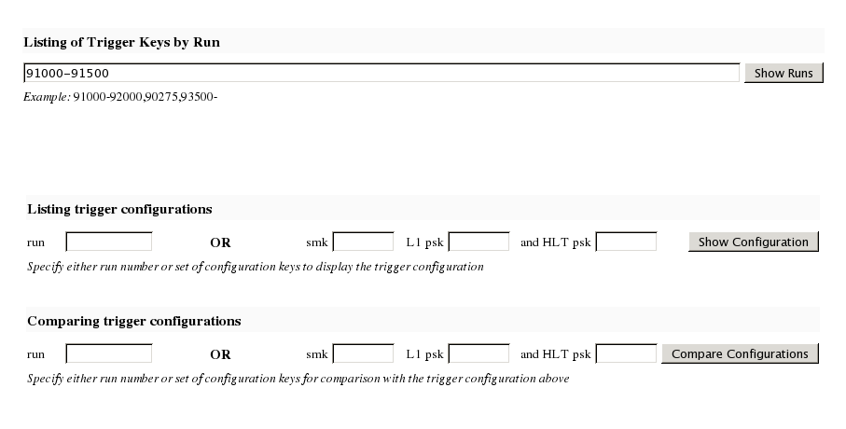
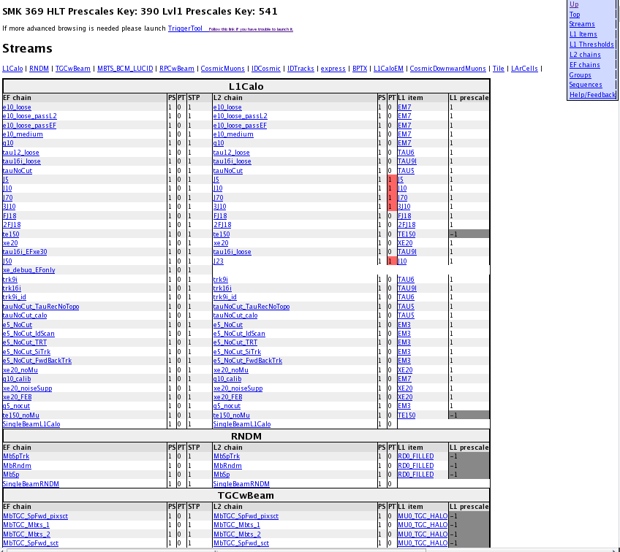
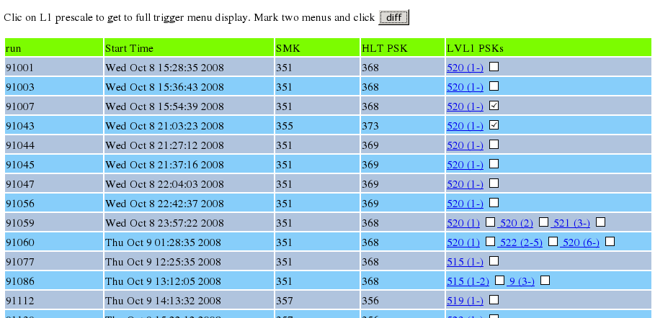
Example for the Configuration Portal
3. Browse the trigger configuration (definition, algorithms, selection cuts)
1. Enter run-range
Go to http://atlas-trigconf.cern.ch
2. Click on link in resulting run list
Also with simple comparison functionality

Slide 44
Trigger Menu Listing
Trigger Menu and L1 rates stored in COOL, HLT rates coming. Quick access via
AtlCoolTrigger.py (command line tool)
AtlCoolTrigger.py –r 91000‐99000 (many run summary)
AtlCoolTrigger –v –m –r 90272 (single run menu)
Prints keys, trigger menus, streams, allows diff‐ing of menus in different runs, creates menu in xml format
Run summary pages (WEB based):http://atlas-service-db-runlist.web.cern.ch/atlas-service-db-runlist/query.html
Trigger names, rates for single run

Slide 45
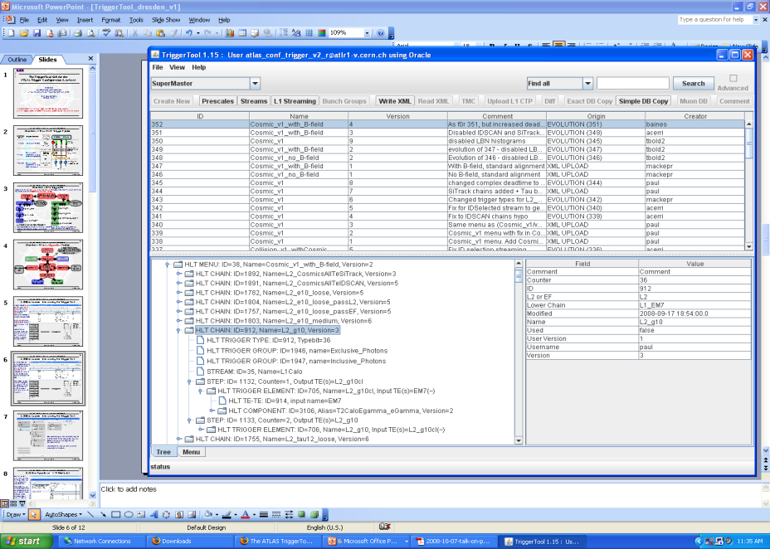
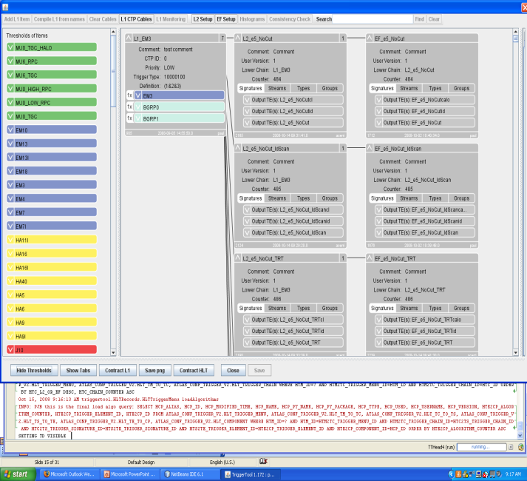
TriggerTool
Java based front end to TriggerDB, launch from the web (Java web-start): http://www.cern.ch/triggertool
Overview of all trigger configurations (data taking and MC)
Detailed and convenient investigation of trigger menus
Trigger definition L1->L2->EF: prescales, threshold algorithms, selection criteria, streaming information, etc.
Possibility to compare different trigger configurations
Used at point 1 for trigger operation
TDAQ training tutorial for the TT

Slide 46
Scripts to Check Pool File Content
checkTrigger.py AOD.pool.root
Runs over ESD/AOD/DPD and presents detailed (chain‐wise) counts of the trigger decision
checkTriggerConfig.py ‐d AOD.pool.root
Runs on ESD/AOD/DPD and presents detailed trigger configuration(s)
Shows multiple configurations (merged DPD)
File:AOD.pool.root
Size: 55955.492 kb
Nbr Events: 250
Trigger configuration summary:
SMK: 0, HLTpsk: 0, L1psk: 0
Config source: TriggerMenuXML/LVL1config_MC_lumi1E31_no_prescale_15.1.0.xml and TriggerMenuXML/HLTconfig_MC_lumi1E31_no_prescale_15.1.0.xml
L1 Items : 146
HLT Chains : 556
================================================================================
ID level Trigger name Passed events: raw, after PS, after PT/Veto
================================================================================
LVL1 Global LVL1 250
LVL2 Global LVL2 250
EF Global EF (LVL3) 250
--------------------------------------------------------------------------------
13 LVL1 L1_2EM13 71 71 71
14 LVL1 L1_2EM13I 34 34 34
163 LVL1 L1_2EM13_MU6 8 8 8
....
--------------------------------------------------------------------------------
...
77 LVL2 L2_2g10 118 118 118
246 LVL2 L2_2g10_mu6 12 12 12
....
--------------------------------------------------------------------------------
...
477 EF EF_2e6_medium 8 8 8
478 EF EF_2e6_medium1 7 7 7
79 EF EF_2g20 39 39 39
248 EF EF_2j42_xe30 3 3 3
....
================================================================================
> checkTriggerConfig.py –d data09_cos.00121733.physics_L1Calo.recon.ESD.r733_tid073522/ESD.073522._000001.pool.root.1
…
EF: EF_mu0_tgc_halo_IDSCAN (1.00), L2: L2_mu0_tgc_halo_IDSCAN (1.00), L1: L1_MU0_TGC_HALO (1) [streams: TGCwBeam]
…

Slide 47
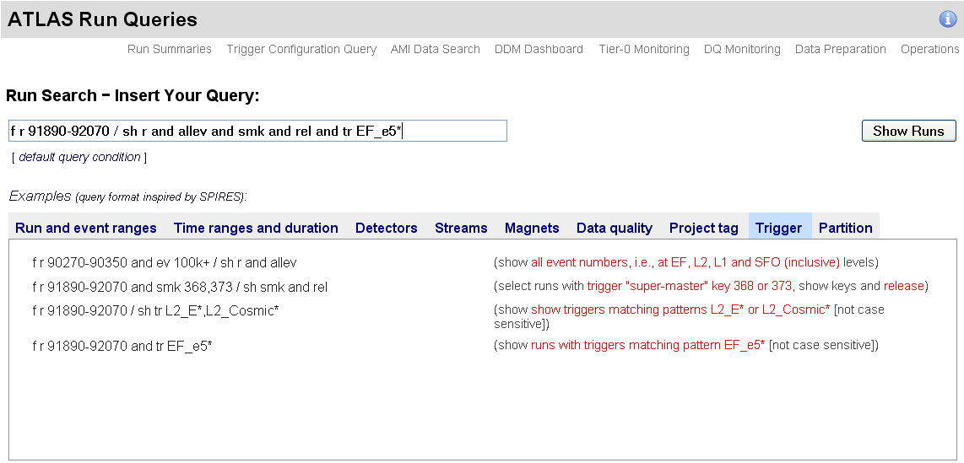
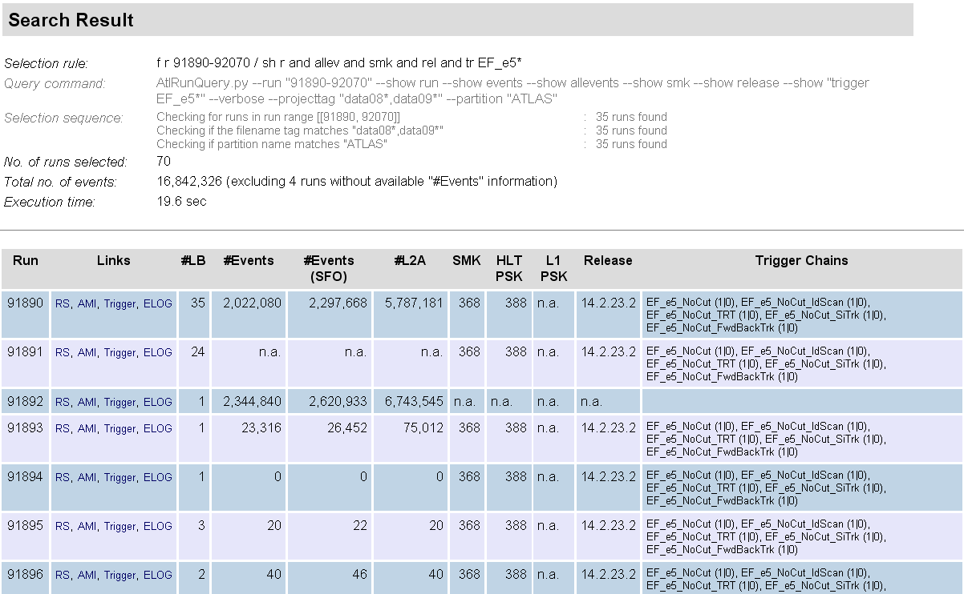
Trigger Content of Atlas-Runquery
Search for runs by release, configuration key, trigger content
Display and have links to run-summary, AMI, trigconf.ch, e-log

Slide 48
Additional Information
Trigger user info: https://twiki.cern.ch/twiki/bin/view/Atlas/TriggerUserPages
Tutorials: https://twiki.cern.ch/twiki/bin/view/Atlas/TriggerSoftwareTutorialPage
TDT Twiki: https://twiki.cern.ch/twiki/bin/view/Atlas/TrigDecisionTool
TDT Doxygen: http://atlas-computing.web.cern.ch/atlas-computing/links/nightlyDevDirectory/AtlasOffline/latest_doxygen/InstallArea/doc//TrigDecisionTool/html/index.html
Trigger obj matching: https://twiki.cern.ch/twiki/bin/view/Atlas/TriggerObjectsMatching
TrigAnalysisExample: http://atlas-computing.web.cern.ch/atlas-computing/links/nightlyDevDirectory/AtlasOffline/latest_doxygen/InstallArea/doc/TrigAnalysisExamples/html/index.html
UserAnalysis example: https://twiki.cern.ch/twiki/bin/view/AtlasProtected/UserAnalysis
Trigger Configuration: http://trigconf.cern.ch
TriggerTool: http://www.cern.ch/triggertool
Run query: http://atlas-runquery.cern.ch/
Trigger EDM: https://twiki.cern.ch/twiki/bin/view/Atlas/TriggerEDM, http://alxr.usatlas.bnl.gov/lxr/source/atlas/Trigger/TrigEvent/TrigEventARA/TrigEventARA/selection.xml
TriggerMenu group: https://twiki.cern.ch/twiki/bin/view/Atlas/TriggerPhysicsMenu
TriggerSW group: https://twiki.cern.ch/twiki/bin/view/Atlas/TAPMCoreSW
TriggerConfig group: https://twiki.cern.ch/twiki/bin/view/Atlas/TriggerConfiguration
Help on e-groups: hn-atlas-TriggerHelp at cern.ch

Slide 49
Trigger Contacts in Analyses
Higgs Group | Channel | Contact Person
HSG1 | H->γγ | Li Yuan
HSG2 | H->4l | Diego Rodriguez
 | H->2l2tau, H->2l2nu and H->2l2b | Paul Thompson
 | HZ (H->invisible) | Sylvie Brunet
HSG3 | H->WW (gg, VBF, WH, ttH, inv.) | Gemma Wooden
HSG4 | H->ττ leptonic and lep-had final states | Matthew Beckingham and Henrik Nilssen
 | H->ττ hadronic final states | Stefania Xella
HSG5 | ttH (H->bb) semileptonic | Catrin Bernius
 | ttH (H->bb) hadronic | Michael Nash
 | H+ (light, hadronic tau) | Martin Flechl
 | H+ (light, leptonic tau) | Arnaud Ferrari
 | H+ (heavy) | Martin zur Nedden

Slide 50
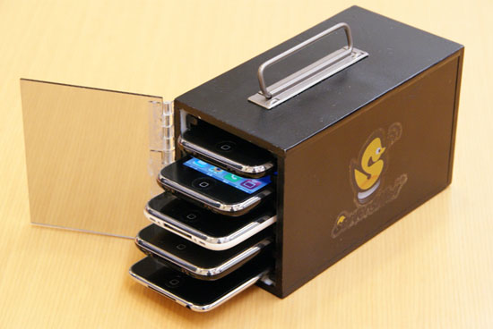
Project for TDAQ farm of tomorrow

