Slide 1
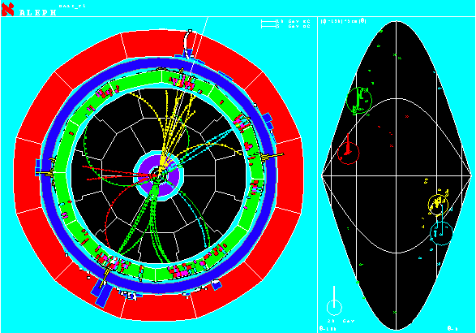
H➝bb Note Meeting Malachi Schram, McGill Ricardo Gonçalo, RHUL H->bb 7TeV meeting, 5/11/2011

Slide 2
New Monte Carlo Samples
Channel | Sample ID | Generator | #events | M_{H} (GeV)
VBF H->bb | 116306 | Herwig | 30k | 115
 | 116307 | Herwig | 30k | 125
 | 116308 | Herwig | 30k | 130
WH | 116309 | Pythia | 30k | 115
 | 116310 | Pythia | 30k | 125
 | 116311 | Pythia | 30k | 130
ZH | 116312 | Pythia | 30k | 115
 | 116313 | Pythia | 30k | 125
 | 116314 | Pythia | 30k | 130
ttH -> l⁺ν jj bb | 116300 | Pythia | 30k | 115
 | 116301 | Pythia | 30k | 125
 | 116302 | Pythia | 30k | 125
ttH -> l⁻ν jj bb | 116303 | Pythia | 30k | 115
 | 116304 | Pythia | 30k | 125
 | 116305 | Pythia | 30k | 125
Zbb+γ | 109370 | Sherpa | 50k | --
bb+γ | 109371 | Sherpa | 50k | --
New samples being produced/finished
MC09 samples to be reprocessed with MC10
Also, large statistics tt+X samples
Still to come: hadronic ttH
Thanks to Chris and Malachi for pushing these through!

Slide 3
Trigger Validation “Sample T”
In addition to these, there is a set of data samples intended for checking new trigger menus
First production to happen in next few days
Important that interested groups check samples and provide feedback to Higgs trigger contact, Gemma Wooden
Sample ID | Nr. Events | Description | Higgs mass
109910 | 10k | bbA, A->tautau->lh | 120
105333 | 10k | VBF H->tautau->ll | 120
106534 | 10k | H->WW->lnulnu | 130
106384 | 10k | H->gamgam | 120
116002 | 10k | H->ZZ->llnunu | 300
109851 | 20k | tt->bWbH+: H+->tau(inc)nu, W->inc | 130
109855 | 10k | tt->bWbH+: H+->cs, W->inc | 130
109921 | 10k | bbA, A->tautau->hh | 100
109861 | 10k | nMSSM a->mumu | 7
109351 | 10k | ZH, H->bb & Z->nunu | 120
105338 | 10k | VBF H->tautau->hh | 120
109840 | 10k | ttH->(blnu)(bqq)bb | 120
116342 | 10k | H->WW->lnuqq | 300
116127 | 10k | WH, H->bb | 120
106324 | 10k | VBF H -> inv | 250
109930 | 10k | bbA, A->mumu | 120
105300 | 10k | H->ZZ->4l | 130
105334 | 10k | VBF H->tautau->lh | 120
109900 | 10k | bbA, A->tautau->ll | 120
? | 10k | ttH (fully-Hadronic) | ?
total | 210k

Slide 4
http://indico.cern.ch/conferenceOtherViews.py?view=standard&confId=105264
Previous workshop at CERN focused on inclusive cross sections
This one devoted to discussions of exclusive Higgs cross-sections
Chris Potter replacing Chris C-T as ATLAS contact for H->bb final state

Slide 6
CONF Note Plans
Plan to propose one CONF note intended for Moriond 2011:
“Estimation of the Z+jets background to ZH→llbb Search with the ATLAS Detector at 7TeV”
Based on SM Z+jets analysis
Follow same cut flow up to “pre-tag” stage only, to avoid b-tagging calibration and b-jet energy scale issues
Follow same systematics as Z+jets analysis
Intend to use rel.16: updated Z-width calibrations from data/MC comparison, updated trigger, updated jet EDM
Latest status report in Malachi’s talk at our last meeting:
http://indico.cern.ch/getFile.py/access?contribId=2&resId=0&materialId=slides&confId=109652

Slide 7
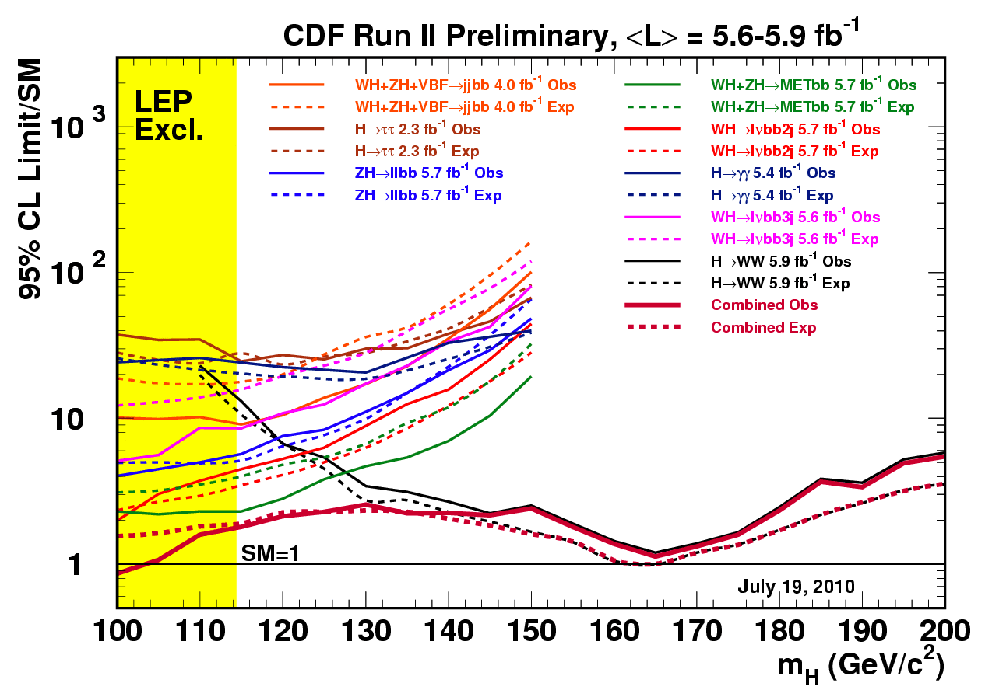
Uncovered Channels
Next year we have good chances of excluding a large range of Higgs masses
Should try to cover all possibilities… the tevatron is covering all possibilities… ☺
Several good channels are available for interested people :
VH -> E_{T}^{miss} + bb
MSSM H->bb: see Eirik Gramstad’s talk in Dubna: http://indico.cern.ch/getFile.py/access?contribId=32&sessionId=7&resId=0&materialId=slides&confId=83611
But Eirik can’t follow up. Any takers?

Slide 8
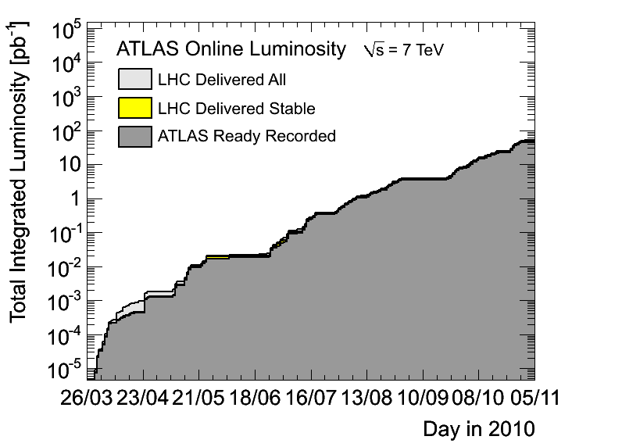
Food for Thought: The Road Ahead
Need to think about our goals for next year:
Moriond: try to get one CONF note (ZH backgrounds)
Anything for Summer conferences?
What partial results do we expect to have at the end of Summer 2011?
Expect 1fb⁻¹ at end of 2011:
Would mean running for about 40 weeks at our best lumi and performance so far
But expect to go higher in instantaneous luminosity (perhaps x10)
Current estimates are to reach ~1.6E33 next year – assumes all bunches filled at nominal charge and perhaps smaller β*
Can we get more than 1fb⁻¹?
By end of 2011 should have all machinery in place to make exclusion plots including H->bb channels

Slide 9
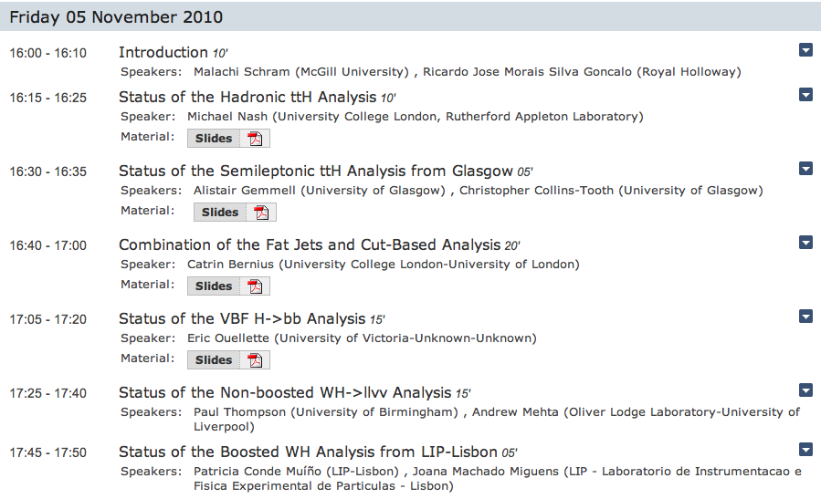
Today’s Agenda

