Slide 1
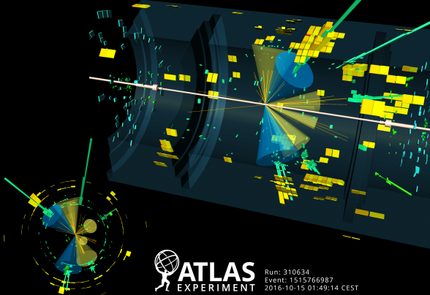
Constraining CP of Higgs-top coupling
Ricardo Gonçalo
UC/LIP
HTop Workshop 2020

Slide 2
Outlook:
Why constrain the CP quantum numbers of the ttH vertex?
Recent results from ATLAS and CMS
What’s our next step?
The ttH(H→bb) analysis
HL-LHC extrapolations
Conclusions

Slide 3
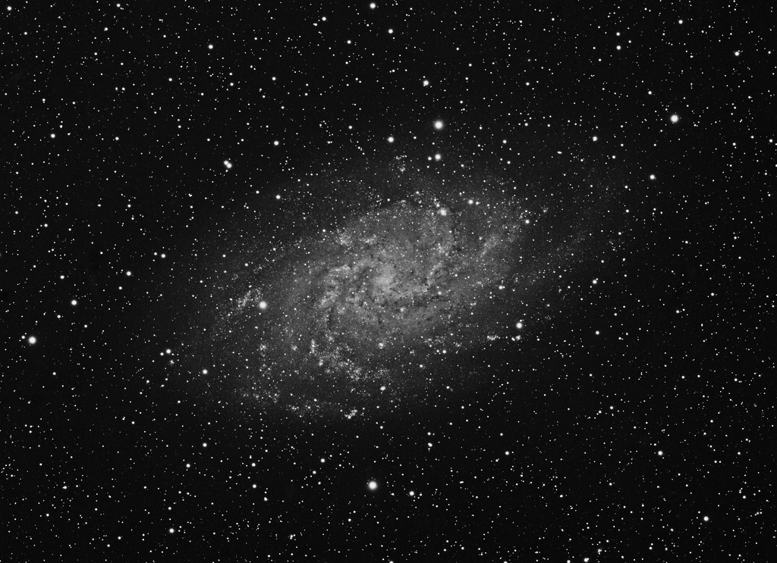
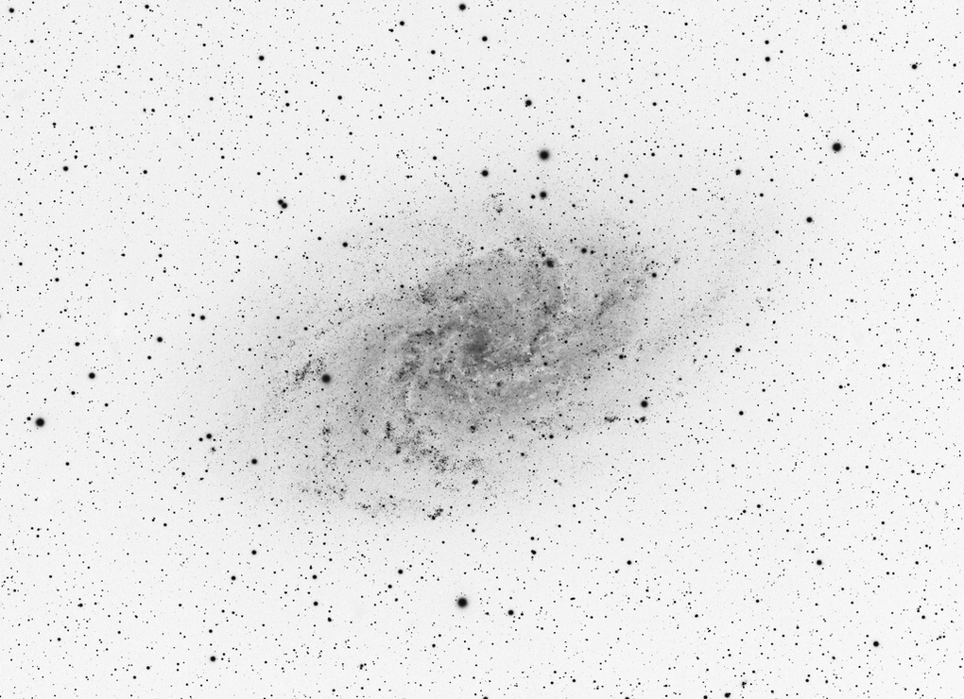
Why constrain CP of Higgs-top coupling?
The violation of CP symmetry is our best explanation for a matter-dominated universe
Sakharov’s conditions for baryogenesis
But not enough known sources of CP violation
Does the Higgs sector play a role here?
“Higgs-genesis”!! ☺
Needs CP-odd admixture
Higgs not necessarily a CP eigenstate (e.g. C2HDM)

Slide 4
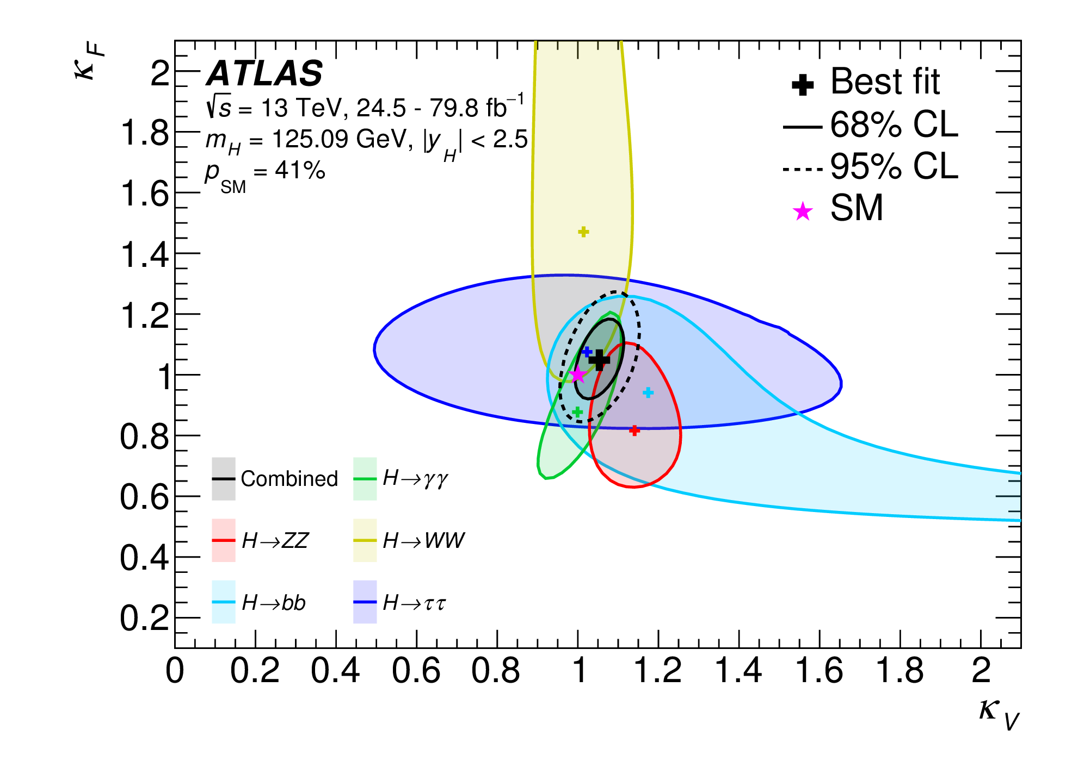
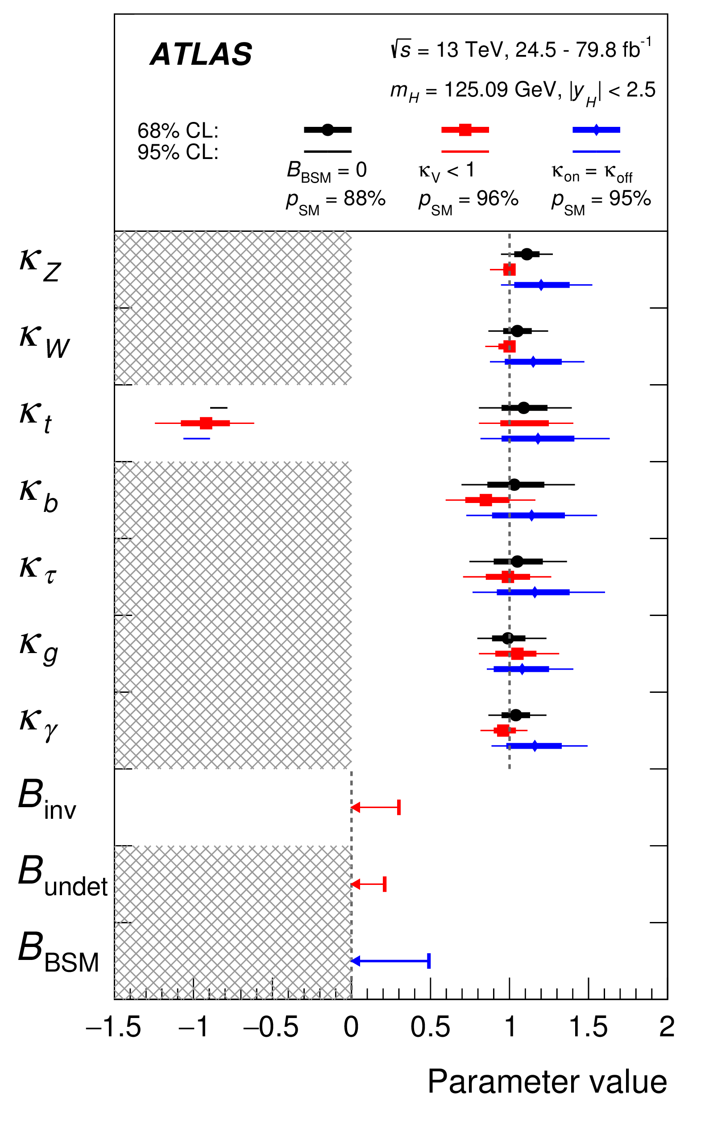
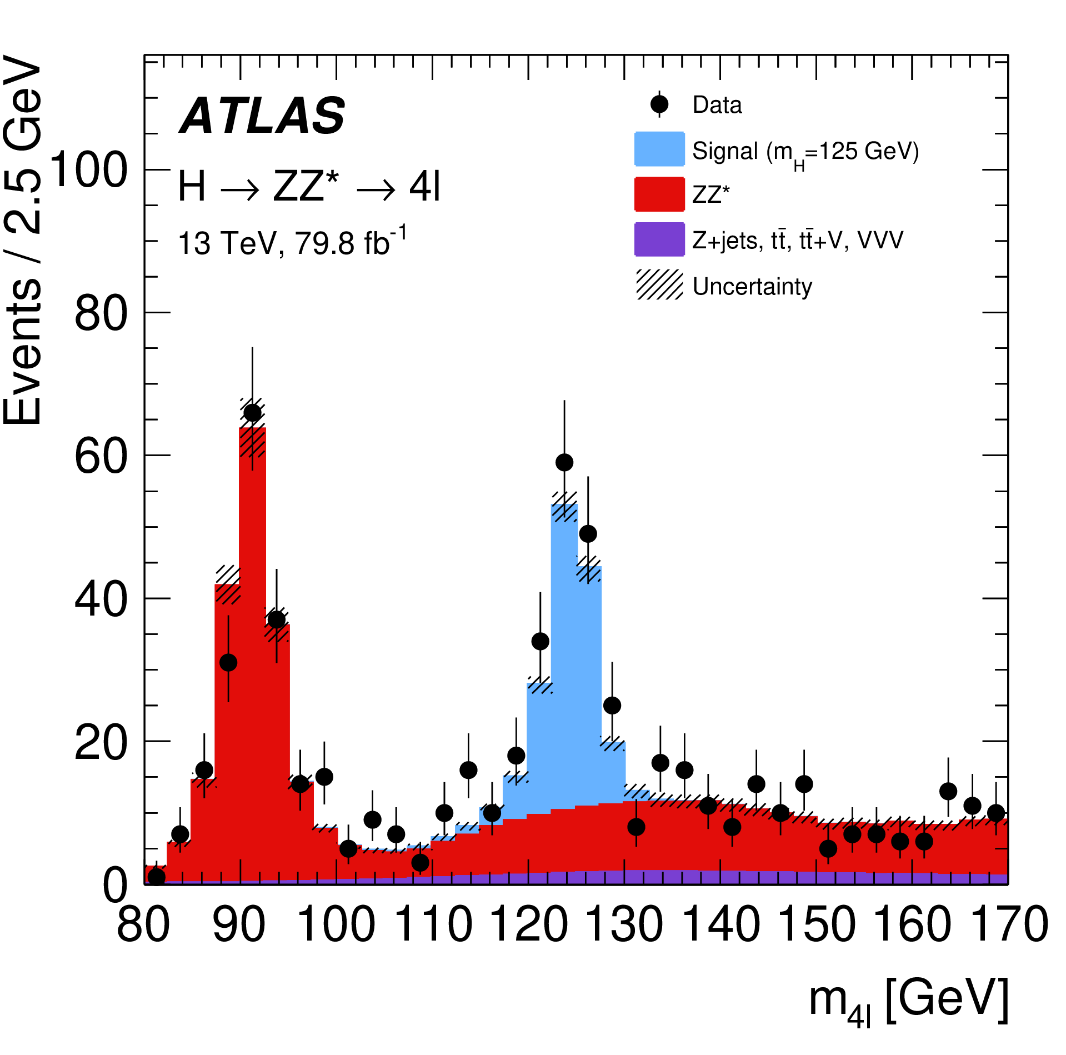
Why constrain CP of Higgs-top coupling?
8 years after Higgs discovery
Higgs mass known to º/_{oo} level
Bosonic couplings known to ≈10%
Fermionic couplings known to ≈20%
Not pure CP-odd (J^{CP} = J⁺⁻)
Looks a lot like SM Higgs!
But CP-odd admixture is possible
How would we know?
CP-odd mixture in bosonic couplings are suppressed
Need to look at Yukawa couplings in detail
Space for surprises...

Slide 5
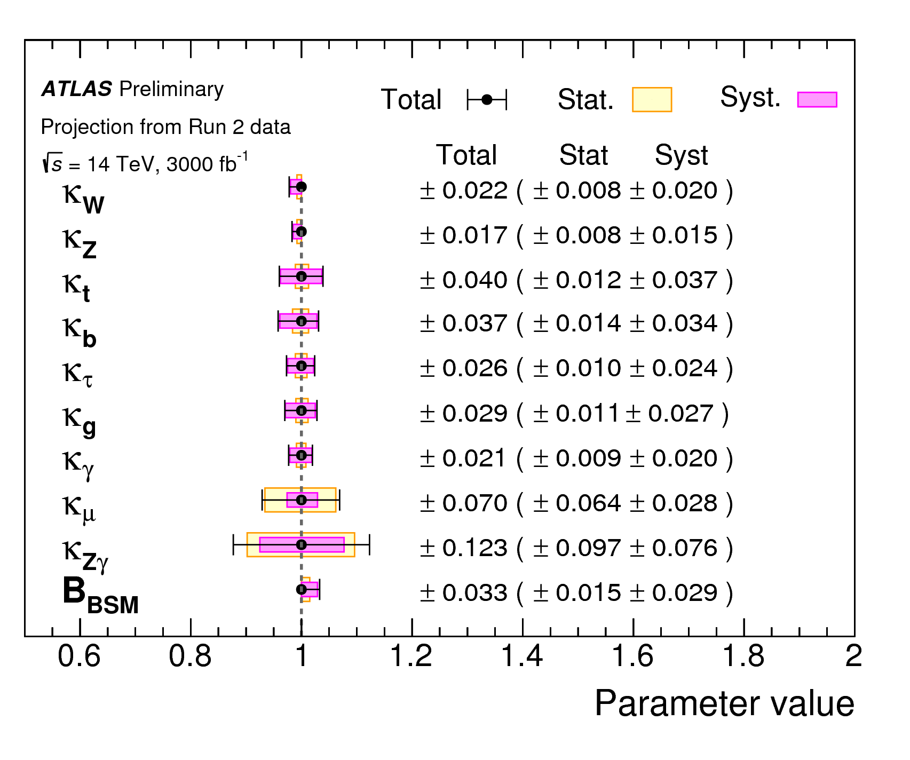
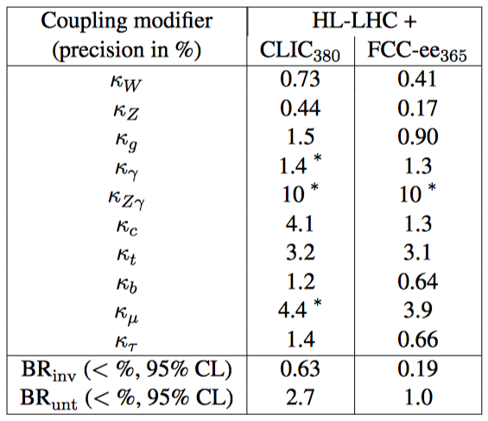
Why constrain CP of Higgs-top coupling?
8 years after Higgs discovery
Higgs mass known to º/_{oo} level
Bosonic couplings known to ≈10%
Fermionic couplings known to ≈20%
Not pure CP-odd (J^{CP} = J⁺⁻)
Looking ahead...
Expect ≈2-3% uncertainties in couplings with full HL-LHC lumi
Fighting systematic uncertainties all the way
Progress will be essential but not fast
But more detailed observables can now be reached – CP of ttH!
ATL-PHYS-PUB-2018-054

Slide 6
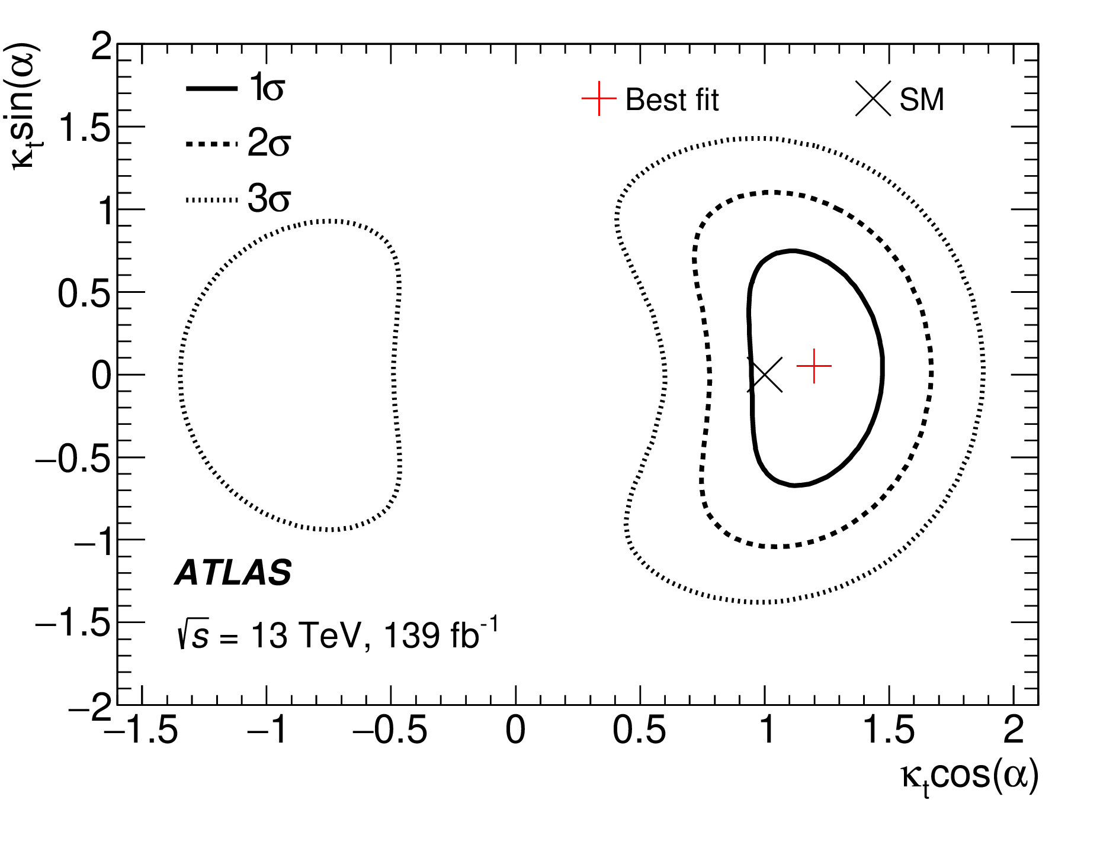
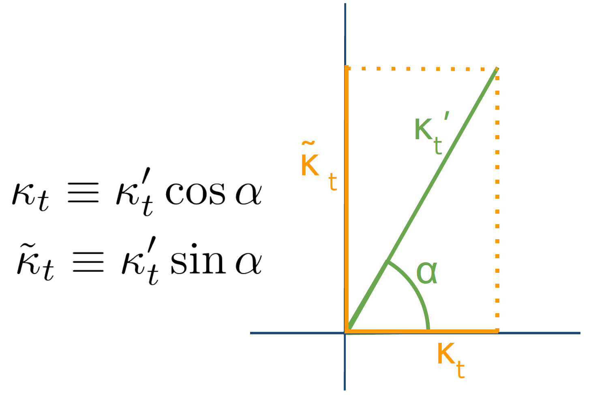
What do we want to measure?
Generalized Lagrangian gets a new CP-odd term and a mixing angle to allow non-pure CP Yukawa interactions
Two parametrizations: κ’_{t} and α mixing angle, or real and imaginary coefficients κ_{t} and κ_{t}˜
Next we need observables sensitive to these parameters
CP even
CP odd
See talk by Lisa Mijovic

Slide 7
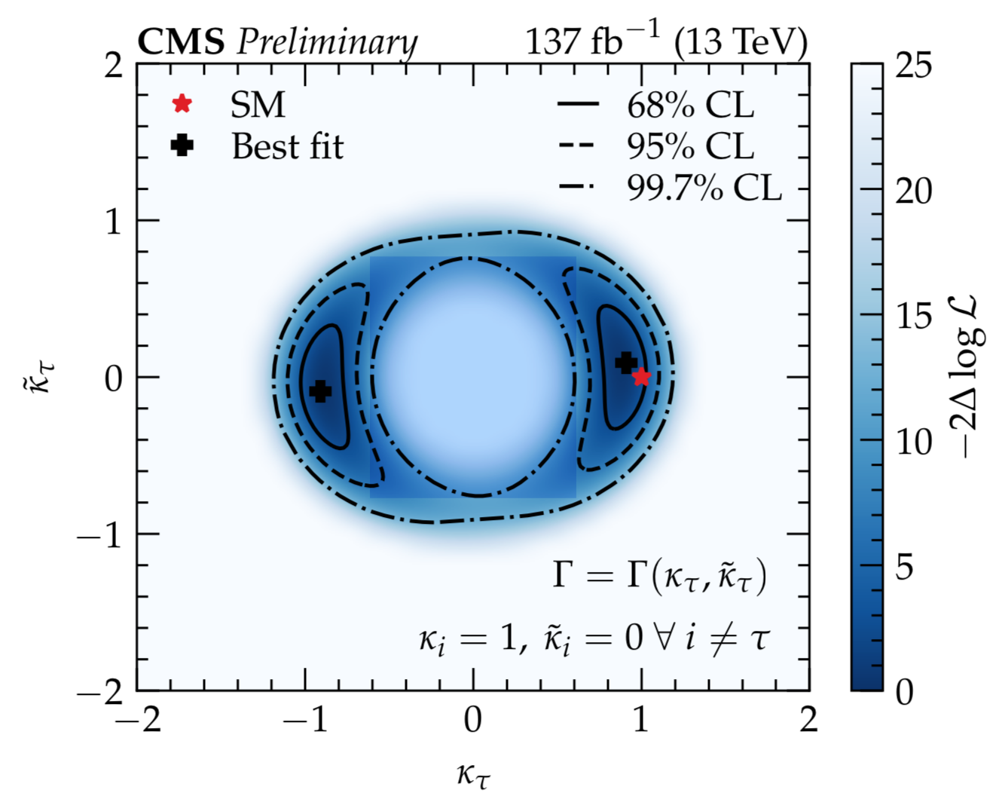
Recent measurements
ATLAS:
CP-mixing angle > 43° excluded @95%
Pure CP odd excluded with 3.9(2.7)σ
Phys. Rev. Lett. 125 (2020) 061802
See Lisa Mijovic’s talk on
CMS:
CP-odd model of Htt coupling excluded at 3.2σ
PRL 125 (2020) 061801
CP of τ Yukawa coupling in H→ττ decays
CP-odd excluded with 3.2σ (2.3 exp.)
CMS-PAS-HIG-20-006

Slide 8
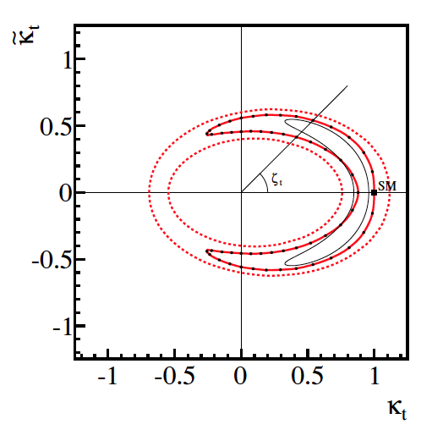
Also more indirect constraints
Electron and neutron EDM able to constrain mixing angle
Personal bias: nothing beats a direct measurement...
JHEP04(2014)004

Slide 9
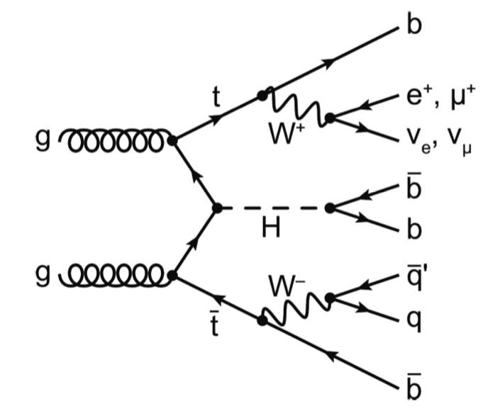
ATLAS ttH→bb Analysis
Showing work by: Emanuel Gouveia, Nicolas Schamberg, Luís Coelho, Brian Le, Zak Lawrence, Ana Luísa Carvalho Ricardo Gonçalo, António Onofre, Yvonne Peters, Ian Conelly, Daniel Mori, Yang Qin

Slide 10
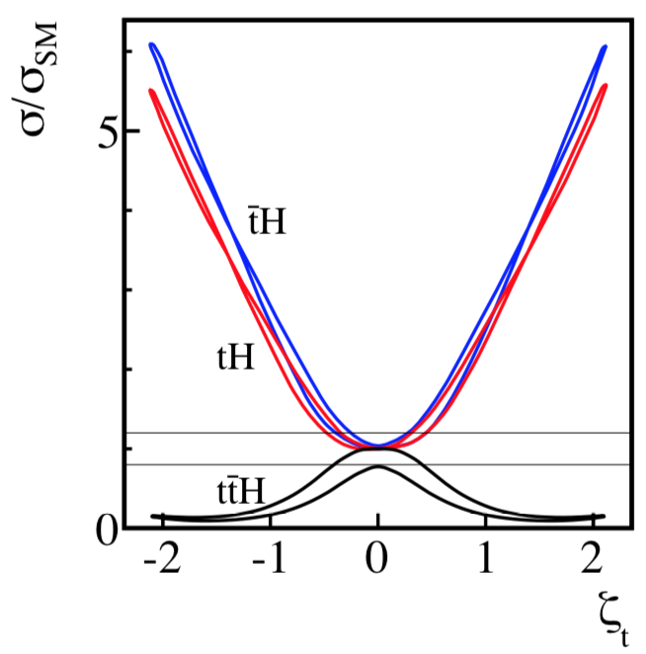
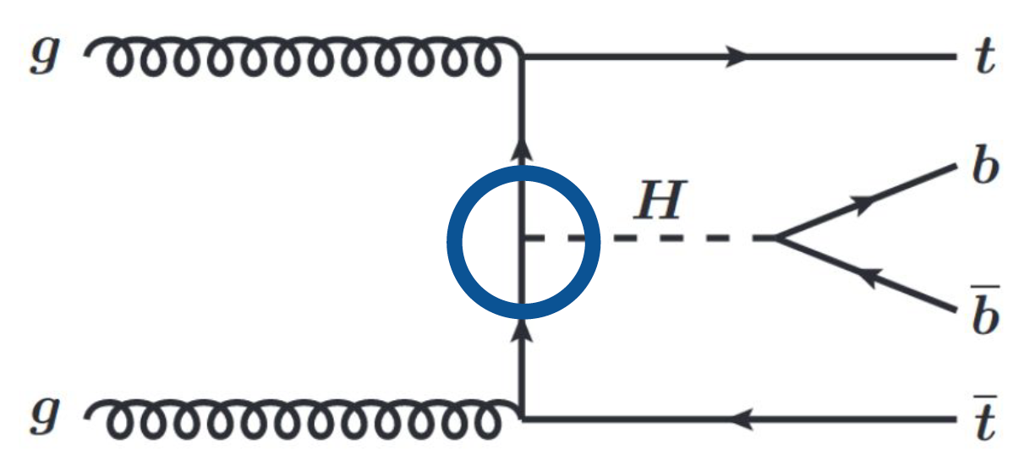
ATLAS ttH→bb Analysis
Follows the inclusive ttH(bb) analysis closely
See talk by Jelena Jovicevic
Single-lepton and dilepton channels
Full Run-2 dataset: 139 fb⁻¹
Sensitive to ttH and tH production
tH cross section is low and ttH drives analysis selection, but
tH cross section varies strongly with α
JHEP04 (2014) 004
α

Slide 11
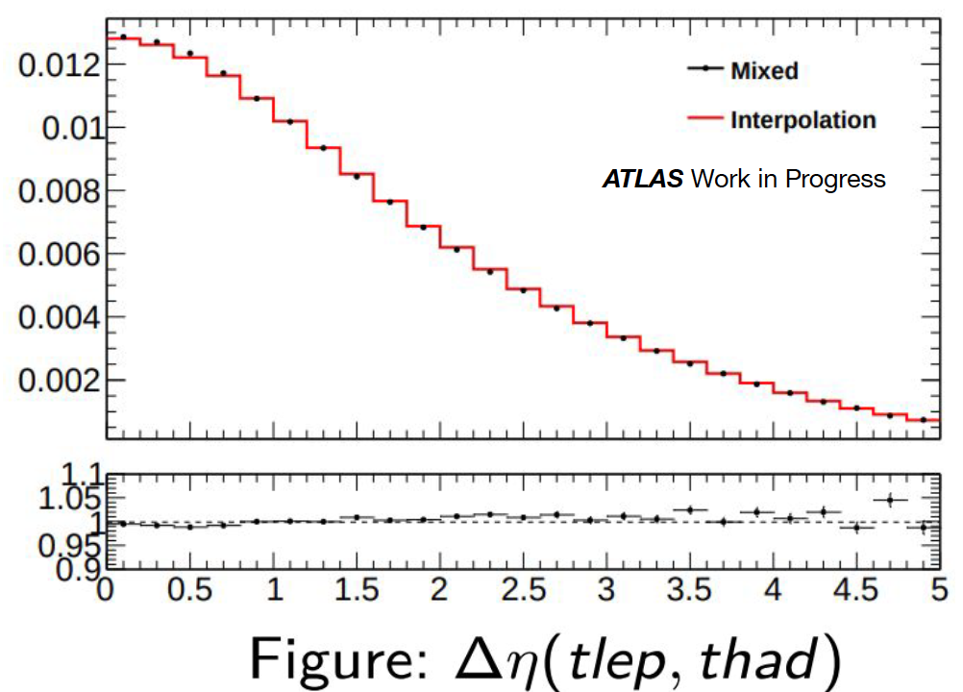
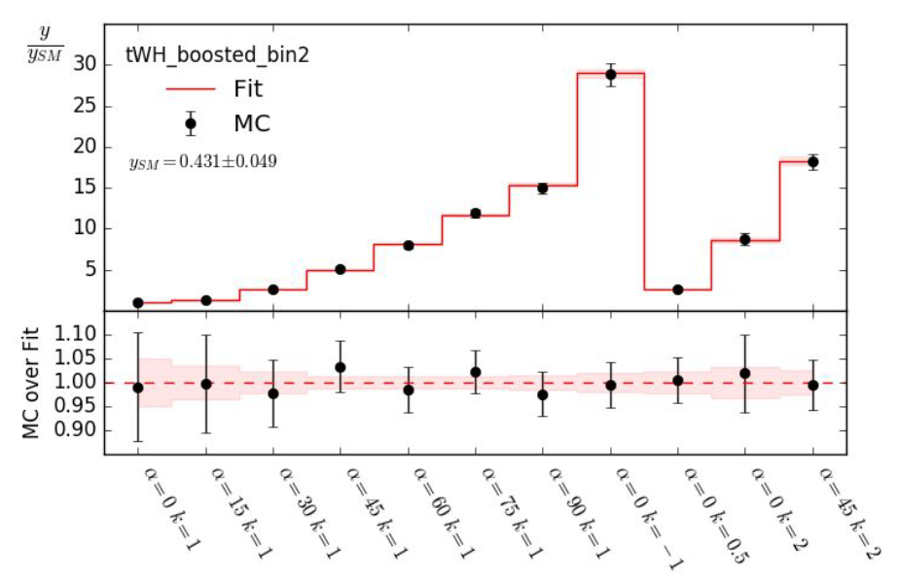
Signal modeling for intermediate α and κ’_{t}
Monte Carlo available for a few κ’_{t} and α points
ttH: weighted sum of CP-even and CP-odd samples per bin, according to:
Validated at truth-level in both channels (single lepton and dilepton) using many different variables
Means that interference between CP-even and CP-odd components is neglegible
tH: destructive interference means large dependence of cross-section on κ’_{t} and α
Parameterized separately for tHjb and tWH:
Coefficients from fitting the MC samples to samples generated for different κ’_{t} and α

Slide 12
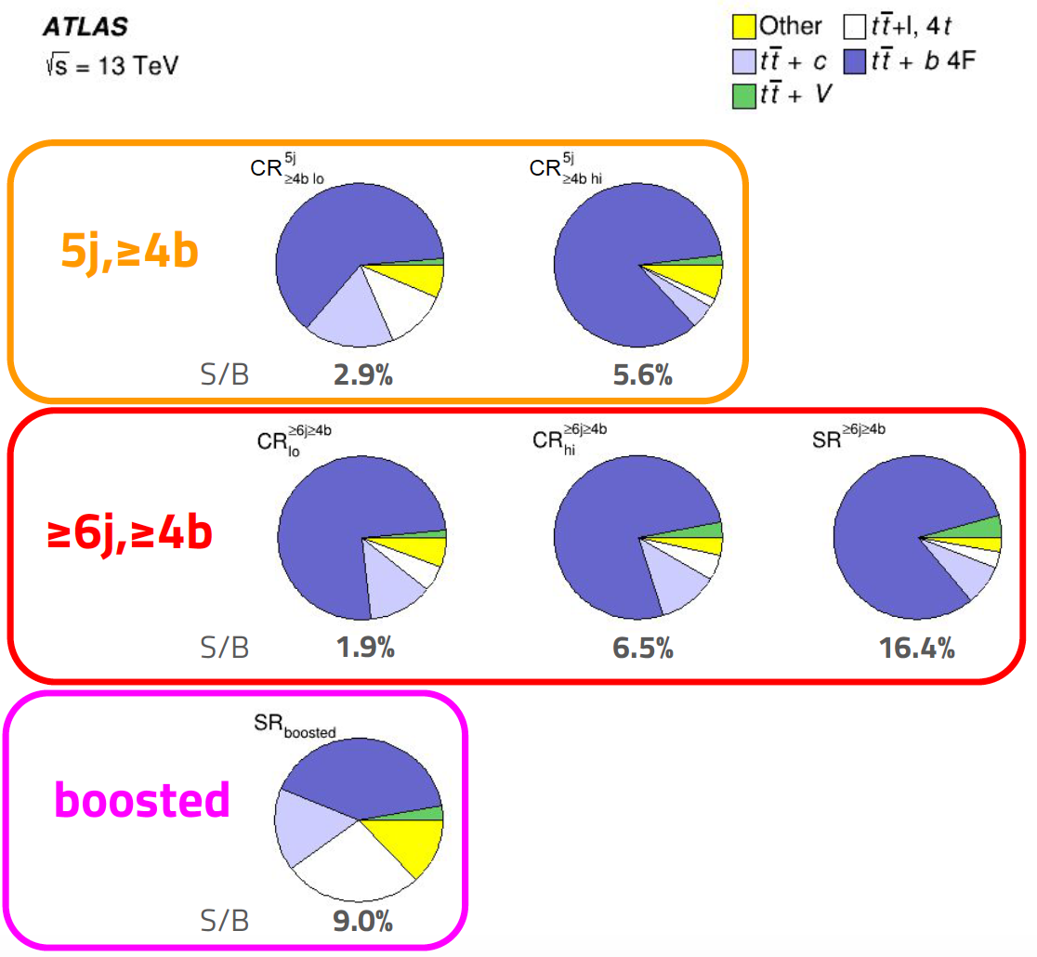
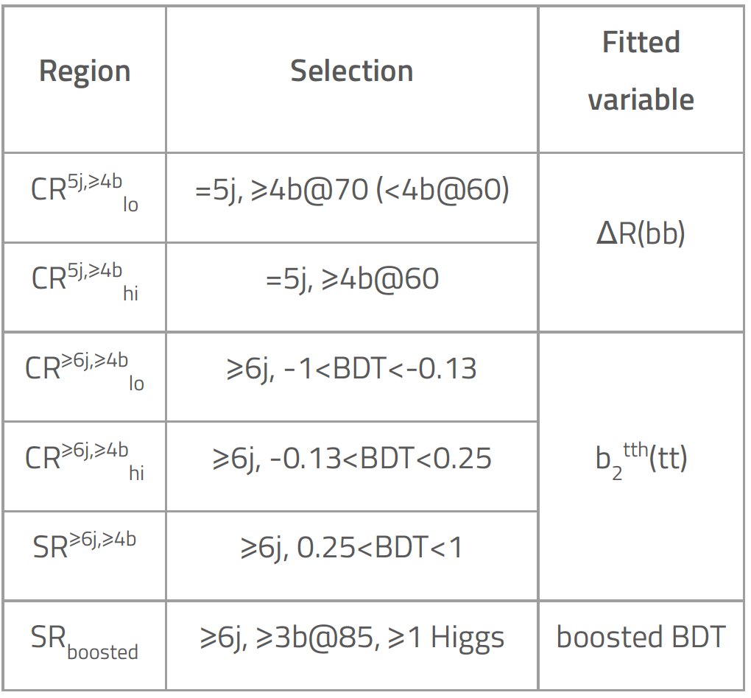
Single lepton channel: event selection

Slide 13
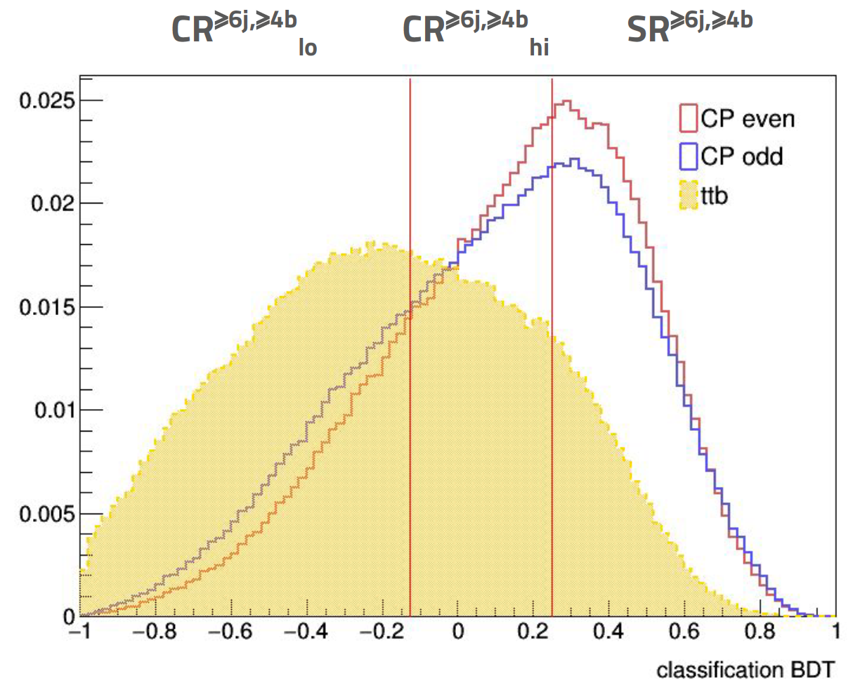
Single lepton channel: analysis strategy
6-jet, 4-b region separated into control and signal regions based on the classification BDT output
Fit a CP discriminant in resulting region
Replaced with highest-ranked variable (b₂) with very small loss
Boosted region adds sensitivity because Higgs p_{T} distribution depends on CP

Slide 14
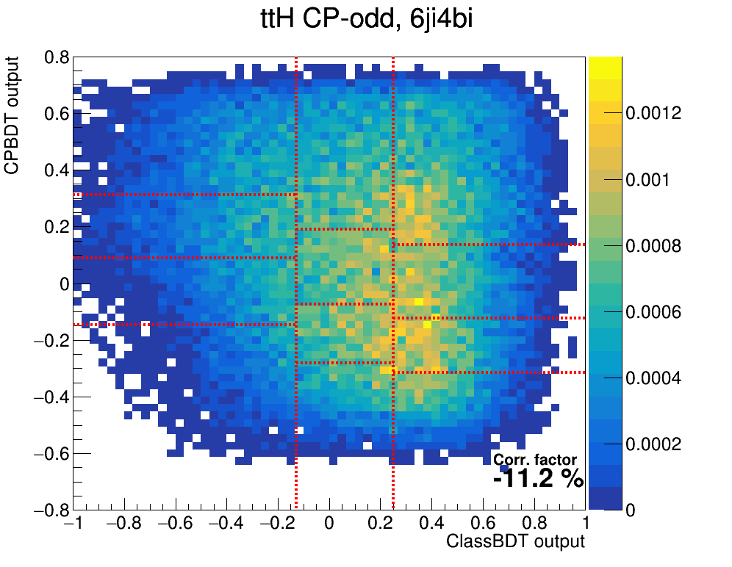
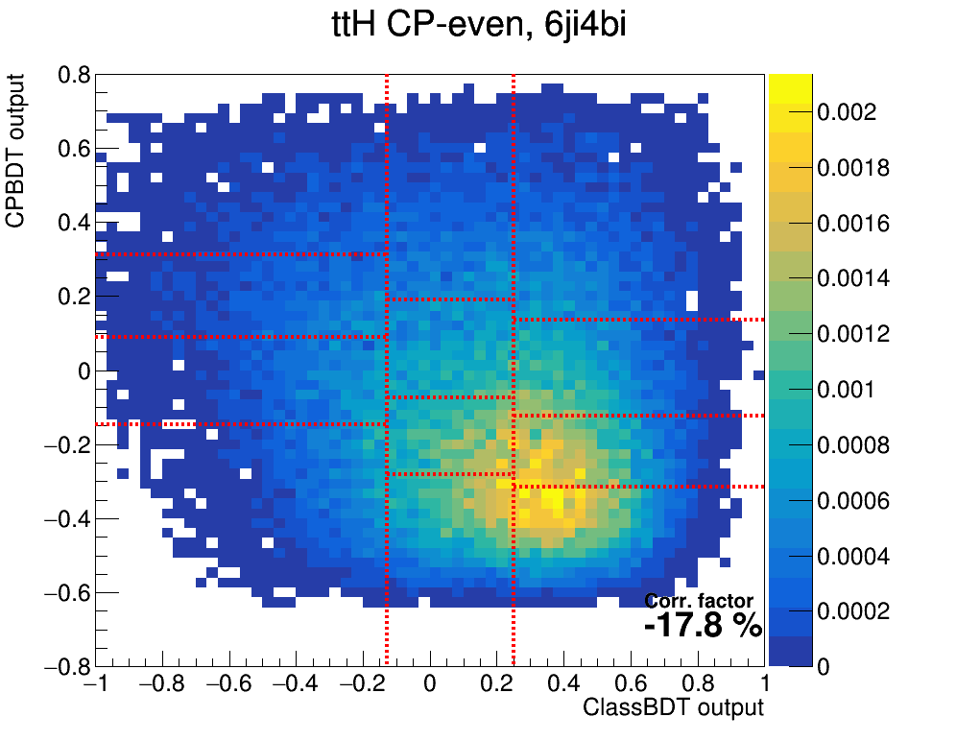
Single lepton channel: analysis strategy
6-jet, 4-b region separated into control and signal regions based on the classification BDT output
Fit a CP discriminant in resulting region
Replaced with highest-ranked variable (b₂) with very small loss
Boosted region adds sensitivity because Higgs p_{T} distribution depends on CP

Slide 15
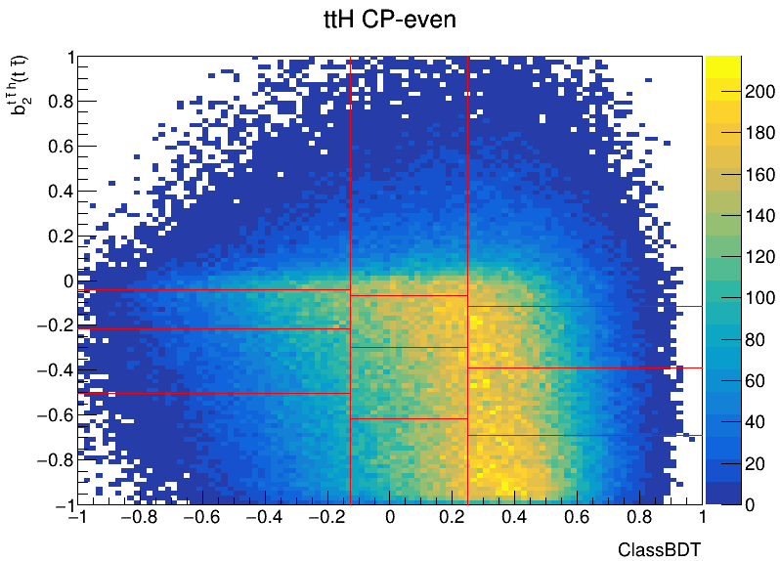
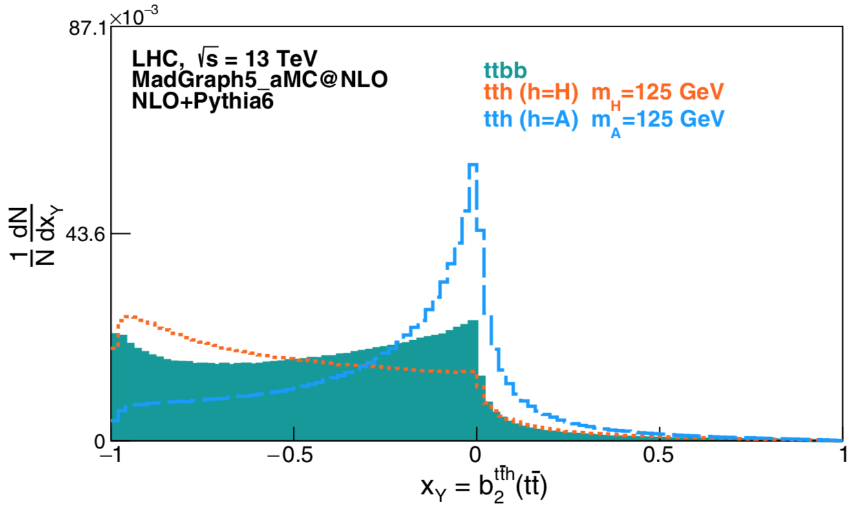
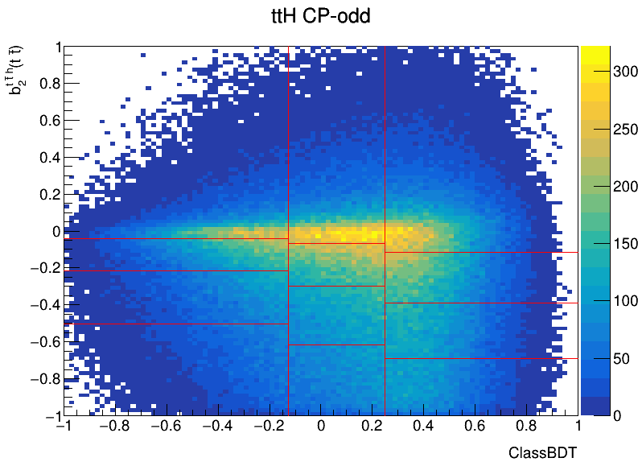
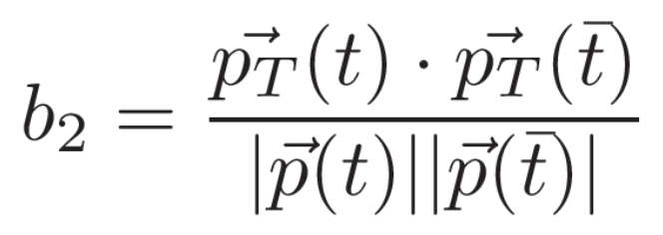
Single lepton channel: analysis strategy
6-jet, 4-b region separated into control and signal regions based on the classification BDT output
Fit a CP discriminant in resulting region
Replaced with highest-ranked variable (b₂) with very small loss
Boosted region adds sensitivity because Higgs p_{T} distribution depends on CP
PRD 100, 075034 (2019)
b₂ calculated in the ttH rest frame:

Slide 16
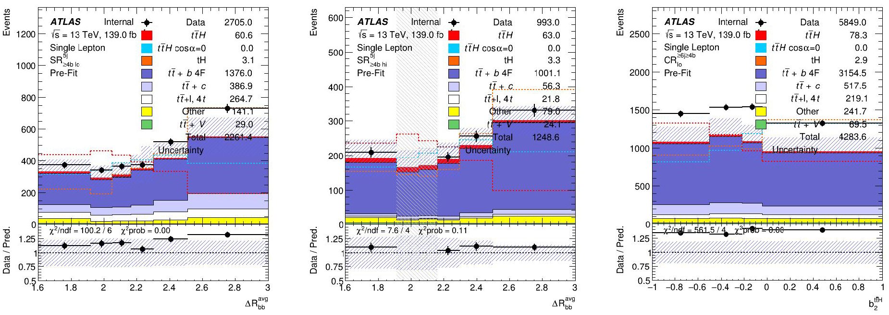
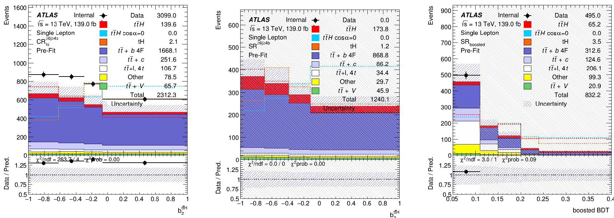
Input distributions

Slide 17
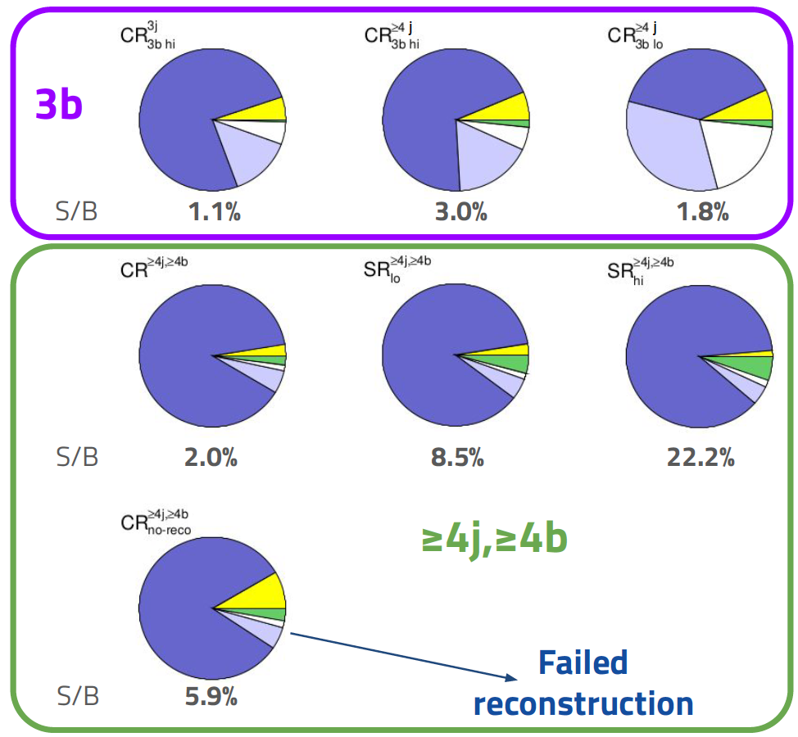
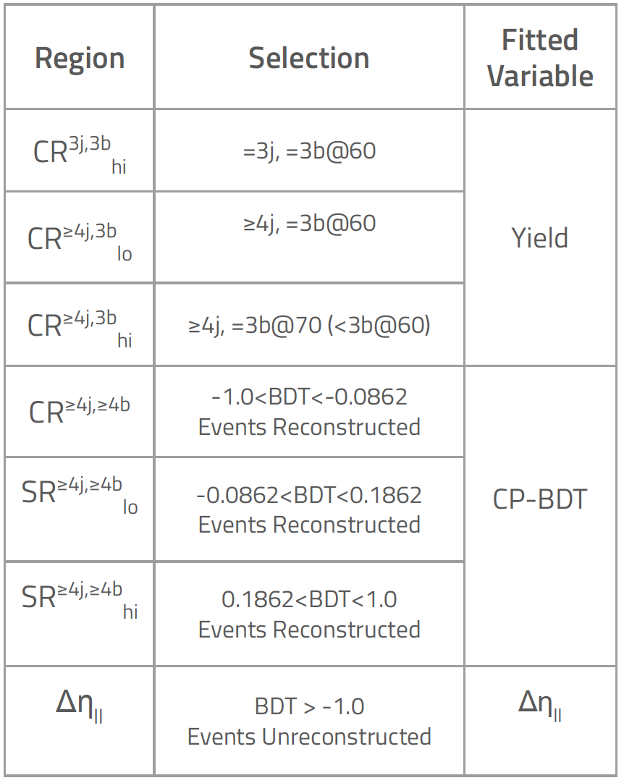
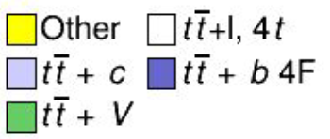
Dilepton channel: event selection

Slide 18
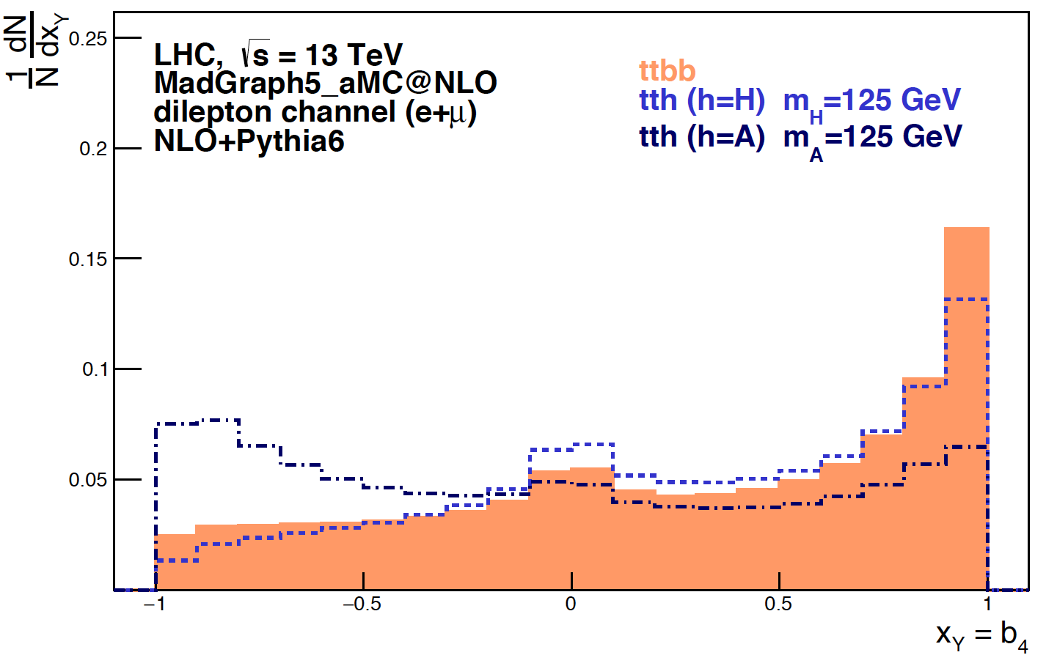
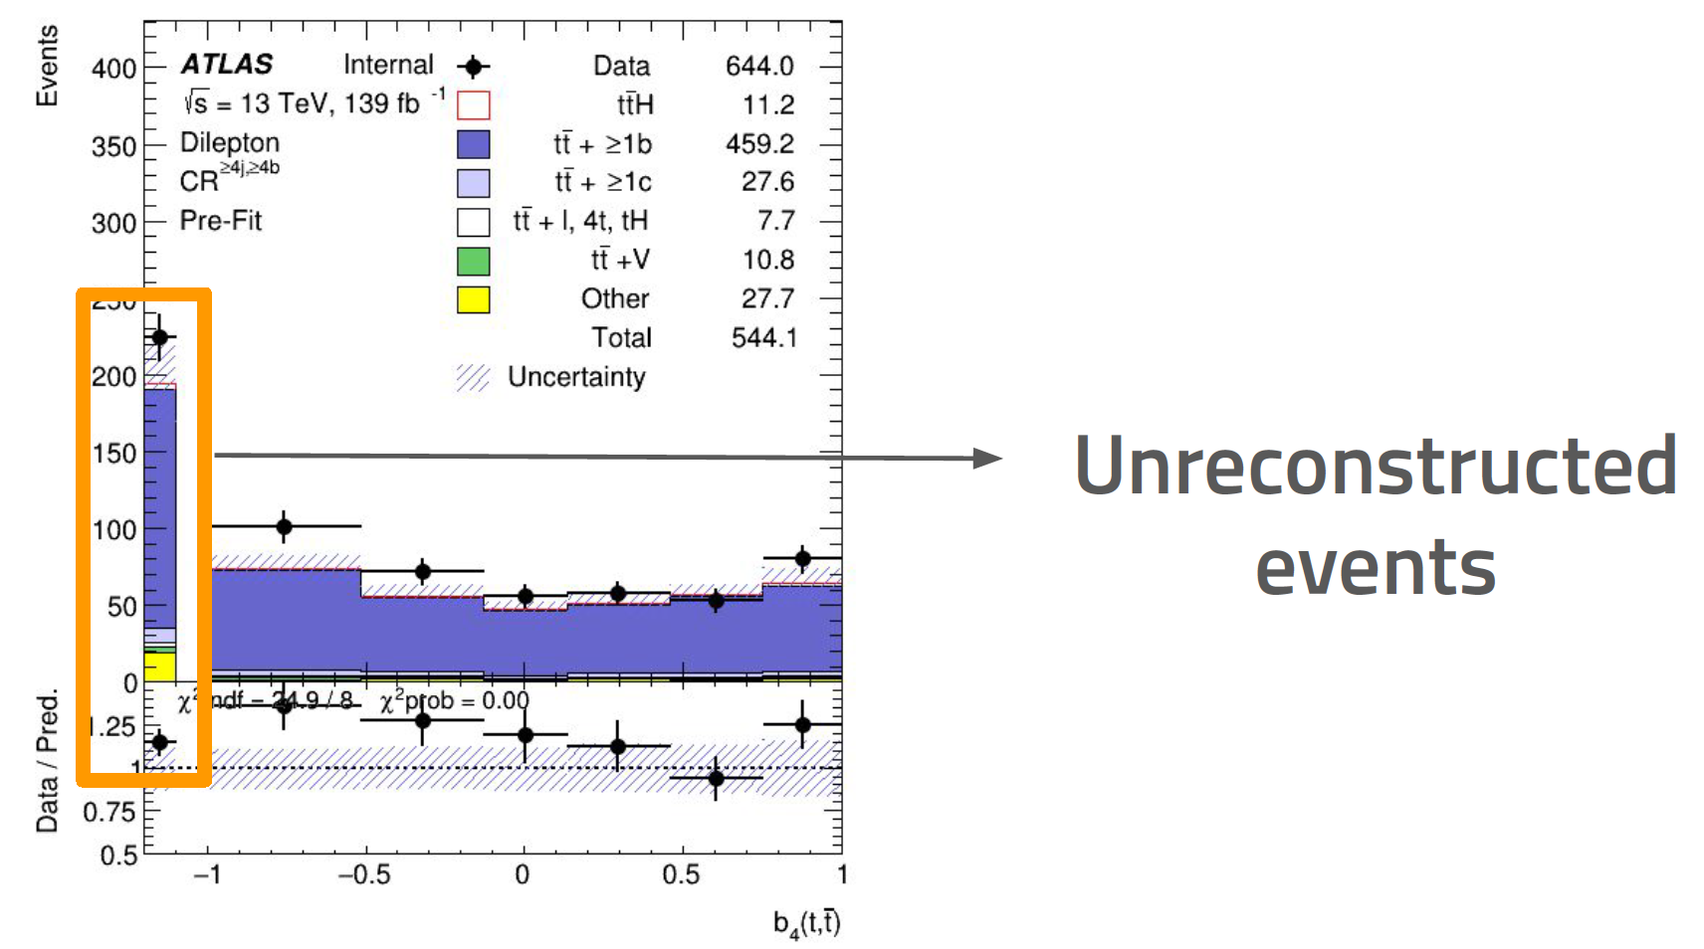
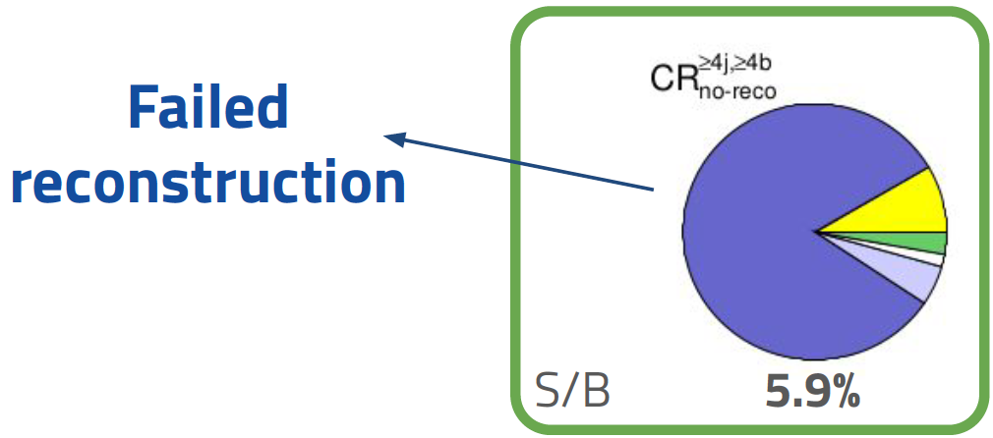
Dilepton channel: analysis strategy
Again, reconstructed events are separated into regions defined by classification BDT output
In each regions, fit CP-BDT – large sensitivity loss when using highest ranked discriminants
Inputs to CP-BDT include angles between reconstructed particles in various rest frames
From PRD 96 (2017) 1, 013004
Event reconstruction fails in a few events
Fit Δη(l⁺,l⁻) – highest-ranked variable in original CP-BDT
b₄

Slide 19
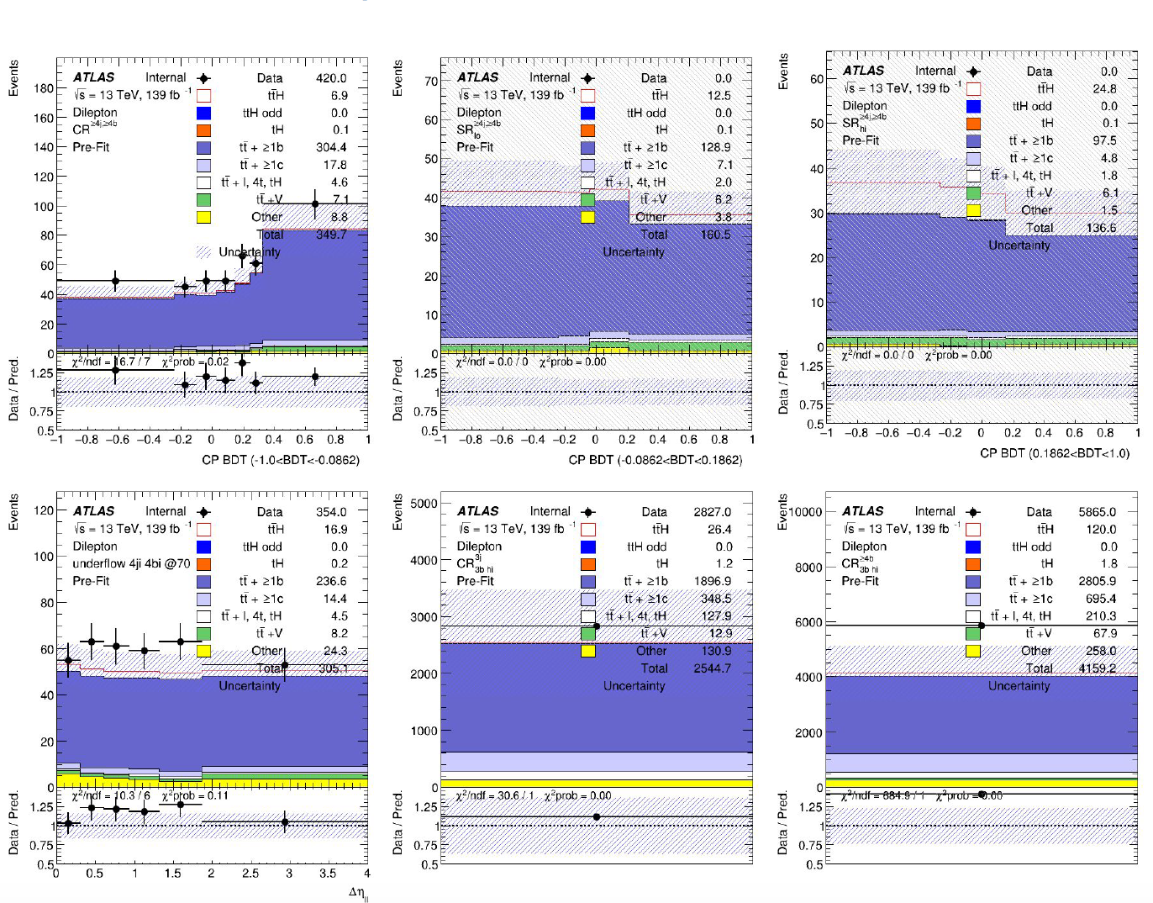
Input distributions

Slide 20
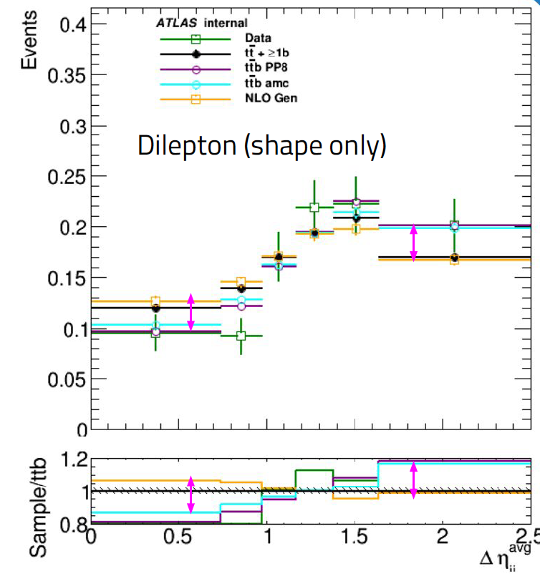
tt+b systematic uncertainties
Based on cross-section measurement, with a couple of differences:
No p_{T}(bb) dependent systematics
Additional uncertainty comparing tt (5F) vs ttbb (4F) predictions for tt+b
Significant impact on dilepton CP-BDT (PP8 and aMC)
Difference between 5FS prediction is small
The difference between 4FS and 5FS prediction cannot be covered by comparing different 5FS generators

Slide 21
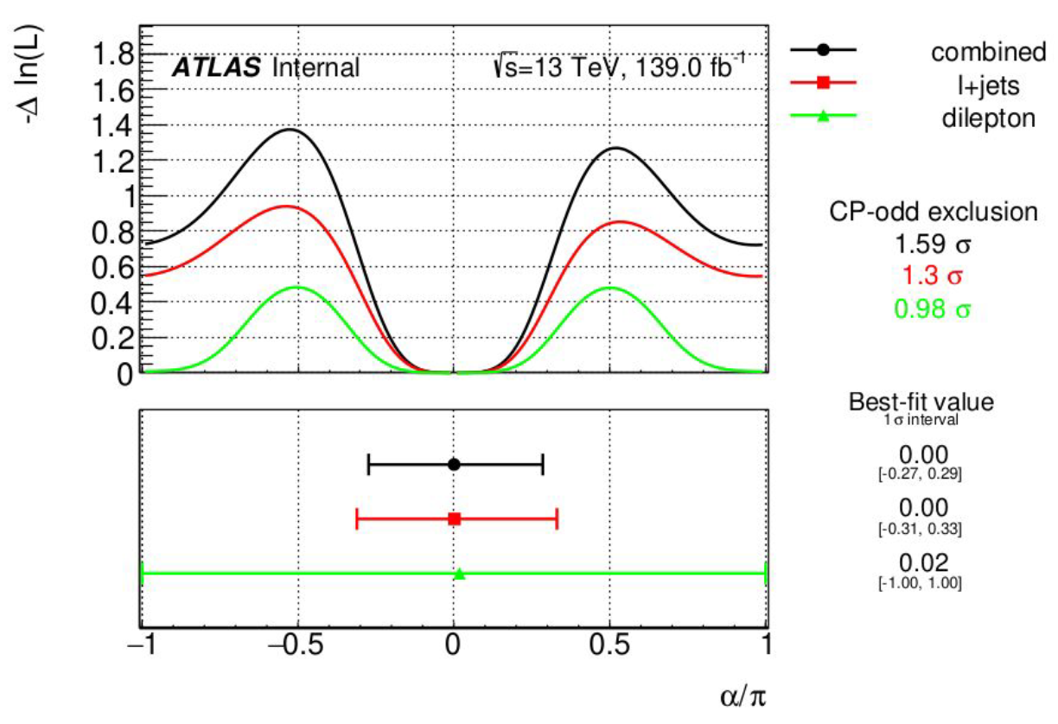
Asimov fits
Sensitivity to mixing angle α
Fit CP-even Asimov dataset in l+jets, dilepton and combined
Log-likelihood scan of α
All other parameters profiled, including coupling modifier
1σ intervals and CP-odd exclusion significance: -49º,+52º
Some exclusion of α=π (inverted coupling) scenario
CP-odd exclusion significance for individual channels
Single lepton: 1.32σ
Dilepton: 1.02σ

Slide 22
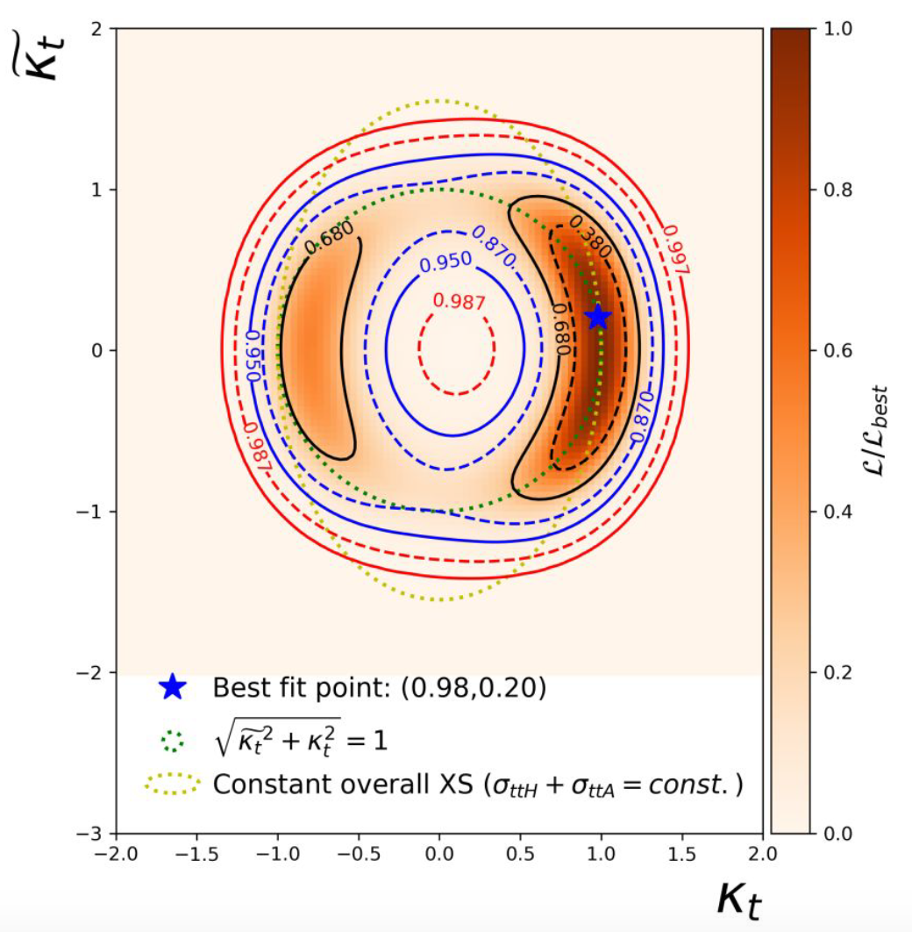
Asimov fits
Combined fit to CP-even Asimov dataset
Log-likelihood scan of κ̃ and κ
All other parameters profiled
CP-odd scenario outside 1σ contours
But inside 2σ contour
Inverted coupling scenario inside 1σ contour
CP-odd exclusion significance for individual channels
Single lepton: 1.32σ
Dilepton: 1.02σ

Slide 23
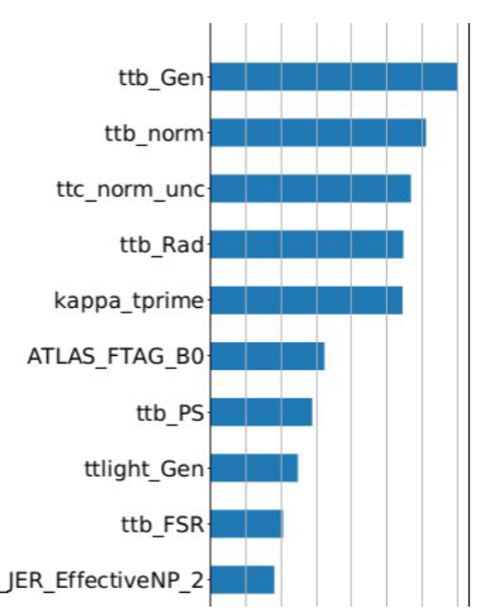
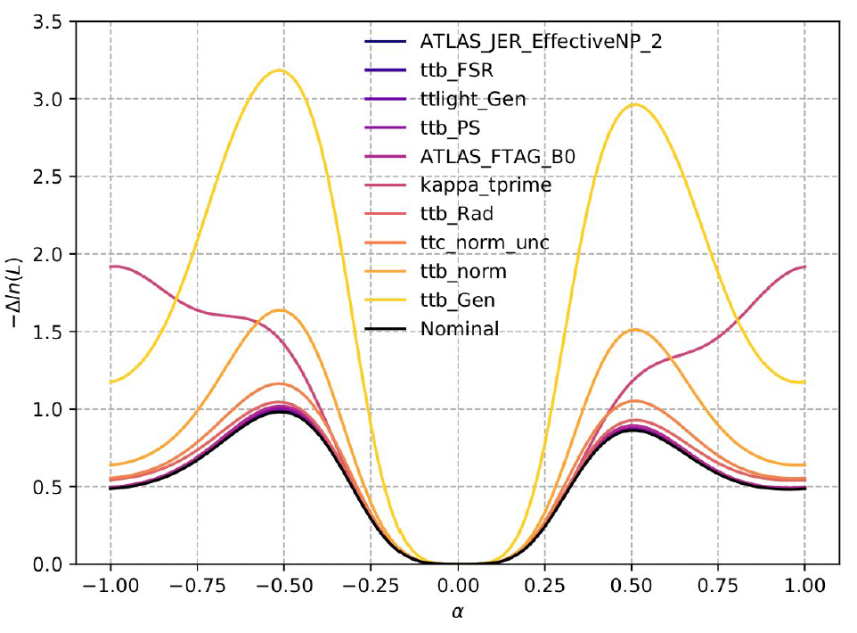
Impact of systematic uncertainties
Usual ranking method is sensitive to the sign of 𝛼 flipping
Several NPs assigned artificially large impacts
Width of the 1𝜎 interval is robust against changes in the value of the minima ⇒ use it to rank systematics:
Ranking:
Do LH scan for each NP
Calculate 1𝜎 interval
Calculate impact as the square root of the quadratic difference between the 1𝜎 intervals
Highest ranked NPs are dominated by ttb theory uncertainties

Slide 24
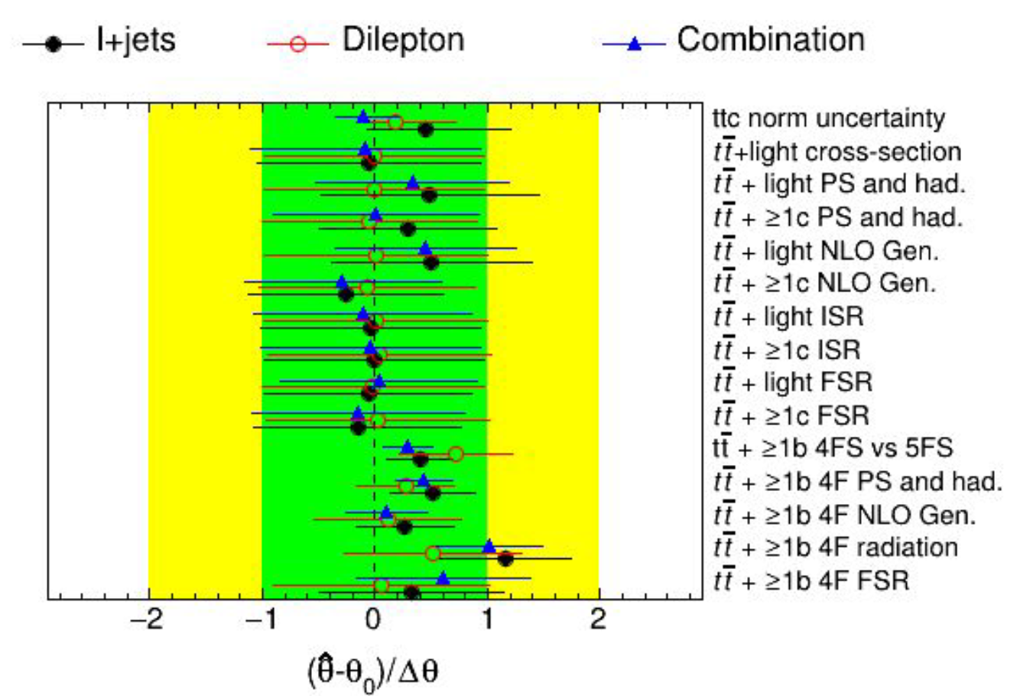
Background modeling
Validate background model by fitting it to data in signal-poor bins
tt+b normalisation corrected by factor 1.23
Good agreement in pulls between channels
Largest tt modelling pull is ttb ISR (just above 1σ)
Known from SM analysis that it corrects the mismodelling in the Njet distribution

Slide 25
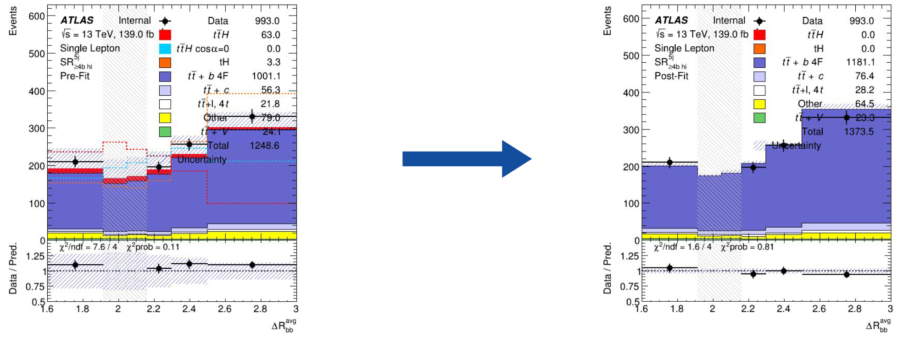
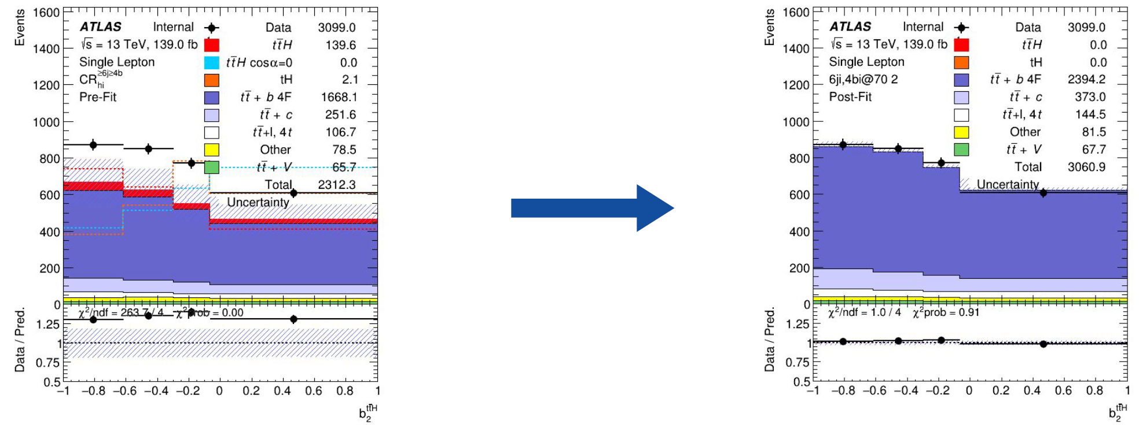
Post-fit modelling (background-only)
Fit corrects modeling of discriminant variables (ΔR_{bb}^{avg} and b₂^{ttH})

Slide 26
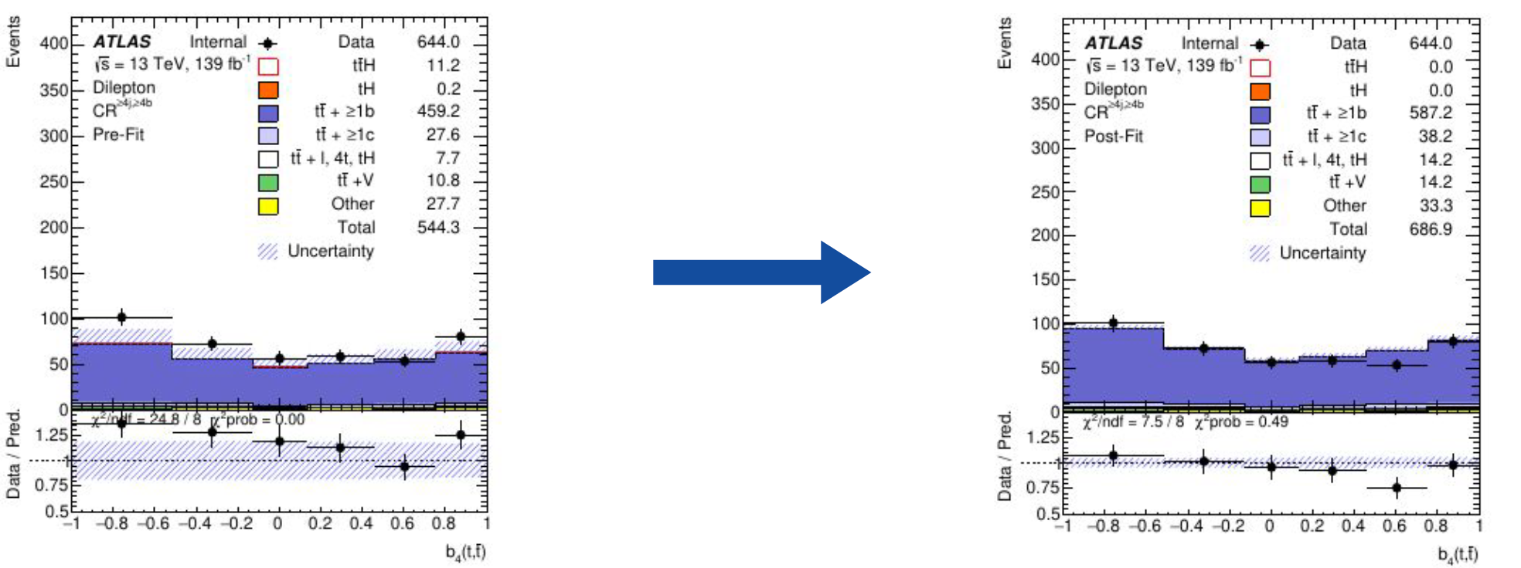
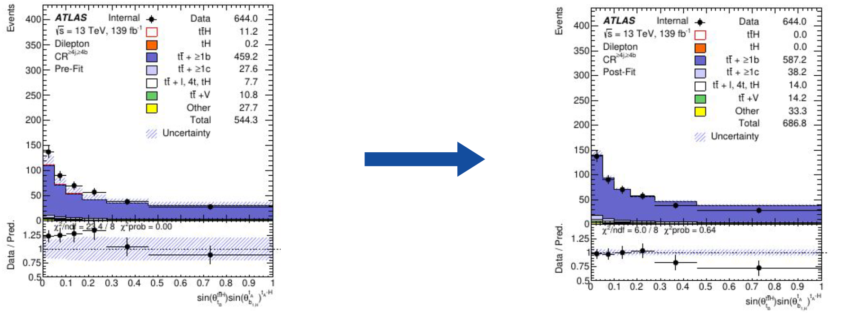
Post-fit modelling (background-only)
... and improves modelling of the CP BDT input features

Slide 27
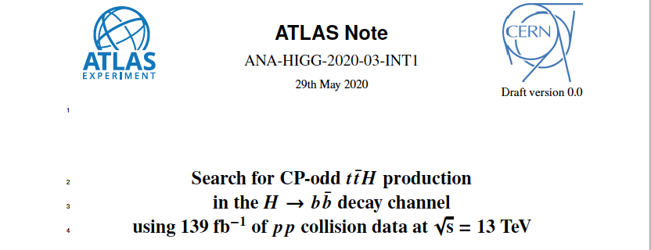
Status of ttH, H→bb CP analysis
Analysis is basically mature
It was carefully kept up-to-date with cross-section analysis
INT note basically up to date in Git: ANA-HIGG-2020-03-INT1
But needs urgently an Editorial Board, to proceed work after unblinding the SM analysis

Slide 28
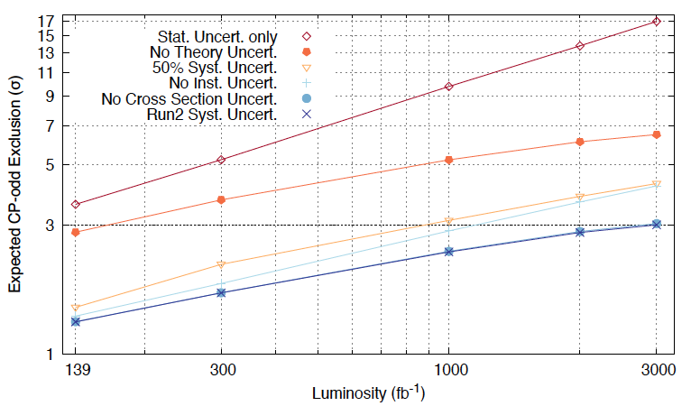
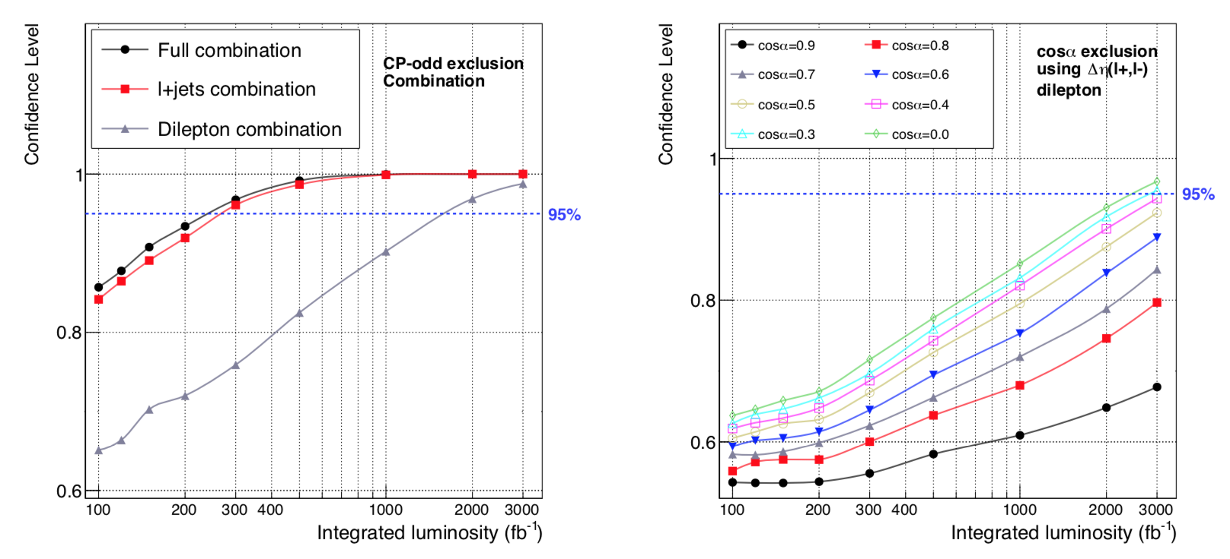
The far future...
What can we expect from the HL-LHC? What is relevant?
Phenomenological projection (ttH→bb only) indicate CP-odd exclusion in near future (~250/fb)
Actual mixing angle sensitivity depends logarithmically on luminosity
More realistic projection using current analysis
Factor ≈2 worse in integrated luminosity
Theory uncertainty (i.e. Background modeling!) is the limiting factor
arXiv:1902.00298 [hep-ph]
Luis Coelho, MSc Thesis

Slide 29
Conclusions
These are important analyses and the LHC experiments are now becoming sensitive to them
Great results released recently!
Using CP-odd exclusion as benchmark we’re clearly at the 3σ exclusion level in several analyses
Next in line is ttH(H→bb)
Analysis mature and waiting for deeper review
The future has lots of great measurements in store for us
But good ideas are essential!

Slide 30
Backup

Slide 31
ttH(bb) CP analysis documentation
Presented at HTop Workshop 2019 in DESY:
https://indico.cern.ch/event/773548/timetable/#b-330794-tthbb-session-cp-odd
Glance: https://atlas-glance.cern.ch/atlas/analysis/analyses/details.php?id=3727
Supporting note (ATL-COM-PHYS-2020-230) : https://cds.cern.ch/record/2713731
Draft in GIT: https://gitlab.cern.ch/atlas-physics-office/HIGG/ANA-HIGG-2020-03/ANA-HIGG-2020-03-INT1

Slide 32
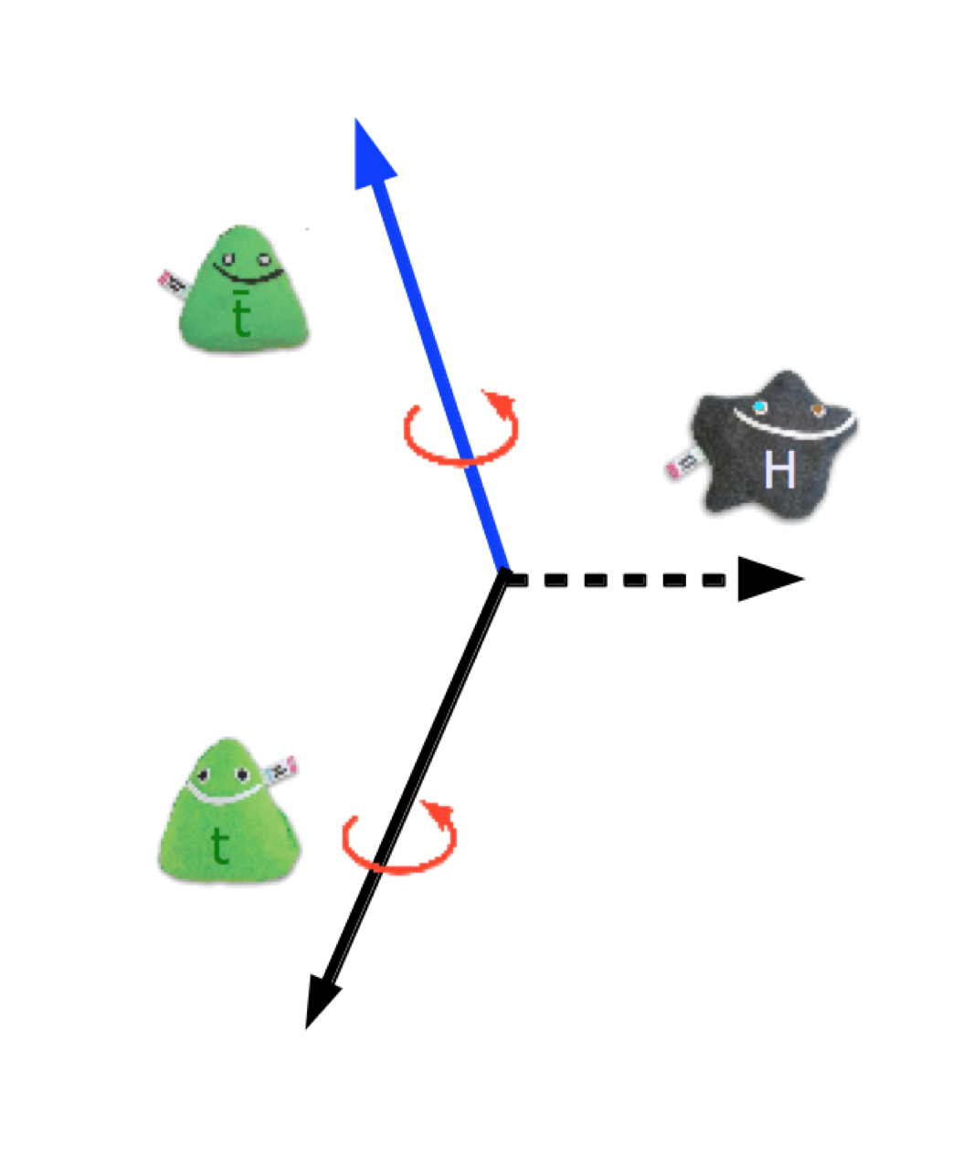
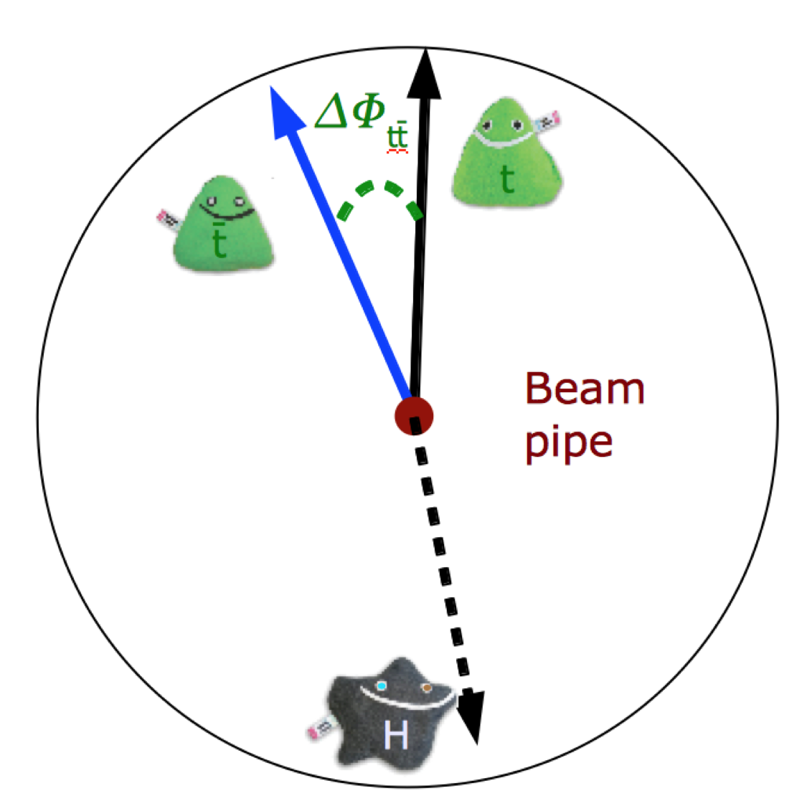
What do we want to measure?
Intuitive impression of origin of sensitivity
CP even: coupling to opposite helicity top & antitop
CP odd: coupling to same helicity top & antitop
Y.Peeters’ talk at HTop workshop 2019

