Slide 1


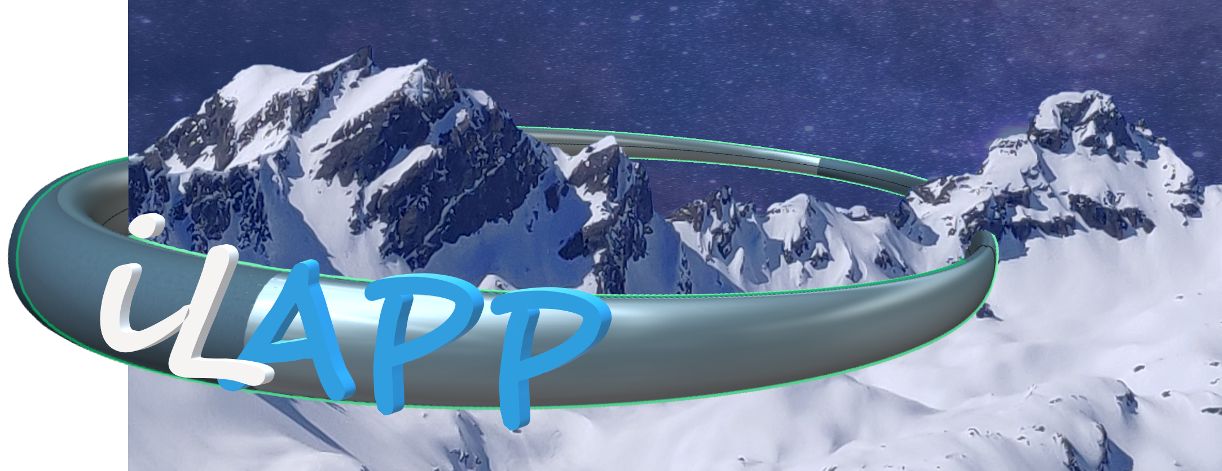


LIP contributions
People involved (but need to understand plan better):
  LIP: 1 PhD student (Luisa) 70% FTE
  LIP/SFUM: 1 MSc student (Pedro Chaves) 70% FTE
  3 academics (Antonio, Ricardo) 30% FTE
Interested in tasks:
  CP analysis
  Performance of new reconstruction
  Data/MC comparison for new reconstruction and new MC
  Statistical analysis
Need to understand:
  Intended timescale and data set – will Run-3 be included?
  Main changes intended for analysis strategy

