Slide 1
H->bb Status
Ricardo Gonçalo (RHUL)
on behalf of the H->bb analysis team
HSG5 Meeting, 16 February 2011

Slide 2
H->bb at a glance
WH and ZH analyses progressing in parallel – concentrating on non-boosted for now
Birmingham/Liverpool, Wisconsin, LMU Munich, Lisbon, Carleton, Argonne, Glasgow and Royal Holloway
Boosted WH/ZH to follow – more relevant at higher lumi but essential for this year
Activity in UCL London at the moment – commission jet substructure observables
Manpower badly needed here – volunteers welcome!
ttH analysis progressing – developing multivariate analysis
Glasgow involved, Edinburgh just joined… a Scottish Higgs channel!
VBF H->bb – activity from Victoria
Rough estimate: sensitivity between hh and ll channels of VBF H->ττ (no trigger, 30fb⁻¹)
Trigger is crucial in this analysis – currently working on this, in contact with jet trigger
SUSY H->bb – activity in Freiburg within the SUSY working group
See ATL-COM-PHYS-2011-030 – Atlfast II study
Challenging: no discovery at √s = 10 TeV, 10fb⁻¹
Becomes quite interesting for √s = 14 TeV, 30pb⁻¹, at m₀≈500GeV, m_{1/2}≈350GeV (mSUGRA)
Trigger is crucial in this analysis – ongoing work

Slide 3
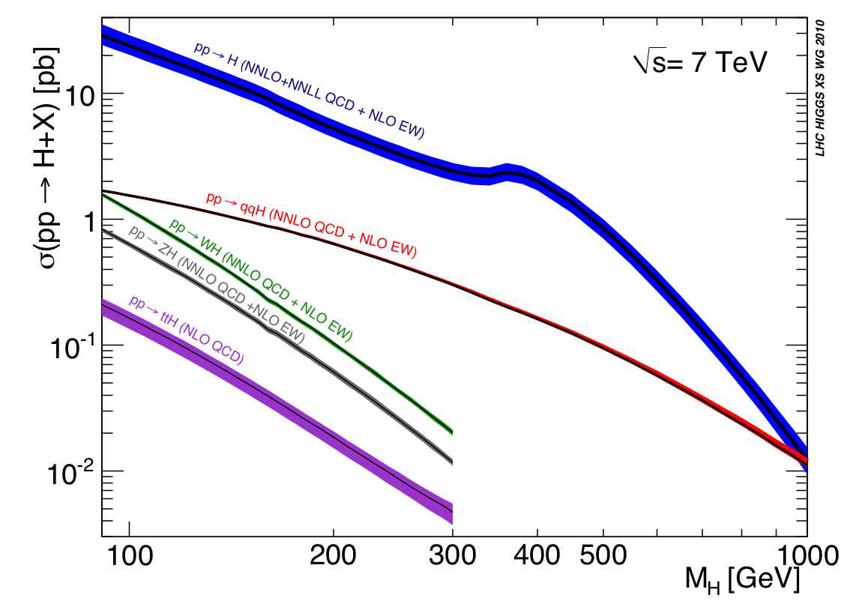
LHC Higgs Cross Section Working Group
LHC Higgs Cross Section Group: https://twiki.cern.ch/twiki/bin/view/LHCPhysics/CrossSections
Yellow report with inclusive cross sections:
Yellow report recently released: http://arxiv.org/abs/1101.0593
Higgs WG requested to use numbers from the LHC xsec wiki: https://twiki.cern.ch/twiki/bin/view/LHCPhysics/CERNYellowReportPageAt7TeV
Second phase of work starting now: exclusive Higgs observables
Higgs Signal: cross sections with cuts, differential K-factors, effect of jet-veto or b-tag jet on differential K-factors, comparison between NLO MC and NNLO codes
SM Backgrounds: define control regions, estimate theoretical errors, use the most advanced NLO MC (POWHEG, MC@NLO, new Sherpa), signal/background interference
Theory Uncertainties: for exclusive observables, for both SM and MSSM Higgs, QCD scale and PDF error correlations among different Higgs production channels and among
First results expected for BNL workshop in May; plan for 2 publications this year
H→bb meeting on 17 February 2011:
Survey of the codes (for both VH→Vbb and ttH), loose (i.e. non-boosted) VH analysis
Will start with validation on Wbb calculations
Volunteers welcome!

Slide 4
WH/ZH Status & Plans
Cut-flow tables being compared by most active analyses: https://twiki.cern.ch/twiki/bin/view/AtlasProtected/WHNoteSummer2011
Comparison in release 15 down to 5% agreement between different groups
Served to get analyses debugged and running
On-going comparison with release 16 – results expected in next week’s meeting
Following steps:
Define final event selection - study optimal object selection and cuts
Identify relevant systematic uncertainties and improve wherever possible
Take into account existing knowledge from W/Z+jets SM analyses
etc…
Aim to have good quality results to make public by Summer
Important: work towards a boosted VH analysis needs to be integrated with the on-going work at some point – plans in the planning being carefully planned…

Slide 5
Other channels
ttH - semileptonic:
Multivariate analysis under development in Glasgow
Expect results from release 15 next week
Analysis moving to release 16
Edinburgh joined and ramping up
ttH hadronic:
Ramping up:
Need up-to-date MC sample at 7TeV
Studying triggering options
VBF H->bb
Currently studying trigger options

Slide 6
Other ongoing issues
Good Run List – definition and maintenance
Common monitoring code – prompt analysis after event reconstruction
Being investigated… plans in the plannning

