Slide 1
Overview of the Jet Trigger
Heavy Ion Trigger Menu Forum
10 February 2015
Ricardo Goncalo, David Miller
On behalf of Jet Trigger

Slide 2
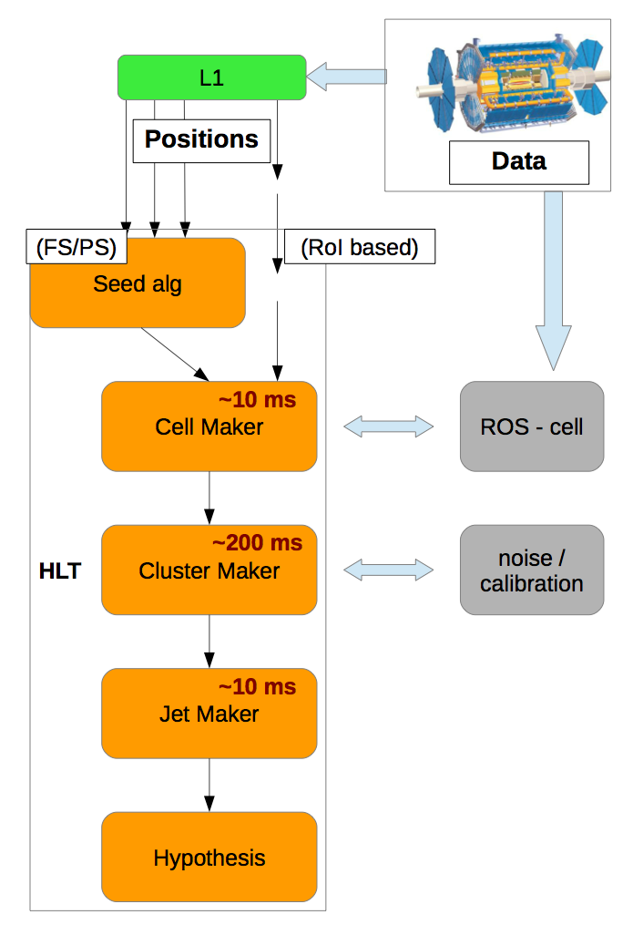
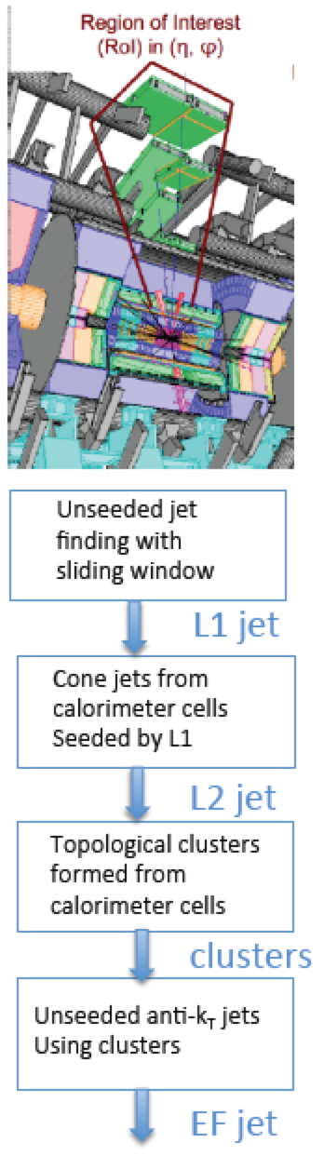
Changes Since Run 1
No L2 anymore
  And no EF, just High Level Trigger
Move as close as possible to offline jet reconstruction
  Add pileup subtraction (jet area)
  Recover from L1 bias in close-by jets
  Get best possible ET resolution to optimize use of bandwidth
    Use offline calibration schemes
Two possible readout schemes:
  Full-scan of calorimeter: more accurate but takes time/CPU
  Partial-scan as plan B if needed: no pileup subtraction
Ongoing: Use L1.5 Trigger Tower full scan to reduce input HLT rate

Slide 3
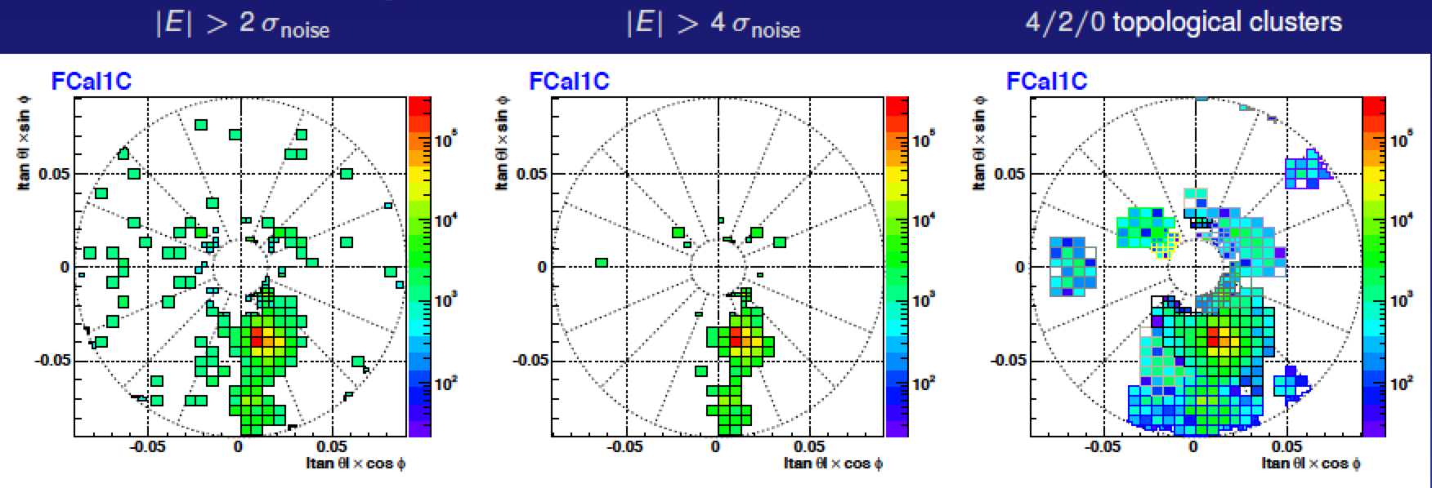
TopoClustering, Full and Partial Scan, and all that…
Several techniques developed and maintained in the offline world that are needed in trigger
  Pileup suppression will become more important
  Calibration should be taken from offline
  We don’t have the capability to keep maintain our own versions (and would complicate things)
TopoCluster making:
  3D groups of adjoining cells started from seed cells (4σ above noise)
  Add adjoining cells if above 2σ above noise, plus an extra layer 0σ above noise (4/2/0 scheme)
  Split initial clusters into smaller ones surrounding hot spots – splitting
  Following that: calculate cluster moments, classify clusters (EM/HAD), apply calibration, find jets, calibrate

Slide 4
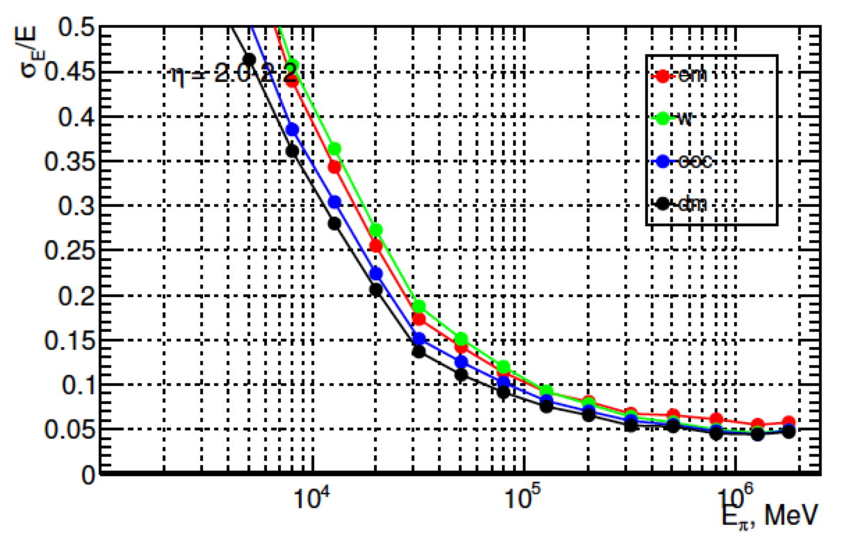
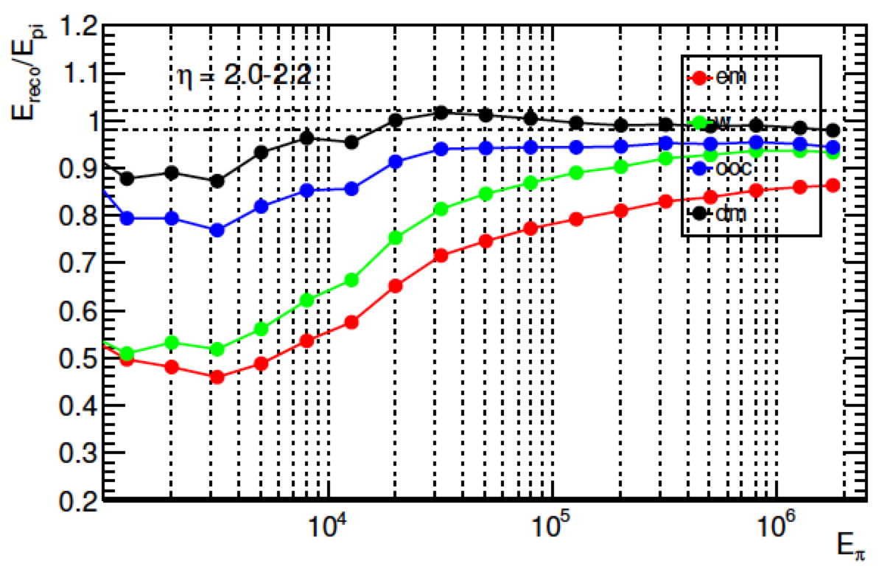
Calibration
Sven Menke
Resolution and linearity improvement for charged pions after each correction:
  EM
  LCW
  Out of cluster
  Dead material
Conditions:
  <μ>=0
  IBL geometry
  2<|η|<2.2
  4 samplings

Slide 5
Overview of the offline jet calibration

Slide 6
Overview of the offline jet calibration
Requires full event topoclusters for rho calculation
Only requires derived constants:
f(pT, eta)
Requires full event tracks and PV identification
Requires extra jet info like layer energies and full tracking info

Slide 7
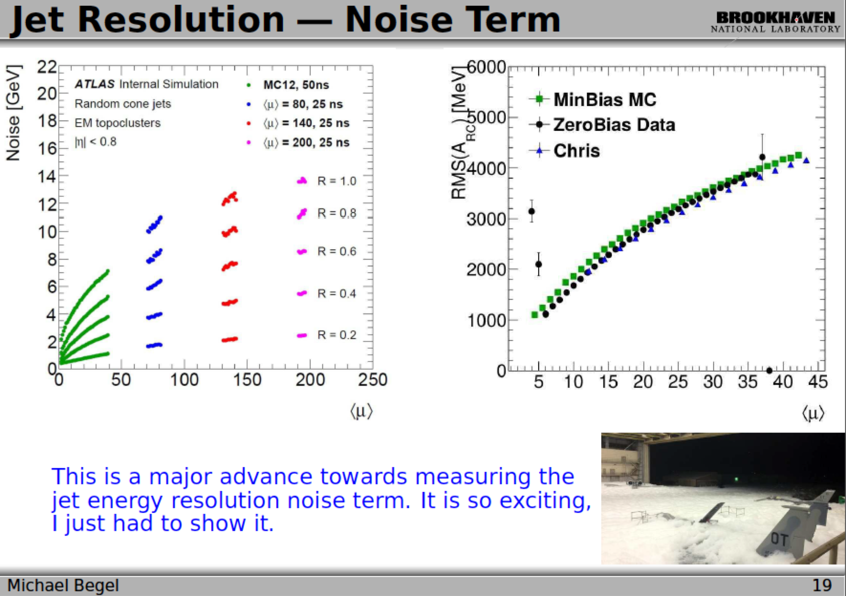

Slide 8
Pile-up subtraction: rho
Requires full event topoclusters for rho calculation

Slide 9
Partial vs Full Scan – Timing Summary
Ademar Delgado
NOTE: indicative numbers only!
Cluster making time roughly same as calibration
PS much less than FS but longer tails
Small effect from pileup
Comparing to r.17:
  6% increase in clustering in r.19
  6x reduction in cell container making (60 to 10ms/evt)
Clustering [ms] | <μ>=40 | <μ>=80 | Calibration [ms] | <μ>=40 | <μ>=80
Cells | 9.9 | 9.7 | Moments | 27.0 | 29.7
Clusters | 53.7 | 52.7 | Dead Material | 18.5 | 17.2
Cluster splitting | 57.7 | 61.9 | Out of cluster | 17.8 | 16.3
Full calorimeter scan |  |  | Local calibration | 23.9 | 26.4
 |  |  | Out of cluster Pi0 | 17.8 | 16
Totals: | 121.3 | 124.3 | Totals: | 105 | 105.6
Clustering [ms] | <μ>=40 | <μ>=80 | Calibration [ms] | <μ>=40 | <μ>=80
Cells | 4.9 | 5.1 | Moments | 2.3 | 2.5
Clusters | 4.8 | 5.4 | Dead Material | 2.1 | 2.4
Cluster splitting | 6.0 | 6.6 | Out of cluster | 2.0 | 2.2
Partial calorimeter scan |  |  | Local calibration | 2.9 | 3.2
 |  |  | Out of cluster Pi0 | 2.0 | 2.2
Totals: | 15.7 | 17.1 | Totals: | 11.3 | 12.5

Slide 10
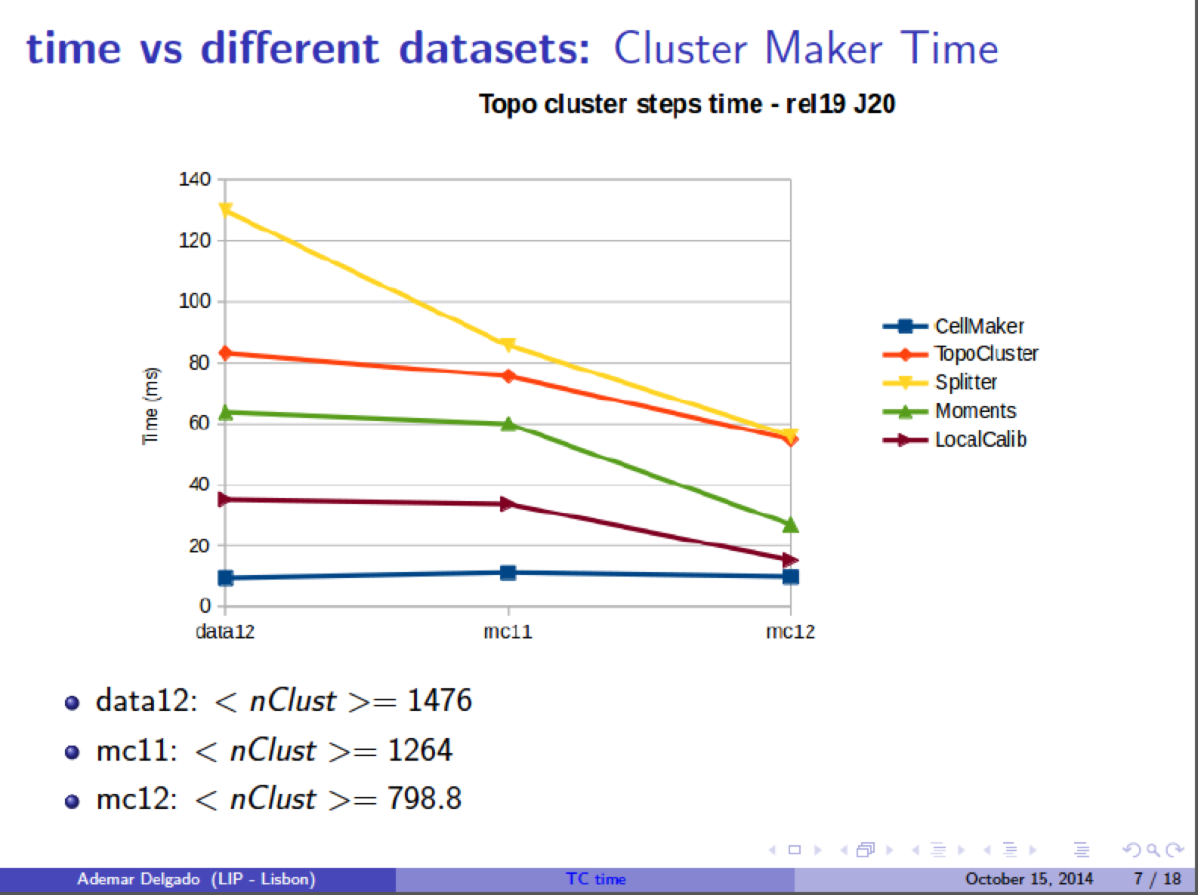

Slide 11
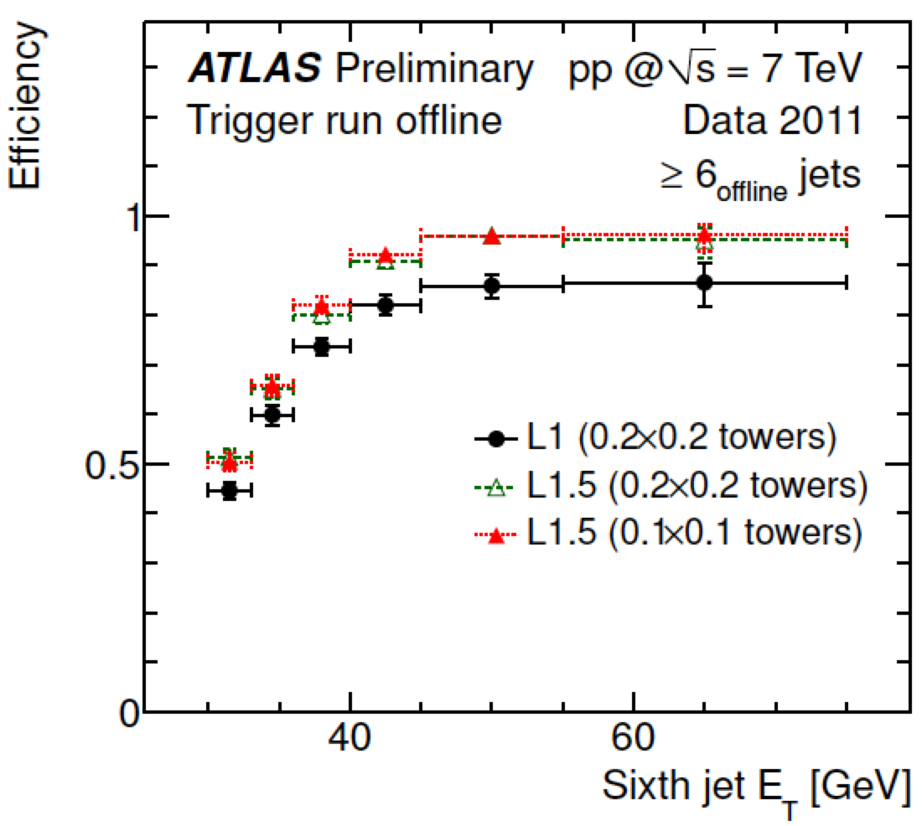
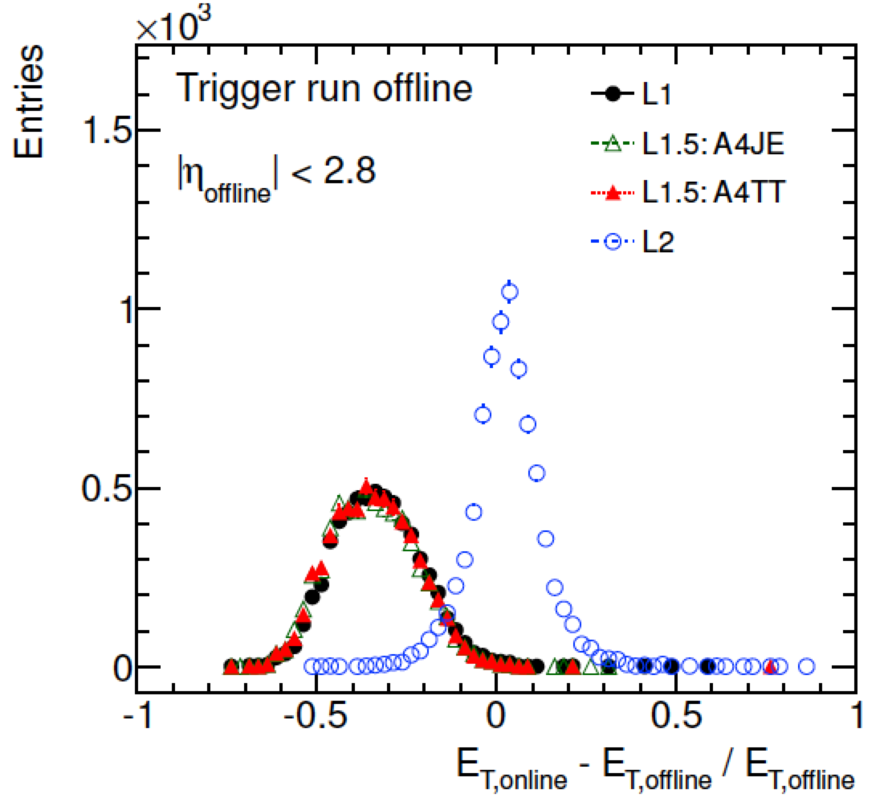
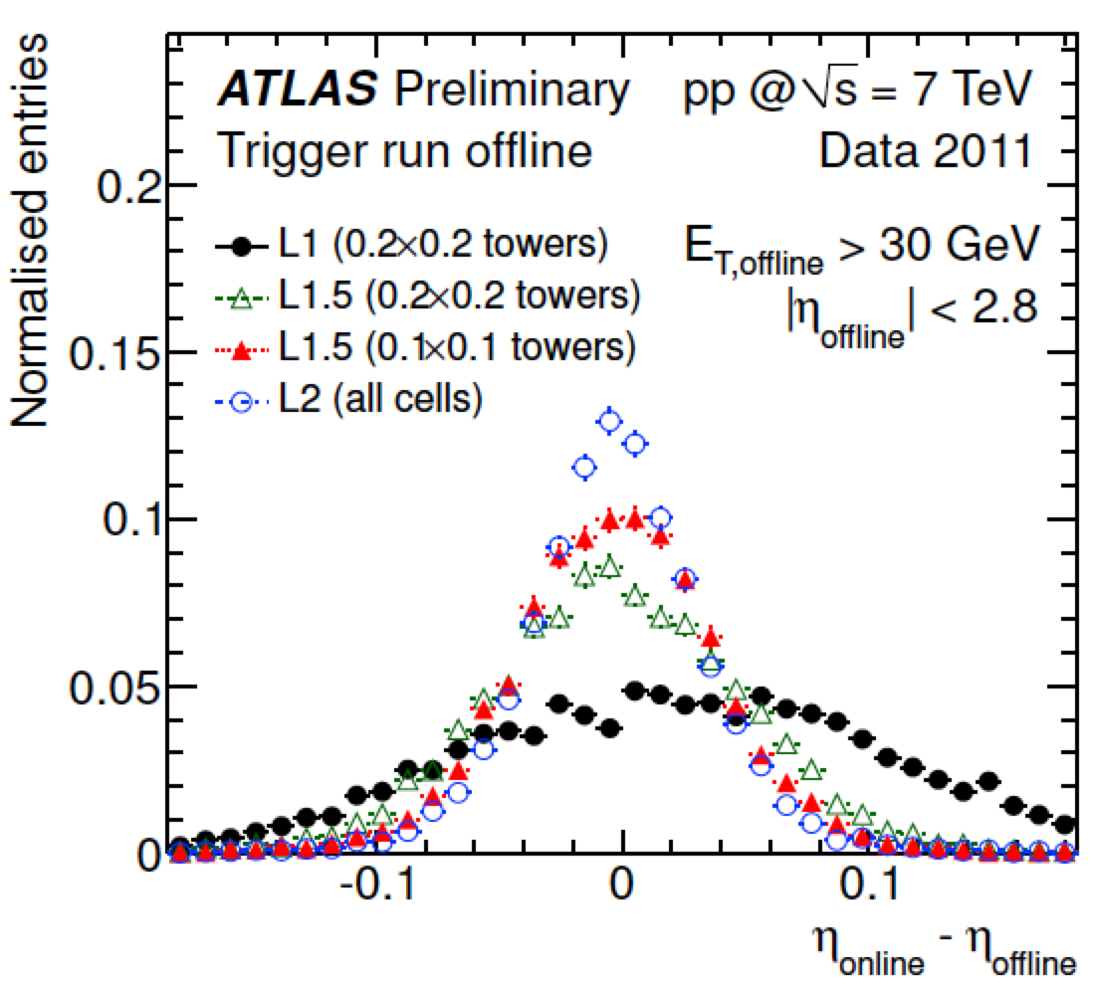
L1.5 performance
The TriggerTower full scan recovers L1 inefficiency for close-by jets
  See ATL-COM-DAQ-2012-009
Reasonable spacial resolution
Energy resolution same as L1
  See ATL-COM-DAQ-2012-009

Slide 12

Jet Menu for p-p Data

Slide 13
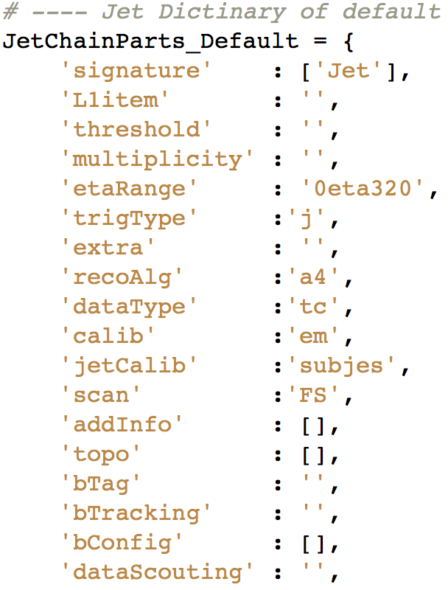
Key
Jet Algorithm:
  a4 = anti-kt jet finding algorithm with R parameter of 0.4
  a10 = anti-kt jet finding algorithm with R parameter of 1.0
Input objects used for jet finding:
  tc = TopoClusters reconstructed from calorimeter cells
  TT = Level 1 TriggerTowers read out in HLT to allow fast but coarse full calo scan (a.k.a. Level 1.5)
Calorimeter scan:
  PS = partial calorimeter scan seeded by L1 RoI or L1.5
  FS = full calorimeter scan (default)
Pseudorapidity range:
  xxetayy = jets in interval xx < |η| < yy – default is 0eta32 (old central jets)
Cluster Energy Scale correction:
  em = no weights applied
  lcw = local cluster weighting
Jet Energy Scale correction:
  jes = JES calibration factors without pileup subtraction
  sub = pileup subtraction applied but no JES factors
  subjes = both pileup subtraction and JES factors
  nojcalib = no jet calibration
Defaults:
  Default options don’t appear in chain names
  0eta320
  a10_tc_em_subjes_FS = jets built from EM-scale clusters from calorimeter full scan, with pile-up subtraction and jet-level calibration
  a10_tc_em_nojcalib_FS = jets built from EM-scale clusters from calorimeter Full Scan and no jet-level calibration or area subtraction

Slide 14
Primary p-p jet menu
Primary unprescaled triggers:
  5x10³³ menu: j360, fatjet360, 4j85, 5j60, 6j50.0ETA24, ht800
  2x10³⁴ menu: j400, fatjet450, 4j100, 5j85, 6j50.0ETA24, ht1000
Default calibration: em_subjes
  Plus cross check chains with different calibration for a few specific thresholds
Additional chains to add segmented eta ranges
  [0, 2.5] for e.g. b-tag (ID coverage)
  [2.8, 3.2] + [3.2, 4.9] for granularity in forward region
In each scenario, total jet menu rate adds up to around 100Hz
Chain Type | L1 Seed at 0.5x10³⁴ | HLT Item at 0.5x10³⁴ | L1 Seed at 2x10³⁴ | HLT Item at 2x10³⁴
Single jet | J75 | j360 | j100 | j400
Single fat jet | HT150 | j360_a10 | HT190 | j450_a10
4 jets | 3J40 | 4j85 | 3J50 | 4j100
5 jets | 4J15 | 5j60 | 4J20 | 5j85
6 jets | 5J15.0ETA24 | 6j50.0ETA24 | 5J15.0ETA24 | 6j50.0ETA24
HT trigger | HT190 | ht800 | HT190 | ht1000

Slide 15
Summary
Lots going on in preparation for the p-p run (much more than I could put here)
  Huge migration from run-1 code
Several unknowns still exist/things which are ongoing or haven’t yet converged/been tested
  L1.5 Trigger Tower full scan?
  Calorimeter-only GSC?
  Effect of nMCM L1Calo calibration on input rate
  Data scouting
  Jet reclustering
  …
Close interaction with offline jet/MET group
  Extremely useful for software development and monitoring
  Implies tight link with offline software – 2-edged sword
  But expect great benefits from improved performance and sharing maintenance load
Clear need for full-scan as default solution
  Pileup subtraction essential to good performance in coming LHC runs
  Keep in sync with offline developments to help maintainability and make use of offline effort
  But keep partial scan as a crucial plan B
NOW is time to include developments needed for HI run!

Slide 16
Backup

Slide 17
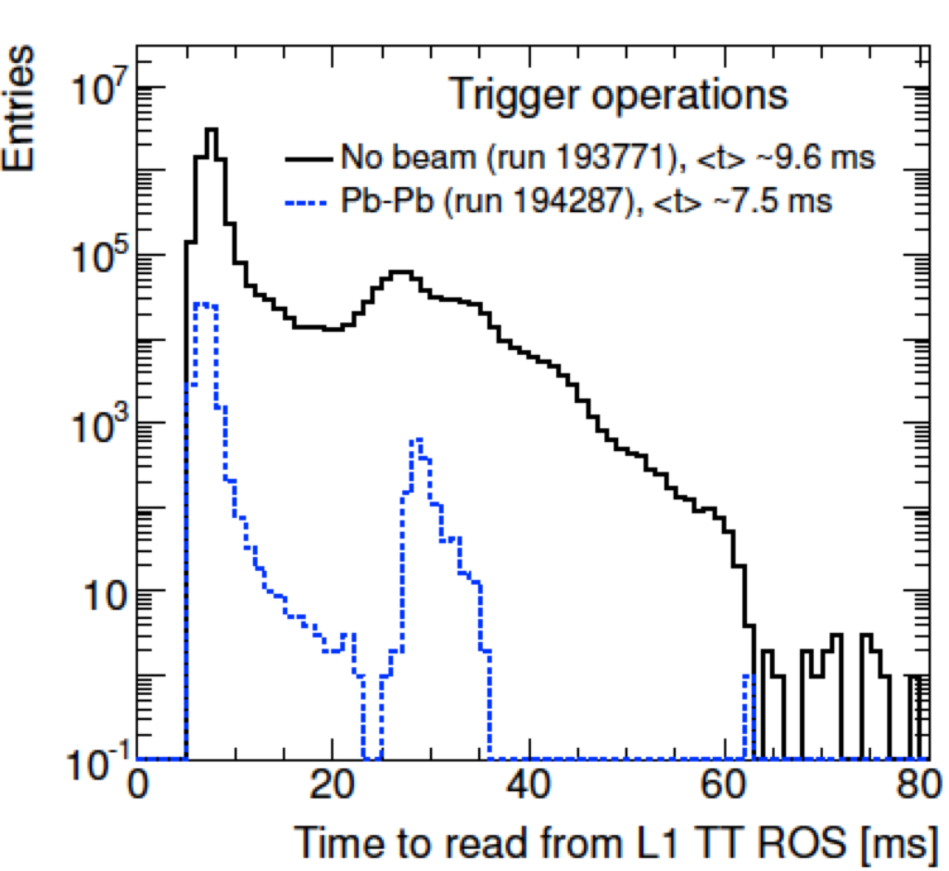
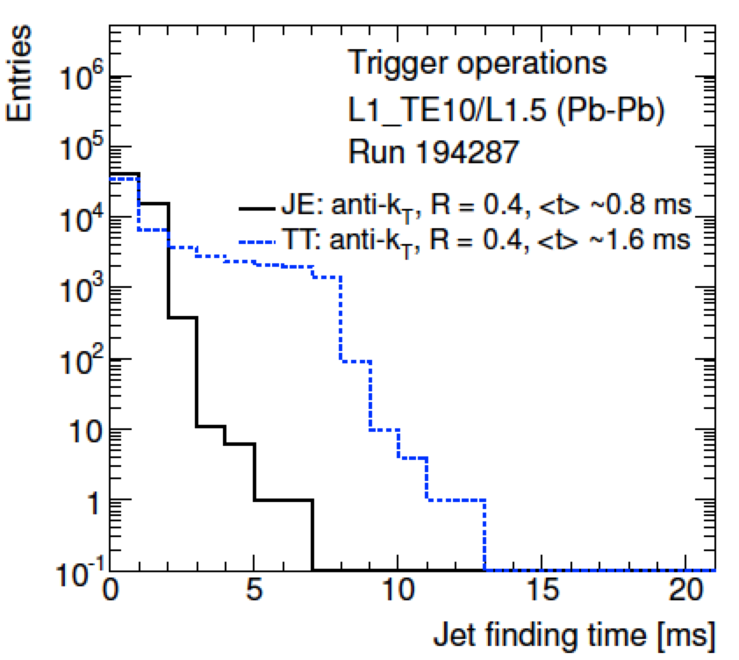
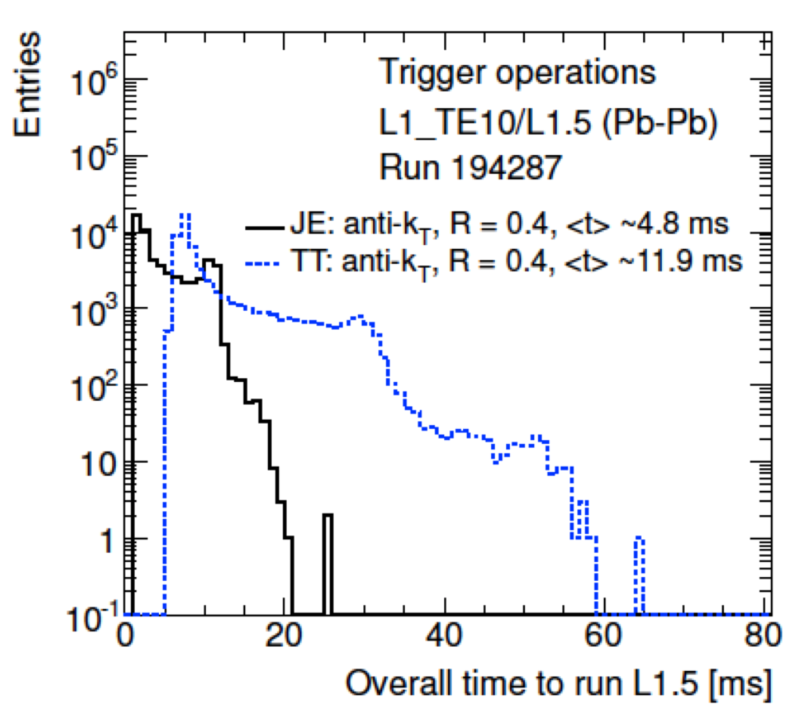
L1.5 cost
From Run I tests (see ATL-COM-DAQ-2012-015):
  L1Calo ROSes (3 for TT, 1 for JE) read out at up to 7kHz
  Expect up to 15kHz with upgraded ROSes
Total time around 12ms
  Readout time around 9ms
  Jet finding (anti-kT 0.4) around 1-2ms

Slide 18
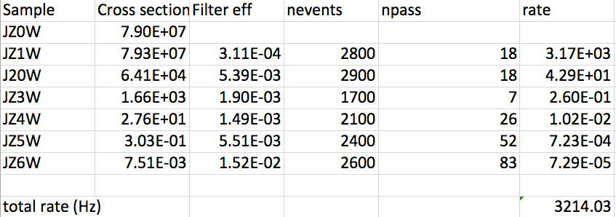
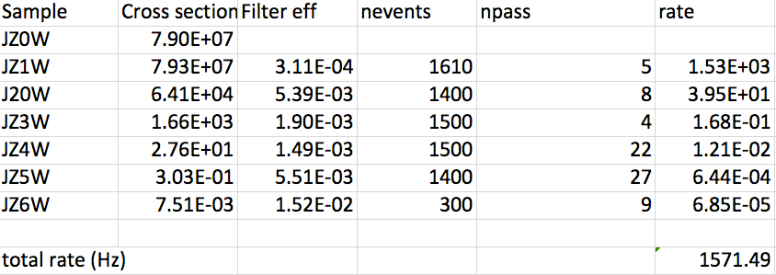
Bonus: rates with pileup correction
Conditions:
  L=2x10³⁴
  4j45 rate
  No event weighting
Only fixed ρ=6 here
ρ calculation works in private code so far
Top: no areas subtraction
Bottom: with ρ=6 area subtraction

Slide 19
Inclusive single jet chains
Level 1 seed | Rate @ 0.5 & 2x10³⁴ | HLT chain | Rate @ 0.5 & 2x10³⁴ | Prescale@2x10³⁴ | Clients
L1_RD0 |  | j55_a4tcemsubjes | O(Hz) | ? | bootstrap
 |  | j60_a4tcemsubjes | O(Hz) | ? | bootstrap
J12 | 0.95 / 3.8 MHz | j55_a4tcemsubjes | 150 / 600 kHz | 600,000 – 1 Hz | taus
J15 | 0.53 / 2.1 MHz | j60_a4tcemsubjes | 100 / 400 kHz | 400,000 – 1 Hz | taus, btag
J20 | 240 / 970 kHz | j85_a4tcemsubjes | 21 / 85 kHz | 85,000 – 1 Hz | taus, multi-j
 |  | j85_a4tcemjes
 |  | j85_a4tclcwsubjes
 |  | j85_a4tclcwjes
J25 | 130 / 510 kHz | j100_a4tcemsubjes | 10 / 41 kHz | 41,000 – 1 Hz | taus
J30 | 75 / 300 kHz | j110_a4tcemsubjes | 6.5 / 26 kHz | 26,000 – 1 Hz | LAr calib
J40 | 32 / 130 kHz | j150_a4tcemsubjes | 1.6 / 6.5 kHz | 6500 – 1 Hz | J+MET
J50 | 15 / 60 kHz | j175_a4tcemsubjes | 0.75 / 3 kHz | 3000 – 1 Hz | multijet
 |  | j175_a4tcemjes
 |  | j175_a4tclcwsubjes
 |  | j175_a4tclcwjes

Slide 20
Inclusive single jet chains
Level 1 seed | Rate @ 0.5 & 2x10³⁴ | HLT chain | Rate @ 0.5 & 2x10³⁴ | Prescale@2x10³⁴ | Clients
J60 | 7.5 / 30 kHz | j200_a4tcemsubjes | 0.4 / 1.6 kHz | 1600 – 1 Hz | btag
J75 | 4 / 17 kHz | j260_a4tcemsubjes | 140 / 400 Hz | 400 – 1 Hz | btag, low Lumi
J85 | 2.5 / 10 kHz | j300_a4tcemsubjes | 67 / 270Hz | 200 – ≈1 Hz | multijet, medium Lumi
 |  | j320_a4tcemsubjes | 43 / 170 Hz | 150 – ≈1 Hz | multijet, medium Lumi
J100 | 1.3 / 5 kHz | j360_a4tcemjes | 22 / 90 Hz | 100 – ≈1 Hz | unprescaled at 1x10³² or lower: aim for 1-2 points during year to change lowest unprescaled chain Also re-think set of cross-check chains with different calibrations if needed
 |  | j380_a4tcemsubjes | 16 / 65 Hz | 50 – ≈1 Hz
 |  | j380_a4tcemjes
 |  | j380_a4tclcwsubjes
 |  | j380_a4tclcwjes
 |  | j400_a4tcemsubjes | 9 / 35 Hz | unprescaled
 |  | j400_a4tcemjes
 |  | j400_a4tclcwsubjes
 |  | j400_a4tclcwjes
J120 | 1.3 / 2.7 kHz | j460_a4tcemjes + cross-check chains | <1 / 2.8 Hz | unprescaled | High Lumi
J400 | 0 / 0 Hz | noAlg | 5.5 Hz | unprescaled | Passthrough

Slide 21
Multi-jet and fat jet chains
Level 1 seed | @ 0.5 & 2x10³⁴ | HLT chain | @ 0.5 & 2x10³⁴ | Prescale@2x10³⁴ | Clients
3J40 | 0.4 / 1.6 kHz | 4j85_a4tcemsubjes | 45 / 180 Hz | 180 – 1 Hz
3J50 | 0.3 / 1.0 kHz | 4j100_a4tcemsubjes | 12 / 50 Hz | unprescaled | SUSY, SM, top, jets
4J15 | 2.4 / 9.5 kHz | 5j55_a4tcemsubjes | 65 / 260 Hz | 260 – 1 Hz
4J20 | 0.5 / 1.9 kHz | 5j60_a4tcemsubjes | 40 / 170 Hz | 170 – 1 Hz
4J20 | 0.5 / 1.9 kHz | 5j85_a4tcemsubjes | 4 / 15 Hz | unprescaled | SUSY, SM, top, jets
 |  | 5j85_a4tcemjes
 |  | 5j85_a4tclcwsubjes
 |  | 5j85_a4tclcwjes
5J15.0ETA24 | 0.1 / 0.3 kHz | 6j45.0eta24_a4tcemsubjes | 25 / 100 Hz | 100 – 1 Hz | SUSY, SM (*)
5J15.0ETA24 | 0.1 / 0.3 kHz | 6j50.0eta24_a4tcemsubjes | 10 / 40 Hz | unprescaled | SUSY, SM (*)
5J15.0ETA24 | 0.1 / 0.3 kHz | 6j55.0eta24_a4tcemsubjes | 8 / 30 Hz | 30 – 1 Hz | SUSY, SM (*)
HT150 | 3 / 12 kHz | j360_a10tcemsubjes | 14 / 60 Hz | 60 – 1 Hz | exotics, jets
HT190 | 1.2 / 5 kHz | j450_a10tcemsubjes | 2 / 8 Hz | unprescaled | exotics, jets
(*) A new study from SUSY indicates that 6j chains can/should start from 4J20 to save bandwidth – need to understand if this is also ok for SM

Slide 22
Forward jet and HT chains
Level 1 seed | Rate @ 0.5 & 2x10³⁴ | HLT chain | Rate @ 0.5 & 2x10³⁴ | Prescale@2x10³⁴ | Clients
J15.24ETA49 | ? | j60.24eta49 | ? | ? – 1 Hz | egamma
J15.28ETA32 | ? | j60.28eta32 | ? | ? – 1 Hz | SUSY, SM, top, jets
J20.28ETA32 | ? | j85.28eta32 | ? | ? – 1 Hz | jets
J15.32ETA49 | ? | j60.32eta49 | ? | ? – 1 Hz | jets
J20.32ETA49 | ? | j85.32eta49 | ? | ? – 1 Hz | jets
J30.32ETA49 | ? | j110.32eta49 | ? | ? – 1 Hz | jets
J50.32ETA49 | ? | j175.32eta49 | 0 | unprescaled | Jets, SM
J75.32ETA49 | ? | j260.32eta49 | 0 | unprescaled | SM
J100.32ETA49 | ? | j360.32eta49 | 0 | unprescaled | SM
Default R parameter and calibration is a4tcemsubjes
Add cross-check chains (a4tcemjes, a4tclcwsubjes, a4tclcwjes) for:
  j85.28eta32, j85.32eta49, j175.32eta49, j260.32eta49, j360.32eta49
Level 1 seed | Rate @ 0.5 & 2x10³⁴ | HLT chain | Rate @ 0.5 & 2x10³⁴ | Prescale@2x10³⁴ | Clients
HT190 | 1.2 / 5 kHz | ht1000 | 3.5/14 Hz (0 unique) | unprescaled
HT150 |  | Ht500(?) |  | prescaled

