Slide 1
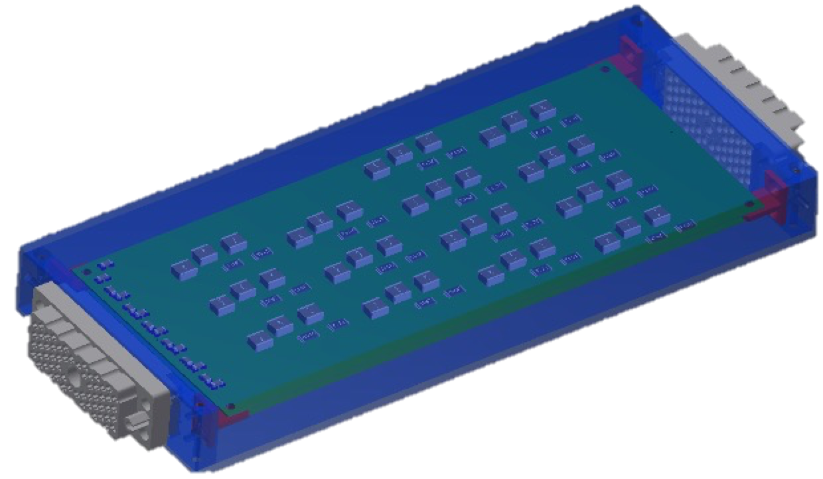
HGTD HV Patch Panels Status
Luis Lopes, Orlando Cunha, Ricardo Gonçalo

Slide 2
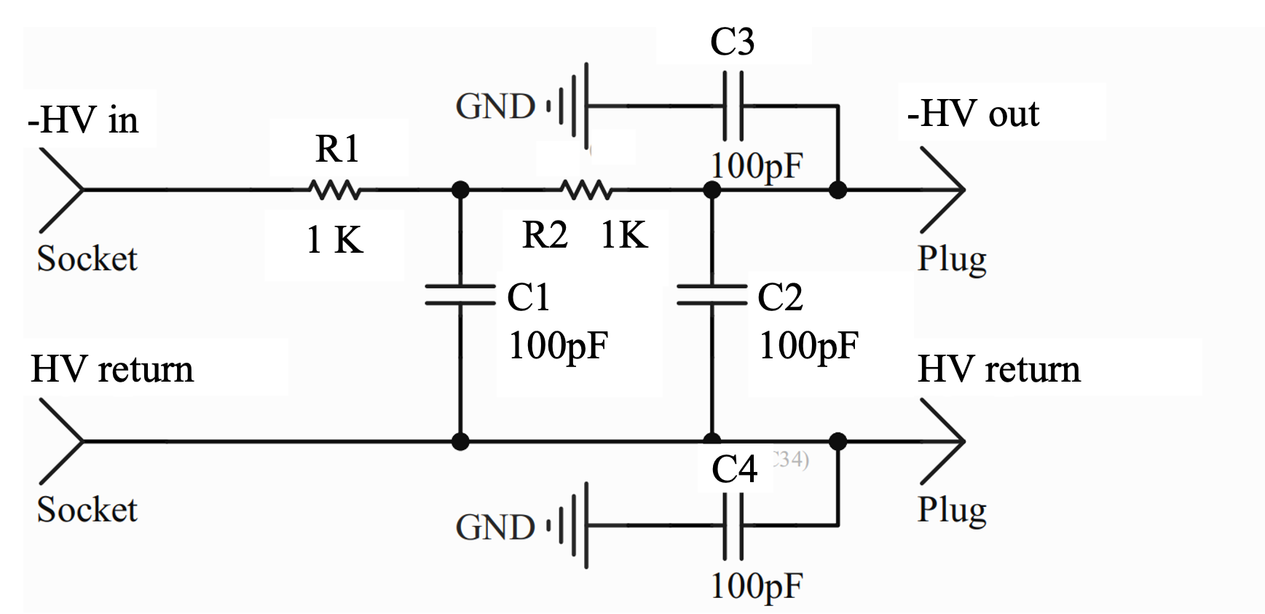
Patch Panel Filter Design For PDR
HV routing through fixed wire connections between input long cables from USA15 and short cables to detector modules
2nd order RC-RC low-pass filter to suppress AC noise
Up to -900 V with, no significant leakage, supply currents up to 3 mA per channel
Decoupling capacitors to suppress common-mode noise (C3, C4)

Slide 3
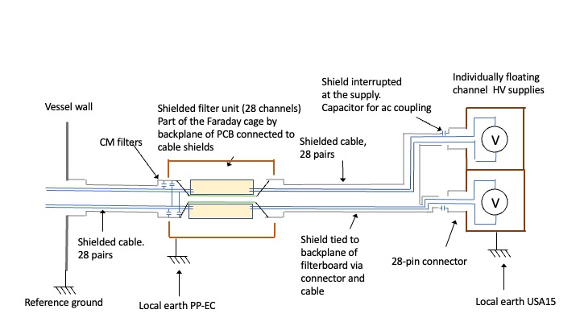
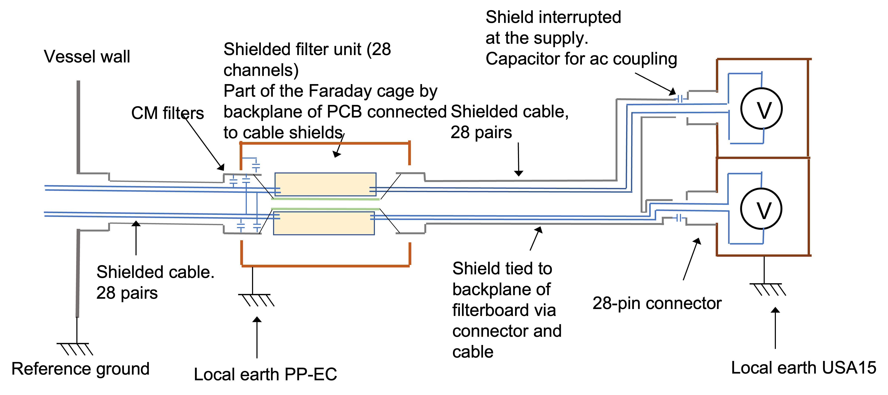
Patch Panel Filter Design For PDR
Differential HV channels, insulated from the patch panel unit
Module aluminium boxes act as Faraday cage, electrically connected to the Tilecal surface
HGTD earth extends through cable sleeve to filter board backplanes
HGTD/Filter earth insulated from module earth (=Tilecal earth) to avoid ground loops

Slide 4
PDR Discussion and Updates
HV PDR meeting on 29 August: https://indico.cern.ch/event/1190013/
Questions raised by Vincent Bobillier on grounding scheme and best way to suppress noise
Suggested a discussion with Georges Blanchot, electronics engineer at CERN
Proposal for changed design in next page

Slide 5
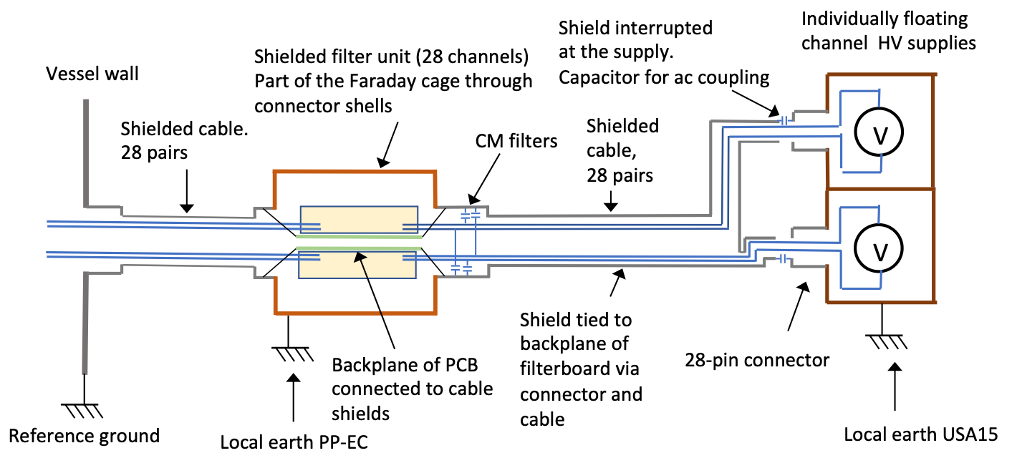
Proposed Changes
Use filter module boxes as continuation of vessel Faraday cage
Also DC connecttion of filter boards backplane to cage
DC connection of Faraday cage to local TileCal earth
DC current not as bad as HF AC noise
Move common-mode filter capacitors to filter input instead of output
Filter common mode current at input

Slide 6
Prototype tests and quality control
Planned tests:
Connectivity of components and filter performance tested by measuring the filter response as function of frequency and load
Leakage current
Insulation between internal and external ground.
Cross talk between channels
Temperature under load
Long term reliability including enhanced aging by temperature cycling in a climate chamber
Radiation and magnetic field tolerances
NEW: test with and without DC ground
For production:
Based on prototype results will establish set of quality control benchmarks to be done in production and upon delivery

Slide 7
Thanks!

Slide 8
HGTD HV Patch Panels
Each of the 8032 HGTD modules will need a bias voltage between -300 V and -900 V, adjusted individually
Electronic noise induced in the DC bias voltage at the power supply or in the cables between USA15 and the detector must be filtered out.
Filter modules (EC-PP) will be installed on the end-cap calorimeter surfaces – filter noise and allow HV channel routing

Slide 9
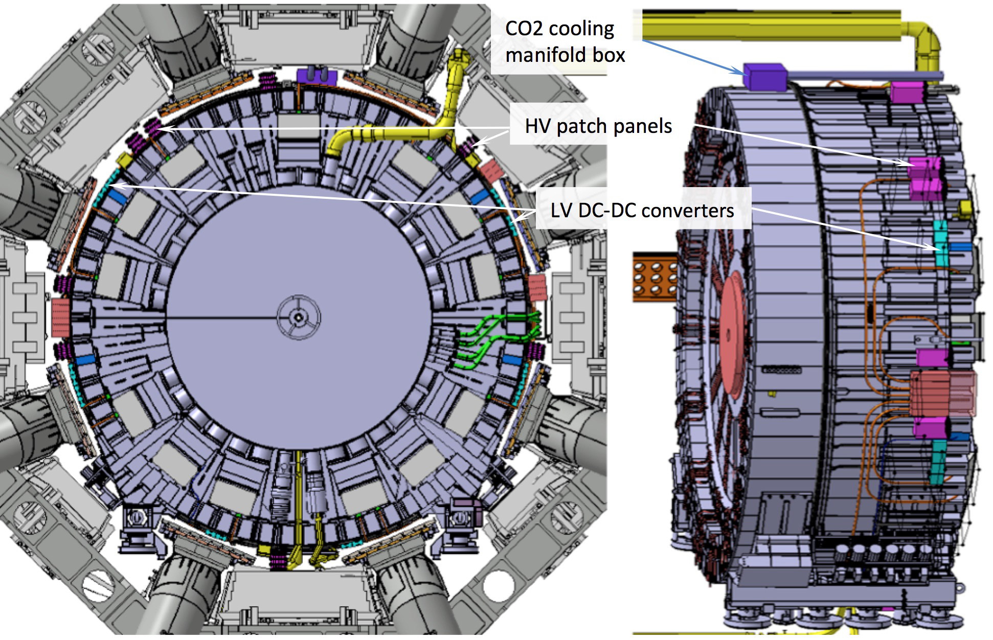
Patch Panel design parameters
Materials to withstand radiation and magnetic field:
TID 15.0 Gy and 1 MeV neq fluence 1.0 × 10¹² cm⁻²
Magnetic field up to 0.5 Tesla
Avoid easily activated and magnetic materials
Avoid extensive use of dielectrics
Mechanical stability and ease of access during shutdowns
Robust connectors
Fixation to Tilecal and cable strain relief staves – to be studied together with Technical Coordination
Space constraints
Around 20cm free in radial direction
Number of wires should present good match to cables from HV supplies

Slide 10
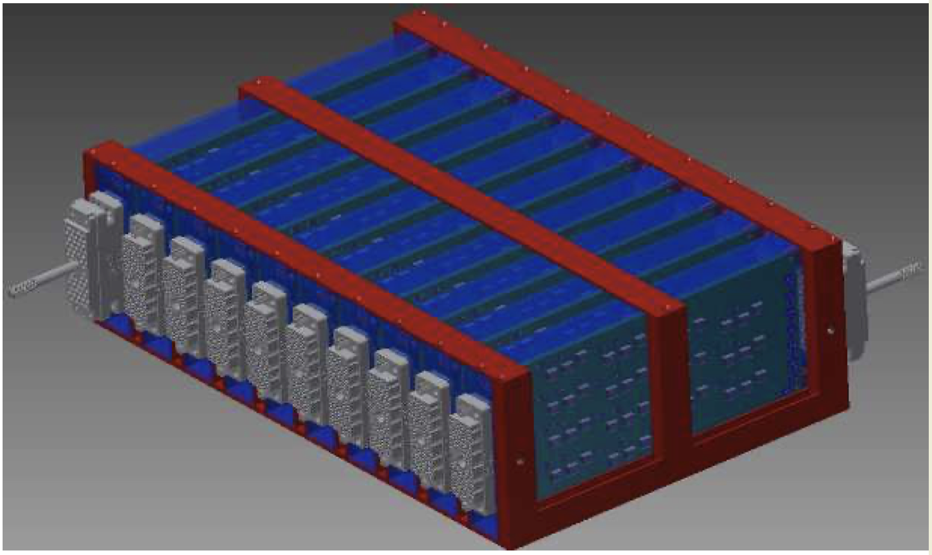
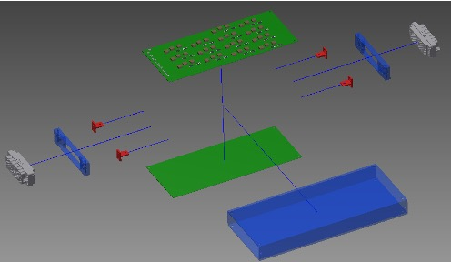
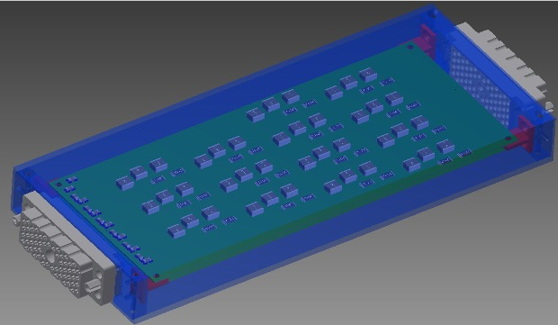
Patch Panel Units Design
A modular design is proposed for the patch panels
Individual modules are aluminium boxes containing two filter boards and connectors
Provide mechanical support and insulate each pair of boards within separate Faraday cage
Easy to construct, handle and access for maintenance
14 RC-RC low-pass filters in each filter board
Means one 56-wire cable connected to each module: = 28 HV channels = 14 channels x 2 boards
Routing of individual HV channels through wires connecting cables to each filter board

Slide 11
Shield interrupted
at the supply.
Capacitor for ac coupling
Individually floating channel HV supplies
Vessel wall
Shielded filter unit (28 channels)
Part of the Faraday cage by backplane of PCB connected to cable shields
CM filters
Shielded cable,
28 pairs
V
V
Shielded cable.
28 pairs
Shield tied to backplane of filterboard via connector and cable
28-pin connector
Reference ground
Local earth PP-EC
Local earth USA15

Slide 12
Shield interrupted
at the supply.
Capacitor for ac coupling
Individually floating channel HV supplies
Shielded filter unit (28 channels)
Part of the Faraday cage through connector shells
Vessel wall
Shielded cable.
28 pairs
Shielded cable,
28 pairs
V
CM filters
V
Shield tied to backplane of filterboard via connector and cable
Backplane of PCB connected to cable shields
28-pin connector
Reference ground
Local earth PP-EC
Local earth USA15

Slide 13
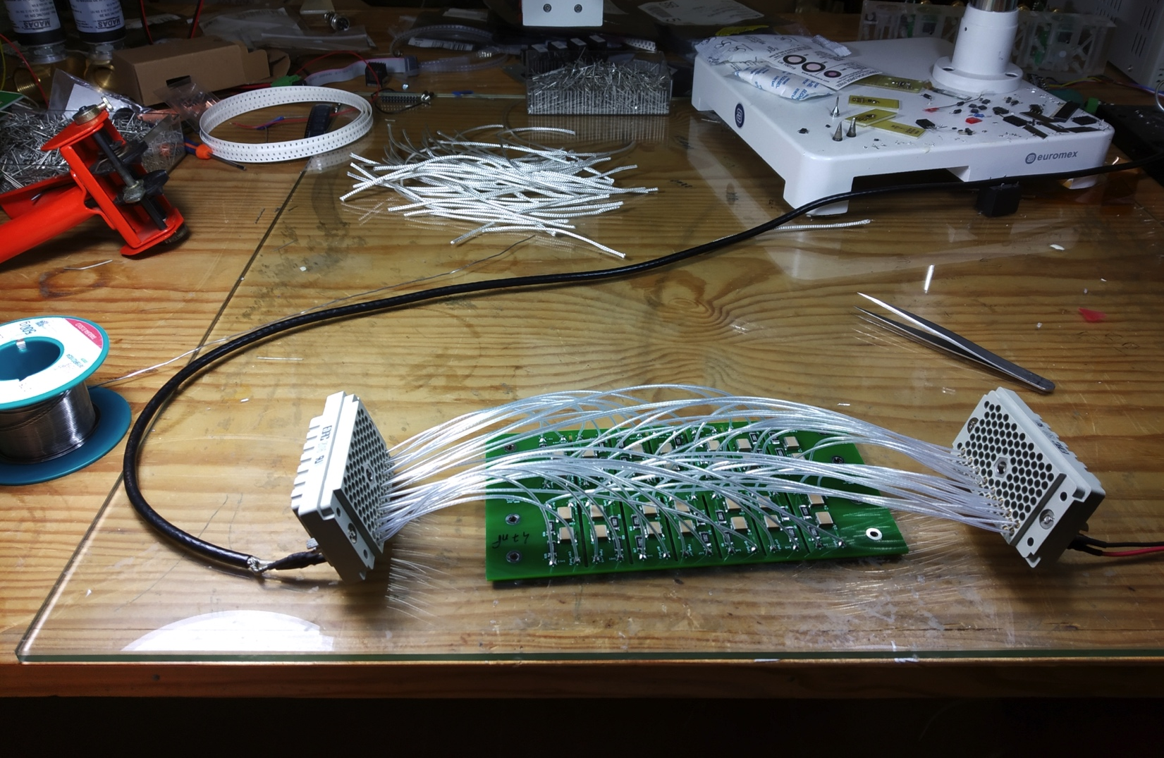
Initial (pre-)prototype tests
RC–RC filter: 10 kΩ x 33 nF or 47 nF
Note R and C not final – must be defined together with sensors and tested together
Assuming 3 mA maximum current means:
60 V voltage drop
180 mW max. dissipation per channel
I.e. 5 W / 24-channel box
Ideal response:
f_{c} = 338 Hz (33 nF) or 482 Hz (47 nF)
-40 dB / decade
Achieved this when tested inside shielding box

Slide 14
Prototype tests
Response improves with shielding (Faraday cage )
Closer to -40 dB / decade
Response flat above 10 kHz
Other tests foreseen:
Leak current under HV bias – waiting for precision HV module to be free, to ease measurement
Final tests must be done with HGTD HV source prototype

Slide 15
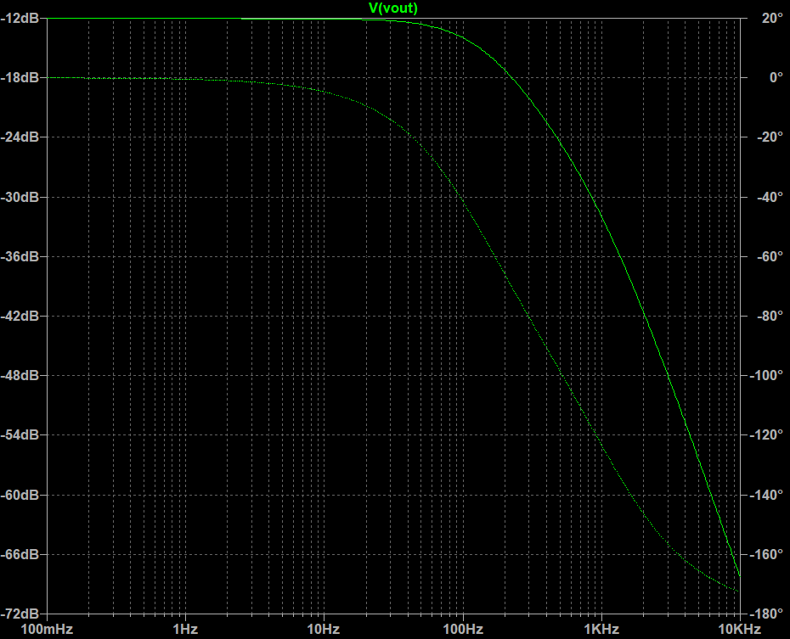
Response curve
Response after adding common-mode decoupling capacitors

Slide 16
Optimising design
Also tried an alternative design to:
Ease assembly: reduces production time and manufacture errors
Improve robustness: assess robustness of routing cables / soldering
Add decoupling capacitors against common-mode noise in each channel
Lower cost:
Especially by reducing length of cable for HV routing
Trying routing in 4-layer PCB

Slide 17
Connectors
REF:516-120-000-101 REF:516-056-000-301 REF:516-120-000-402 REF:516-056-000-402 REF:516-230-512 REF:516 230-556
Found potentially interesting connectors from Farnell:
http://www.farnell.com/datasheets/2916873.pdf
Unit price (120 pins, small quant.): 53 € plug; 45 € pins; 26 € connector
To be used for this prototype and replaced later

Slide 18
Measurements
Difficult to measure low-frequency behaviour with our current setup due to output capacitor in waveform generator

