Slide 1
Patch Panels
Luis Lopes, Orlando Cunha, Ricardo Gonçalo

Slide 2
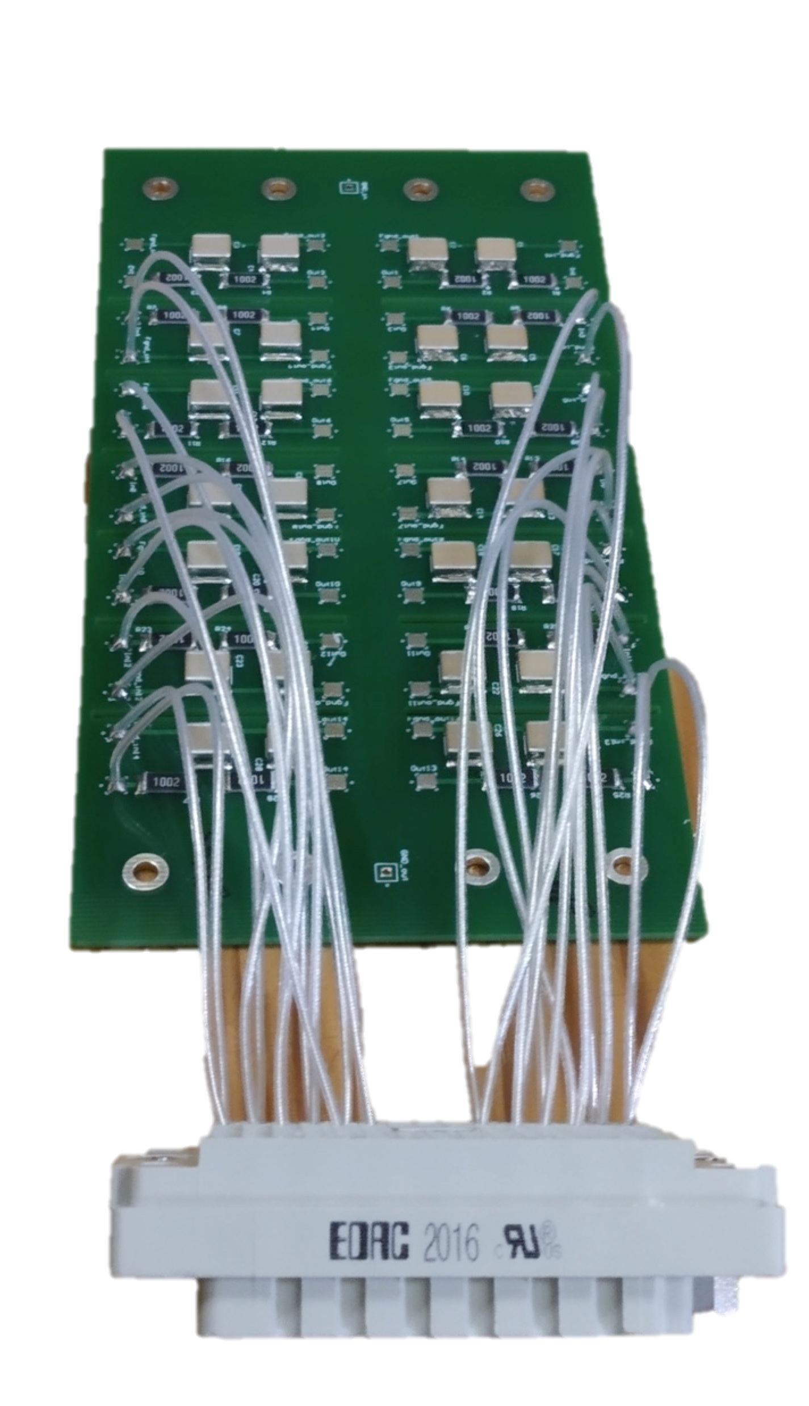
Status
Not much change since July
Holiday period and other activities
Tests done so far show necessary performance
Would like to better understand high-frequency response (see below)
Now working on:
Budget – assess assembly time and final cost
Optimizing design to improve cost and robustness
Collating information for SPR

Slide 3
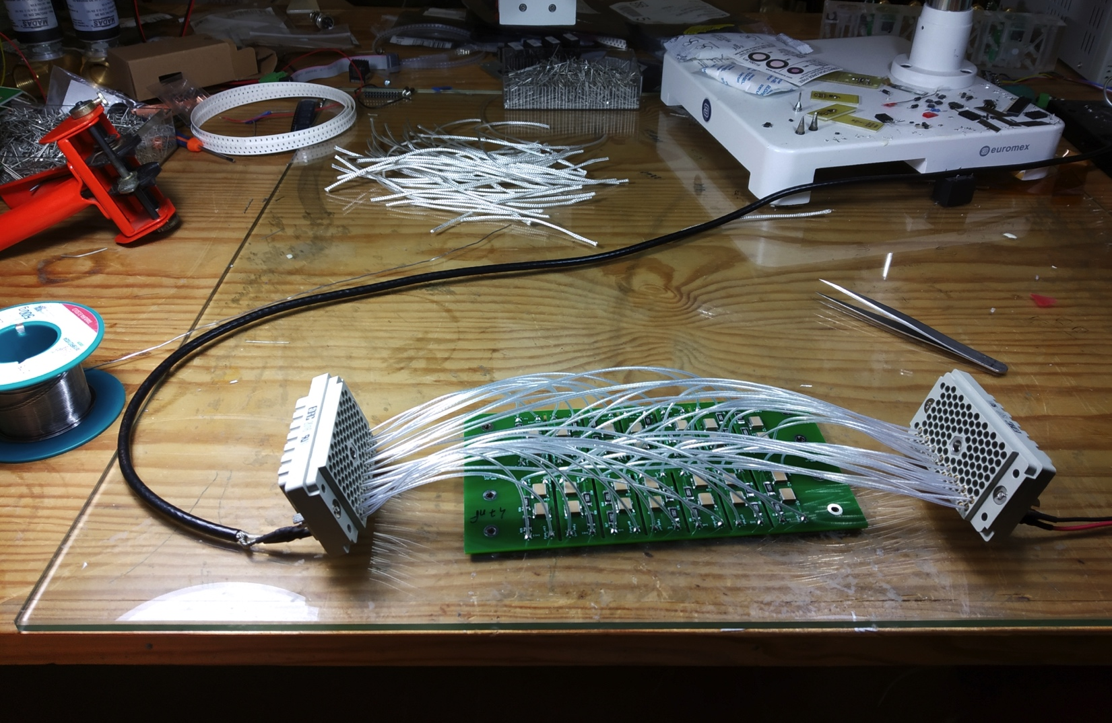
Prototype tests
RC–RC filter: 10 kΩ x 33 nF or 47 nF
Note R and C not final – must be defined together with sensors and tested together
Assuming 3 mA maximum current means:
60 V voltage drop
180 mW max. dissipation per channel
I.e. 5 W / 24-channel box
Ideal response:
f_{c} = 338 Hz (33 nF) or 482 Hz (47 nF)
-40 dB / decade
Not quite what we see, but not far
Later tried same test inside metal box

Slide 4
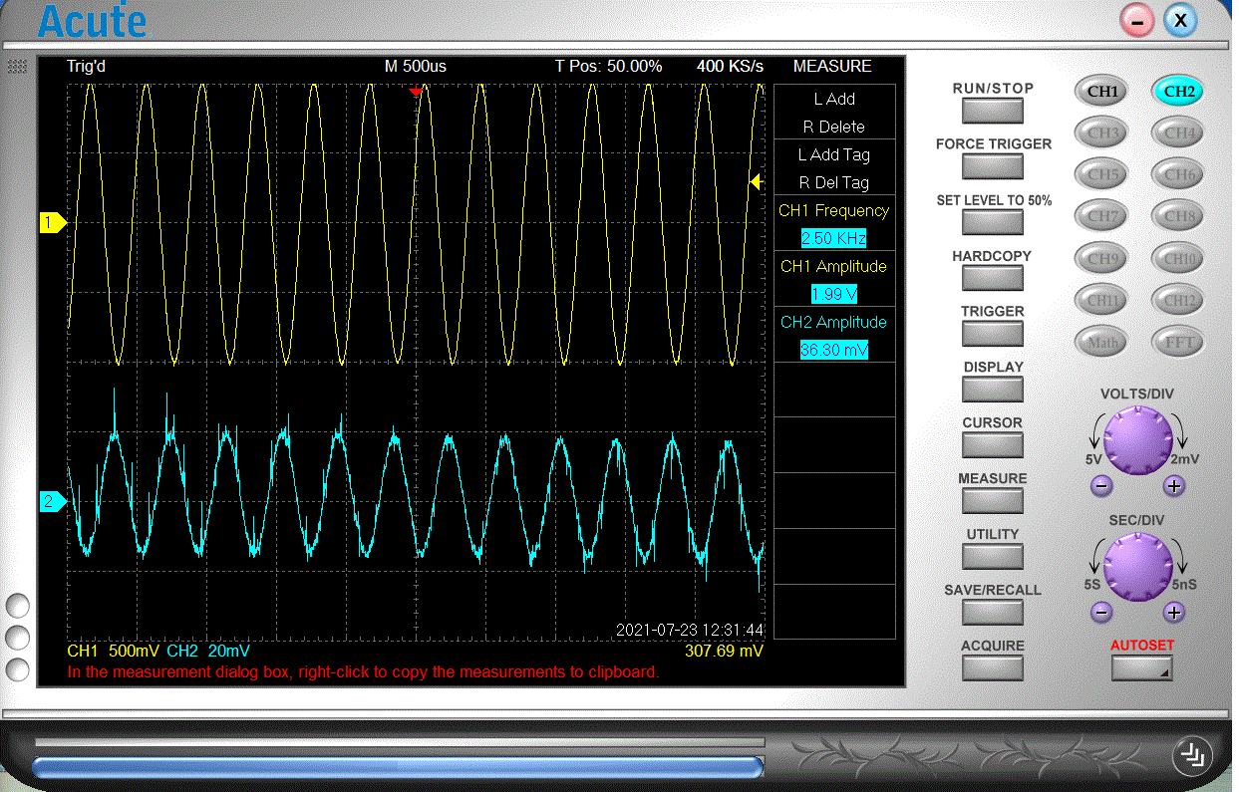
More tests
Measurements both with direct coupling (no High Voltage) and under HV bias from 0 V to 1000 V - injected signal through decoupling capacitor

Slide 5
Current questions
Response improves with shielding (Faraday cage )
Closer to -40 dB / decade
Response flat above 10 kHz
Can investigate further
Or is this good enough?
Still to check:
Leak current under HV bias – waiting for precision HV module to be free, to ease measurement
Final tests must be done with HGTD HV source prototype

Slide 6
Optimising design
Also trying an alternative design to:
Ease assembly: reduces production time and manufacture errors
Improve robustness: assess robustness of routing cables / soldering
Lower cost:
Especially by reducing length of cable for HV routing
Trying routing in 4-layer PCB

Slide 7
Conclusions... so far
Initial prototype was very useful to gain confidence in design and performance
Some work still to be done, but seems in track
Now aim to improve plans with a view on production
Must define:
Final R and C values – together with sensor development
Final connectors – together with infrastructure
Would be very usefil to test together with prototype HV source
Prepare for SPR in October

Slide 8
Thanks!

Slide 9
Backup

Slide 10
Connectors
REF:516-120-000-101 REF:516-056-000-301 REF:516-120-000-402 REF:516-056-000-402 REF:516-230-512 REF:516 230-556
Found potentially interesting connectors from Farnell:
http://www.farnell.com/datasheets/2916873.pdf
Unit price (120 pins, small quant.): 53 € plug; 45 € pins; 26 € connector
To be used for this prototype and replaced later

Slide 11
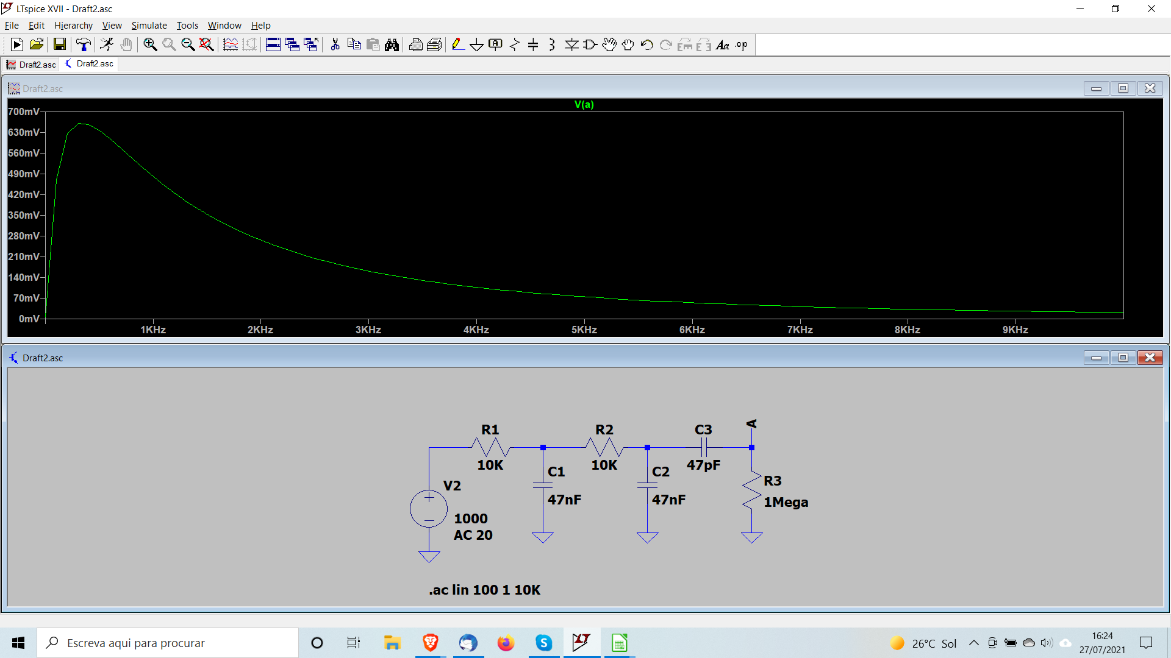
Measurements
Difficult to measure low-frequency behaviour with our current setup due to output capacitor in waveform generator

Slide 12
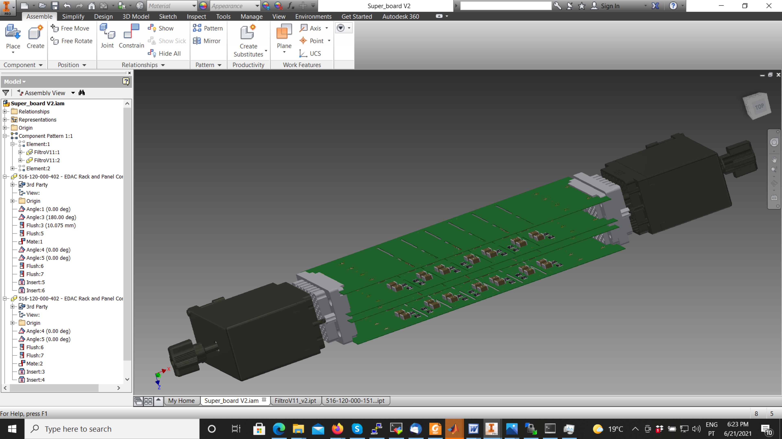
Status of development
Preparing to build initial “Prototype 0”
Will produce 2 equipped boards for basic tests of insulation, mechanics, grounding, noise before end July
I.e. 2 × 14 RC-RC filters mounted 1/RC = 450 Hz
Initial guess (to be corrected): R = 100 kΩ; C = 22 nF
To be replaced with final values later

Slide 13
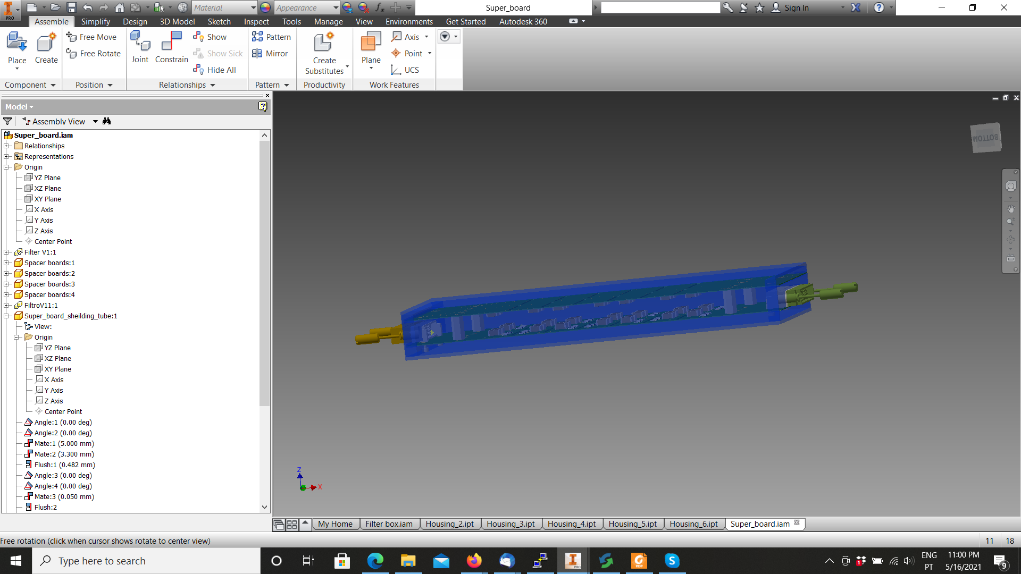
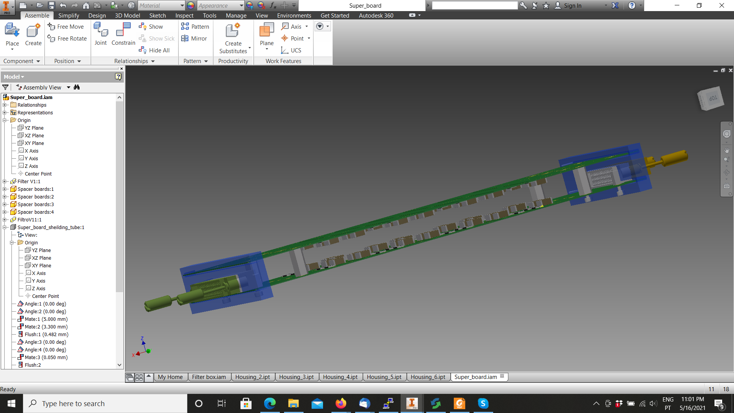
Filter module
Initial idea: two PCBs per module with filters

Slide 14
Modular box
Dimensions: 360 x 195 x 104 mm³ Weight: 7.5 kg (final around 10 kg)
56 wires in (28 pairs)
For insulation: male pins on USA15 side; female plugs on sensor side

Slide 15
PCB with filters
14 RC-RC filters per PCB – 28 per module / Wire routing from connector to filter
Patching options:
56 wires in (28 pairs) – 56 wires out (28 pairs)
48 wires in (24 pairs) – 56 wires out (28 pairs)

Slide 16
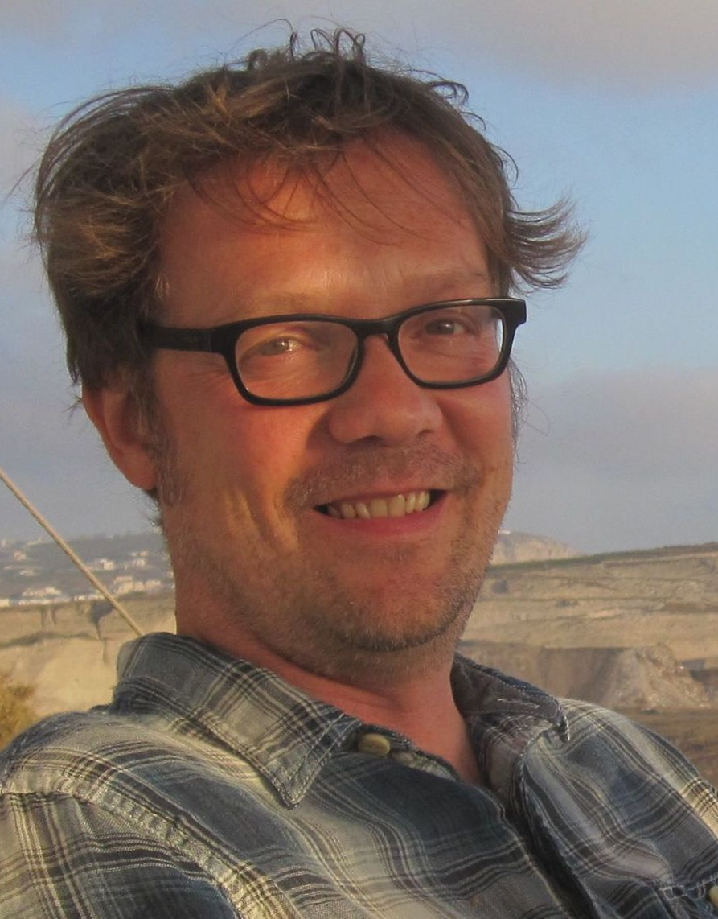
HGTD Involvement
Producing HV patch panels with CERN group:
16 patch panel boxes located around the calorimeter perimeter
Routing of High Voltage to HGTD detector and filtering AC noise out
Presented in Electronics meetings
Team: 1 academic, 2 engineers
Looking for new projects to get involved with in HGTD
Notes:
Possibilities: TDAQ and DCS

