Slide 1
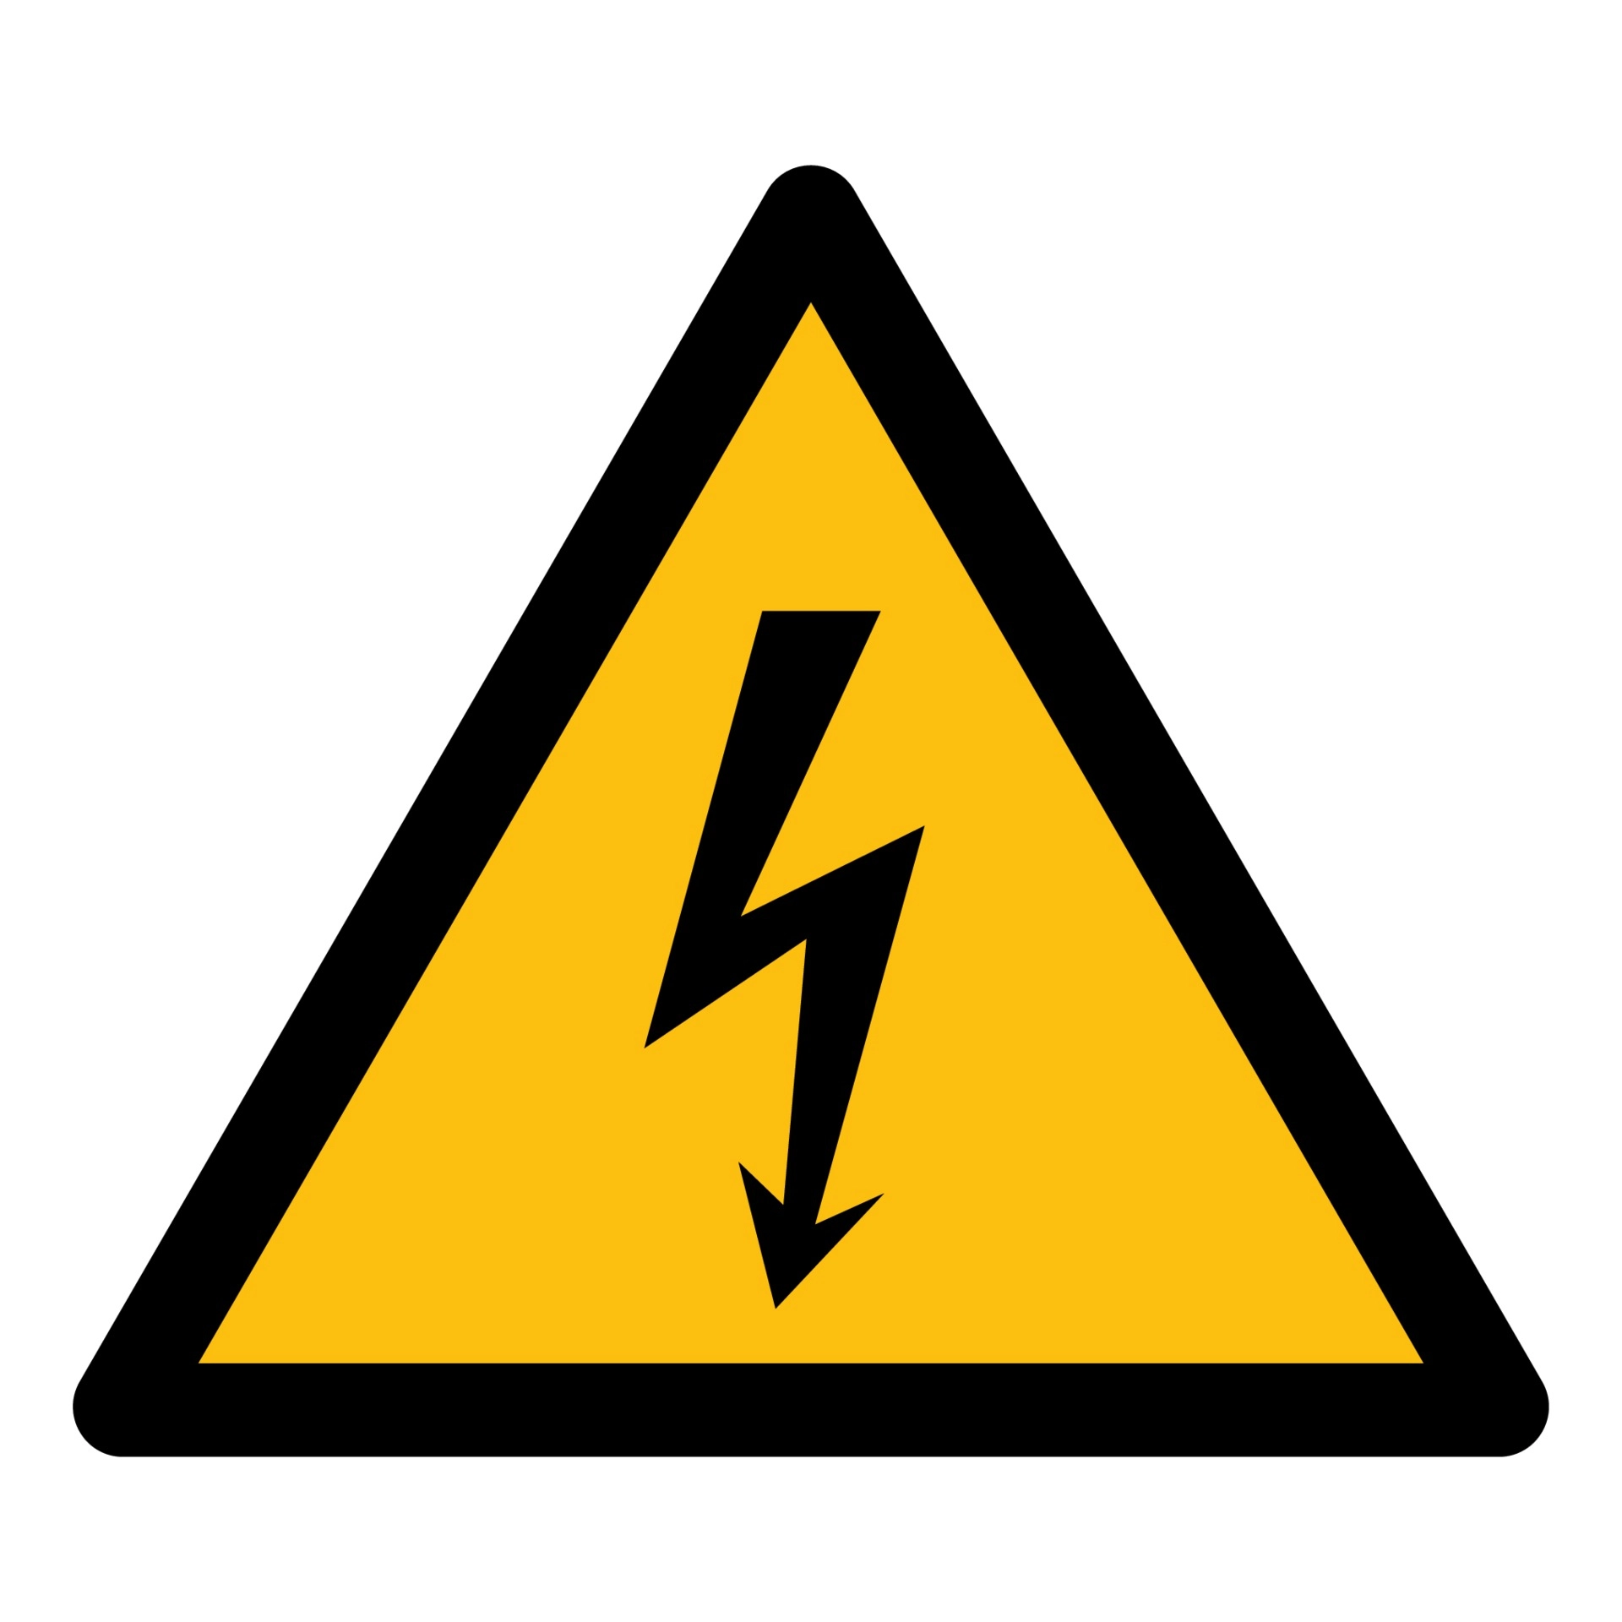
HGTD High Voltage Status
Ricardo Gonçalo (LIP/Univ. Coimbra) for the HV PS and PP teams
HGTD Week in Ljublijana, September 2023

Slide 2
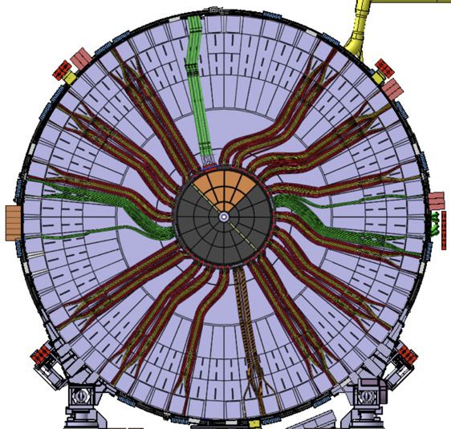
Outlook
High Voltage Power Supplies
Patch Panels
Grounding & Shielding
Cables & Connectors

Slide 3
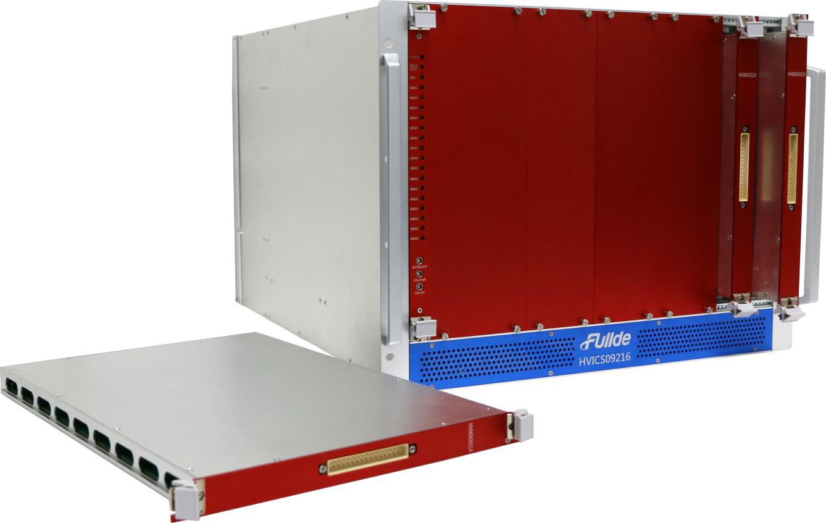
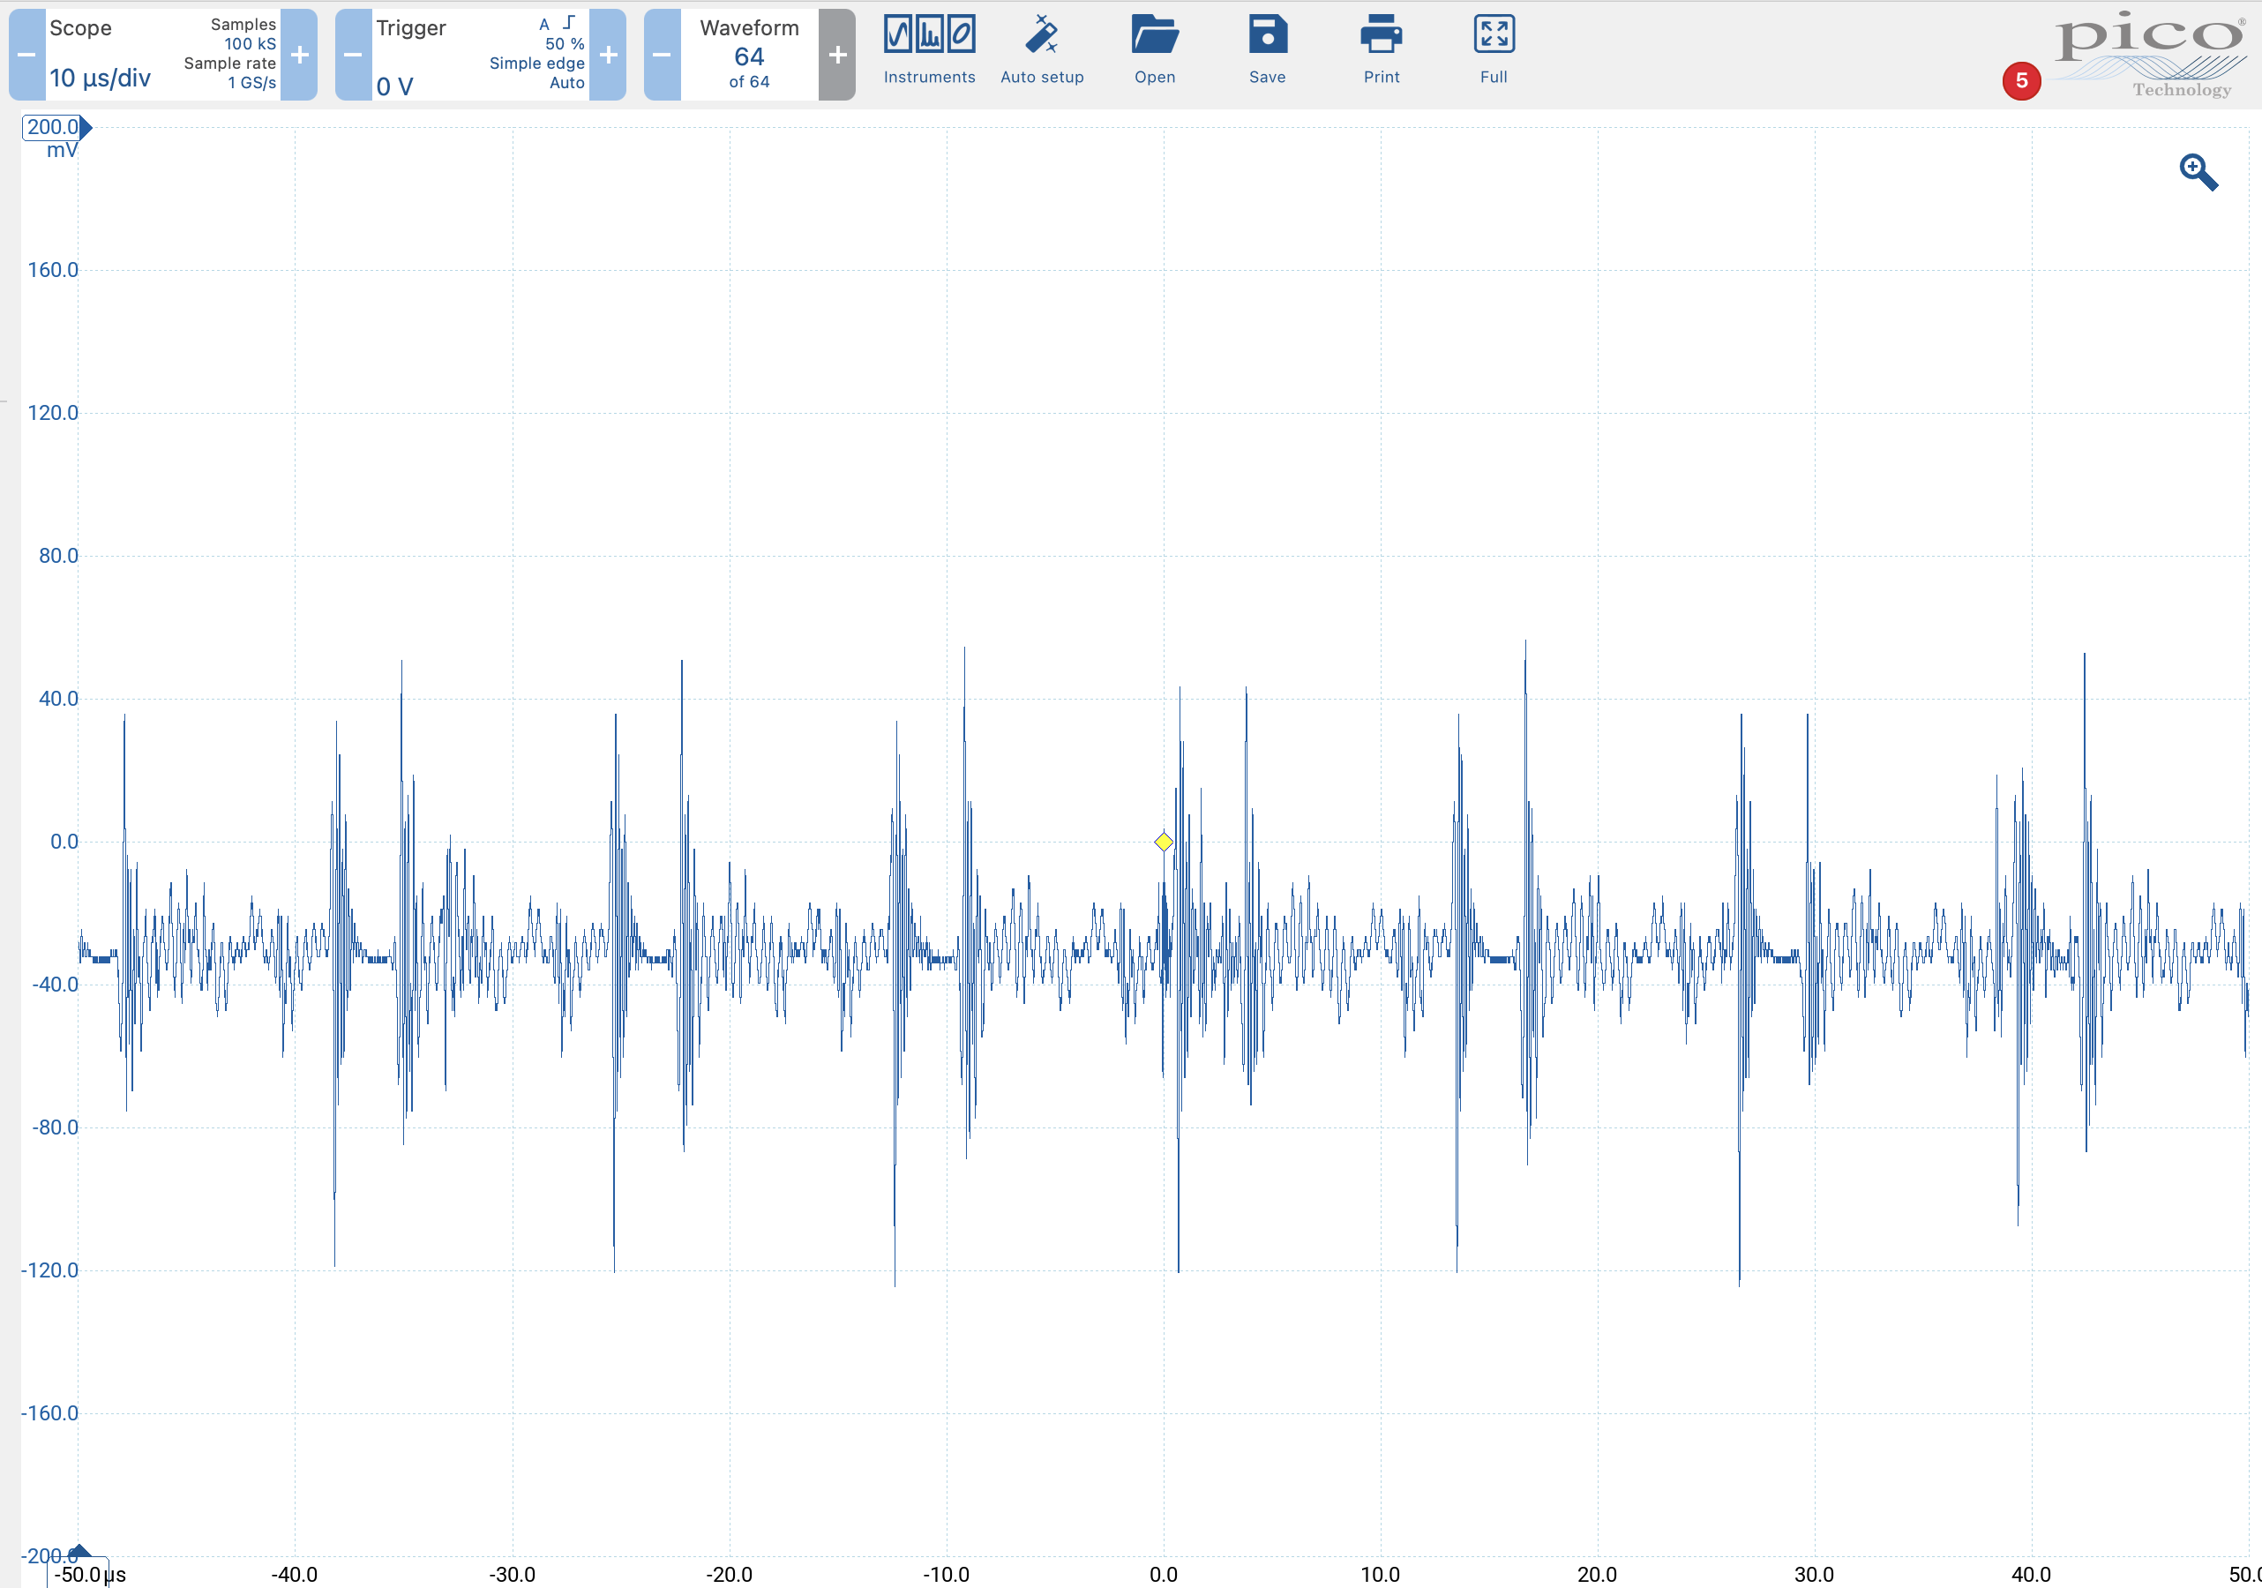
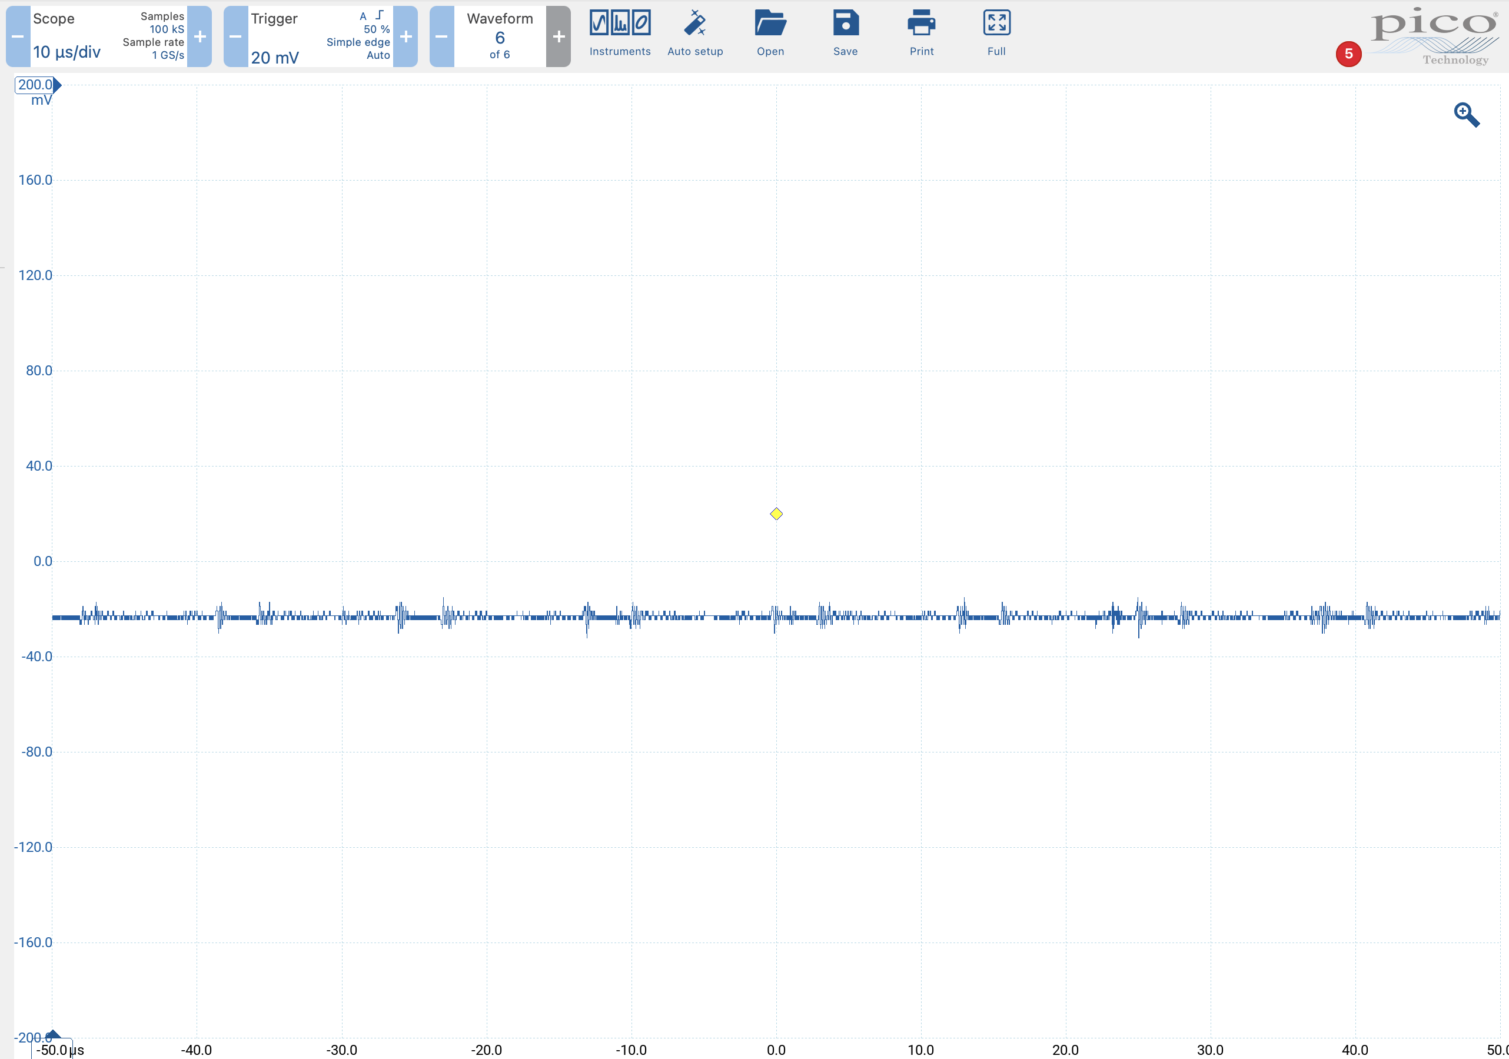
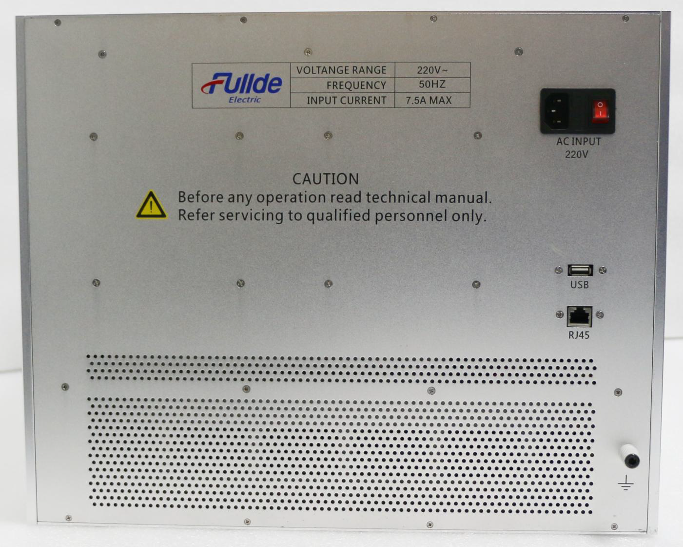
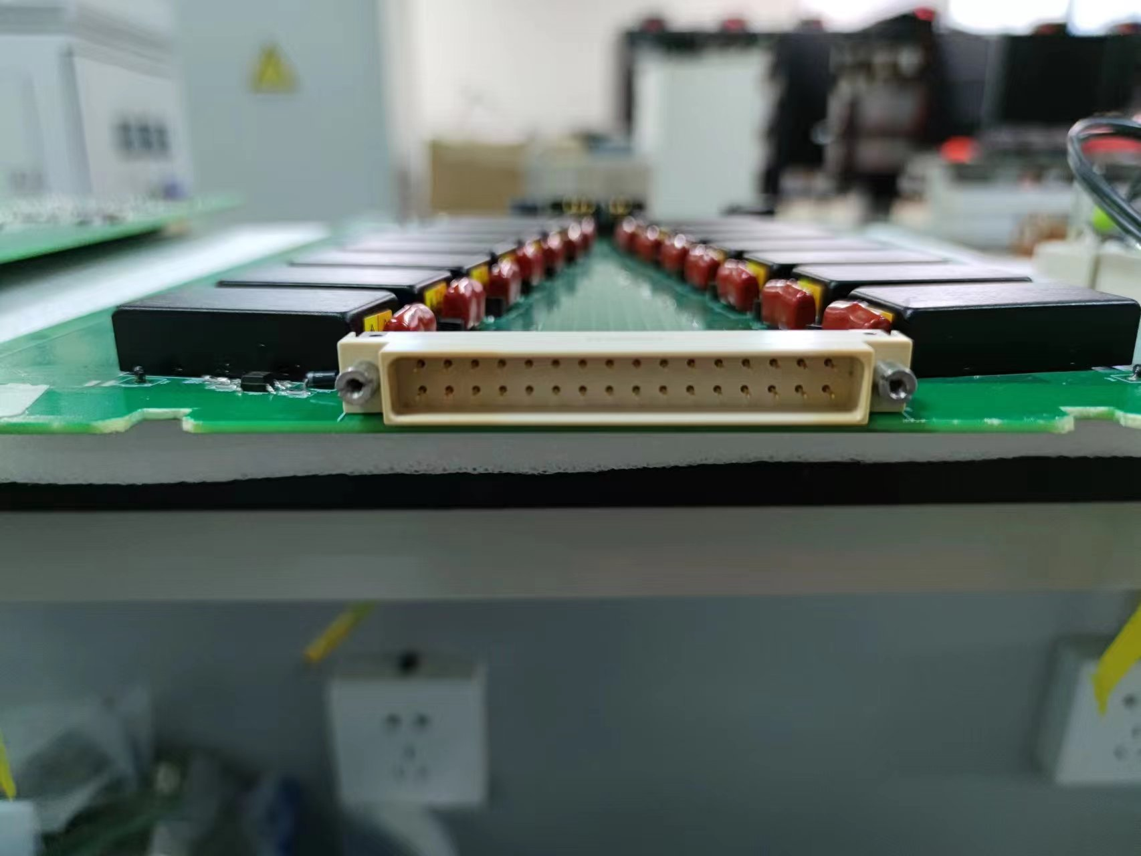
High Voltage Power Supplies
Sent to CERN in May after factory tests
Tested together with patch panels in June and August
Performance good:
  ≲ 200 mV ripple at ≈ 100 – 150 KHz
  Attenuated further to ≲ 20 mV by patch panels (see A.Caramelo’s talk tomorrow)

Slide 4
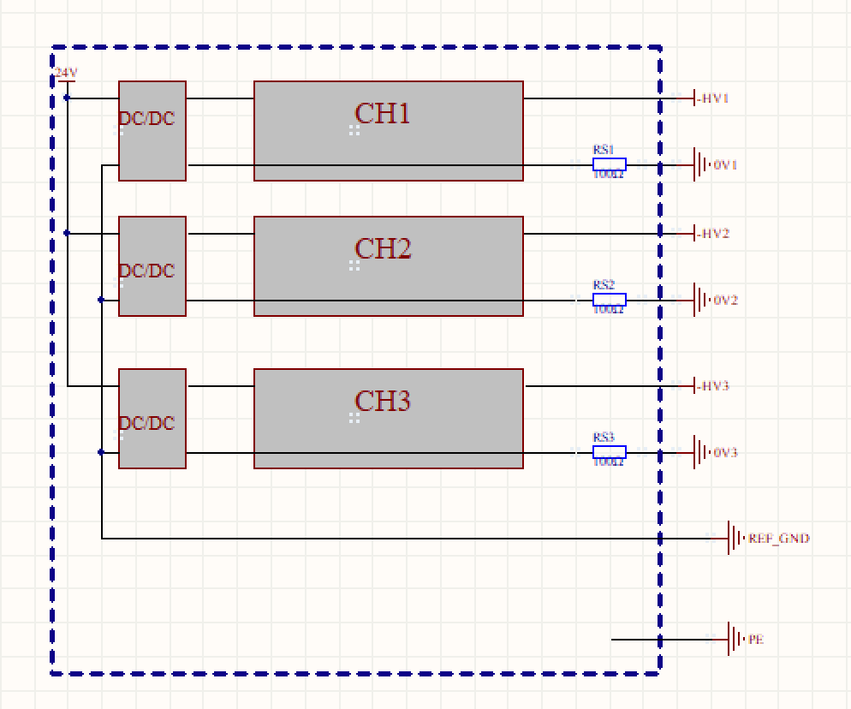
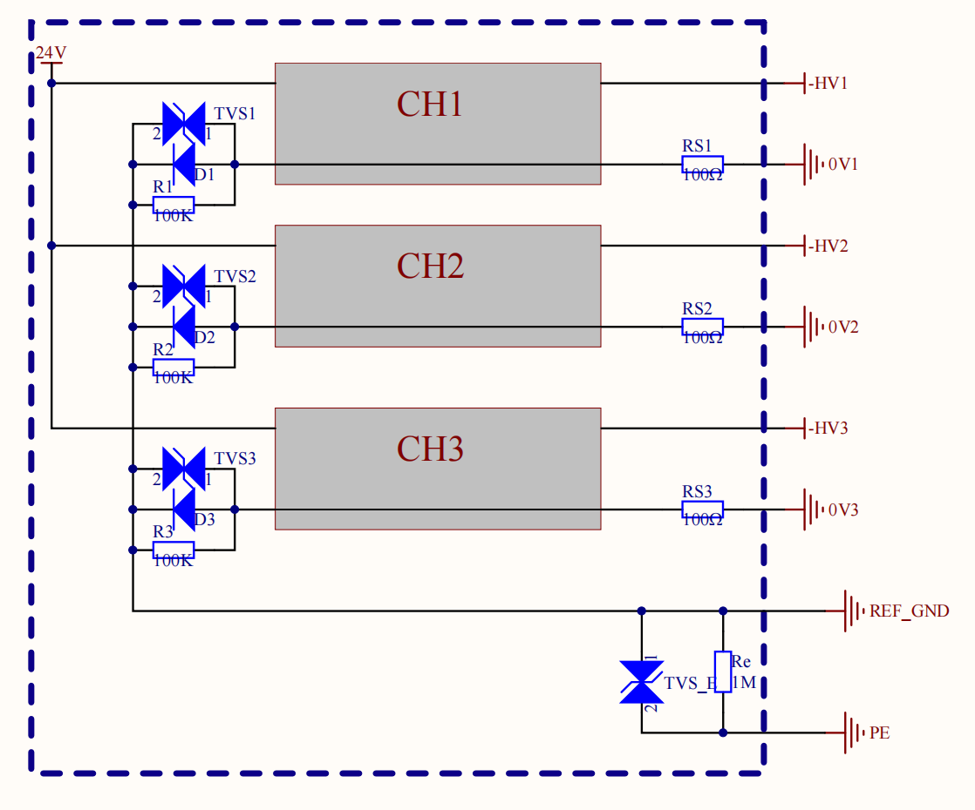
Floating Channels
Initial prototype modules have 14 independent channels but common ground
  Results in possibility of small (< 1 V) voltage being applied in turned-off channels
Company investigating a fully-isolated solution and two possible workarounds
  Inter-channel resista
  New prototype to be produced in around one month
04
Solution 1 isolated
Solution 2 non-isolated

Slide 5
Floating Channels
Fully insulated but ×2 in cost
Not insulated: voltage difference between grounds limited to drop in diodes
 | Solution 1 Isolated | Solution 2 Non-Isolated with diodes,resistors, and voltage-regulator tubes | Solution 3 Non-Isolated with diodes
Performance | Best | Acceptable | Acceptable
Stability | Nomal | Acceptable | Best
Size | Maximum | Nomal | Minimum
Cost | Double | Minor increase | Unchanged

Slide 6
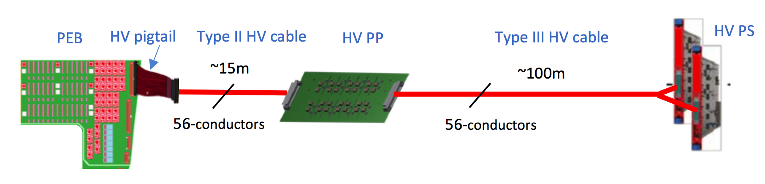
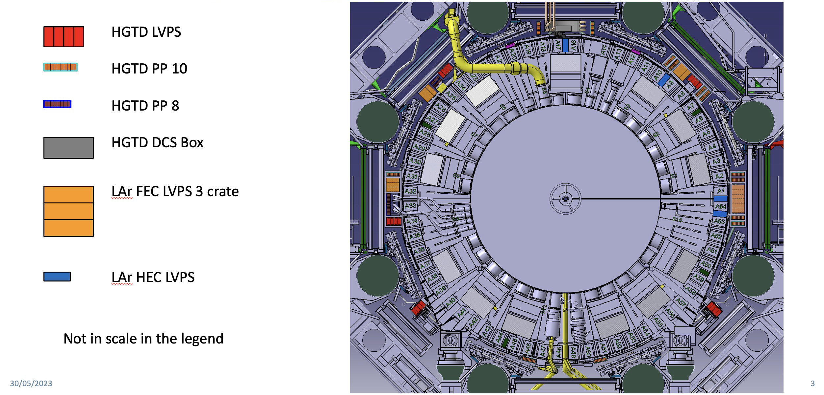
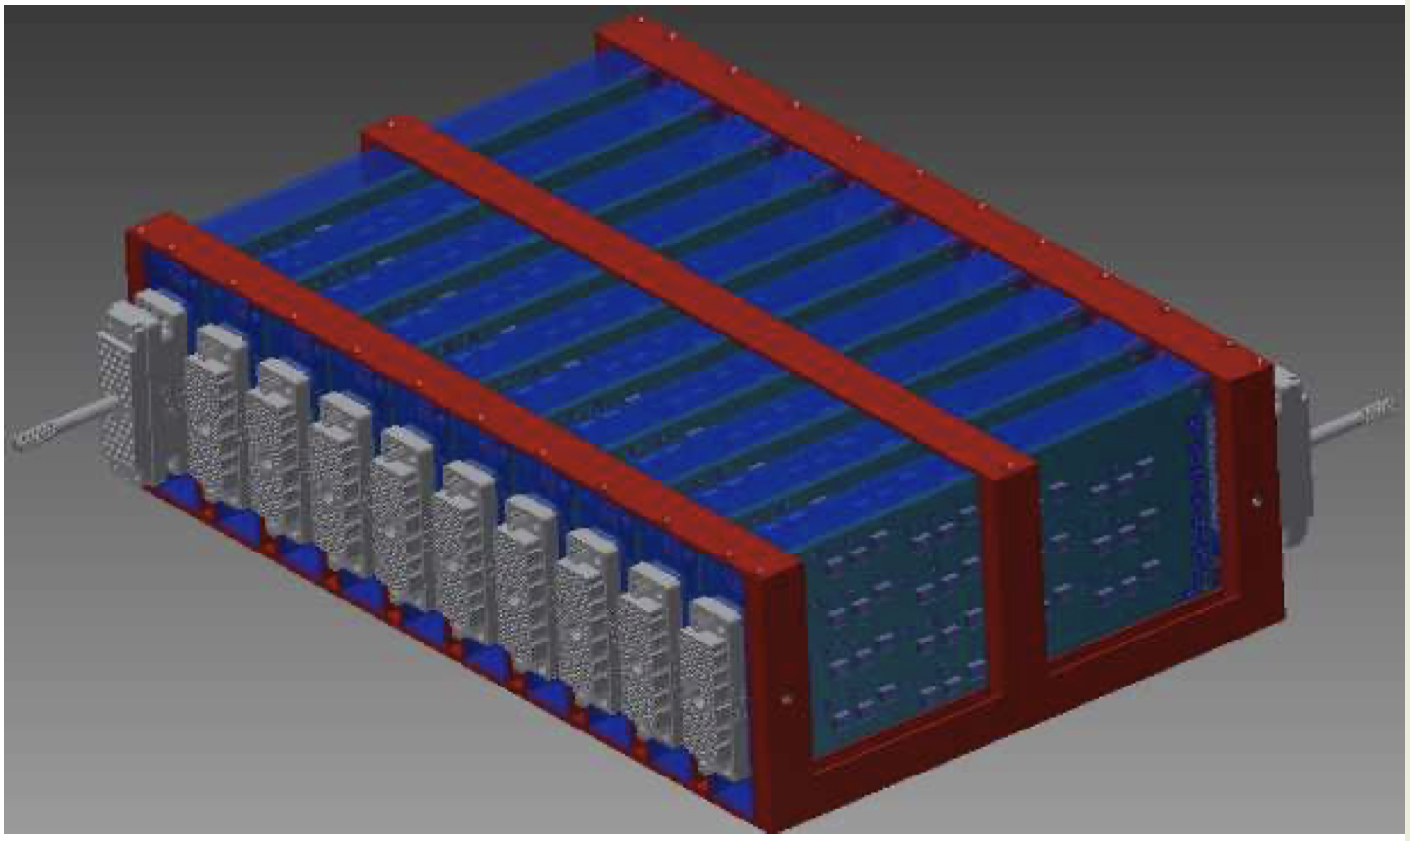
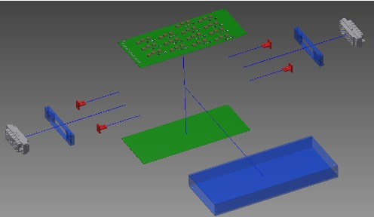
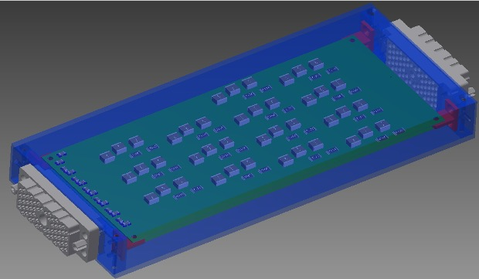
Patch Panels
HV filtered and routed between input long cables from USA15 and short cables to detector
  2nd order RC-RC low-pass filter to suppress AC noise
  8032 HV channels: at least 574 boards of 14 filters each
From Sergei and Tech.Coord.

Slide 7
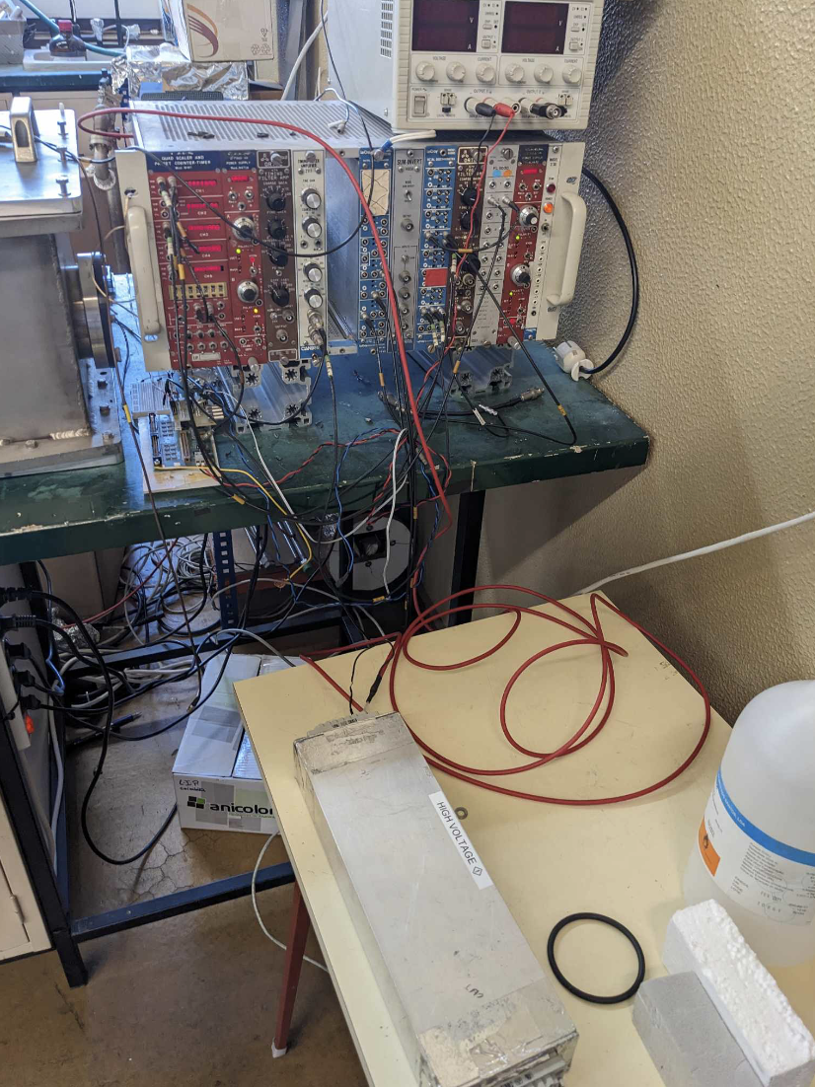
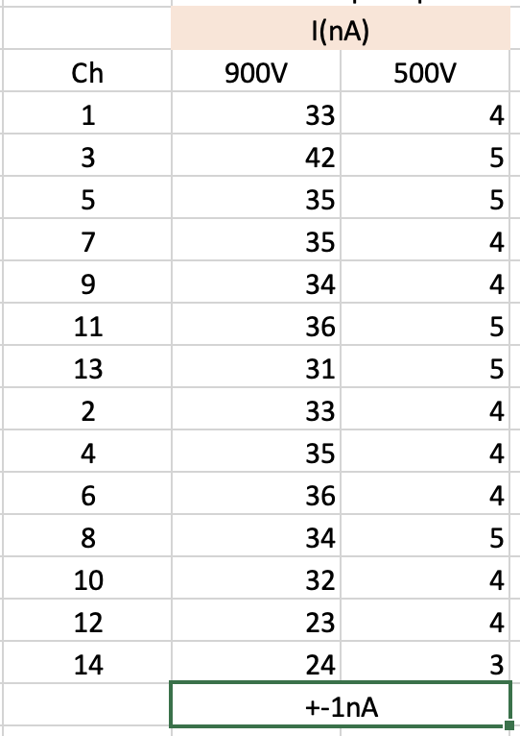
Patch Panel Prototype Testing
Leakage current:
Leakage current previously measured to be of order 500 nA
  Turned out to come from dirt and impurities on the PCB
After cleaning decreased to ≈ 30 nA
  Applied insulating coating on all channels except 12 and 14
  No significant increase in current
  Protects surface in the long run

Slide 8
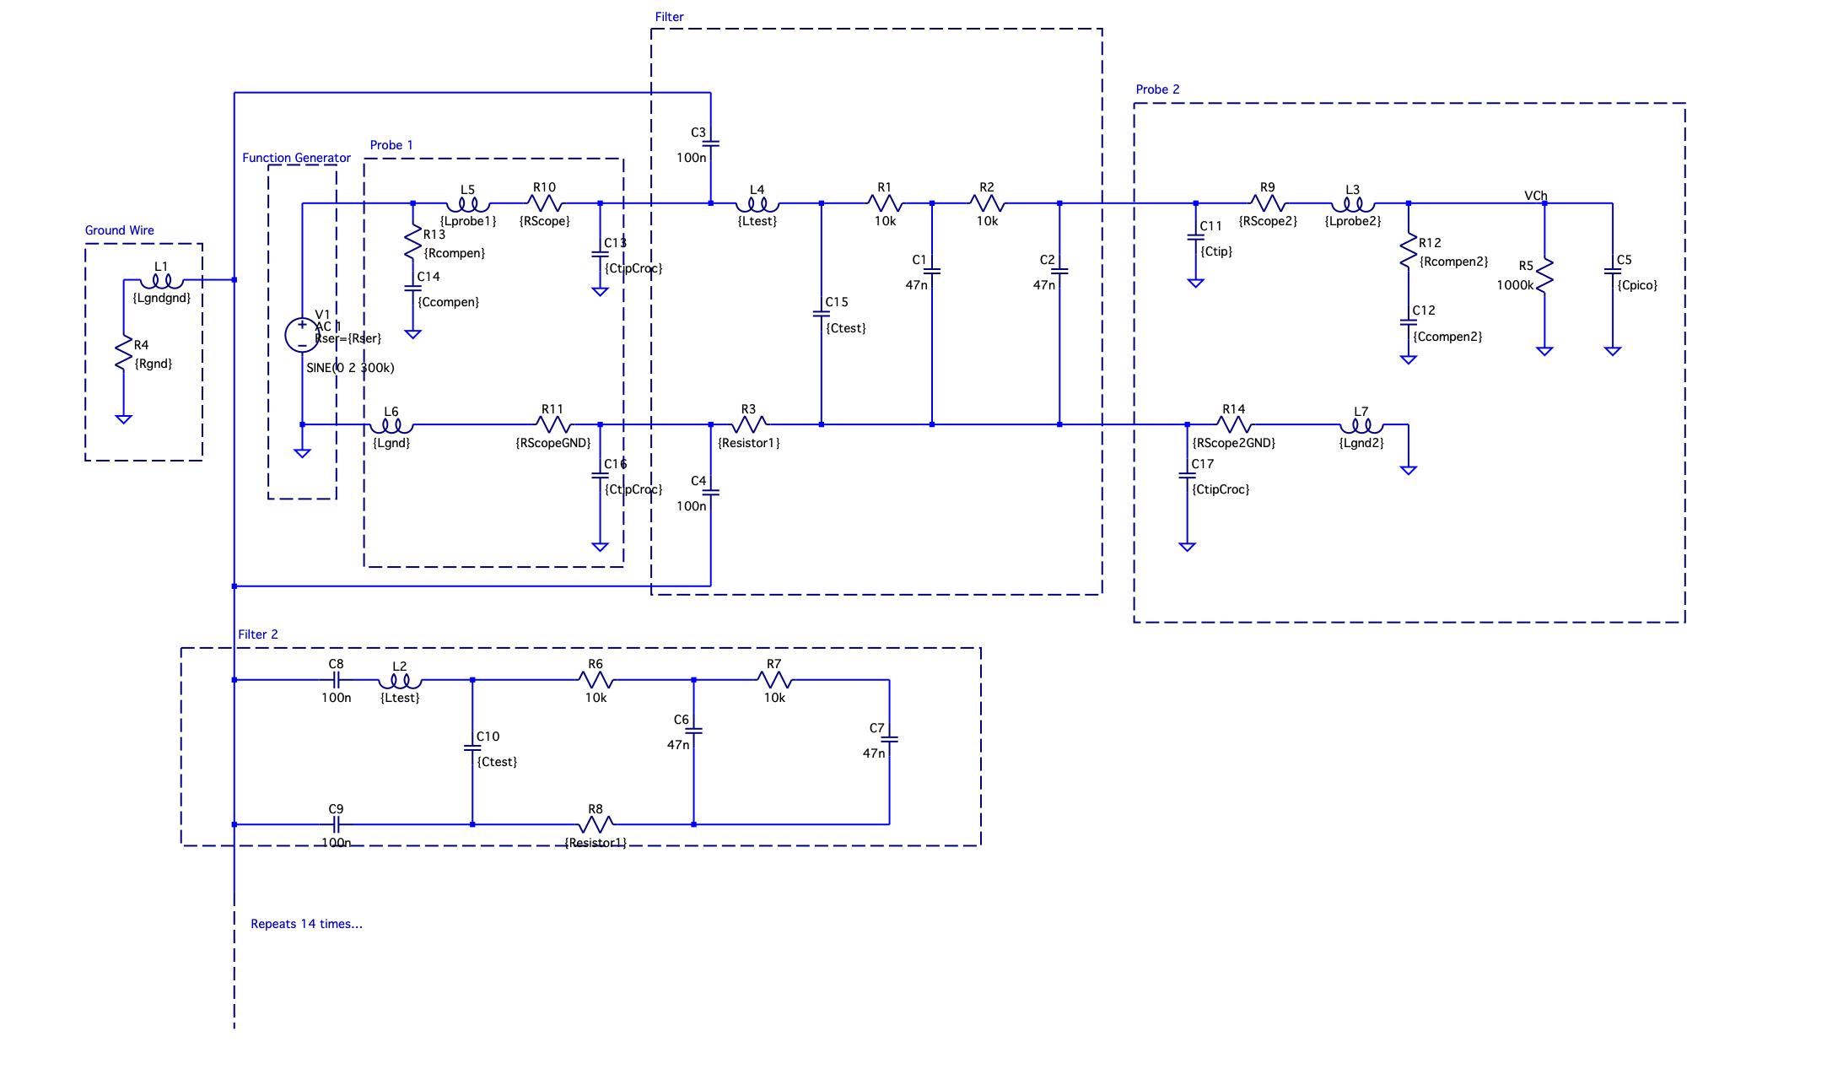
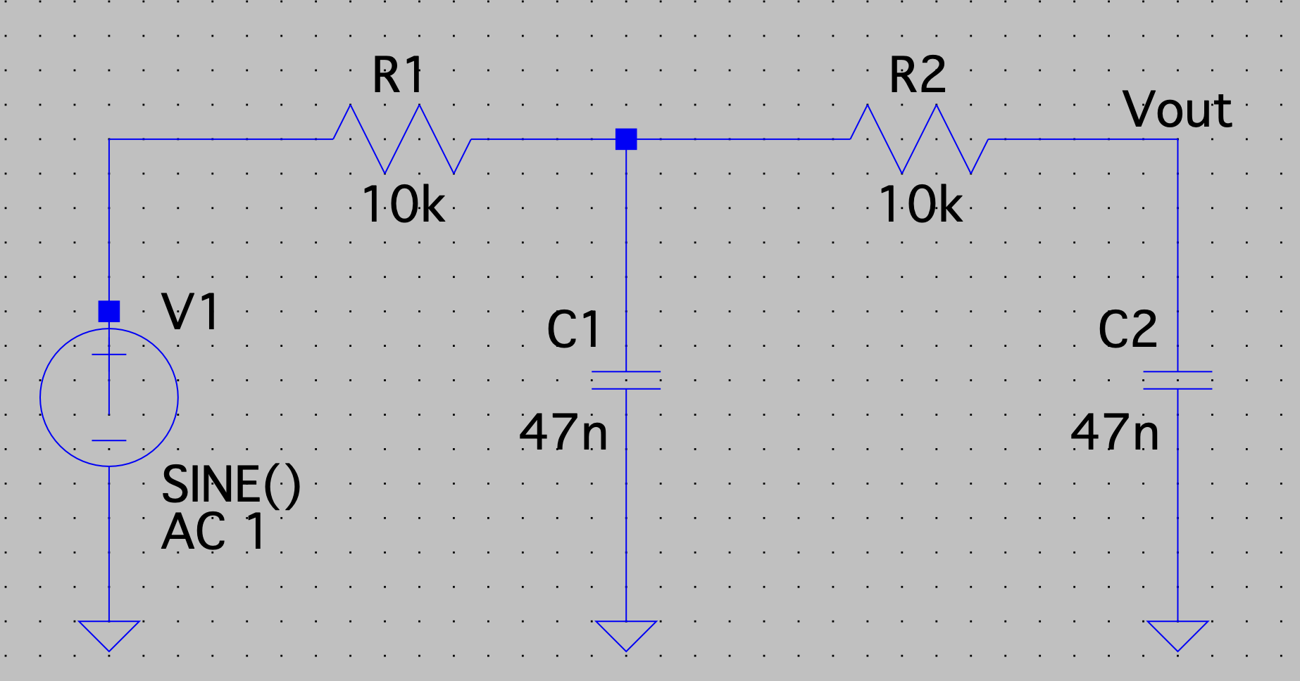
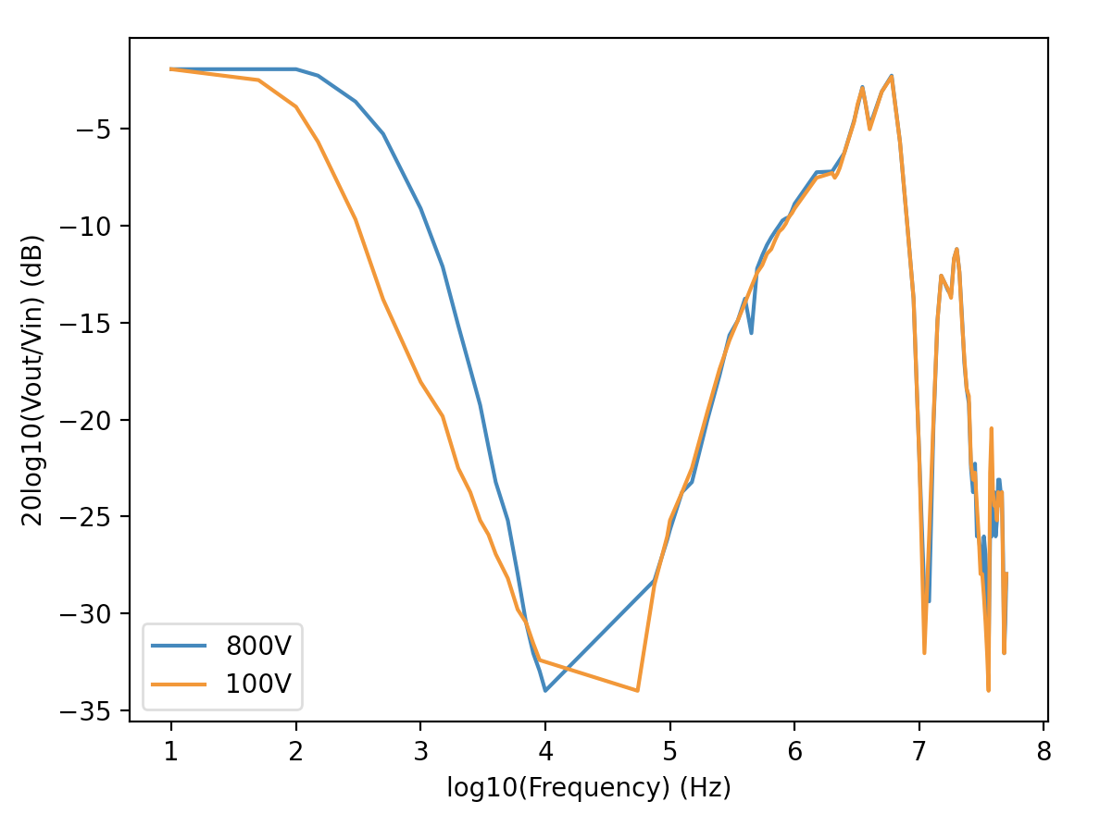
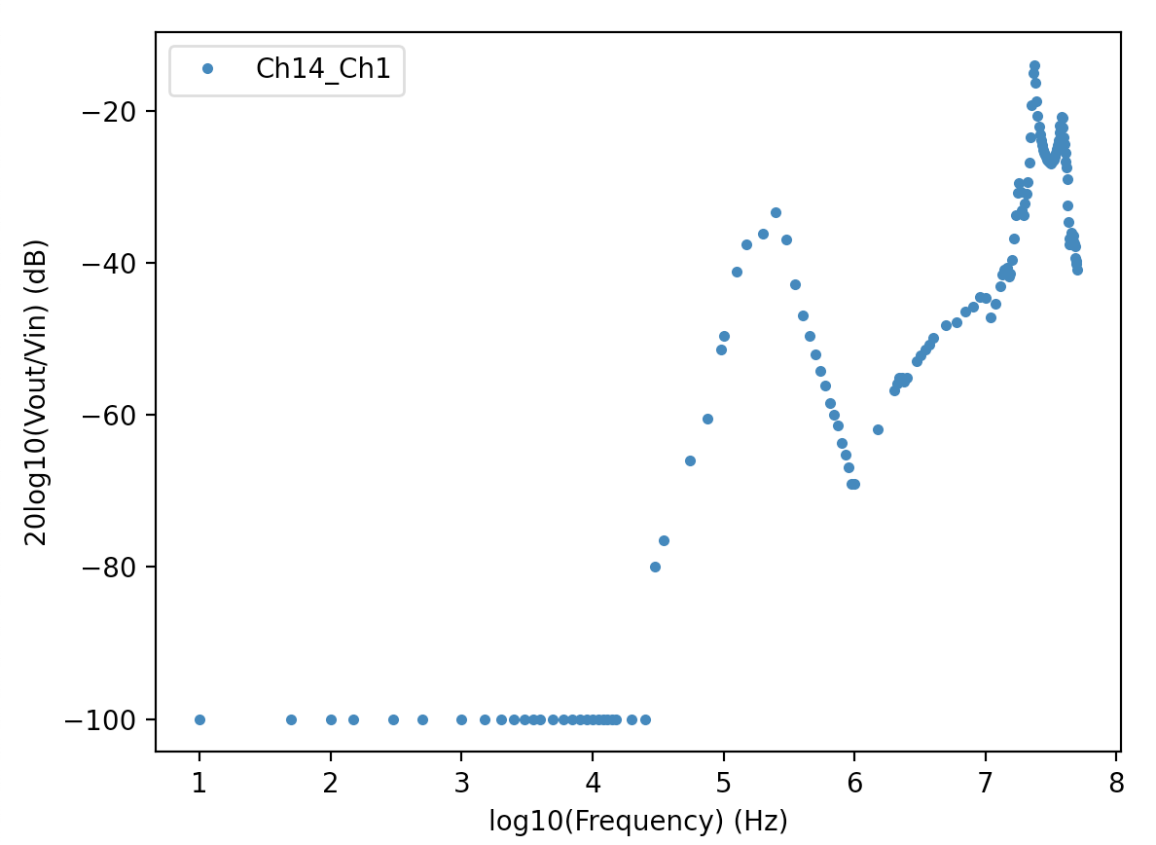
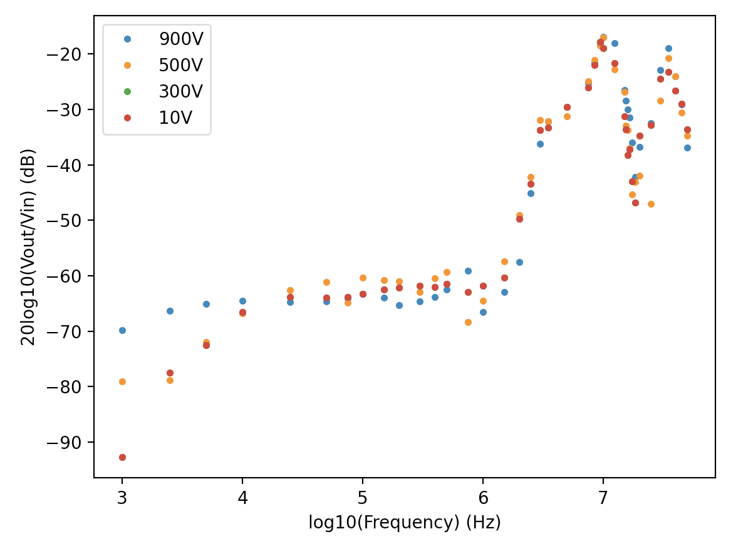
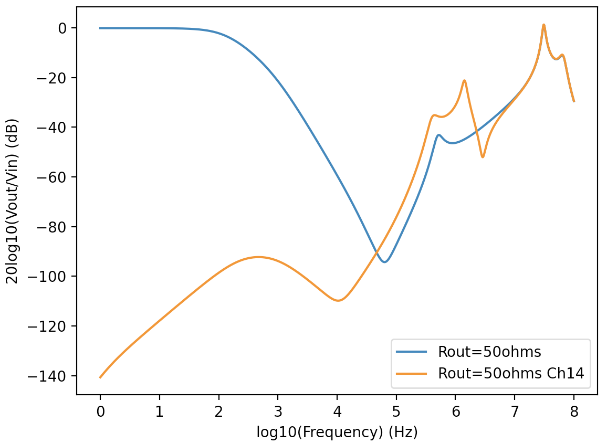
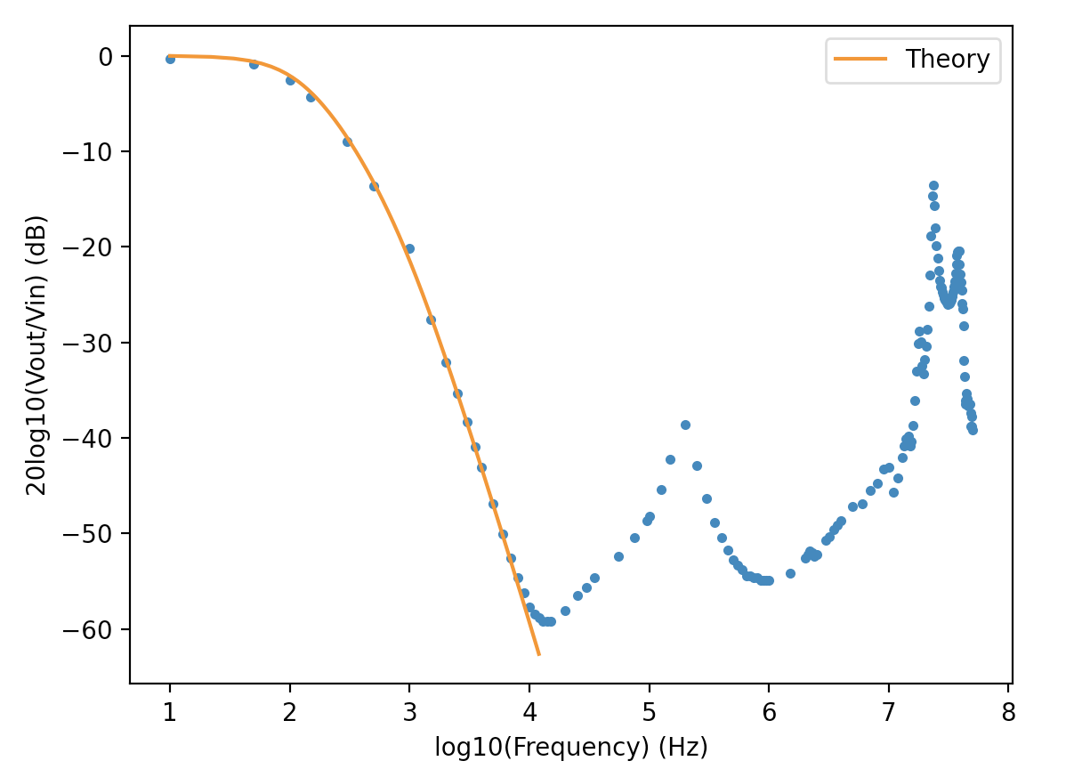
Frequency Response
Filter 1
Probe
Ground
Several effects better understood now:
  Common mode noise transfer: above ≈ 1 MHz
  Some cross talk: above ≈ 100 kHz
  Changes under bias traced to changing capacitance of filter capacitors
Complex model constructed
  Predicts response at least qualitatively
  Including effects from common mode, cross talk, cables &measuring probes
HV PS ripple expected at 1 – 1.5×10⁵ Hz
Probe & Osciloscope
Filter 2
Cross talk
Common mode

Slide 9
Combined HVPS+Patch Panel
HV PS ripple expected at 100 – 150 kHz (1 – 1.5×10⁵ Hz)
Ripple attenuated by 10× (-20 dB) to ≈ 20 mV
  Lower than initially expected (≈ -120 dB) but seems to be explained by probe L and R
Consistent results across all channels

Slide 10
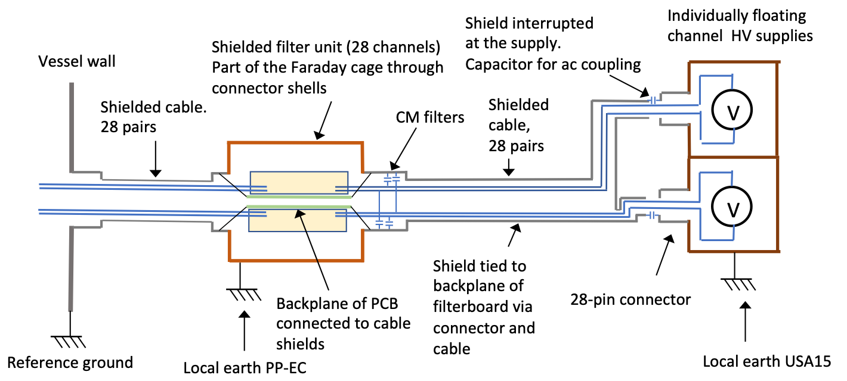
Grounding and Shielding
Use filter module boxes as continuation of vessel Faraday cage
  Also DC connecttion of filter boards backplane to cage
DC connection of Faraday cage to local TileCal earth
  DC current not as bad as HF AC noise
Move common-mode filter capacitors to filter input instead of output
  Filter common mode current at input

Slide 11
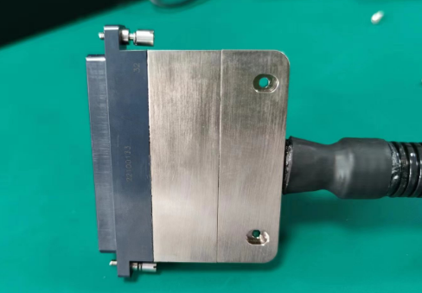
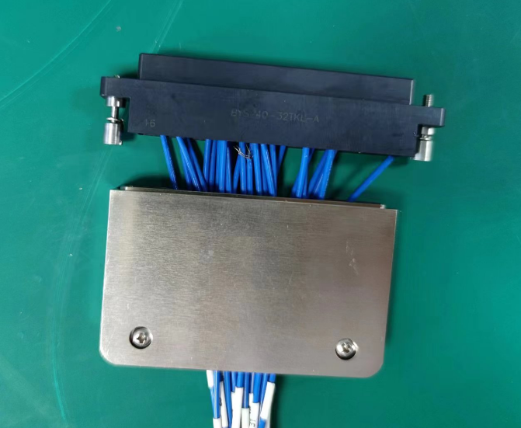
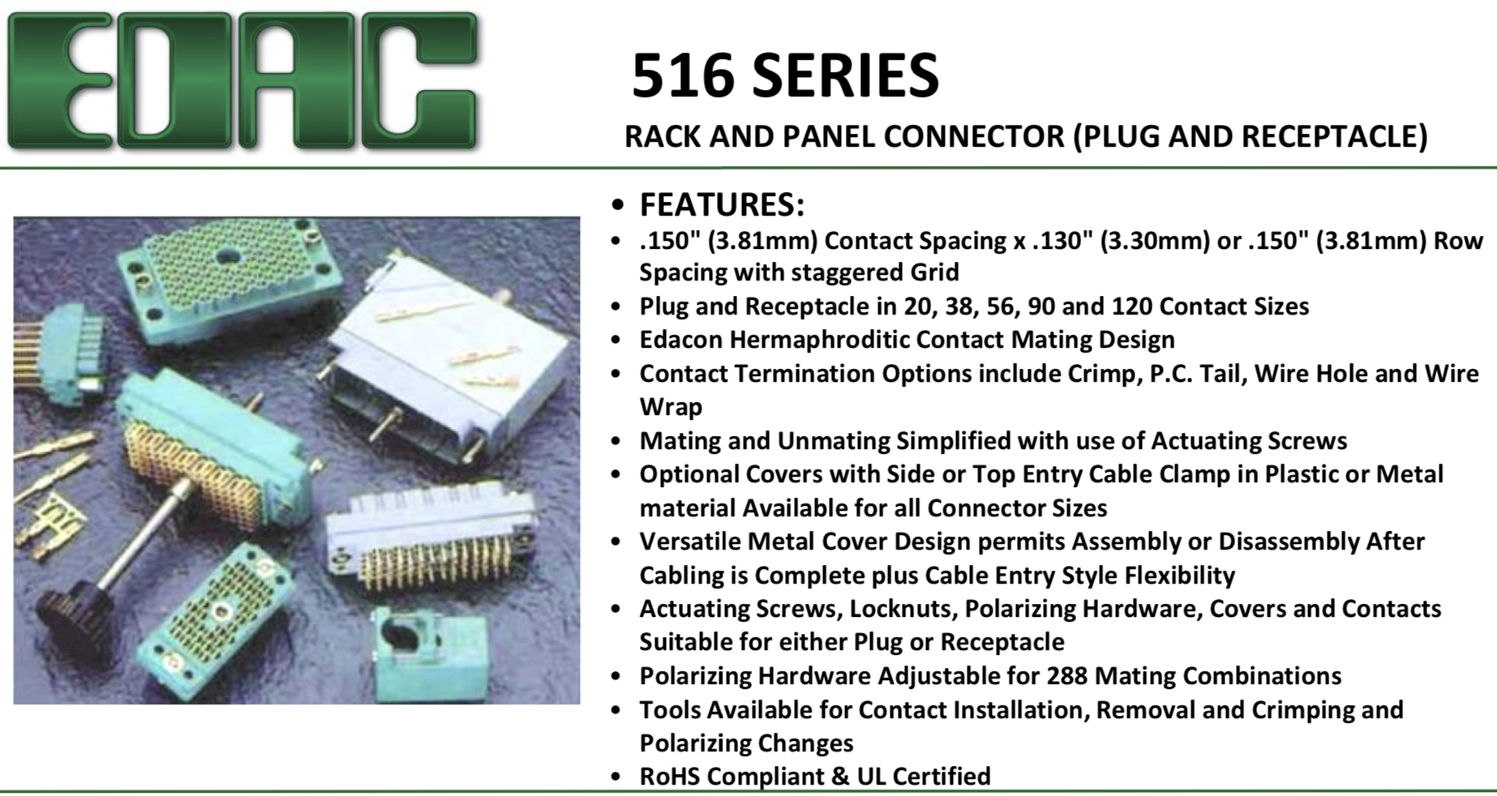
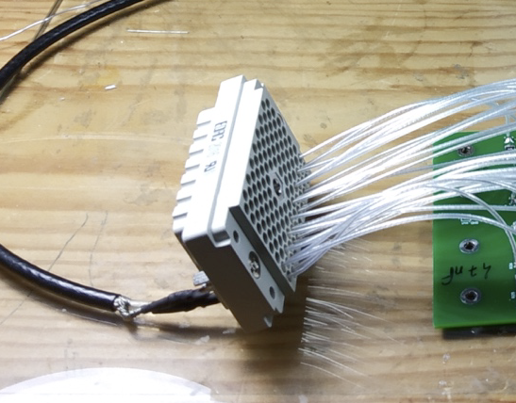
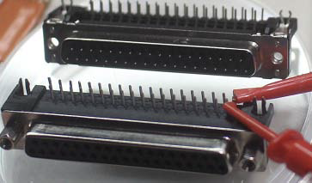
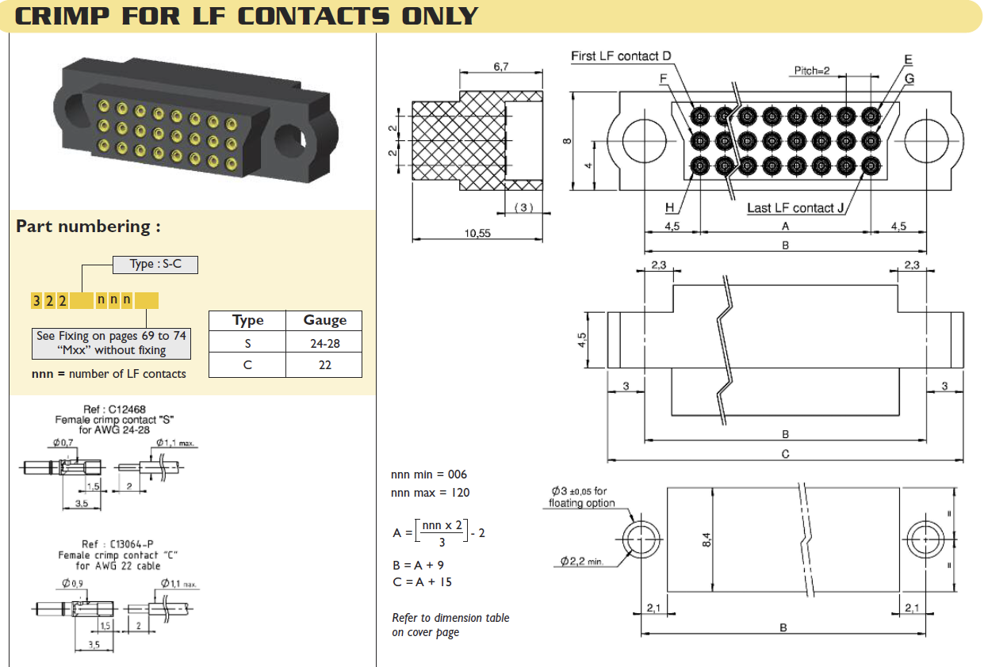
Cable Connectors
Connectors under discussion: see presentation by Sergei
Different constraints at each connection:
Power-supply end (14 channels):
  Not often moved and good accessibility: medium mechanical requirements
  Company proposing own connectors (plugs for free)
  Also testing Sub-D from Harting
HV PS to Patch Panel connection (28 Channels):
  Poor accessibility and frequent reconnections: need strong and easy to handle connectors
  Using field-tested EDAC 516 connectors
Patch Panel to short cable (28 Channels):
  Fixed in place at installation: no special mechanical requirements
Short cable to outer ring (28 Channels):
  No disconnect, but very little available space (small pins) and demanding criteria for thermal and electrical behaviour
  Planning to use Nikomatic connectors

Slide 12
Bonus slides

Slide 13
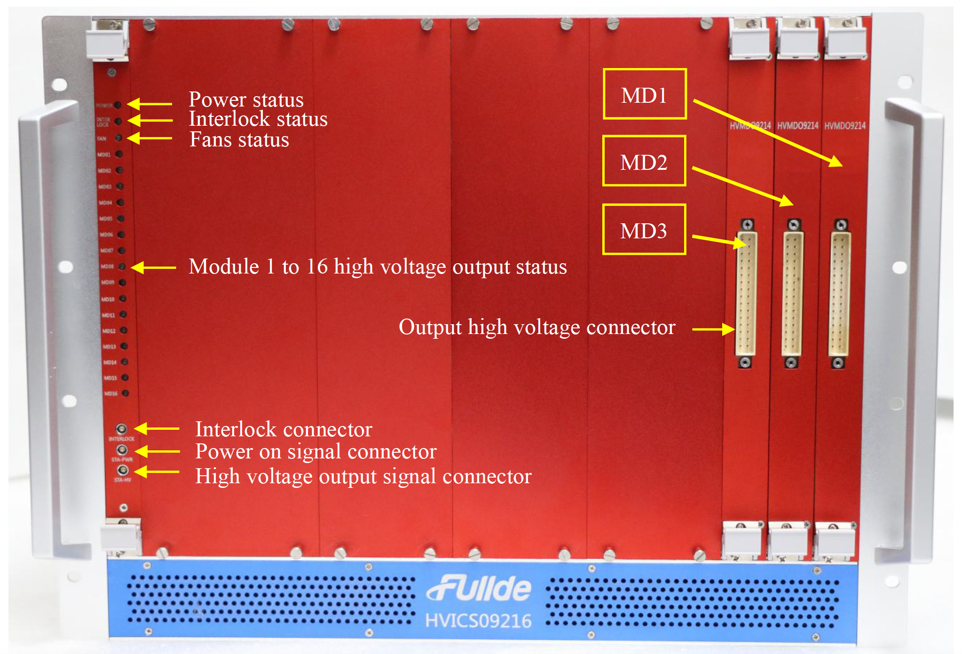

Slide 14
Fully insulated but ×2 in cost
Best performance
Increase in size; stability normal
Not insulated: voltage difference between grounds limited to drop in diodes
Best stability; performance ok
Cost unchanged
Stability and performance ok
Minor cost increase

Slide 15

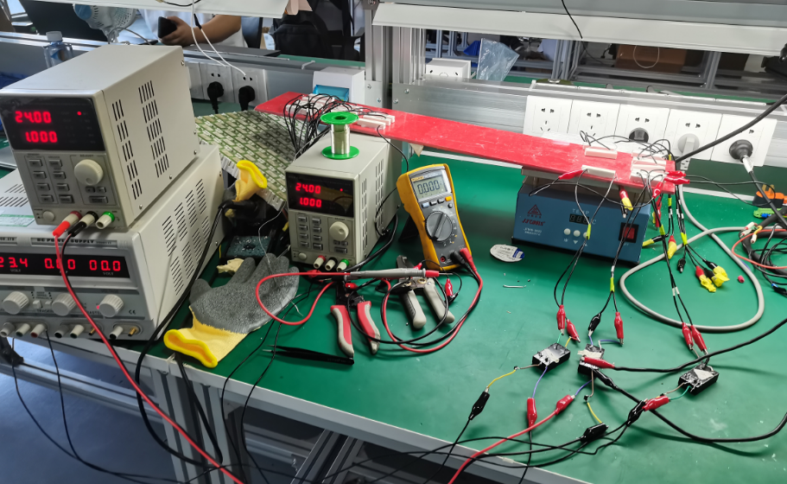
Topic 1 Test
01
项目目标
After last discussion, we built a temporary environment to test solution 1 and 2.
实验室建设
02
03
9
25
04
The test results can serve as a reference, but the formal PCB version cannot be welded until the end of the month.
Solution 1 isolated
Solution 2 non-isolated

Slide 16
Test 1.1(Non-isolated with diode)
Condition
01
项目目标
3 channels sharing the same ground through a diode.
3 loads(300k resistor) sharing ground.
Result
实验室建设
02
 | CH1 ON | CH1&3 ON | All ON
Voltage of current sampling resistor CH1 | 86.8mV | 86.6mV | 83.0mV
Voltage of current sampling resistor CH2 | 7.6mV | 6.7mV | 79.7mV
Voltage of current sampling resistor CH3 | 4.0mV | 82.0mV | 77.4mV
Voltage of load CH1 | 240.01V | 240.08V | 240.0V
Voltage of load CH2 | 0.008V | 0.007V | 240.6V
Voltage of load CH3 | 0.251V | 241.4V | 241.2V
03
9
25
04
Conclusion
The sampled current is almost equivalent to the actual load current, but there is still diode leakage current between channels.

Slide 17
Test 1.2(Non-isolated with resistor，diode and voltage-regulator tube)
Condition (solution 2)
3 channels is grounded through a 200k resistor ,diode and a voltage-regulator tube.
3 loads(300k resistor) sharing ground.
实验室建设
02
Result
 | CH1 ON | CH1&3 ON | All ON
Voltage of current sampling resistor CH1 | 87.2mV | 87.2mV | 81.9mV
Voltage of current sampling resistor CH2 | 7.3mV | 9.3mV | 80.1mV
Voltage of current sampling resistor CH3 | 3.1mV | 83.2mV | 77.0mV
Voltage of load CH1 | 241.0V | 240.0V | 239.5V
Voltage of load CH2 | 0.007V | 0.01V | 239.2V
Voltage of load CH3 | 0.261V | 240.4V | 240.4V
03
9
25
04
Conclusion
The test results are similar to the previous situation.
Without isolation, the voltage difference between different gnds will be limited to the voltage drop of the diode, so we need to discuss whether it is necessary to add the resistors and voltage regulators.

Slide 18
Test 2.1(Isolated)
Condition(Solution 1)
01
项目目标
3 channels NOT sharing the same ground or 24V.
3 loads(300k resistor) sharing ground.
Result
实验室建设
02
 | CH1 ON | CH1&3 ON | All ON
Voltage of current sampling resistor CH1 | 111.0mV | 111.1mV | 110.4mV
Voltage of current sampling resistor CH2 | 2.3mV | 2.3mV | 110.3mV
Voltage of current sampling resistor CH3 | 2.3mV | 111.1mV | 110.1mV
Voltage of load CH1 | 332V | 332.0V | 332.0V
Voltage of load CH2 | 0.001V | 0V | 331.7V
Voltage of load CH3 | 0.268V | 331.7V | 331.2V
03
9
25
04
Conclusion
When the loads are connected to the same ground, the power supply works well.However, in order to avoid significant voltage differences between different ground wires caused by spatial magnetic fields, it is necessary to add resistors and voltage stabilizing tubes to connect the isolated ground wires together.

Slide 19
Discussion
01
项目目标
 | Solution 1 Isolated | Solution 2 Non-Isolated with diodes,resistors, and voltage-regulator tubes | Solution 3Non-Isolated with diodes
Performance | Best | Acceptable | Acceptable
Stability | Nomal | Acceptable | Best
Size | Maximum | Nomal | Minimum
Cost | Double | Minor increase | Unchanged
实验室建设
03
9
25

Slide 20
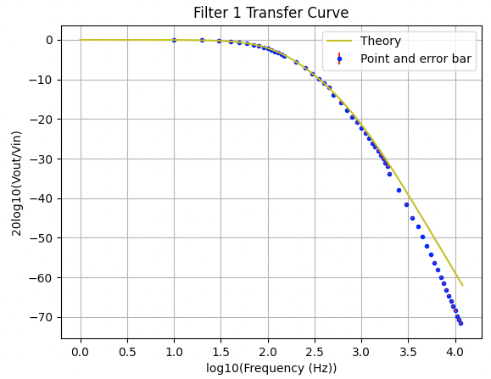
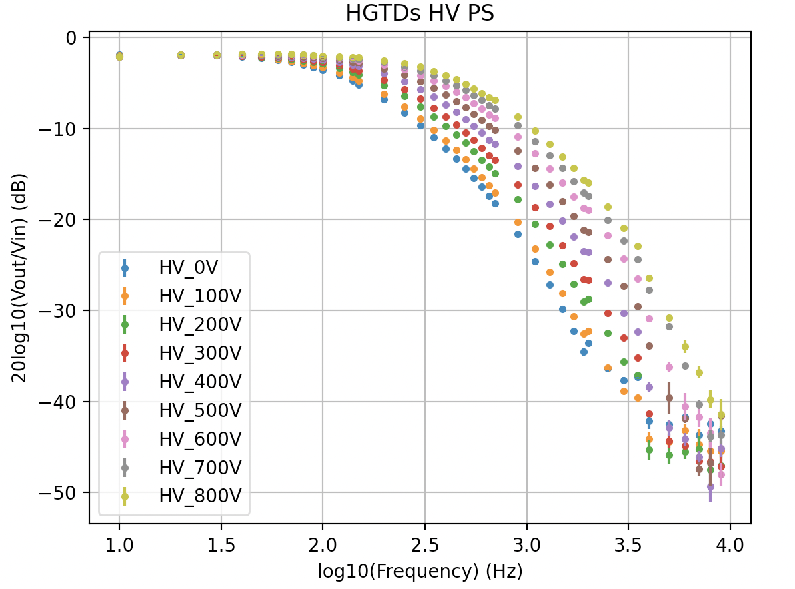
Previously
Explained deviation from theory in LV Transfer Curve
Cross talk was on hold
Leakage current arround 0,5uA per channel
Ripple attenuation
HV transfer curve

Slide 21
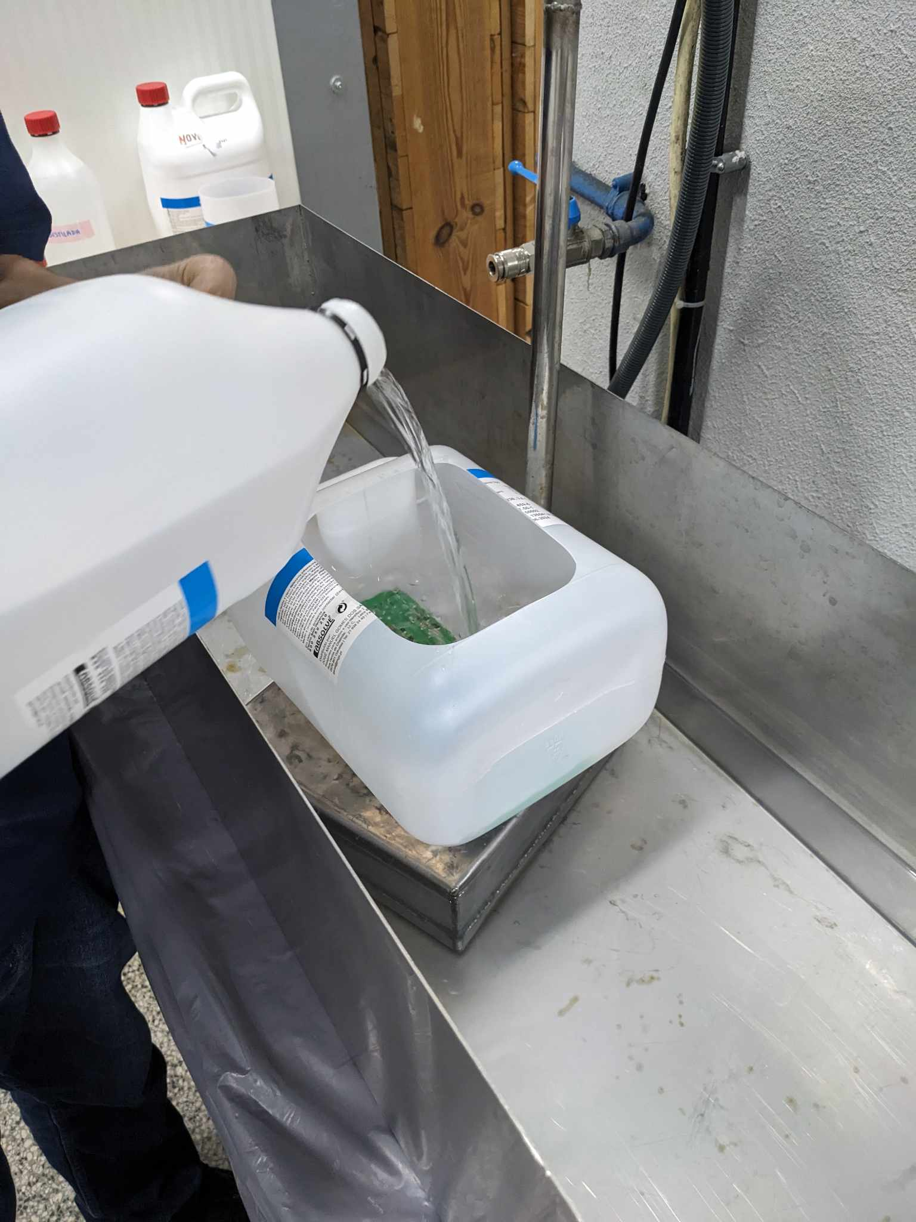
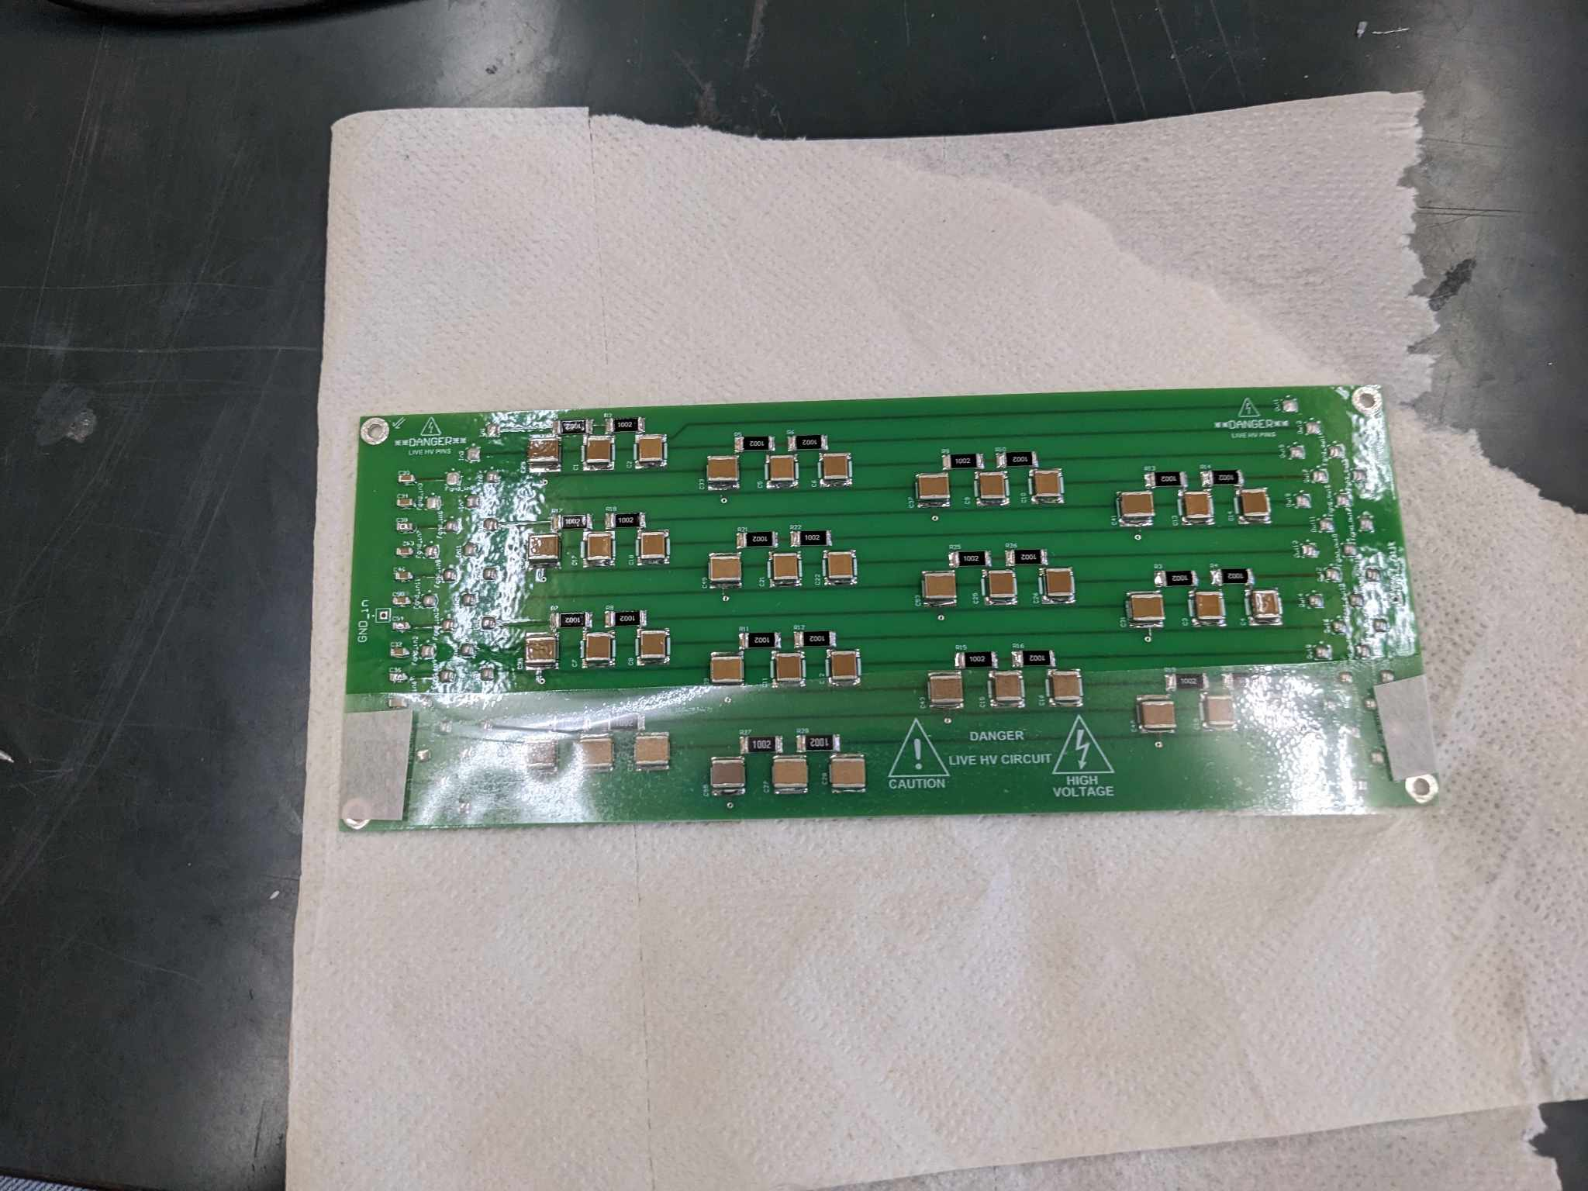
Leakage Current
Leakage current was deemed too high
Board cleaned with ultrasound in methanol
Highly resistant, protective and insulating conformal coating aplied to some channels (Urethane) (used plastic strip to protect others)
Soldered everything together with gloves

Slide 22
Ripple Attenuation
All available HV PS channels tested together with filter board, consistent results across all channels
Ripple big peaks go from ~200mV to ~20mV (~-20dB)
Significant attenuation, but lower from expect theoritcal attenuation at ~300kHz (~-120dB)

Slide 23
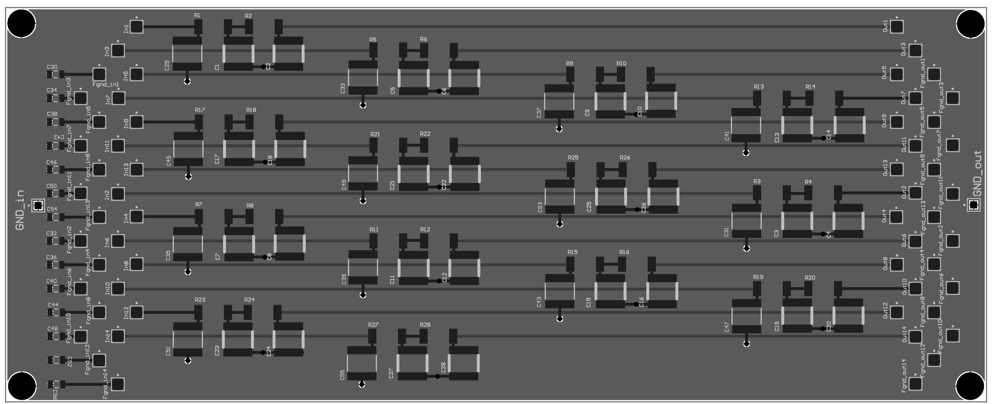
Cross talk
Input into Channel 1, measured Channel 14 (furthest channel)
Detected Cross Talk at ~300kHz and ~25MHz
Plotted transfer curve of what channel 14 picks up from channel 1, seen in plot (done by hand using osciloscope and function generator)
Signal actually propagates through back plane
This prompted transfer curve study to higher frequencies
Expected no signal pick up

Slide 24
High Frequency Transfer Curve
Plotted channel’s 1 transfer curve for higher frequency using osciloscope and function generator (20V 50MHz)
High frequency measurements were not conducted before as PicoScope was limited to 2V 1MHz, and output signal being -60dB attenuated is impractical to measure.
Curve does follow theory beyond ~10kHz

Slide 25
High Frequency HV Transfer Curve
Plotted channel’s 1 transfer curve for higher frequency using osciloscope and function generator (20V 50MHz)
Repeated HV transfer measurement for higher frequencies
Again peaks detected at higher frequencies, same phenomenon as before detected

Slide 26
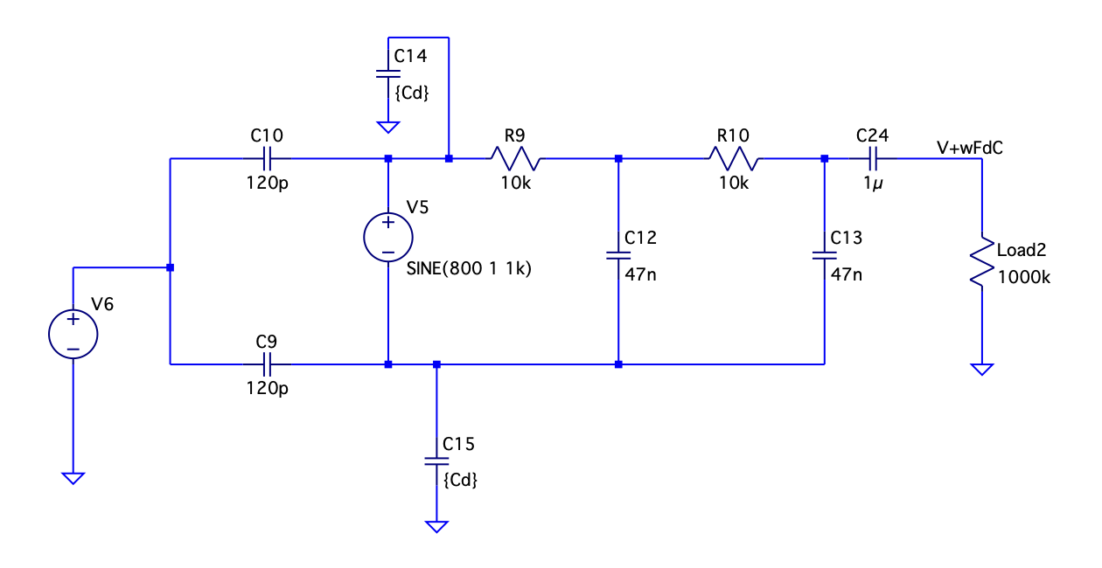
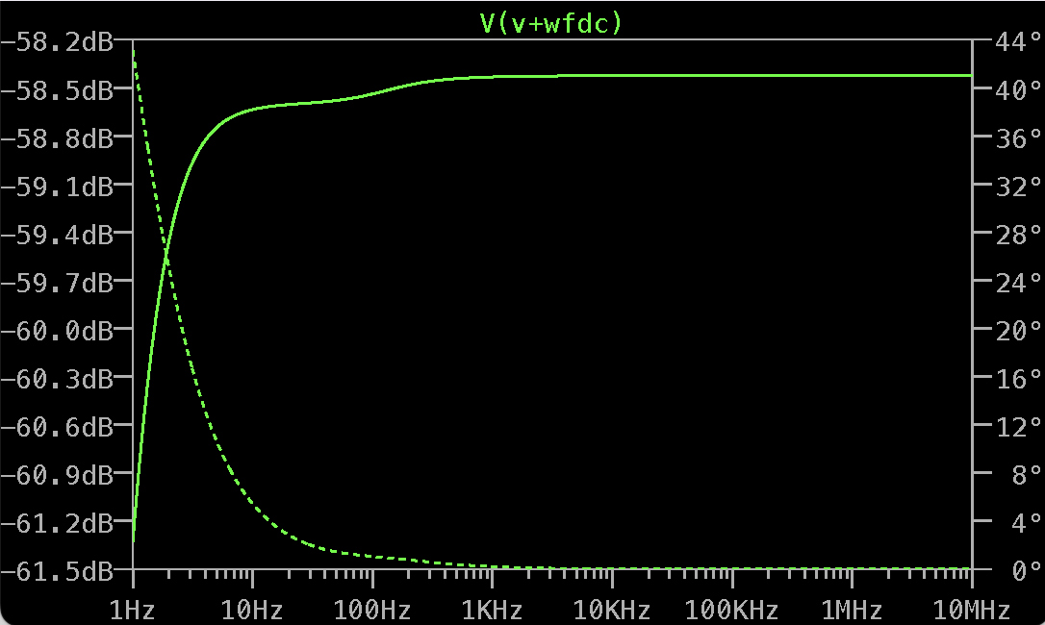
Common Mode noise
Plotted channel’s 1 transfer curve for higher frequency using osciloscope and function generator (20V 50MHz) this time for common mode noise
Expected flat curve at ~-60dB
Again an unexpected peak at higher frequencies, DC voltage does not seem to affect cm noise filtering

Slide 27
Parasitics
Unanticipated high-frequency outcomes in ripple attenuation, cross-talk transfer function, and common mode noise attenuation prompted pursue of explanatory model.
Explored various parasitic factors, constructing a comprehensive model with practical parameter values to account for these phenomena.
Iteratively tested different component combinations until identifying a model approximating observed behavior.
Ongoing refinement and simplification of the model
10

Slide 28
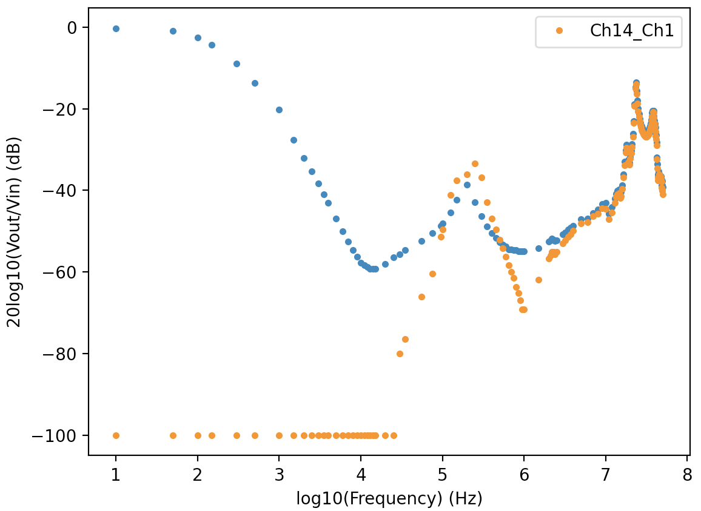
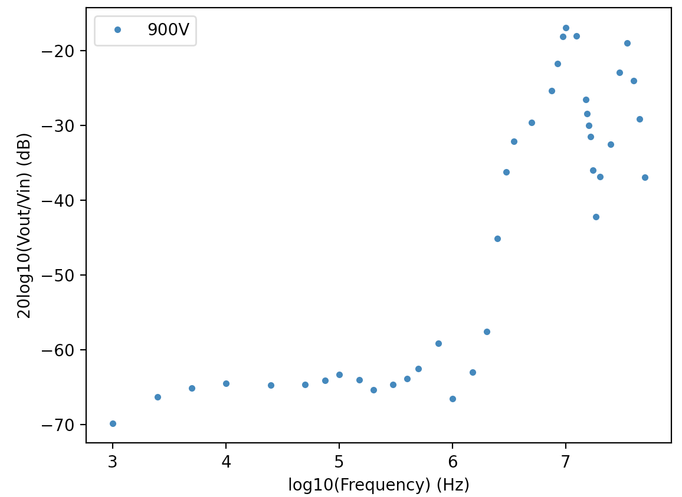
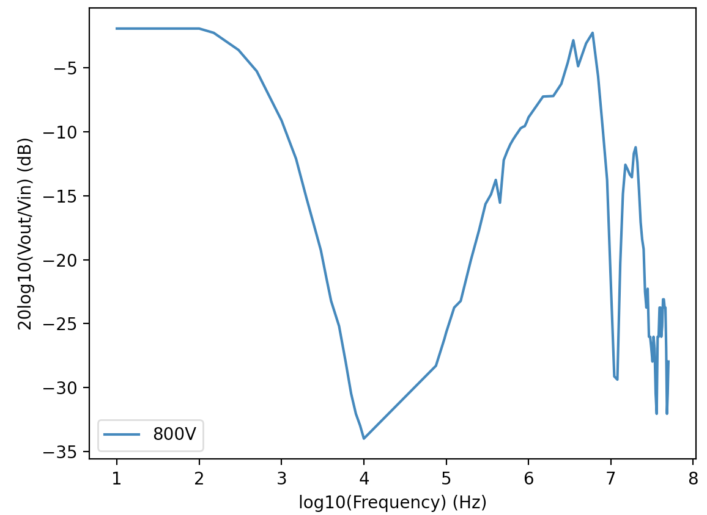
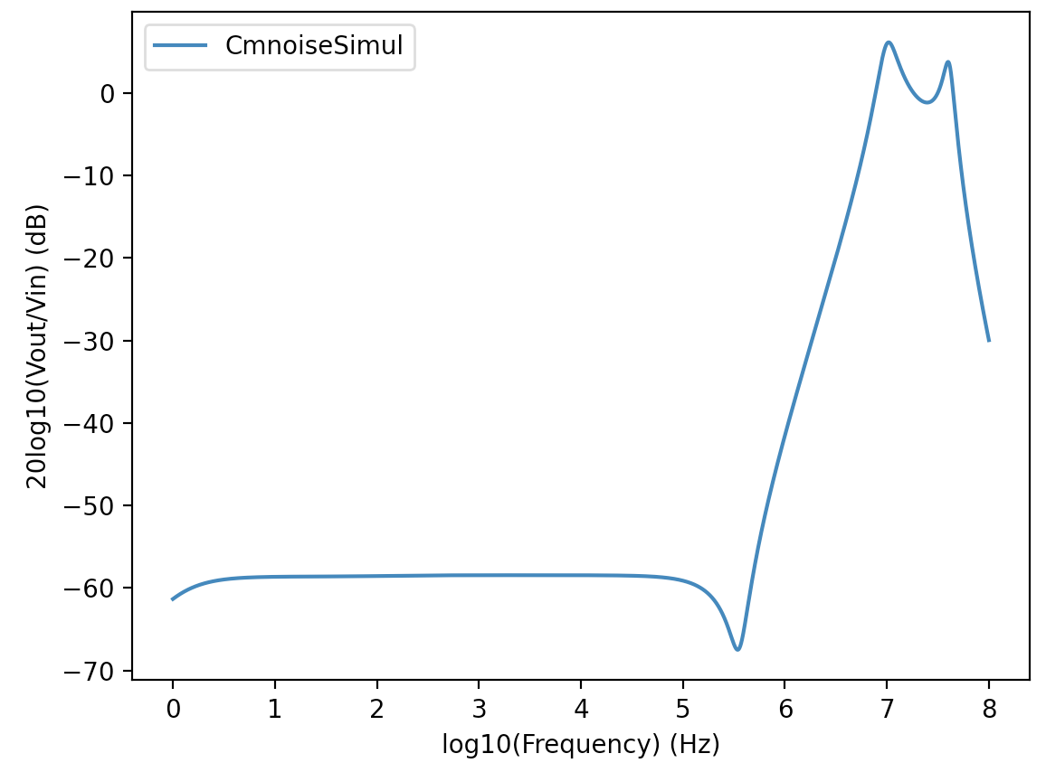
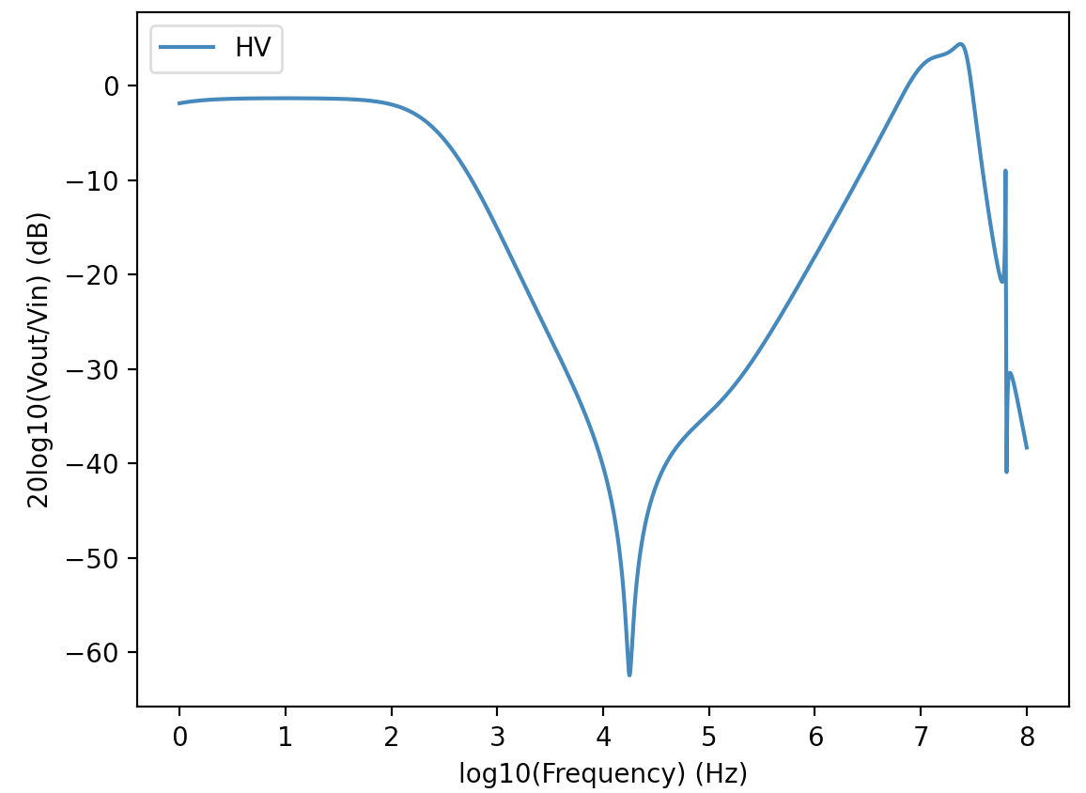
Model Predictions
Model not perfect but seems to roughly explain measured results
LV Transfer Curve
CM noise
HV Transfer Curve
MEASURED
MODEL

Slide 29
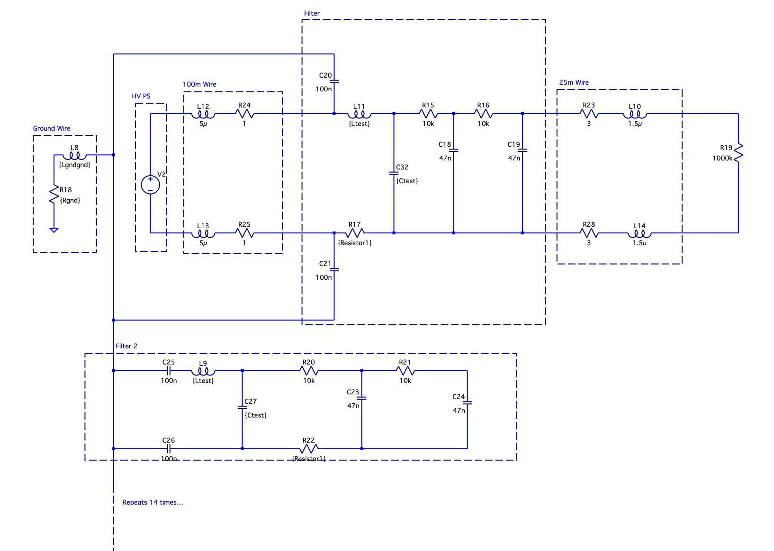
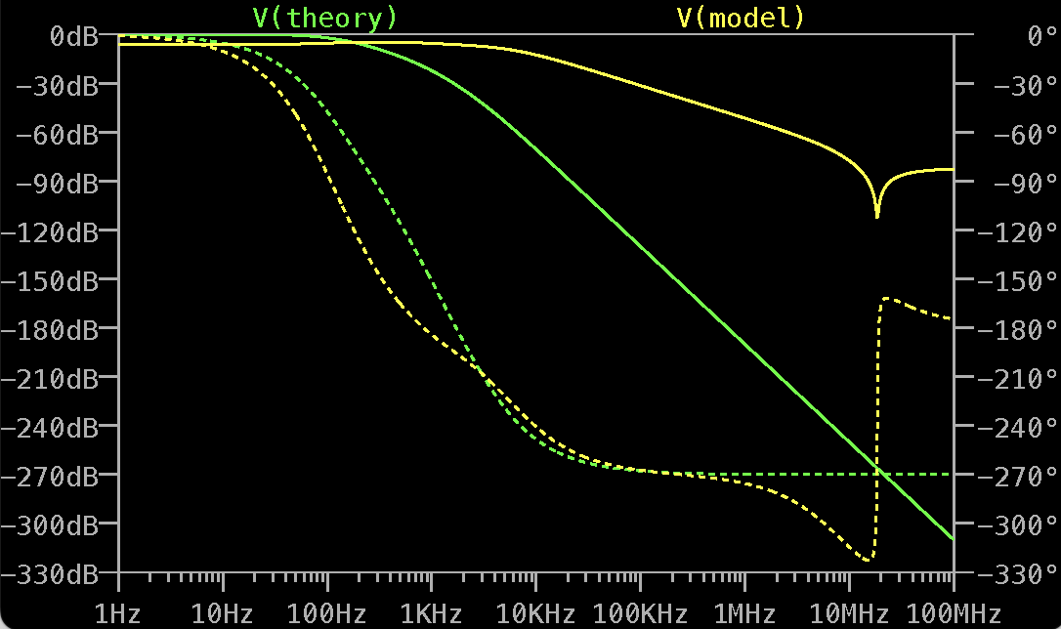
Model Final environment
If model is correct peaks seen at higher frequencies originate not from filter board parasitics but mainly from ground wire and the probes used for measurements
Model can be used to try to roughly predict filter behaviour in final environment, very rough aproximations for wire resistance and inductance
Floating supply helps
Not as good as theory but could still be acceptable
Signal propagation through backboard
in this case is very minimal (~270dB)

Slide 30
Patch Panel Grounding & Shielding
Use filter module boxes as continuation of vessel Faraday cage
  Also DC connecttion of filter boards backplane to cage
DC connection of Faraday cage to local TileCal earth
  DC current not as bad as HF AC noise
Move common-mode filter capacitors to filter input instead of output
  Filter common mode current at input

