Slide 1
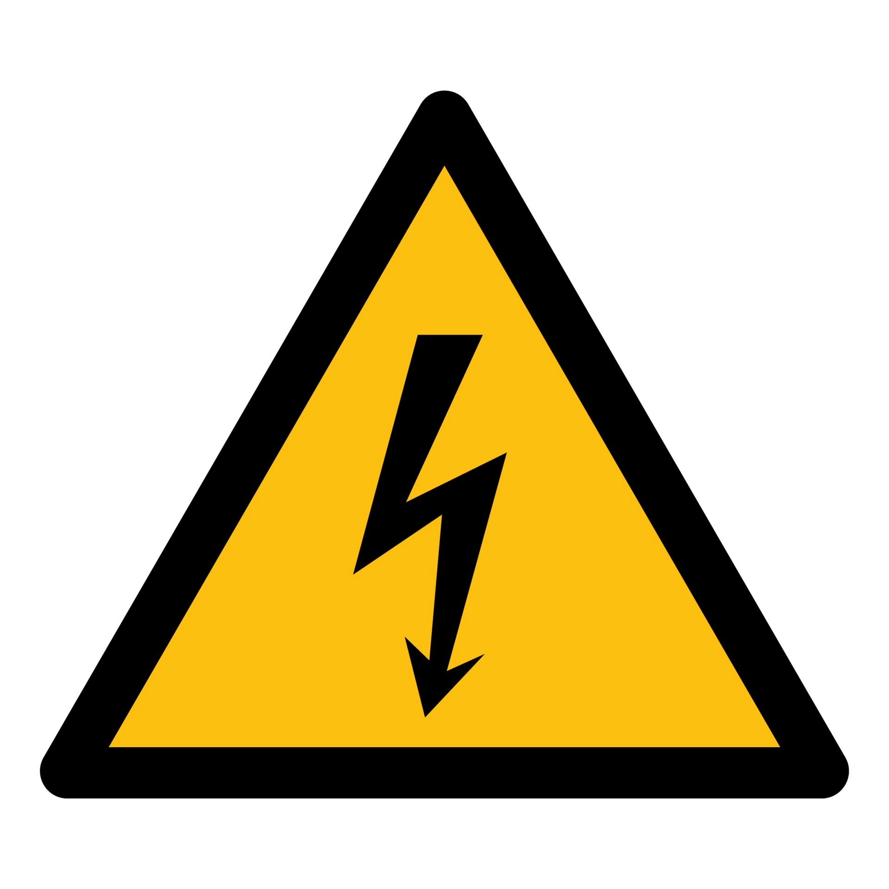
HGTD High Voltage Status
Ricardo Gonçalo (LIP/Univ. Coimbra) for the HV PS and PP teams
HGTD Week at CERN, February 2023

Slide 2
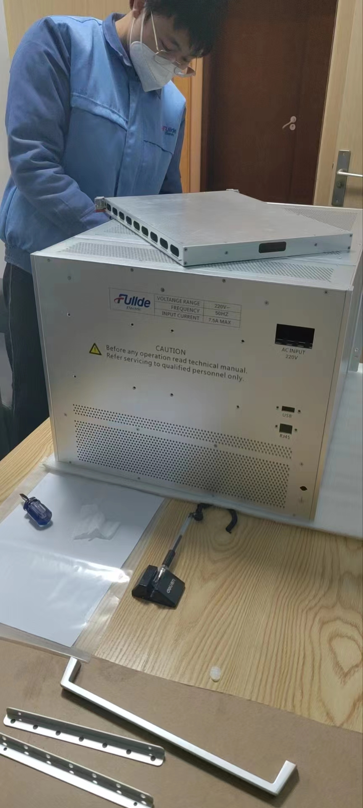
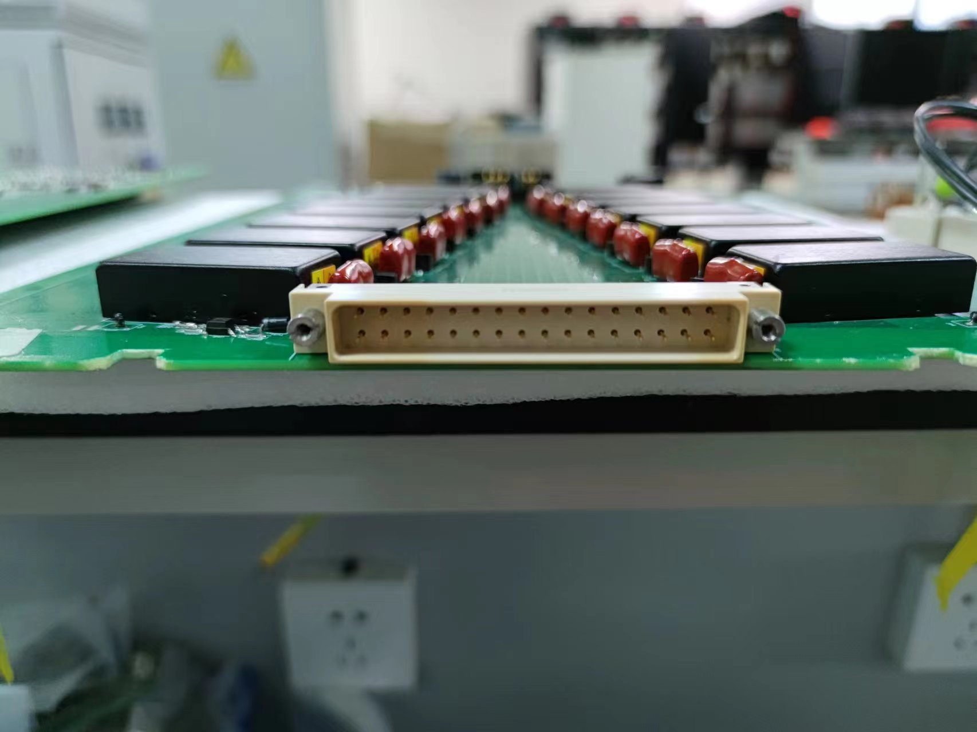
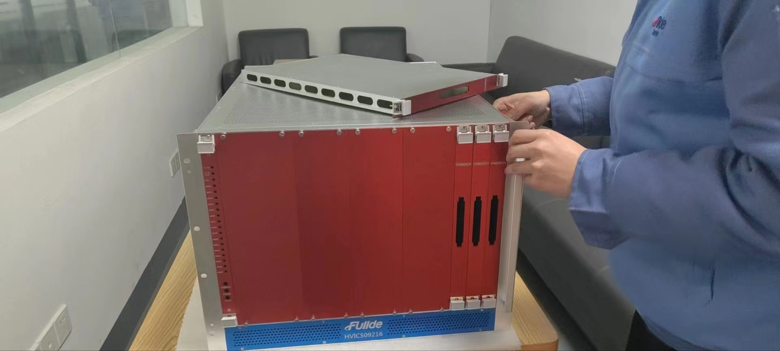
High-Voltage Power Supplies
Power supplies undergoing ageing tests at the factory
To be finished by the end of February
After that will proceed with power supply tests

Slide 3
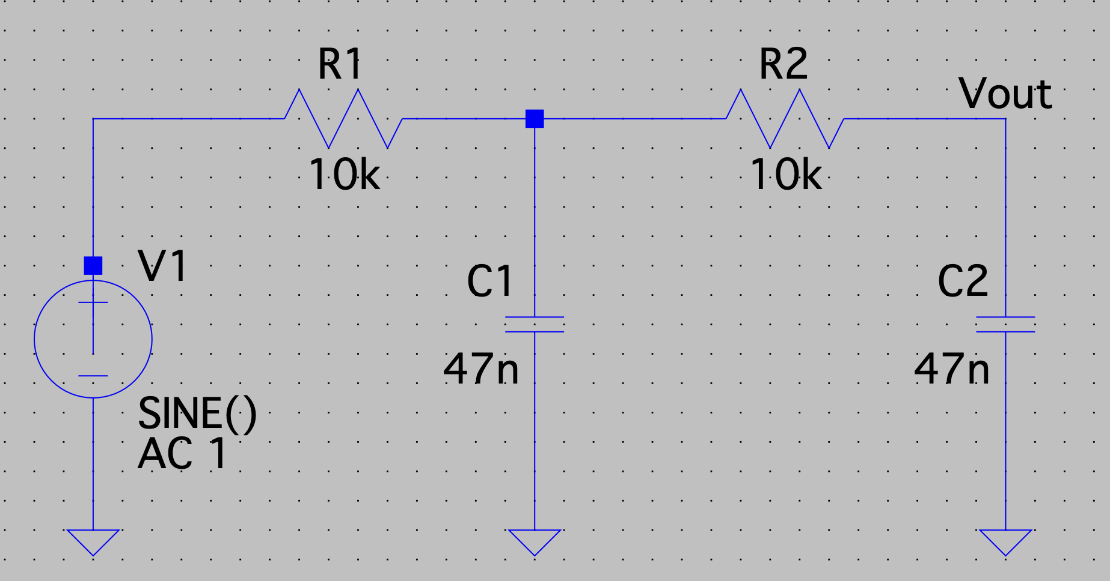
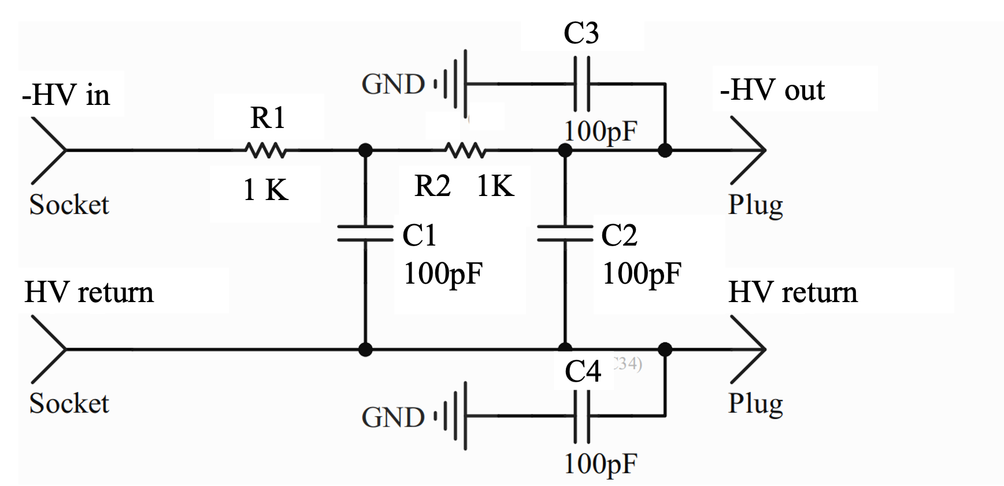
High voltage Patch Panels
HV filtered and routed between input long cables from USA15 and short cables to detector
2nd order RC-RC low-pass filter to suppress AC noise
8032 HV channels: at least 574 boards of 14 filters each
MSc student (Antonio Caramelo) setting up automated testing station for QC
Earlier prototype being used for developing tests
New prototype going for production soon – should be ready for tests in few weeks

Slide 4
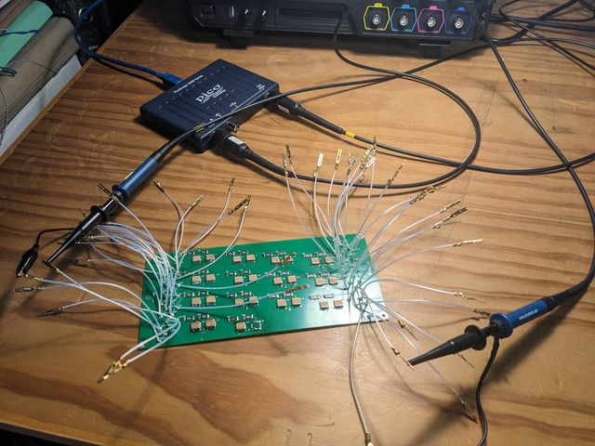
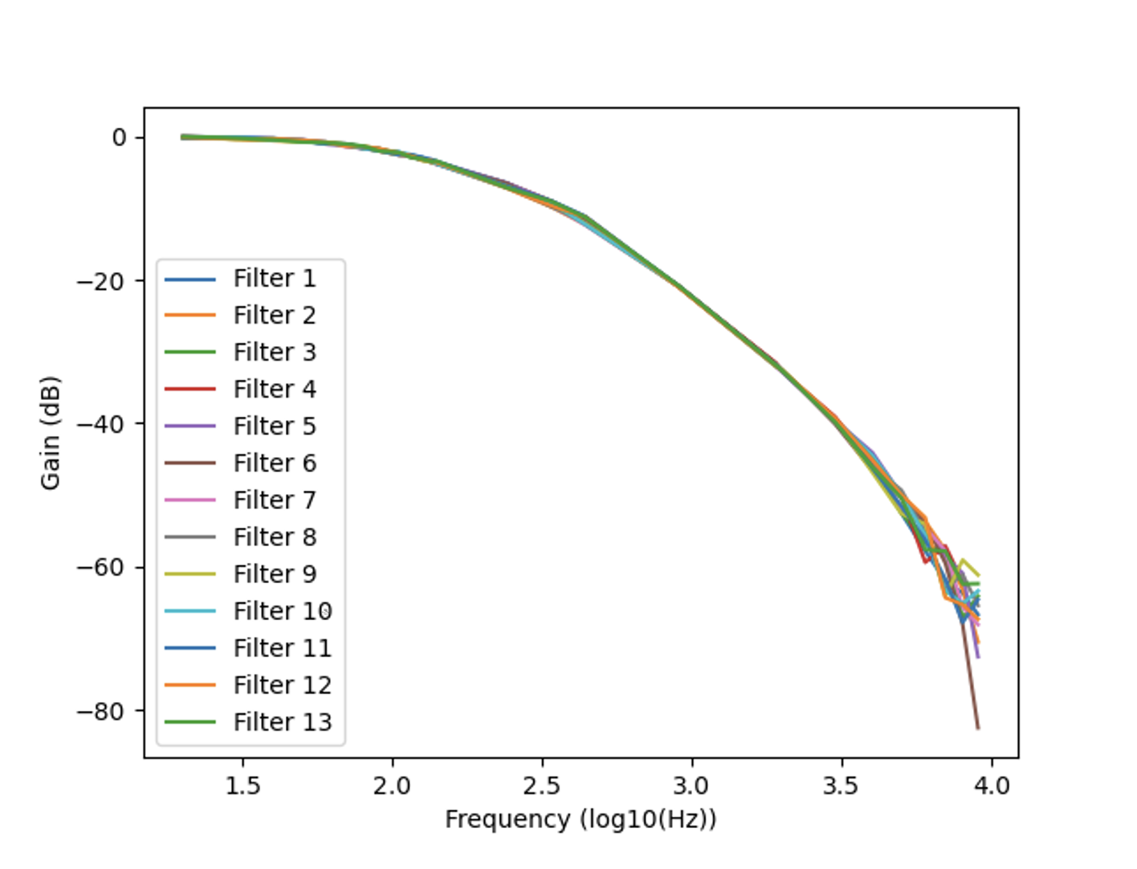
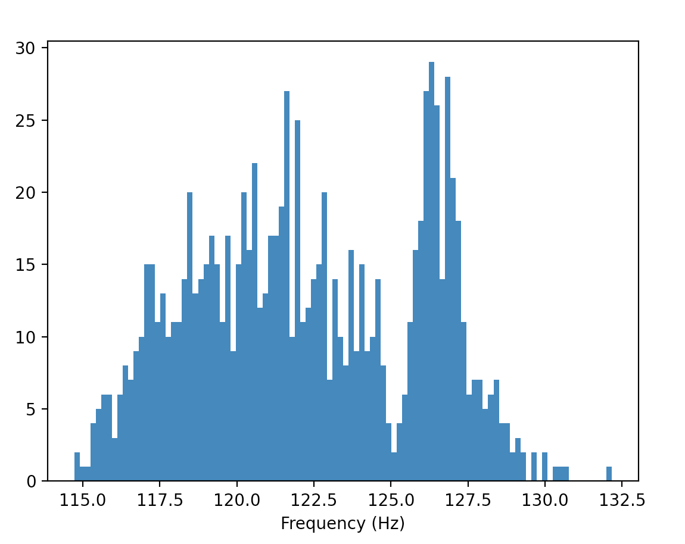
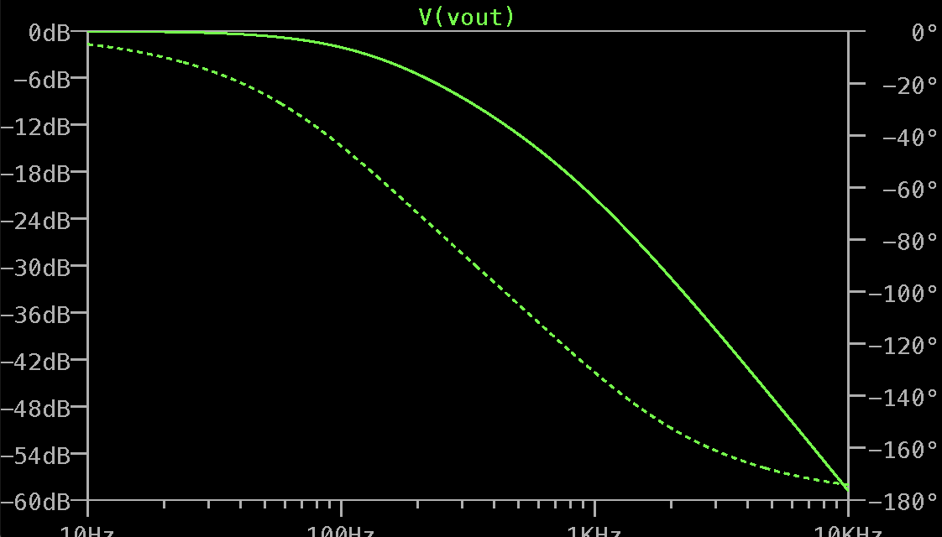
Patch Panel Tests
Using usb oscilloscope to generate and acquire waveform and attenuation curve
Extract cutoff frequency (-3 dB) to use as measure of filter quality
Expect f_{3db}=126,4 Hz and -40dB/decade for this example
Get 122.4±4 and investigating extra peak at the moment

Slide 5
Next Steps
HV Power Supplies:
Ageing tests in February followed by testing of full HV supply units and noise tests
Finalize HV supply specifications in June
Patch panels:
New (hopefully final) prototype next month: 1 month delay but no technical problems
Further tests: leakage current, cross talk, rad. hardness and magnetic field, ageing
QC progressing
High Voltage PDR passed in August 2022:
https://indico.cern.ch/event/1190013/
https://edms.cern.ch/ui/file/2775726/1/HGTD-HVPS-PDR_docx_cpdf.pdf
HV supply FDR meeting on 7 July 2023; PP FDR on 29 August (merge?)

Slide 6
Bonus slides

Slide 7
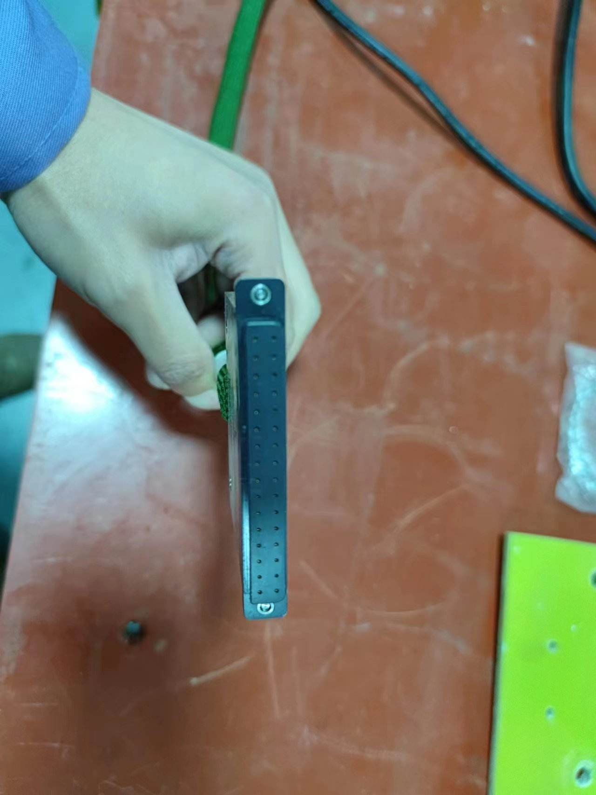
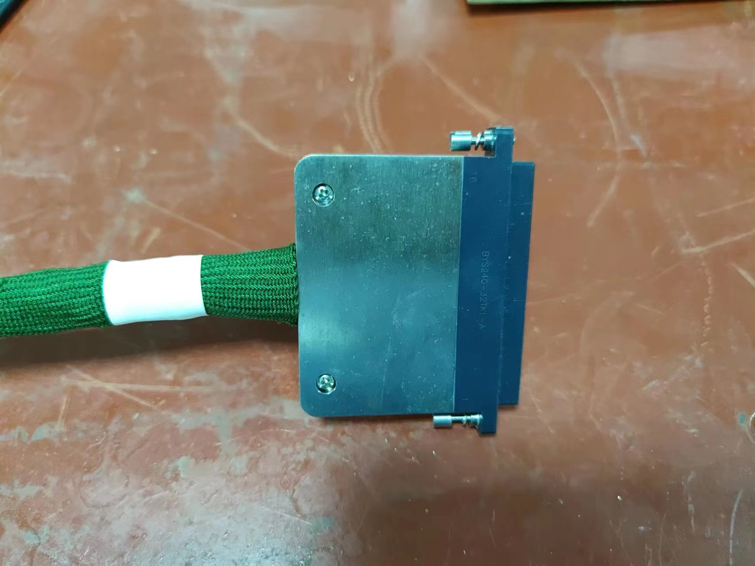

Slide 8
Patch Panel Filter Design For PDR
HV routing through fixed wire connections between input long cables from USA15 and short cables to detector modules
2nd order RC-RC low-pass filter to suppress AC noise
Up to -900 V with, no significant leakage, supply currents up to 3 mA per channel
Decoupling capacitors to suppress common-mode noise (C3, C4)

Slide 9
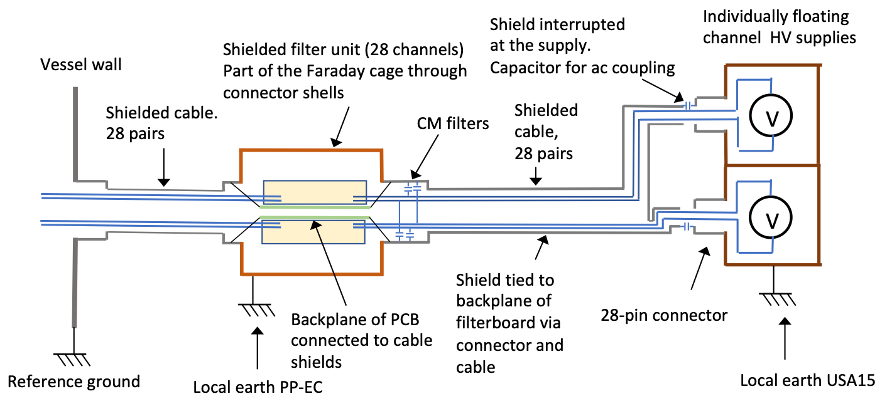
Patch Panel Grounding & Shielding
Use filter module boxes as continuation of vessel Faraday cage
Also DC connecttion of filter boards backplane to cage
DC connection of Faraday cage to local TileCal earth
DC current not as bad as HF AC noise
Move common-mode filter capacitors to filter input instead of output
Filter common mode current at input

Slide 10
Prototype tests and quality control
Planned tests:
Connectivity of components and filter performance tested by measuring the filter response as function of frequency and load
Leakage current
Insulation between internal and external ground.
Cross talk between channels
Temperature under load
Long term reliability including enhanced aging by temperature cycling in a climate chamber
Radiation and magnetic field tolerances
NEW: test with and without DC ground
For production:
Based on prototype results will establish set of quality control benchmarks to be done in production and upon delivery

Slide 11
HGTD HV Patch Panels
Each of the 8032 HGTD modules will need a bias voltage between -300 V and -900 V, adjusted individually
Electronic noise induced in the DC bias voltage at the power supply or in the cables between USA15 and the detector must be filtered out.
Filter modules (EC-PP) will be installed on the end-cap calorimeter surfaces – filter noise and allow HV channel routing

Slide 12
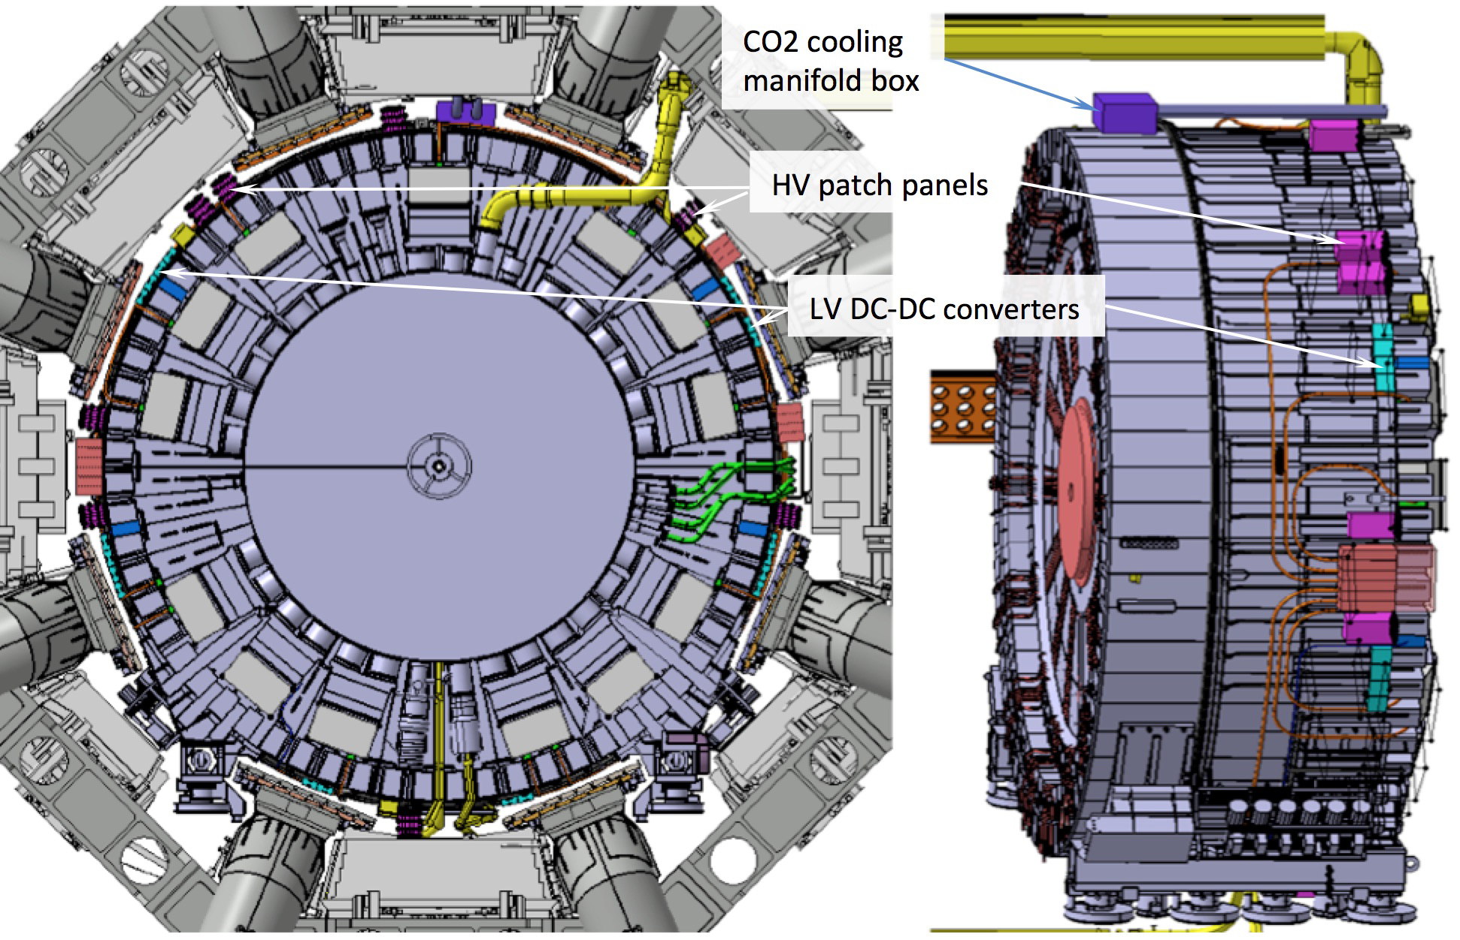
Patch Panel design parameters
Materials to withstand radiation and magnetic field:
TID 15.0 Gy and 1 MeV neq fluence 1.0 × 10¹² cm⁻²
Magnetic field up to 0.5 Tesla
Avoid easily activated and magnetic materials
Avoid extensive use of dielectrics
Mechanical stability and ease of access during shutdowns
Robust connectors
Fixation to Tilecal and cable strain relief staves – to be studied together with Technical Coordination
Space constraints
Around 20cm free in radial direction
Number of wires should present good match to cables from HV supplies

Slide 13
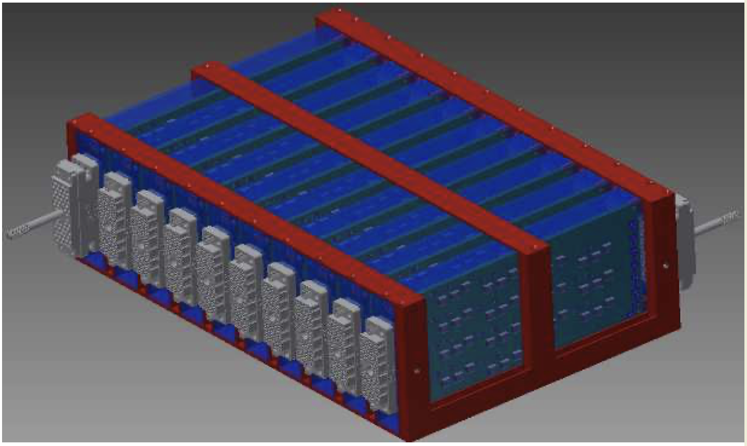
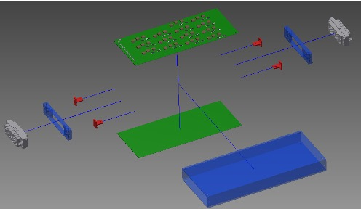
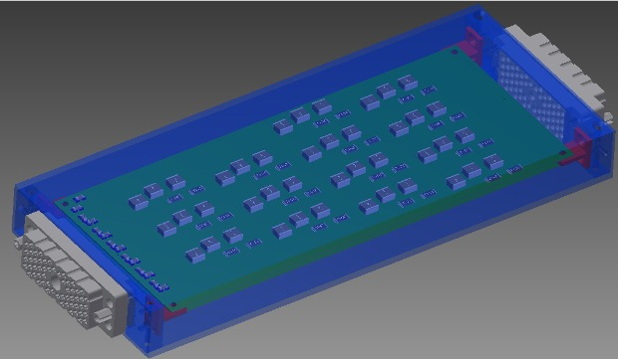
Patch Panel Units Design
A modular design is proposed for the patch panels
Individual modules are aluminium boxes containing two filter boards and connectors
Provide mechanical support and insulate each pair of boards within separate Faraday cage
Easy to construct, handle and access for maintenance
14 RC-RC low-pass filters in each filter board
Means one 56-wire cable connected to each module: = 28 HV channels = 14 channels x 2 boards
Routing of individual HV channels through wires connecting cables to each filter board

