Slide 1
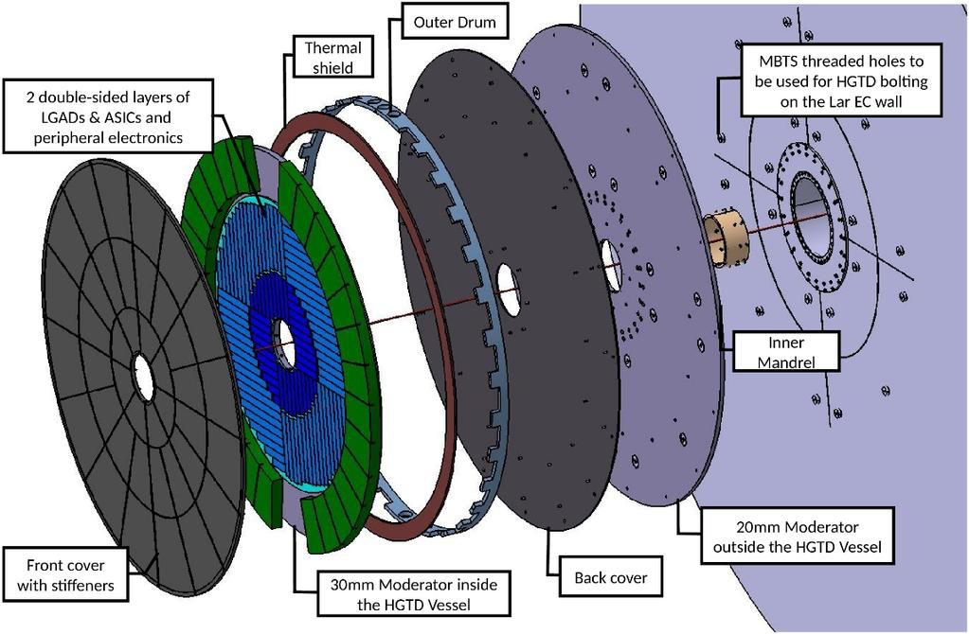
LIP – Expression of Interest

Slide 2
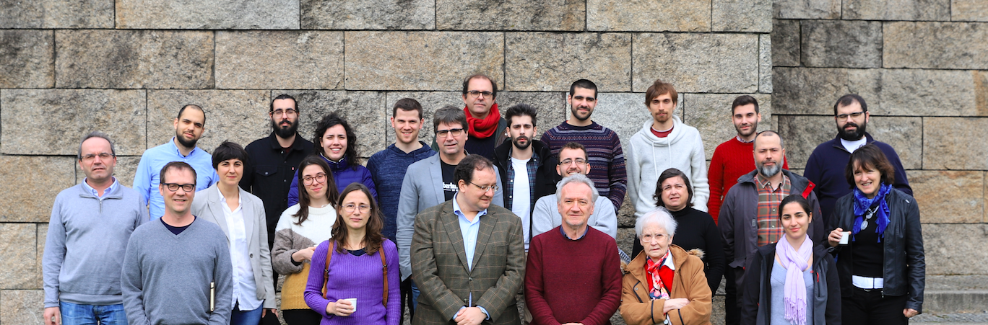
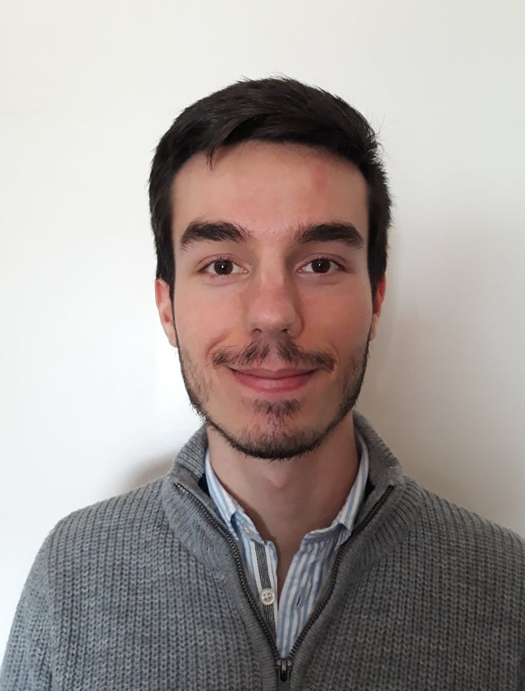
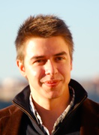
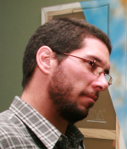
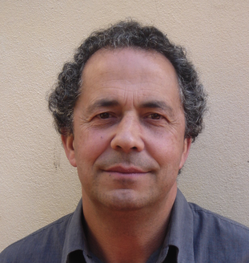
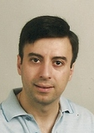
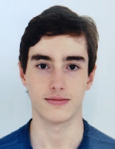
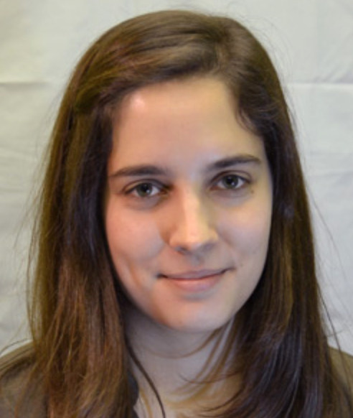
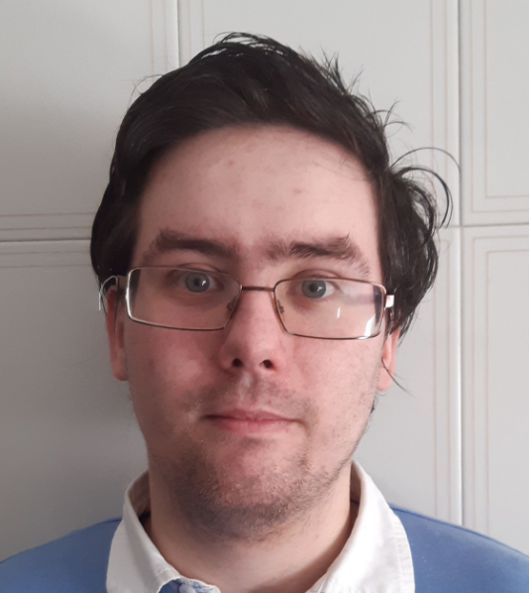
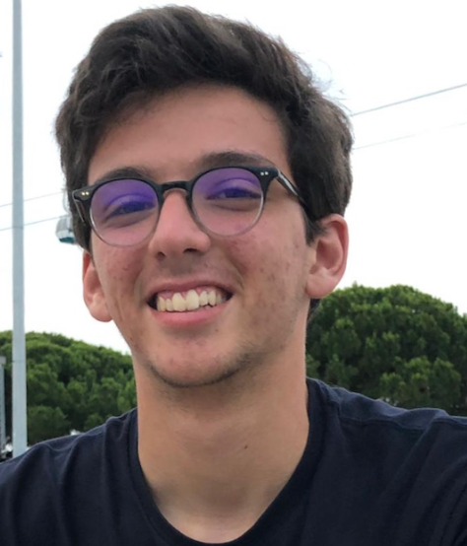
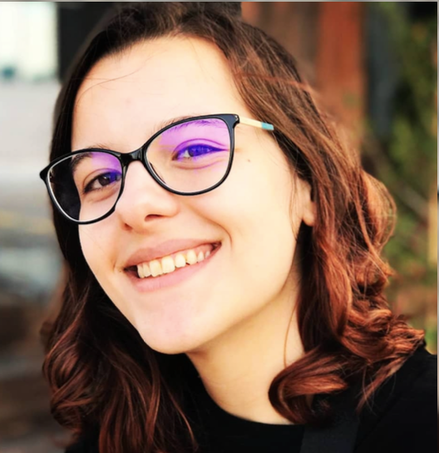
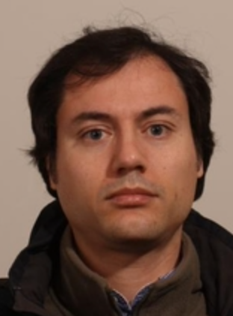
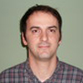
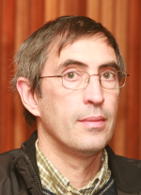
Portuguese ATLAS Team
National group:
LIP (Lisbon, Coimbra, Minho), FCUL, FCTUC, U. Minho, CFNUL
CEFITEC/UNL, INESC, CFMC, AdI engineers training program

Slide 3
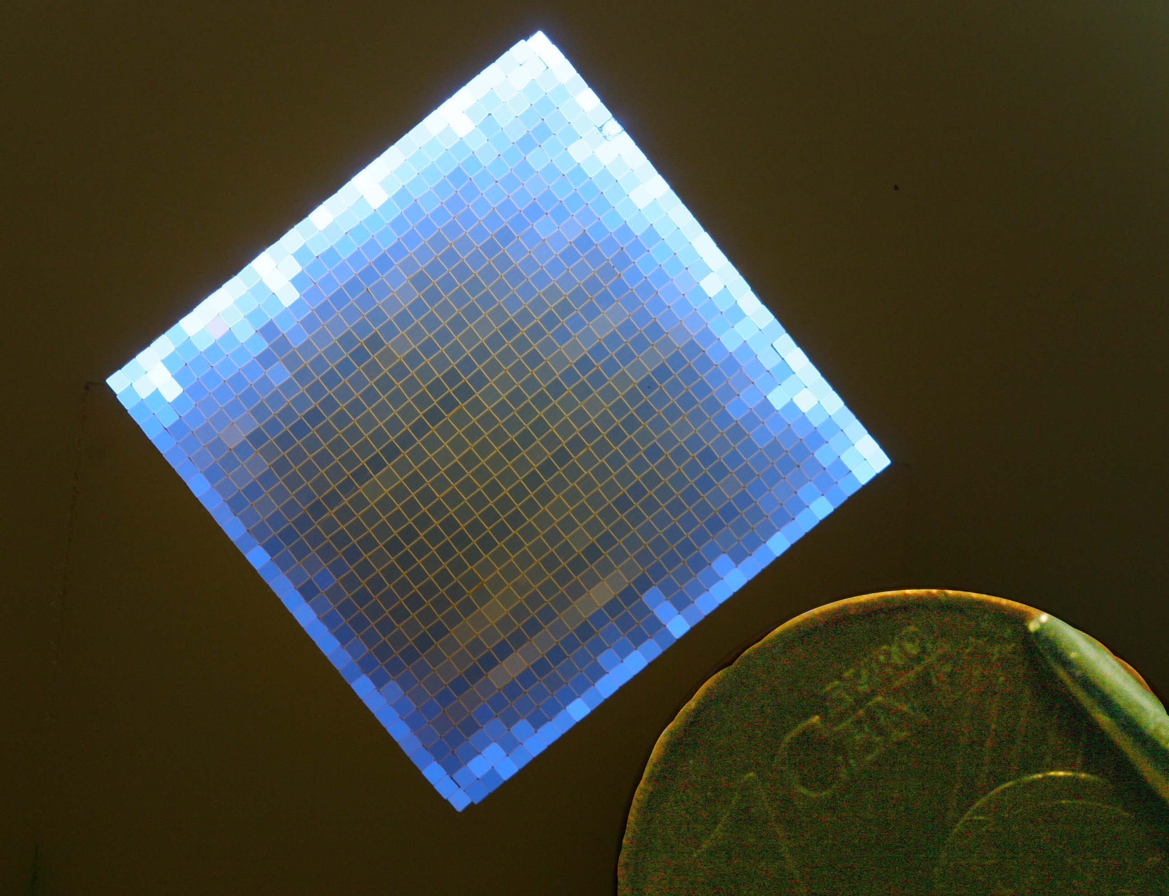
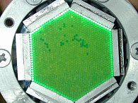
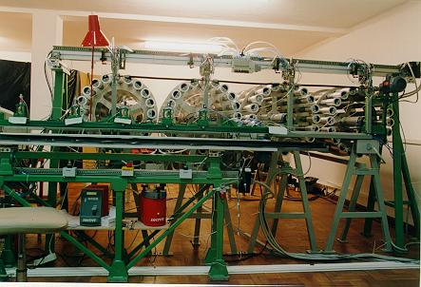
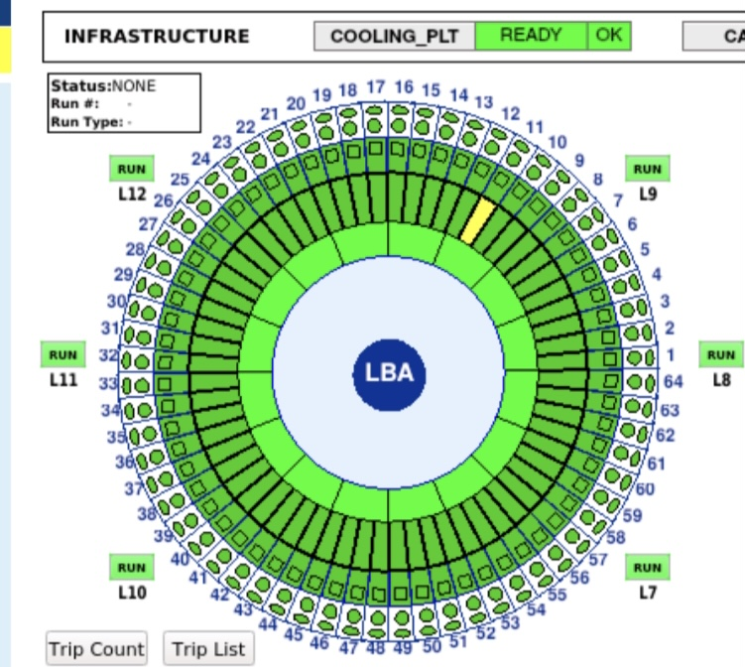
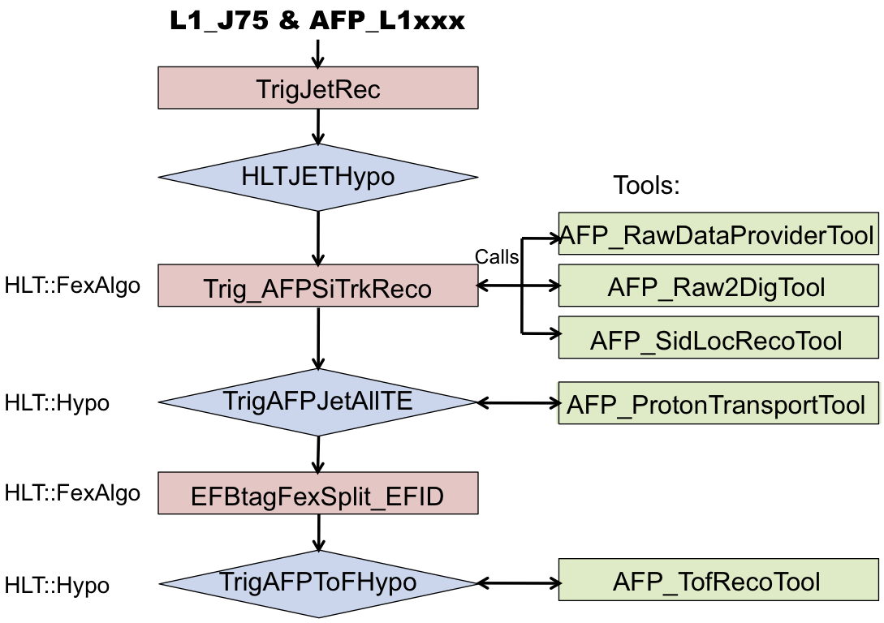
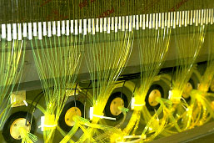
Long-term Portuguese contributions to ATLAS construction
Forward detectors
TileCal hadronic calorimeter
600 k WLS fibres
aluminized
Detector Control System
Fibres insertion with robot
in 15 k plastic profiles
Trigger/DAQ
Design of the cells and fibres routing
In addition: scintillators, laser calibration, PMT quality control, instrumentation of the modules, calibration, certification and commissioning

Slide 4
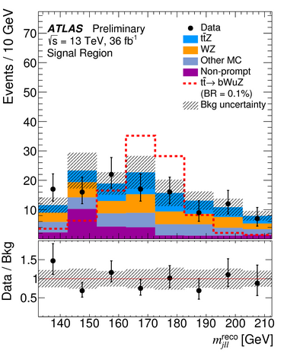
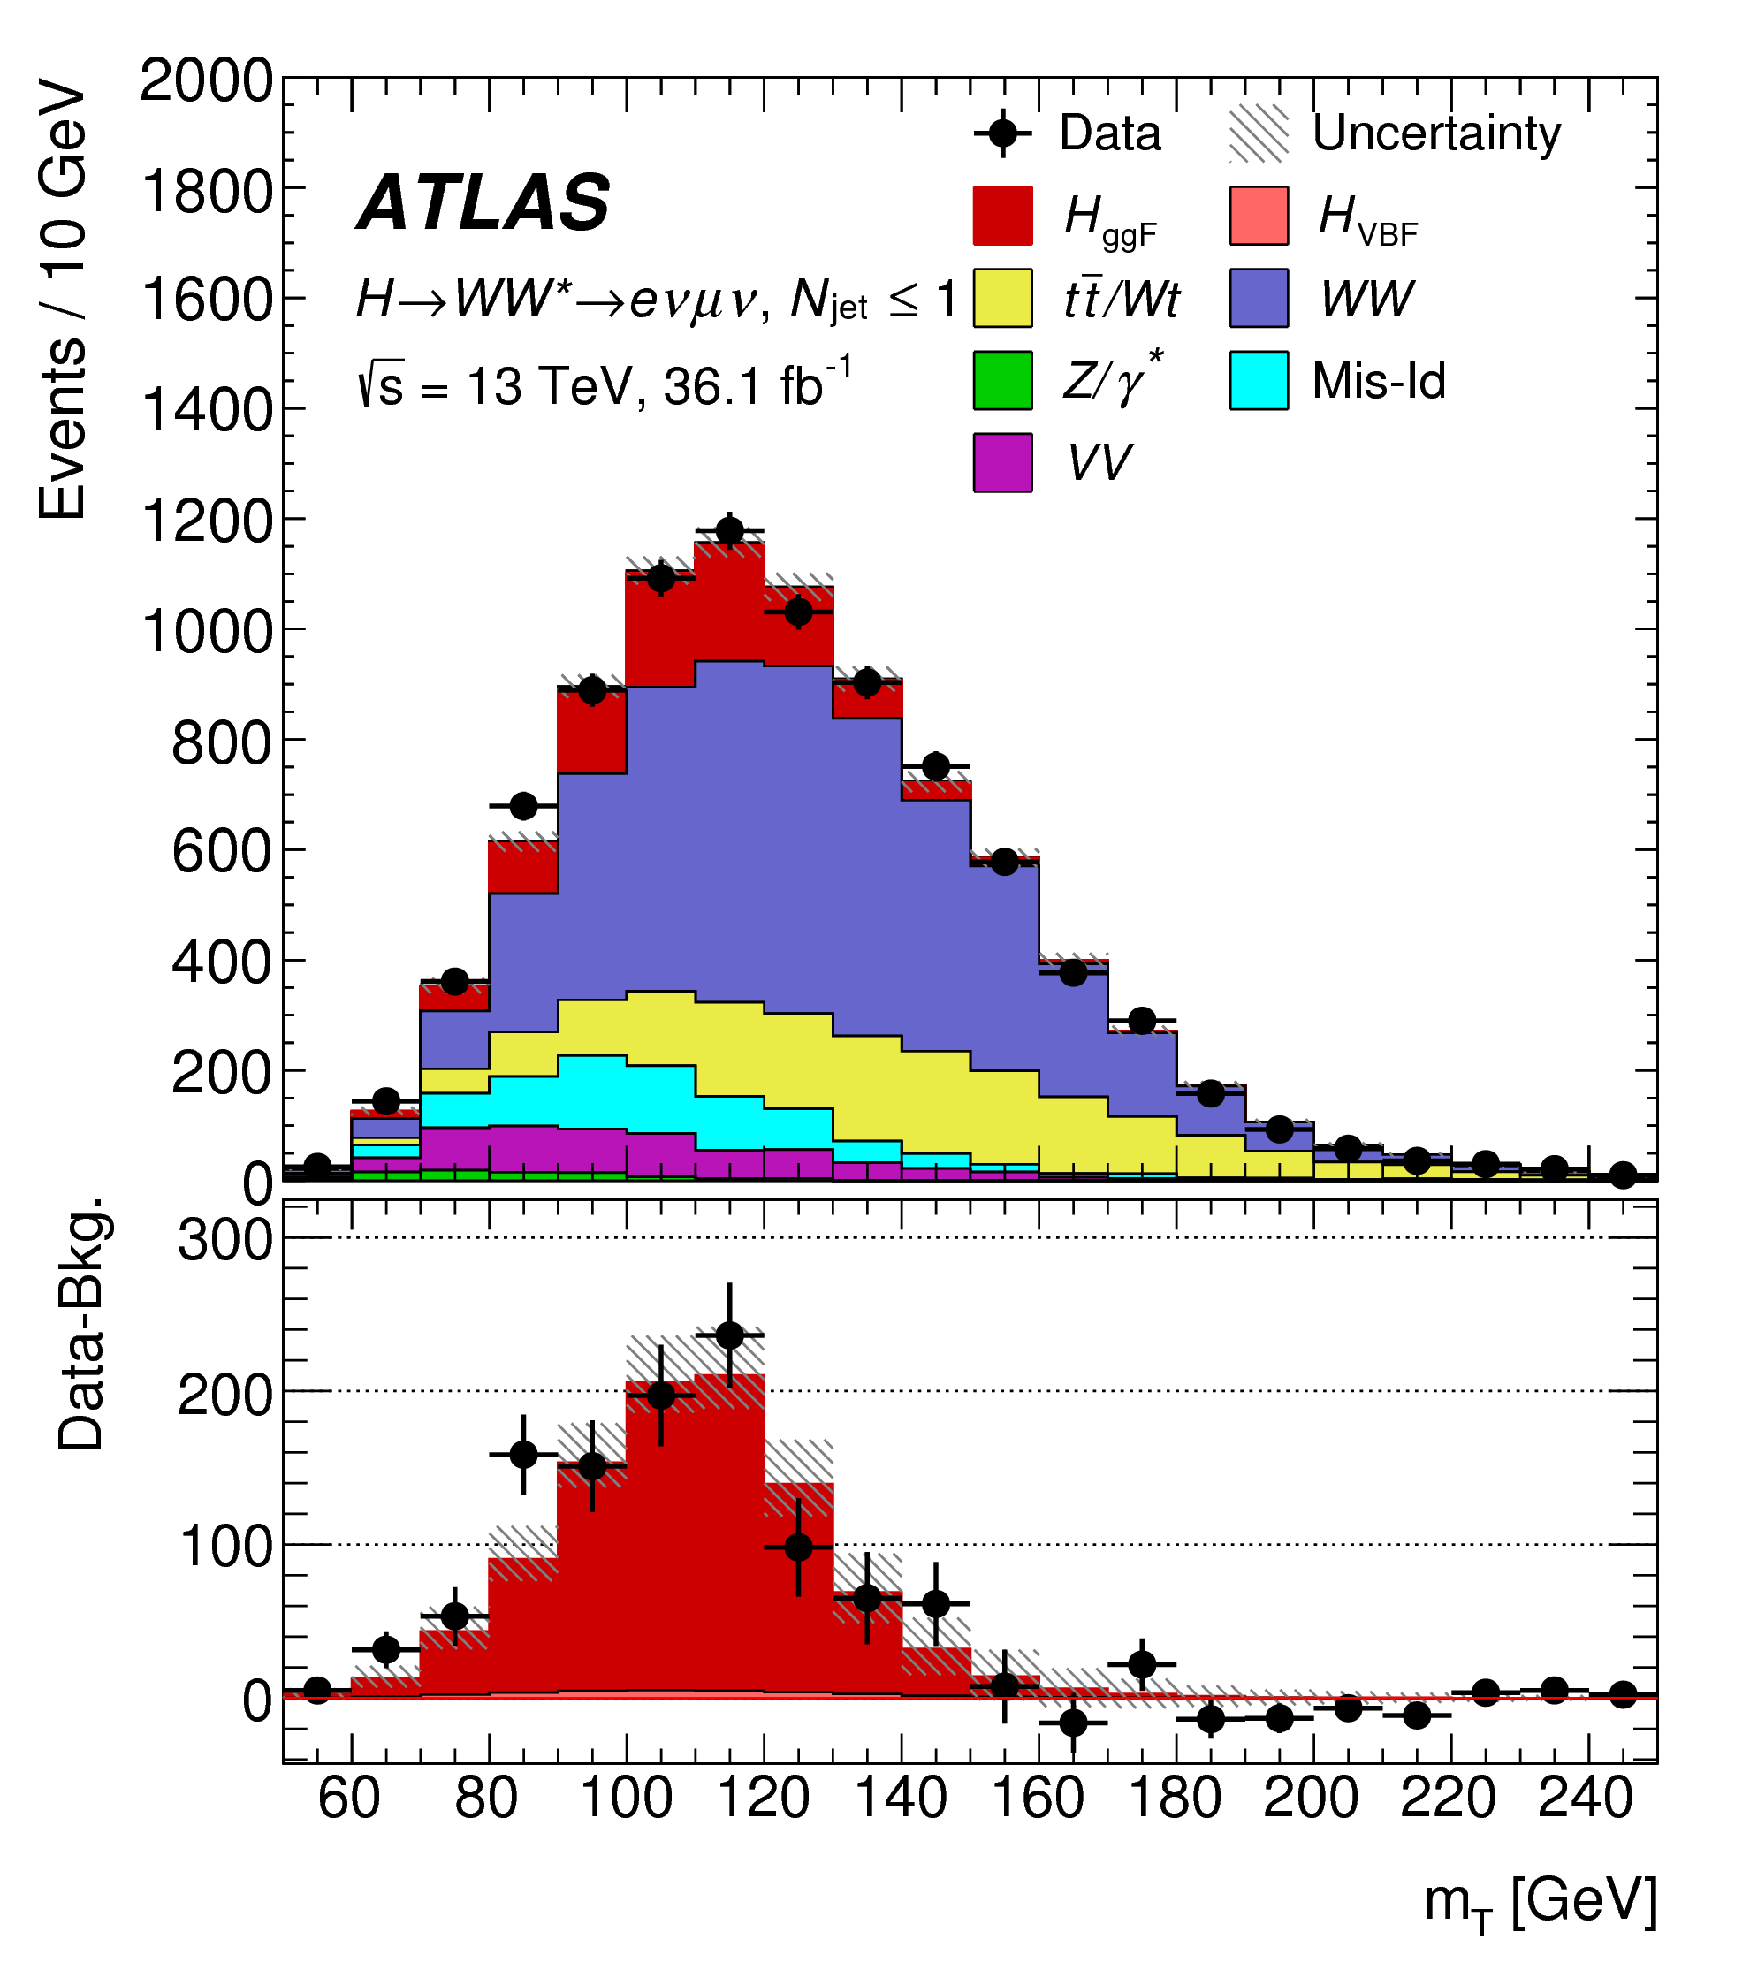
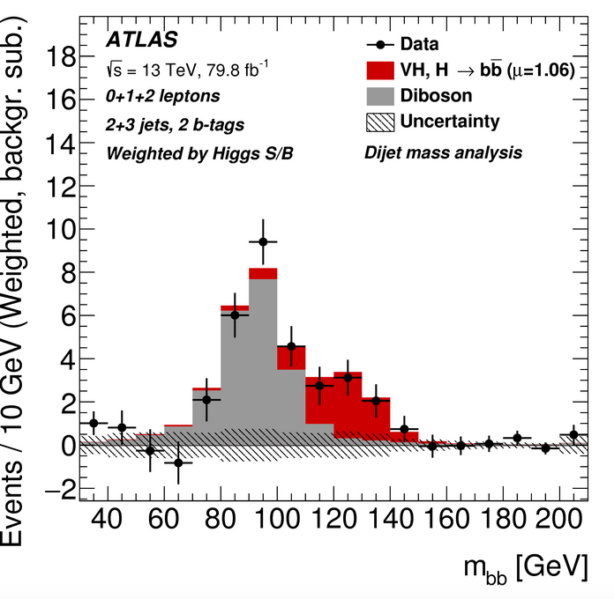
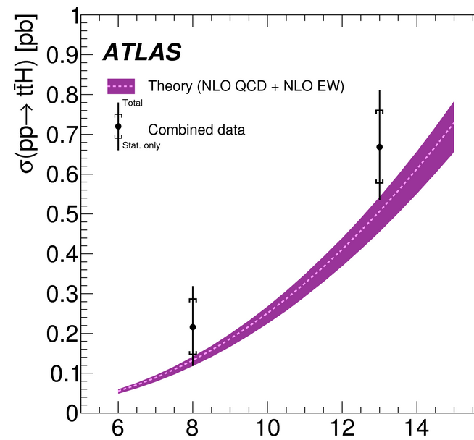
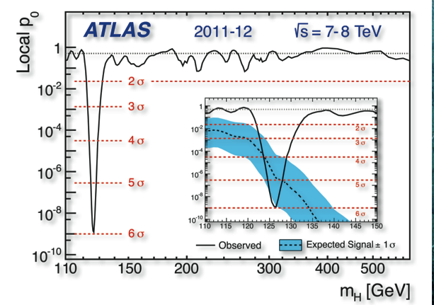
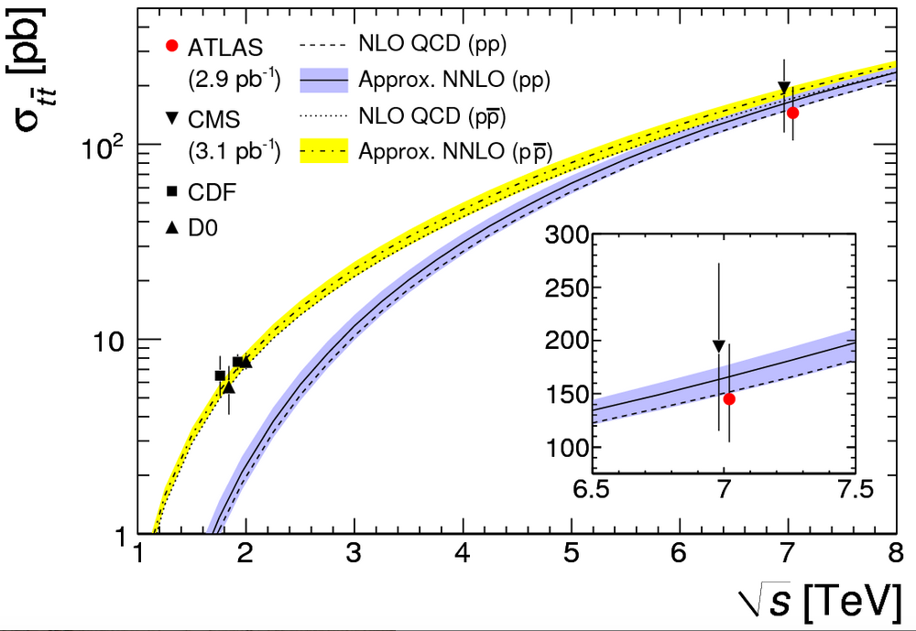
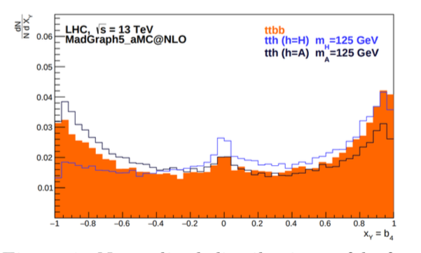
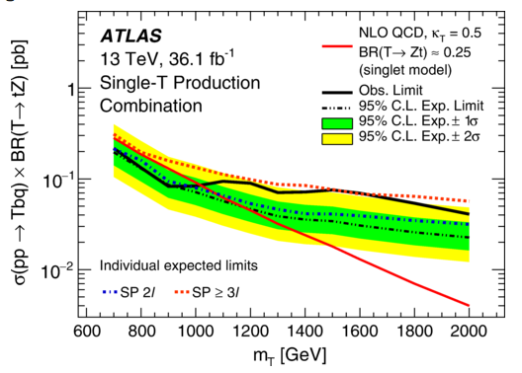
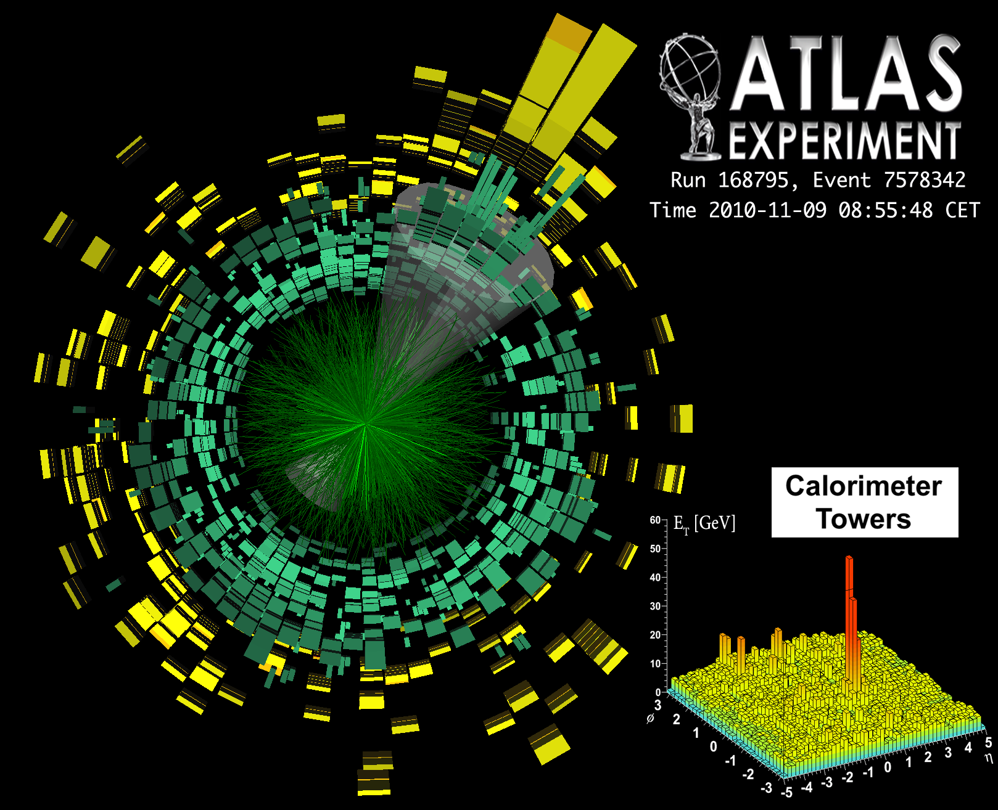
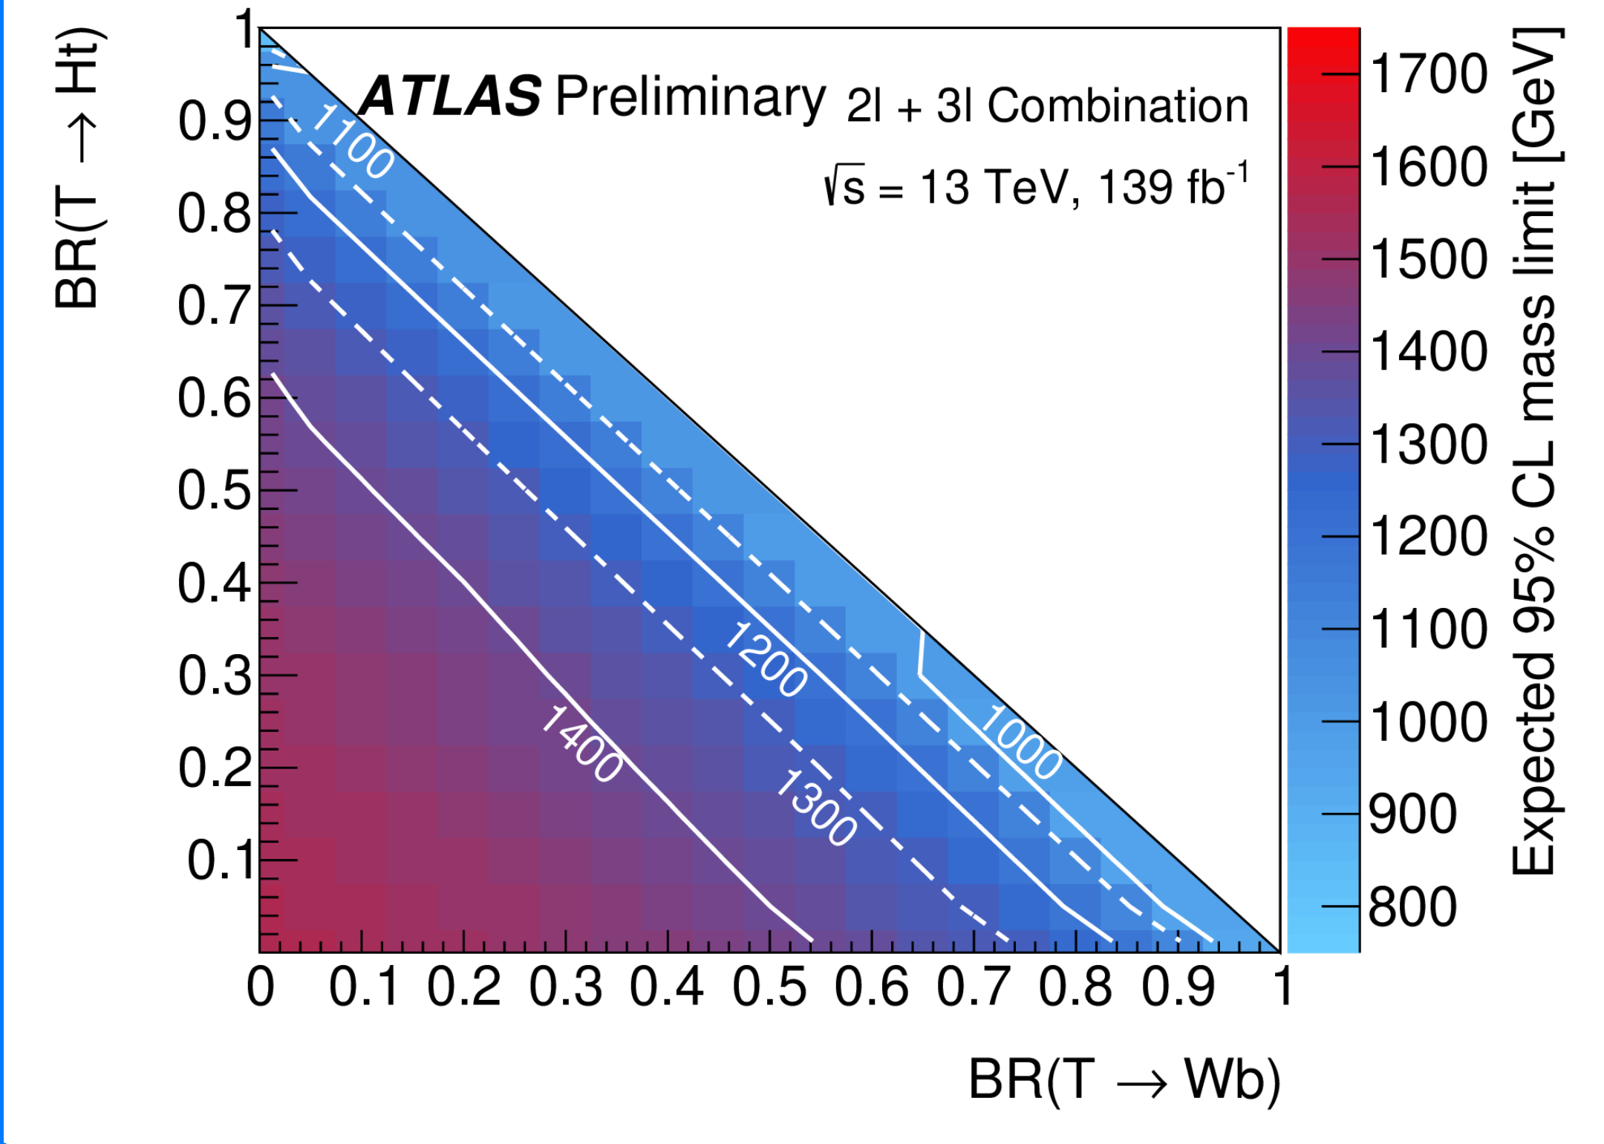
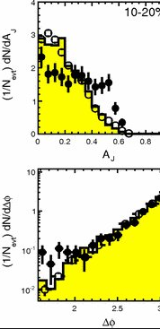
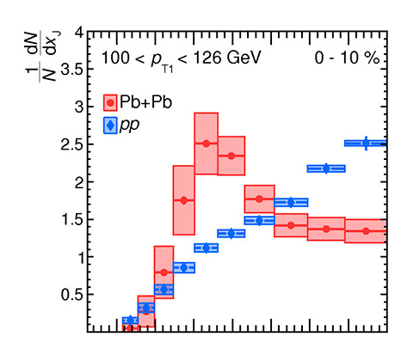
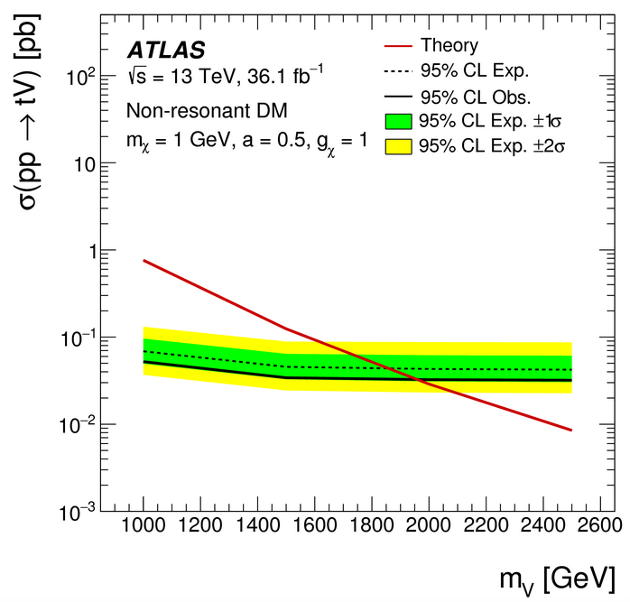
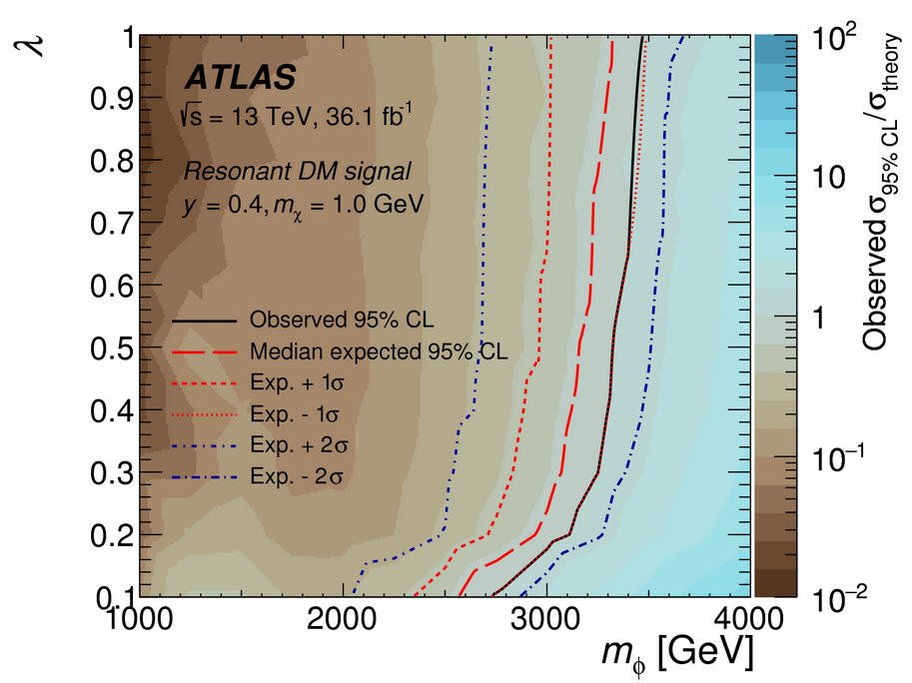
Portuguese contributions to ATLAS Physics Results
Top quark properties
Top properties measurements
Higgs boson discovery and properties
H➝WW, H➝bb, ttH
Spin/CP properties
Searches for New Particles & Interactions
Vector-like quarks, FCNC, dark matter, …
Heavy Ion Physics
Leading positions in some analysis
QGP jet quenching

Slide 5
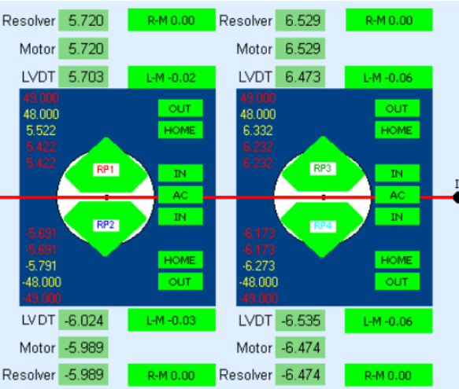
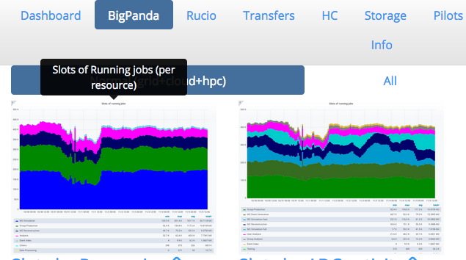
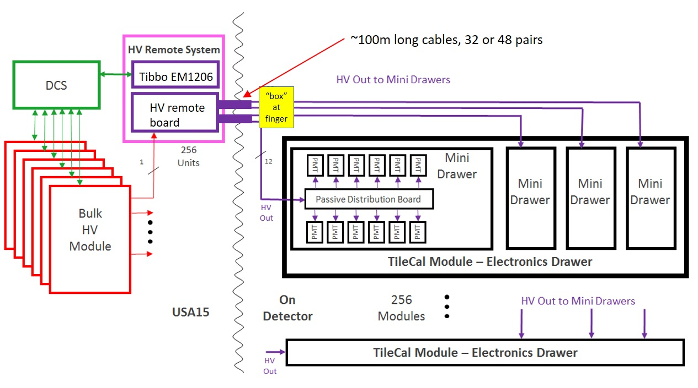
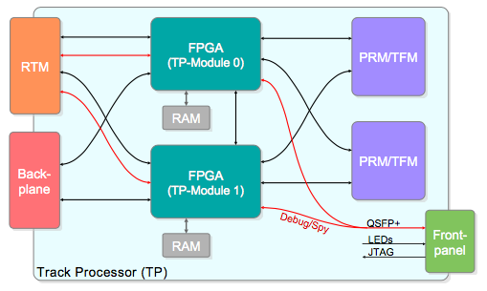
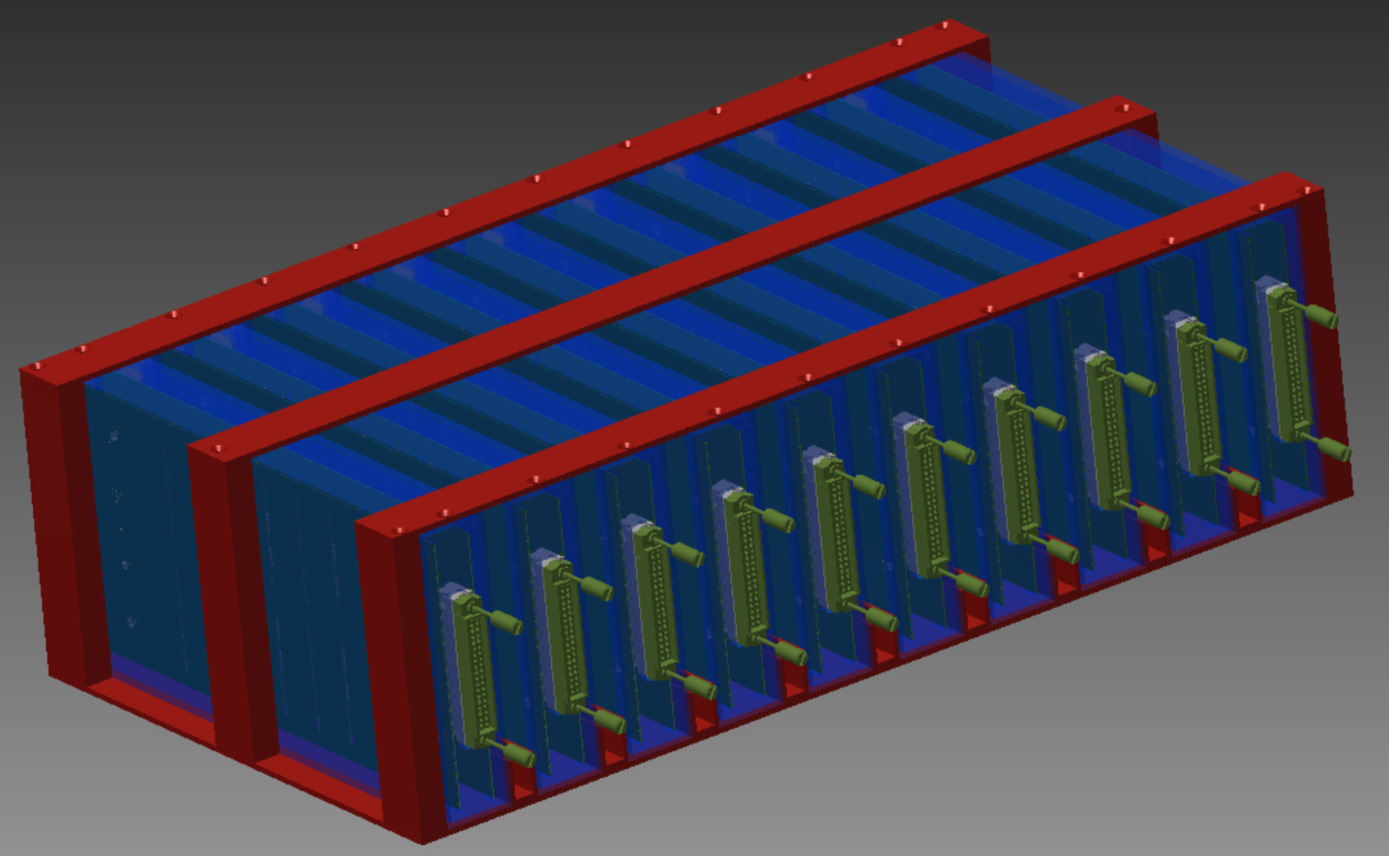
Current Portuguese Contributions to ATLAS
ATLAS Roman Pot DCS and HLT
Jets HLT
TileCal
Calibration,
DCS
Distributed computing
Iberian Cloud Coordination
TileCal Upgrade
HV distribution system
Co-leading ARP DCS
Trigger Upgrade: HTT
DCS, simulation, mezzanine production
HGTD
HV patch panels
Leading TileCal DCS

Slide 6
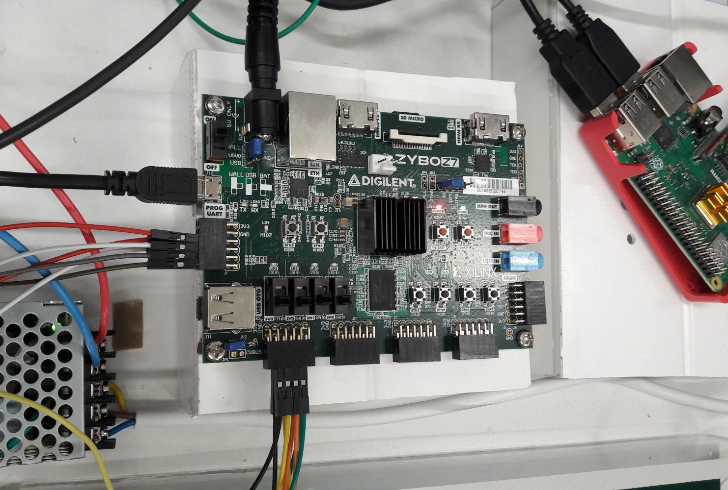
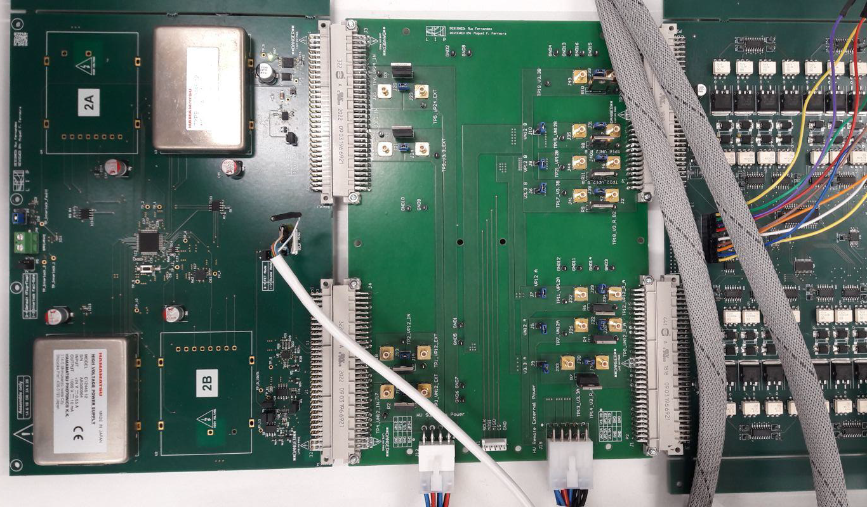
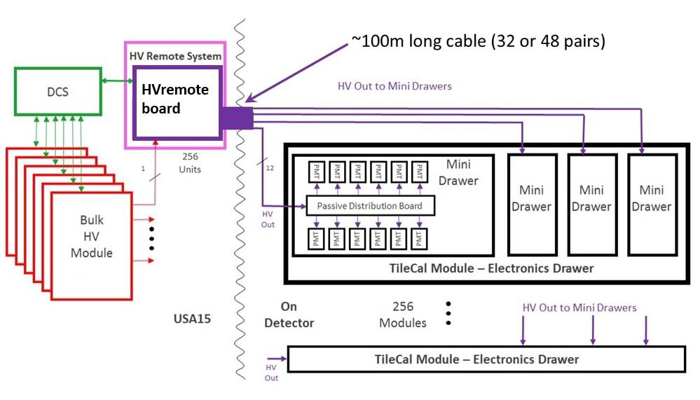
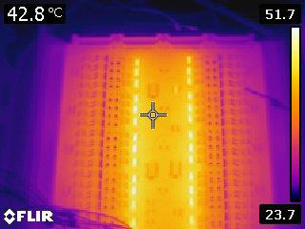
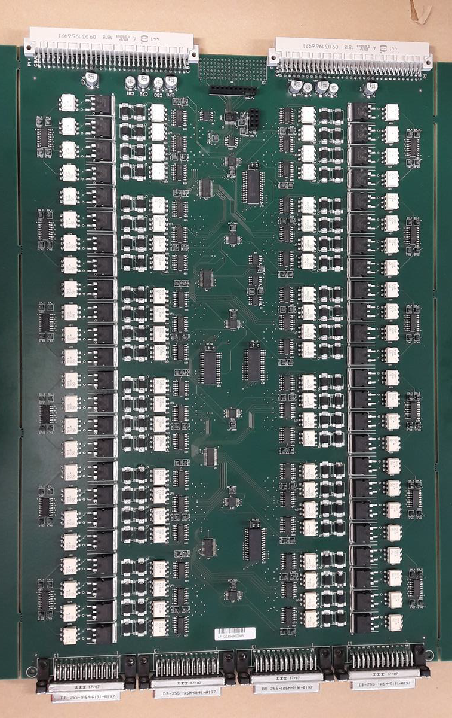
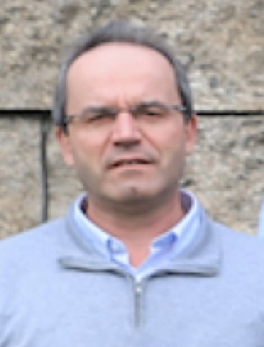
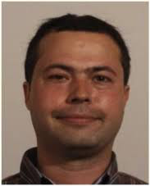
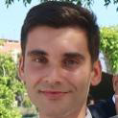
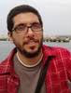
ATLAS Upgrade – TileCal HV Upgrade
HVsupply testing board HVremote
Developing Phase II TileCal HV distribution:
~750±0.5V; < 400mA to ~10000 PMTs
Hvsupply boards in USA15 – DC-DC converters
256 HVRemote boards in USA15 – regulation and control system
Crate control and DCS with Zybo Zynq SoC
1024 passive HVbus board on detector
Sole responsability of LIP: team of 3 academics, 3 engineers, 3 MSc students
+ 3

Slide 7
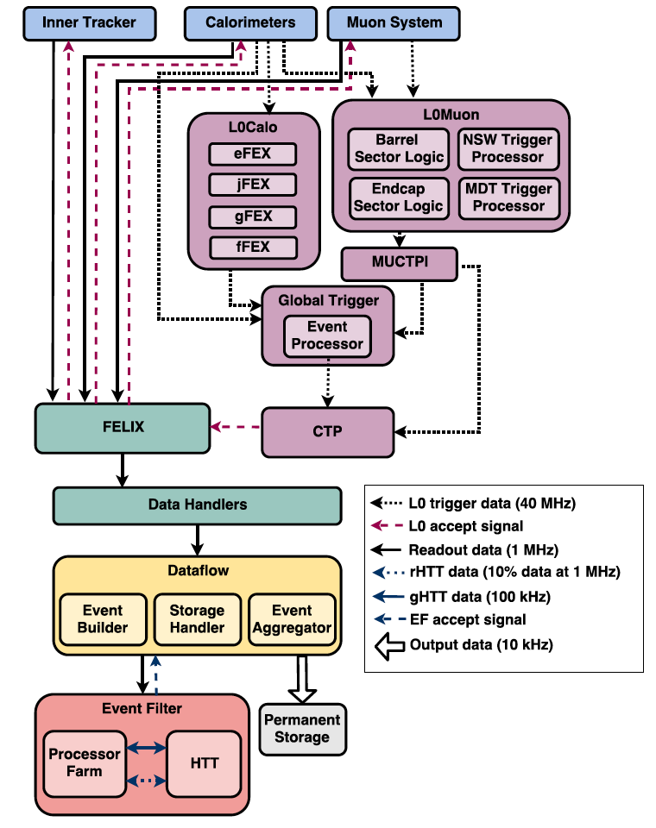
ATLAS Upgrade – HTT electronics and software
Hardware tracking co-processor for the trigger:
Up to 1 MHz RoI-based tracking for |η|<4
727 Tracking Processor (TP) boards with track fitting and communications (RTM) mezzanines in 48 units to process separate η-ϕ regions
Contributions atLIP:
Production of RTM board; development of TP network interface; DCS
HTT fast simulation; studies of tracking performance; alternative tracking algorithm (Hough transform) – MSc and PHD Qualif. Task
Team: 1 academic, 2 engineers, 1 PhD student, 1 MSc student

Slide 8
ATLAS Upgrade – Hardware Accellerators
TopoCluster reconstruction is slowest part of calo reconstruction and scales non-linearly with occupancy – affects e.g. jet trigger
Exploit GPU parallelism to accellerate algorithm
TopoAutomaton Clustering (TAC)
Cellular automaton algorithm based on cell pair-wise cluster flag propagation
1st prototype demonstrated great potential – now optimizing in new, more efficient framework
Both for trigger and offline, as part of ATLAS HCAF (Heterogeneous Computing and Accelerators Forum)
Team: 3 academics, 3 MSc students - collaboration with High Performance Computing group (INESC-ID / IST)
Notes:
Maximimize parallelism:
Data organised in cell pairs
Use cellular automaton
Propagate flag on a grid of elements (cell pair)
Cells get the largest flag on each iteration

Slide 9
ATLAS ARP Phase I – AFP and ALFA
ALFA Luminosity detector
Scintillating fibre preparation
Detector control and monitoring
AFP Atlas Forward Proton spectrometer
Detector control and monitoring
Central Exclusive Jet Production trigger
Exploitation of unique physics opportunities
Team: 2 academics, 1 engineer, 2 PhD students
ToF
SiT

Slide 10
Local expertise and support infrastructures
DCS expertise:
Filipe Martins and Luis Seabra coordinating DCS of TileCal, ALFA, AFP
Support/collaboration with local groups:
Radiation detector lab. and precision mechanical workshop at LIP
Electronics (LIP-eCRLab)
Computing (INESC-ID / IST)

Slide 11
HGTD Involvement
Producing HV patch panels with CERN group:
16 patch panel boxes located around the calorimeter perimeter
Routing of High Voltage to HGTD detector and filtering AC noise out
Presented in Electronics meetings
Team: 1 academic, 2 engineers
Looking for new projects to get involved with in HGTD
Notes:
Possibilities: TDAQ and DCS

Slide 12
Possible team to be involved in HGTD
Initially:
Luís Lopes and Orlando Oliveira – mechanics and electronics
Filipe Martins and Luis Seabra – DCS
Rui Fernandez – electronics/firmware
Ricardo Gonçalo – physicist
In the future, possible involvement of other senior group members, MSc and PhD students for thesis works and qualification tasks
+ others

Slide 13
Thanks!
Acknowledgments

Slide 14
Backup

