Slide 1
HGTD Patch/Filter Panels
Luis Lopes, Orlando Cunha, Ricardo Gonçalo
LIP - Portugal

Slide 2
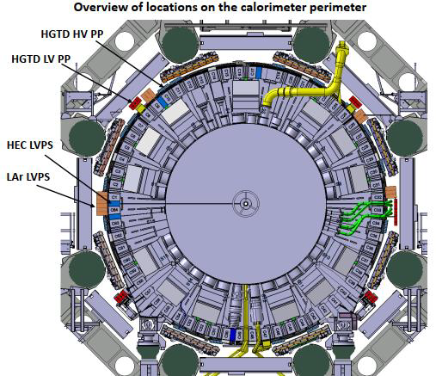
16 Patch Panel boxes
Routing of HV channels from sources to detector
Filtering AC noise
Proposed design shown in next few slides

Slide 3
Modular box
Dimensions: 360 x 195 x 104 mm³ Weight: 7.5 kg (final around 10 kg)
56 wires in (28 pairs)
For insulation: male pins on USA15 side; female plugs on sensor side

Slide 4
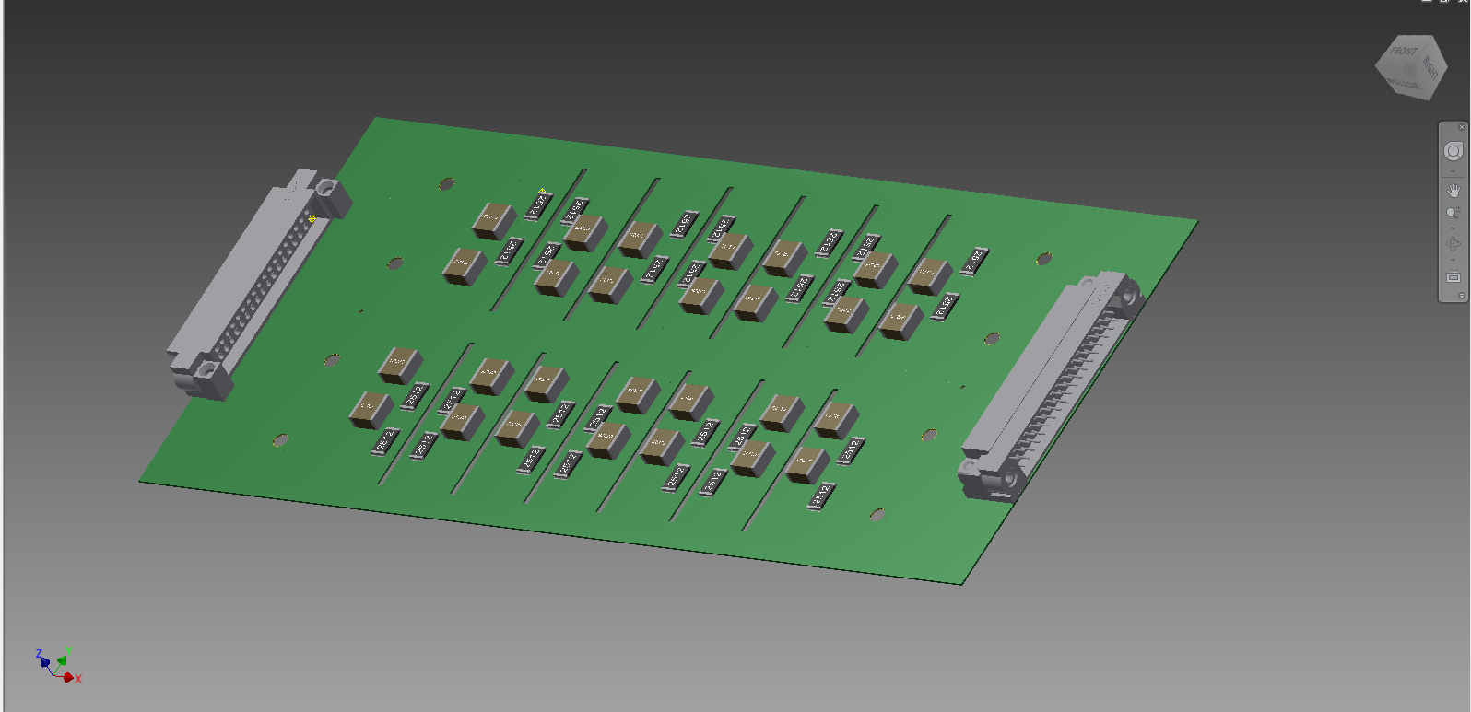
PCB with filters
14 RC-RC filters per PCB – 28 per module / Wire routing from connector to filter
Patching options:
56 wires in (28 pairs) – 56 wires out (28 pairs)
48 wires in (24 pairs) – 56 wires out (28 pairs)

Slide 5
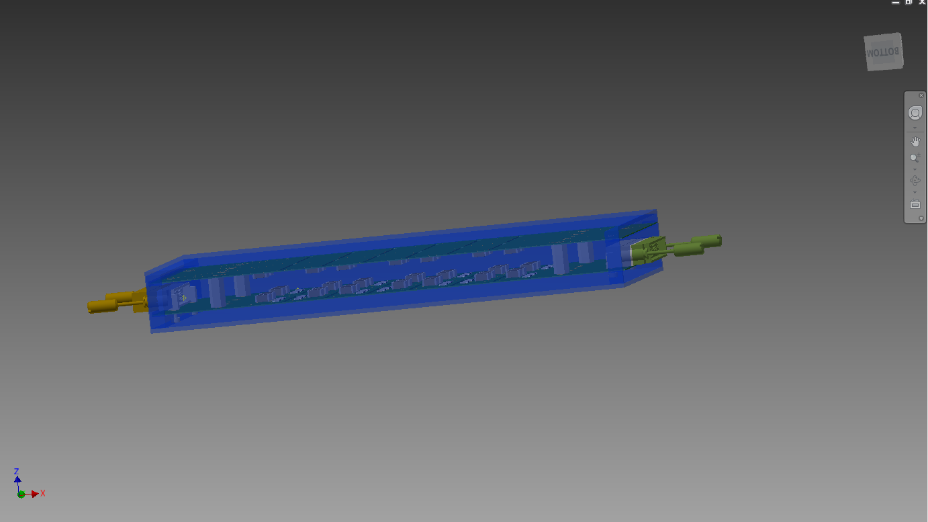
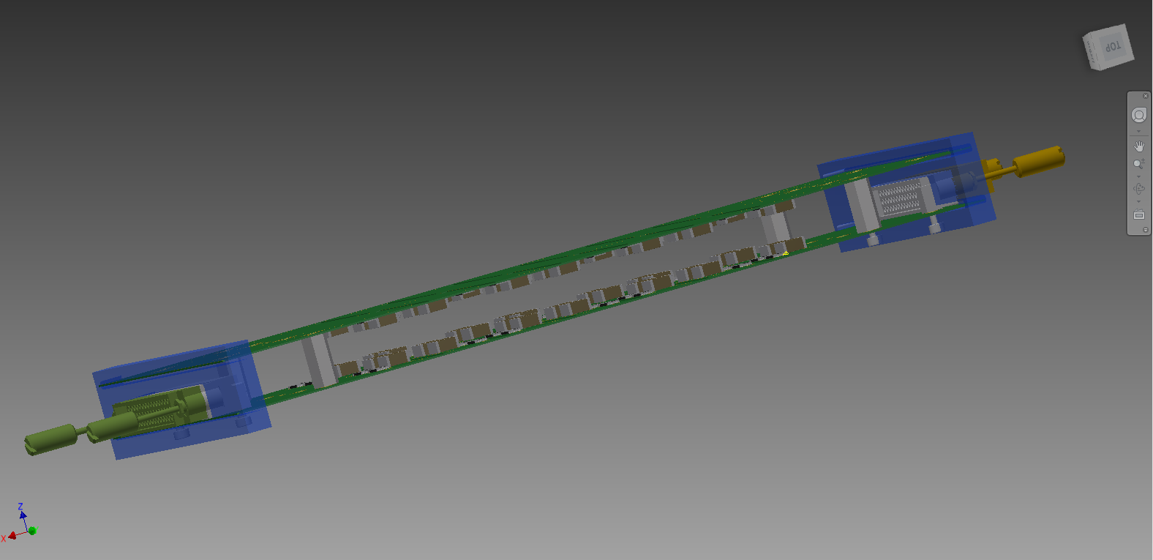
Filter module
Initial idea: two PCBs per module with filters

Slide 6
Filter module
Mechanically independent and insulated modules

Slide 7
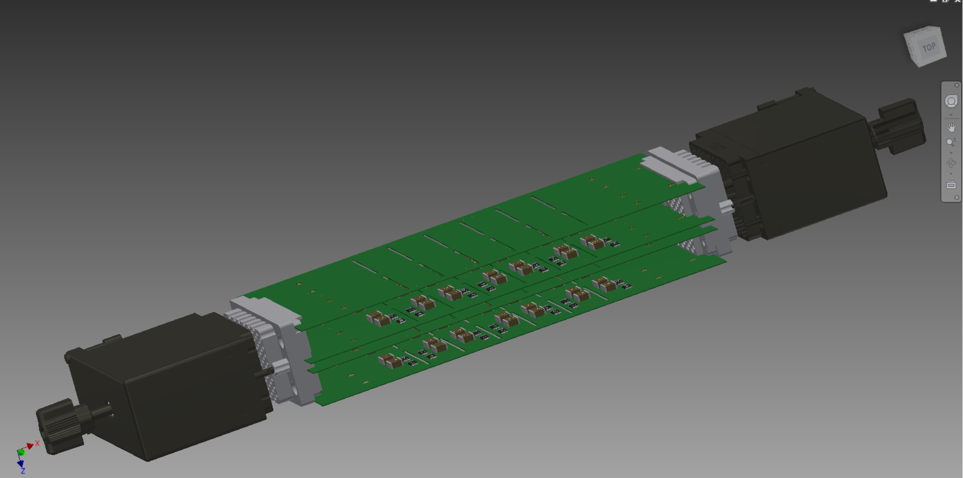
Status of development
Preparing to build initial “Prototype 0”
Will produce 2 equipped boards for basic tests of insulation, mechanics, grounding, noise before end July
I.e. 2 × 14 RC-RC filters mounted 1/RC = 450 Hz
Initial guess (to be corrected): R = 100 kΩ; C = 22 nF
To be replaced with final values later

Slide 8
Connectors
Found potentially interesting connectors from Farnell:
http://www.farnell.com/datasheets/2916873.pdf
Unit price (120 pins, small quant.): 53 € plug; 45 € pins; 26 € connector
To be used for this prototype and replaced later

