Slide 1
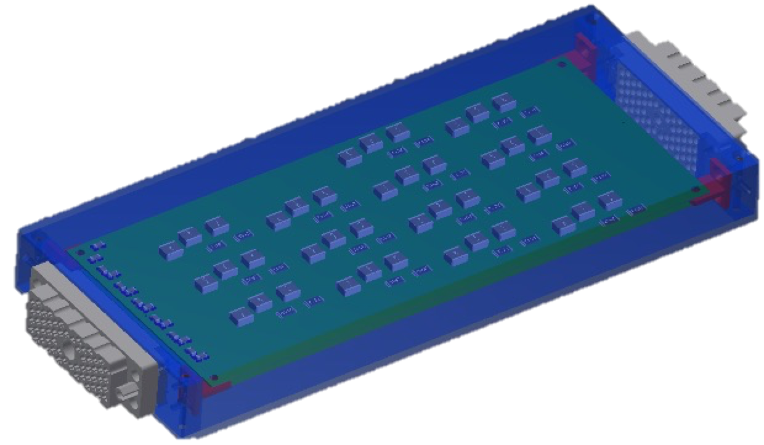
HGTD HV Patch Panels Status
Bengt Lund-Jensen, Lei Fan, Ricardo Gonçalo

Slide 2
HGTD HV Patch Panels
Each of the 8032 HGTD modules will need a bias voltage between -300 V and -900 V, adjusted individually
Electronic noise induced in the DC bias voltage at the power supply or in the cables between USA15 and the detector must be filtered out.
Filter modules (EC-PP) will be installed on the end-cap calorimeter surfaces – filter noise and allow HV channel routing

Slide 3
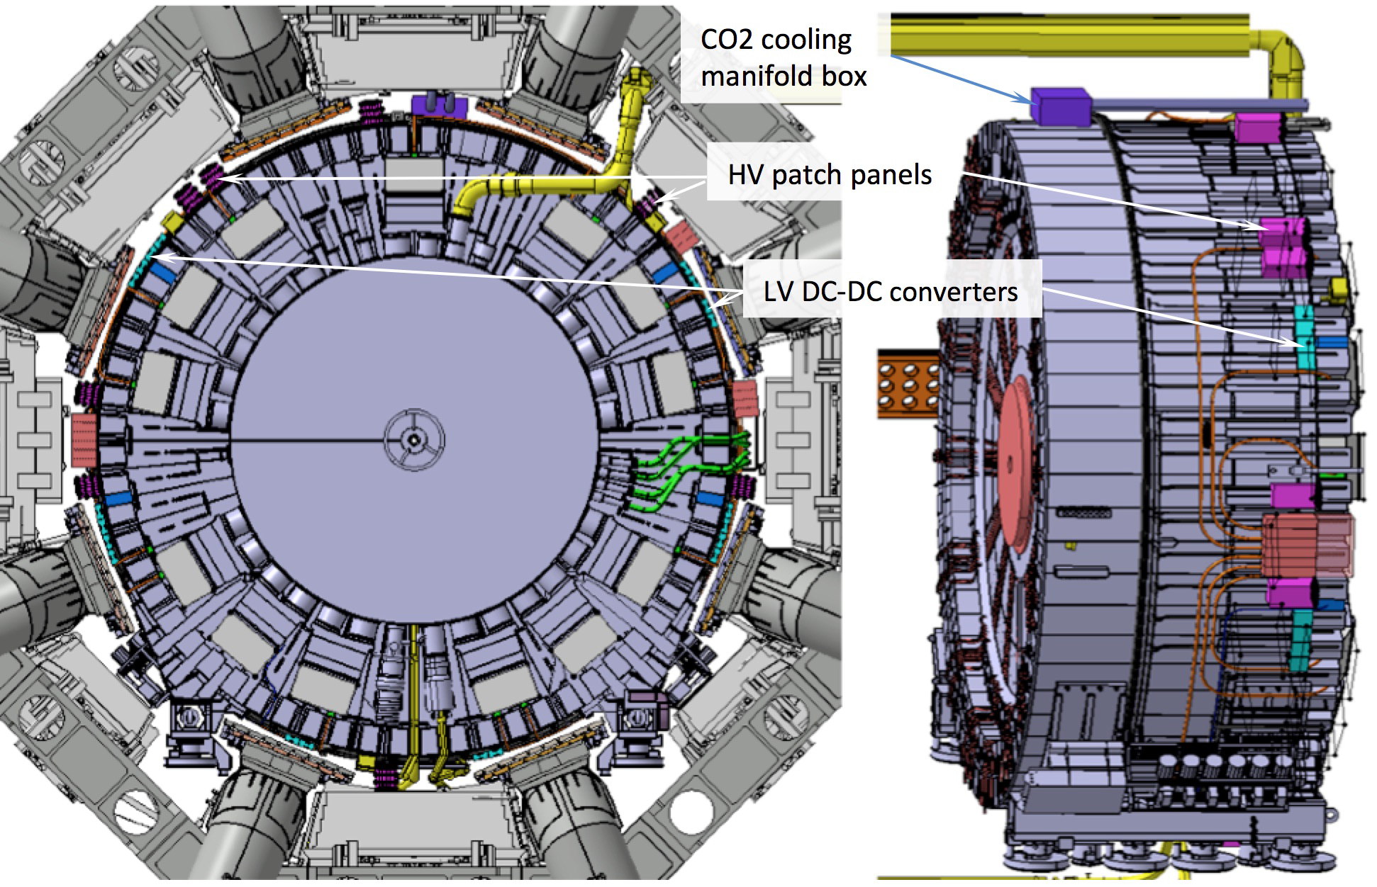
Patch Panel design parameters
Materials to withstand radiation and magnetic field:
TID 15.0 Gy and 1 MeV neq fluence 1.0 × 10¹² cm⁻²
Magnetic field up to 0.5 Tesla
Avoid easily activated and magnetic materials
Avoid extensive use of dielectrics
Mechanical stability and ease of access during shutdowns
Robust connectors
Fixation to Tilecal and cable strain relief staves – to be studied together with Technical Coordination
Space constraints
Around 20cm free in radial direction
Number of wires should present good match to cables from HV supplies

Slide 4
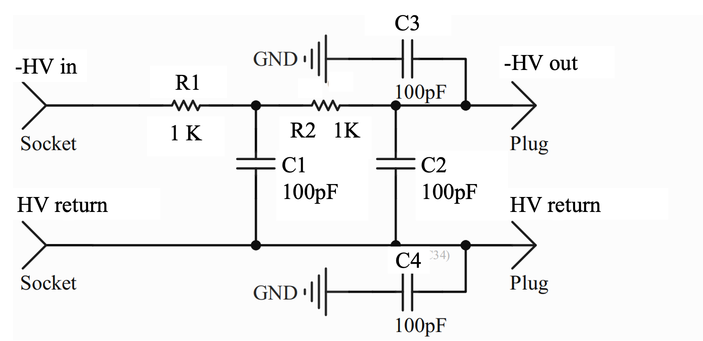
Patch Panel Filter Design
HV routing through fixed wire connections between input long cables from USA15 and short cables to detector modules
2nd order RC-RC low-pass filter to suppress AC noise
Up to -900 V with, no significant leakage, supply currents up to 3 mA per channel
Decoupling capacitors to suppress common-mode noise (C3, C4)

Slide 5
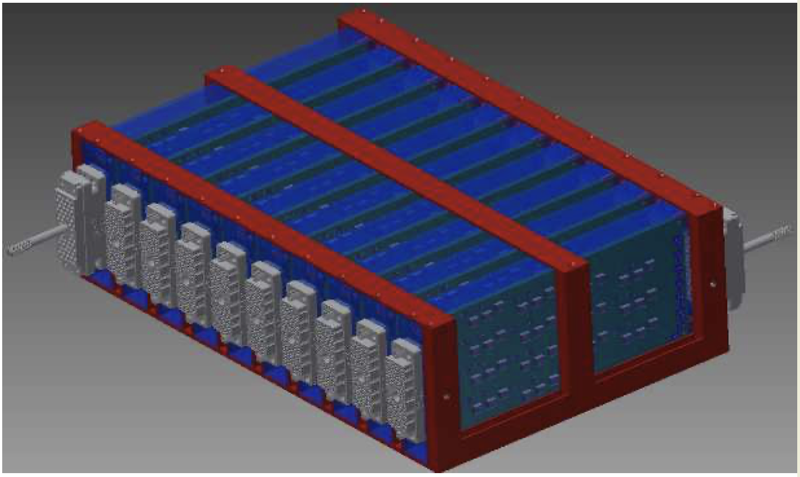
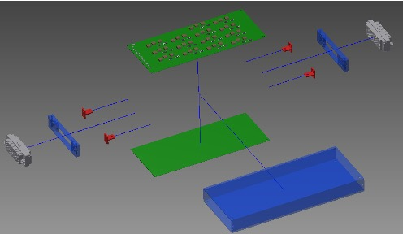
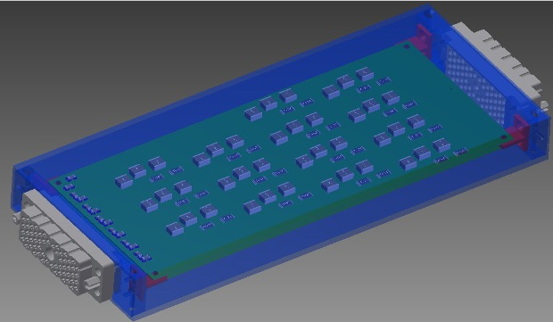
Patch Panel Units Design
A modular design is proposed for the patch panels
Individual modules are aluminium boxes containing two filter boards and connectors
Provide mechanical support and insulate each pair of boards within separate Faraday cage
Easy to construct, handle and access for maintenance
14 RC-RC low-pass filters in each filter board
Means one 56-wire cable connected to each module: = 28 HV channels = 14 channels x 2 boards
Routing of individual HV channels through wires connecting cables to each filter board

Slide 6
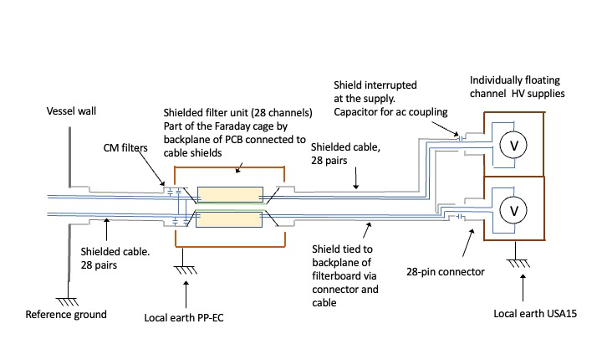
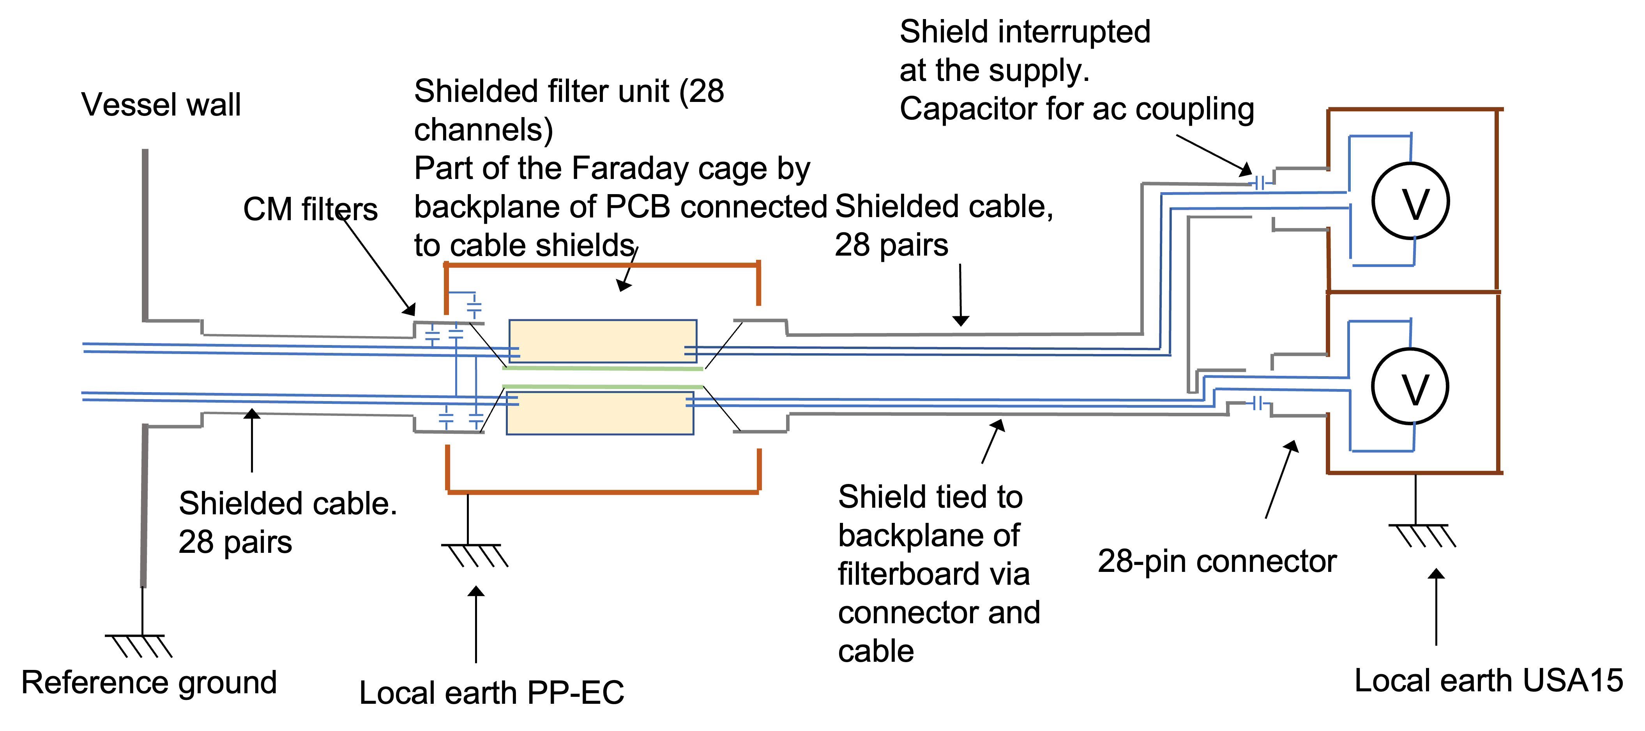
Patch Panel design parameters
Differential HV channels, insulated from the patch panel unit
Module aluminium boxes act as Faraday cage, electrically connected to the Tilecal surface
HGTD earth extends through cable sleeve to filter board backplanes
HGTD/Filter earth insulated from module earth (=Tilecal earth) to avoid ground loops

Slide 7
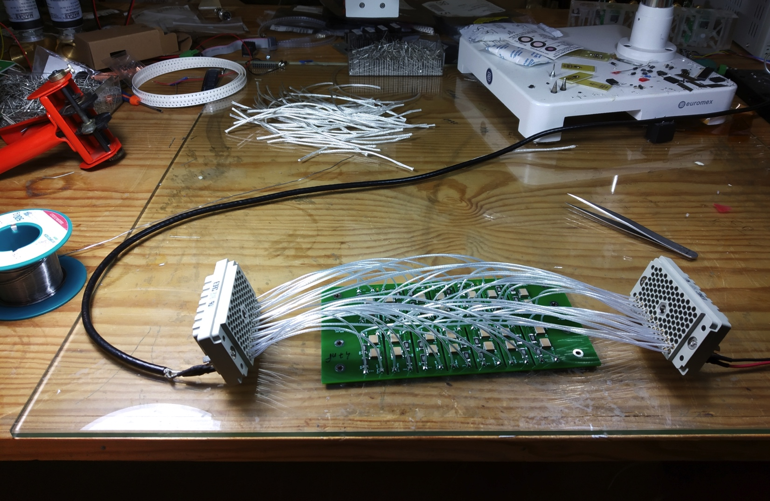
Initial (pre-)prototype tests
RC–RC filter: 10 kΩ x 33 nF or 47 nF
Note R and C not final – must be defined together with sensors and tested together
Assuming 3 mA maximum current means:
60 V voltage drop
180 mW max. dissipation per channel
I.e. 5 W / 24-channel box
Ideal response:
f_{c} = 338 Hz (33 nF) or 482 Hz (47 nF)
-40 dB / decade
Achieved this when tested inside shielding box

Slide 8
Prototype tests and quality control
Planned tests:
Connectivity of components and filter performance tested by measuring the filter response as function of frequency and load
Leakage current
Insulation between internal and external ground.
Cross talk between channels
Temperature under load
Long term reliability including enhanced aging by temperature cycling in a climate chamber
Radiation and magnetic field tolerances
For production:
Based on prototype results will establish set of quality control benchmarks to be done in production and upon delivery

Slide 9
Thanks!

Slide 10
Prototype tests
Response improves with shielding (Faraday cage )
Closer to -40 dB / decade
Response flat above 10 kHz
Other tests foreseen:
Leak current under HV bias – waiting for precision HV module to be free, to ease measurement
Final tests must be done with HGTD HV source prototype

Slide 11
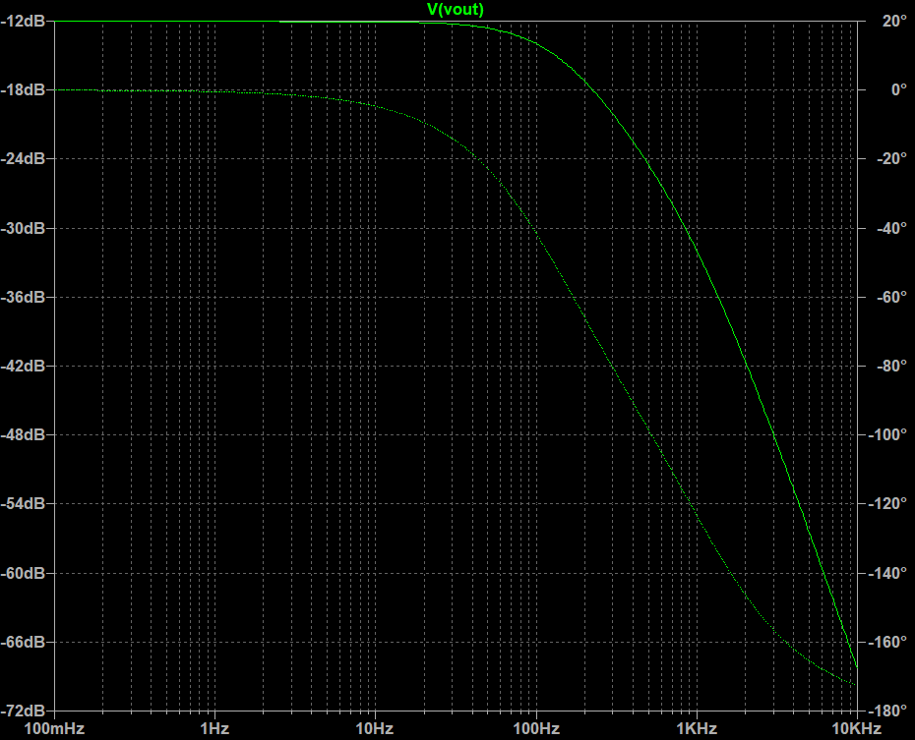
Response curve
Response after adding common-mode decoupling capacitors

Slide 12
Optimising design
Also tried an alternative design to:
Ease assembly: reduces production time and manufacture errors
Improve robustness: assess robustness of routing cables / soldering
Add decoupling capacitors against common-mode noise in each channel
Lower cost:
Especially by reducing length of cable for HV routing
Trying routing in 4-layer PCB

Slide 13
Connectors
REF:516-120-000-101 REF:516-056-000-301 REF:516-120-000-402 REF:516-056-000-402 REF:516-230-512 REF:516 230-556
Found potentially interesting connectors from Farnell:
http://www.farnell.com/datasheets/2916873.pdf
Unit price (120 pins, small quant.): 53 € plug; 45 € pins; 26 € connector
To be used for this prototype and replaced later

Slide 14
Measurements
Difficult to measure low-frequency behaviour with our current setup due to output capacitor in waveform generator

