Slide 1
HGTD Patch/Filter Panels
Luis Lopes, Orlando Cunha, Ricardo Gonçalo
LIP - Portugal

Slide 2
Outlook
LIP interested in producing HV patch/filter panels
First meeting with Bengt Lund-Jensen, Sergey Malykov, Ana Henriques, João Guimarães (thanks!)
First idea now formed, but we need more information to continue

Slide 3
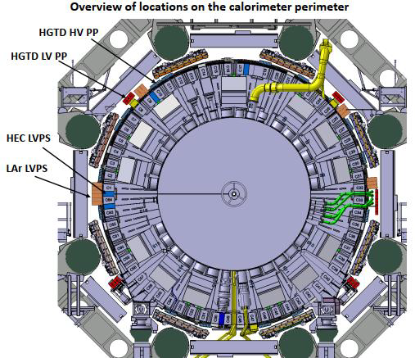
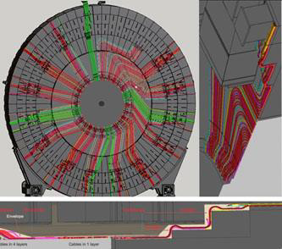

Slide 4
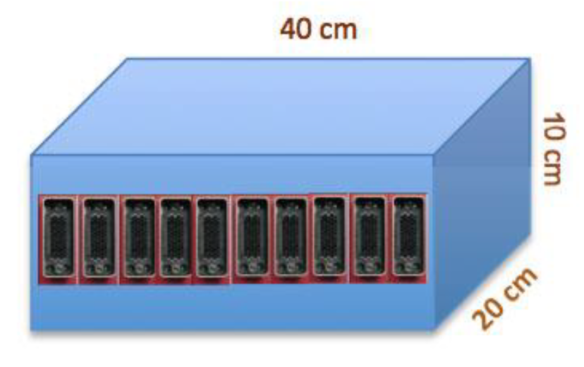
Current understanding
Originally: patch panels map 11 cables (x48 wires) to 10 cables and filter HV
BUT current thinking is: filter boxes near detector and separate HV patch panels in USA15
Probably easier design and better accessibility to each channel
Filter boxes:
16 boxes / endcap
In & out: 10/11 cables of 24 pairs (48 wires) each
Means 240/264 filters / box
Low-pass filters (RC-RC)
From Sergey’s slides

Slide 5
Requirements:
Magnetic field: must withstand 0.5 T
Activation: use Aluminium and avoid steel
Grounding:
Floating cable pairs – not connected to box (Faraday cage)
Cable shielding connects to power supplyfloating shield, not filter box
Grounding scheme in Bengt’s talk 2 weeks ago

Slide 6
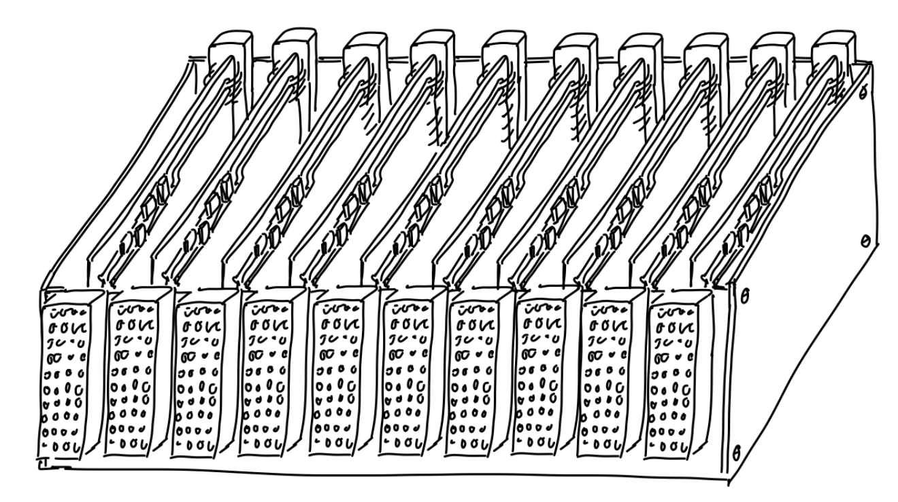
Simplest solution for filter boxes
1 cable in / 1 cable out (48 pairs/cable)
Assuming RC-RC filter with discrete SMD components
24 channels / board
Can use both sides of each board if needed

Slide 7
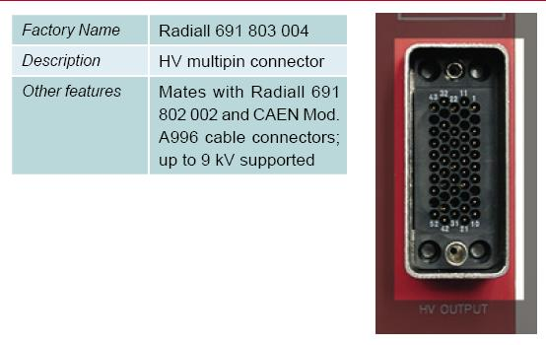
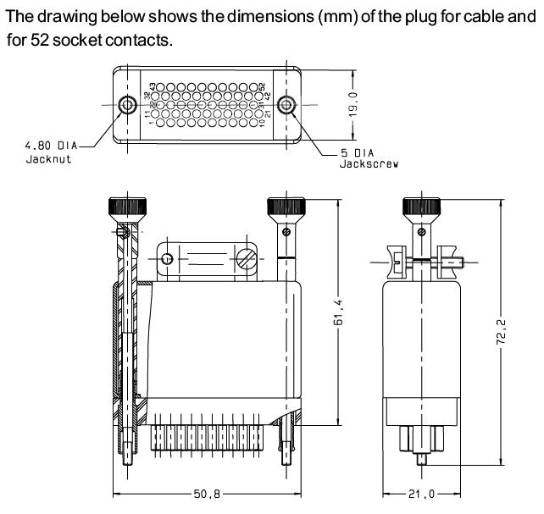
Identified possible connector:
52 HV pins
Insulator : Thermoplastic UL94V0 - halogen free and rad.hard
Backshell & shroud : Aluminium alloy nickel plated
Locking device : Stainless steel and nickel plated copper alloy
Can probably be replaced
Contacts : Copper alloy gold over nickel plated.
Notes:
Already used in ATLAS & etc
Expensive?
19mm wide plus margin should be easy for 10/11 in 40cm box – anything we’re missing?

Slide 8
Questions:
Need more information to proceed:
Is this design suitable or do we need other options?
Filter characteristics?
Identified range of SMD components but need to know values of capacitance and resistance
What power / current per channel?
Is there a list of allowed materials / components?
Any limits on cross-talk between channels?
Accessibility and ease of maintenance:
In case of failure assume whole box is taken to repair? Or best to access individual boards?
Anything else we’re missing?
Once the above are understood we can make proper design and start testing
Would be very useful to decide which connector will be used
Would it be possible to obtain one LGAD of the type we’ll use?

