Slide 1
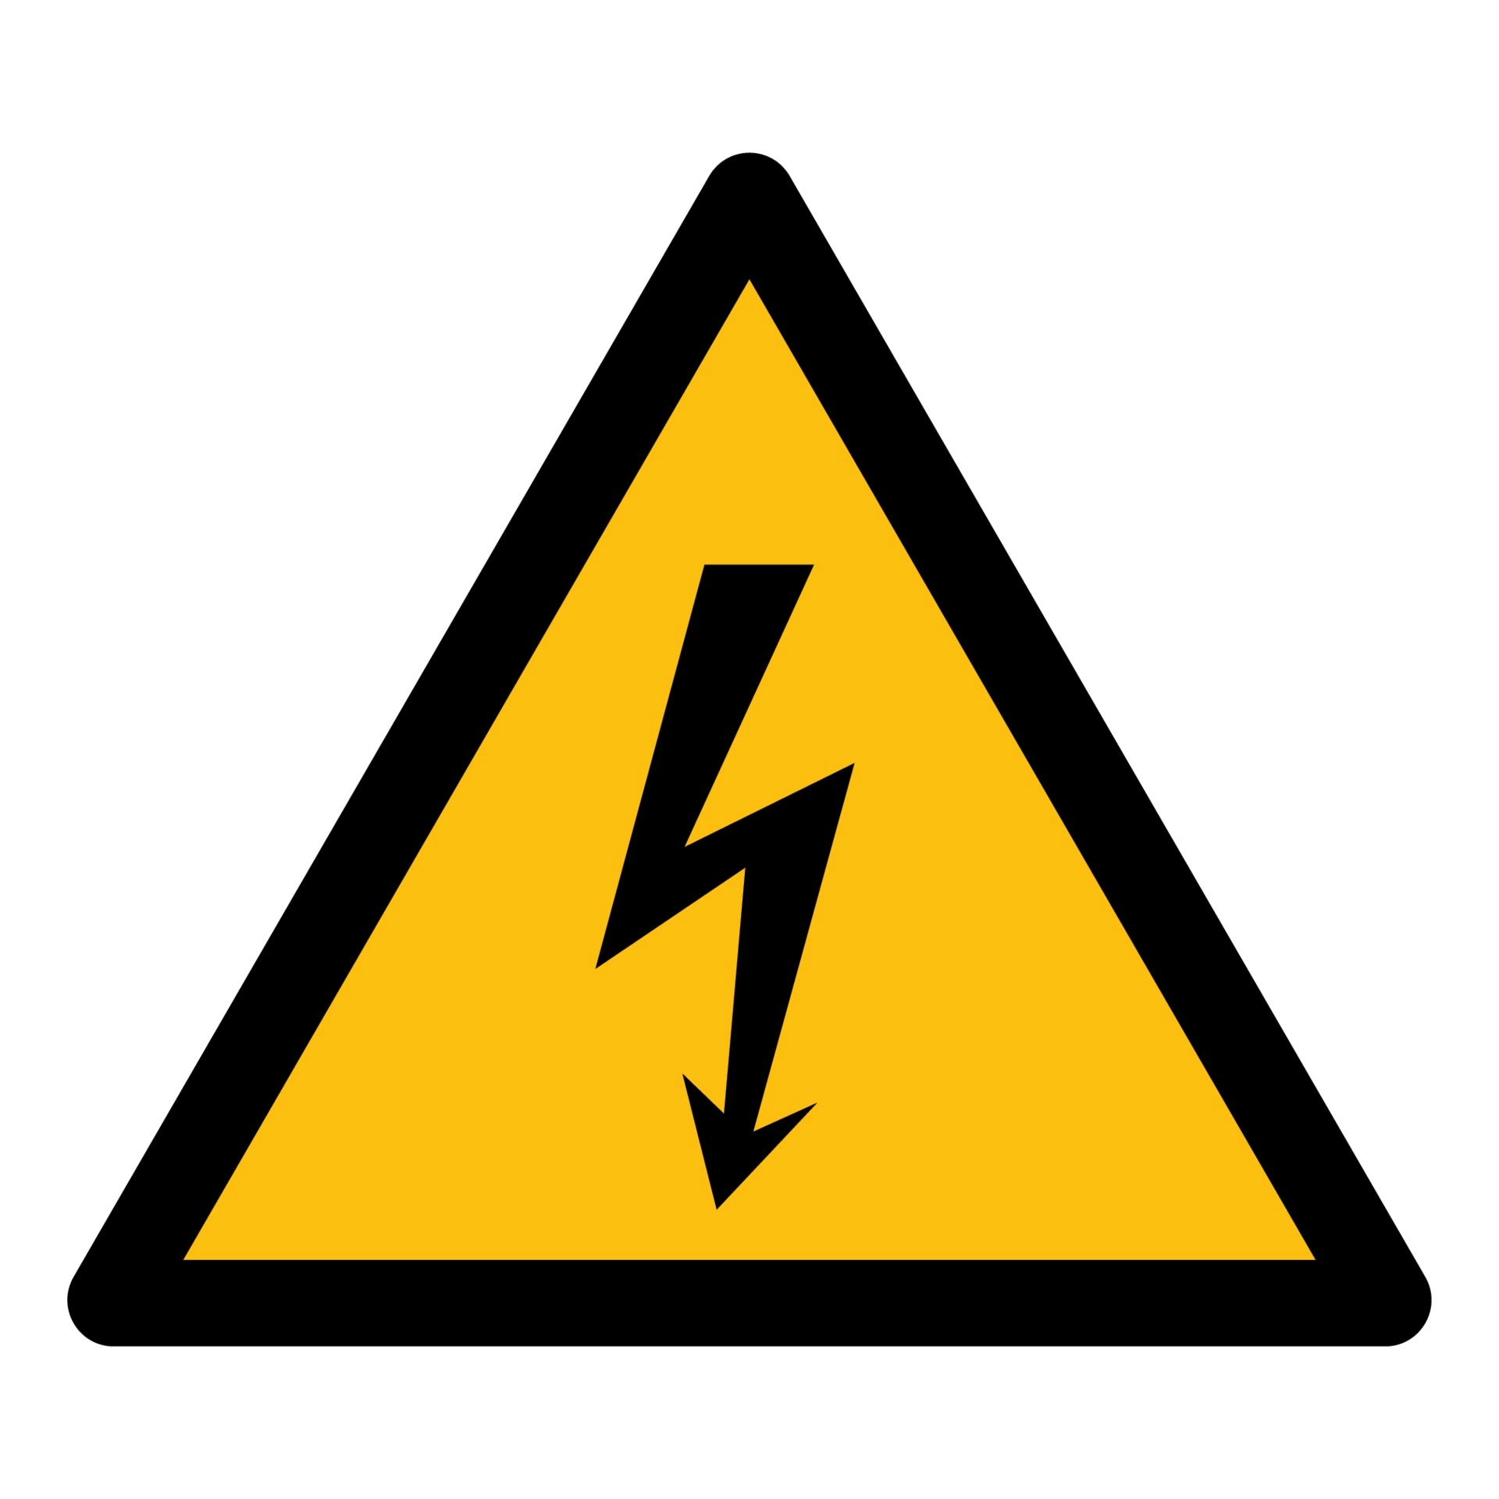
HGTD Cables and Connectors
Ricardo Gonçalo (LIP/Univ. Coimbra)

Slide 2
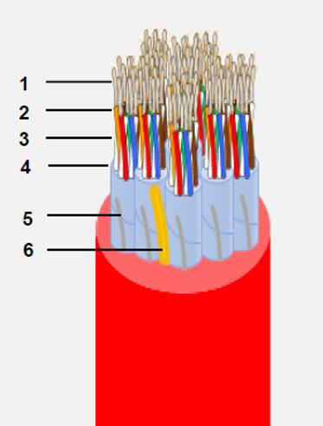
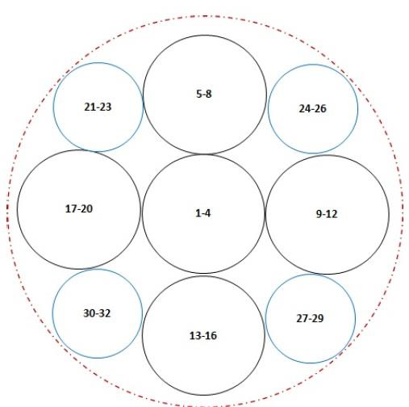
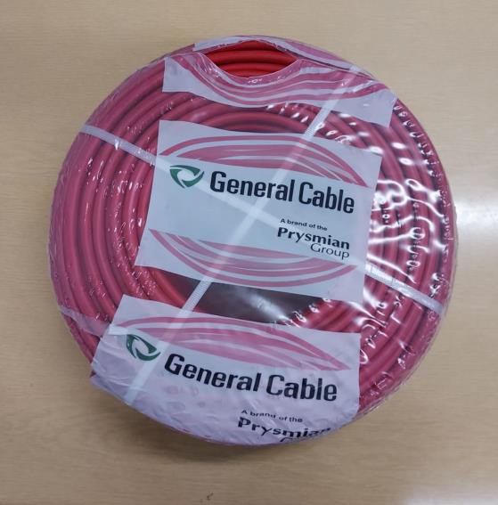
Cables: from TileCal (General Cable)
Last version not good in fire test – needed to change insulation thickness
Two new prototypes are being produced – to be done this week or next
Circular section, unlike last one
Expected diameter 13.5– 14 mm

Slide 3
Connectors
REF:516-120-000-101 REF:516-056-000-301 REF:516-120-000-402 REF:516-056-000-402 REF:516-230-512 REF:516 230-556
We have been using this one for Patch Panel development:
http://www.farnell.com/datasheets/2916873.pdf
Unit price (120 pins, small quant.): 53 € plug; 45 € pins; 26 € conector (old price)
Good mechanical stability
Looks good for long-cable to
Patch Panel conneciton

Slide 4
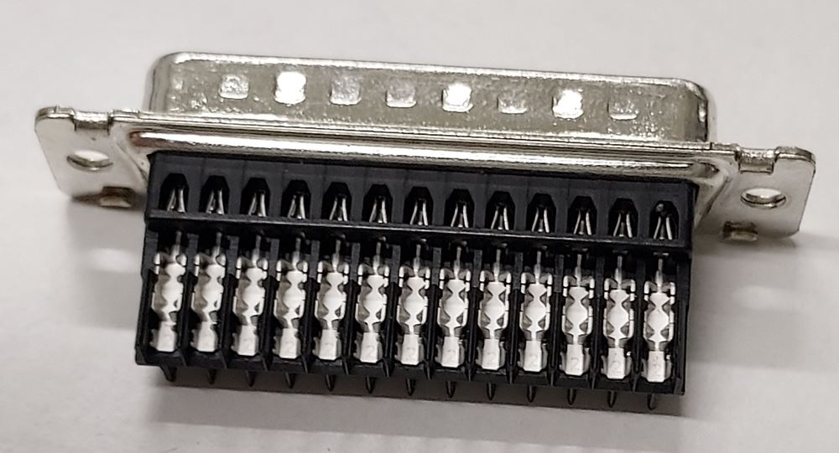
IDC Connectors – from Agostinho Gomes
CERN BE-EA Cabling Team suggested Insulation Displacement Crimping Connectors (IDC)
Found IDC connectors from TE suited for solid copper wires: https://pt.farnell.com/amp-te-connectivity/1-745495-8/socket-idc-d-metal-25way/dp/1098474?CMP=GRHB-OCTOPART https://www.farnell.com/datasheets/1639165.pdf
Tested the connectors
From the shelf their voltage limitation is low: sparks appear around 1.6 kV in any of the 2 rows, but not inter rows
Is it a problem? Neither for ground pins nor for HV pins (max voltage difference is 360 V), but it is a problem for pin 13 (drain wire) that has a neighbour at HV.

Slide 5
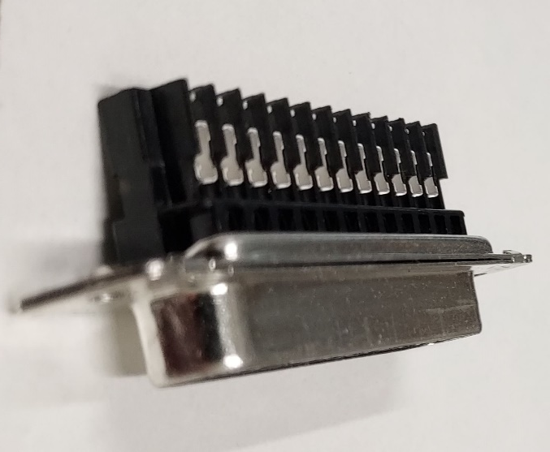
IDC Connectors fix using Araldite epoxy
Weak point is a ~1 mm wide line where the pin to pin lateral insulation is cut/missing
Distance between sharp metallic contacts of the order of 0.5 mm, prone to generate sparks above 1.5 kV
After insertion of the wires, covering the contacts with Araldite epoxy provides excellent insulation between adjacent pins
Limit for sparks in the connector jumps to ~2.7 kV

Slide 6
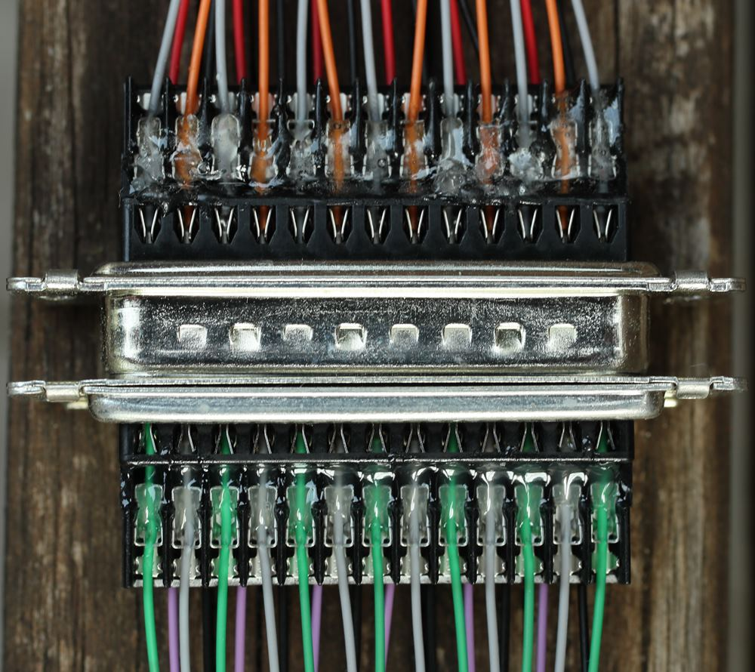
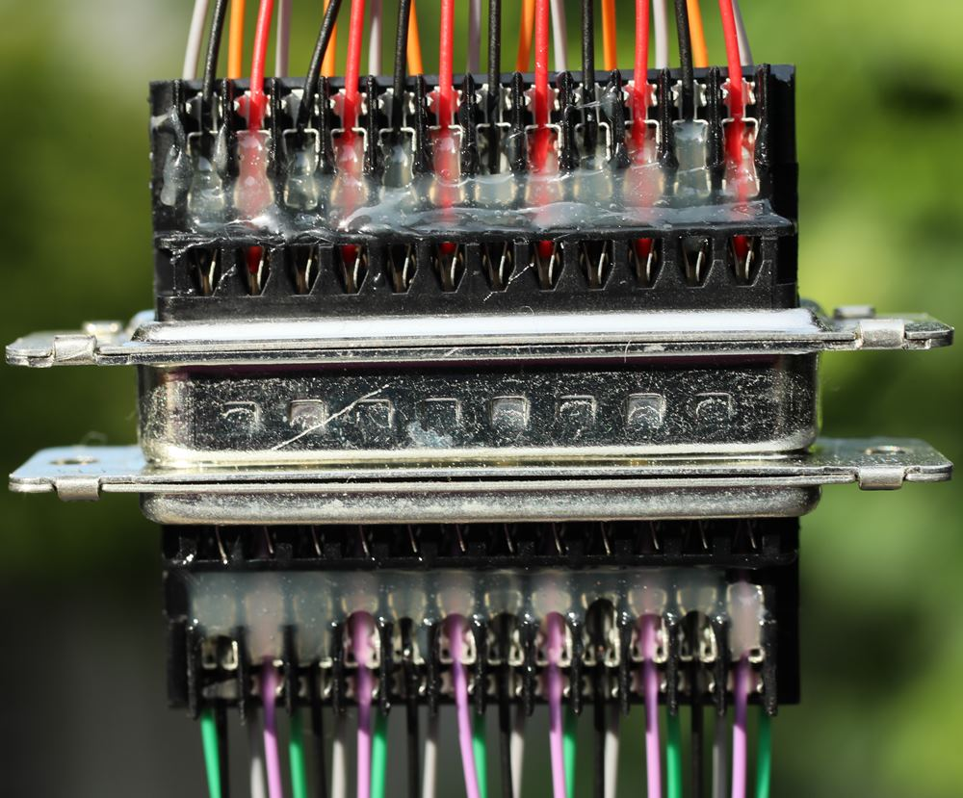
IDC Connectors with Araldite
First test with a “slow” epoxy
Araldite epoxy, thick layers after 2 applications
As a bonus, the epoxy strengthens the wire connections
First test with a “5 min” fast araldite epoxy, only a thin transparent layer of epoxy

Slide 7
Bonus slides

Slide 8
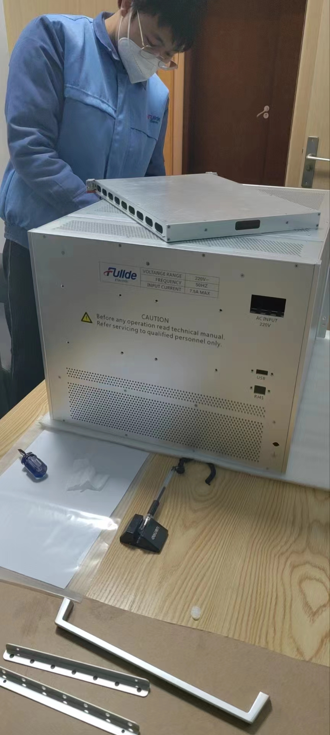
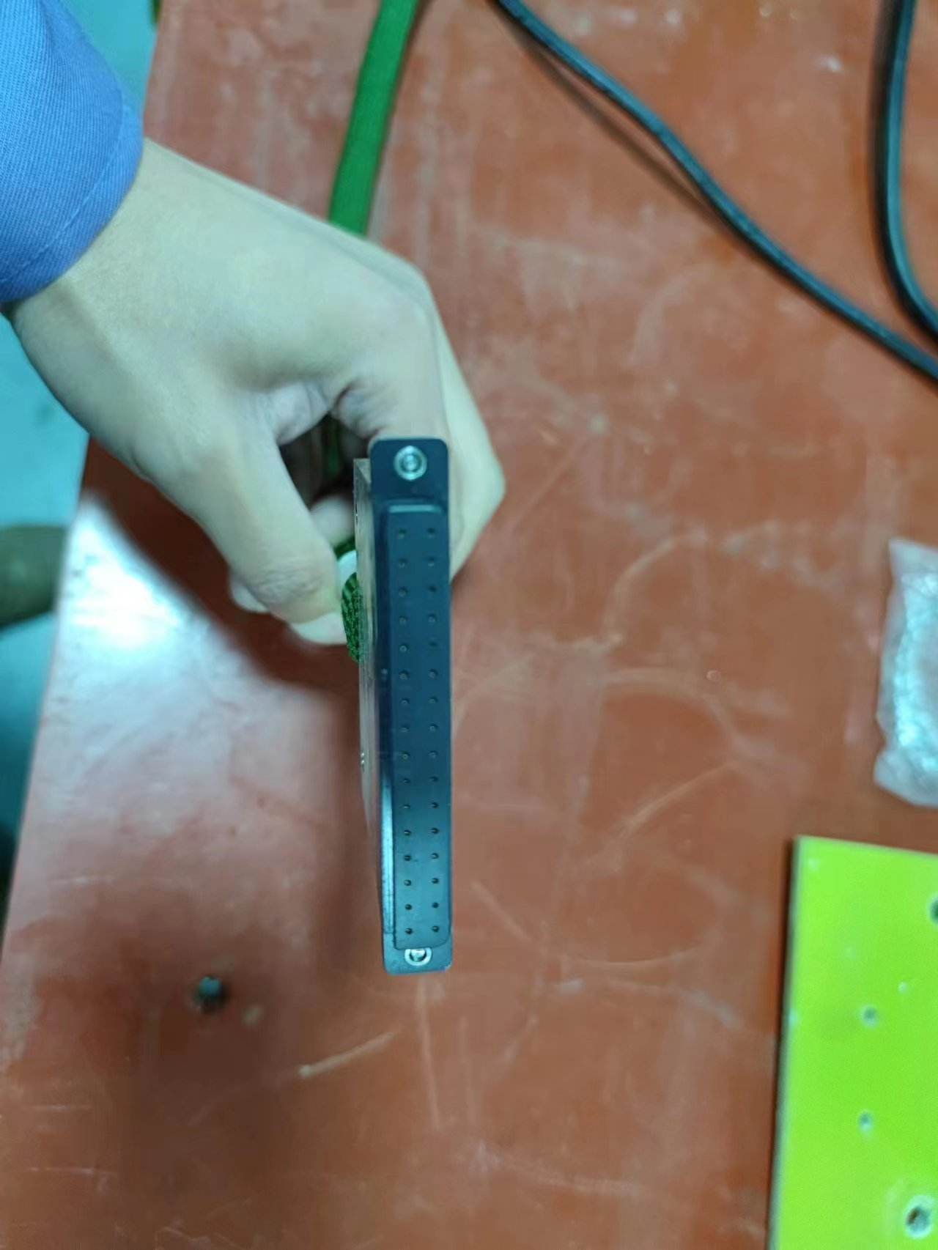
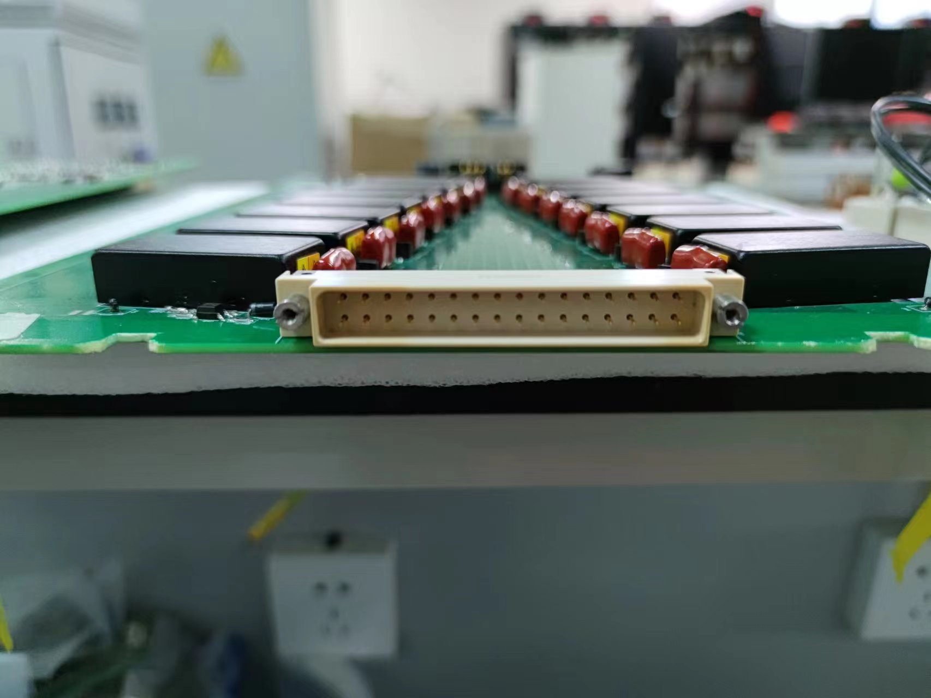
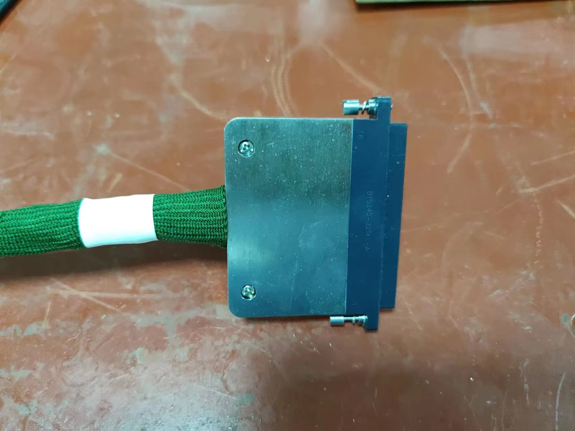

Slide 9
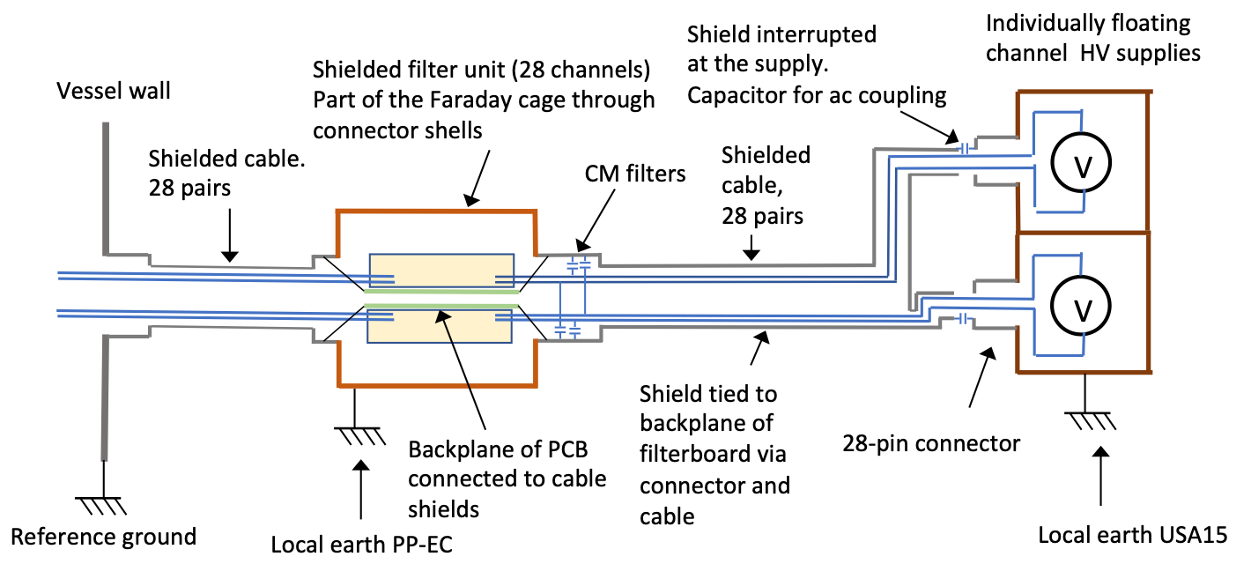
Patch Panel Grounding & Shielding
Use filter module boxes as continuation of vessel Faraday cage
Also DC connecttion of filter boards backplane to cage
DC connection of Faraday cage to local TileCal earth
DC current not as bad as HF AC noise
Move common-mode filter capacitors to filter input instead of output
Filter common mode current at input

Slide 10
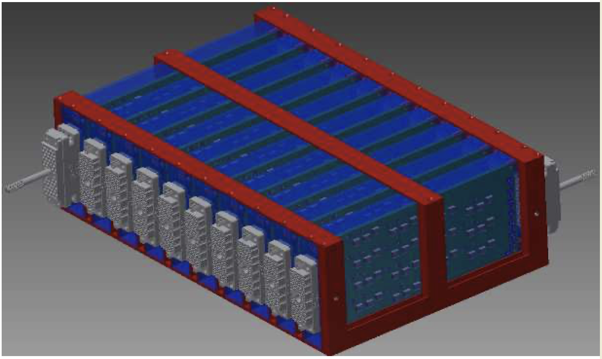
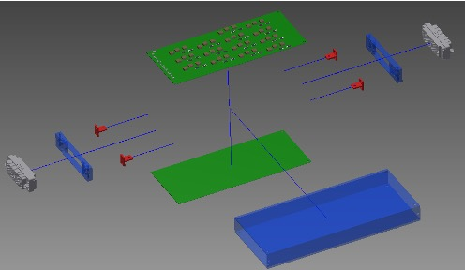
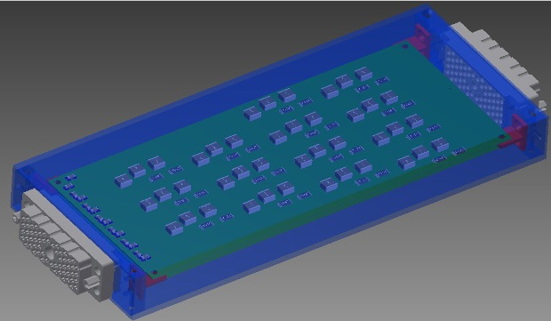
Patch Panel Units Design
A modular design is proposed for the patch panels
Individual modules are aluminium boxes containing two filter boards and connectors
Provide mechanical support and insulate each pair of boards within separate Faraday cage
Easy to construct, handle and access for maintenance
14 RC-RC low-pass filters in each filter board
Means one 56-wire cable connected to each module: = 28 HV channels = 14 channels x 2 boards
Routing of individual HV channels through wires connecting cables to each filter board

Slide 11
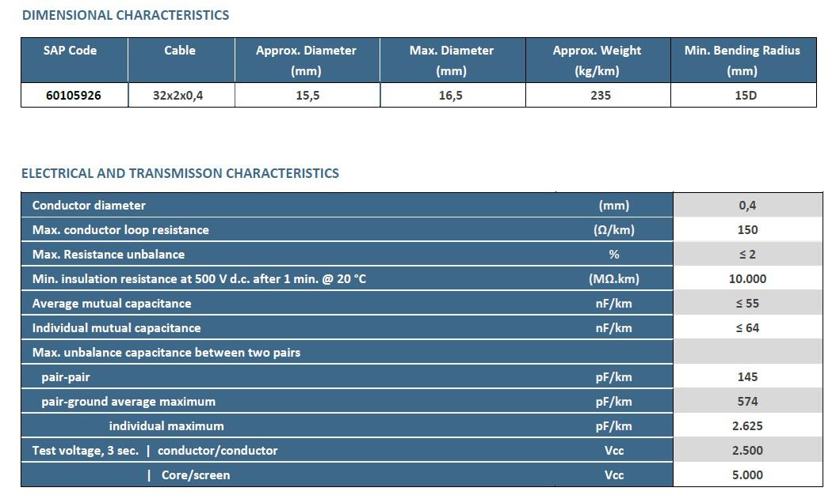
Old prototype

