Slide 1
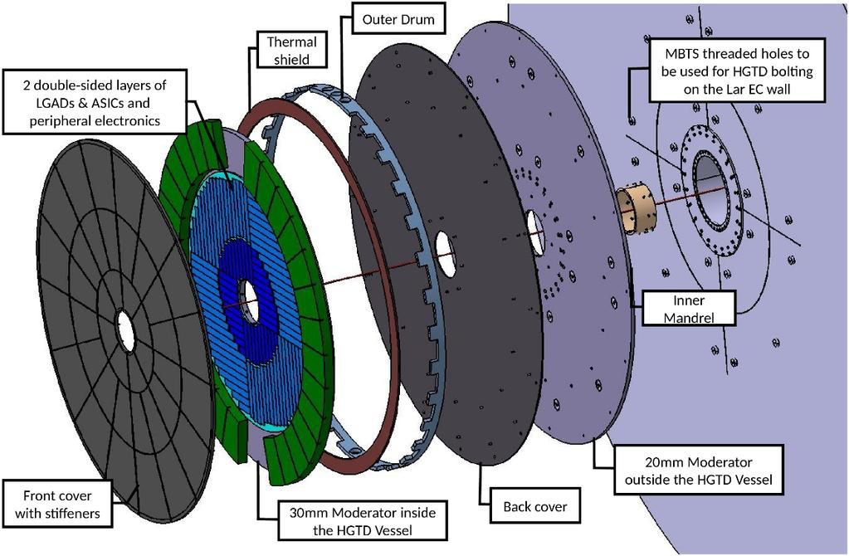
LIP – Joining Proposal

Slide 2
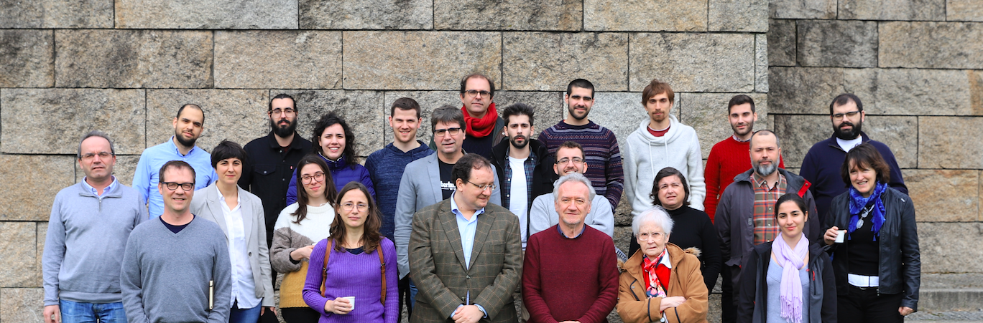
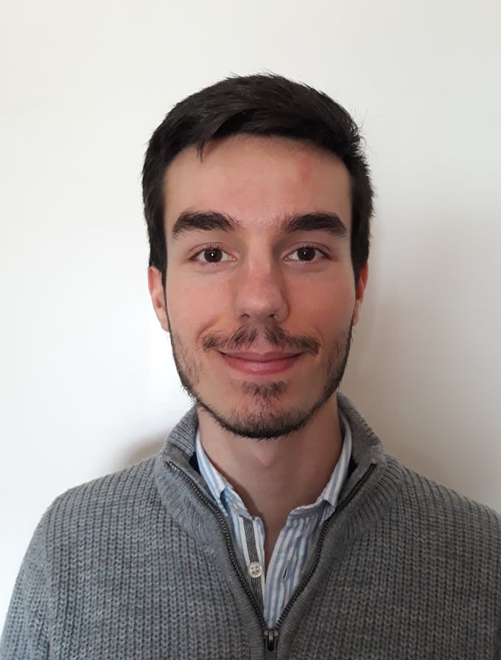
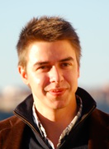
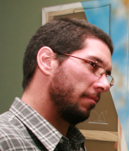
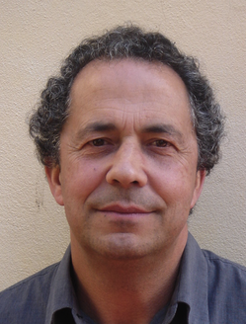
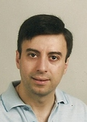
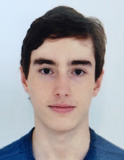
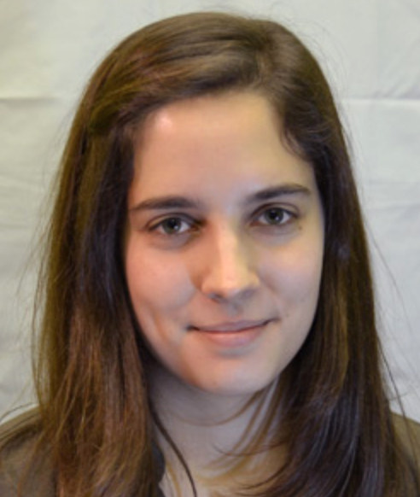
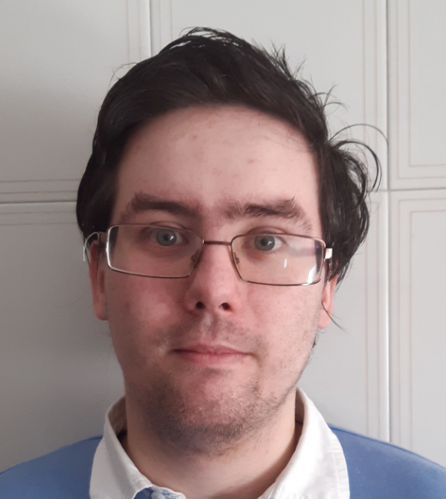
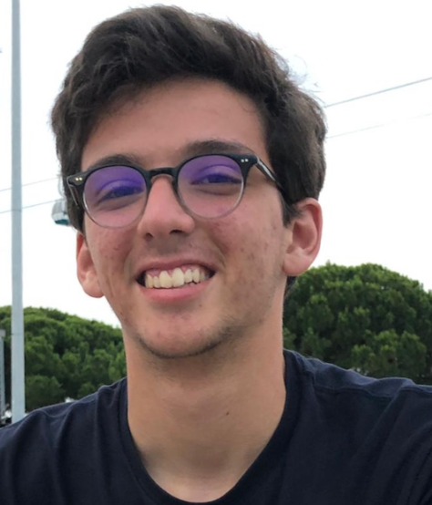
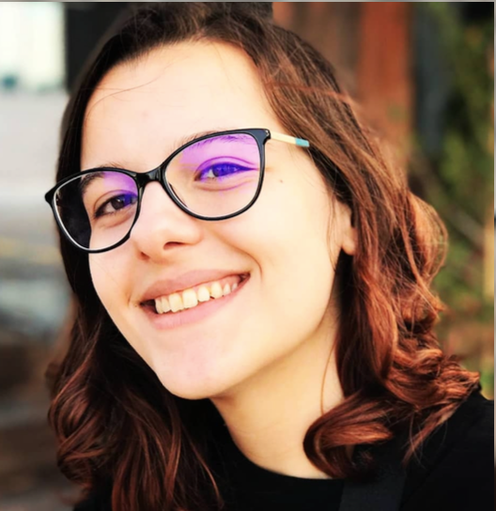
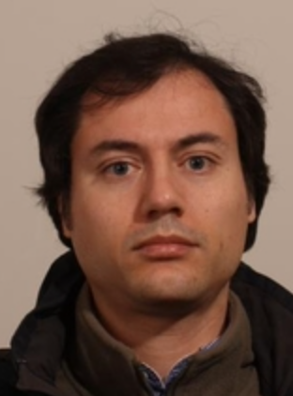
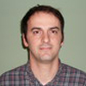
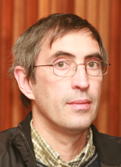
Portuguese ATLAS Team
National group:
LIP (Lisbon, Coimbra, Minho), IST, FCUL, FCTUC, U. Minho, CFNUL CEFITEC/UNL, INESC, CFMC, AdI engineer training program

Slide 3
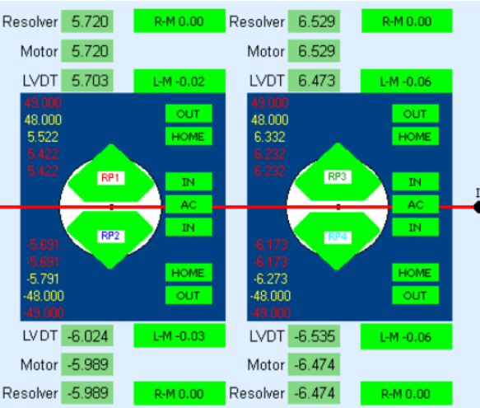
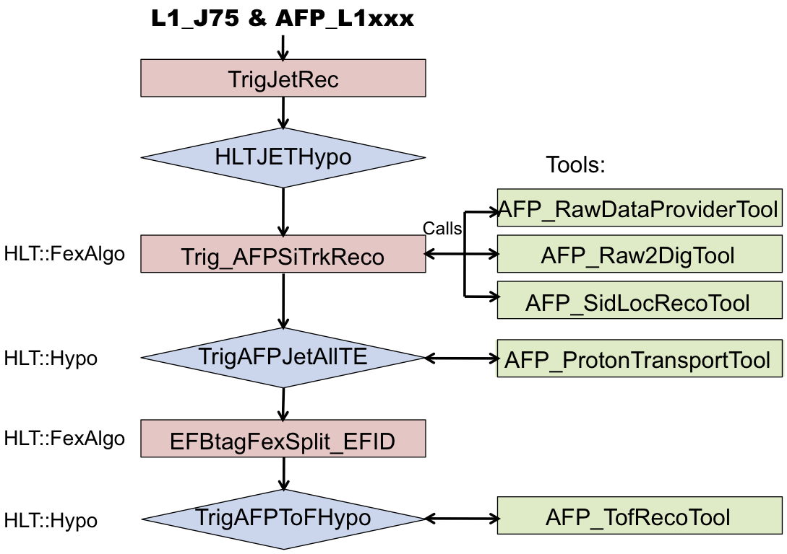
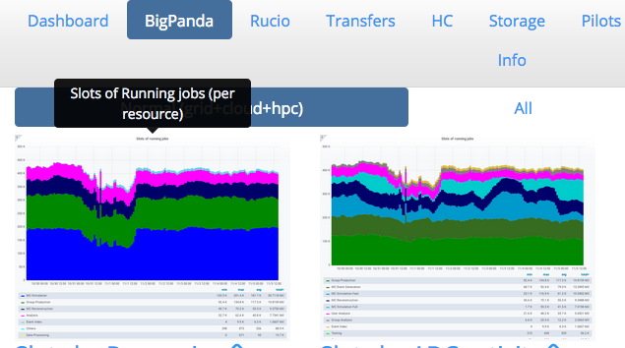
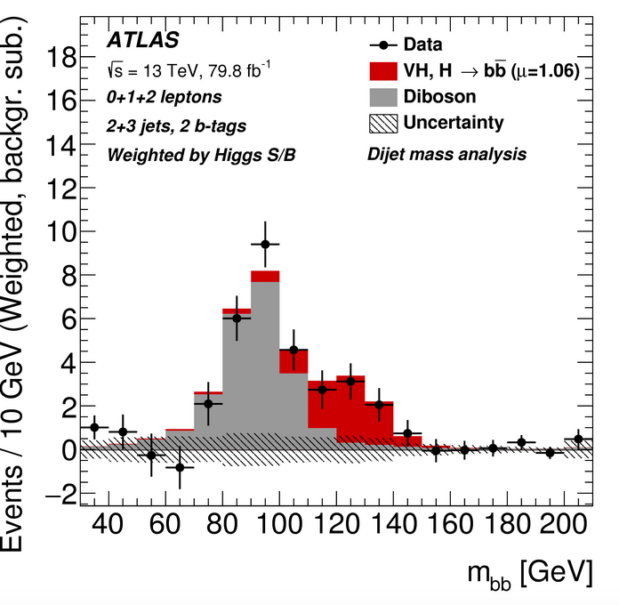
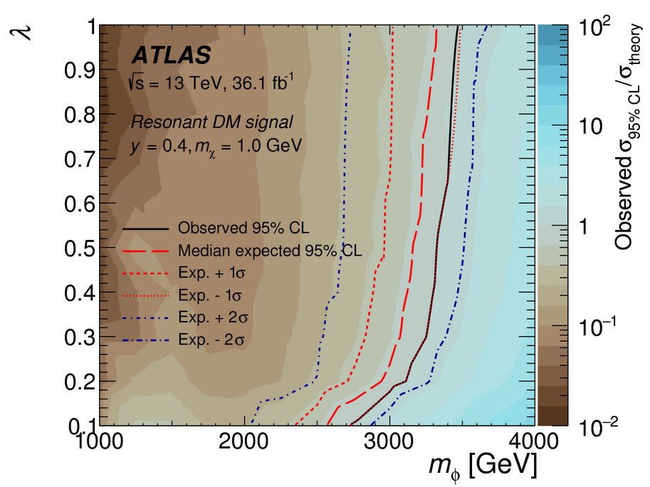
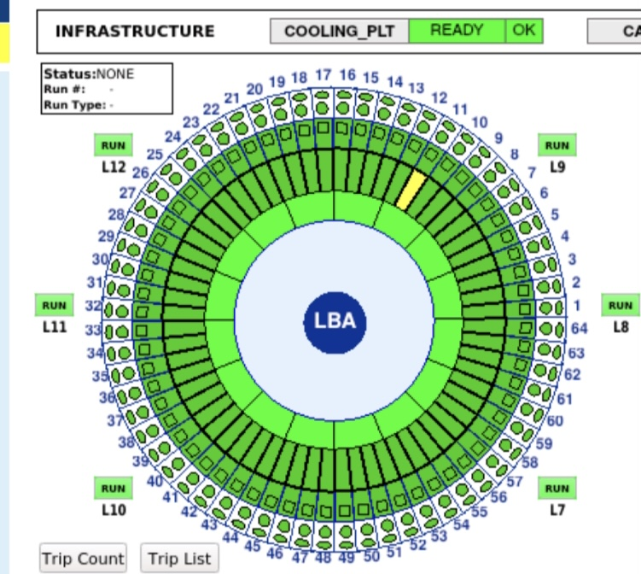
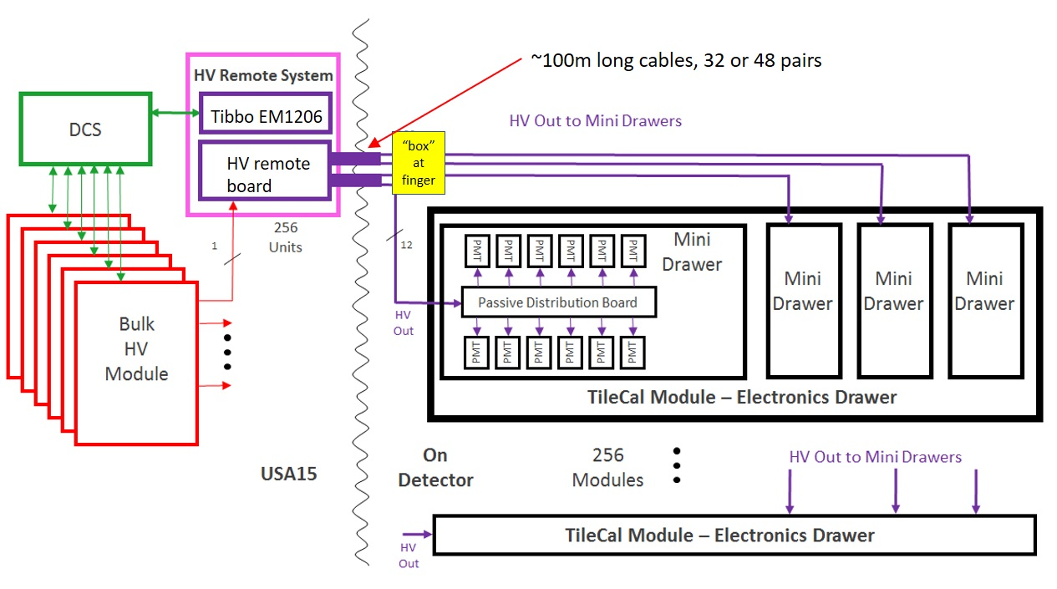
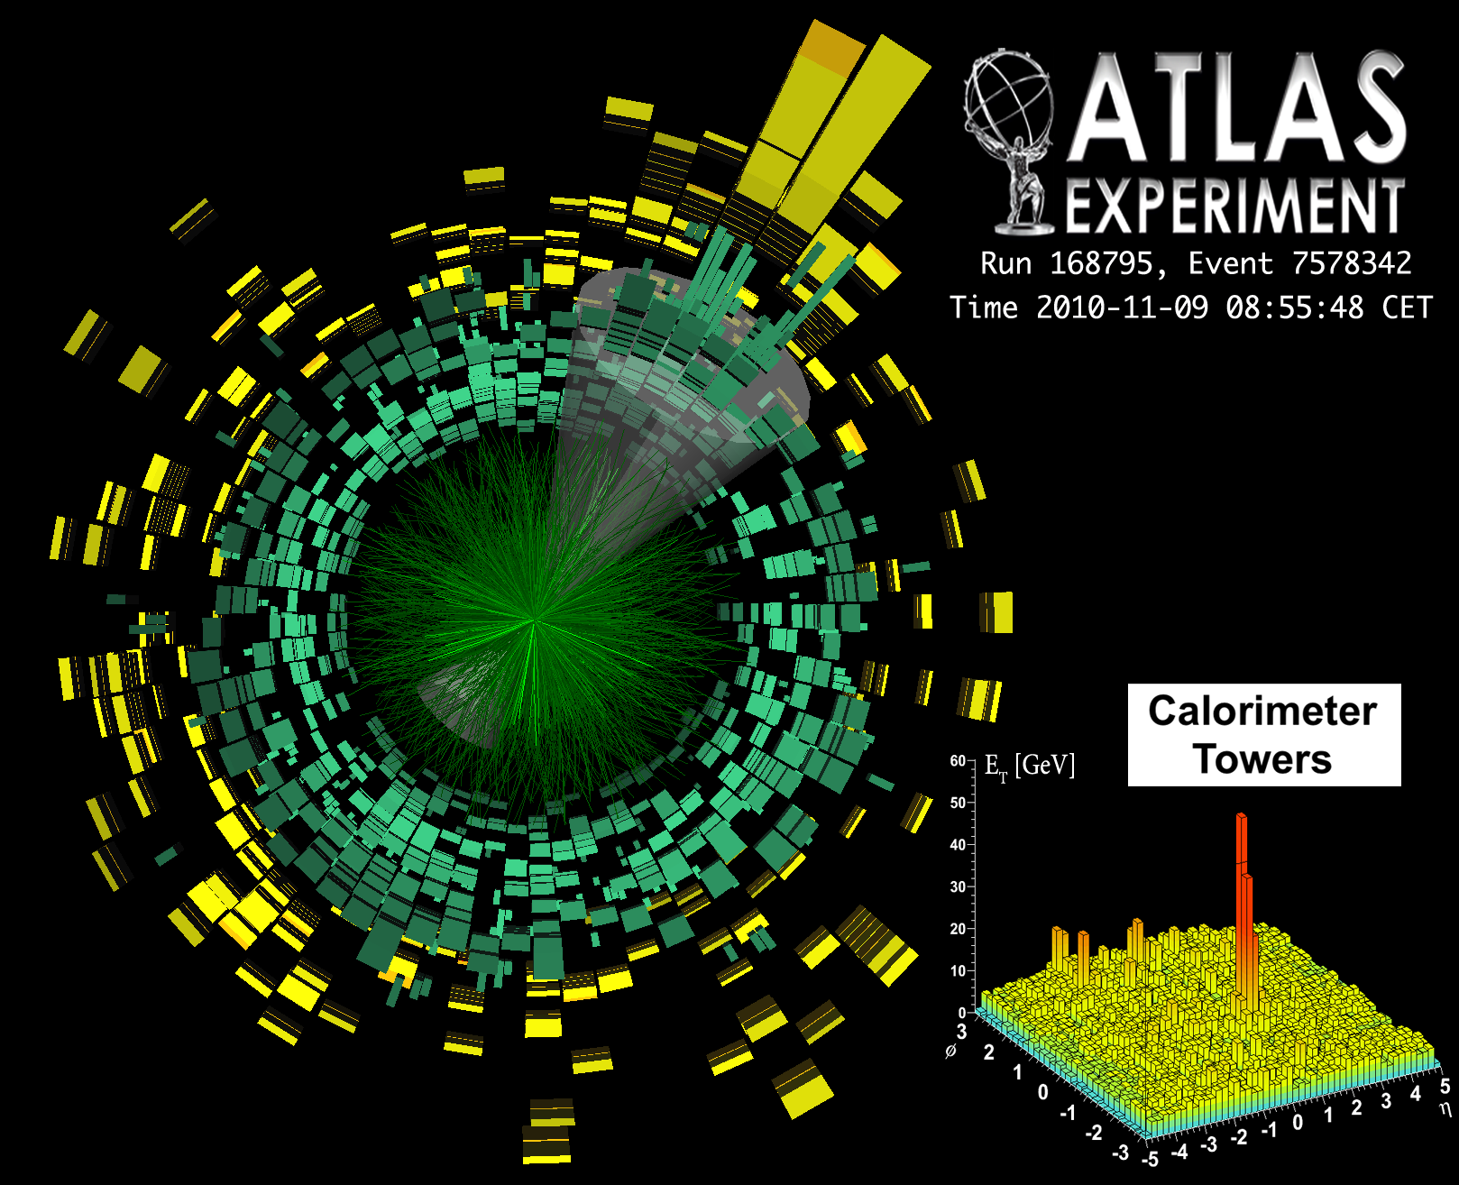
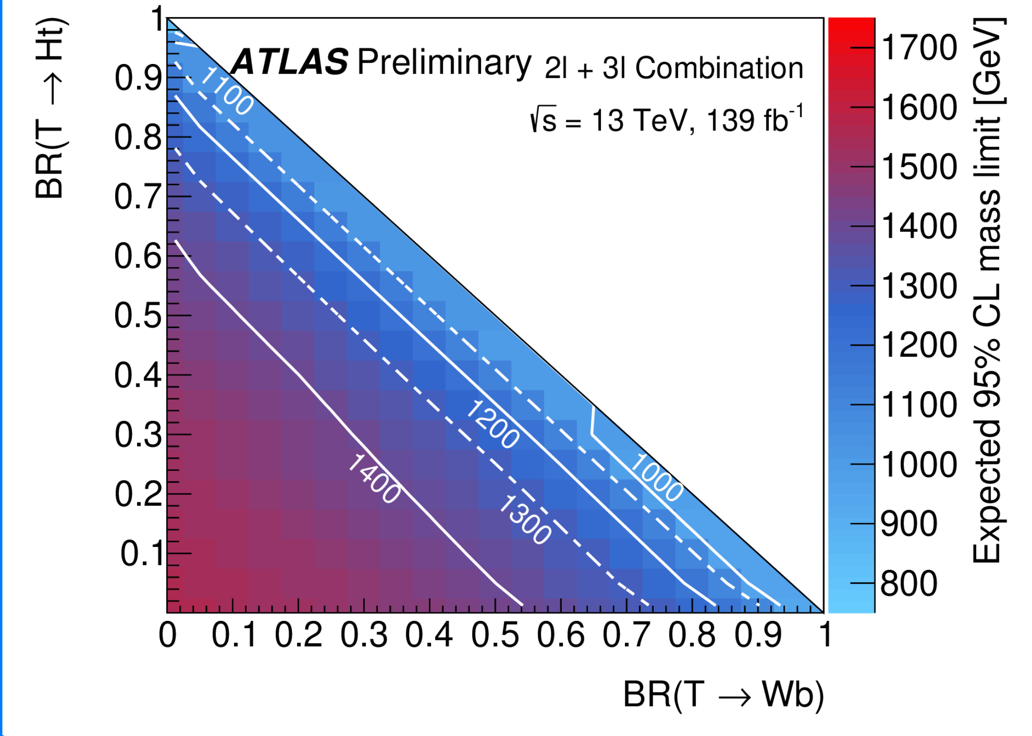
Current Portuguese Contributions to ATLAS
ATLAS Roman Pot DCS and HLT
Jets HLT
Physics:
Higgs, Vector-Like Quarks, top, heavy ions, forward physics, Dark Matter
Distributed computing
Iberian Cloud Coordination
Co-leading ARP DCS
TileCal Upgrade
HV distribution system
Leading TileCal DCS

Slide 4
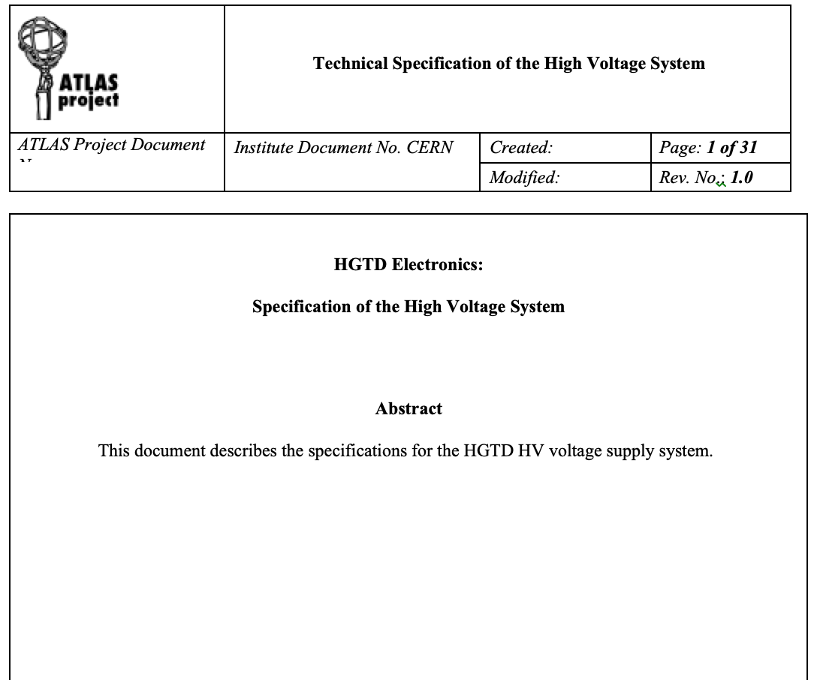
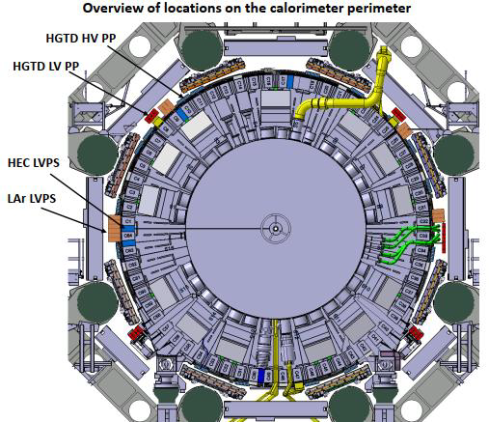
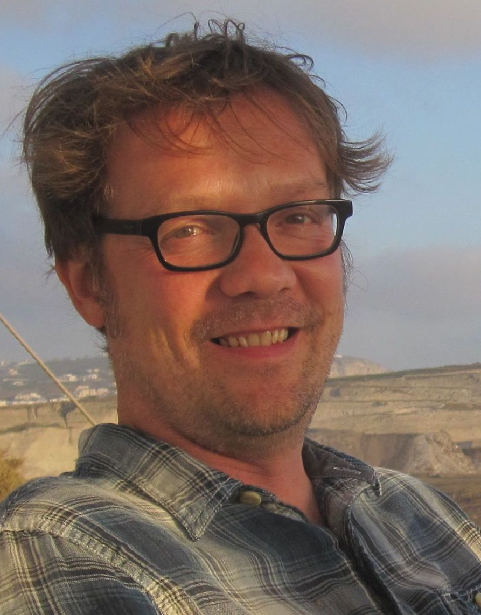
HGTD Involvement: HV Patch Panels
Producing HV patch panels CERN group:
16 patch panel boxes located around the calorimeter perimeter
Routing of High Voltage to HGTD detector
Filtering out AC noise
Preliminary layout done and prototype tested
Contributing to Specifications Review (SPR) document
Ricardo coordinating Patch Panels (L3)
Team: 2 engineers, 1 academic
Luís Lopes
Orlando Cunha
Ricardo Gonçalo
Notes:
Possibilities: TDAQ and DCS

Slide 5
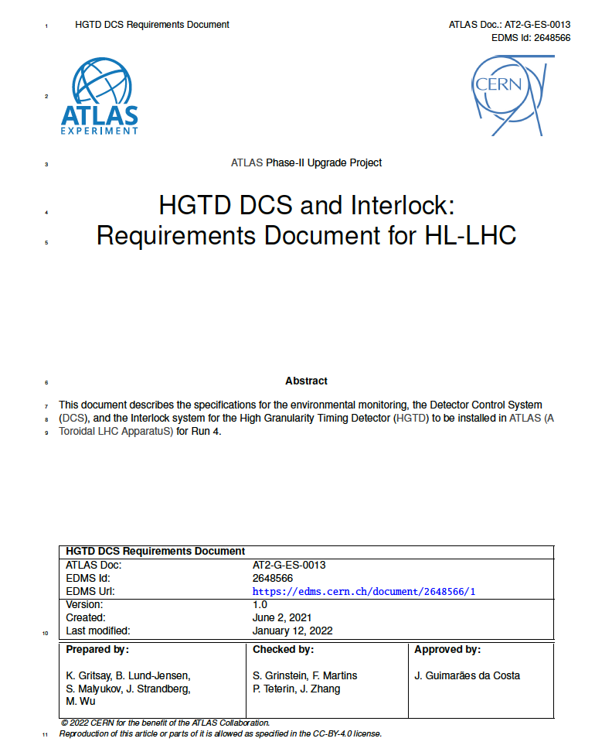
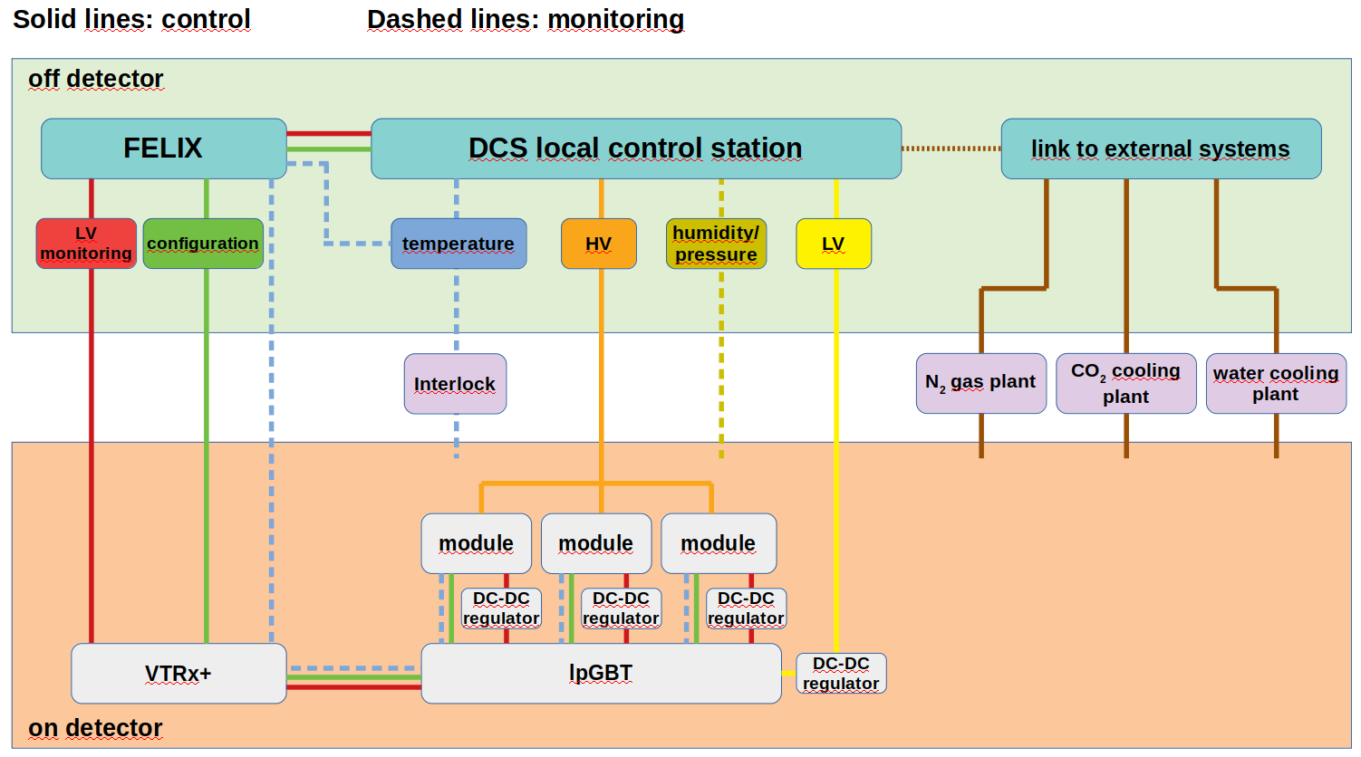
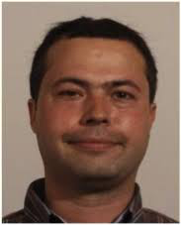
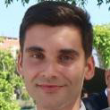
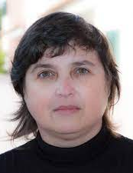
DCS and Interlocks
HGTD DCS – ongoing work:
Filipe:
Contributed to DCS Specifications Review document
Working on DCS temp. sensor setup and HV DCS
Collaborating with student from Morocco (Yassine)
Rui:
Adapting ITk solution to read DCS data through FELIX
Interlocks (Helena, Guiomar):
Planning HGTD interlock from ITk solution
Guiomar will contribute to electronics (HV protection signal for HGTD and Pixels)
Team: 2 engineers, 1 researcher, 2 academics
Filipe Martins
Rui Fernandez
Helena Santos
Guiomar Evans
R Gonçalo

Slide 6
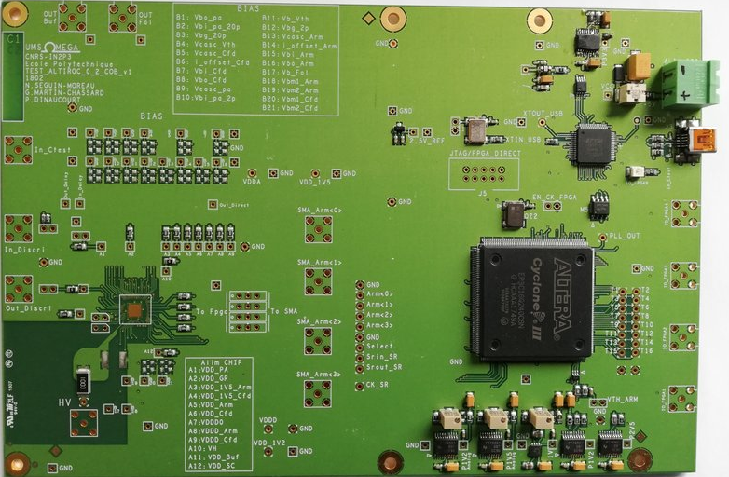
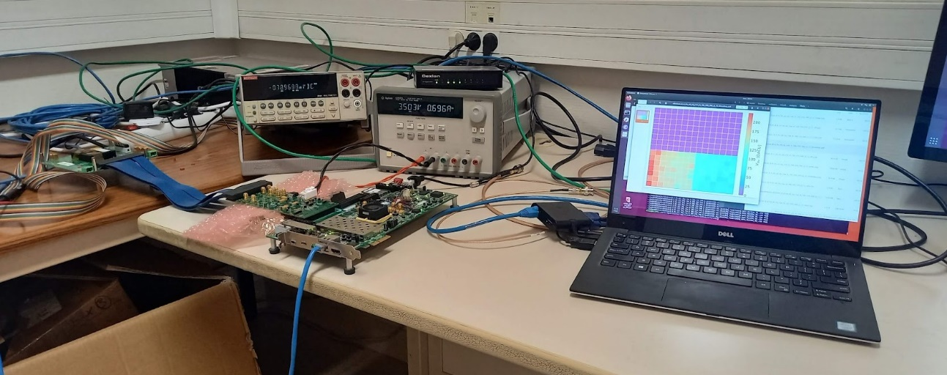
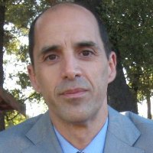
Electronics: Altiroc
Characterization of Altiroc
Installing a test setup at LIP following very useful visit to Omega laboratory (thanks!)
Previous experience with Omega ASICs and frontend electronic design & production
Team: 1 engineer (Rui)
(with support from senior engineer Miguel and 2 academics)
Rui Fernandez
Miguel Ferreira
Pedro Assis
Ricardo Gonçalo

Slide 7
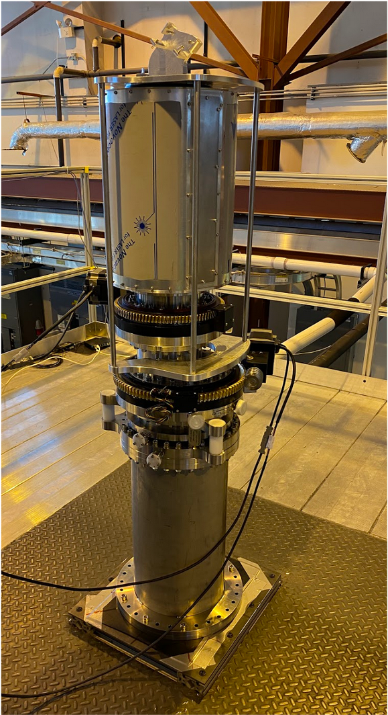
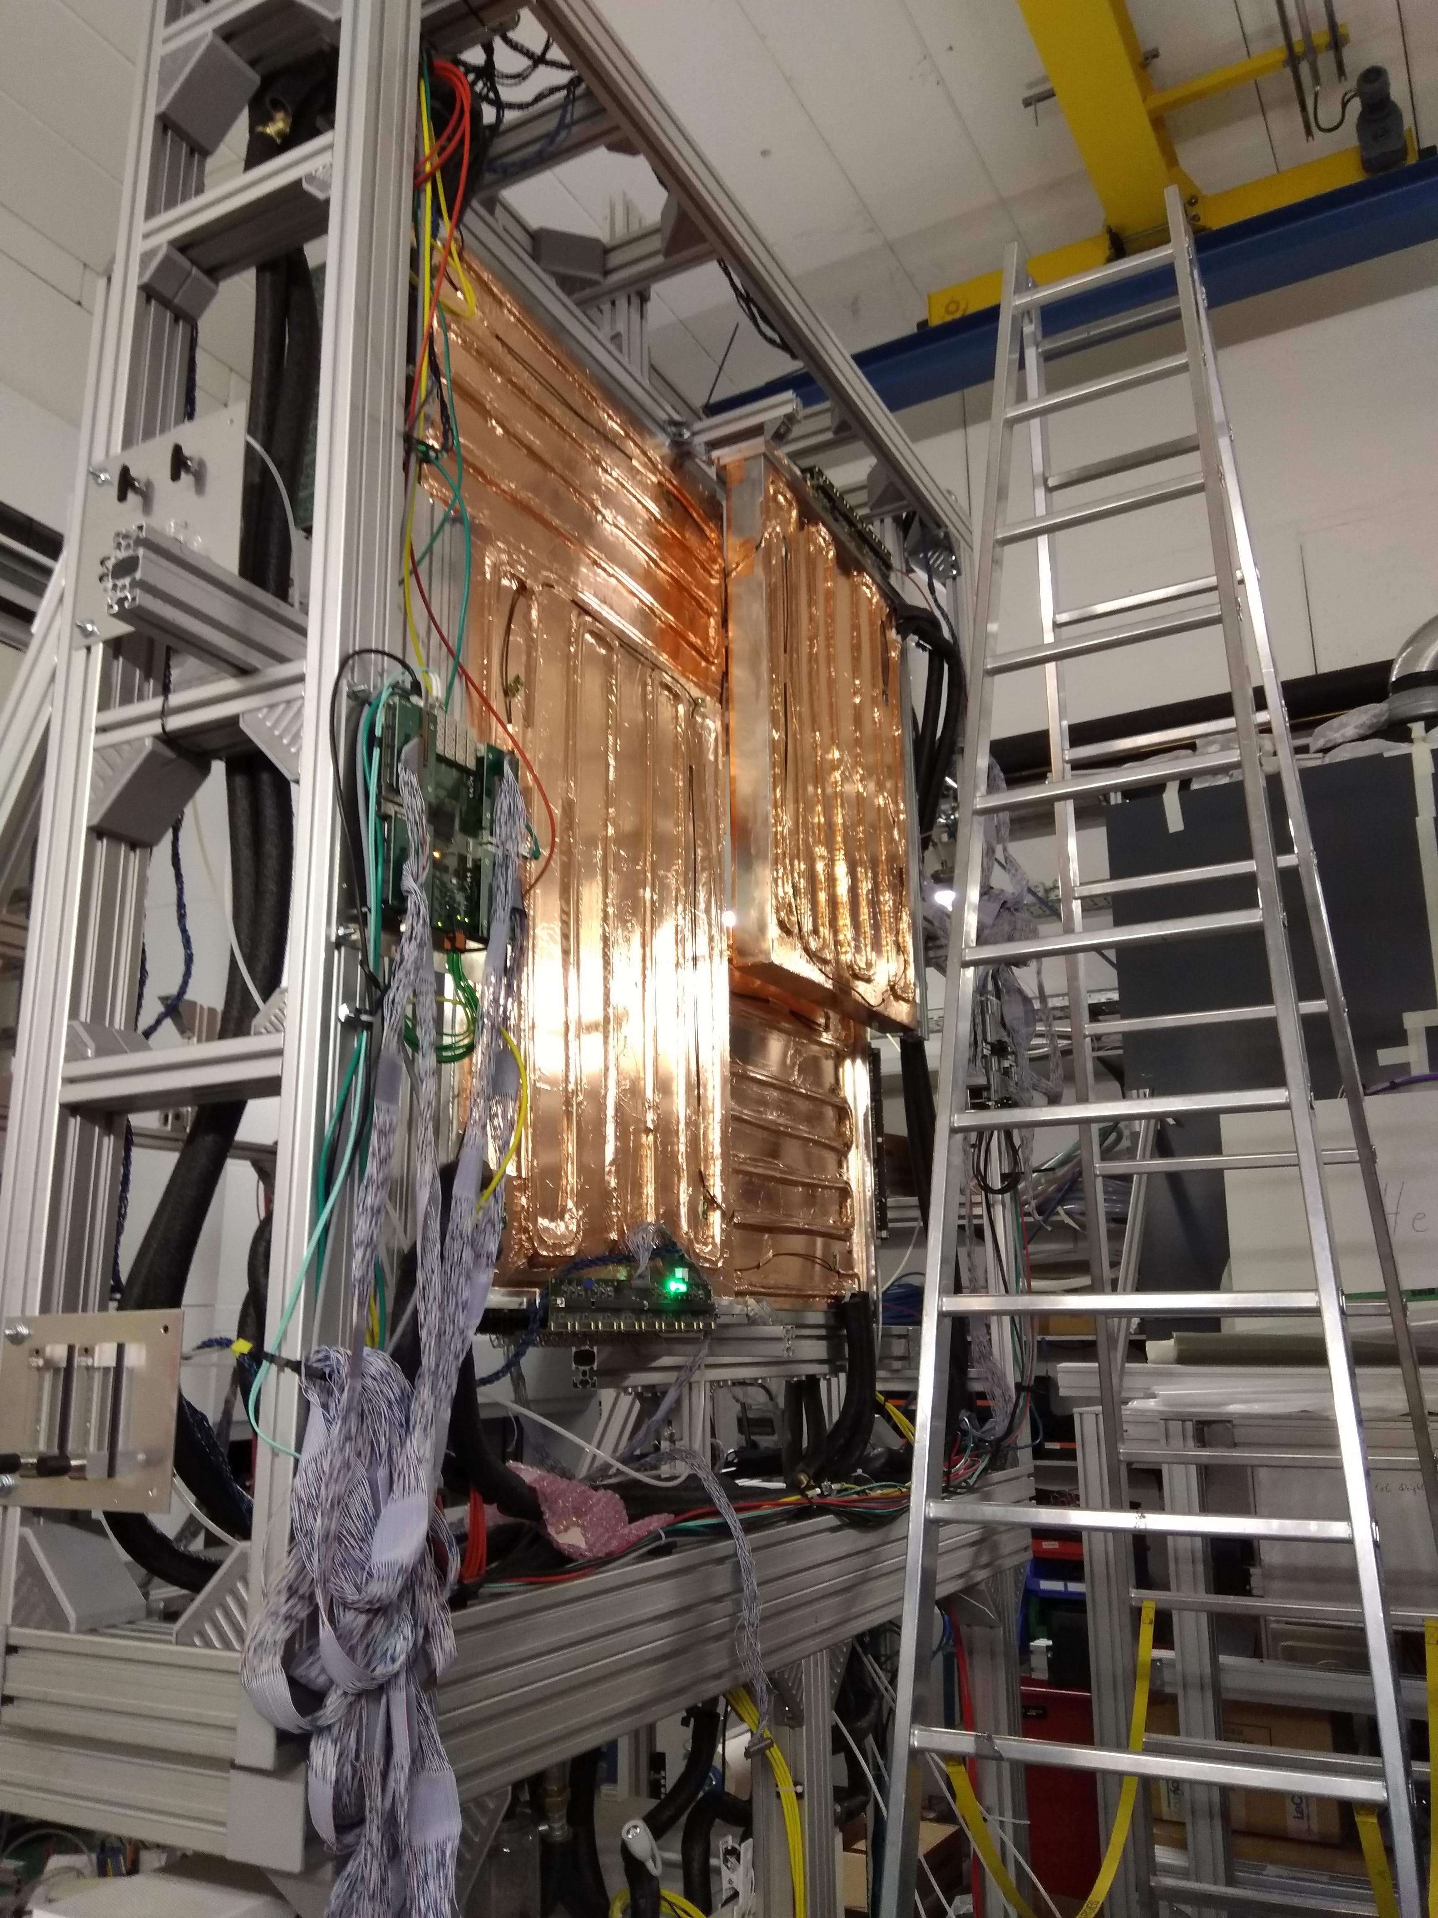
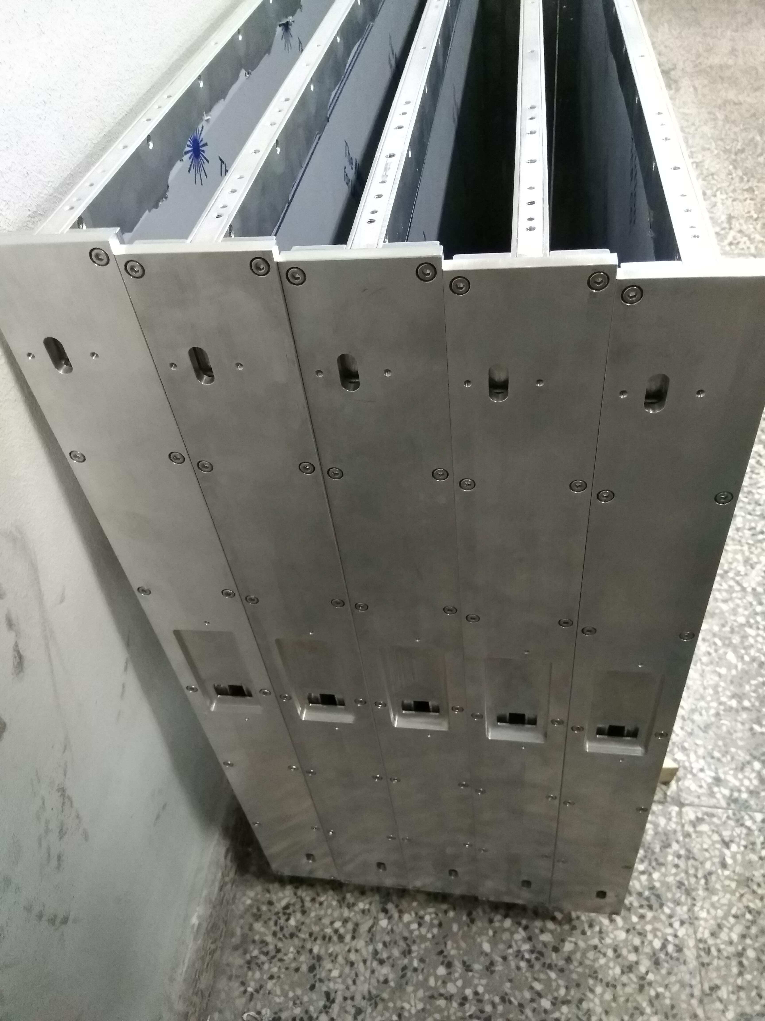
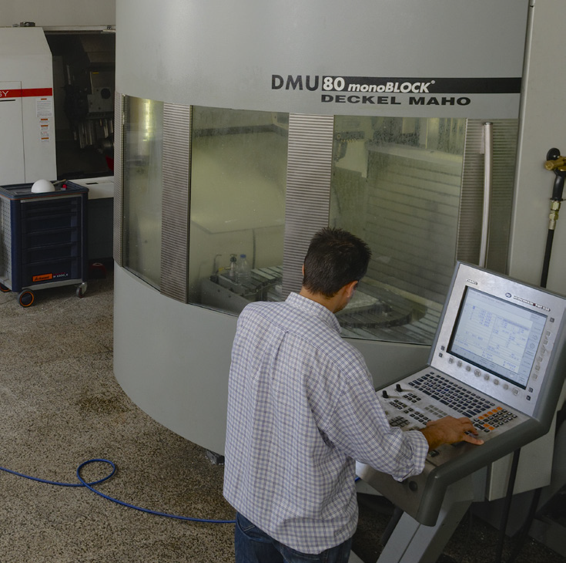
Other local capabilities: Mechanics
Mechanical workshop at LIP-Coimbra has a long experience in producing instruments and structures for various experiments, e.g.:
Proto-Dune laser calibration periscope
SND (SHIP) support structures
HADES TOF detector & support
TileCal – optical fibre assembly
Brain TOF-PET tomograph
Can provide help in construction or design if required

Slide 8
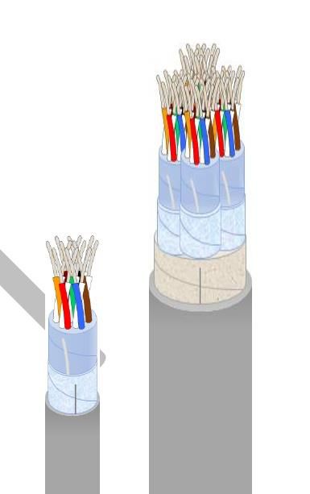
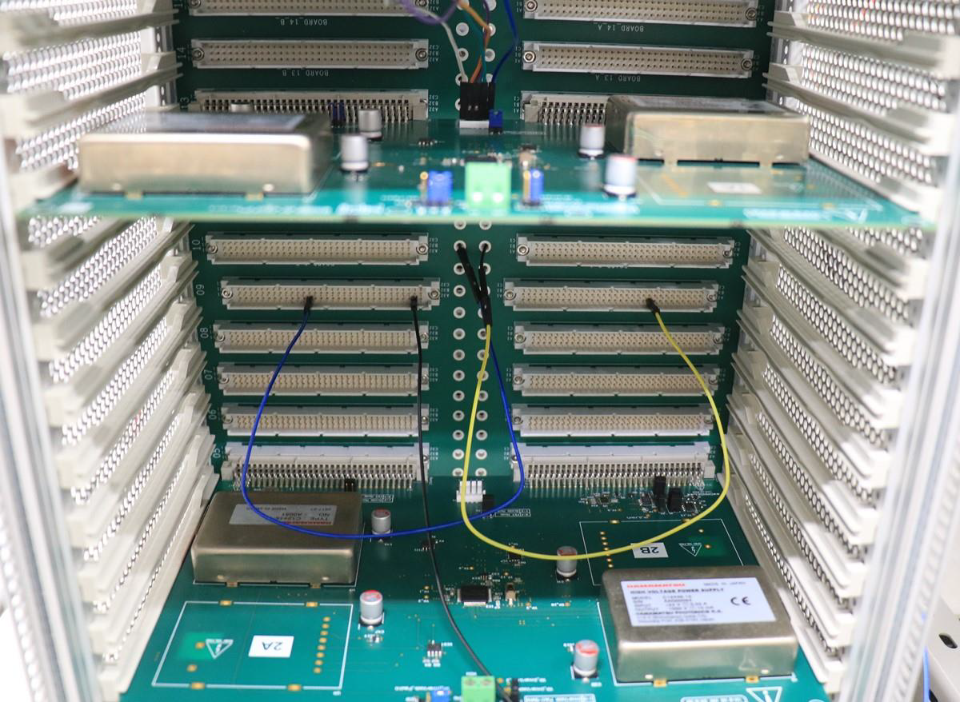
Other possible contribution: HV Cables
We are currently responsible for the production of the upgraded TileCal HV distribution system, to supply HV to 10k PMTs
Similar requirements as for HGTD HV
100 m long cables from USA15 to detector: 32 or 48 pairs
Voltage: average 750 V ± 0.5 V (up to 900 V)
Current: 400 μA
Cable prototype (48 pairs) exists:
Ø 0.4 mm wires; Ø 16.5 mm cable

Slide 9
Team involved in HGTD
Filipe Martins, engineer, DCS
9 people at various levels of commitment
About 3 FTE in total
Expect future engagement from students (Qualification Tasks, etc)
Helena Santos, researcher, Interlock
Guiomar Evans, academic, Interlock board design
R. Gonçalo, academic, coordinating effort
Rui Fernandez, engineer, DCS firmware and ALTIROC tests
Luís Lopes, engineer: mechanics
Miguel Ferreira, engineer, electronics board design
Orlando Cunha, engineer, Patch Panel electronics
Pedro Assis, academic, electronics

Slide 10
HGTD Joining Proposal – Summary
LIP team contributing or starting to contribute in Electronics and DCS tasks
Electronics: HV (patch panels), ASIC (tests)
Lumi/DAQ/DCS: DCS and Interlocks
Expected contribution to CORE costs: between 150 and 300 kCHF
Details being discussed – need to change MoUs (to be negotiated with funding agency) to move funds allocated to HTT
Several other possible contributions using LIP facilities in cable production and mechanics design or part production
Notes:
Possibilities: TDAQ and DCS

Slide 11
Thanks!
Acknowledgments

Slide 12
Backup

Slide 14
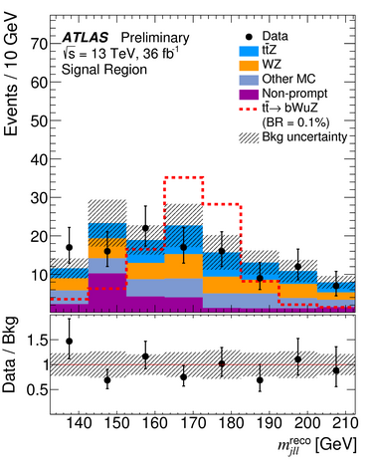
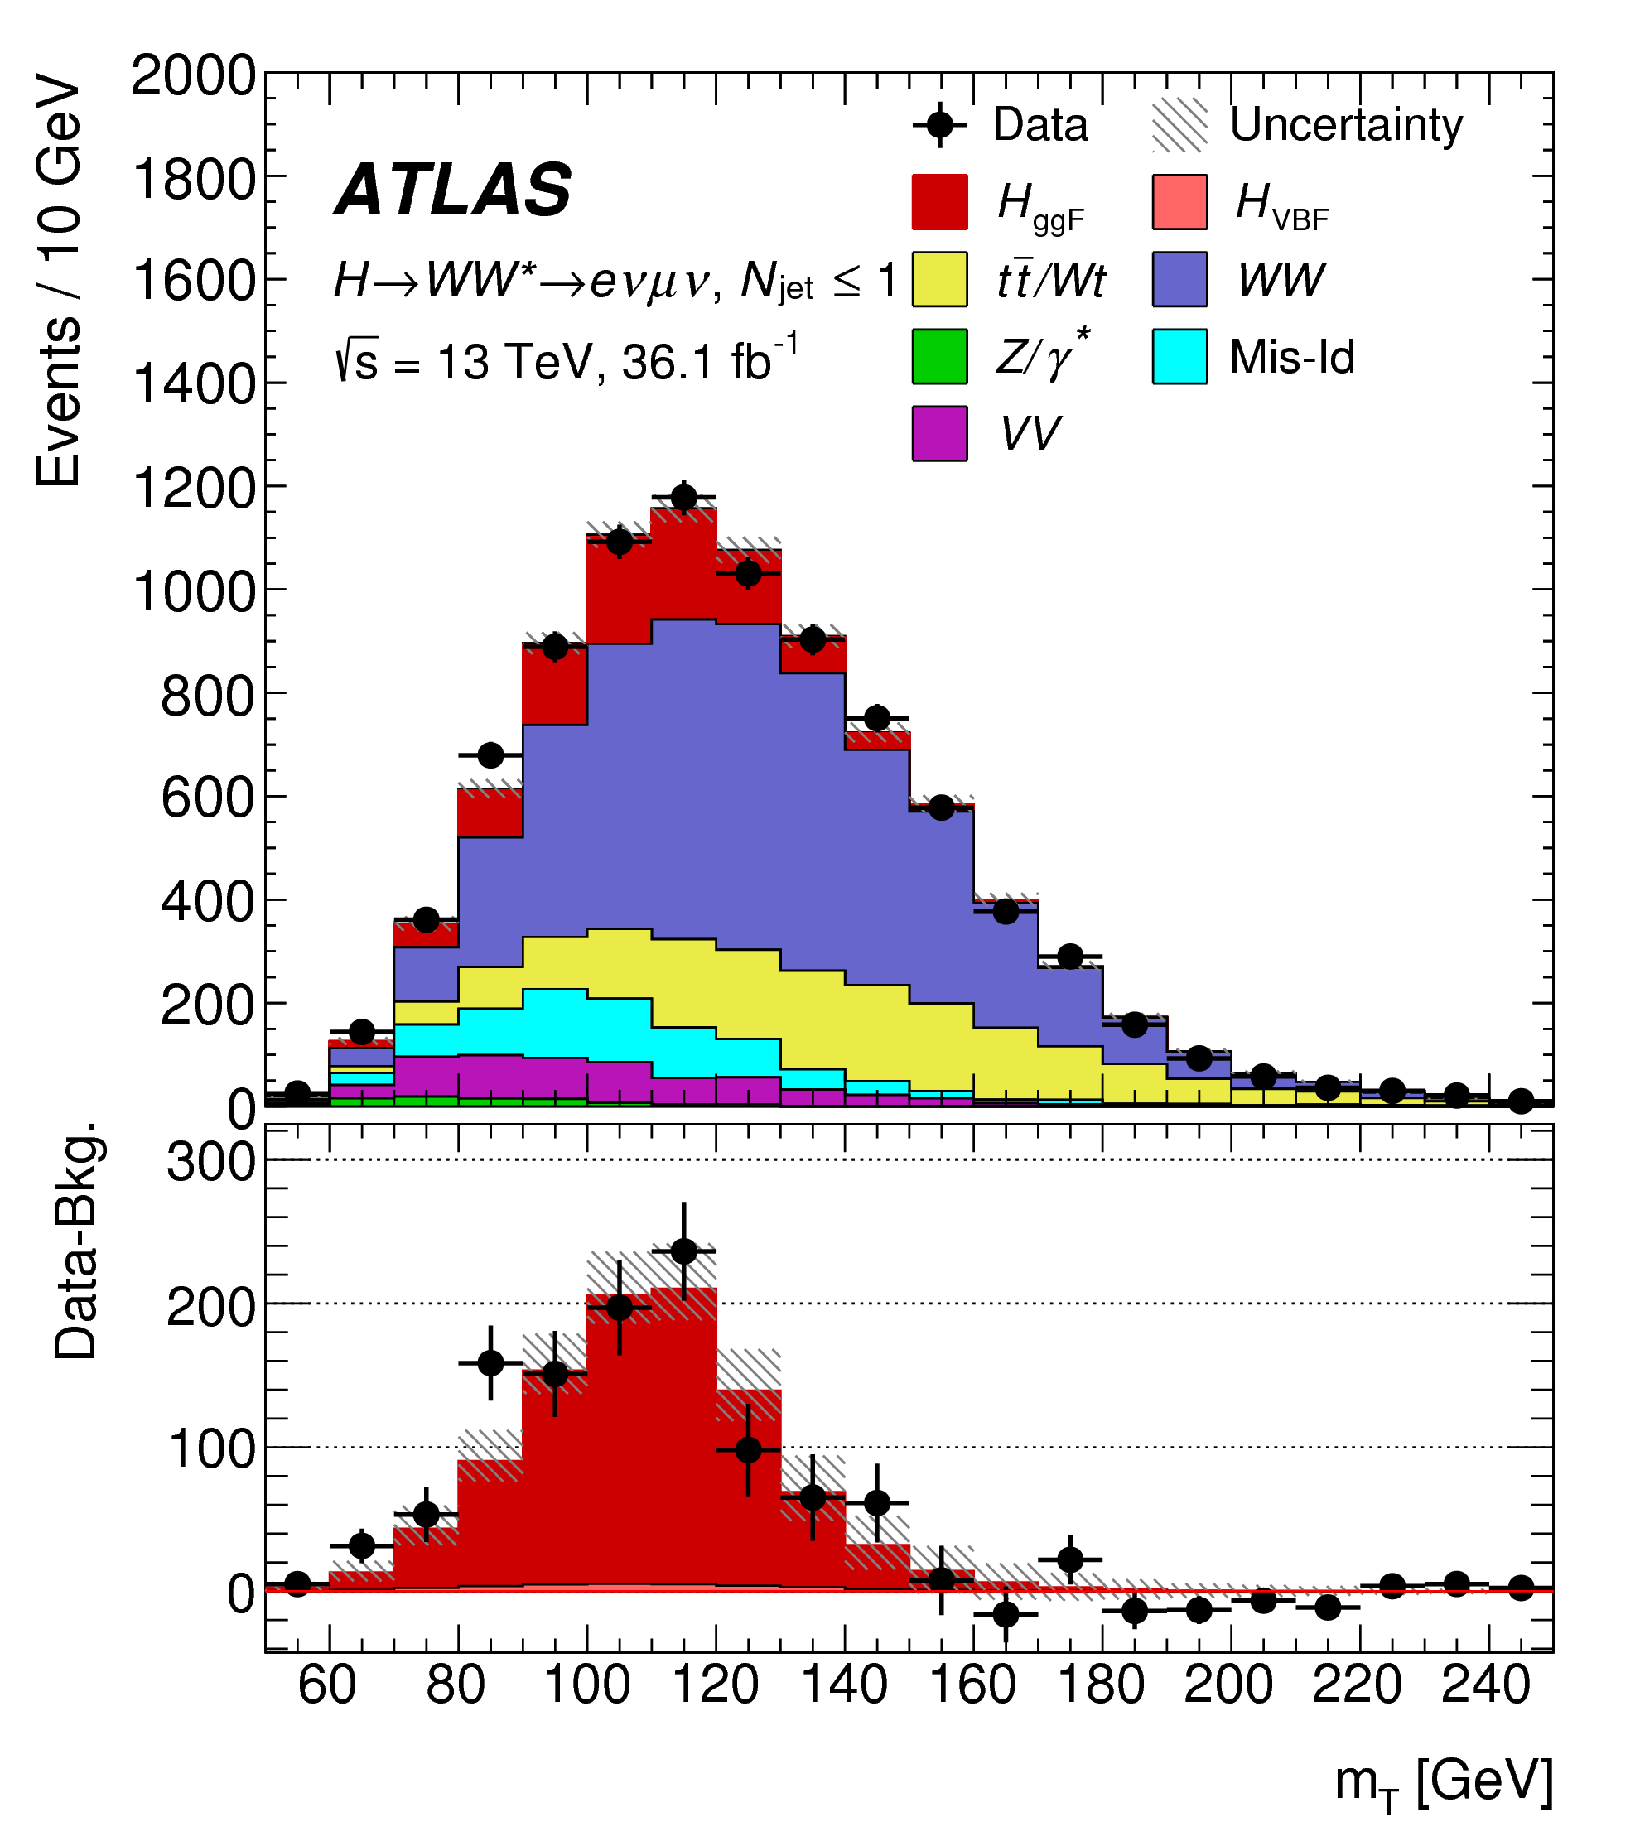
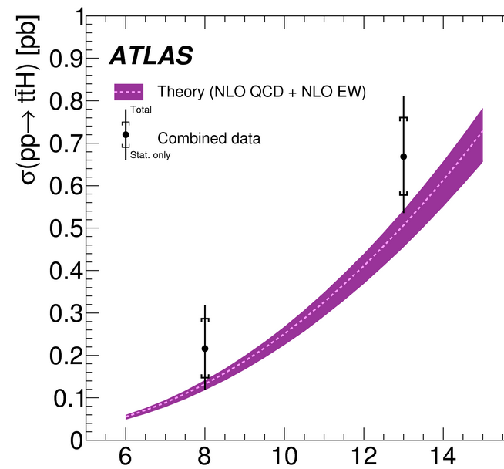
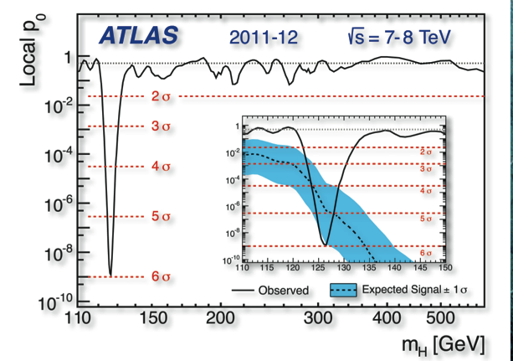
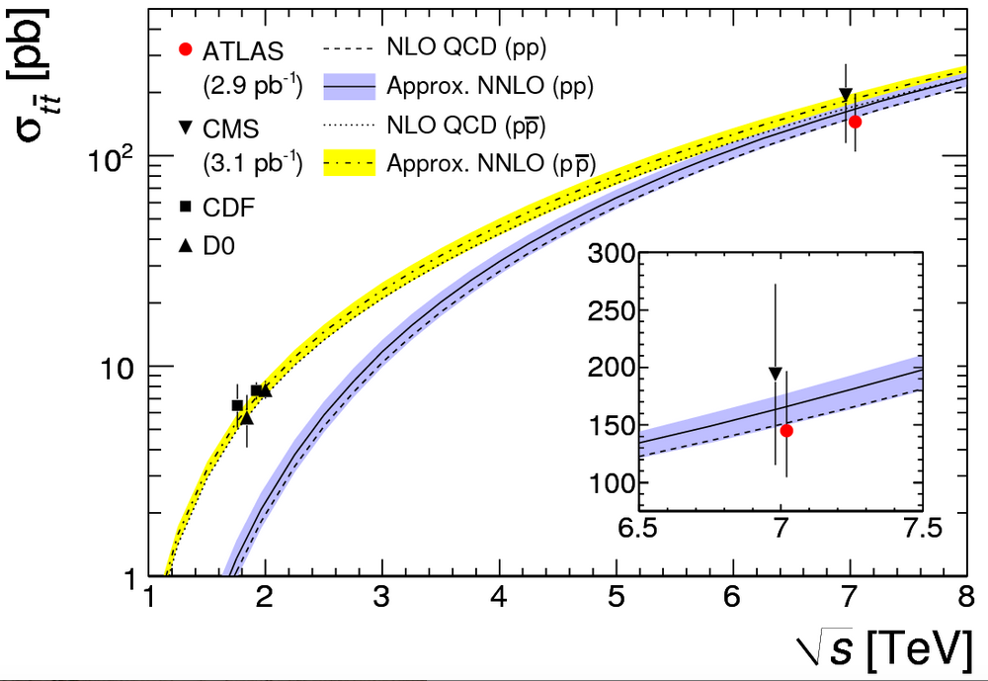
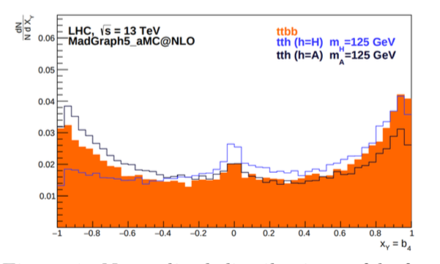
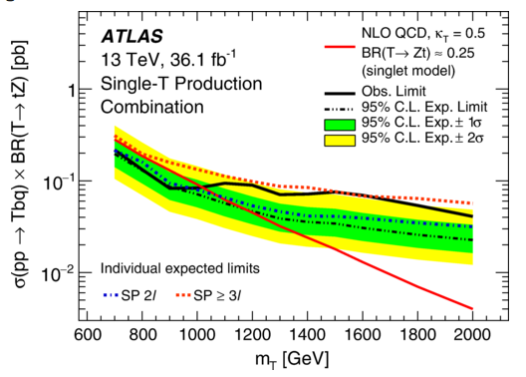
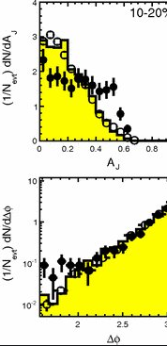
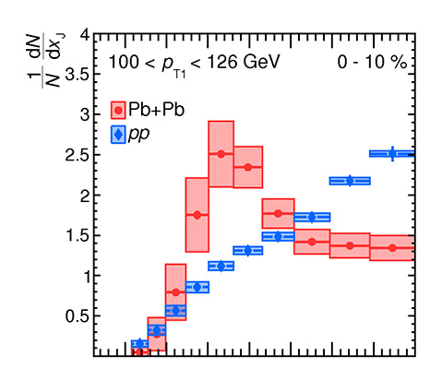
Portuguese contributions to ATLAS Physics Results
Top quark properties
Top properties measurements
Higgs boson discovery and properties
H➝WW, H➝bb, ttH
Spin/CP properties
Searches for New Particles & Interactions
Vector-like quarks, FCNC, dark matter, …
Heavy Ion Physics
Leading positions in some analysis
QGP jet quenching

Slide 15
Current Portuguese Contributions to ATLAS
ATLAS Roman Pot DCS and HLT
Jets HLT
TileCal
Calibration,
DCS
Distributed computing
Iberian Cloud Coordination
TileCal Upgrade
HV distribution system
Co-leading ARP DCS
Trigger Upgrade: HTT
DCS, simulation, mezzanine production
HGTD
HV patch panels
Leading TileCal DCS

