Slide 1
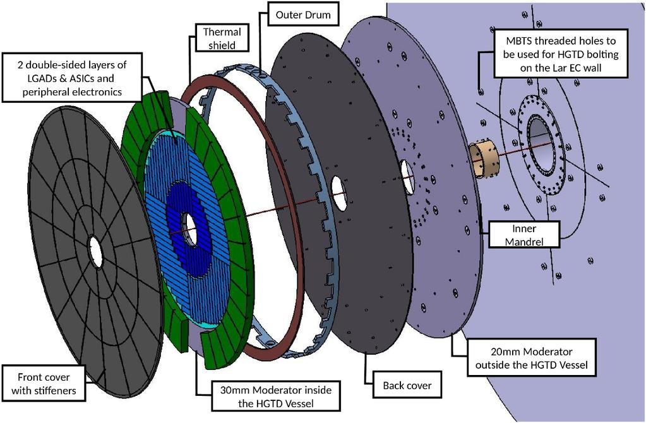
LIP – Joining Proposal

Slide 2
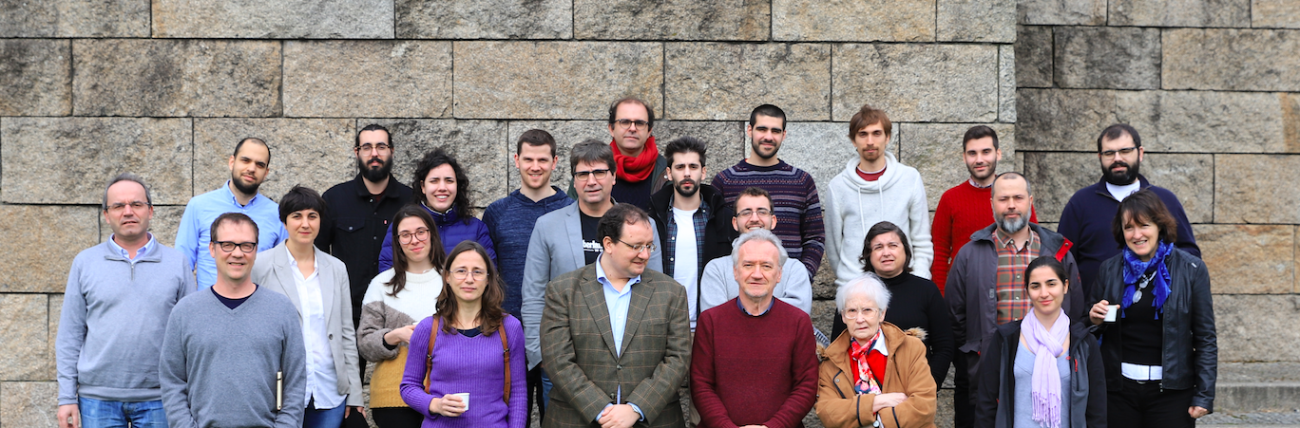
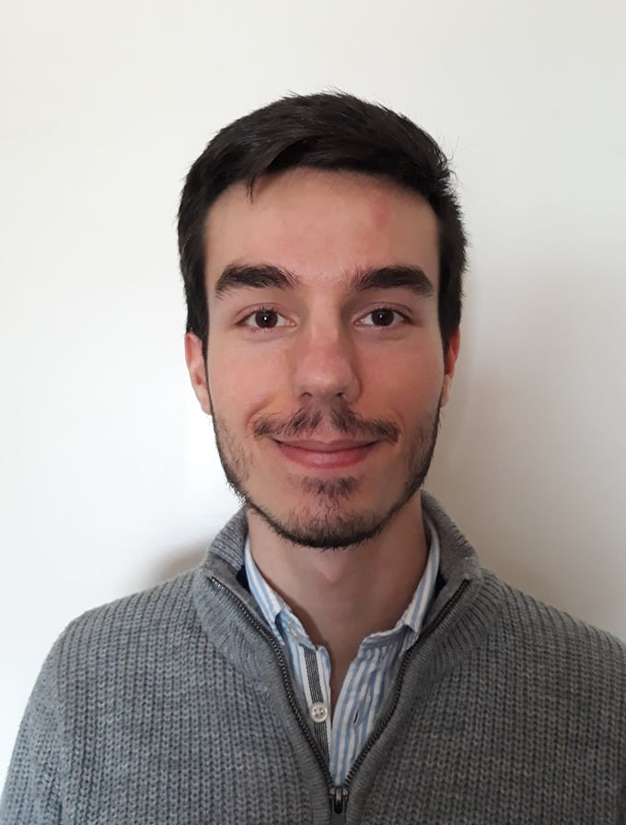
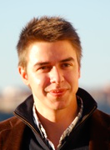
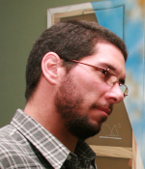
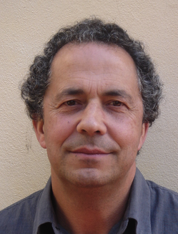
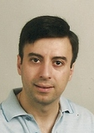
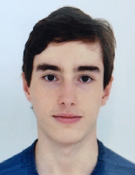
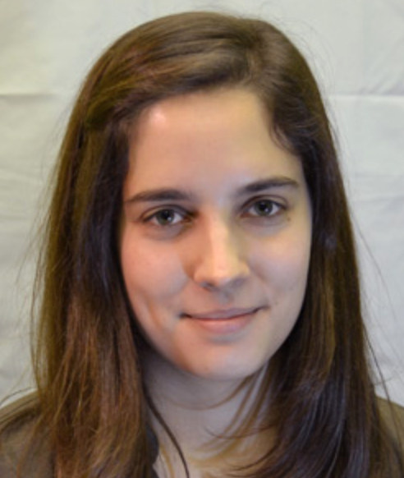
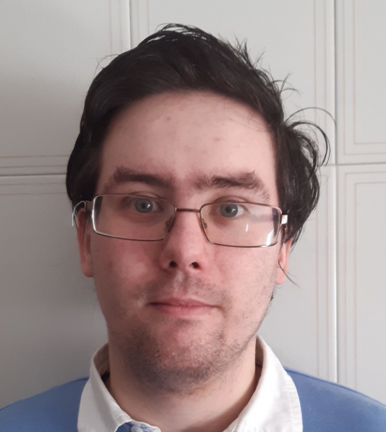
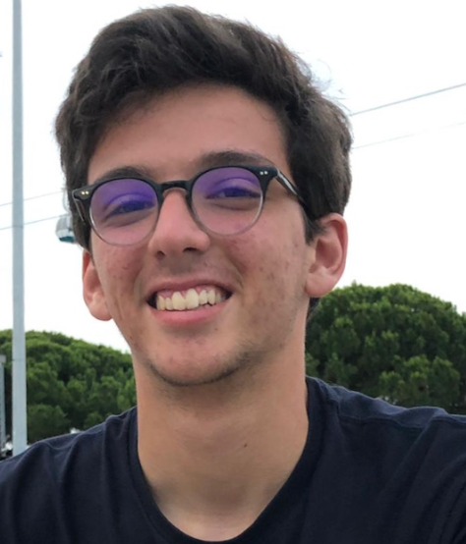
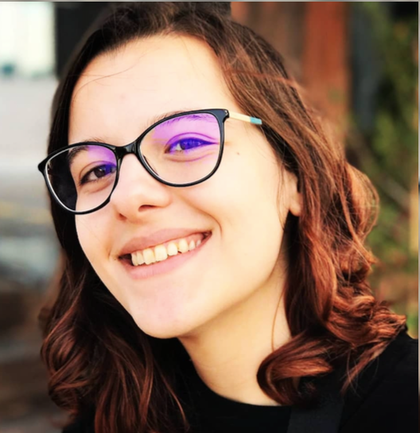
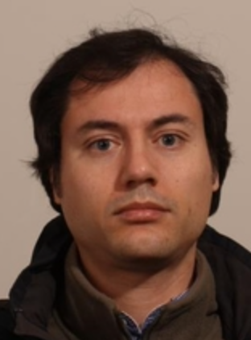
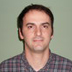
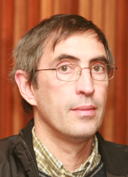
Portuguese ATLAS Team
National group:
LIP (Lisbon, Coimbra, Minho), IST, FCUL, FCTUC, U. Minho, CFNUL CEFITEC/UNL, INESC, CFMC, AdI engineer training program

Slide 3
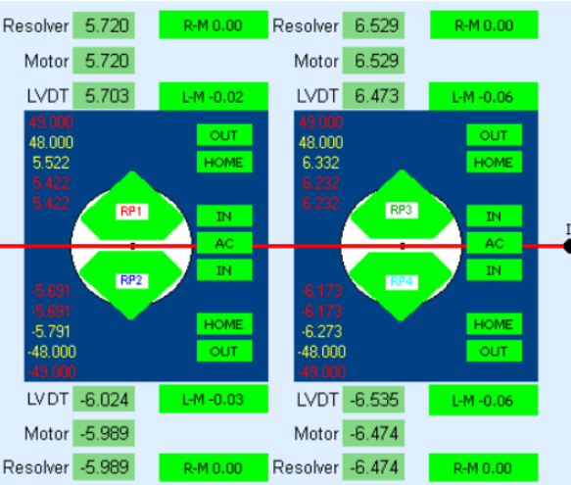
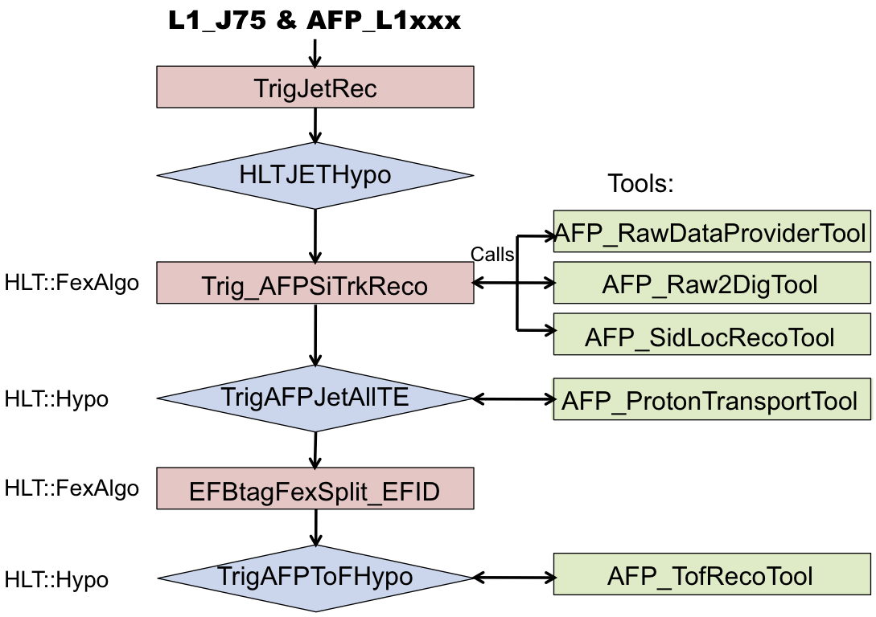
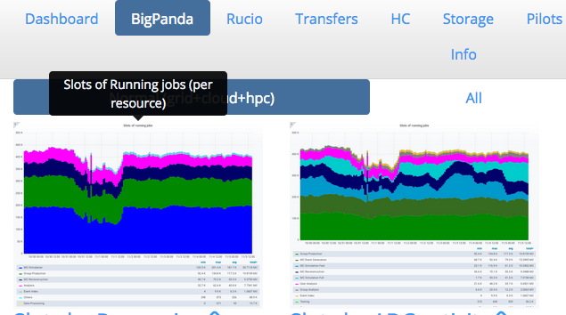
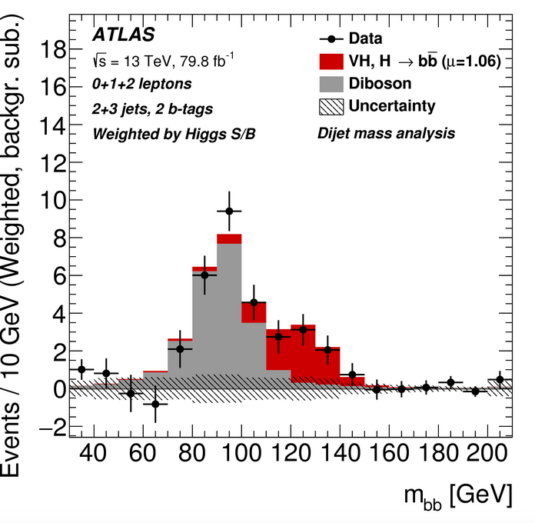
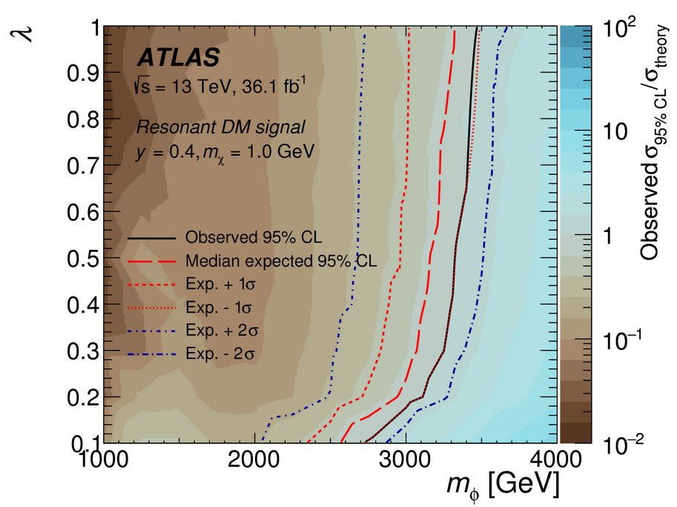
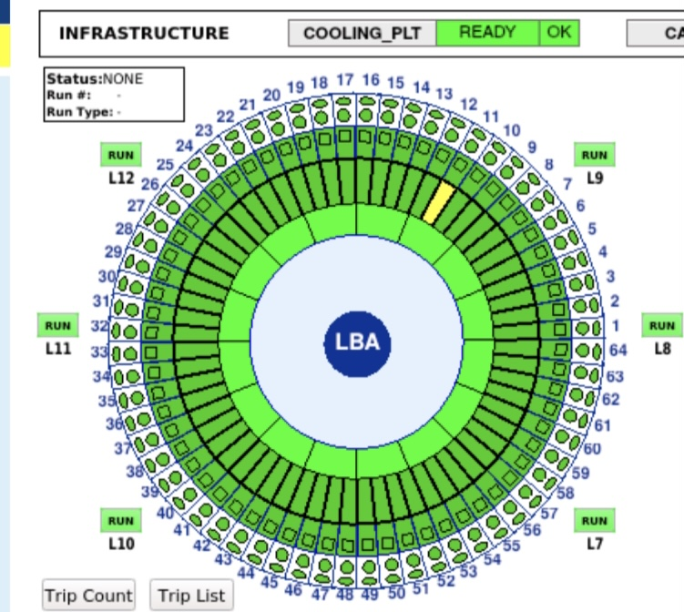
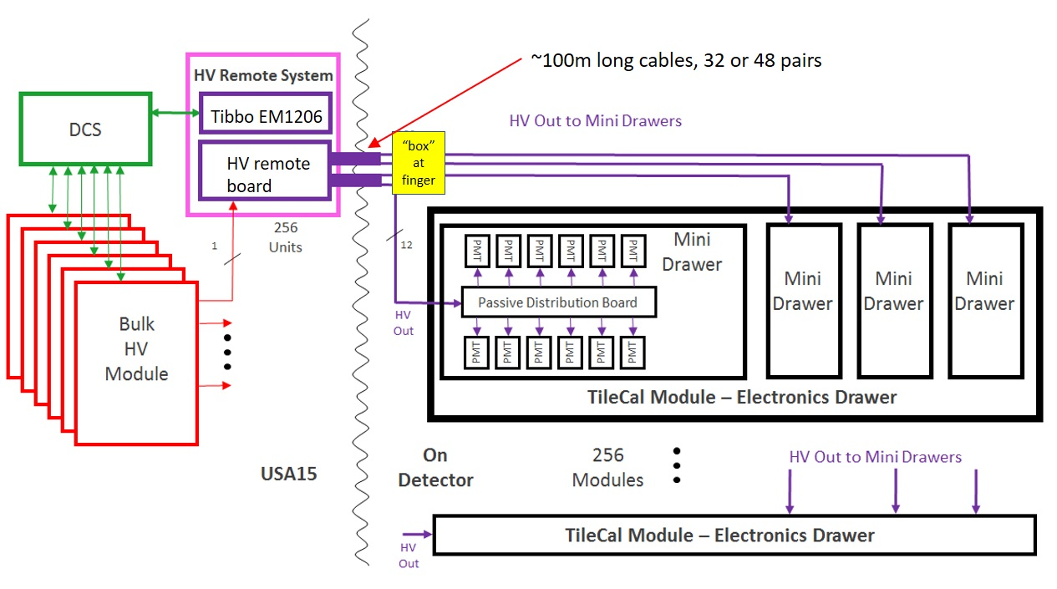
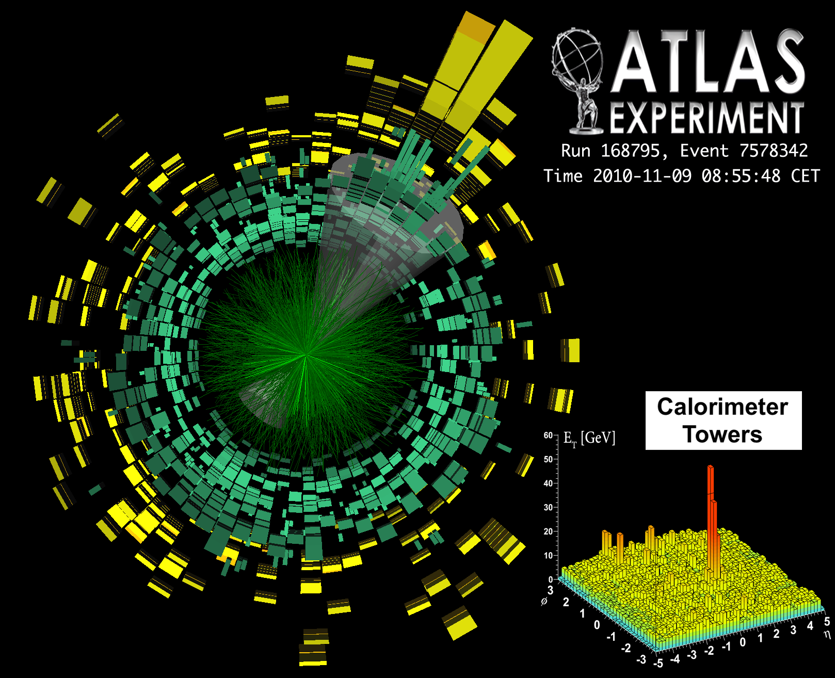
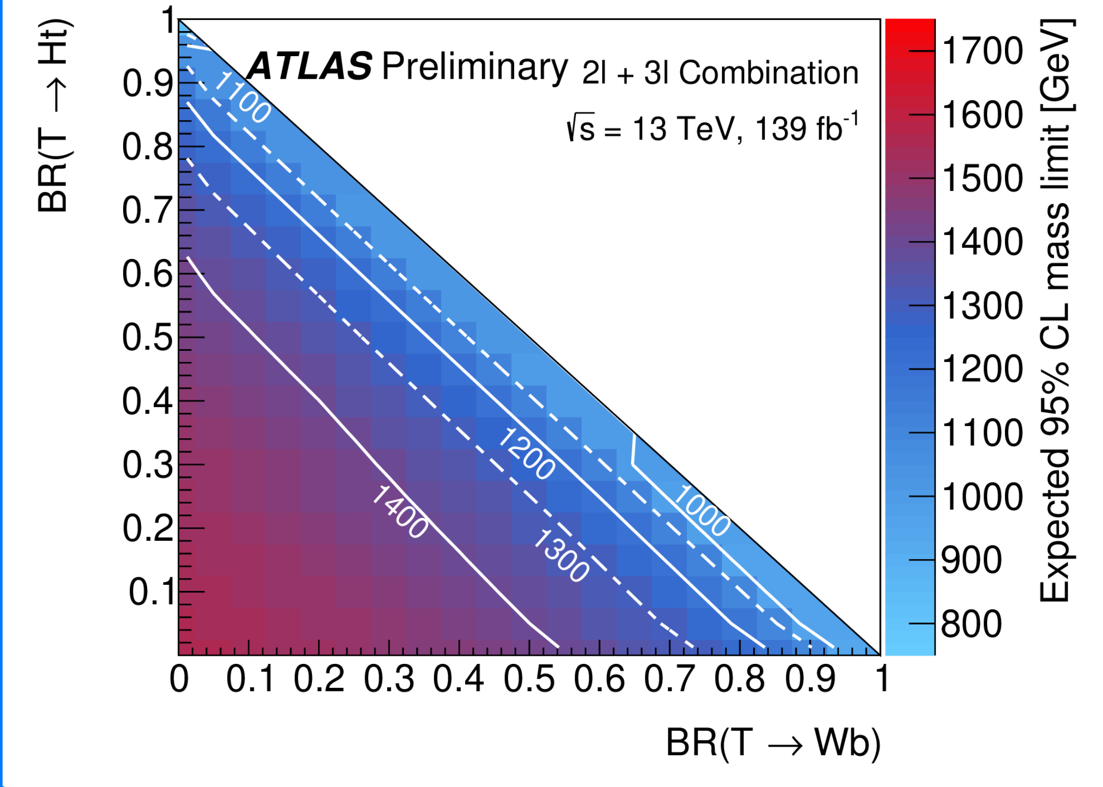
Current Portuguese Contributions to ATLAS
ATLAS Roman Pot DCS and HLT
Jets HLT
Physics:
Higgs, Vector-Like Quarks, top, heavy ions, forward physics, Dark Matter
Distributed computing
Iberian Cloud Coordination
Co-leading ARP DCS
TileCal Upgrade
HV distribution system
Leading TileCal DCS

Slide 4
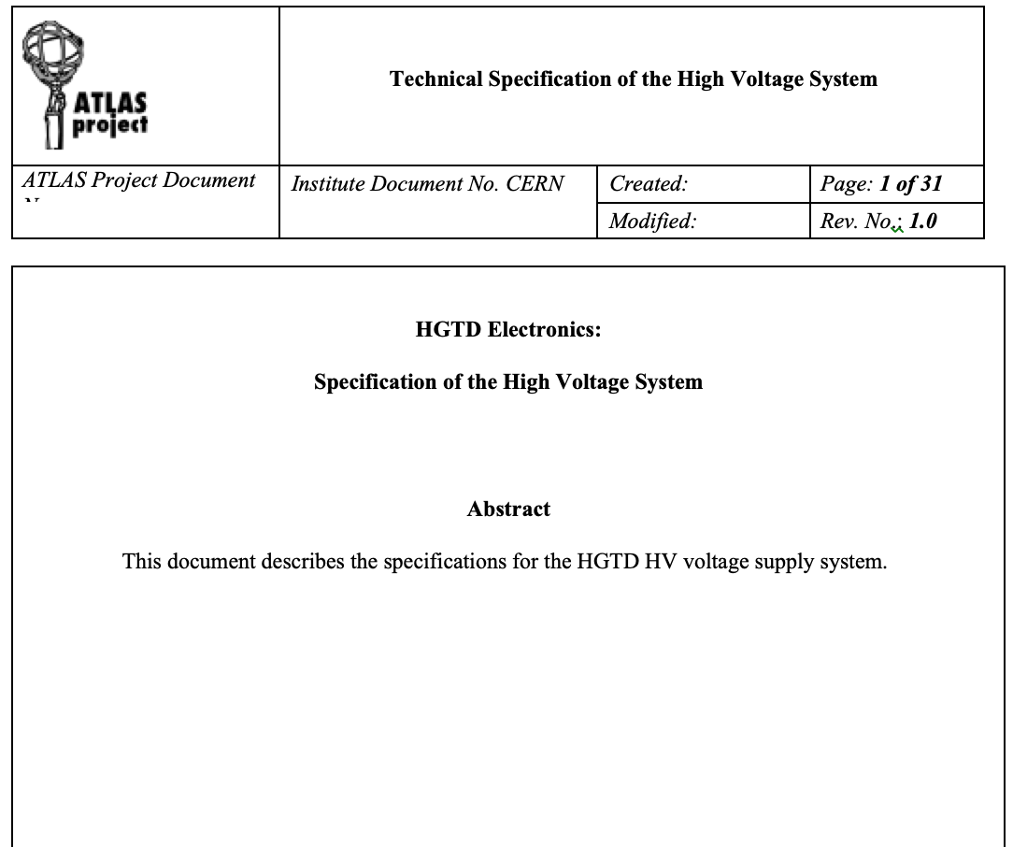
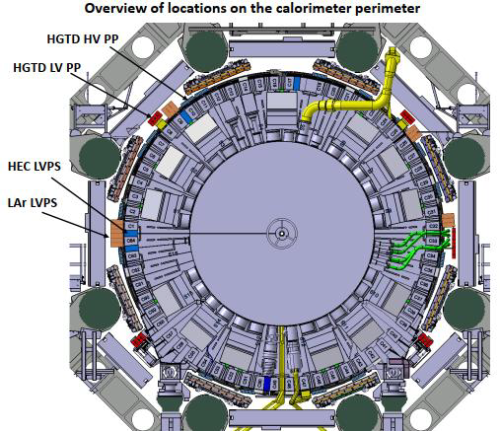
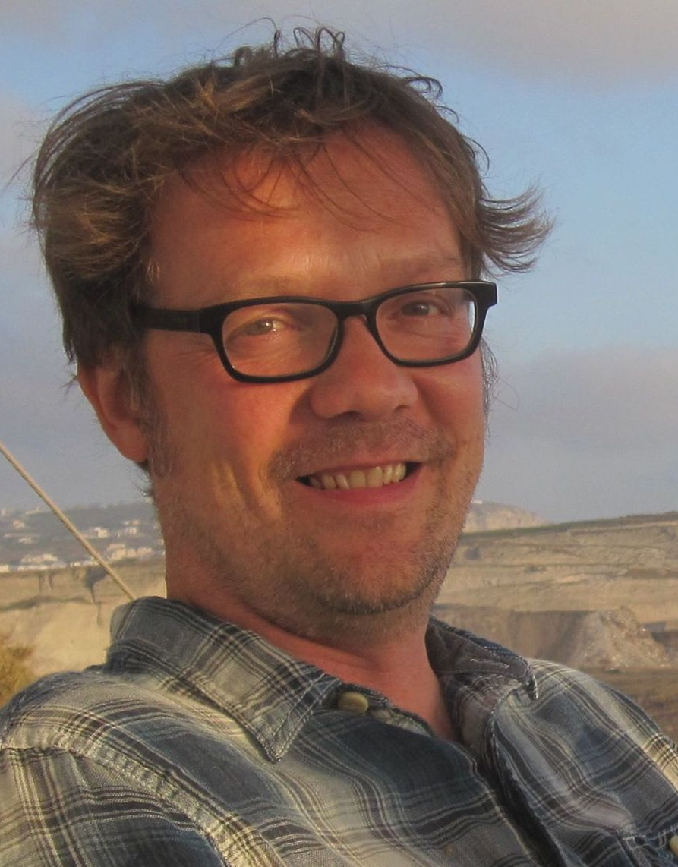
HGTD Involvement: HV Patch Panels
Producing HV patch panels CERN group:
16 patch panel boxes located around the calorimeter perimeter
Routing of High Voltage to HGTD detector
Filtering out AC noise
Preliminary layout done and prototype tested
Contributing to Specifications Review (SPR) document
Ricardo coordinating Patch Panels (L3)
Team: 2 engineers, 1 academic
Luís Lopes
Orlando Cunha
Ricardo Gonçalo
Notes:
Possibilities: TDAQ and DCS

Slide 5
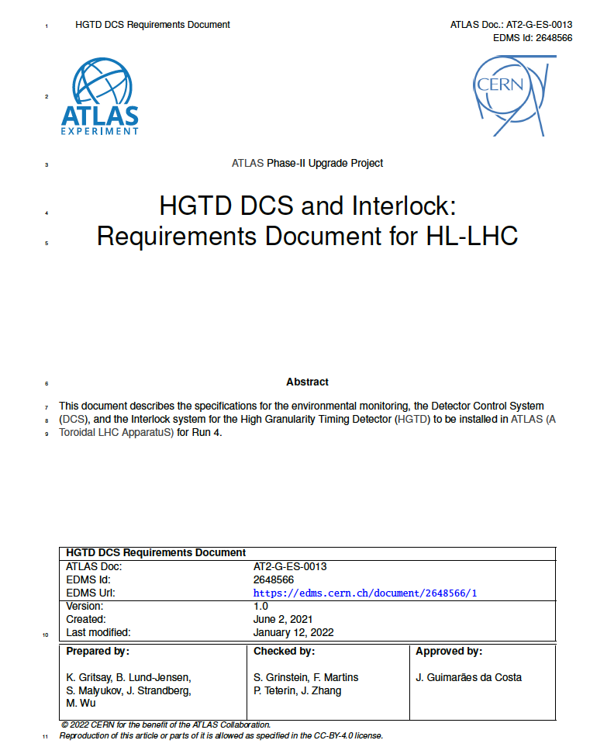
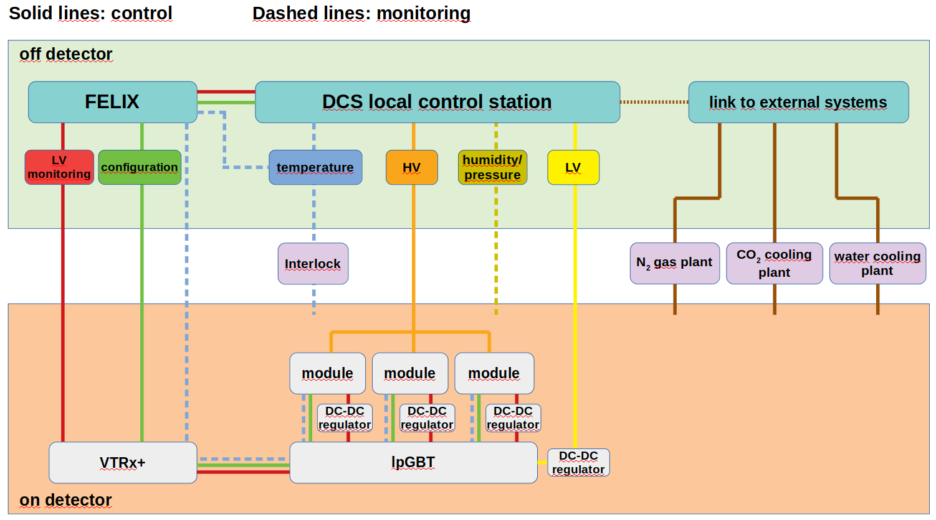
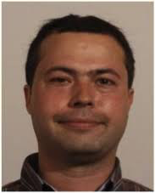
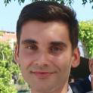
DCS and Interlocks
HGTD DCS – ongoing work (Filipe):
Contributed to DCS Specifications Review document
Following SPR panel recommendations working on alternative for data transfer path separate from FELIX
Working on High Voltage DCS
DCS and Interlocks – plans (Rui, Helena):
Plan to develop monitoring data transfer through FELIX or alternative solution – Rui
Plan to develop design for Interlocks – Helena
Helena’s commitments imply a small re-scheduling
Team: 2 engineers, 1 researcher, 1 academic
Filipe Martins
Rui Fernandez
Helena Santos
Ricardo Gonçalo

Slide 6
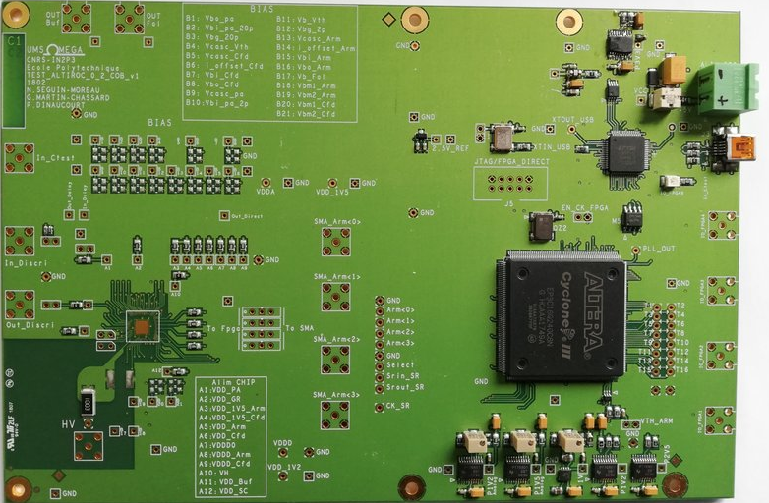
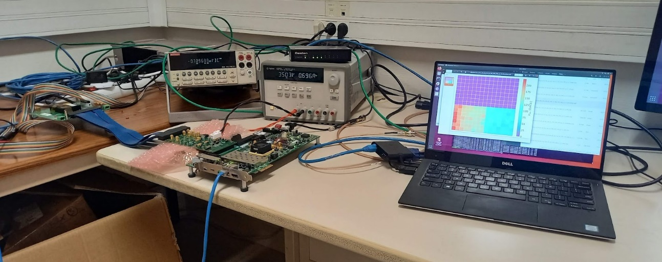
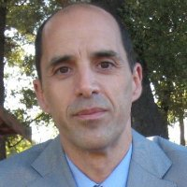
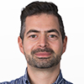
Electronics: Altiroc
Becoming involved in tests of Altiroc v.2
In contact with Omega laboratory to install a test setup at LIP
Previous experience with Omega ASICs and frontend electronic design & production
Serious immediate problem in obtaining a Xilinx board (20 weeks delivery time…)
Team: 1 engineer
(with support from senior engineer and 2 academics)
Rui Fernandez
Miguel Ferreira
Pedro Assis
Ricardo Gonçalo

Slide 7
HGTD Joining Proposal
LIP team contributing or proposing to contribute in Electronics and DCS tasks
Electronics: HV (patch panels), ASIC (tests)
Lumi/DAQ/DCS: DCS and Interlocks
Team in place: 8 people at various levels, about 2.5 FTE total
Expect future engagement from students Qualification Tasks etc
Expected contribution to CORE costs: ~150 kCHF
Details to be firmed up – need change in MoU, to be negotiated with funding agency
To move allocated funds from HTT and TDAQ but don’t expect any problems
Includes Patch Panel production (in-kind contribution) and covering past of outstanding TDAQ funds
Luís Lopes
Orlando Cunha
Ricardo Gonçalo
Filipe Martins
Helena Santos
Rui Fernandez
Miguel Ferreira
Pedro Assis
Notes:
Possibilities: TDAQ and DCS

Slide 8
Thanks!
Acknowledgments

Slide 9
Backup

Slide 10
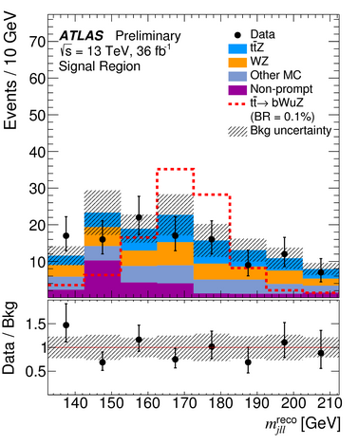
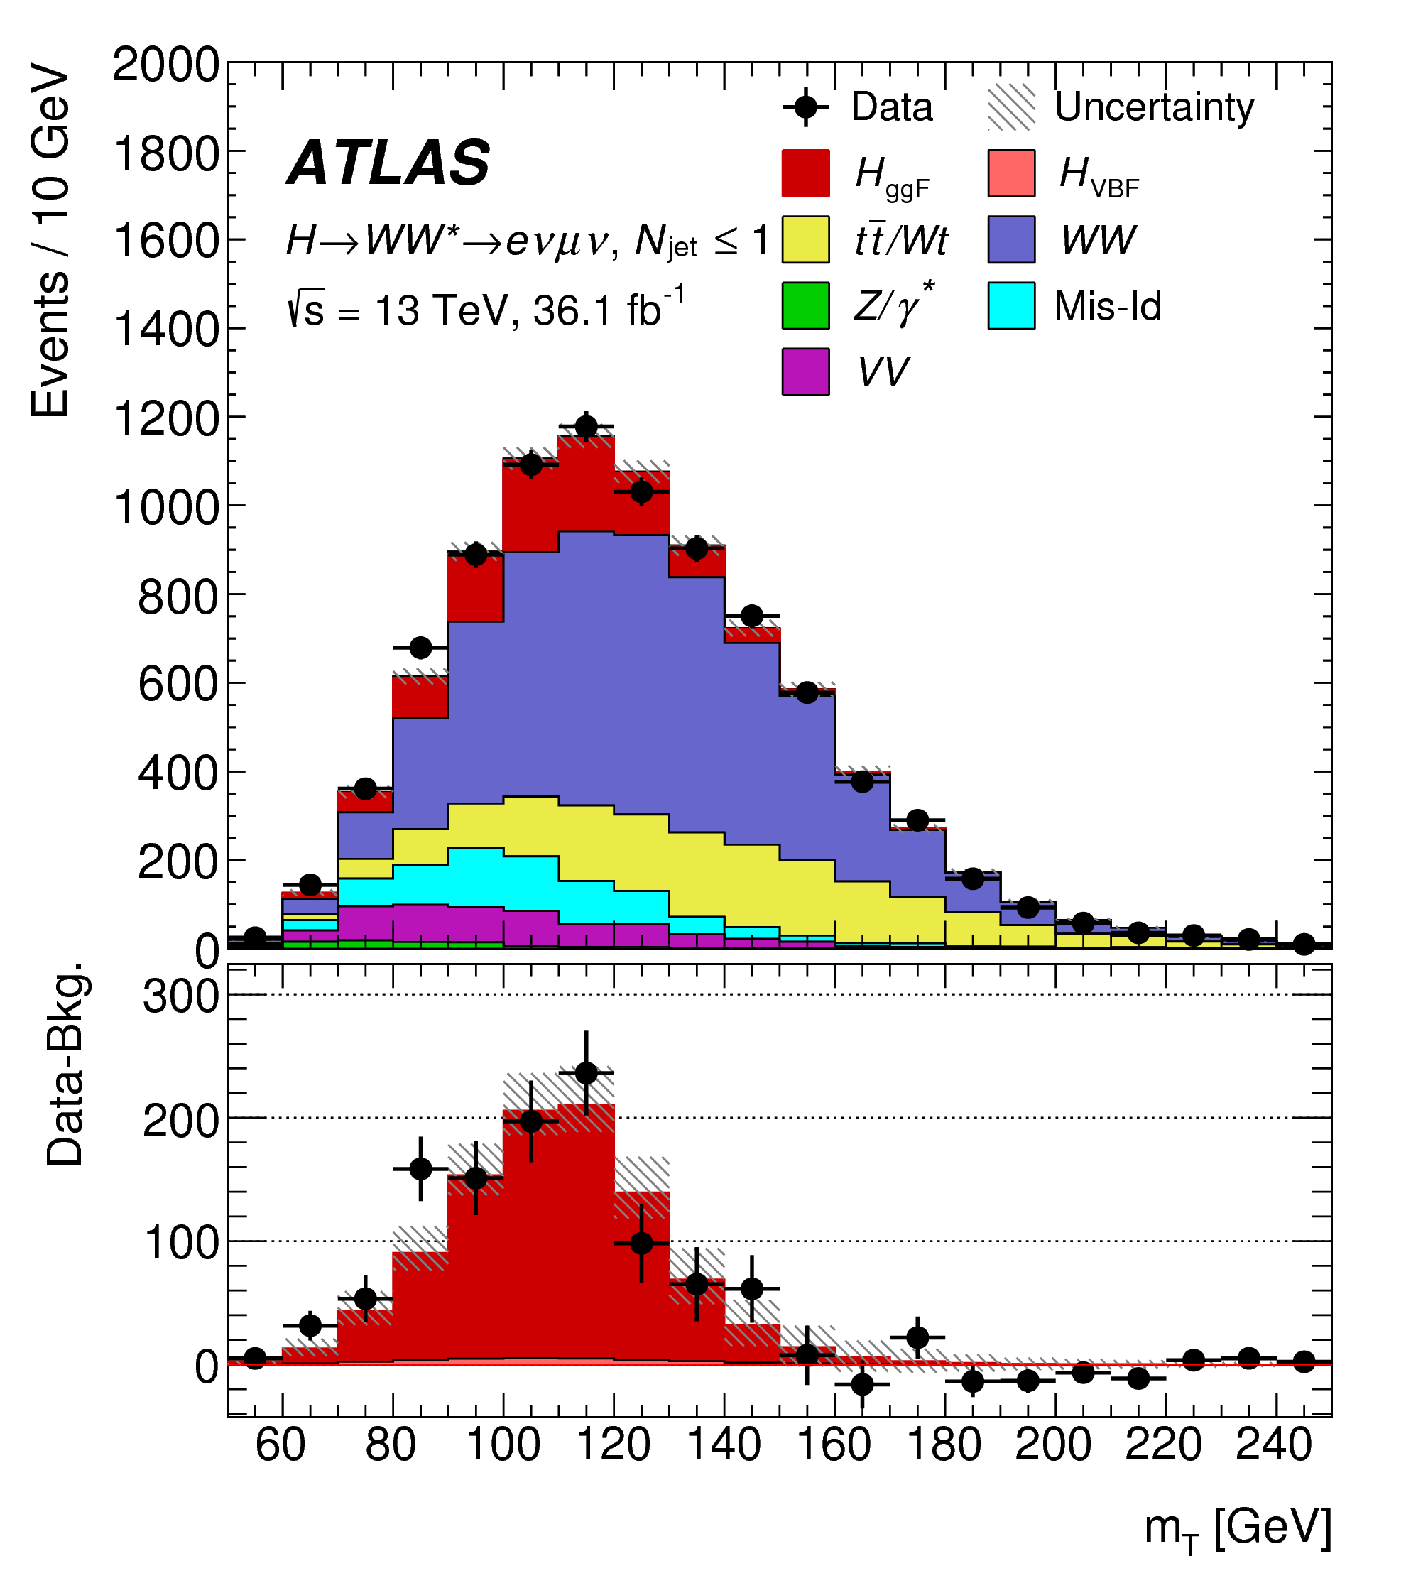
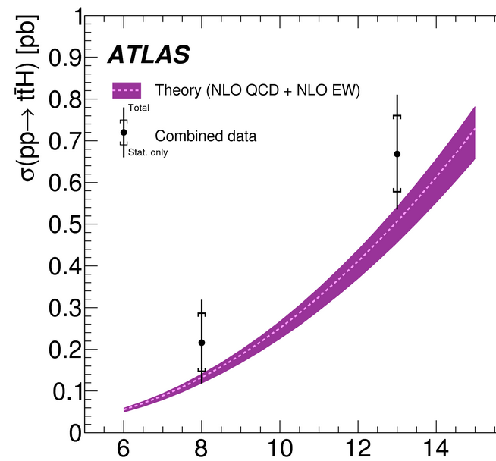
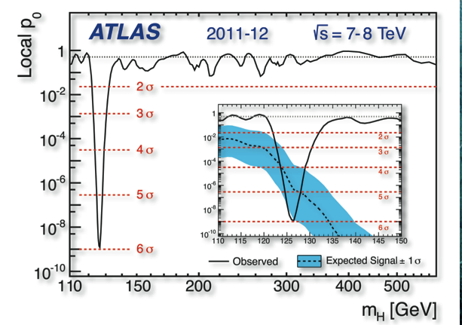
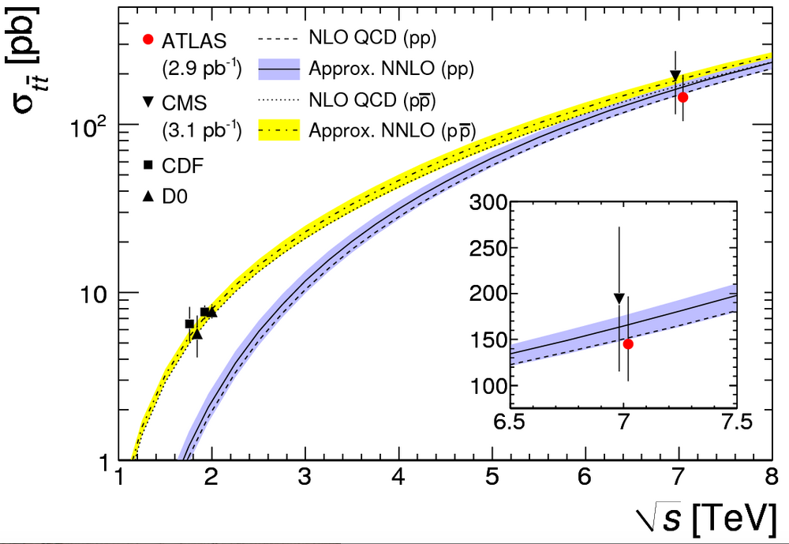
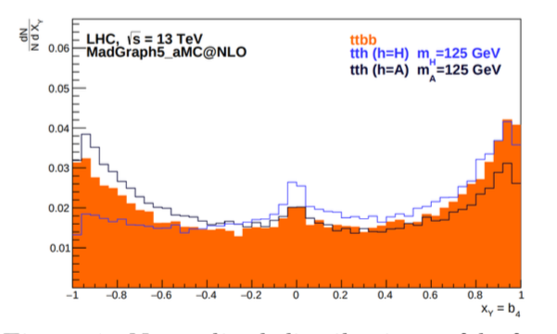
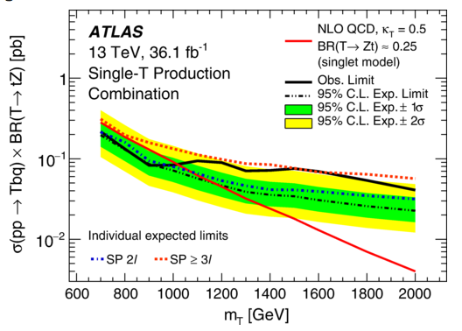
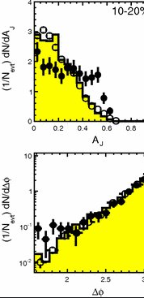
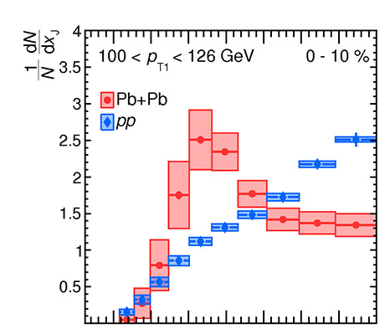
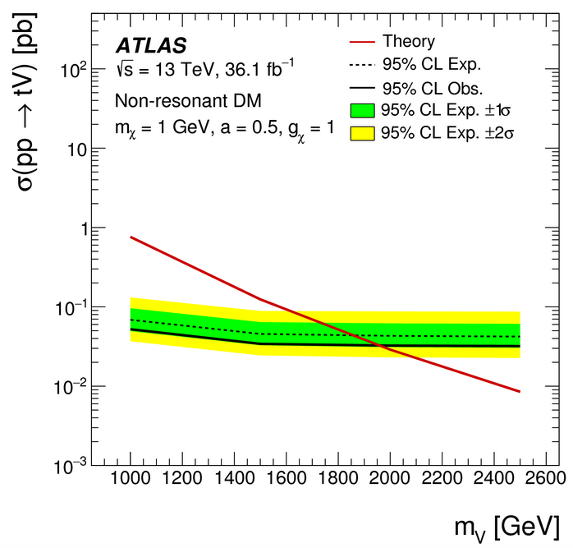
Portuguese contributions to ATLAS Physics Results
Top quark properties
Top properties measurements
Higgs boson discovery and properties
H➝WW, H➝bb, ttH
Spin/CP properties
Searches for New Particles & Interactions
Vector-like quarks, FCNC, dark matter, …
Heavy Ion Physics
Leading positions in some analysis
QGP jet quenching

Slide 11
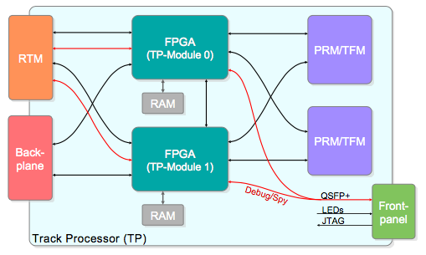
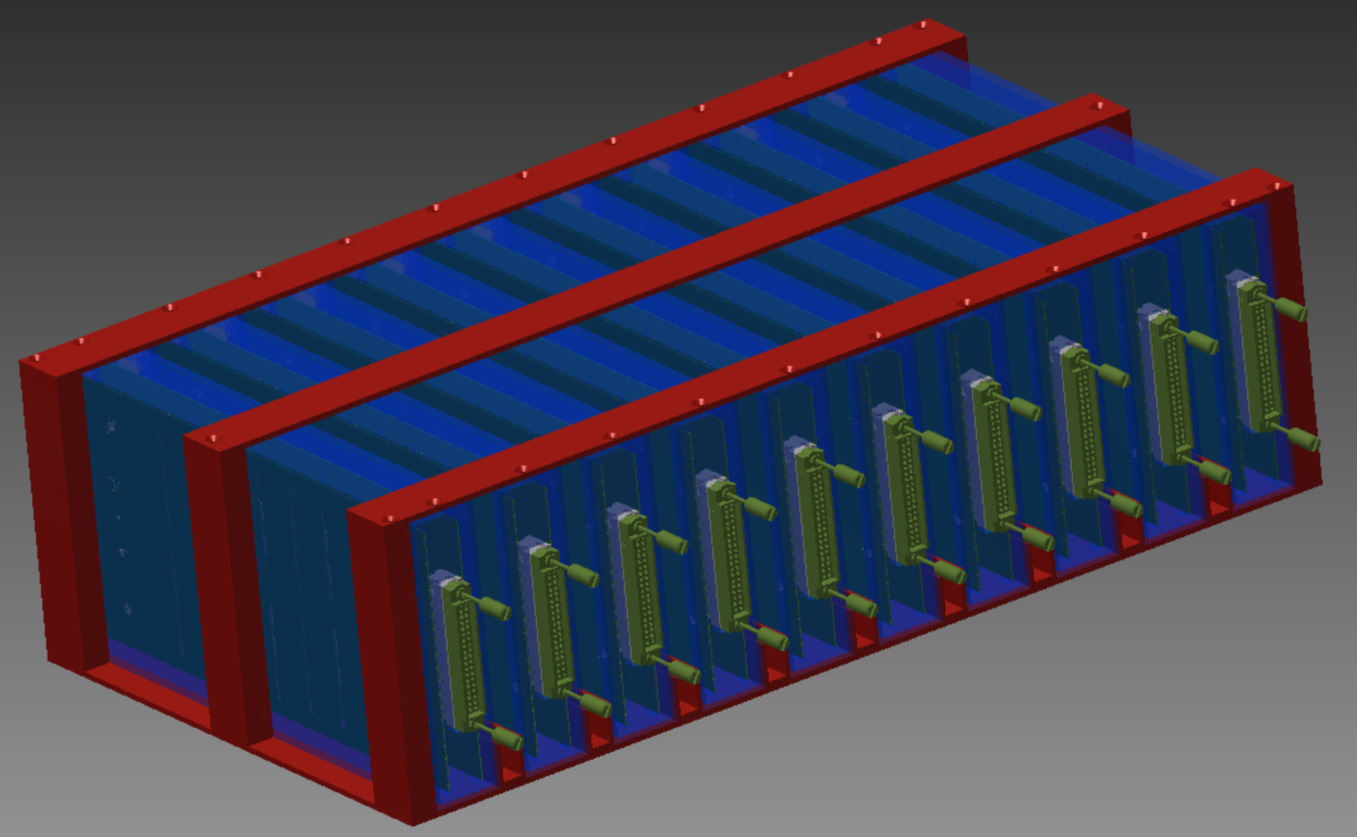
Current Portuguese Contributions to ATLAS
ATLAS Roman Pot DCS and HLT
Jets HLT
TileCal
Calibration,
DCS
Distributed computing
Iberian Cloud Coordination
TileCal Upgrade
HV distribution system
Co-leading ARP DCS
Trigger Upgrade: HTT
DCS, simulation, mezzanine production
HGTD
HV patch panels
Leading TileCal DCS

