Slide 1


High Level Trigger Jets
Ben Carlson, Kenji Hamano, Ricardo Gonçalo

Slide 2
The Trigger
First step in every physics analysis
Similar goals:
  Analysis optimizes efficiency vs purity
    Searches: maximize significance
    Measurements: minimize uncertainty
But different constraints:
  Maximize signal efficiency vs rate
    To first order, all events are background
    Rate and latency impose strict limits
Escape constraints by being clever
  Prescales, TLA, partial event building, etc
Expect the unexpected:
  Passthrough, error stream, etc
Not only “signal”:
  Calibration data, backup triggers, etc
7 TeV

Slide 3

The Jet Trigger

Slide 4
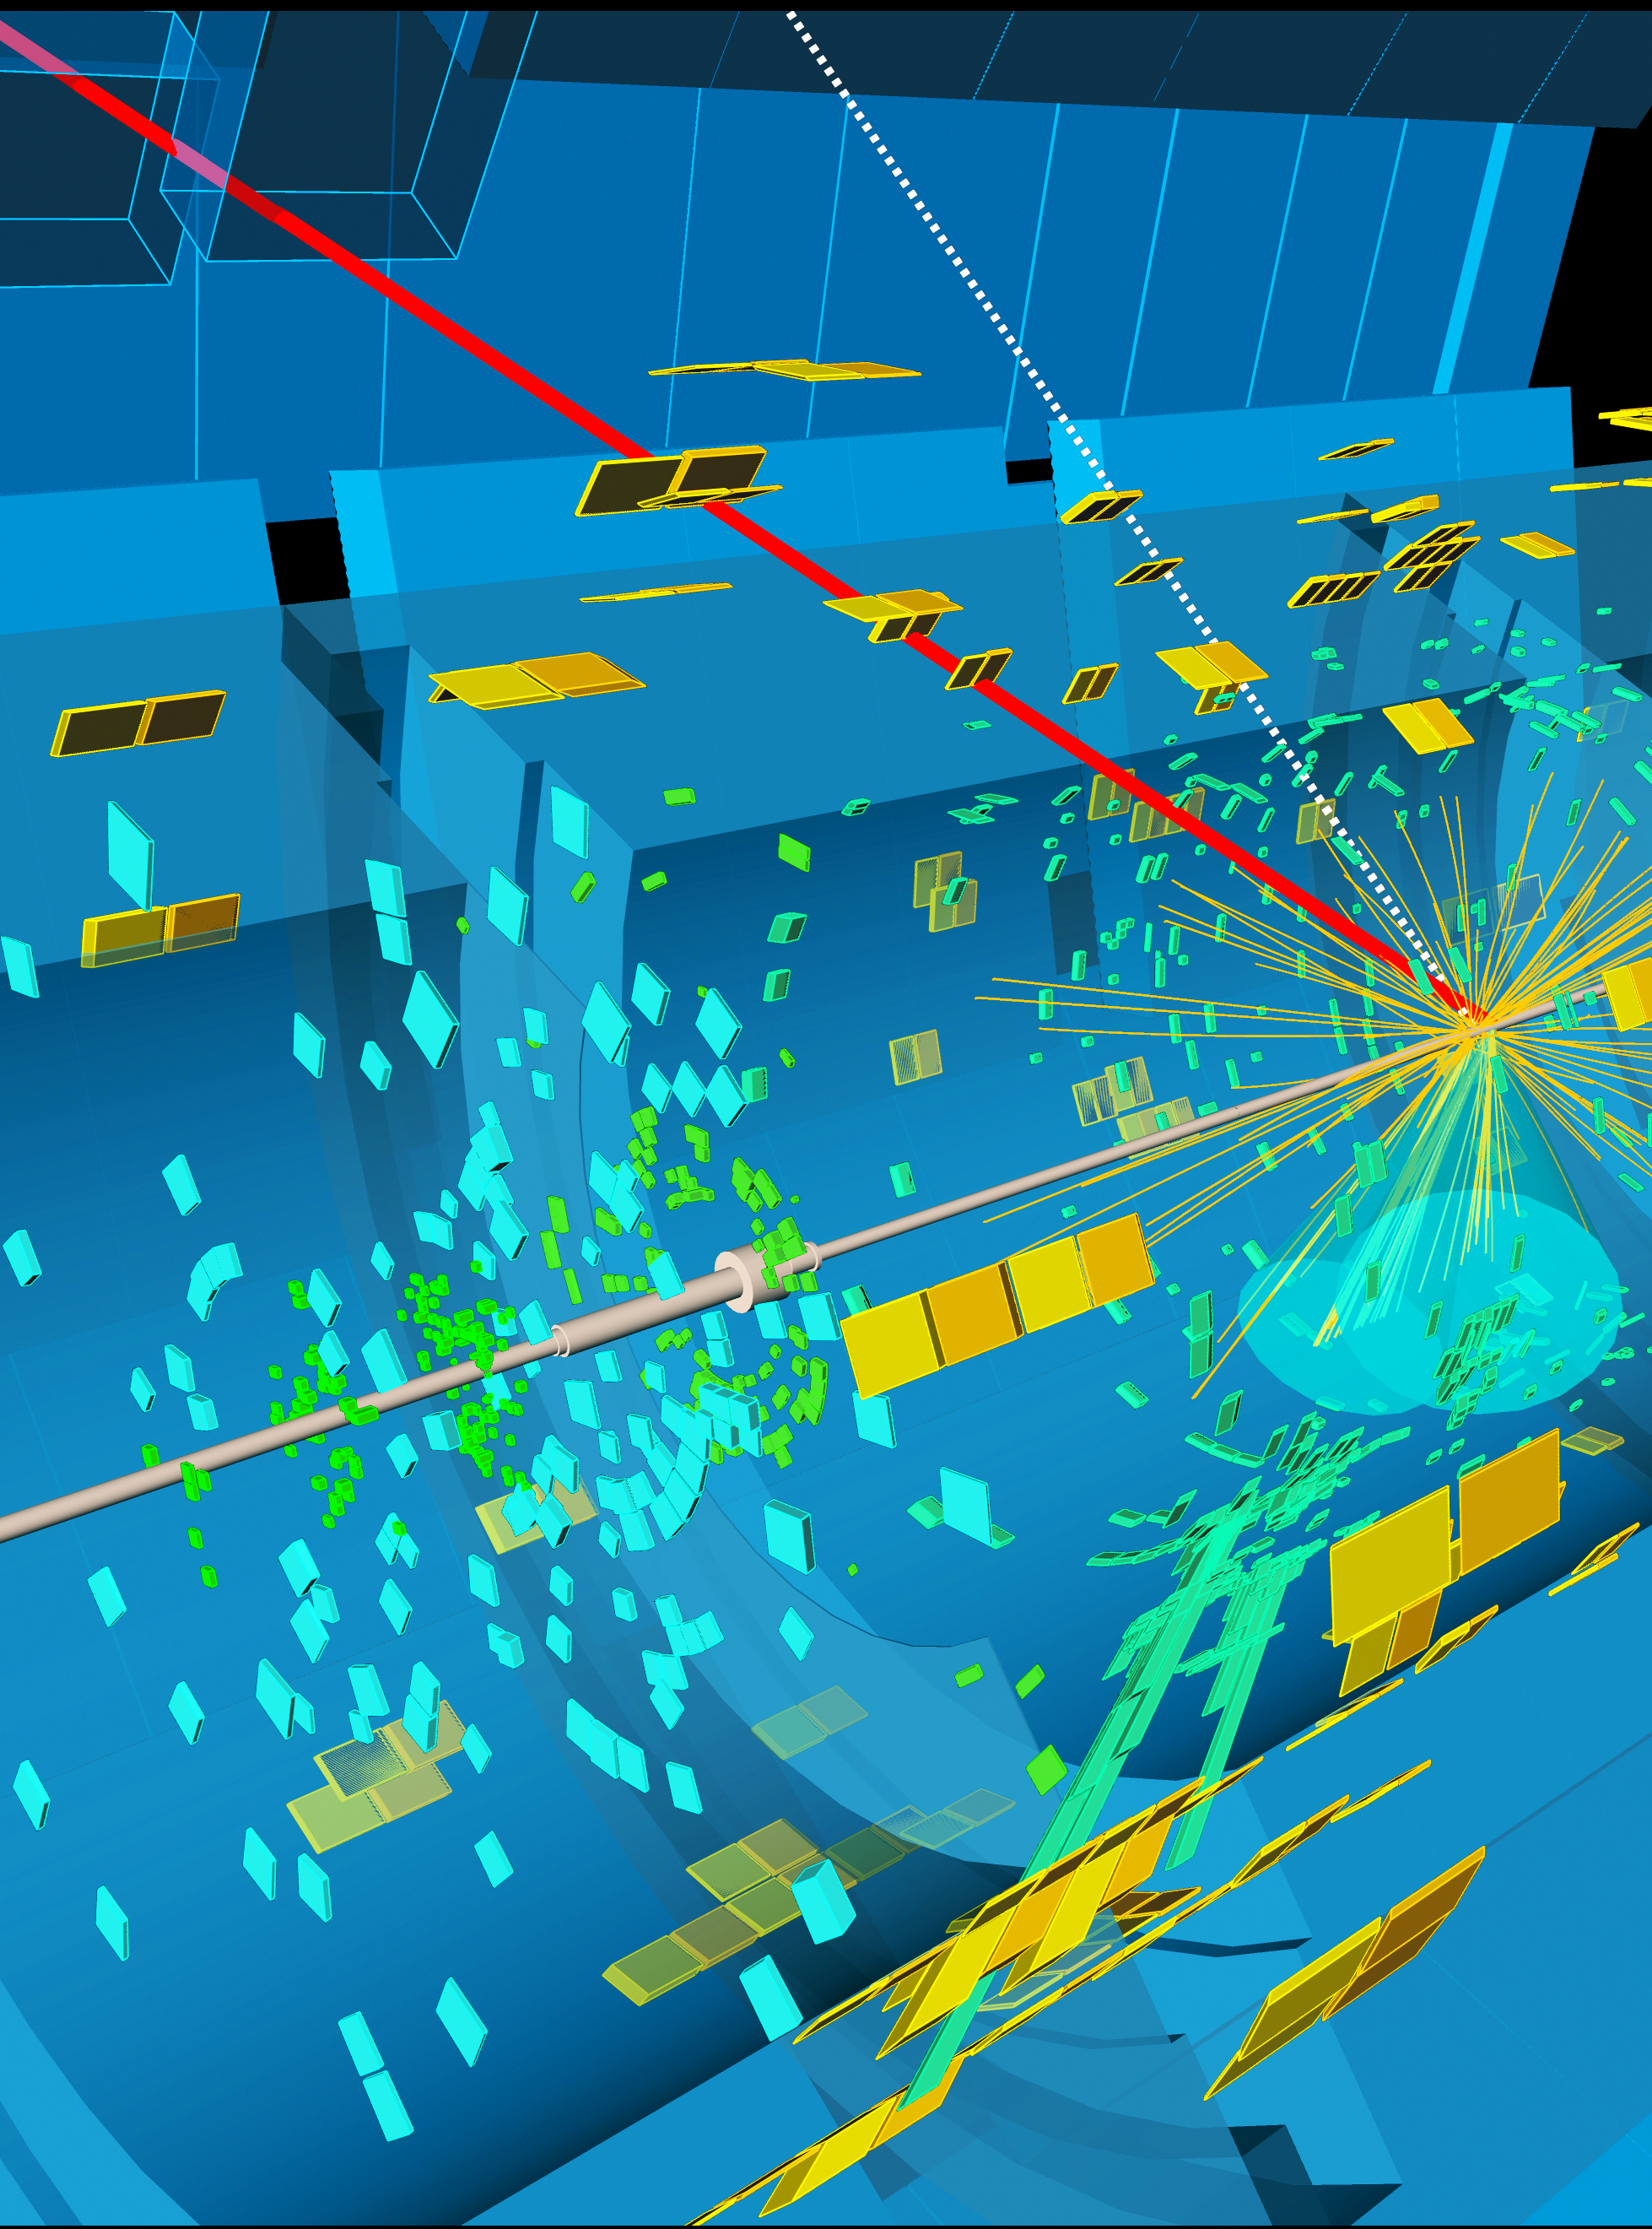
Jet and MET are not usual triggers
Usual game is to trigger on distinctive objects
  But all LHC collisions produce jets
E.g. electron trigger: play with identification purity
Jet and MET are different:
  Jets are defined by jet algorithm
    Cut on phase-space
    Need resolution!
  Then clean up false positives
    Pileup jets, fake MET – need resolution!

Slide 5
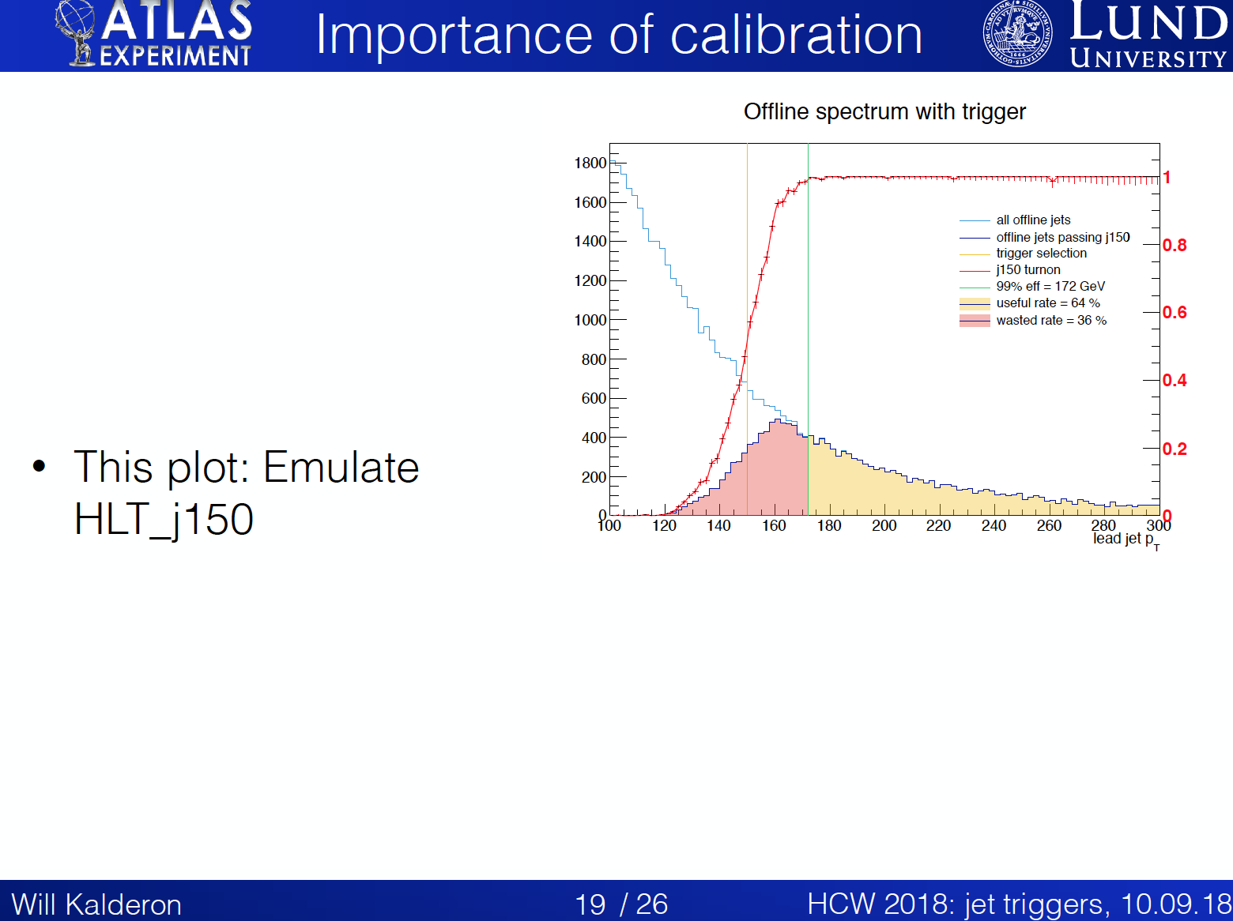
See: Jet trigger overview in HCW2018

Slide 6
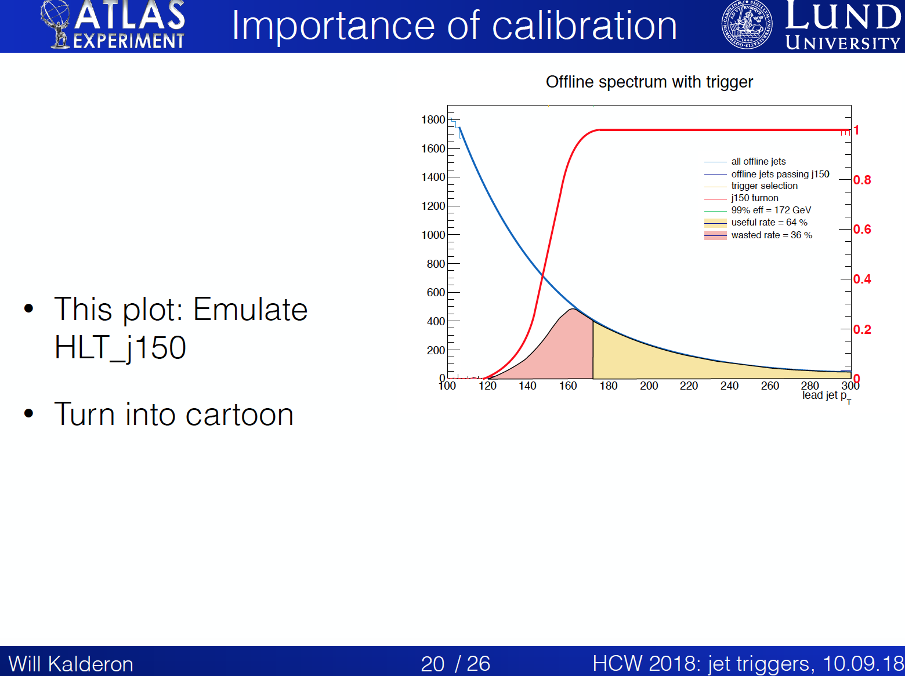
See: Jet trigger overview in HCW2018

Slide 7
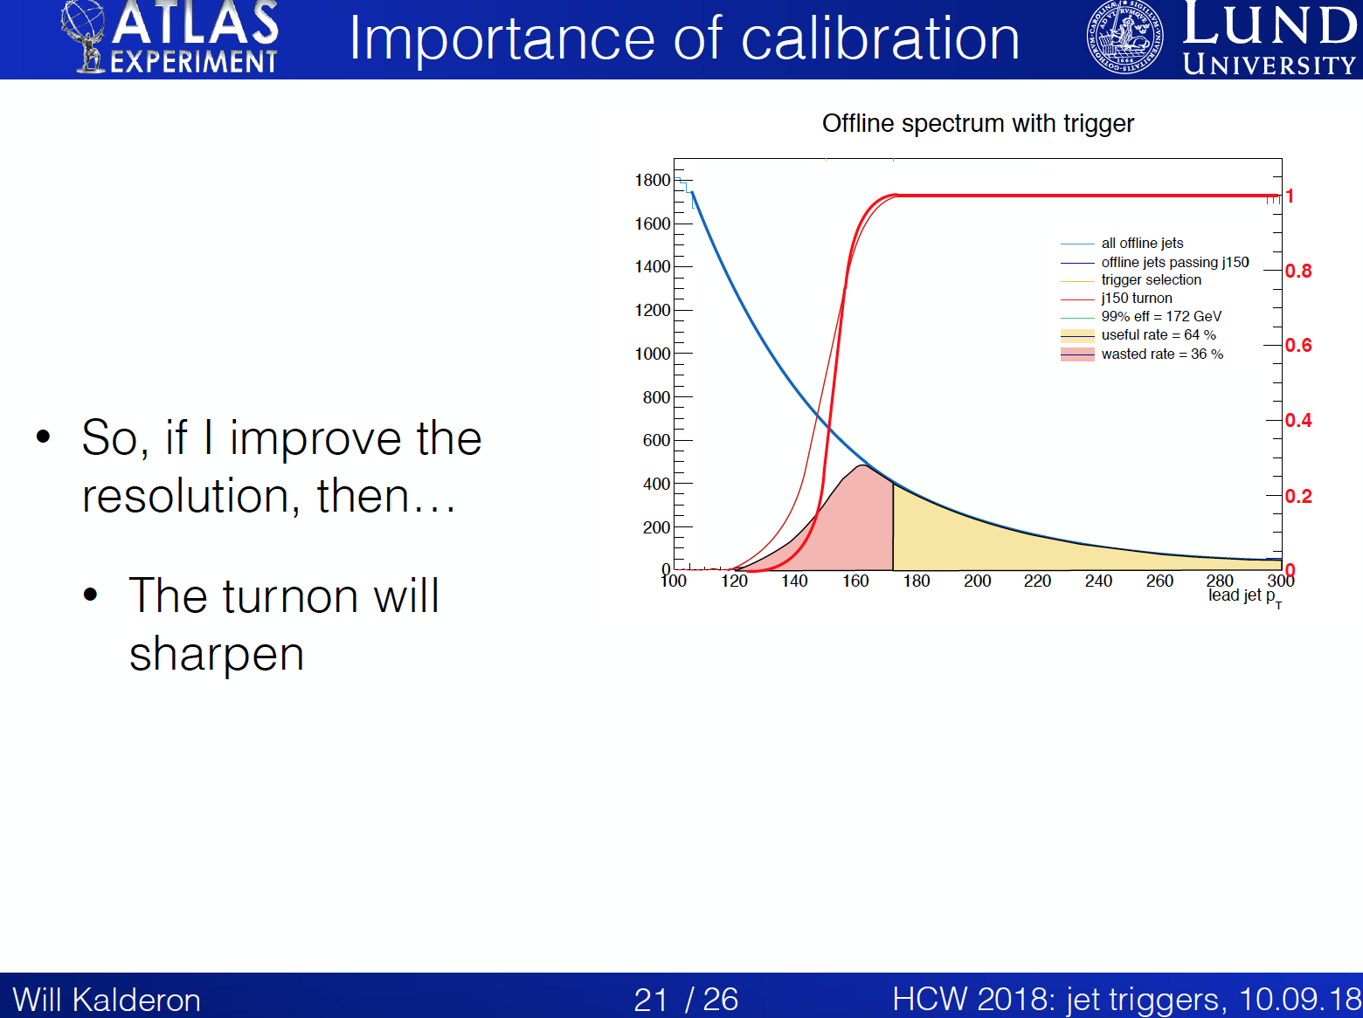
See: Jet trigger overview in HCW2018

Slide 8
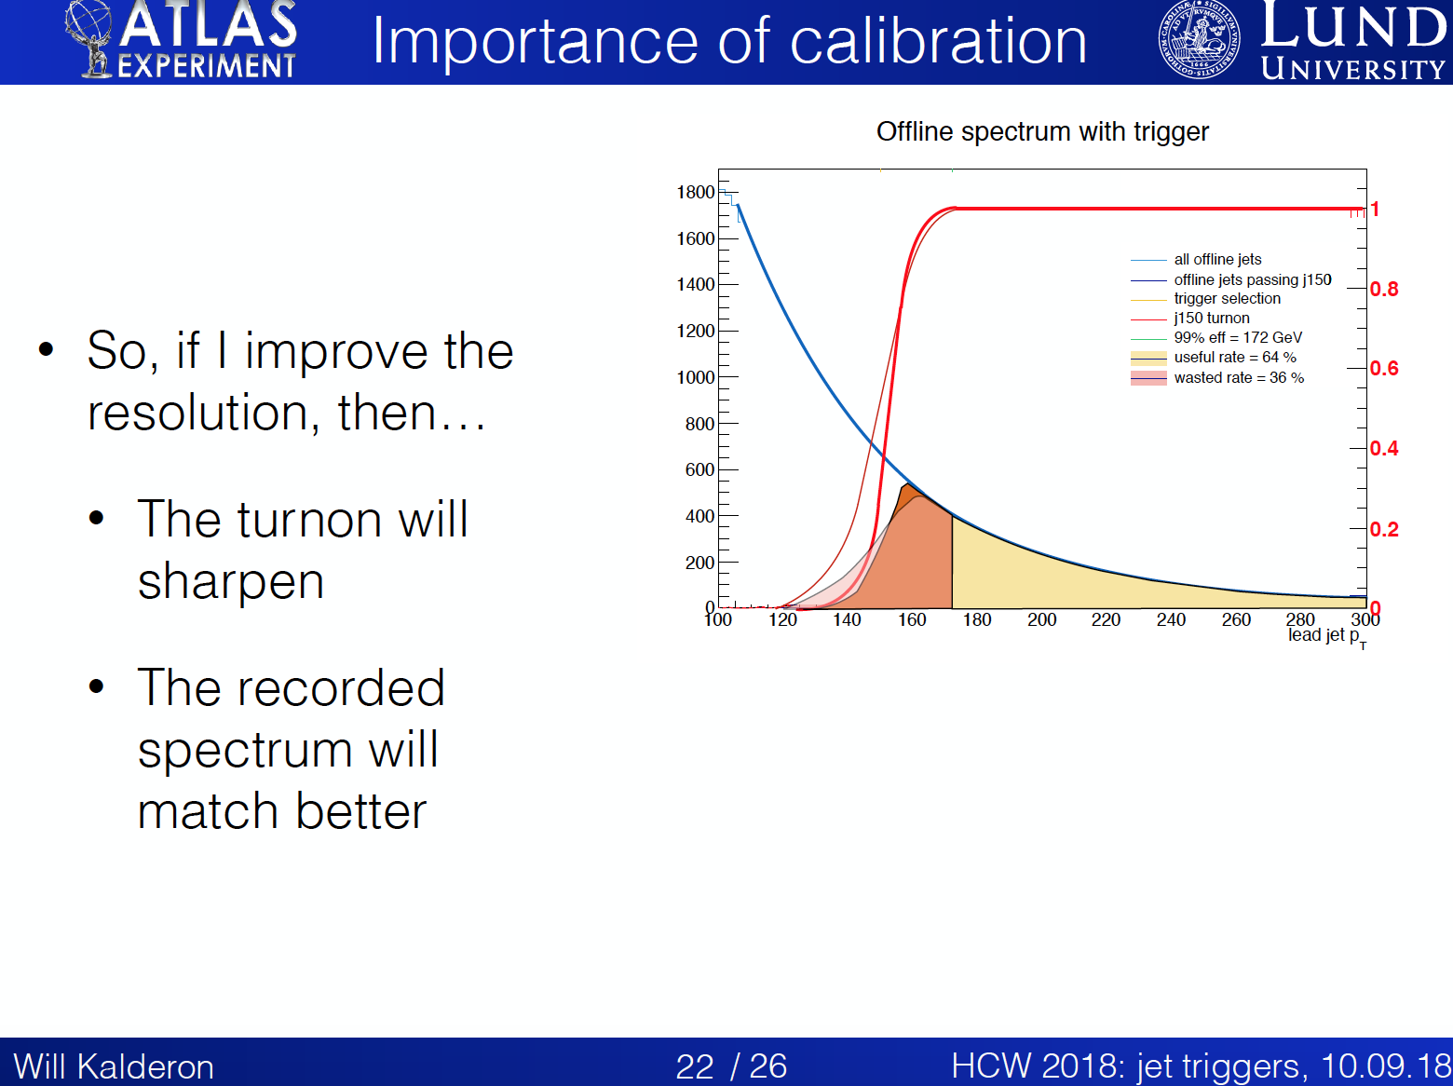
See: Jet trigger overview in HCW2018

Slide 9
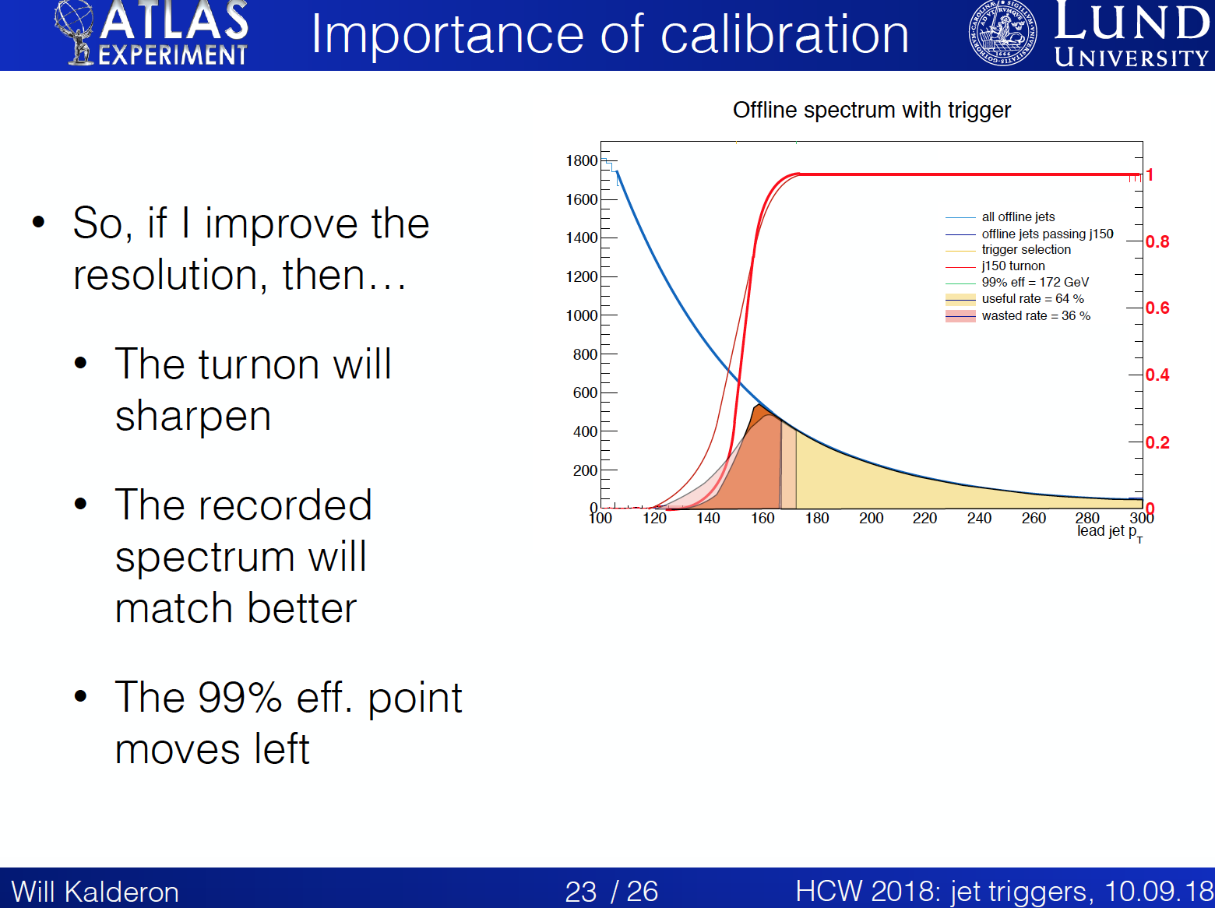
See: Jet trigger overview in HCW2018

Slide 10
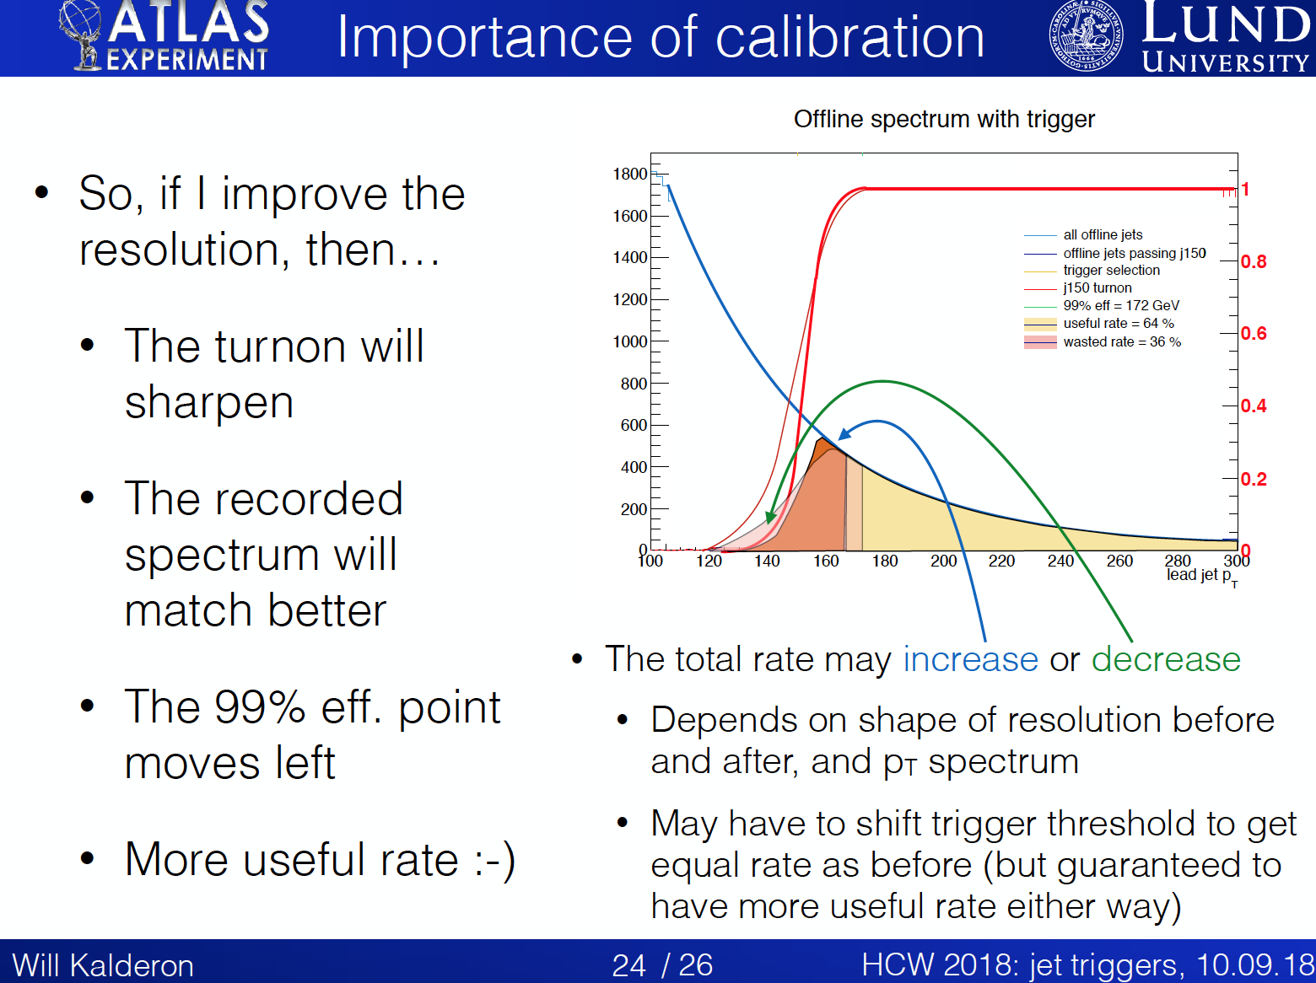
See: Jet trigger overview in HCW2018

Slide 11

Jet Trigger Calibration

Slide 12
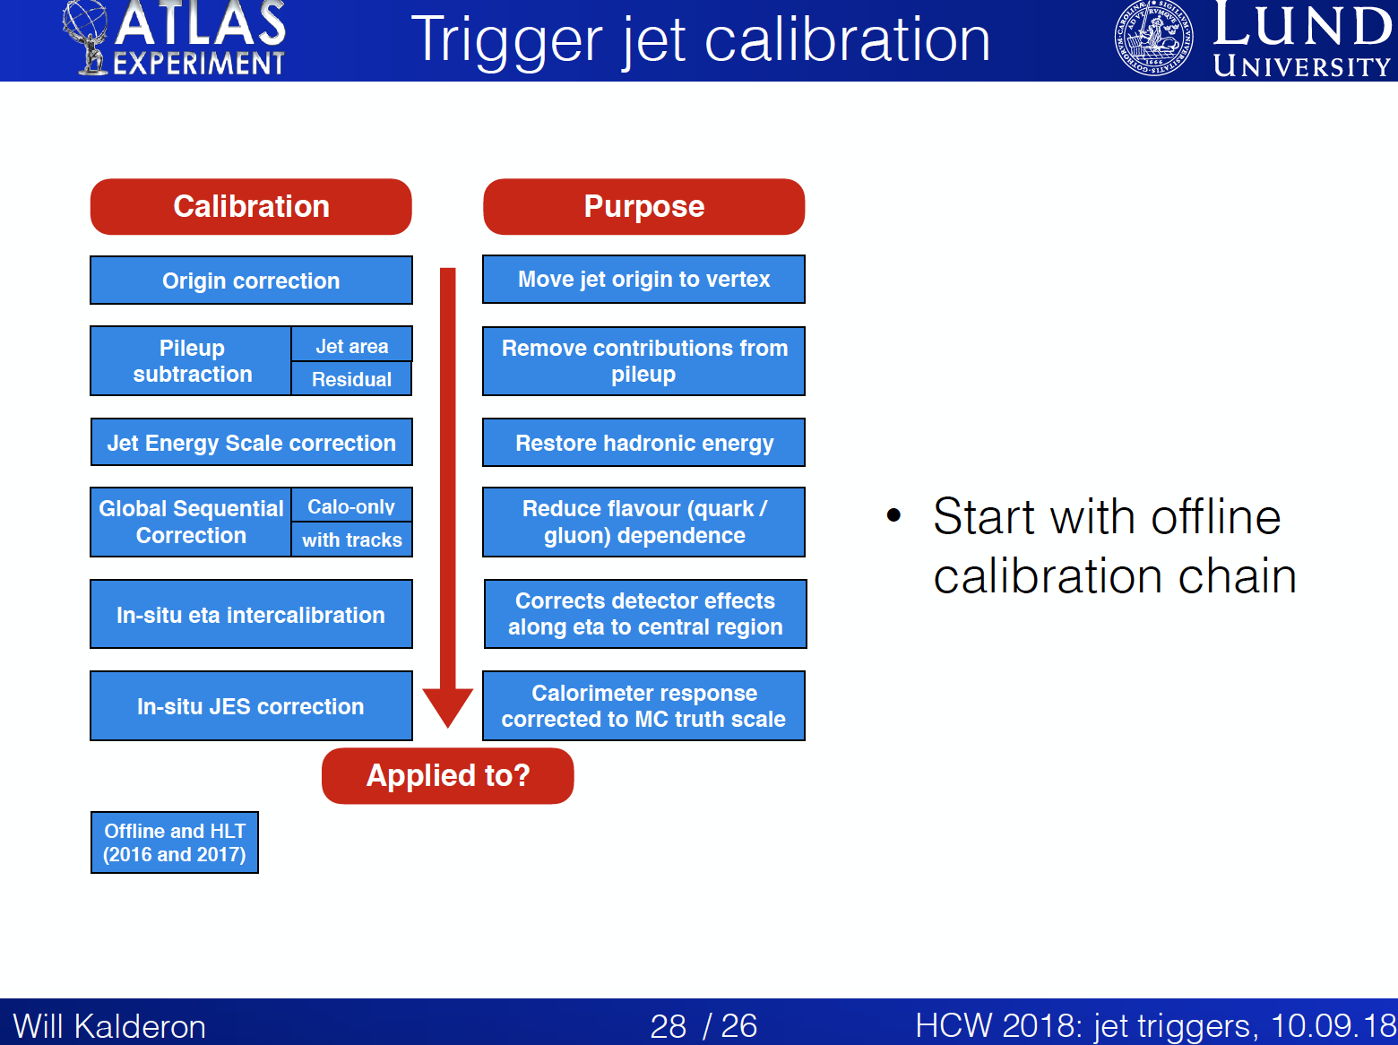

Slide 13
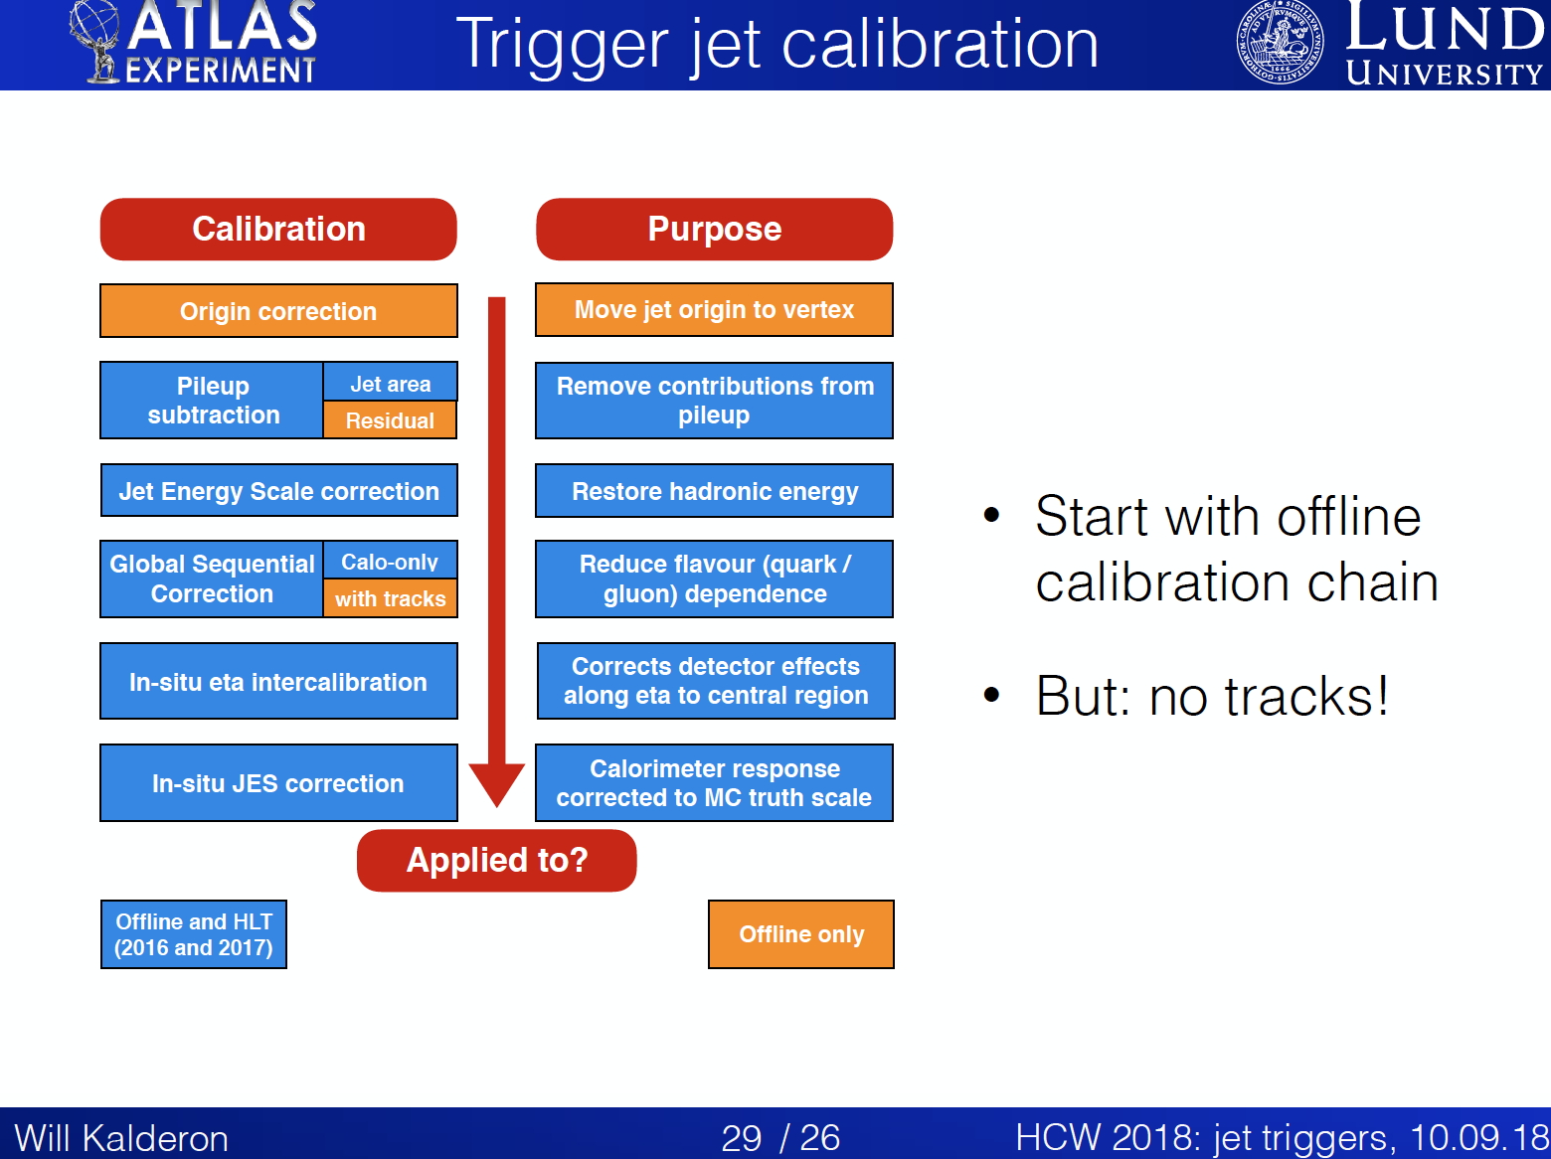

Slide 14
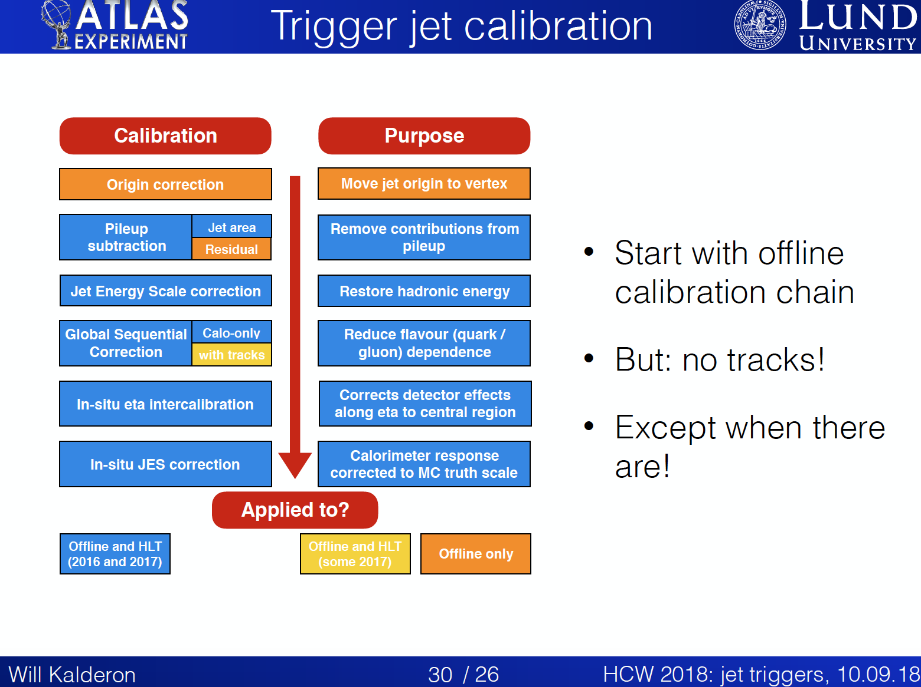

Slide 15
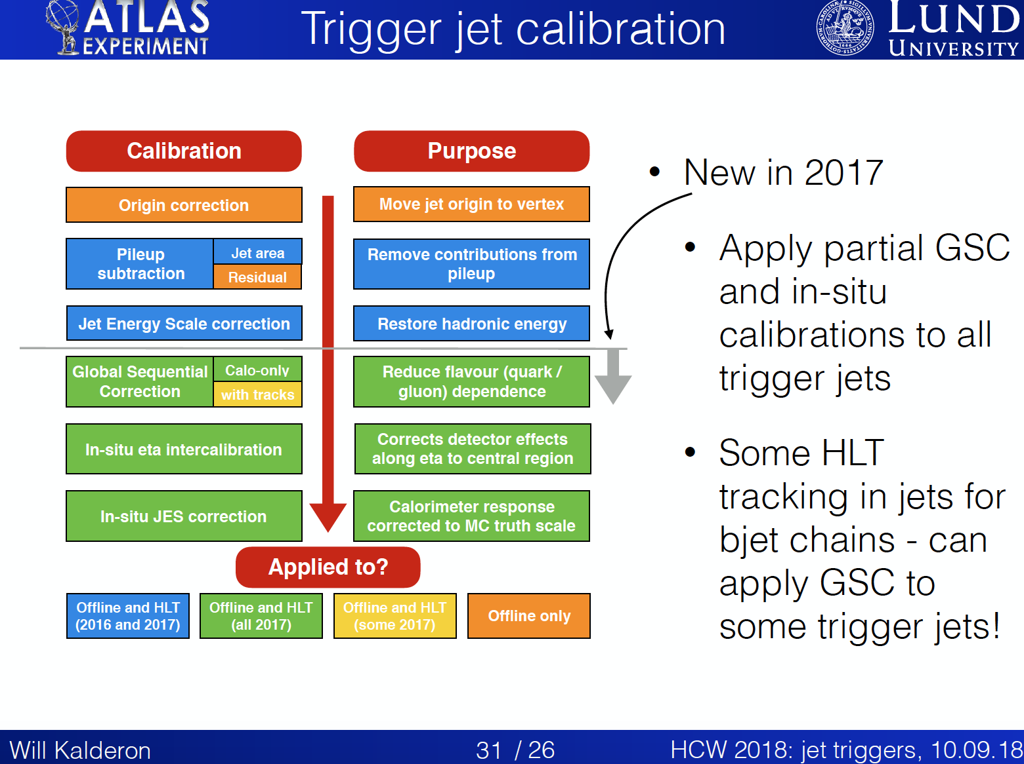

Slide 16

Ideal World
Full-scan tracking at the HLT would mean:
No complicated RoI-based tracking
  All triggers would have tracking, not just b chains
PFlow available for all thresholds
  Better match with offline jets
  Less rate wasted with migrations from below the threshold
Pileup suppression with JVT
  Less rate wasted from pileup effects
See Ben’s contribution in HCW2019

Slide 17
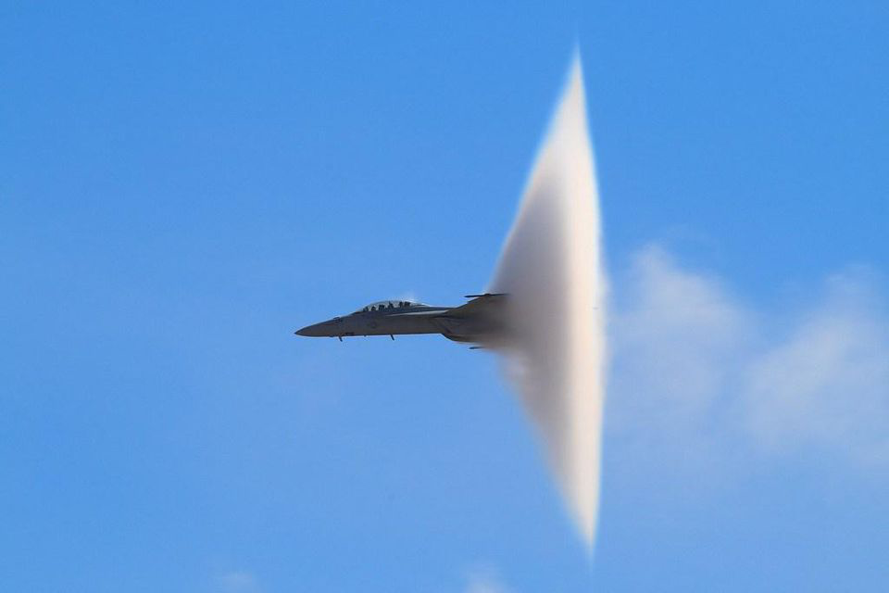
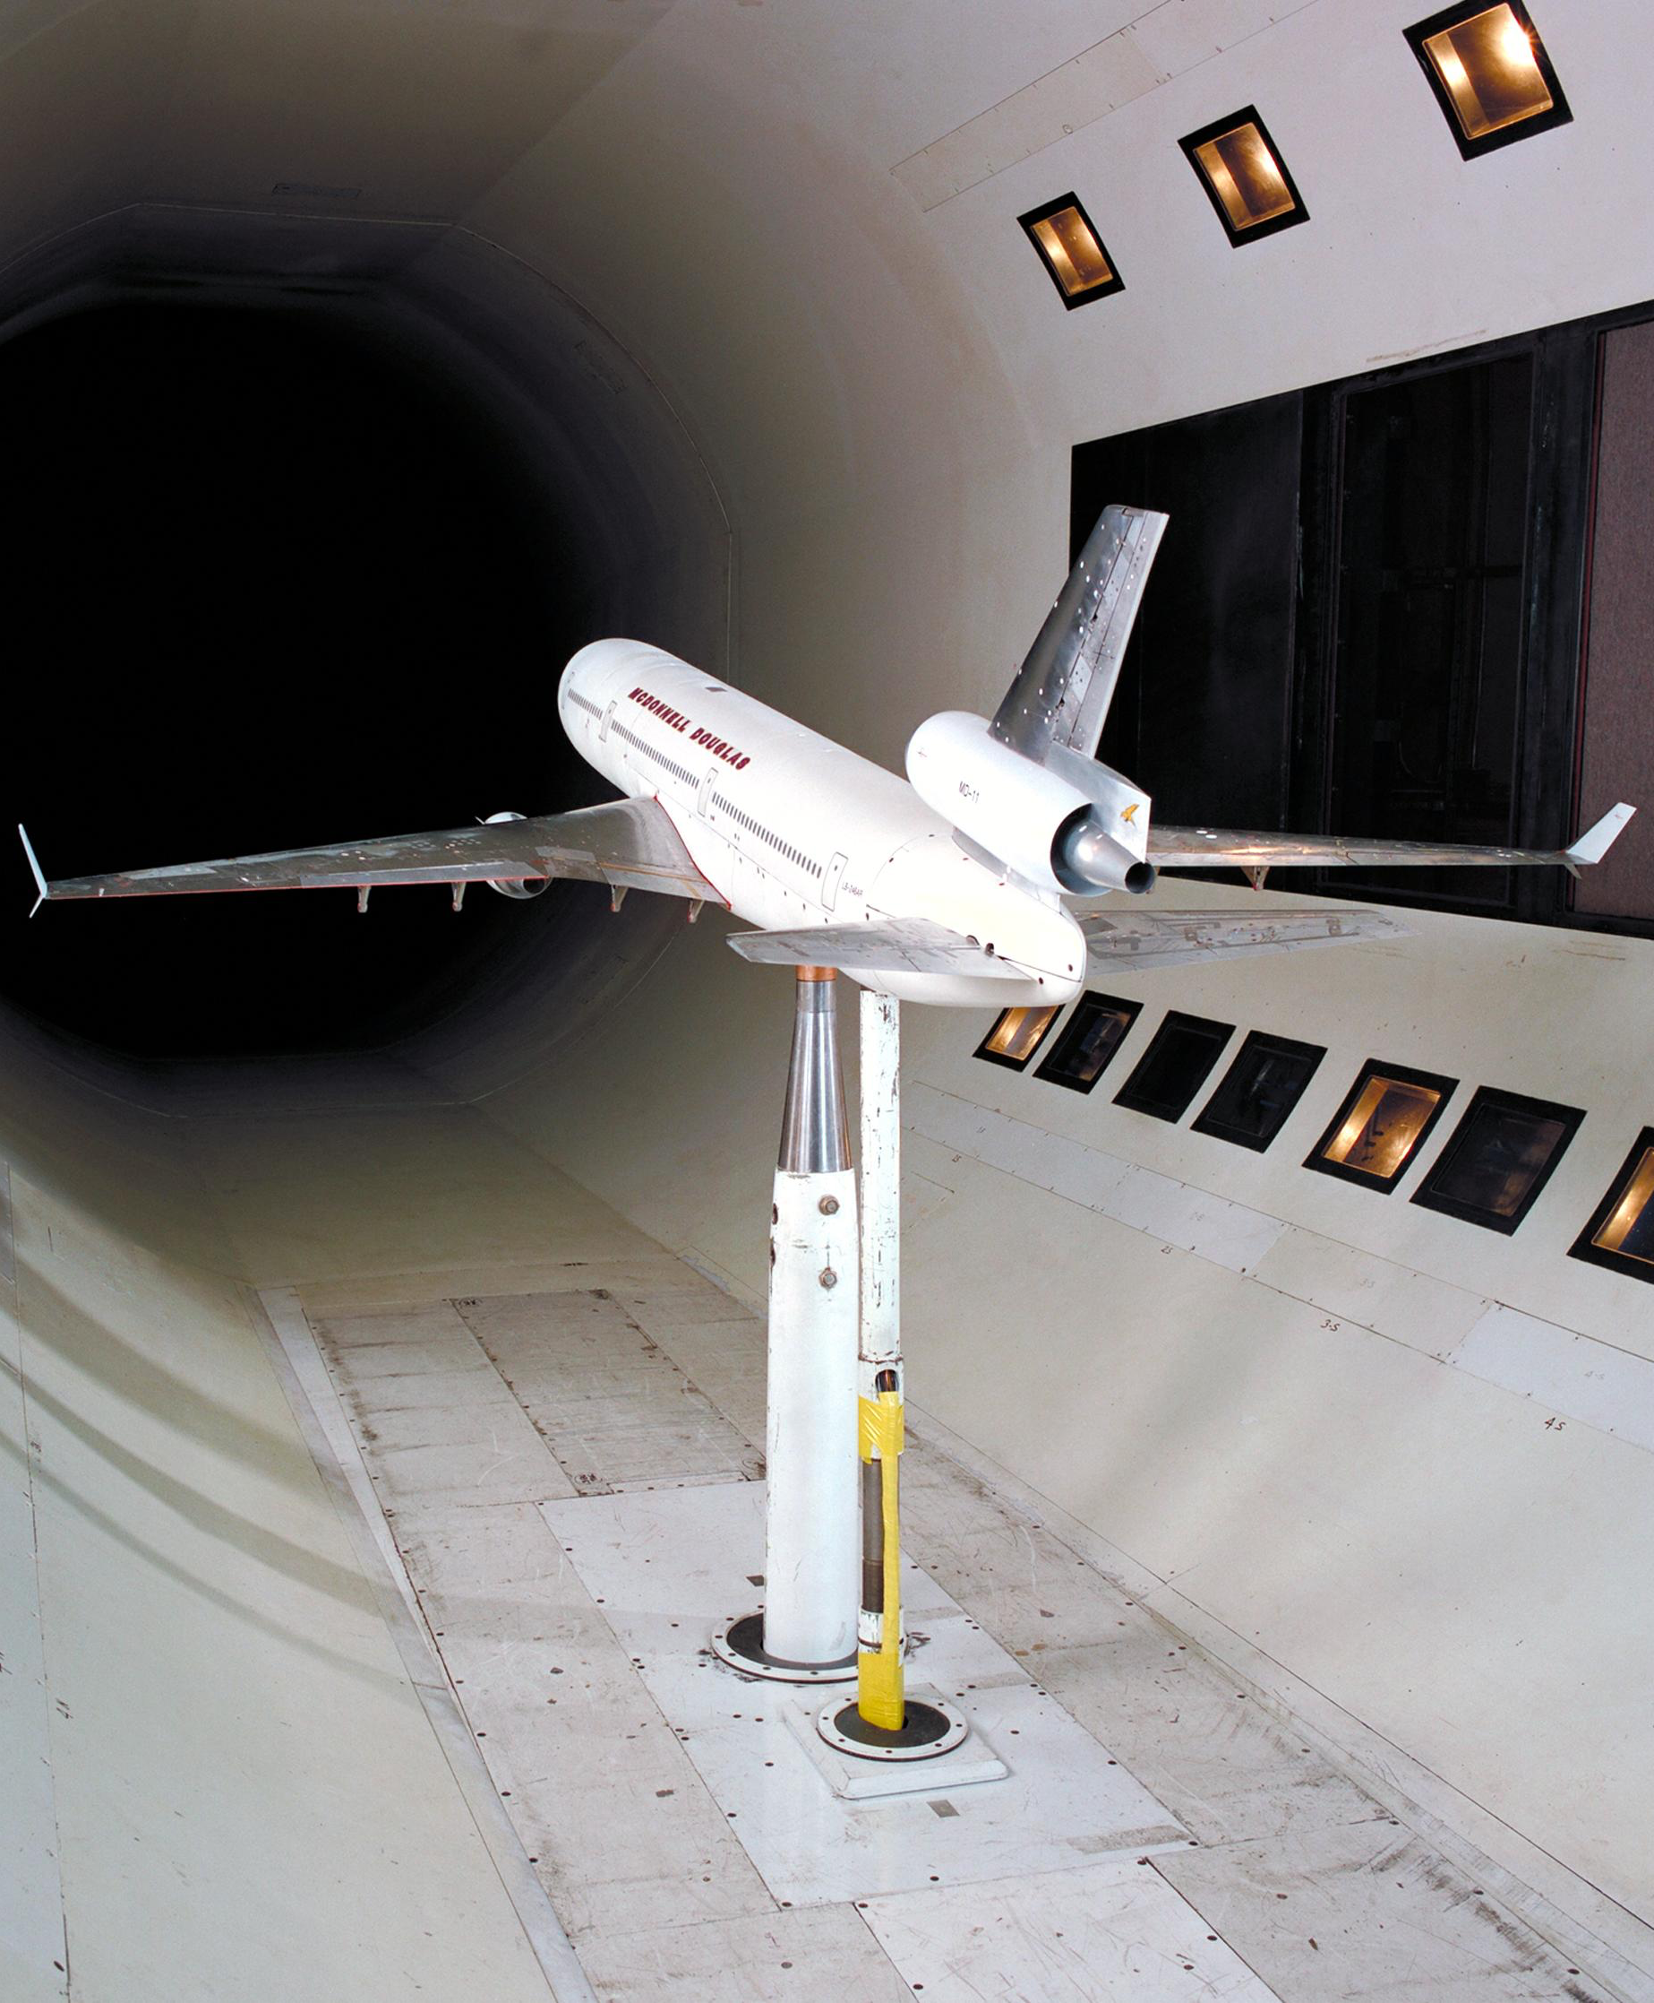
Jet Trigger Performance in Run 2

Slide 18
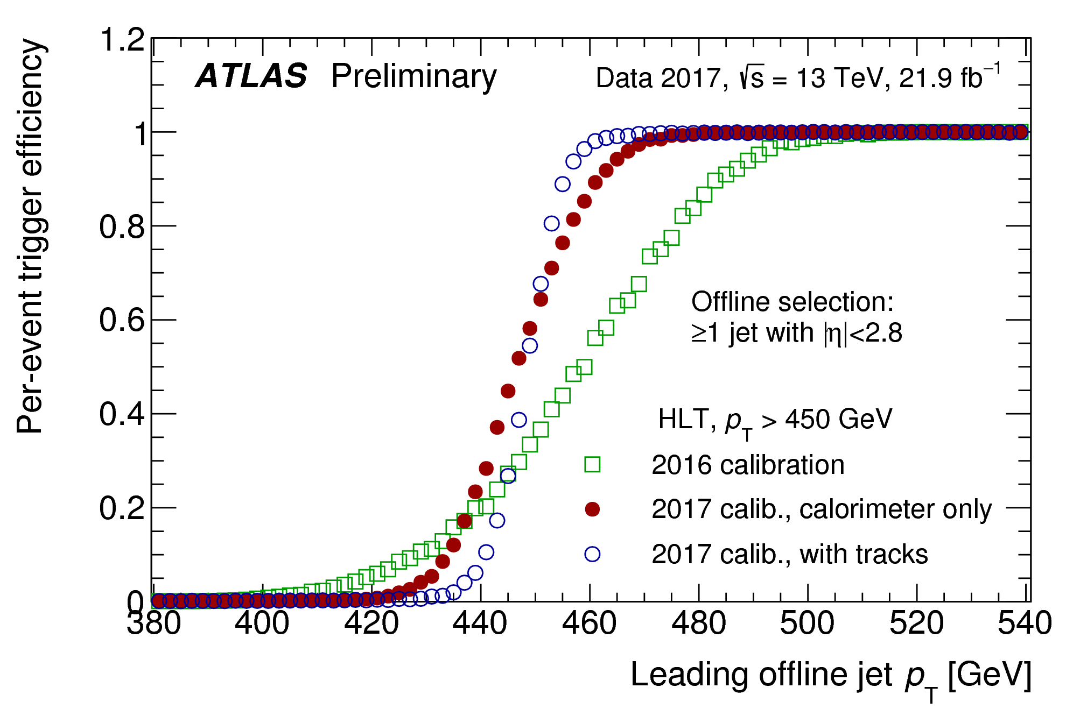
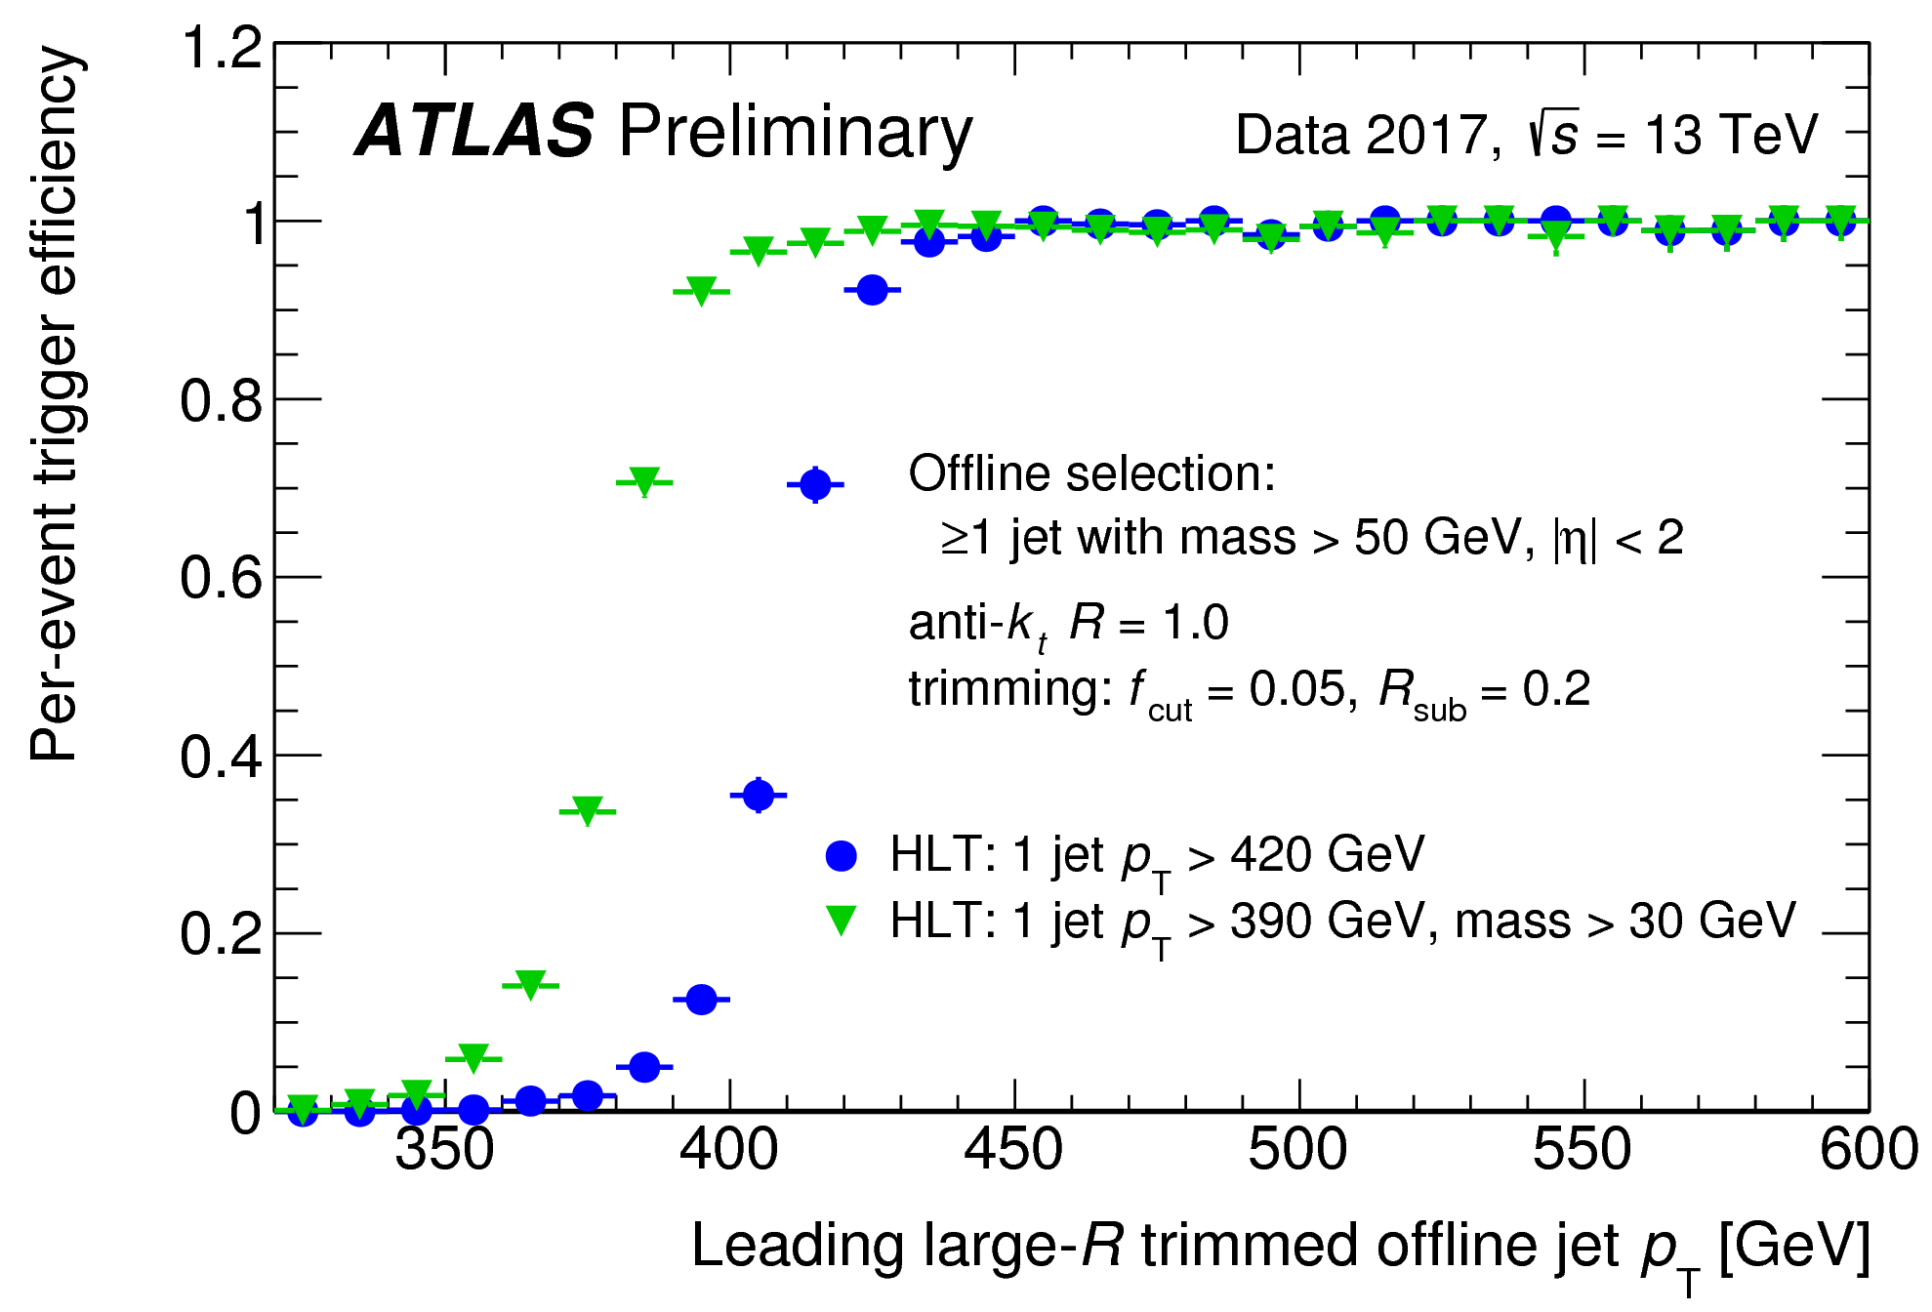
2017 Performance
See ATL-DAQ-PUB-2018-002
Single-jet trigger with different calibrations
  2016 calibration
  2017 calorimeter-only calibration
  2017 calibration plus GSC and in-situ corrections
Better jet resolution!
HLT large-R single-jet triggers
  |η|< 2.0
  jet mass > 50 GeV

Slide 19
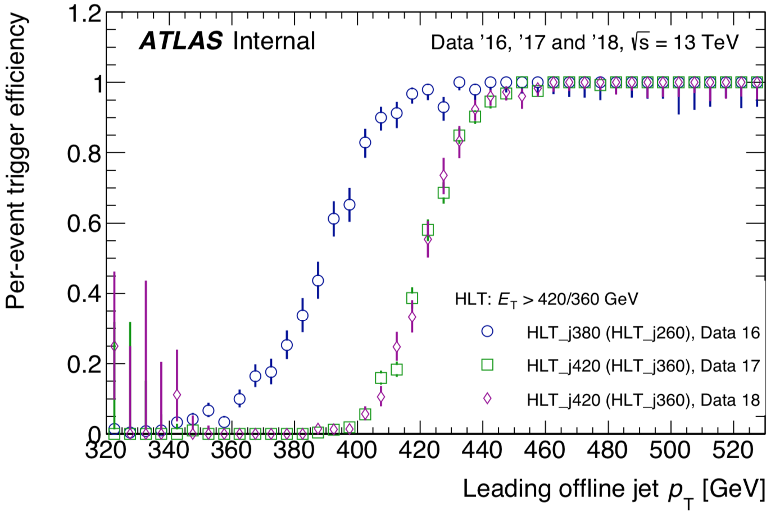
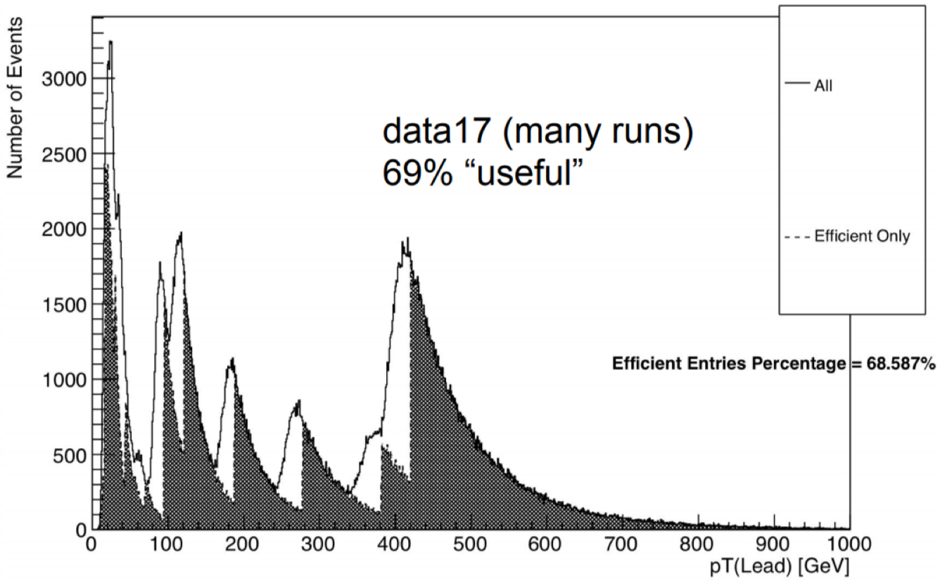
Latest updates
Preliminary plots
  Work in progress; not full stats
Lowest unprescaled single jet turn-on
2016 data(*)
NOTE: your latest calibration doesn’t exist when trigger is running...
2017 and 208
  Updated JES
  Added GSC
  Added in-situ correction
Impact of HLT calibration: (shaded: >99% efficiency)
Efficiency increased from 51% (2015to 69%

Slide 20
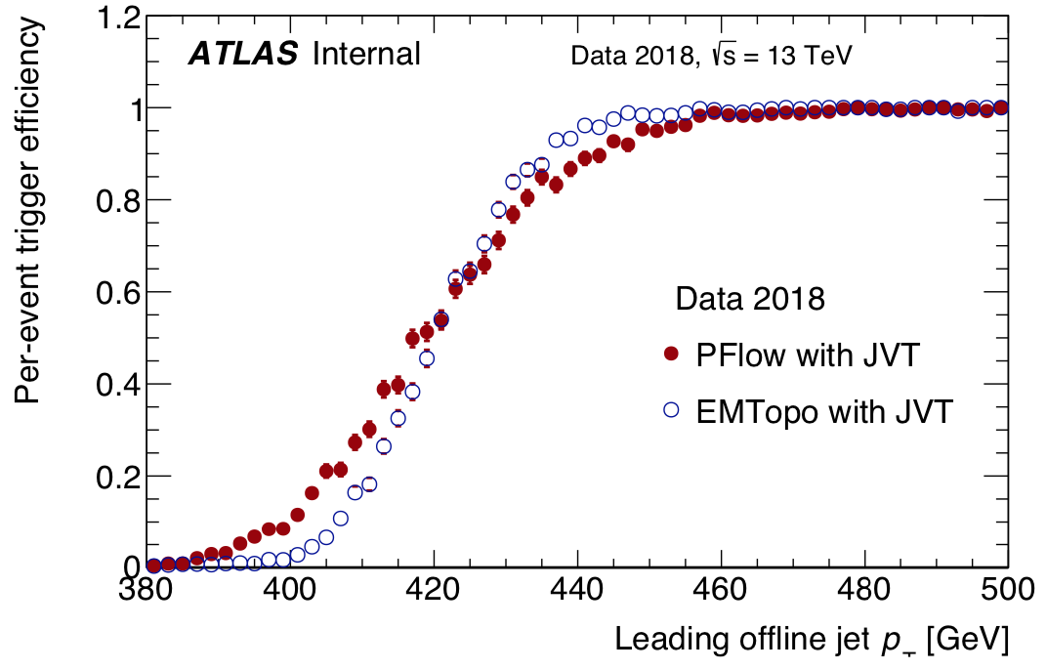
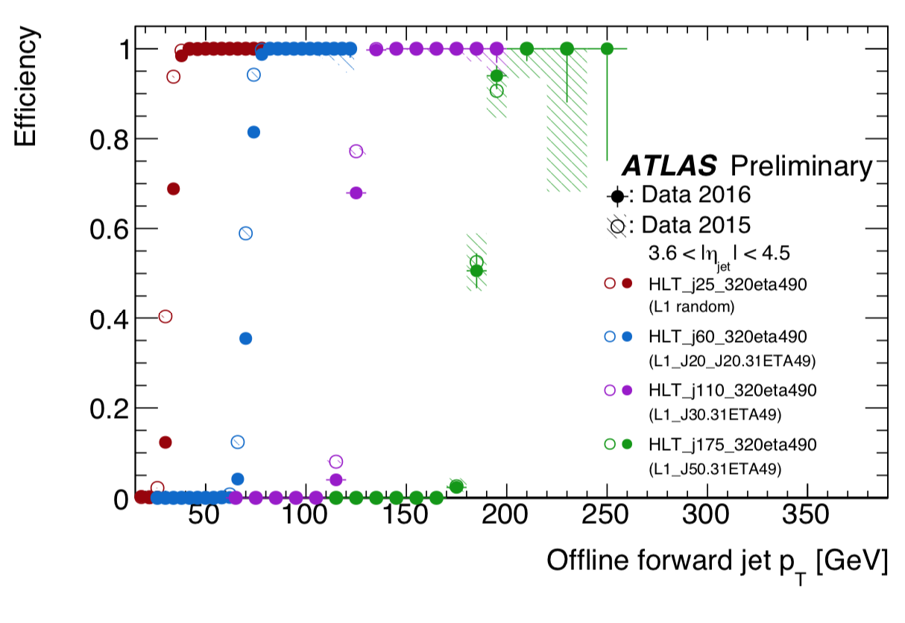
EMTopo trigger jets plotted vs offline EMTopo or Pflow
  Note: x-axis is either EMTopo or PFlow
For completeness: forward jets

Slide 21

Tracking in the jet trigger(*)
(*) In an FTK-less world

Slide 22
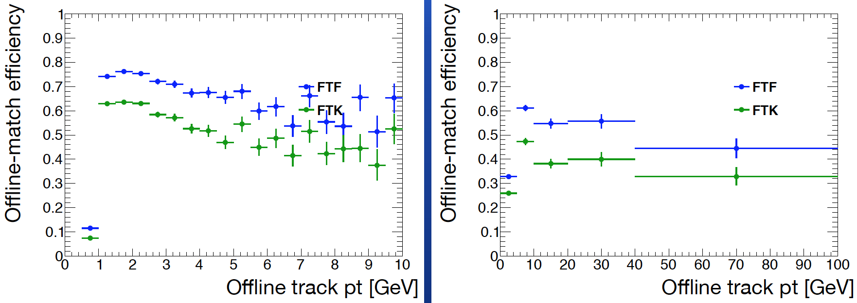
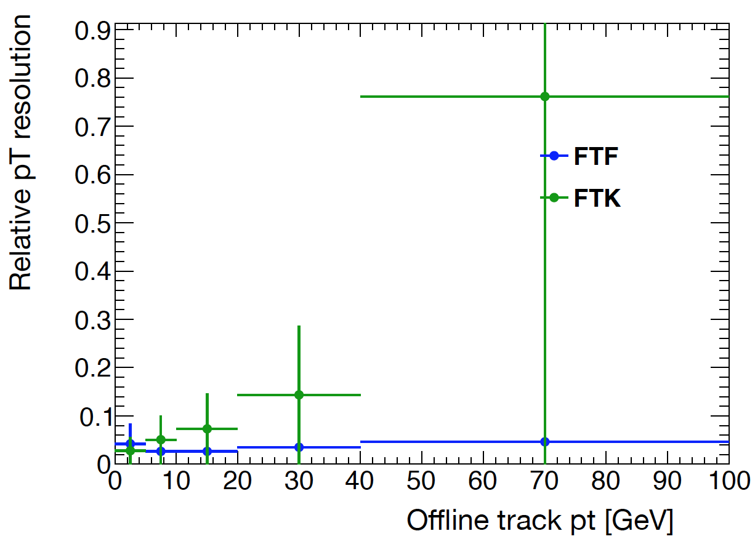
FTK vs FTF comparison
TJ Khoo
Took 21.3 AOD sample with FTF & FTK tracks (ART test)
Match tracks to offline with min deltaR cut of 0.01
  Good enough, no overlaps
Applied 500 MeV pT cut and TightPrimary WP
Compare resolution and efficiency for FTF and FTK (non-refit)
Resolution is width of Gaussian (fitted to +/- 2 sigma)
Rate wrt no JVT | JVT>0.15
HLT_j15 | 81%
HLT_j45 | 85%
HLT_4j15 | 13%
HLT_2j45 | 45%
HLT_4j45 | 76%
HLT_6j45 | 68%
p_{T} < 1 GeV

Slide 23
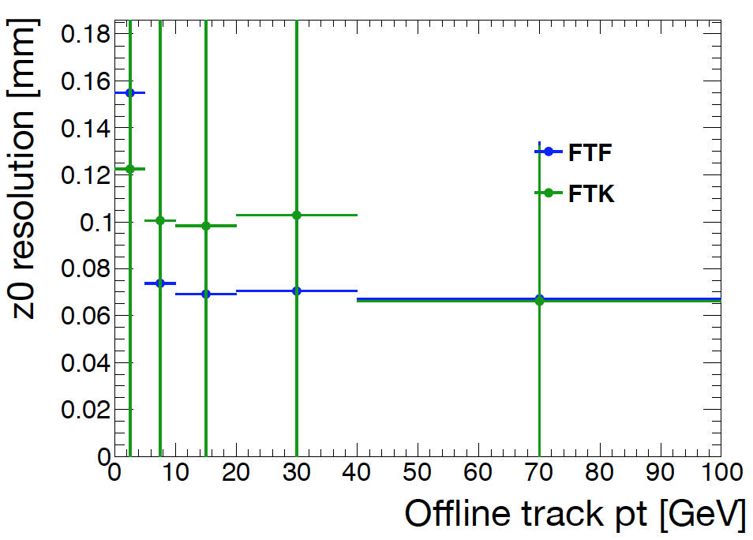
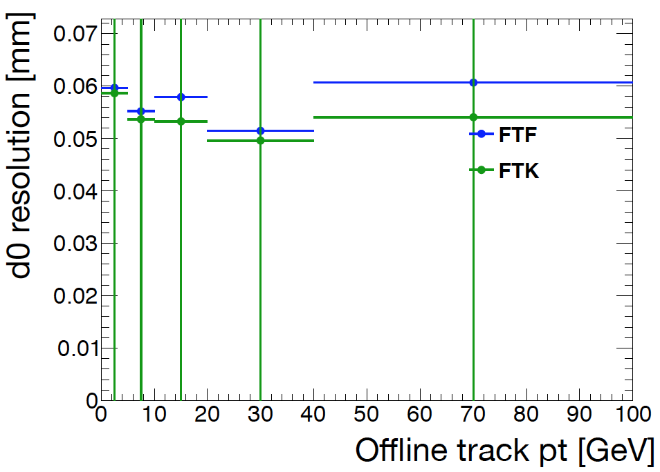
FTK vs FTF comparison
Performance of these FTF tracks seems better than FTK benchmark
  Except resolutions at very low p_{T}
  And have not checked fake rate
BUT: this version of FTF takes 5s/event
  Not only tracks, also need vertexing algorithm
  Goal is 1s/evt but compatible with FTK performance ; currently 5s/evt

Slide 24
Tracking scenarios
First: need a better assessment of PFlow performance with HLT tracks
  Initial results from 2016, but raised questions recently
  Need to establish that the HLT PFlow gives us a significant benefit over pure calo triggers.
Baseline procedure would be:
  Run HLT fast-tracking (re-optimised for speed, performance similar to FTK)
  Run PFlow with HLT tracks & clusters
  Run PFlow jet-finding
Plan B (if we get decent FTF track performance but fail CPU constraints):
  Build jets from topoclusters for pre-filtering (no track GSC)
  Run HLT fast-tracking (reoptimised for speed, performance similar to FTK)
  Run PFlow with HLT tracks & clusters
  Run PFlow jet-finding
Plan C (if PF still worth it but plans A and B fail CPU constraints):
  Do tracking only in RoIs around jets (a la current b-jet tracking) with low enough thresholds to build vertices and achieve some pileup suppression

Slide 25

Jet Trigger Inputs

Slide 26
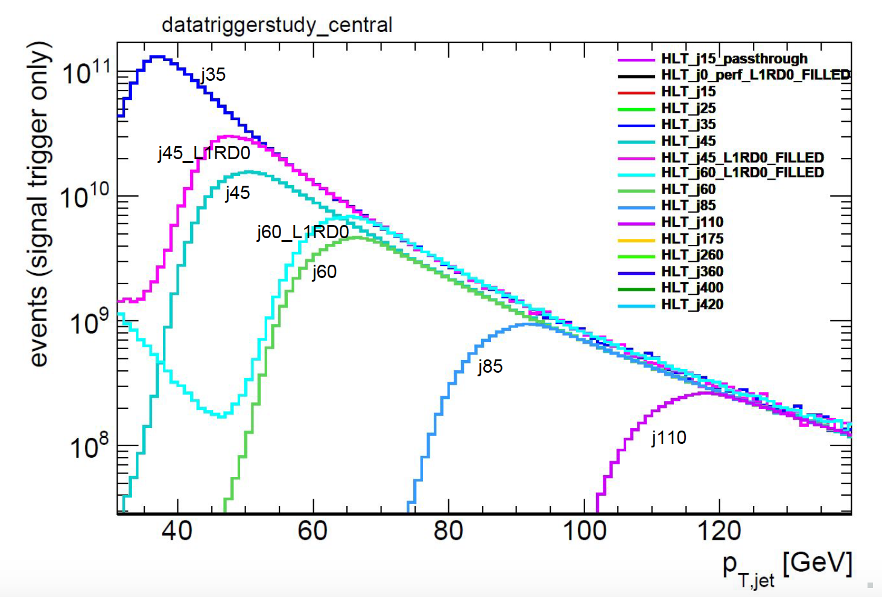
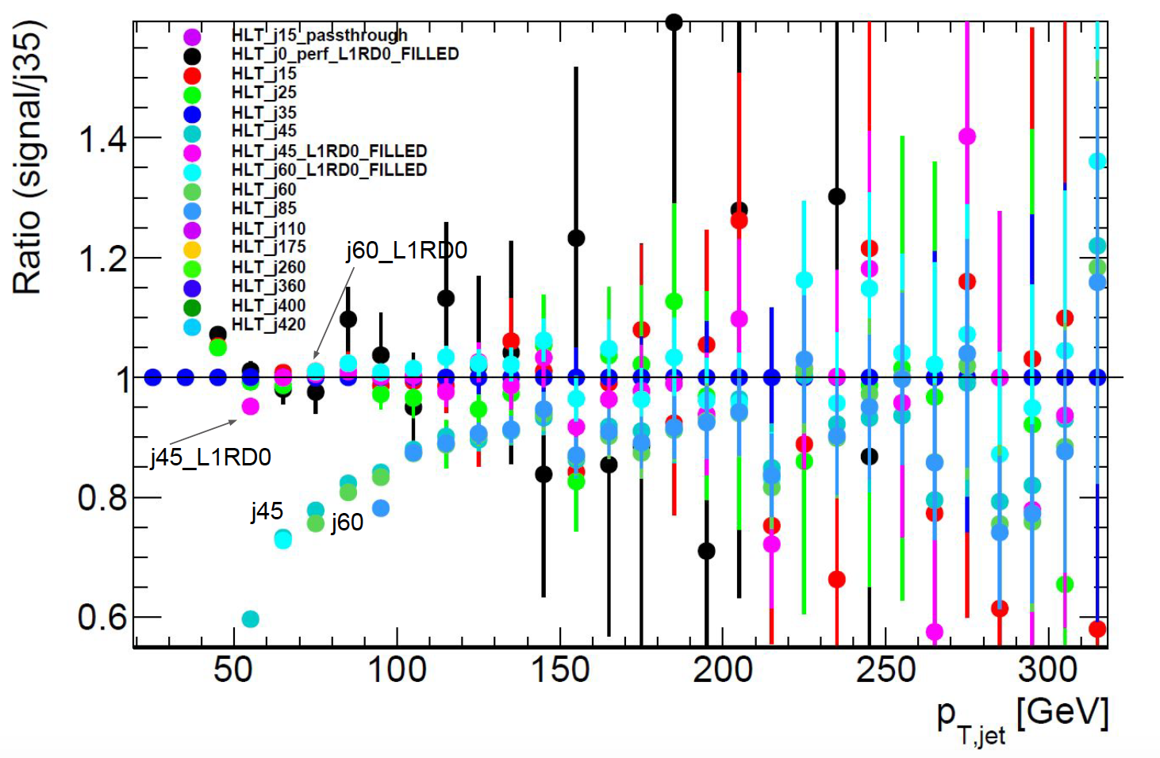
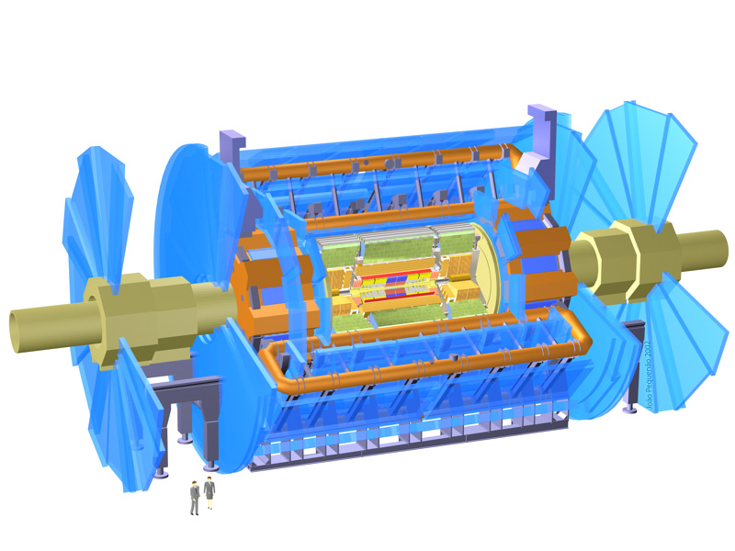

Jet trigger performance in low-μ data
Tancredi Carli, Tigran Mkrtchyan
L1 Trigger
HLT Jet Trigger
j45
J45_L1RD0
Evaluated efficiency jet trigger efficiency in 2017 data using the minimum bias trigger

Slide 27
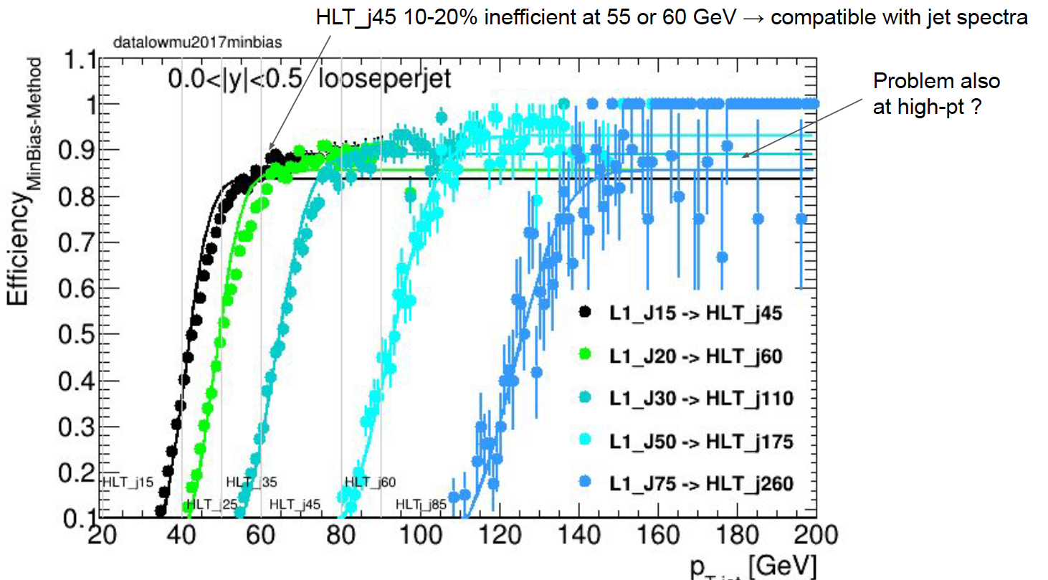
L1Calo efficiency wrt L1 MB trigger
0 <|y|< 0.5
10-15% inefficiency

Slide 28
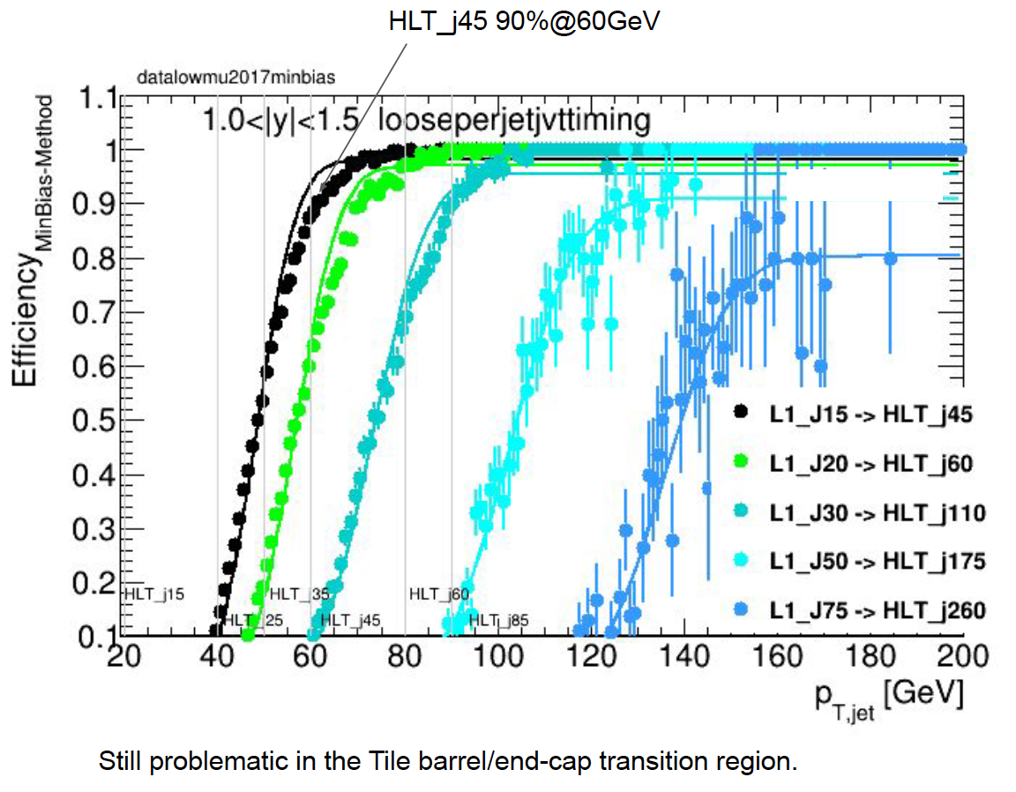
L1Calo efficiency wrt L1 MB trigger
2 <|y|< 2.5
Clue:
Ok for higher y

Slide 29
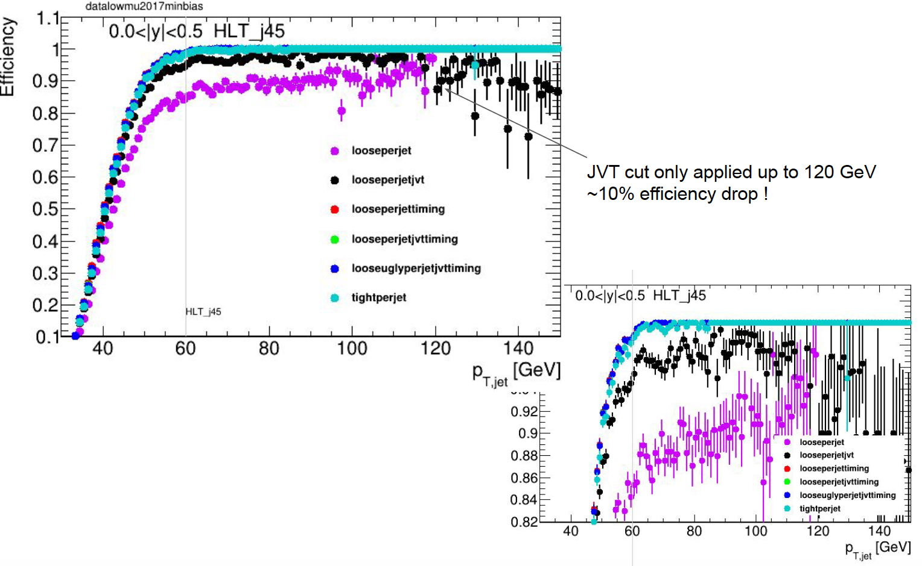
L1Calo efficiency wrt L1 MB trigger
Clues:
Ok after JVT and timing
0 <|y|< 0.5

Slide 30
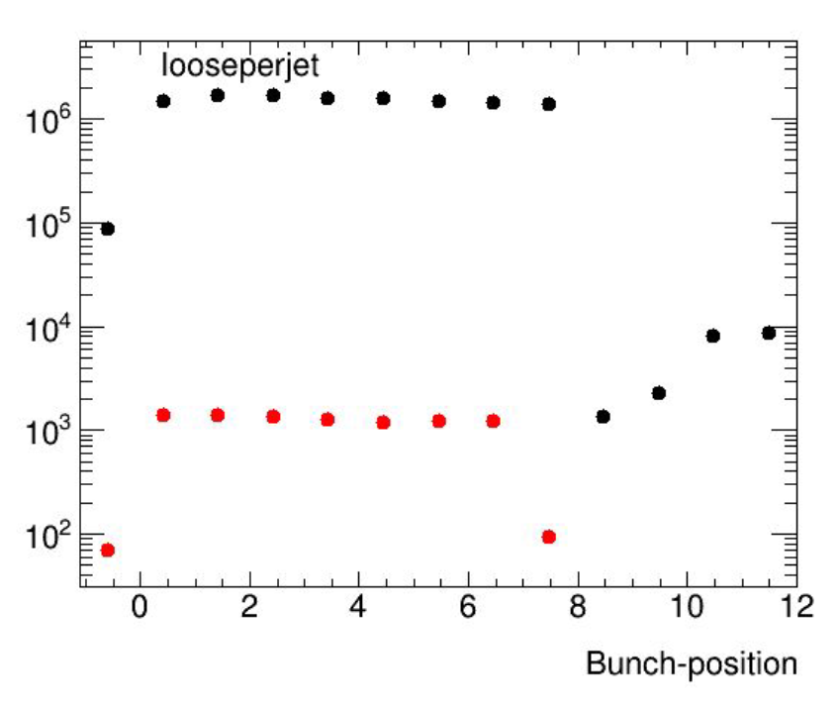
Rate vs position in bunch train
Filling scheme:
8 filled, 4 empty
Possibility is that effect comes from 1st empty bunch
All MB triggers
MB triggers with no L1 jet
1st filled bunch last filled bunch

Slide 31
Current understanding
There is a 10-15% inefficiency in L1 jets wrt L1 random-triggered events
  Under investigation
  Observed for |y| < 2
  Full efficiency is regained by applying jet timing cut
Steve’s explanation
My theory is that the effect seen is mostly due to jets in the next BC (since if there was a bigish jet in the previous BC in low mu data, we'd have probably triggered it already, so be in the deadtime of a genuine L1A). This means you should not see the effect in the last bunch in a train, since there are
no genuine jets 25 ns later in that case. This corresponds well to the plots on 29/30 where Tancredi sees little L1Calo 'inefficiency' in the last bunch of these 8b4e trains. Let’s put it another way, in those bunches, there are no out of time jets to be over-counted by his analysis!

Slide 32

Conclusions
Thank you for a great workshop!
Jet trigger performance has steadily improved by increasing commonality with offline jets
Currently at a crossroads: HLT tracking is necessary to continue to evolve

Slide 33







The End

Slide 34

Backup

Slide 35
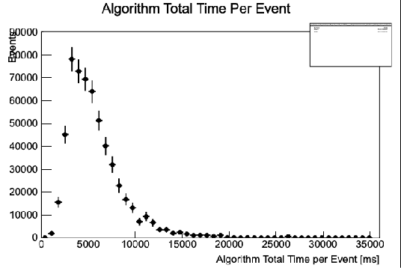
Tracking
HLT full-scan tracking considered possible if tracking CPU time is <1s/evt.
Maximal scenario of 22 kHz HLT tracking+PF rate considered viable with 2022 HLT farm — 175% of CPU needed w/o FTK
See this contribution in HCW2019

Slide 36
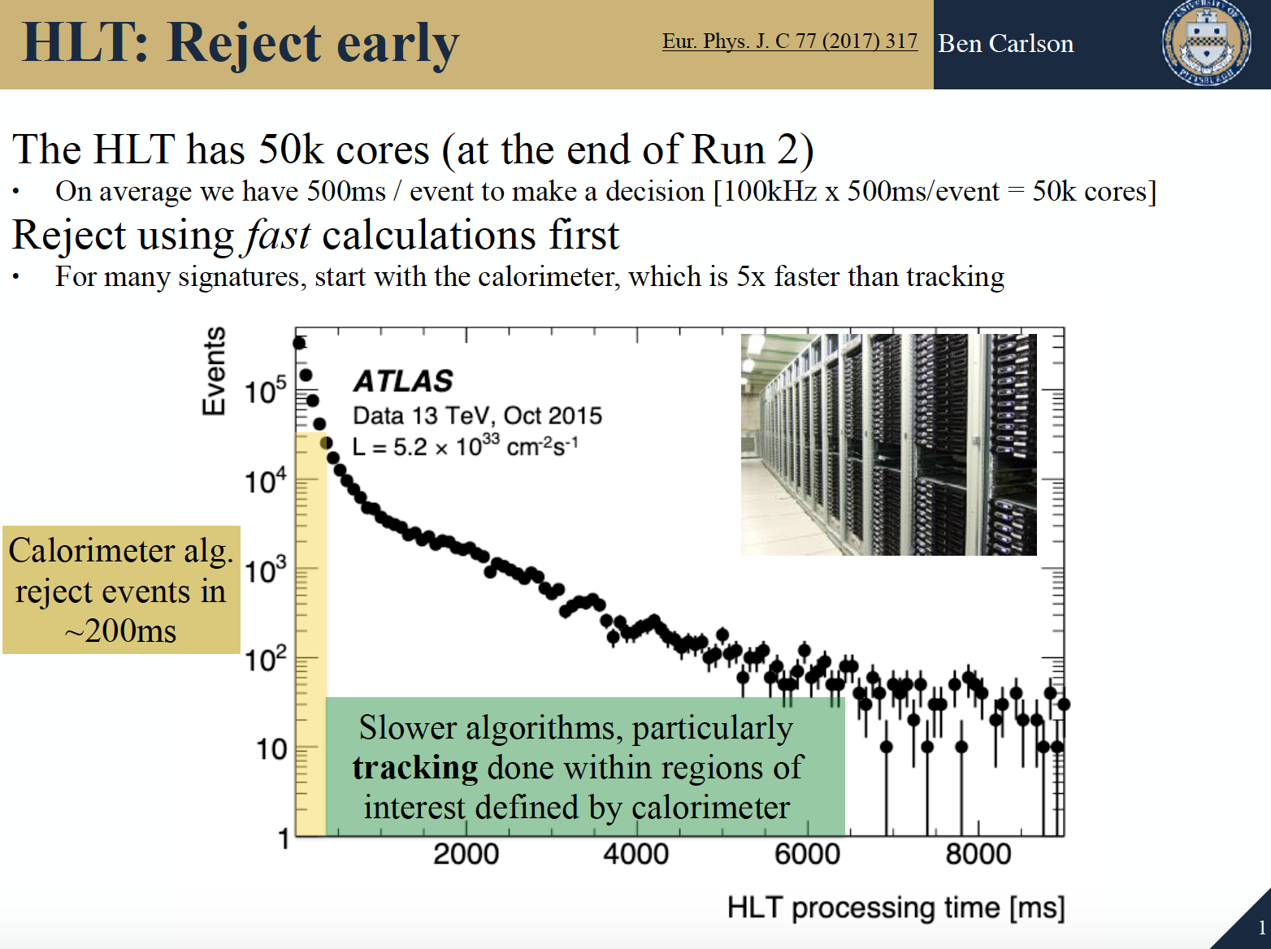
See this contribution in HCW2019

Slide 37
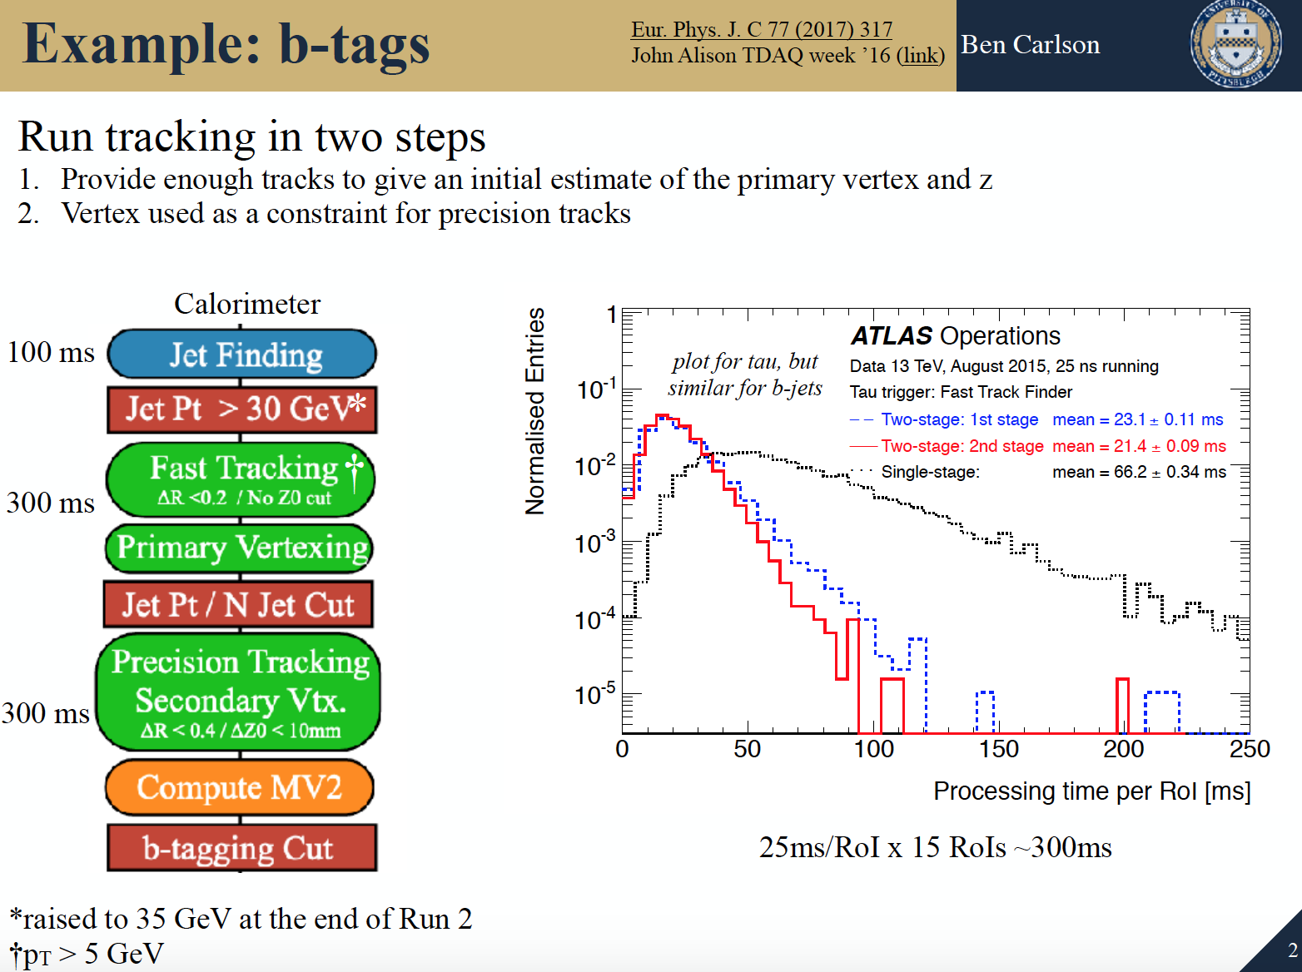
See this contribution in HCW2019

Slide 38
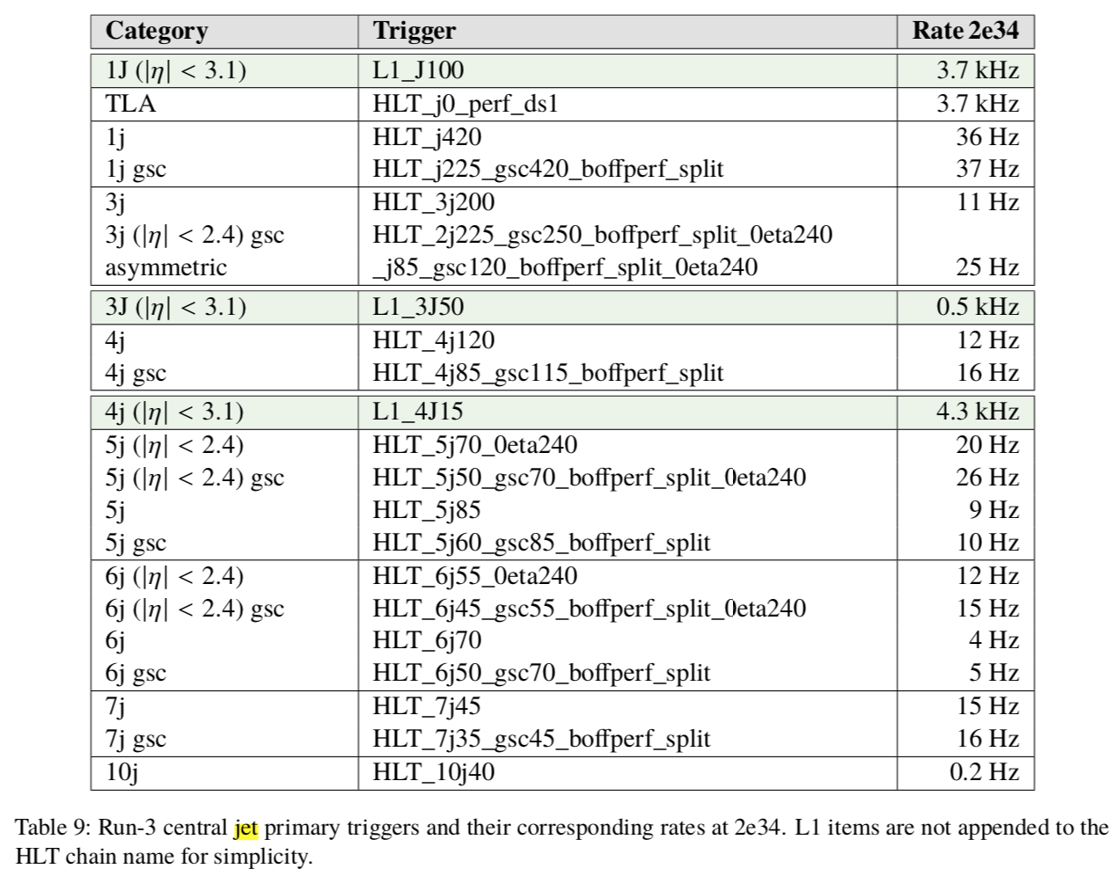
Run 3 Menu
Described in note ATL-COM-DAQ-2019-116

Slide 39
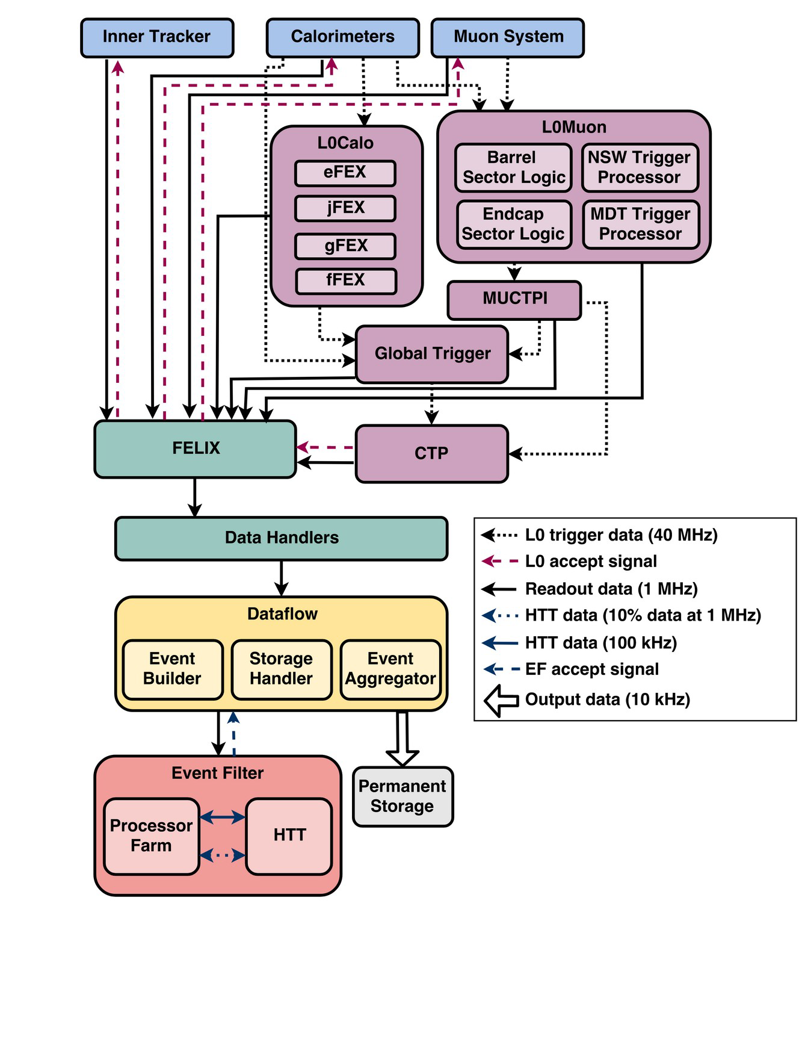
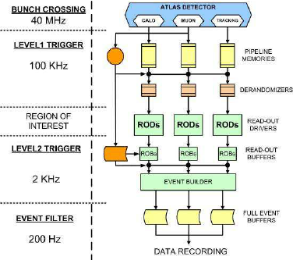
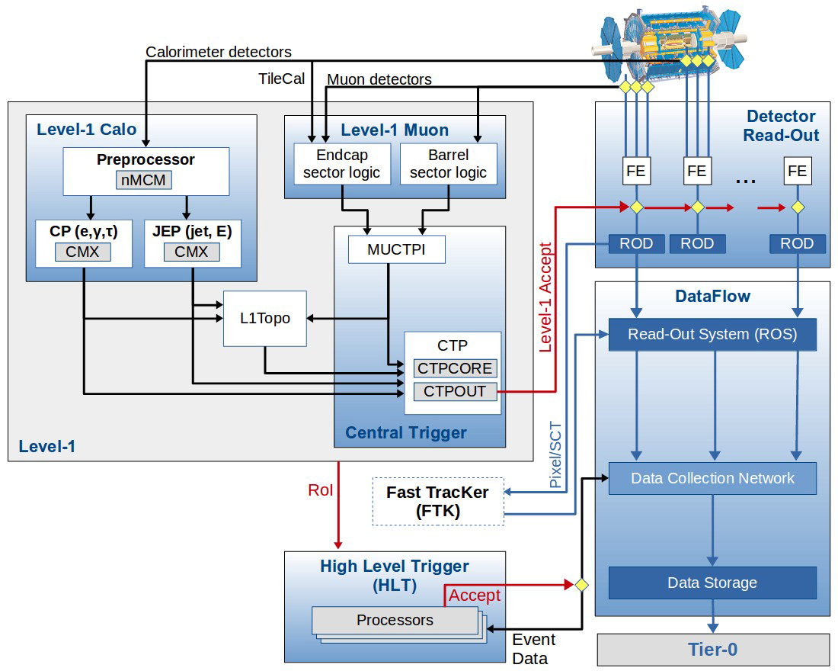

Slide 41
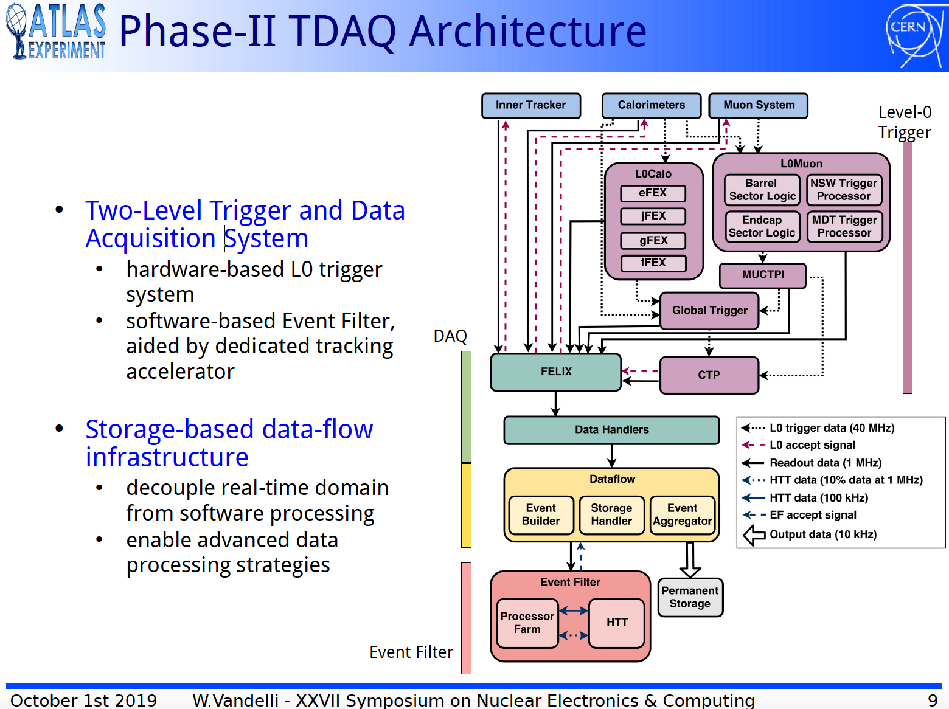

Slide 42
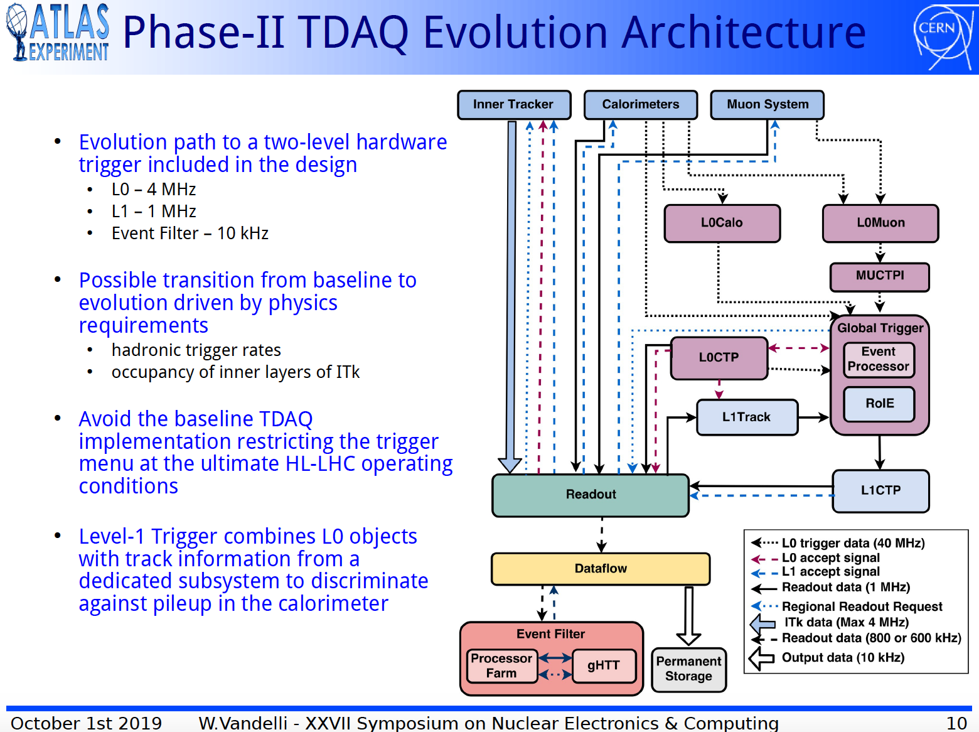

Slide 43

The Jet Trigger Wants YOU!

