Slide 1
Search for the Standard Model Higgs boson produced in association with a vector boson and decaying to a b-quark pair with the ATLAS detector at the LHC
Ricardo Gonçalo (RHUL)
on behalf of Higgs Subgroup 5 (H->bb)

Slide 2
Acknowledgements
Many thanks to our editorial board for their dedication, many fruitful discussions and thoughtful guidance!
Editorial board:
Chair: Pippa Wells
Members: Elzbieta Richter-Was, Christian Weiser, Gavin Hesketh
Editors:
Ricardo Gonçalo, Andrew Mehta, Giacinto Piacquadio, Paul Thompson
Editors of ZH->ννbb support note:
Bill Murray, Song-Ming Wang
Special thanks to all other members of the analysis team!
Especially (but not only!): Benedict Allbrooke, Heather Gray, Carl Gwilliam, David Jamin, Lianliang Ma, Jike Wang

Slide 3
CDS record: https://cdsweb.cern.ch/record/1425880
Support material:
ZH➝llb & WH➝lνbb: https://cdsweb.cern.ch/record/1404176/
ZH➝ννbb: https://cdsweb.cern.ch/record/1418230

Slide 4
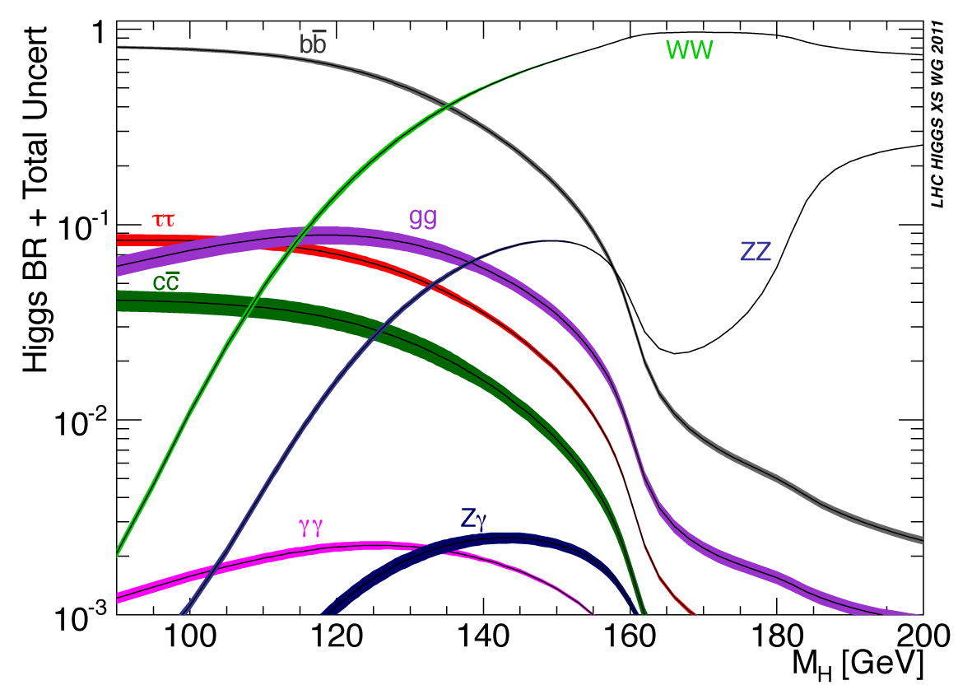
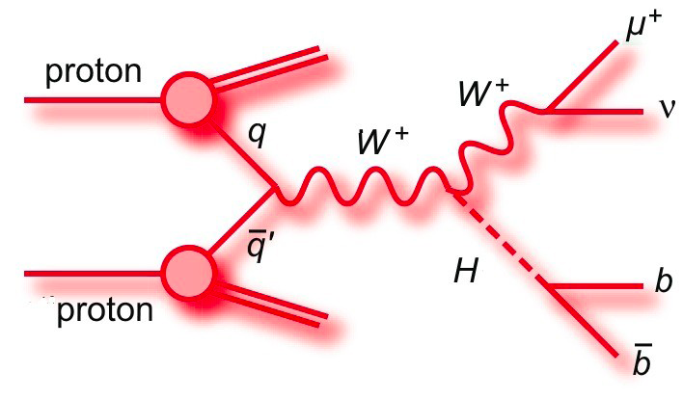
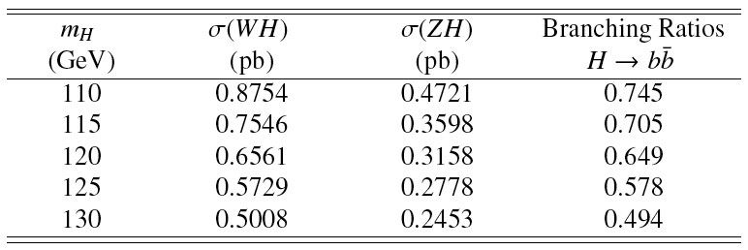
This paper:
ZH➝llb, WH➝lνbb and ZH➝ννbb
4.6 – 4.7 fb⁻¹ analyzed
H->bb dominant at low mass
WH cross section factor ≈2x higher than ZH, but important top background
Cut-based analyses:
Select Z or W or large E_{T}^{miss} and search for 2 additional b jets
Search Higgs in m_{bb} spectrum

Slide 5
Datasets
Full 2011 data from periods B-M
4.7 fb⁻¹ e/μ streams (ZH➝llb, WH➝lνbb)/4.6 fb⁻¹ JetTauETmiss (ZH➝ννbb)
Signal (MC11c)
ZH➝llbb, WH➝lνbb, ZH➝ννbb simulated in Pythia
Normalized to NLO (EW) + NNLO (QCD) from LHC Higgs cross section WG (Yellow Report I)
m_{H} = 110 − 130 GeV in steps of 5 GeV
Background (MC11c)
Z/W+jets: ALPGEN to model l (l and c jets) for Z(W)
High statistics Zcc/Zbb(Wbb) using SHERPA(POWHEG)
Top: ttbar + single top from MC@NLO
Diboson: ZZ/WZ/WW from MC@NLO
QCD background
ZH➝llbb multi-jet electron from loose-loose no medium data scaled
WH➝lνbb electron and muon from anti-isolation data scaled
ZH➝ννbb from data (ABCD method) – negligible

Slide 6
Lepton Selection: WH➝llb, WH➝lνbb
Electrons
medium++ (tight++) with pT > 20(25) GeV and |η| < 2.47 for Z(W)
Include crack region
Trackisolation: Ptracks /pT < 0.1 within R = 0.2
For WH: Calo isolation: Pcalo /ET < 0.14 within R = 0.3
For WH: Impact parameter cut d0 < 0.1 mm
Latest recommended smearing and efficiency corrections
Veto in WH: use central loose++ with pT > 10 GeV and forward loose
with pT > 20 GeV(|η| < 4.5). Require trk/calo isolation (except forward)
Muons
STACO(Muid) tight with pT > 20(25) GeV and |η| < 2.5 for Z(W)
Track isolation (as for electrons); For WH calo isolation
Impact paramter cuts d0 < 1(0.1) mm for Z(W)
Impact parameter cut against cosmics z0 < 10 mm
Latest recommended smearing and efficiency corrections
For veto in WH extend to Loose/standalone, pT > 10 GeV and
|η| < 2.7. Require track isolation (except standalone)

Slide 7
Jet/E_{t}^{miss} selection
Jets – not updated to last week’s recommendations
Anti-kT 4 with pT > 25 GeV and |η| < 2.5 ”AntiKt4TopoEMJets”
For jet veto in WH pT > 20 GeV and |η| < 4.5
Remove events with jets pointing to the bad FEB region
Pile-up: reject jets with |JVF| < 0.75 for jets with |η| < 2.5
Current JES/JER uncertainty including pile-up, close by and b JES
b-tagging – not updated to last week’s version
MV1 with w > 0.602 ( 70% efficiency)
Applying corrections and uncertainties derived by b-tagging group.
MET – not updated to last week’s version
MET RefFinal out-of-the-box
Apply pile-up reweighting for each MC run period
Additional μ scaling reweighting: scale <μ> by 1.03±0.03

Slide 8
Lepton and jet veto: ZH➝ννbb, WH➝lνbb
Veto leptons:
Electron : medium , pT>10 GeV, |η|<2.47, pTcone20/pT<0.1
Muon : Combined & segmented-tagged STACO, pT>10 GeV, |η|<2.4, pTcone20/pT<0.1
Veto on any event having an object with:
pT > 20 GeV. Veto lepton has wider range than trigger electron
(standalone muons, forward electrons).
Remove any event with:
1 extra lepton with pT > 20 GeV
1 extra opposite sign lepton with pT < 20 GeV
> 1 extra leptons
Remove any event with ≥ 3 jets (veto jet: pT > 20 GeV and |η| < 4.5)
In ZH➝llbb, WH➝lνbb: remove overlaps between electrons, muons, jets

Slide 9
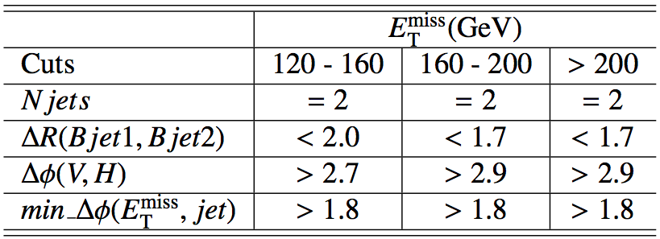
Event selection
Common selection
Using WZ+jets GRL (incl. b-tagging)
Primary vertex containing at least 3 tracks
ZH➝llb
Triggers: single and dilepton triggers
Exactly 2 leptons with 83 < mll < 99 GeV
Opposite charge required for muons
ET^{miss} < 50 GeV
At least 2 jets (1 jet with p_{T} >45 GeV), exactly 2 b tagged
WH➝lνbb
Triggers: single lepton trigger
1 lepton and MT > 40 GeV
Emiss
T > 25 GeV
Exactly 2 jets(1 jet with pT >45 GeV) and both b tagged
ZH➝ννbb
Trigger: EF_xe70_noMu
No lepton (e or μ)
Etmiss > 120 GeV
Ptmiss > 30 GeV (remove events with fake high Etmiss)
2 or 3 jets, exactly 2 b-tagged jets
Leading jet Pt>45 GeV (new)
B-tagged jets separated by dR(b1,b2)>0.7 (for 120<Etmiss<200 GeV)
Δφ(Etmiss, Ptmiss) < π/2 (new)
Plus optimized angular cuts (table)

Slide 10
Other aspects of the analysis
Selected sample is divided into pT(W/Z) categories to increase significance
Some cuts are optimized for each bin in ZH➝ννbb analysis
Heavily data-driven estimation of backgrounds
Normalization of main backgrounds transferred from
ZH➝llbb/WH➝lνbb analysis to ZH➝ννbb analysis
More info in support material:
ZH➝llb & WH➝lνbb: https://cdsweb.cern.ch/record/1404176/
ZH➝ννbb: https://cdsweb.cern.ch/record/1418230

Slide 11
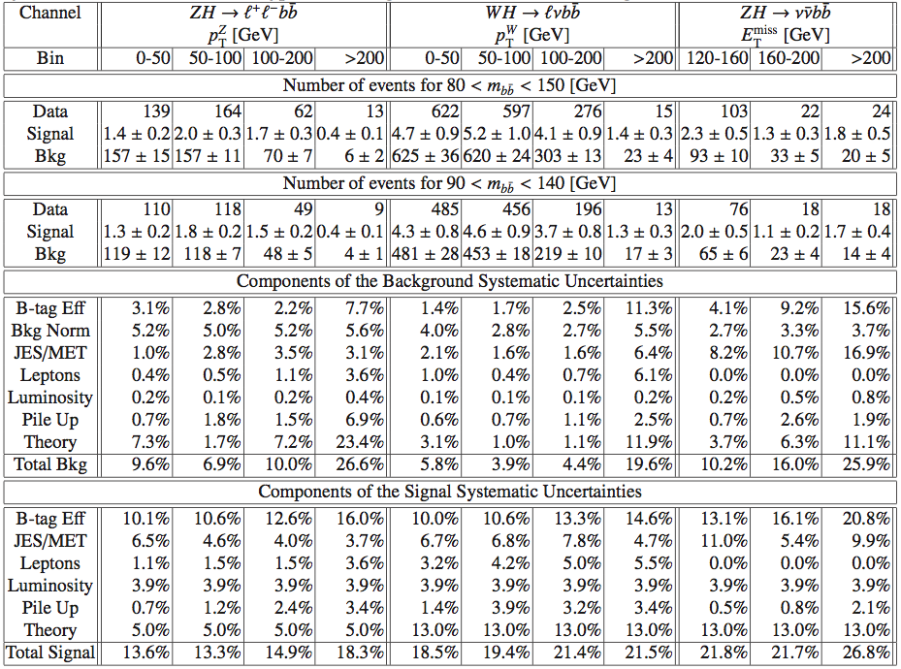
Table 1

Slide 12
Plots for approval – Fig.1

Slide 13
Plots for approval – Figs.2, 3, 4
Inclusive selected sample for each analysis
Next 3 slides show the same distributions separately in bins of p_{T}^{W/Z} bins for each analysis
ZH➝llb
ZH➝ννbb
WH➝lνbb

Slide 14
Plots for approval – Fig.2 (ZH➝llbb)

Slide 15
Plots for approval – Fig.3 (WH➝lνbb)

Slide 16
Plots for approval – Fig.4 (WH➝lνbb)

Slide 17
Limits plots for approval

Slide 18
Table 2 – Exclusion Limits

Slide 19
Last public results:
First H➝bb search from the LHC shown at EPS – July 2011
ZH➝llb, WH➝lνbb only
1fb⁻¹ @ 7 TeV
Combined sensitivity: ≈10-20xSM
Ref.: ATLAS-CONF-2011-103

Slide 20
CDS comments & answers

Slide 21
Un-tagged m(j,j) plots
Added to WH/ZH support note (appendix O.7): https://cdsweb.cern.ch/record/1404176/
Also in control regions of ZH->ννbb support note: https://cdsweb.cern.ch/record/1418230
ZH->llbb
ZH->vvbb
WH->lvbb

Slide 22
Rationale behind using different MC generators for different samples
Alpgen was used for describing V+light jets due to better description of some distributions (e.g. number of jets) – but is very time consuming to produce and use, and requires approximate procedure for removal of heavy-flavour jets
When appropriate, other generators such as Sherpa were used instead if large statistical samples were needed
In some cases it was a question of convenience: e.g. large standard MC@NLO top sample
Powheg was tried for the signal but a large (≈10%) difference in b-tagging efficiency was found – moved to Pythia; Powheg being validated for 2012 analysis in vvbb

Slide 23
Signal contamination
There is some small contamination expected from other channels
E.g. from H->ZZ(*)->llqq on ZH->llbb:
Negligible number of events passing ZH->llbb selection (0.06 at most)
Other sources either small or included in the signal cross section
Higgs mass [GeV] | #events (total) | #events (80<m_{bb}<150GeV)
110 | 0.002 | 0.002
115 | 0.005 | 0.004
120 | 0.007 | --
125 | 0.04 | 0.04
130 | 0.06 | 0.04

Slide 24
Backup slides

Slide 25
Nice things to do later…
JES – new recommendations released last week
MET – new MET code version released last week
B-tagging – discussion ongoing

Slide 26
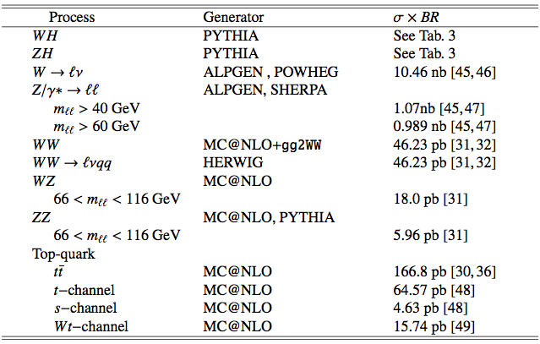
Monte Carlo samples

Slide 27
Table 1 – Nr of events

Slide 28
From Summer analysis: WH➝lνbb
Trigger: e (p_{T}^{e}>20GeV) or μ (p_{T}^{μ}>18GeV)
Exactly 1 lepton – p_{T} > 25GeV
M_{T} = √2p_{T}^{l}p_{T}^{ν}(1 - cos Δφ_{lν} ) > 40 GeV
E_{T}^{miss} > 25GeV
Exactly 2 jets (anti-k_{T} 0.4; E_{T} > 25GeV) to reduce top background
Both jets b tagged

