Slide 1
H->bb Note Schedule
Ricardo Gonçalo (RHUL)
HSG5 H->bb WH/ZH note meeting with Editorial Board, 28 June 2011

Slide 2
Last call for EPS
June 23rd: final “analysis update”
Assumes ~ 7-10 days to run full analysis
Data taken up to June 18th available with GRL (recorded L=1 fb⁻¹);
Jul 5th: Drafts submitted to EdBoard
Early drafts should be circulated to the EdBoard earlier; very similar to PLHC
Final drafts on Jul 8th to PC;
Jul 9th: last circulation of Papers/Notes
Run again the full analysis to include the data after June 26th , at least for benchmark analyses? (technical stop on June 29th^{th}, for ~10 days)
Jul 15th: last approval meetings
Present the circulated results and the ones obtained updating the analysis
Jul 18th: conclude sign-offs of Papers/CONF Notes
Assumes 1 week for EdBoard and two sign-offs from PC/PubComm/Mngt
18→20: 3 days contingency
Jul 21st: EPS Conference
Leandro (ATLAS Week)

Slide 3
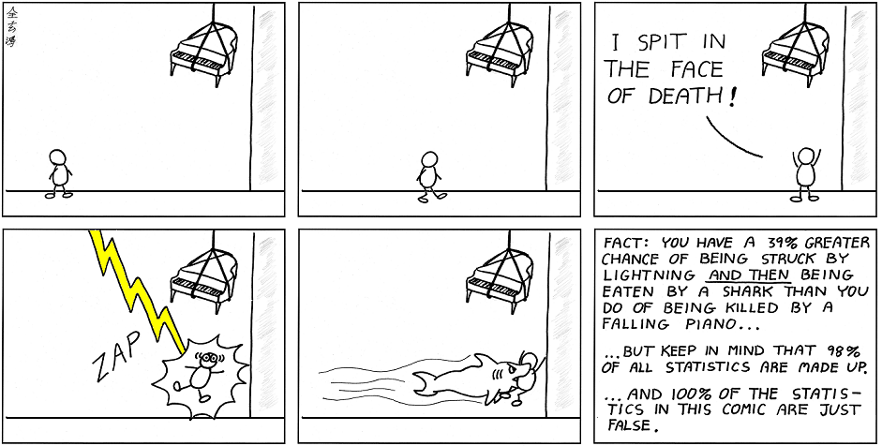
Statistics issues
All ATLAS results for summer conferences should be made using CLs
(All except analyses with a Bayesian history and Bayesian usage in CMS)

Slide 4
Need to discuss…
INT note approval – what’s missing?
Systematics: b-tagging, JES
Limits: status…
Anything else?
Life after INT – need to plan meetings for CONF editorial board approval – will everyone be available?

Slide 5
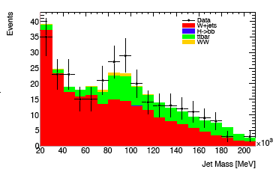
Potentially relevant…
Some development on the boosted VH side
Boosted H->bb not included in note so far!
Hint of W->jj peak hints at sensitivity for Higgs with more data – paves way for future results
Shown at H->bb meeting today
Discussion started with Phys.coord. about possibly how to make these public

Slide 6
Backup

Slide 7
WH/ZH Note: Missing Ingredients
Moving to MC10b: done
b tagging:
Need advanced tagger for increased background rejection
Efficiency scale factors almost done
Calibration & fake rate: preliminary on week of 20th June - will re-do analysis with final numbers
IP3D+SV1, 60% efficiency working point
Jet Vertex Fraction:
Fix exists but applicable only to AOD-based analyses – i.e. only one analysis in our group
D3PDs including the bug fix exist for part of the 2011 run – being transferred to Grid site
Validation?
Editorial board:
Richard Bateley (chair)
Alex Read
Emmanuel Lemonier
Niels van Eldik
Good 1st meeting with Ed.Board
QCD background (incl. bb, cc):
Almost there
One feature to be understood in anti-track isolation QCD background in electron channel
Watch this space!
Systematics:
First estimates done – dominated by b-tagging uncertainty (around 30%)
SM Higgs combination:
Need to produce inputs for SM Higgs combination

