Slide 1
Introduction
Ricardo Gonçalo
HSG5 weekly meeting – 9 February 2012

Slide 2
WH->lνbb
p_{T}>45GeV
ΔR(b,b) > 0.7
No Cuts

Slide 3
p_{T}^{lead jet} > 45 GeV

Slide 4
No Cuts

Slide 5
ZH ->llbb
ZH->llbb: No p_{T}>45GeV cut
ZH->llbb: with p_{T}>45GeV cut

Slide 6
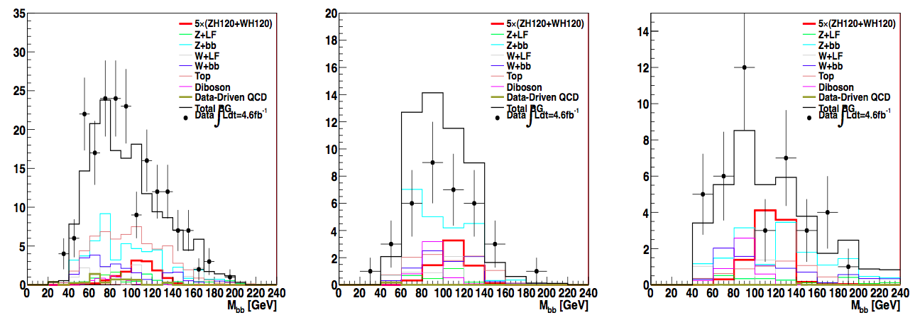
ZH->ννbb
ZH->ννbb: with pT>45GeV

Slide 7
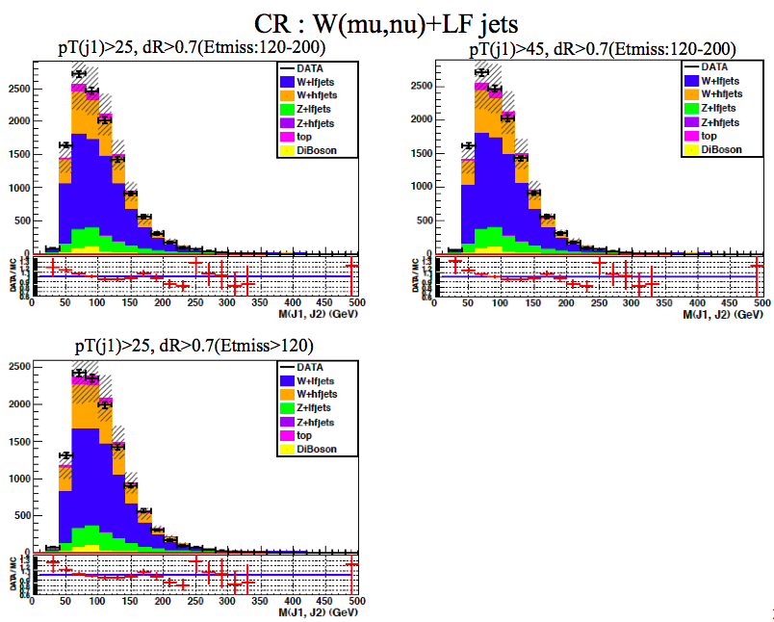
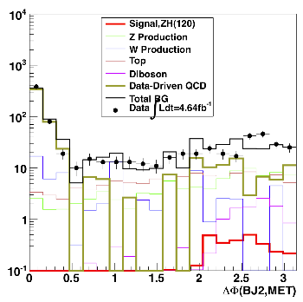

Slide 8
Backup Slides

Slide 9
ZH->ννbb Backup
ZH->ννbb (Jike): with pT>45GeV
ZH->ννbb (Matt): with pT>45GeV

Slide 10
