Slide 1
H->bb Note: Exclusion Limits
Ricardo Gonçalo (RHUL)
HSG5 H->bb WH/ZH note meeting with Editorial Board, 7 July 2011

Slide 2
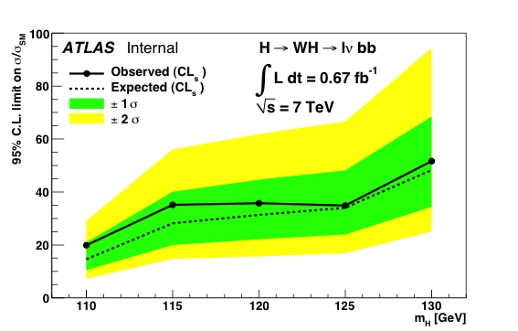
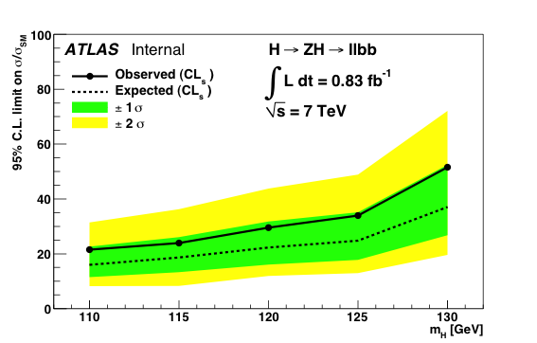
MCLimit
Looks much better after fitting top sideband
WH mH (GeV) | Expected (before) | Expected (after) | Observed (before) | Observed (after)
115 | 35.7 | 28.2 | 39.1 | 35.1
120 | 39.8 | 31.4 | 41.4 | 35.8
125 | 44.2 | 34.0 | 43.2 | 34.9
130 | 64.1 | 48.3 | 63.8 | 51.6

Slide 3
WH mH (GeV) | MCLimit Expected | Roostats Expected | MCLimit Observed | Roostats Observed
115 | 28.2 | 27.3 | 35.1 | 27.1
120 | 31.4 | 30.6 | 35.8 | 31.6
125 | 34.0 | 32.3 | 34.9 | 27.8
130 | 48.3 | 45.2 | 51.6 | 38.2

Slide 4
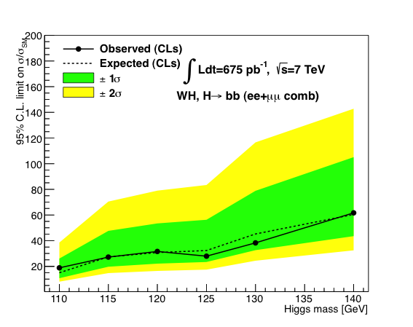
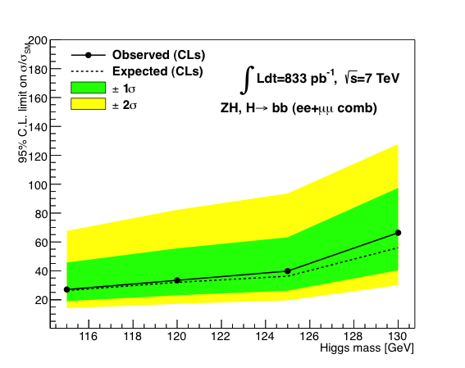
MCLimit
Roostats

