Slide 1
H->bb Note
Ricardo Gonçalo (RHUL)
HSG5 H->bb WH/ZH note meeting with Editorial Board, 7 July 2011

Slide 2
Editorial board comments

Slide 3
Emmanuel
L150 Is it true that the JVF cut work for the in time pileup ? (word “same”)
It should work for both: the JVF cuts on the pT of tracks associated to a given vertex, divided by the tracks from any vertex. For in-time pileup it rejects events from non-primary vertex; for jets from out-of-time pileup a small JVF (basically zero) should also be expected
L151 the cut at 2.5 is justified for JVF, I understand that this cut is applied for all jets and that only those jets are furthermore considered in the analysis. It seems to me that only quoting the JVF justification is a bit weak to reject all jets out of the +-2.5 range. I guess there are other justification that can be mentioned ? (btag for ex)
Yes, for the WH analysis b-tagging is a justification since we only accept events with exactly 2 jets. For ZH we accept >2 jets but only 2 b-jets, but since we cut on the number of jets we would like to be sure they come from the primary event ad not pileup. This is especially important for WH, since the 3-jet bin is heavily contaminated by top, so we need to reject this bin and so we need to count jets properly
Boosted VH analysis: why are there differences compare to the ZH/WH standard analysis? I would remove everything from this section and only keep the things that are different (if it is for good reasons if not comply with the choices taken with the W/ZH standard analysis.
This was an independent analysis and it developed on its own from the Z/W+jets analysis. In any case, it should probably be tuned independently of the un-boosted analysis. Also, this is only a record for the INT note, to give an accurate description of what was done (for later reference). It won’t be available outside the collaboration.

Slide 4
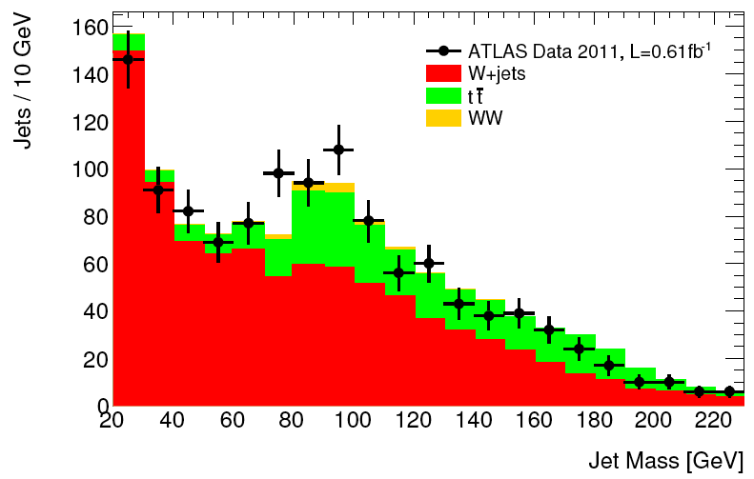
Richard
Is there a shoulder in the (red) W+jets histogram? Is this expected?
From Adam: the shoulder in W+jets is simply because the shape of this distribution is not entirely flat in QCD. The distribution of unfiltered jet mass of has a kinematic peak at about pt/3 or something. The filtering flattens this a lot but not entirely. This shape has been shown to be fairly well modelled in the previous CONF note. I think we can be fairly confident that mismodelling is not faking a peak in the data of this size.

Slide 5
Alex
I don't quite get it. The reconstruction efficiency IS higher in the higher pt-region...but raising the pt-cut reduces the overall acceptance for W->electron. The lower cut for the Z-leptons somewhat compensates for the double electron requirement. The efficiency-motivation for raising the electron pt for W is still not clear for me (I would understand the purity argument as my question shows). I guess I am being pressed to read the W/Z-cross section papers - I just read the relevant bit for the 2010 publication and the 2011 conf note (March) and the same pt cut is used for Z and W (20 GeV).
I believe (someone please correct me) a better way to explain it is that the trigger threshold for electrons is at 20GeV so we need to go to >20GeV in WH where we only have 1 lepton (or accurately describe the trigger turn-on). This is not a problem in ZH where we have 2 electrons.

Slide 6
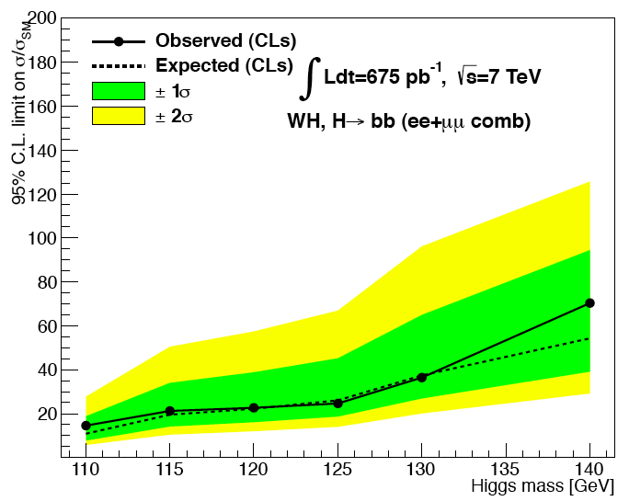
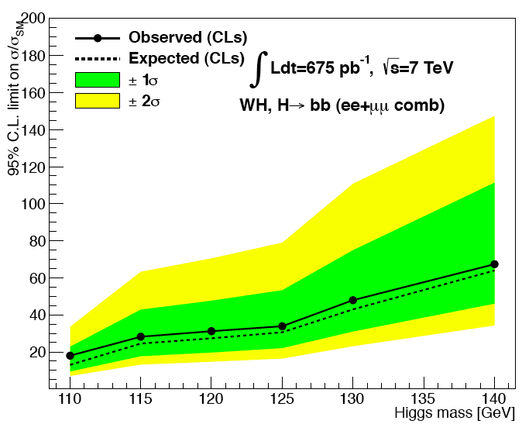
The story so far…
MCLimits:
ZH
115 expected = 18.6317
120 expected = 22.2756
125 expected = 24.8103
130 expected = 37.078
115 observed = 23.9211
120 observed = 29.5454
125 observed = 33.9751
130 observed = 51.5583
WH
115 observed = 39.0706
120 observed = 41.4142
125 observed = 43.2355
130 observed = 63.7609
115 expected = 35.6636
120 expected = 39.833
125 expected = 44.2224
130 expected = 64.0624
Without top systematics
=======================
115 expected = 24.0444
120 expected = 26.2167
125 expected = 27.6998
130 expected = 38.8661
Un-smoothed
Roostats toys
mH = 130GeV
Obs. = 48
Exp. = 34.5
-2sig = 1.5
-1 sig = 12
+1 sig = 67.5
+2 sig = 129
(Over-)smoothed

