Slide 1
Introduction
Ricardo Gonçalo (RHUL)
HSG5 H->bb weekly meeting, 31 May 2011

Slide 2
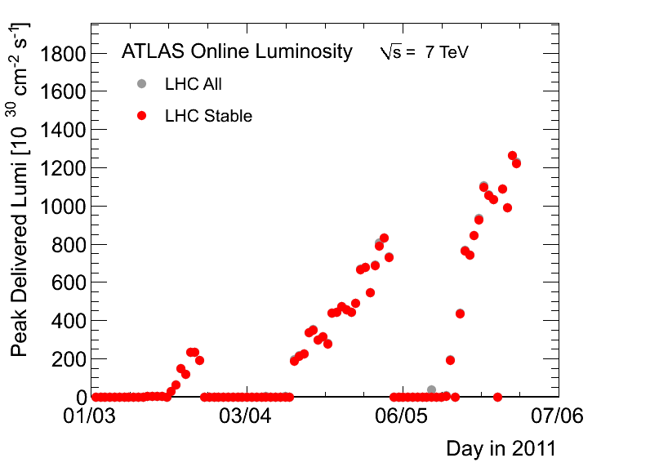
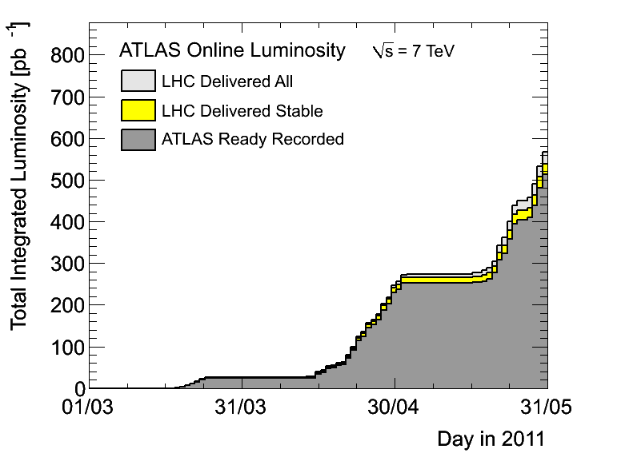
News! News! News!
About 0.51 fb⁻¹ collected with stable beams so far
Peak pileup stays ≈ 10 collisions per bunch crossing
Up to 1042 colliding bunches so far – will go up to 1380 in next few weeks
Lumi up to 1.26x10³³cm⁻²s⁻¹
Should expect up to 5x10³³cm⁻²s⁻¹ in next few months
Last few days collected almost as much data per day as in 2010!…

Slide 3
MC requests for H->bb
Current list in Junichi’s page here: https://twiki.cern.ch/twiki/bin/view/AtlasProtected/HiggsWGHSG5Dataset7TeV
People responsible for each requested MC sample:
Un-boosted channels:
Haifeng – WH mH=110 GeV and 140GeV
Jike – ZH mH=110 GeV and 140GeV
(|Donny> + |Mike>) – ttH mH=110 GeV and 140GeV
Boosted Higgs:
Wahid
WH, W->e/mu/tau+nu, H->bb, pt(H)>100GeV, Pt(W)>100GeV with 1e/mu filter, mH=110/120/130
ZH, Z->2e/2mu/2tau, H->bb, pt(H)>100GeV, Pt(W)>100GeV, mH=110/120/130
Song-Ming
ZH, Z->2nu, H->bb, pt(H)>100GeV, Pt(W)>100GeV, mH=110/120/130

Slide 4
Trigger News
Stefania Xella replaced Gemma Wooden as Higgs trigger contact
New sample T produced:
Allows quickly checking efficiency of new menus in signal samples
r2400 has conditions which do NOT include the noise suppression.
r2434 has conditions which DO include the noise suppression.
Find samples with e.f.: dq2-ls "valid*r2400*"
Samples with r2434 are being produced now
L1 calo options (…or how can e/gamma and tau triggers survive?!)
Very interesting report form Stephen Hiller at TDAQ week: https://indico.cern.ch/getFile.py/access?contribId=41&sessionId=6&resId=1&materialId=slides&confId=112739
Introduce eta-dependent EM thresholds or L1 isolation
Can be studied on current MCs , to estimate efficiency losses
Important: need study of analysis efficiency with several possible triggers, to prepare for near term future! (Discussion starting in tomorrow)
See details in Brian Petersen’s talk: https://indico.cern.ch/getFile.py/access?resId=0&materialId=slides&confId=139948

Slide 5
Efficiencies for older release/menu (r2210) and new sample T (r2400) WH inclusive sample: valid1.116127.HerwigH120W_bbinc.recon.AOD.e598_s933_s946_r2400 Should expect BR≈11% into each lepton flavour (13% including τ decays to e and μ) See some clear efficiency change in new menu!! How does this compare with our current signal MC?? Note that we need to move to e20_medium1 and mu20* already at 2x10³³ (in principle after EPS)
 | Efficiency for incl. WH (%)
Single Electron Trigger | 16.6.3.2.1/r2210 | 16.6.4.2.1/r2400
EF_e20_medium | 10.9 ± 1 | 8.6 ± 0.7
EF_e20_medium1 | 11.7 ± 1 | 7.6 ± 0.6
EF_e20_medium2 |  | 7.8 ± 0.6
EF_e20_tight | 9.2 ± 1 | 7.4 ± 0.6
EF_e22_medium | 10.6 ± 1 | 8.3 ± 0.7
EF_e22_medium1 |  | 7.4 ± 0.6
EF_e22_medium2 |  | 7.6 ± 0.6
EF_e25_loose | 11.1 ± 1 | 9.0 ± 0.7
EF_e25_medium | 9.7 ± 1 | 7.8 ± 0.6
EF_e30_loose | 9.7 ± 1 | 7.3 ± 0.6
EF_e30_medium |  | 7.0 ± 0.6
 | Efficiency for incl. WH (%)
Single Muon Trigger | 16.6.3.2.1/r2210 | 16.6.4.2.1/r2400
EF_mu18 | 9 ± 1 | 10.1 ± 0.7
EF_mu18_MG | 8.8 ± 1 | 10.0 ± 0.7
EF_mu18_medium |  | 9.8 ± 0.7
EF_mu20 | 8.3 ± 1 | 9.0 ± 0.7
EF_mu20_MG | 8 ± 1 | 9.0 ± 0.7
EF_mu20_MG_medium |  | 8.8 ± 0.7
EF_mu20i | 5.8 ± 0.8 | 6.0 ± 0.6
EF_mu20i_medium |  | 6.0 ± 0.6
EF_mu22 | 7.6 ± 1 | 8.6 ± 0.7
EF_mu22_MG | 7.2 ± 1 | 8.6 ± 0.7
EF_mu100_MSonly | 0.9 ± 0.3 | 1.0 ± 0.22

Slide 6
Trigger Timeline
Current menu is stretched until end of July (if possible)
EF_e20_medium should be ok until then
Muon items seeded by L1MU10 may need to move to L1MU11
3-station coincidence instead of 2; 10% loss in eta<1)
Regarding L1 menu update for support triggers in case of too high rate until end of July:
There is one slot for possible update: June technical stop.
Please give feedback now if you think you need this
By end of July the menu for 2-5E33 needs to be ready
This menu will look very different from the current one, with raised thresholds at L1 , not only at EF
So, it’s important to find which trigger we’ll use after EPS

Slide 7
Jet Vertex Fraction Bug
Bug present in 16.6.X:
TRT tracks got accidentally included – no eta info, so set to point to (0,0,0)
Track-vertex association only done for one vertex – problems if with 2 nearby vertices
Savannah report: https://savannah.cern.ch/bugs/index.php?82544
Should be fixed in JetMomentTools-00-00-37-01
Will be discussed in reconstruction meeting today: https://indico.cern.ch/conferenceDisplay.py?confId=141432
Phys. Validation requests feedback from the physics groups:
Current data/MC agreement on JVF
Which information analyses would like to have in the future – e.g. flag to say if jet comes from PV? probability for that? JVF for different verteces, etc.

Slide 8
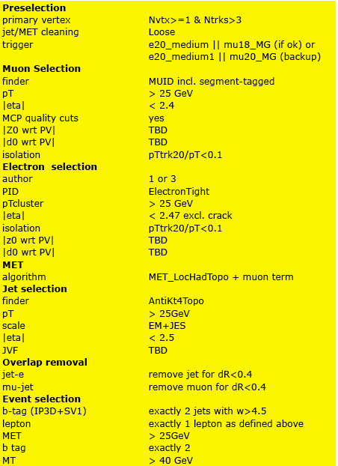
WH analysis
Z0 and d0 cuts
Jet Vertex Fraction
To be agreed on today!

Slide 9
CONF note for EPS-HEP 2011
Tight time scale – but feasible!
First INT note draft should be ready on 10 June
Finished finished by the end (20th – 24th) of June
Data frozen for EPS on 22 June – expect final calibrations etc soon after
CONF note circulated early July to be approved before conference
Conference starts 21 July
Notes:
Re-using existing CDS number ATL-COM-PHYS-2010-929
Having a bit of difficulty finding willing and able editorial-board members
SVN area for notehttps://svn.cern.ch/reps/atlasgrp/Physics/Higgs/HSG5/data_7TeV/ATL_COM_PHYS_2010_929/trunk/

Slide 10
Backup

Slide 11
Poster abstract for EPS-HEP
H->bb searches with the ATLAS detector at the LHC
The H -> bb channel is extremely important for the observation of a Higgs boson signal at the LHC. In the Standard Model, this channel would provide a significant contribution to the Higgs boson search in the low mass region, where this decay mode constitutes the dominant Higgs decay channel. Due to the enormous jet production cross-section at the LHC, the search must target channels where the Higgs boson is produced in association with a weak boson, a pair of top quarks, or jets separated by a rapidity gap. It also requires complex techniques to reconstruct the signal and separate it from an overwhelmingly large background. We present the status of Higgs searches in the H->bb channel currently being performed within ATLAS.
In case it’s accepted we’ll need a candidate to present it at EPS
Please let me know by email before Friday if you would like to do this
Will randomly choose a presenter from candidates

Slide 12
Conferences:
for EPS-HEP, focus on papers instead of notes
Higgs approvals for EPS-HEP: 20th – 25th July
https://indico.cern.ch/getFile.py/access?contribId=0&resId=0&materialId=slides&confId=136406

Slide 13
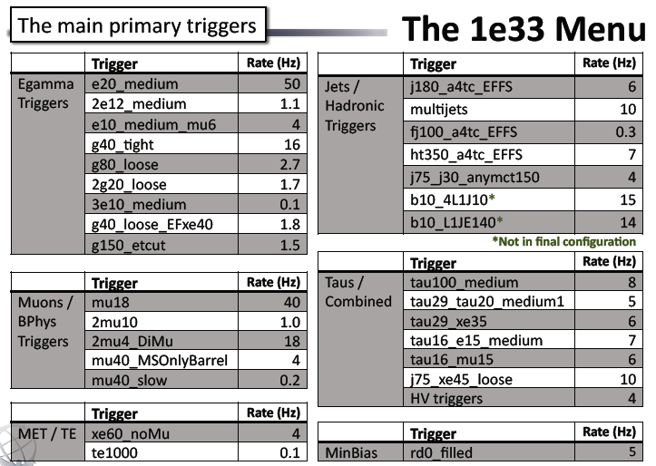

Slide 14
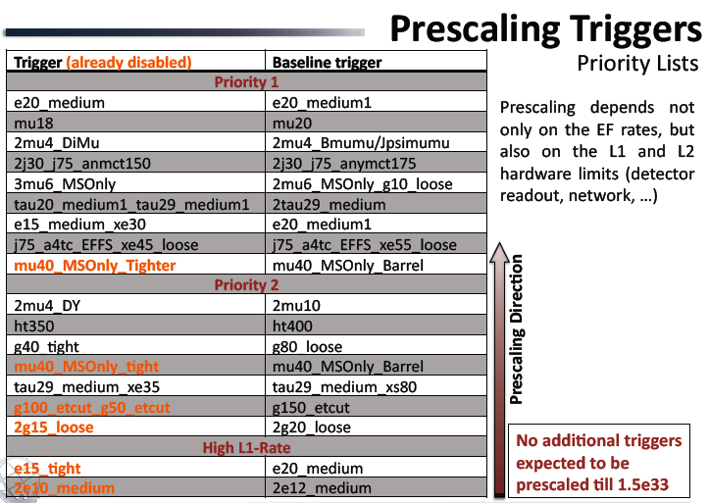

Slide 15
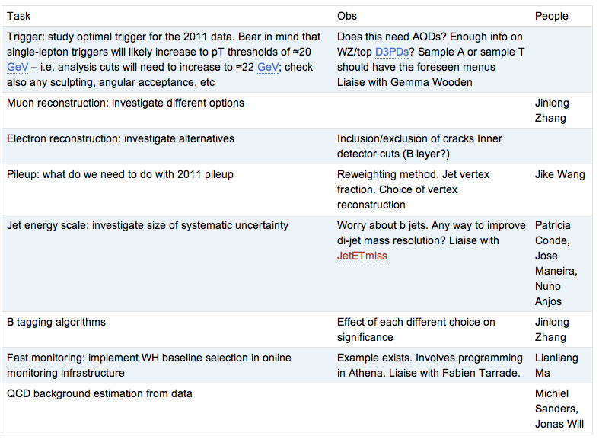
WH Task List
https://twiki.cern.ch/twiki/bin/view/AtlasProtected/WHNoteSummer2011#Analysis_Tasks

Slide 16
Reconstruction issues
Muon CP group recommendations for release 16:
Reconstruction efficiency and isolation efficiency scale factors, momentum smearing functions
https://twiki.cern.ch/twiki/bin/view/AtlasProtected/MCPAnalysisGuidelinesRel16
Jet/Etmiss recommendations for jet cleaning in release 16:
Medium jet cleaning should give similar rejection to rel 15 cleaning but with better efficiency
Tight jet cleaning should not be used – still under discussion
https://twiki.cern.ch/twiki/bin/view/AtlasProtected/HowToCleanJets#Bad_jets_rel16_data
New!: Final b-tagging calibrations for release 16 based on full 2010 data:
https://twiki.cern.ch/twiki/bin/view/AtlasProtected/Analysis16
e/gamma recommendations for energy scale and resolution in release 16:
https://twiki.cern.ch/twiki/bin/view/AtlasProtected/EnergyScaleResolutionRecommendations
And rescaler tool: https://twiki.cern.ch/twiki/bin/view/AtlasProtected/EnergyRescaler
Standard Model W/Z group baseline selection for release 16 (next 4 slides):
See discussion in W/Z group Sharepoint
Also, finer points (and perhaps the not so fine) still being discussed

