Slide 1
ttH Status report
On behalf of the HSG5 ttH group

Slide 2
Issues & Status
TODAY:
  Concentrating on HT discrepancy investigation
    Update from HSG5 meeting last week
  Latest fits for semileptonic SVA
  Not showing any of the progress in MVA (ready to run fits)
  Only a small note on dileptons

Slide 3
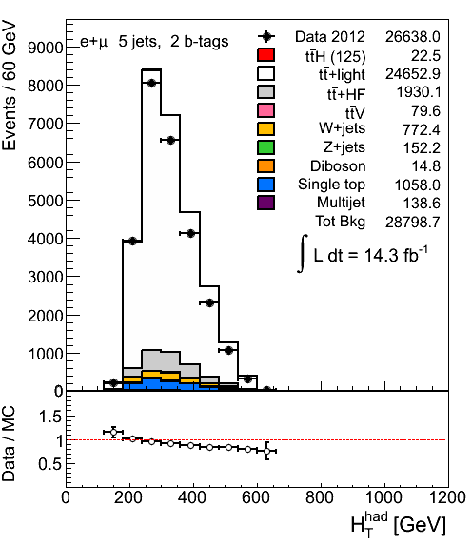
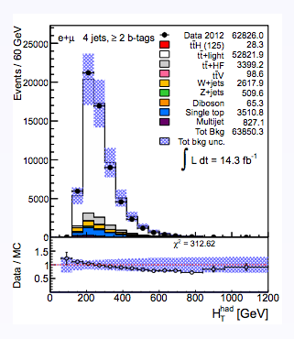
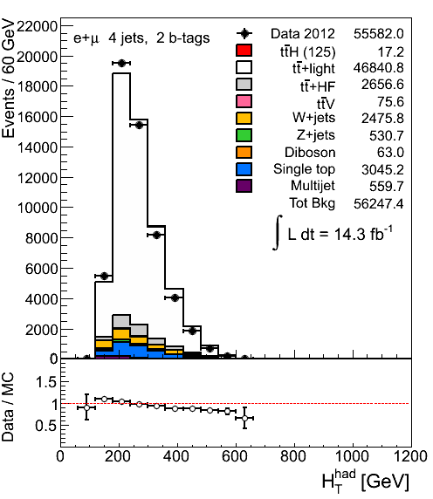
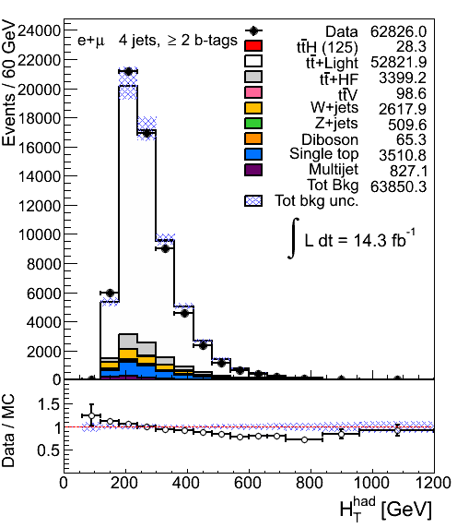
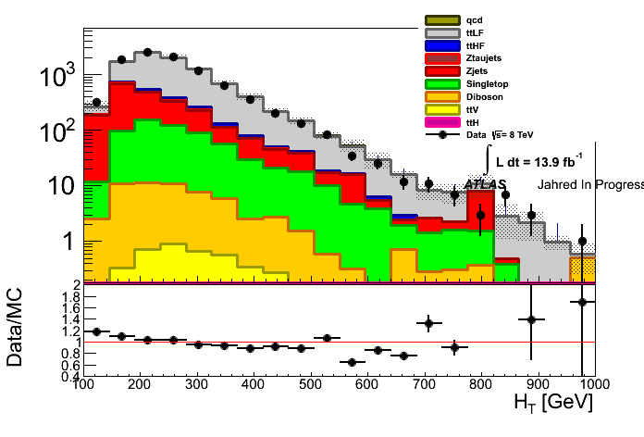

The issue
ttH analysis for Moriond is performed using two options
  single variable fit (exactly same approach as used in the approved CONF note)
    HT and mbb variables
  fit to NN discriminant in signal bins and HT in other bins
For both approaches good modelling of data by MC model is critical
We observe slopes in data/MC ratio in all analysis bins with at least one tag
5j 2b
4j 2b
only ttbar modelling uncertainties
≥2j ≥1b
4j ≥2b
Same trend in dilepton channel!

Slide 4
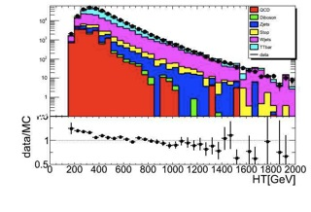
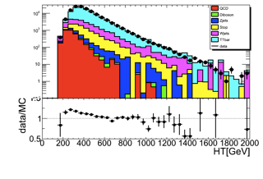
Other top analysis
≥0 b
4j+5j
≥ 1b
the first plot produced outside ttH group
  uses the same TopRootCore package
similar trend
  could be a problem in TopRootCore, but at least this shows it’s not just a bug in our code

Slide 5
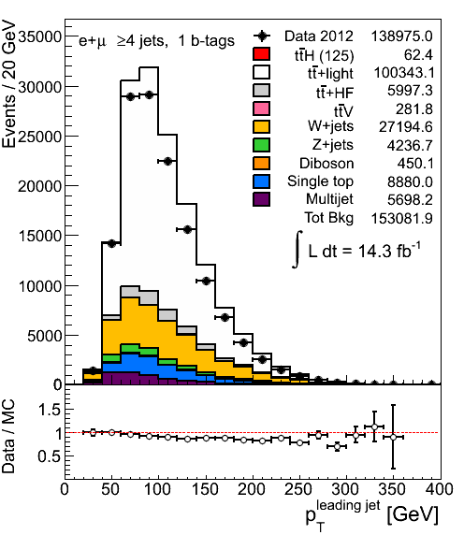
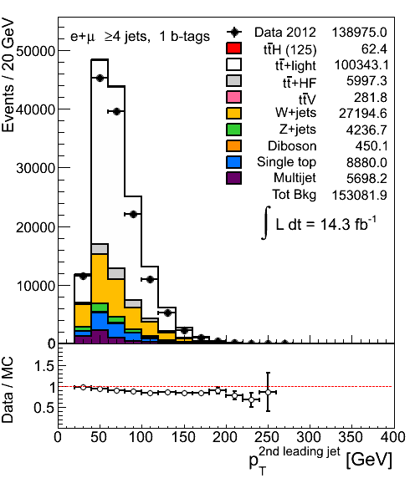
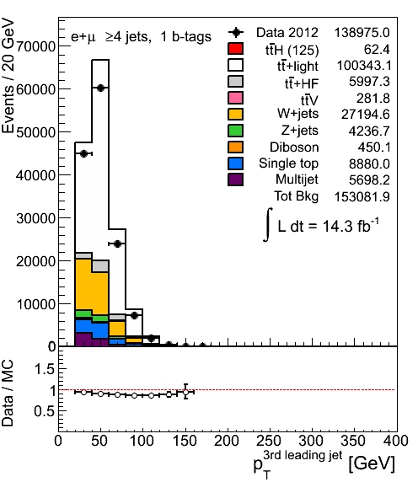
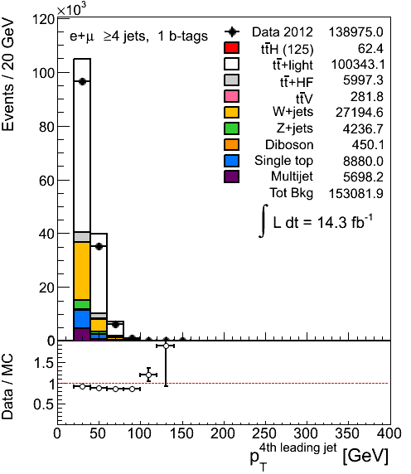
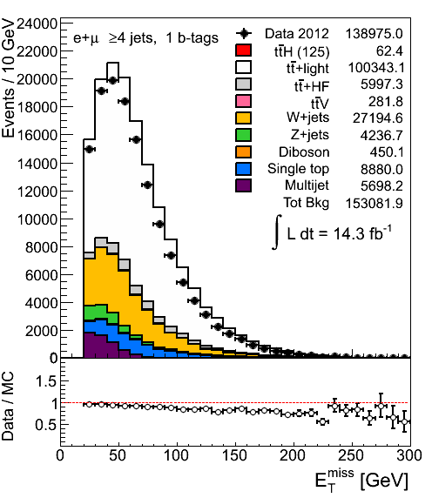
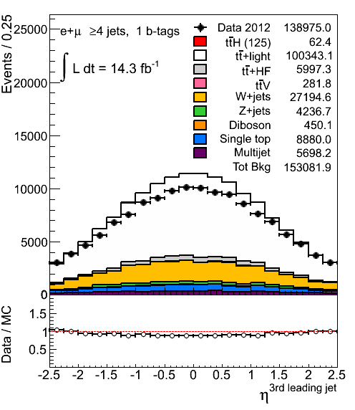
More distributions
Mismodelling of HT comes from mismodelling of jet PTs and ηs
4j1b
Same features are observed in other jet and tag multiplicity bins

Slide 6
What is it?
ttbar modelling
pileup modelling
effect of various scale factors
  b-tagging (we are using pTrel calibration)
  JVF
test of b-tagging SFs
  try SFs from ttbar calibration
p_{T}^{W} reweighting
  Top W reweighting?
do we see this somewhere else? VH cuts
multiparton interactions?
jets - JES?
  tried EM+JES instead of the default LC jets

Slide 7
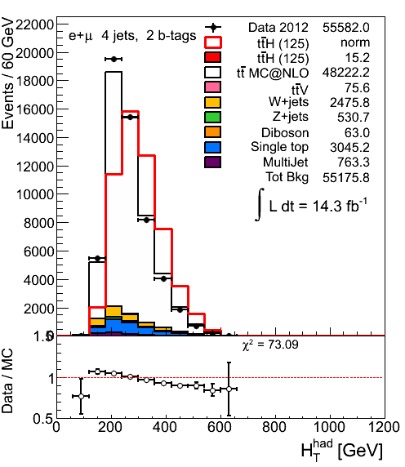
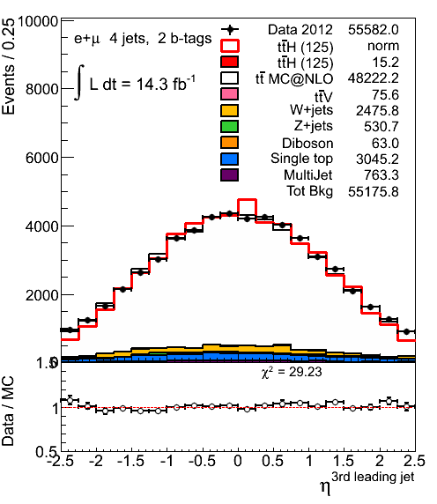
ttbar modelling - I
Given that the problem is seen in ttbar dominated regions we suspected ttbar modelling
Default: Alpgen+Herwig
Tried
  MC@NLO
  Powheg+Herwig (AFII)
  Powheg+Pythia (AFII)
MC@NLO
same slope in HT
jet η looks better

Slide 8
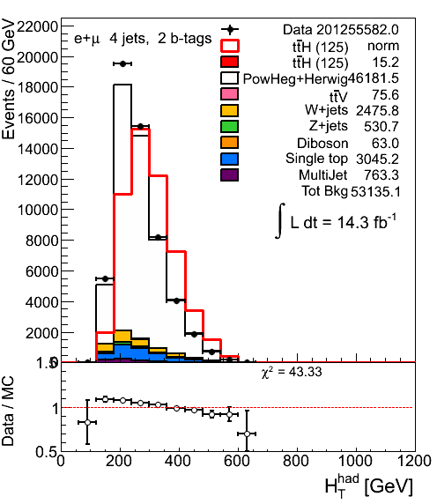
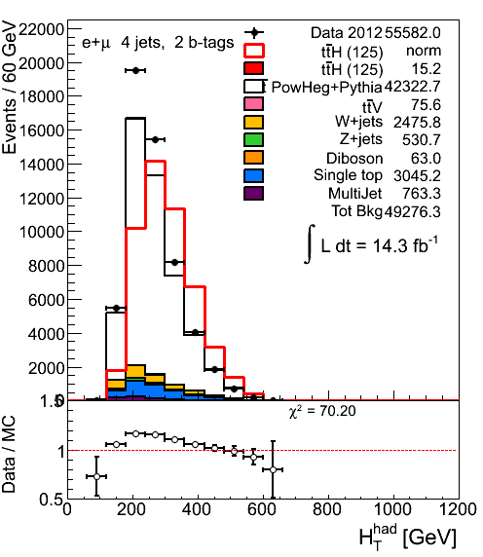
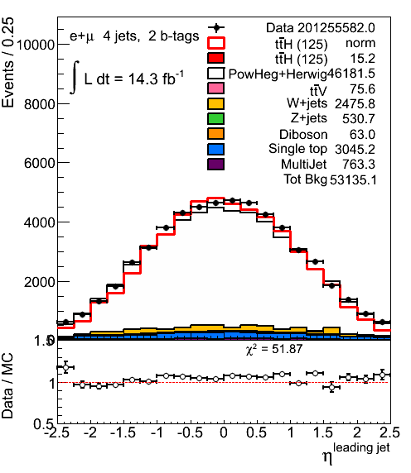
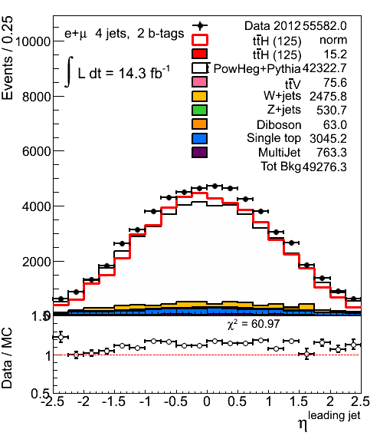
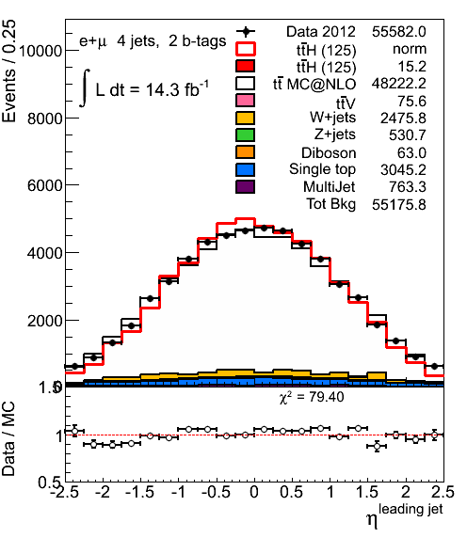
ttbar modelling - II
Powheg+Herwig
Powheg+Pythia
MC@NLO
NLO MC describes jet η distribution better
8

Slide 9
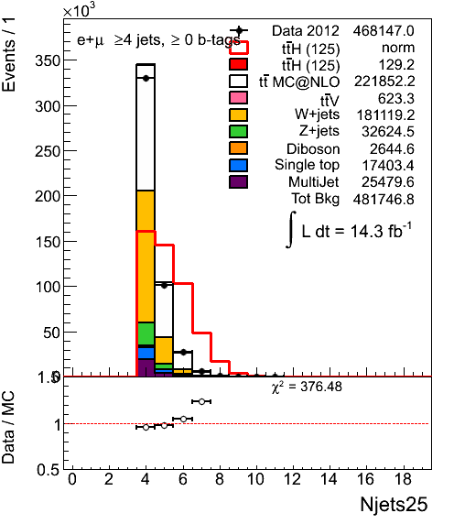
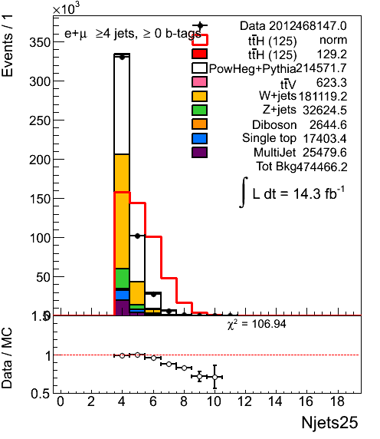
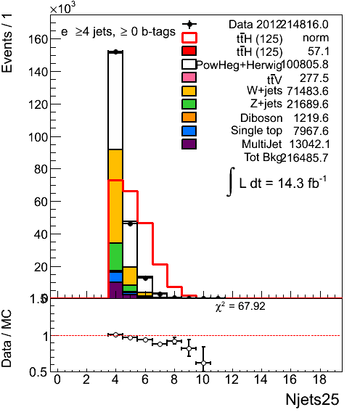
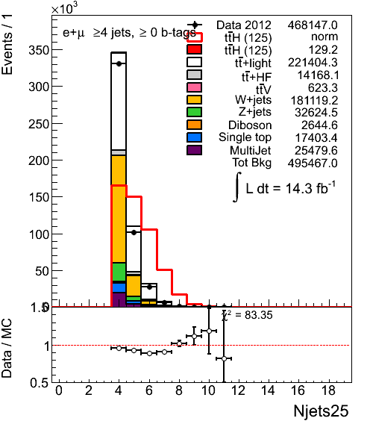
Jet multiplicity
MC@NLO
Powheg+Pythia
Powheg+Herwig
4 jets inclusive pretag
Alpgen+Herwig default

Slide 10
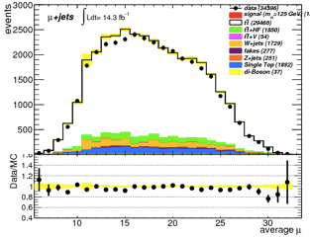
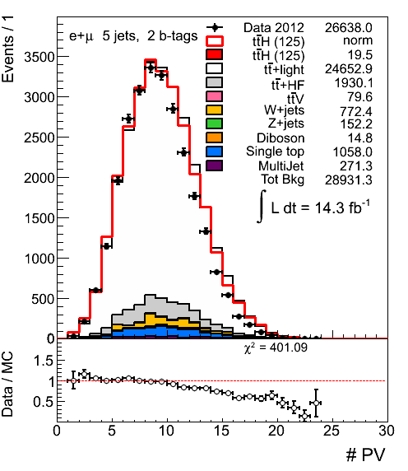
Pileup
We perform luminosity reweighting following recommendations but the NPV distribution in data is not well described
MC overestimates NPV in data
However the twiki says that agreement in NPV is not expected to be perfect even after μ reweighting
https://twiki.cern.ch/twiki/bin/viewauth/AtlasProtected/InDetTrackingPerformanceGuidelines#Analyses_based_on_Athena_release

Slide 11
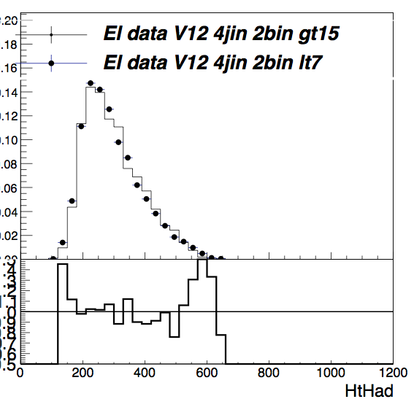
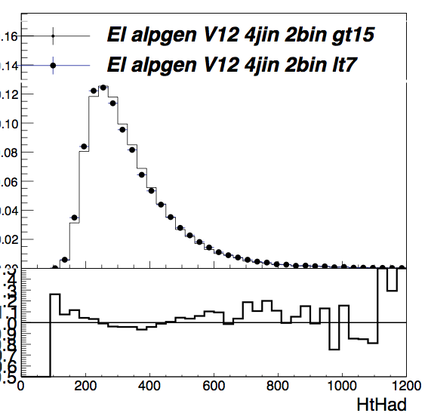
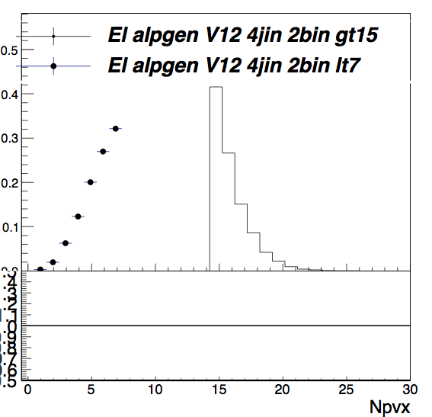
NPV<7 vs NPV>15
e+jets, 4 jet incl 2b incl
HT data
HT MC
NPV<7 - points, NPV>15 - histogram
shape does not change significantly between low and high NPV
trend in MC follows trend in data
does not seem to explain the problem

Slide 12
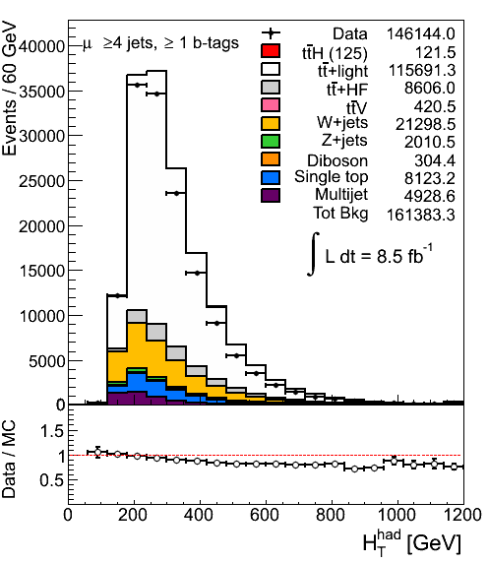

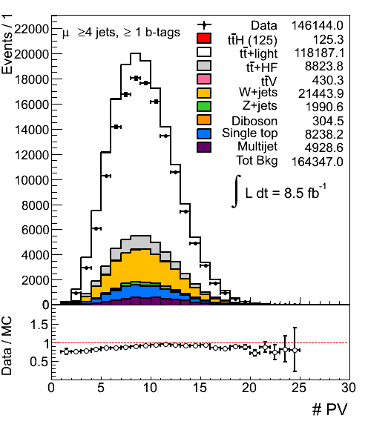
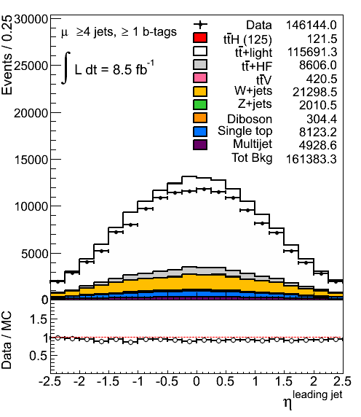
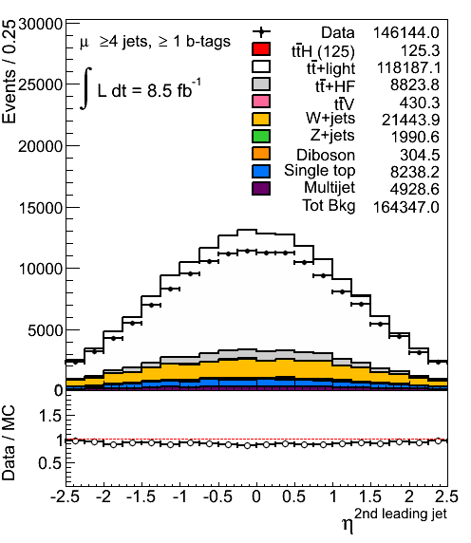
NPV reweighting
Although effect is expected to be small let’s reweight NPV to match data better
before NPV reweighting
after NPV reweighting
reweighted in 2j inclusive
does not help!

Slide 13
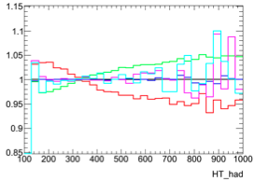
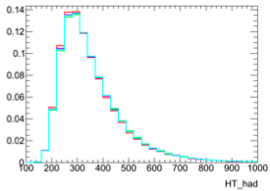
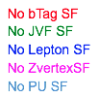
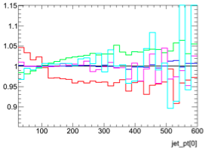
Impact of SFs on HT shape
remove various SFs one by one and look at the effect on HT shape
study on ttbar MC
  tt+light and tt+HF
removing bTag SF: this seems to have a pretty large impact and goes in the direction we would like (increasing low side, decreasing high side)
bTag SF: largest effect on nuisance parameters in the fit

Slide 14
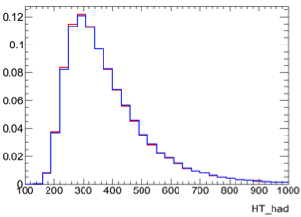

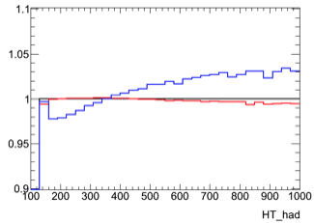
JVF SF
We use “old” JVF SF derived for EMJES jets
In the meantime new JVF SFs were announced
  derived for LC jets!
blue: no scale factor
red: new JVF SF
  effect seems to be small but it goes in the right direction
black: old JVF SF
5jets exclusive, 2tags inclusive

Slide 15
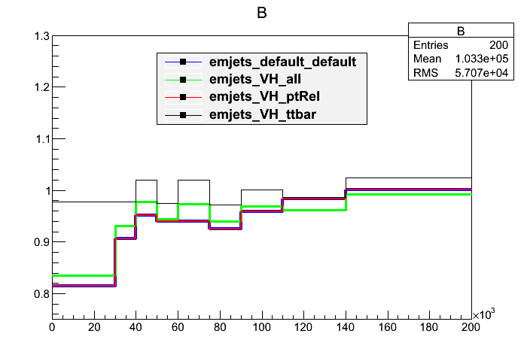

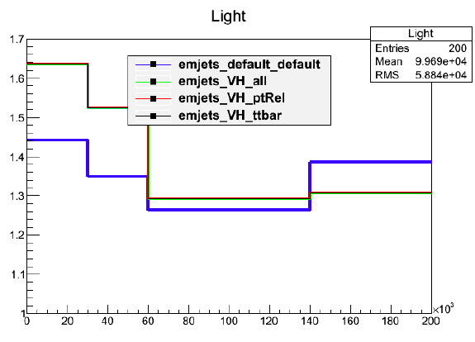
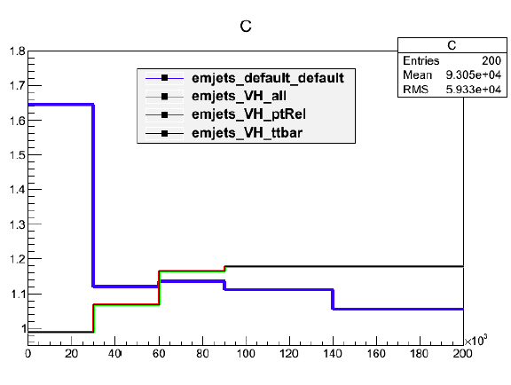
Study of b-tagging
So far using 2011 pTrel calibration
Need to get HCP recommended file:
  2011+2012(a) pTrel calibration
  2011 ttbar calibration
Note:
  VH_ptrel is the one we are using
  We don’t understand what the c and light calibrations are showing

Slide 16
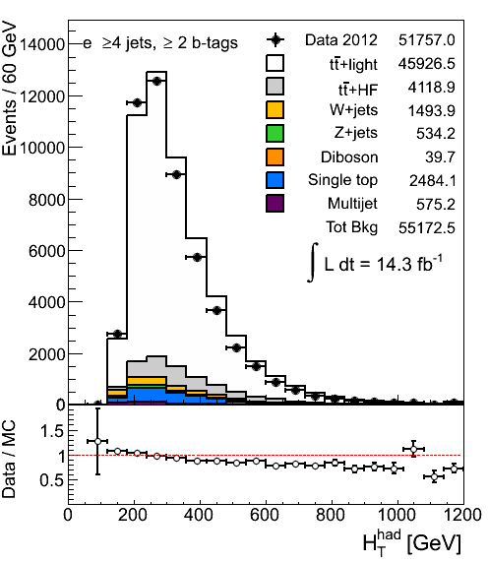
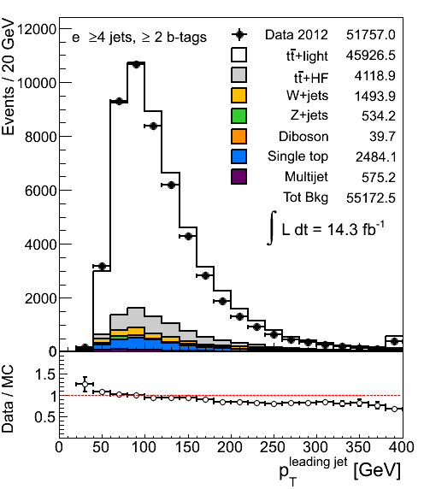
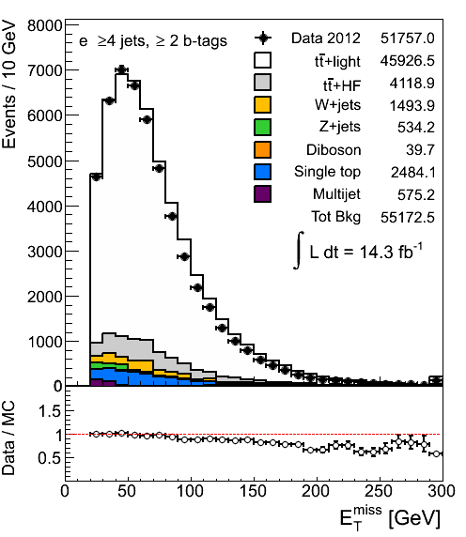
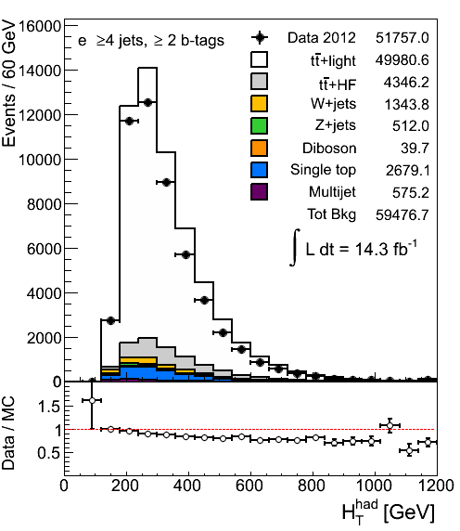
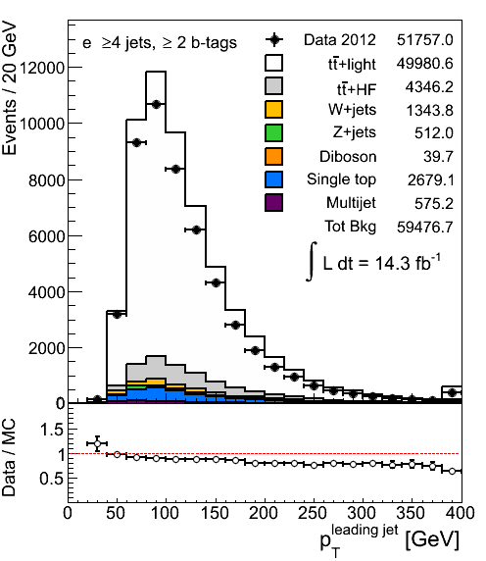
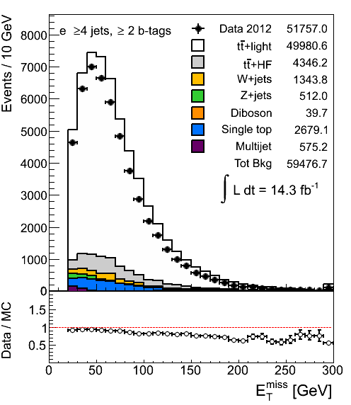
Comparison: ttbar control region
Electron channel, 4jet inclusive, 2tag inclusive
PtRel calibration
ttbar calibration

Slide 17
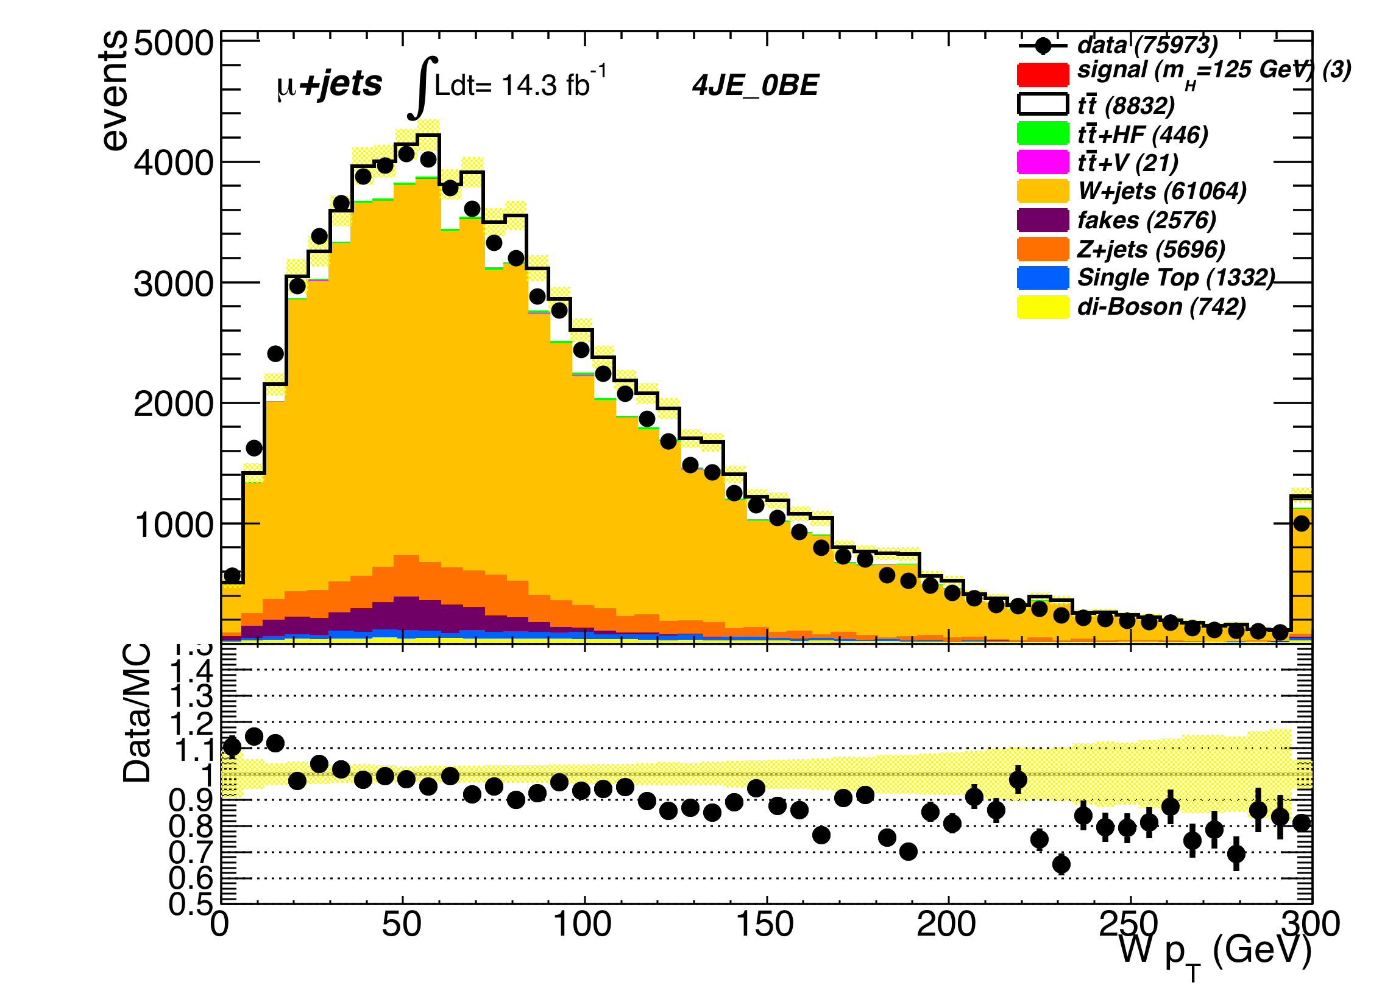
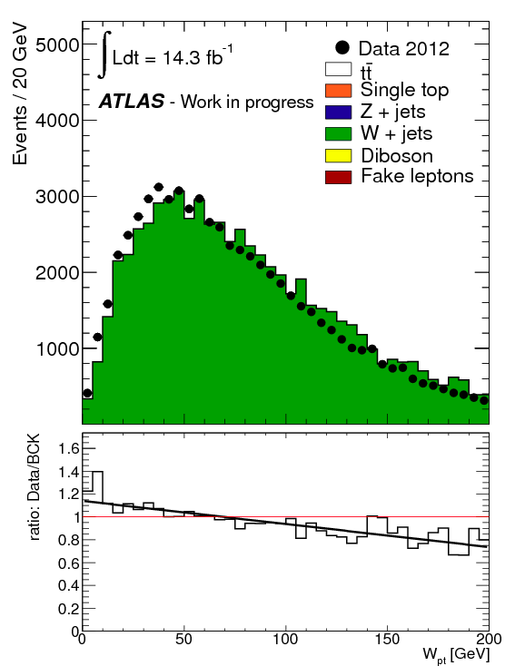

p_{T}^{W} reweighting
4 jet (exclusive) no b-tags
Reweight p_{T}^{W} as done by VH analysis for HCP
Minimizer is Linear
Chi2 = 130.962
NDf = 38
p0 = 1.126 +/- 0.01
p1 = -0.0020 +/- 0.0001

Slide 18






No reweight (up) , reweight (down)
Some improvement but features are still there

Slide 19




No reweight (up) , reweight (down)
Improvement in Jet eta …

Slide 20

Ttbar reweighting?
In progress… we want to test it to see what we get
BUT not clear we should do it when we use the modeling nuisance parameters from Alpgen

Slide 21







Do we see this with VH cuts?
ttH cuts (top)/ VH cuts (bottom)
Can’t tell if it’s really better (low jet pt can be QCD)

Slide 22



Do we see this with VH cuts?
VH analysis ~ with ttH cuts:
≥ 4jets and ≥ 2 b-tags
No p_{T}^{W} reweighting applied

Slide 23



MultiParton Interaction Study
STDM-2012-11: http://cdsweb.cern.ch/record/1456092
Two independent scattering
2 parton pairs: W, dijet.
Δ_{jets}=|p_{T1}-p_{T2}|/|p_{T1}|+|p_{T2}|
JES ≈cancels, should be 0
No indication of missing contribution in e+2jet.
Electrons
2 jets
Pretag
Electrons
4 jets
Pretag

Slide 24



LC jets vs EM+JES
EM+JES seem to give better description of data, but same features as LC
LC jets
EM+JES
jets

Slide 25


Old fit result

Slide 26
Changes
Switched from a theoretical uncertainty in W+4jets production (48%) to the experimental one given by the charge asymmetry normalization
Implemented latest prescription (from 7TeV) for W+HF systematics, they should be uncorrelated against Njets
All systematics are shape+normalization
  For simplicity JVFSF and Xtag were normalization only for the small backgrounds
Introduced ttbarHF systematic
Introduced jet energy resolution
Introduced the breakdown of JES into 8 components
Rebinned the JES breakdown so that the relative error per bin is 2% or less
Corrected a discrepancy in electron QCD in the forward region for 0tag
Rescaled the MC for the missing luminosity (-3% muon, -0.5% electron)

Slide 27






Pre/post fit plots
Prefit: 4jetex 0btagex 4jetex 1btagex 4jetex 2btagin
Postfit: 4jetex 0btagex 4jetex 1btagex 4jetex 2btagin

Slide 28




Pre/post fit plots
Prefit: 5jetex 2btagex 6jetex 2btagex
Postfit: 5jetex 2btagex 6jetex 2btagex

Slide 29




Pre/post fit plots
Prefit: 4jetex 3btagex 4jetex 4btagin
Postfit: 4jetex 3btagex 4jetex 4btagin

Slide 30








Pre- and Post-fit in validation regions: H_{T}
Pre-fit
5 jets 0 btags
5 jets 1 btags
6 jets 0 btags
6 jets 1 btags
Post-fit

Slide 31


New fit result

Slide 32


Electron vs Muon

Slide 33


8TeV Dileptons: Pre and Post Fit Plots (Valid.reg.)
Prefit HT
Postfit HT

Slide 34


Dileptons: Pre and Post Fit Plots (Signal)
Prefit HT
Postfit HT

Slide 35
Dileptons: Fit Results in 8 TeV
Alpgen Systematics not yet in fit

Slide 36
Fit Results at 7 TeV
Full list of systematics

Slide 37
Conclusions
A huge amount of work on studying HT problem
  No silver bullet: looks like combination of several effects
Fits looking better but a few things still to understand
To do:
Some improvement expected but not huge:
  p_{T}^{W} reweighting for 8TeV
  Compare with Z+jets p_{T}^{Z} reweighting and uncertainty derived from the dilepton analysis
  Introduce the recent JVF SF derived for LCjets, there were only available for EM+JES jets until recently (small difference)
  More realistic uncertainties for QCD
Other to-do/Status:
  Run (expected) limits with semileptonic (SVA and MVA)
  Look at (expected) limits for dilepton – 1st version for 8TeV ≈today

Slide 38

Backup
B-tagging eigenvectors

Slide 39

Backup
C-tagging eigenvectors

Slide 40

Systematics in 6jetin 0btagex

Slide 41








Validation regions
Prefit: 5jetex 0btagex 5jetex 1btagex 6jetex 0btagex 6jetex 1btagex
Postfit: 5jetex 0btagex 5jetex 1btagex 6jetex 0btagex 6jetex 1btagex

Slide 42






ttbar modelling - II
Powheg+Herwig
Powheg+Pythia
MC@NLO
NLO MC describes jet η distribution better

Slide 43
Fit Regions in both 7 and 8 TeV
8 TeV – 4 jet inclusive fit is with H_{T} (not m_{bb})

Slide 44
Event Selection

Slide 45
Signal over Background 7 TeV

Slide 46
Backgrounds 7 TeV

Slide 47
Reconstructing mbb

Slide 48


Pre and Post Fit 7 TeV
Prefit HT
Postfit HT

Slide 49


Pre and Post Fit HT
Prefit HT
Postfit HT

Slide 50


Pre and Post Fit Plots
Prefit Mbb
Postfit Mbb

Slide 51
Fit Results at 7 TeV
Full list of systematics

Slide 52
8 TeV Fit
Mbb is being added to the 4 jet bin

Slide 53
Pre and Post Fit Plots
Prefit HT
Postfit HT

Slide 54
Pre and Post Fit Plots
Prefit HT
Postfit HT

Slide 55


Pre and Post Fit Plots 8 TeV
Prefit HT
Postfit HT

Slide 56
Fit Results in 8 TeV
Alpgen Systematics not yet in fit

