Slide 1
H->bb Weekly Meeting
Ricardo Gonçalo (RHUL)
HSG5 H->bb Weekly Meeting, 29 March 2011

Slide 2
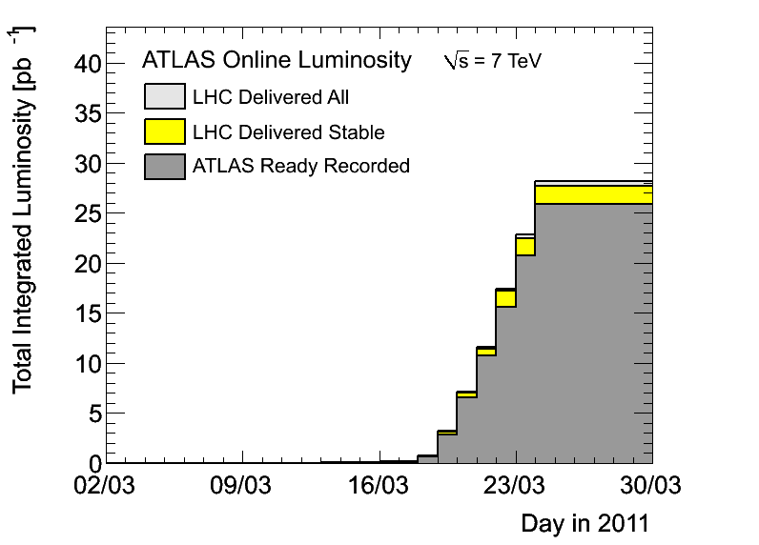
News! News! News!
Technical stop this week
Already ≈ 26 pb⁻¹ collected with stable beams
But ≈ 10 pb⁻¹ with no B field
Peak luminosity ≈2.5 x 10³² cm⁻²s⁻¹ with 200 bunches
≈maximum we had last year
But with lower β* and so higher pileup (around μ=8 so far)
Both in-time and out-of-time pileup will be important this year!

Slide 3
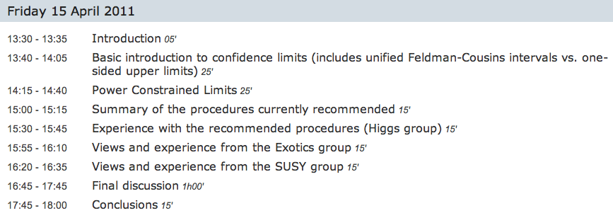
News! News! News!
Preliminary meeting of physics+statistics forum: http://indico.cern.ch/conferenceDisplay.py?confId=131204
New meeting on procedures for statistical interpretation of ATLAS results on April 15: https://indico.cern.ch/conferenceDisplay.py?confId=132499

Slide 4
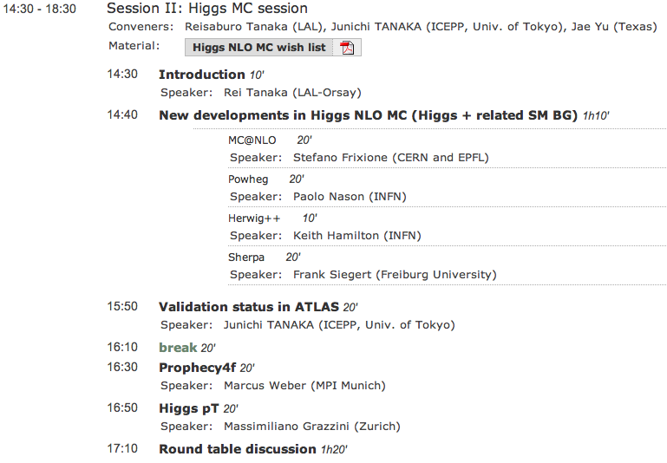
News! News! News!
ATLAS NLO MC mini-workshop on Thursday this week
Should be very interesting, especially for us!

Slide 5
News! News! News!
Analysis of 2011 data has started in Jet/Etmiss
https://twiki.cern.ch/twiki/bin/view/AtlasProtected/AnalysisData2011
It will be important to understand jet performance in the higher-pileup environment
General call to arms was issued – all volunteers interested in contributing to jet studies

Slide 6
News! News! News!
W/Z common selection seems to have become more stable
Version 1.2:https://espace.cern.ch/atlas-sm-wz-physics/Lists/Common%20Selection/AllItems.aspx
Aimed at W/Z 2010 data
My proposal is that we should use this selection for now
Produce our first results for Dubna using 2010 data and this selection
We don’t yet have any full analysis results from 2010 data!
Discussion later in today’s meeting
Then, before Dubna, we should compare results from 2010 data with 2011 data
Understand 2010 data to check for surprises in 2011 data…
First look from Lianliang already today – but remember we still have more 2010 data than 2011 data… and 2010 is well understood by CP groups
Adapt cuts/object selection as needed and as recommended by CP groups

Slide 7
Sharepoint
We have a Sharepoint page available: https://espace.cern.ch/atlas-project-HSG5-H2bb/default.aspx
Hasn’t been used for a long time, but should be useful to exchange information on the ongoing analyses
Feel free to post new items!

Slide 8
Backup

Slide 9
Proposed Roadmap for WH Analysis
After the effort on cut flows, we’re ready to start producing results!
Concentrating on un-boosted results here only because it’s still unclear what would be feasible in boosted analysis until Dubna – commissioning work ongoing
BUT: work on boosted VH is starting in parallel – see e.g. Wahid’s talk today
Intended results:
Cut-based analysis focusing on WH -> e/μ ν b b
I think there should be at least 2 analyses, for cross checking results
Ideally using 2 different data formats (AOD vs D3PD)
Multivariate analysis in parallel, to improve on cut-based analysis
Timeline:
Analyses should be semi-frozen by Dubna (17 – 19 May)
This leaves around 7 weeks
Results in the form of:
Histogram with # events vs m_{H}
Table of # events expected for each value of m_{H} and background type – including statistical and systematic uncertainties
Exclusion plot vs m_{H} (95% C.L. limit on σ/σ_{SM})
…plus control plots etc

Slide 10
Questions to be answered
Cut-based analysis focusing on WH -> e/μ ν b b
Establish analysis selection: why is each cut applied and why at each particular value? Are we convinced this is the right thing to do?
Establish set of systematic uncertainties: start from combined performance group recommendations. What are the most important? Are there any hidden pitfalls for us?
What b-taggers and why? What calibrations do we expect to be ready in time? What is the corresponding systematic uncertainty?
What sort of exclusion limits can we expect for 0.5, 1, 2 fb⁻¹ ?
Multivariate analysis in parallel, to improve on cut-based analysis
What event preselection should be used and why?
Use for signal-background separation only or target particular backgrounds?
What are the possible bias? Where can it go wrong?
What improvement can be expected wrt cut-based analysis for 0.5, 1, 2 fb⁻¹ ?
Exclusion plot vs m_{H} (95% C.L. limit on σ/σ_{SM})
Need someone to implement RooStats workspace

Slide 11
Date | Milestones wish list
17 May | Dubna workshop – analysis frozen After this: add data to un-boosted analysis and prepare for result approval Concentrate more effort on boosted VH with a view to obtaining results quickly
10 May | Review results with 2011 data from cut-based and multivariate analyses
3 May | Margin for dealing with unforeseen problems
26 April | Start looking at 2011 data if enough is available. Any surprises? How does the MC describe the new data? By now we should have a reasonable idea of results from the multivariate analysis
19 April | End of 2 weeks of beam scrubbing. (I’m away for Easter)
12 April | By now we should have a reasonable idea of the exclusion of the cut-based analysis First report on MVA preliminary results – establish plan for getting results by Dubna
5 April | Identify the worst systematics and discuss any possible improvements: Any changes needed in analysis cuts? Any study necessary for corrections to some systematic effect? Multivariate analysis: iterate on preselection cuts, methods, questions Assign tasks – divide the work to achieve better results!
29 March | Establish analysis cuts: If possible as result of optimization Use 2010 data to develop cuts and show that data is well described by background MC Start evaluating systematics
22 March | Iterate on analysis cuts – why is each cut applied at each particular value? Start iteration on multivariate methods to improve analysis

Slide 12
Reconstruction issues
Muon CP group recommendations for release 16:
Reconstruction efficiency and isolation efficiency scale factors, momentum smearing functions
https://twiki.cern.ch/twiki/bin/view/AtlasProtected/MCPAnalysisGuidelinesRel16
Jet/Etmiss recommendations for jet cleaning in release 16:
Medium jet cleaning should give similar rejection to rel 15 cleaning but with better efficiency
Tight jet cleaning should not be used – still under discussion
https://twiki.cern.ch/twiki/bin/view/AtlasProtected/HowToCleanJets#Bad_jets_rel16_data
New!: Final b-tagging calibrations for release 16 based on full 2010 data:
https://twiki.cern.ch/twiki/bin/view/AtlasProtected/Analysis16
e/gamma recommendations for energy scale and resolution in release 16:
https://twiki.cern.ch/twiki/bin/view/AtlasProtected/EnergyScaleResolutionRecommendations
And rescaler tool: https://twiki.cern.ch/twiki/bin/view/AtlasProtected/EnergyRescaler
Standard Model W/Z group baseline selection for release 16 (next 4 slides):
See discussion in W/Z group Sharepoint
Also, finer points (and perhaps the not so fine) still being discussed

