Slide 1
H->bb Weekly Meeting
Ricardo Gonçalo (RHUL)
HSG5 H->bb weekly meeting, 20 September 2011

Slide 2
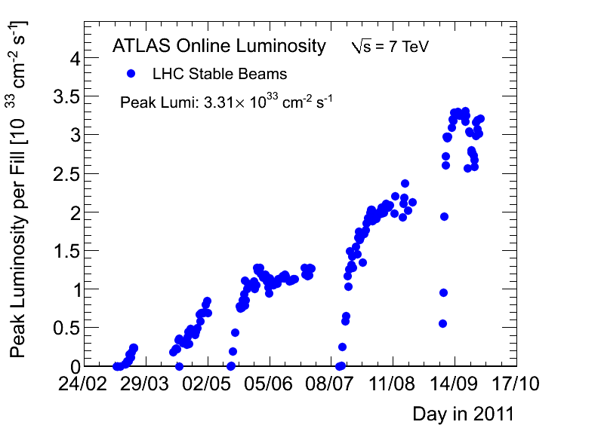
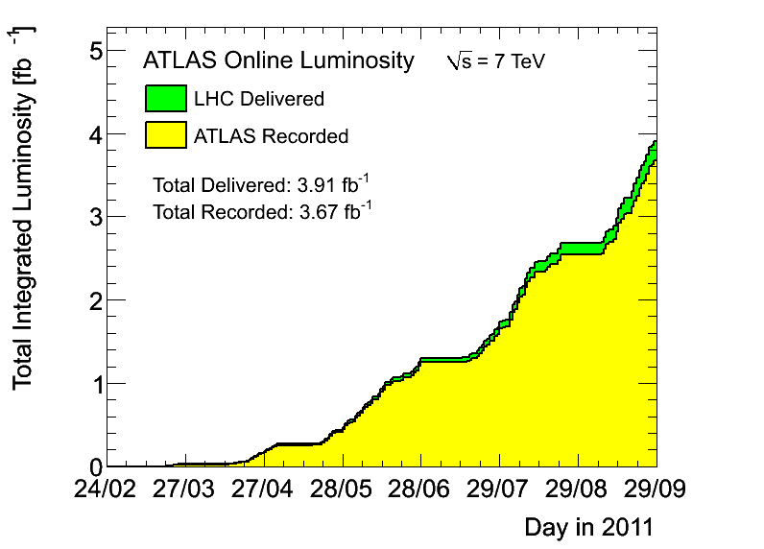
News! News! News!
Peak stable lumi 3.31x10³³cm⁻²s⁻¹
3.67fb⁻¹ with stable beams collected so far
Pileup at <μ> ≈ 14, peak around 19 – 21 (!)

Slide 3
MC requests
Inclusive and boosted H->bb samples for MC11b:
Herwig++ in Powheg
Mass points: M_{H} = 110, 115, 120, 125, 130, 135, 140, 145, 150 GeV
WH->lνbb, ZH->llbb, ZH->ννbb
Both boosted and inclusive for each mass
Approved for production – Junichi asking for it to start now
Next: W+jets

Slide 4
D3PD production
Robert Harrington
The code is in place and in AtlasPhysics-17.3.3.1 cache
Validation ntuples requested - some are already done (tag p717)
D3PDs requested for datasets:
data11_7TeV.periodE.physics_Muons.PhysCont.AOD.t0pro08_v01/
data11_7TeV.periodE.physics_JetTauEtmiss.PhysCont.AOD.t0pro08_v01/
data11_7TeV.periodE.physics_Egamma.PhysCont.AOD.t0pro08_v01/
mc10_7TeV.116591.WH120lnubb_pythia.merge.AOD.e701_s933_s946_r2302_r2300/
mc10_7TeV.109352.WH120lnubb_pythia.merge.AOD.e660_s933_s946_r2302_r2300/
mc10_7TeV.109140.WH120lnbb_Herwig.merge.AOD.e598_s933_s946_r2302_r2300/
mc10_7TeV.109350.ZH120llbb_pythia.merge.AOD.e574_s933_s946_r2302_r2300/mc10_7TeV.109351.ZH120nunubb_pythia.merge.AOD.e574_s933_s946_r2302_r2300/
mc10_7TeV.116591.WH120lnubb_pythia.merge.AOD.e701_s933_s946_r2302_r2300/mc10_7TeV.109352.WH120lnubb_pythia.merge.AOD.e660_s933_s946_r2302_r2300/
mc10_7TeV.109140.WH120lnbb_Herwig.merge.AOD.e598_s933_s946_r2302_r2300/
mc10_7TeV.109300.AlpgenJimmyZeebbNp0_nofilter.merge.AOD.e600_s933_s946_r2302_r2300/
mc10_7TeV.109305.AlpgenJimmyZmumubbNp0_nofilter.merge.AOD.e600_s933_s946_r2302_r2300/
Each ntuple type has a different dataset definition:
NTUP_HSG5WH, NTUP_HSGZHLL, NTUP_HSG5ZHMET, NTUP_HSG5ZBB
NTUP_HSG5GAMH code is in place but not to be used for now: gamma + Z is current priority (see Bill’s talk)
Useful feedback from Ilektra:
Need more detailed truth information, b-tagging weights are missing for some anti-kT jets
Known problems:
Calibration for fat jets needs to be updating in Jos
Infinite loop in SM D3PD code for some MC events: http://savannah.cern.ch/bugs/?86666

Slide 5
Reminders…
Gilad Perez – TH seminar earlier today about template method for jet mass reconstruction
Possible new method for boosted H->bb
Hadronic calibration workshop: https://indico.cern.ch/conferenceOtherViews.py?view=standard&confId=132005

Slide 6
Jet energy scale
Paul Thompson
Top:
mjj for W->jj in top events
Cuts used: pTjet > 25 GeV, η < 2.5
The JES uncertainty seems overestimated
Bottom:
Effect of JES uncertainty on WH->lνbb analysis expected limit (1fb⁻¹)
Note CMS quote 1% rather than our ≈7%
B-tag efficiency systematic is still dominant (≈16%) – can we improve on it?
Ricardo G

Slide 7
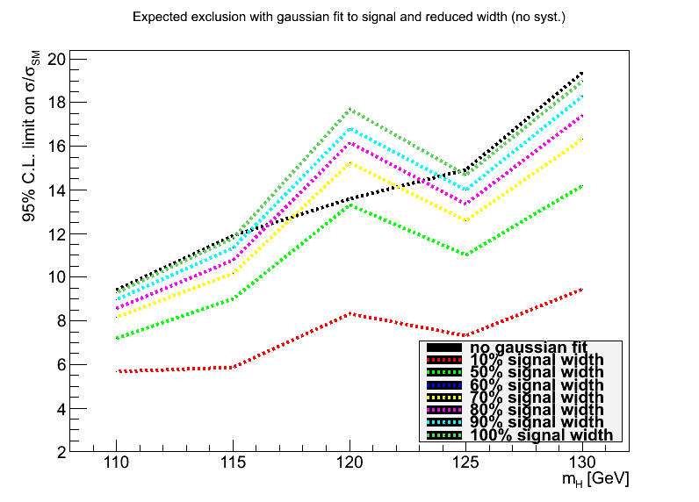
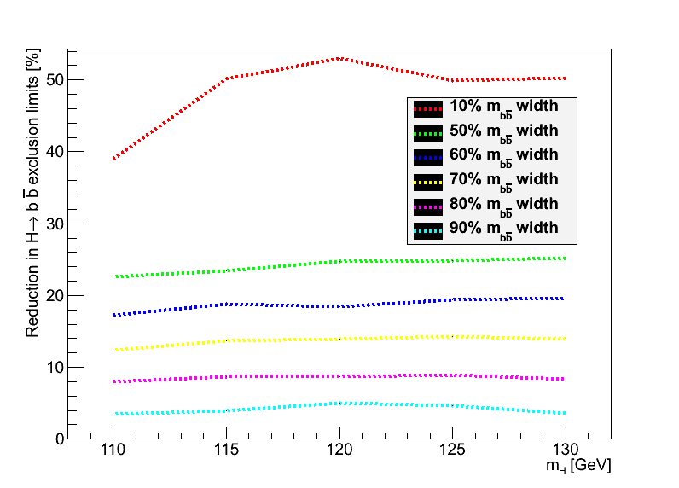
Di-jet mass resolution and limits
Fitted signal by a gaussian and re-did fits (modified code from Lianliang) after thinning signal m_{bb} histo by several factors
Plot shows effect of improved di-jet mass:
Basically linear in range of interest
10% improvement in m(bb) gives 4% improvement in limit across all masses

